Slide 1
Biotechnology 349
Sources
of
DNA

Slide 2
Sources of DNA
Prokaryotic DNA
The DNA of a prokaryote is different from a eukaryote in that a prokaryote has a single, circular chromosome (DNA molecule) sectioned functionally into operon. The chromosome is significantly shorter than in a eukaryote and holds fewer genes.
Prokaryotic cells may also contain small circular pieces of DNA called plasmids. They contain a few nonessential genes. These genes code for extra traits that help bacteria survive some extraordinary circumstances, such as antibiotics or extreme temperatures.
R Plasmids contain antibiotic resistance genes.
Bacteria can transfer plasmids – therefore, always ‘evolving’.

Slide 3
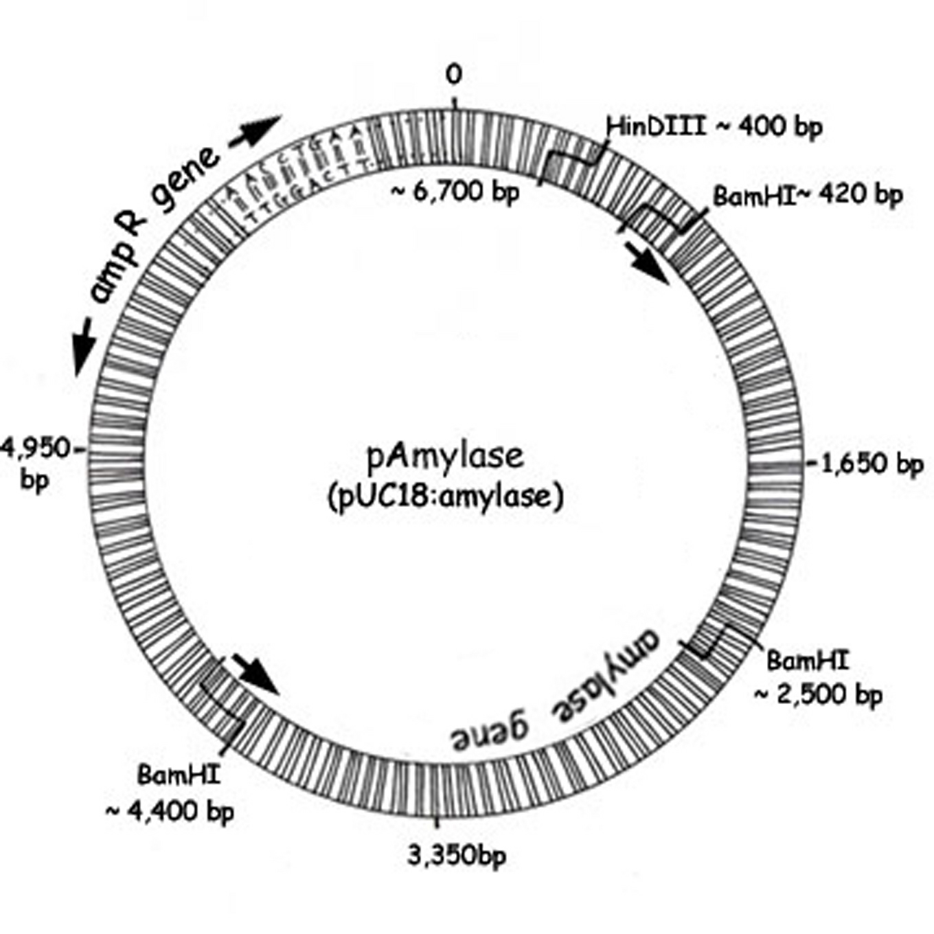
Example of a plasmid

Slide 4
Plasmids can be used as vectors to carry foreign DNA into cells. Plasmid vectors are important tools for genetic engineers.
Gene expression in prok. cells is rel. simple.
Operons are one or more genes and their controlling interests
Operons are the main way that prokaryotes regulate gene expression (protein production). RNA polymerase attaches to the promoter region of the operon and moves toward the structural gene to start transcribing mRNA. If a regulatory molecule is attached at the operator region of the operon, the RNA polymerase (an enzyme) is blocked from reaching the structural gene, and no mRNA is made and, thus, no protein is produced.

Slide 5
Bacterial Operon (sketch Fig. 4.10)
Lac Operon (sketch Fig. 4.11)

Slide 6
Eukaryotic DNA
Eukaryotic cells have several chromosomes that are long linear strands, coiled around histone proteins, and interrupted by noncoding regions.
Eukaryotic DNA does not have operators, but does have promoters and structural genes. Enhancers may increase RNA polymerase interaction at the promoter to increase gene expression. (in other words – a section of DNA that increases the expression of a gene)

Slide 7
Viral DNA
Virus particles contain either small DNA or RNA molecules as their nuclear material.
Scientists have been able to use nonpathogenic viral DNA as a vector for transferring genes used for genetic engineering and gene therapy.
Recombinant virus technology is used in the process gene therapy
The genetic engineering process includes the following: identification of a target molecule(s) for production;
isolation of the DNA instructions for that molecule’s production;
manipulation of the DNA instructions into cells that use the DNA to produce the target; and
harvest of the target product.

