Slide 1
RESTRICTION FRAGMENT ANALYSIS AND DNA FINGERPRINTING
0
Nucleic acid probes identify clones carrying specific genes
DNA technology methods
Can be used to identify specific pieces of DNA

Slide 2
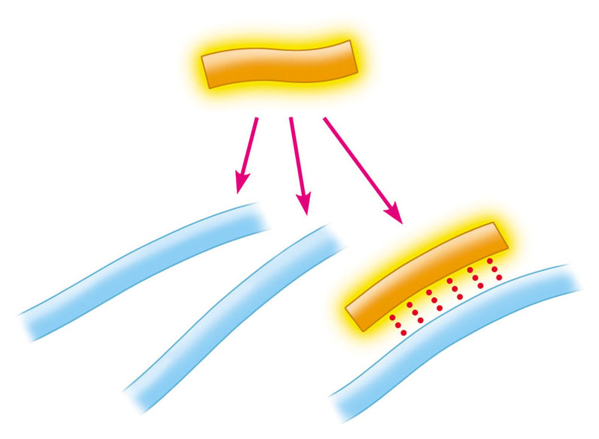
0
A nucleic acid probe
Is a short, single-stranded molecule of radioactively labeled or fluorescently labeled DNA or RNA
Can tag a desired gene in a library
Radioactive
probe (DNA)
A T C C G A
Mix with single-
stranded DNA from
various bacterial
(or phage) clones
Single-stranded
DNA
A T G C G C T T A T C G
A T C C G A
A G C C T T A T G C A T
A G G T A G G C T A A
Base pairing
indicates the
gene of interest
Figure 12.8

Slide 3
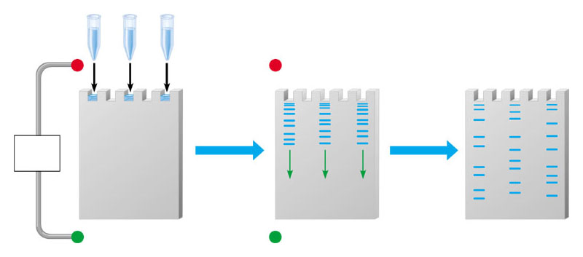
0
12.10 Gel electrophoresis sorts DNA molecules by size
Mixture of DNA
molecules of
different sizes
–
–
Longer
molecules
Power
source
Gel
Shorter
molecules
+
+
Completed gel
Figure 12.10

Slide 4
0
Restriction fragment length polymorphisms can be used to detect differences in DNA sequences

Slide 5
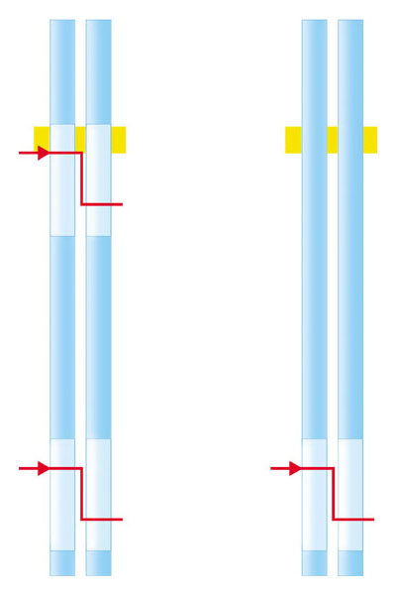
0
How Restriction Fragments Reflect DNA Sequence
Restriction fragment length polymorphisms (RFLPs)
Reflect differences in the sequences of DNA samples
Crime scene
Suspect
w
Cut
C
G
A
T
C
G
C
G
G
C
G
C
G
C
z
G
C
x
Cut
C
G
Cut
C
G
C
G
C
G
y
G
C
y
G
C
G
C
G
C
Figure 12.11A
DNA from chromosomes

Slide 6
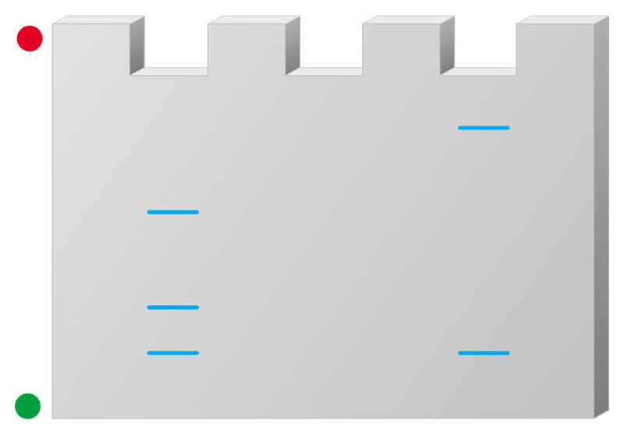
0
After digestion by restriction enzymes
The fragments are run through a gel
–
1
2
Longer
fragments
z
x
w
Shorter
fragments
y
y
Figure 12.11B
+

Slide 7
0
Using DNA Probes to Detect Harmful Alleles
Radioactive probes
Can reveal DNA bands of interest on a gel

Slide 8
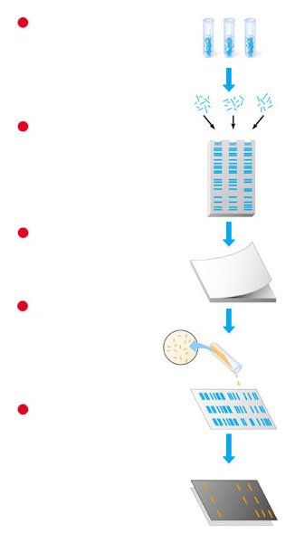
0
Detecting a harmful allele using restriction fragment analysis
Restriction fragment
preparation
1
I
II
III
Restriction
fragments
Gel electrophoresis
2
I
II
III
Blotting
3
Filter paper
Radioactive probe
4
Radioactive, single-
stranded DNA (probe)
Probe
Detection of radioactivity
(autoradiography)
I
5
II
III
Film
I
Figure 12.11C
II
III

Slide 9
CONNECTION
0
DNA technology is used in courts of law

Slide 10
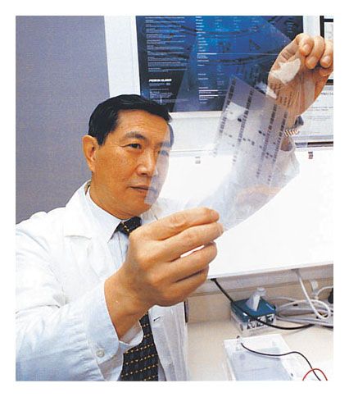
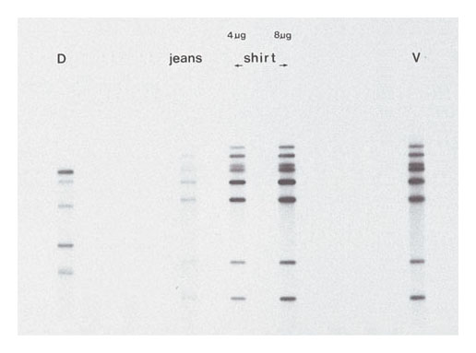
0
DNA fingerprinting can help solve crimes
Defendant’s
blood
Blood from
defendant’s clothes
Victim’s
blood
Figure 12.12A
Figure 12.12B

Slide 11
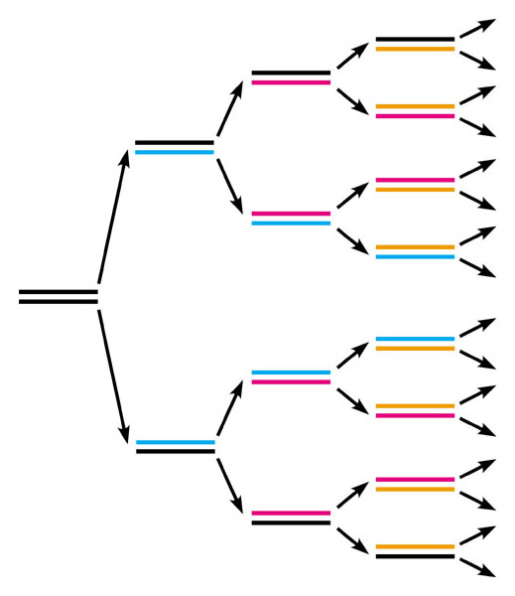
0
The PCR method is used to amplify DNA sequences
The polymerase chain reaction (PCR)
Can be used to clone a small sample of DNA quickly, producing enough copies for analysis
Initial
DNA
segment
1
2
4
8
Figure 12.14
Number of DNA molecules

