Slide 1
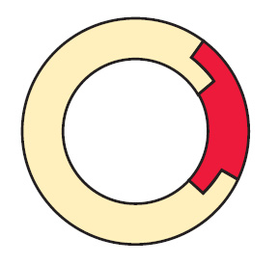
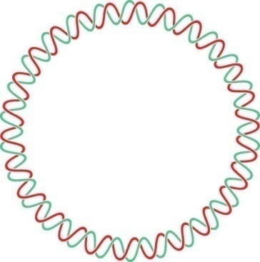
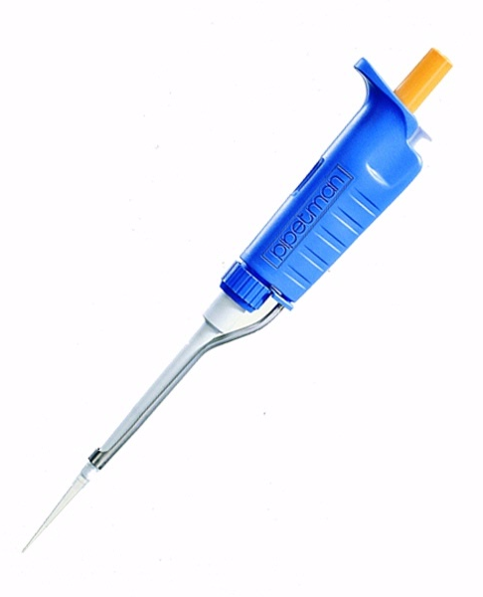
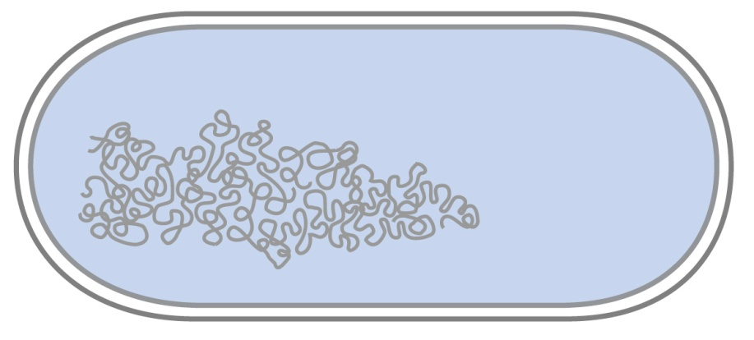
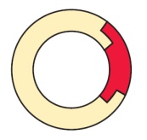
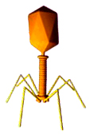
Biotechnology
Recombinant DNA and its Applications
Notes:
BIOTECHNOLOGY
Recombinant DNA and its Applications
Michael J. Freudiger 2008
References and Source Material:
Nelson, David L. and Michael M. Cox: Lehninger Principles of Biochemistry, 4th ed. W.H. Freeman & Co., 2005.
Lippert, Ross A., Introduction to Computational Molecular Biology, Lecture 2: Brute Force and Digestion Problems, Massachusetts Institute of Technology.
http://www-math.mit.edu/~lippert/18.417/lectures/02_PartialDigest/
The Astbury Centre for Structural Molecular Biology
http://www.astbury.leeds.ac.uk/gallery/leedspix.html#covers

Slide 2
Introduction
What are Plasmids?
How can we modify plasmids?
Restriction Enzymes
Origins of restriction enzymes.
A close look at restriction enzymes.
Understanding plasmid diagrams.
Notes:
This slide is meant to introduce the first part of the lecture. Every question proposed here will be answered shortly.

Slide 3
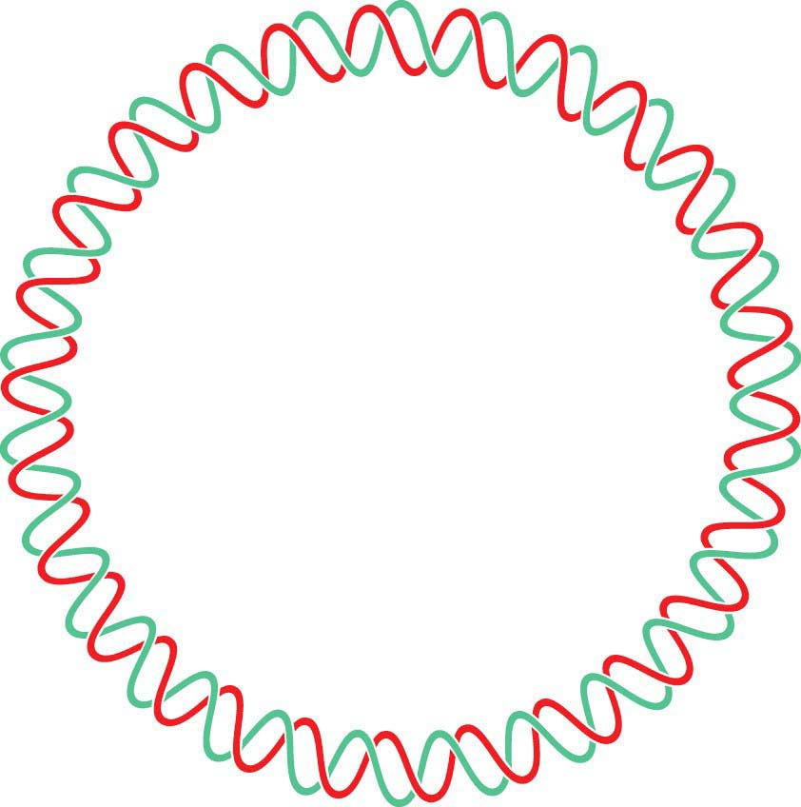
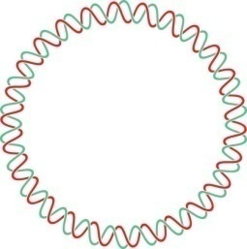
What are Plasmids?
In this Lecture…
Circular DNA that is used by bacteria to store their genetic information.
Modifying plasmids to include extra genes allows for the production of new proteins.
Notes:
This slide is meant to introduce the first part of the lecture. Plasmids are circular DNA used by bacteria to store their genetic information. Modifying plasmids to include extra genes allows for the production of new proteins.

Slide 4
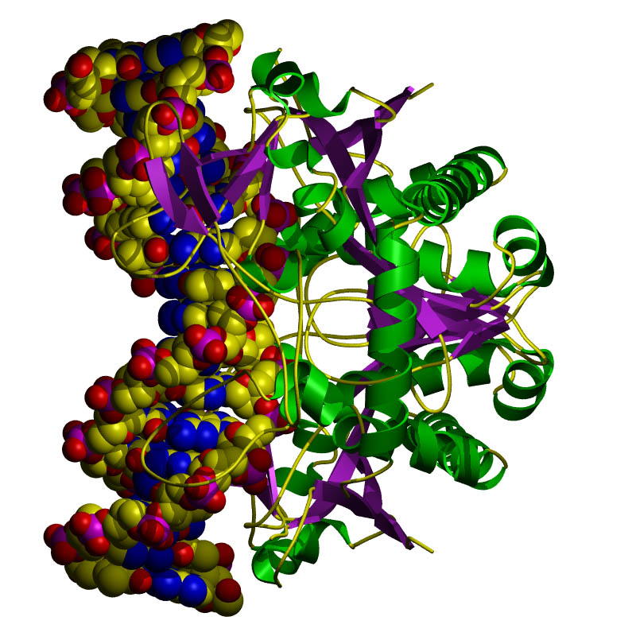
How Can We Modify Plasmids?
In this Lecture…
Restriction Enzymes
BamHI, HindIII, etc.
Where do they come from?
How do they work?
Different restriction enzymes do different things.
DNA Ligase
Restriction Enzyme attached to DNA before cleavage
Notes:
This slide is meant to introduce the first part of the lecture. Every question proposed here will be answered shortly.

Slide 5
Origins of Restriction Enzymes
Bacteria produce restriction enzymes to protect against invading viral DNA/RNA.
Notes:
More details can be given if necessary, however all the students need to know is that the bacteria have biologically designed the restriction enzymes as a defense mechanism. Many restriction enzymes exist, and they all do similar things, however their restriction sites (the site of DNA cleavage) differ in their base recognition sequences.

Slide 6
Origins of Restriction Enzymes
The enzymes cut the invading DNA/RNA, rendering it harmless.

Slide 7
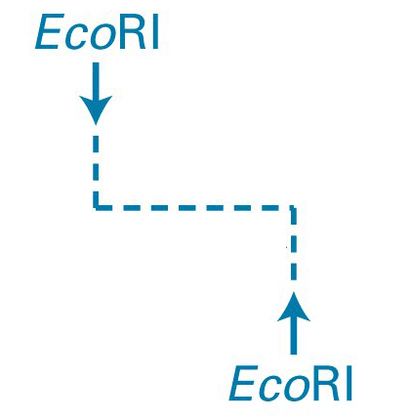
Restriction Enzyme in Action
Sticky Ends
DNA strand with EcoRI restriction site highlighted.
EcoRI restriction enzyme added (outline of separation about to occur).
Restriction fragments separate, with “sticky ends” at each edge.
Notes:
This slide shows a restriction enzyme cutting DNA. The enzyme used here is EcoRI, which cuts at any site where the base sequence is GAATTC.

Slide 8
Adding DNA Ligase
Sticky Ends
DNA ligase bonds sticky ends cut with the same restriction enzyme.
Sticky ends cut with different restriction enzymes will not bond together.
Why?
Because the base pair sequence of the two sticky ends will be different and not match up.

Slide 9
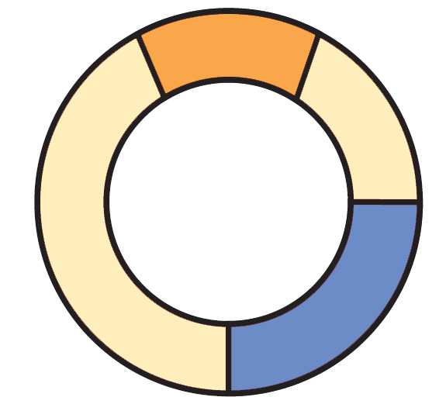
Plasmids Can Be Drawn to Show the Genes They Carry
In this diagram:
Blue and Orange are drawn as genes.
Triangles are indicating the known restriction sites for a restriction enzyme. (shapes can vary)
Plasmid Maps are more complex.
Plasmid Name
Bp size
Notes:
The purpose of this slide is to show the students how plasmids can be diagramed to indicate certain areas. In this particular image, the blue and orange regions were added to represent genes. The lighter tan colored areas indicate the rest of the plasmid. The red triangles (which can also be lines or some other shape) indicate areas of restriction by some arbitrary restriction enzyme. If a different restriction enzyme (with a different restriction site recognition) were to be used, the red triangles would appear in different locations (obviously).
The plasmid’s name and base pair size (Bp size) is found in the center of the plasmid, but it can also be written elsewhere.

Slide 10
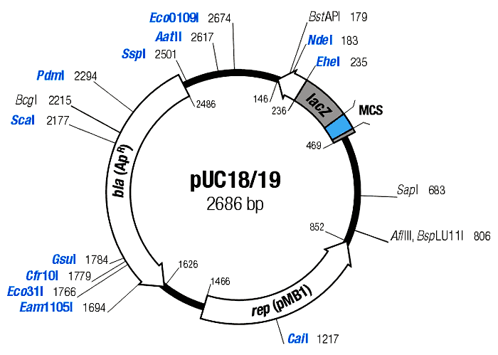
Plasmid Maps Indicate Restriction Sites and Genes
Notes:
This slide is meant to show the complexities in mapping DNA. Notice the many mapped restriction sites and the 3 genes labeled on the plasmid. This plasmid is 2686 base pairs in size.

Slide 11
Application Exercise
Make Recombinant DNA Using Restriction Enzymes
Notes:
This next series of slides is meant to use the knowledge from the previous slides and simply make recombinant DNA.

Slide 12
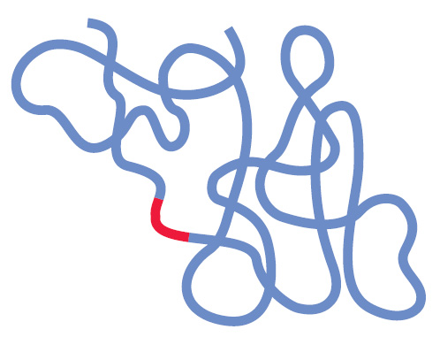
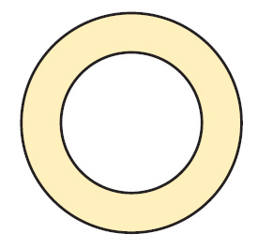
DNA From Two Sources (Restriction Sites Labeled)
Circular DNA
Linear DNA
Notes:
Here we are presented with the DNA to be cut. The restriction sites for a particular restriction enzyme have been labeled. Take note of the red area in the linear DNA. The goal of this series of slides is to produce a plasmid containing a single copy of this red sequence.

Slide 13
Application of Restriction Enzymes

Slide 14
Adding DNA Ligase
Notes:
Adding DNA ligase will cause the “sticky ends” to come together, and many combinations are possible.

Slide 15
Recombinant DNA Plasmid
Many possible recombinant DNA plasmids can be produced, but this was the desired plasmid for the experiment.

Slide 16
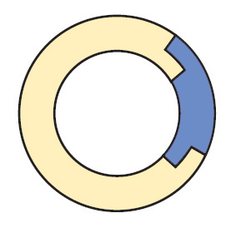
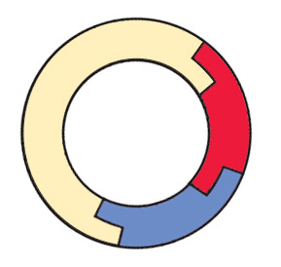
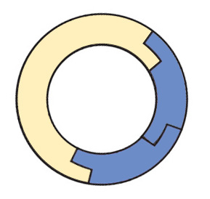
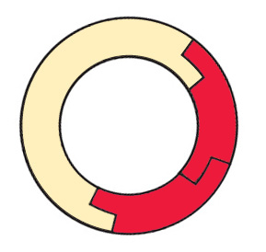
Many Other Recombinant Possibilities
…and many more!

Slide 17
Plasmid DNA Insertion
DNA plasmids can be inserted into bacteria using a variety of laboratory processes.

Slide 18
Transgenic Colony Allowed to Grow

Slide 19
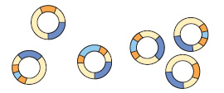
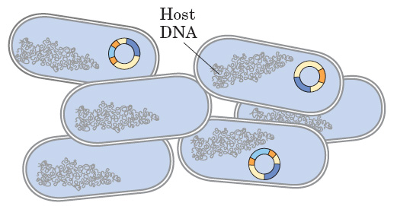
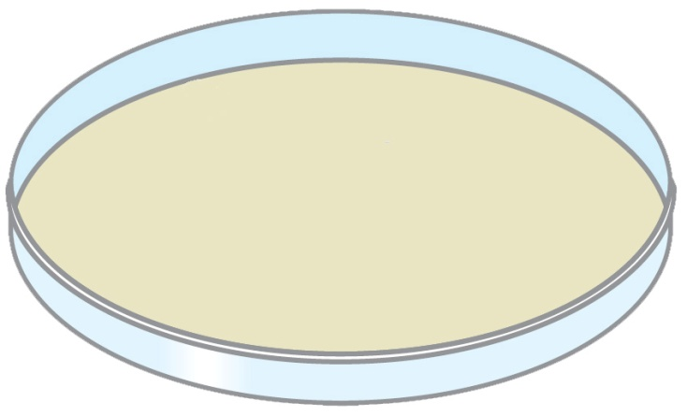
How Do We Get the Desired Plasmid?
Recombinant plasmids
Restriction fragments will ligate randomly, producing many plasmid forms.
Bacterial insertion would be necessary, then colony growth, and further testing to isolate bacteria with the desired plasmid.
Transformation of bacterial cells through electroporation.
Bacteria are then moved to a growth plate, and grown on selective media to “weed out” cells that have not picked up the desired plasmid.

Slide 20
Lab Experiment (Part 1)
Running Digested DNA Through Gel Electrophoresis

Slide 21
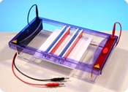
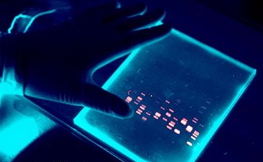
Goals of this Hands-On Lab
Take plasmid DNA that has been previously cut with restriction enzymes and compare that to a plasmid NOT cut with restriction enzymes, by running them through a gel.
Look for different banding patterns and understand how to read them.
Predict what kind of banding pattern a plasmid will make based on:
The restriction enzyme used.
The plasmid’s structural shape.

Slide 22
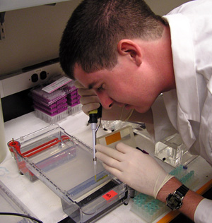
Gel Box Loading Techniques
Look directly down the axis of the pipette.
Loading dye makes the sample heavy, but it can still easily swish out of the well.
Squirt down slowly.
Take the tip out of the buffer.
Then release the plunger.
If you don’t do that, you will suck the sample back up.

Slide 23
Add DNA samples and ladder to the wells and “run to red!”
Notes:
You RUN TO RED because DNA holds a slightly negative charge, and when electrical current is added to the system, the DNA will migrate to the positive end.

Slide 24
10 kb
8 kb
6 kb
5 kb
4 kb
3 kb
2 kb
1 kb
.5 kb
Sample fragments move toward positive end.
Notes:
MAKE SURE TO WARN THE STUDENTS OF THE HIGH VOLTAGE RUNNING THROUGH THE GEL BOXES.

Slide 25
Lab Experiment (Part 2)
Analyzing Your Gel

Slide 26
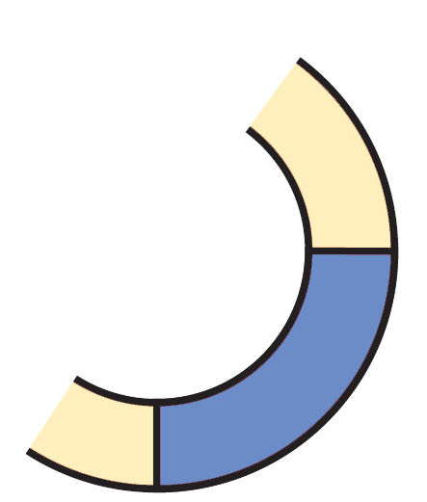
What Makes Up the Banding Pattern in Restricted DNA?
1400 Bp
The restriction enzyme cleaves the DNA into fragments of various sizes.
Each different size fragment will produce a different band in the gel.
Remember that fragments separate into bands based on size.
2000 Bp
Lancer Plasmid
6700 Bp
3300 Bp

Slide 27
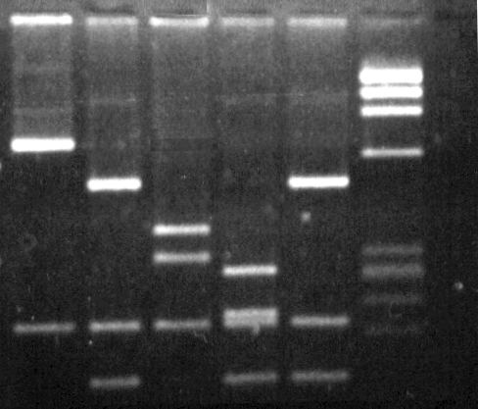
What Makes Up the Banding Pattern After Adding DNA Ligase?
Several combinations of plasmids will result from the reaction.
The many forms will contribute to different bands.
(See following slides for chemical and structural forms)

Slide 28
Different Recombinant Forms
Adding DNA Ligase does not always make the desired plasmid!
Few if any could be what you wanted.
Think about the large number of possible combinations.

Slide 29
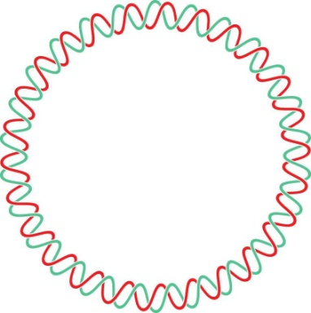
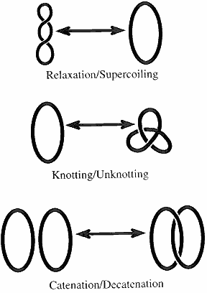
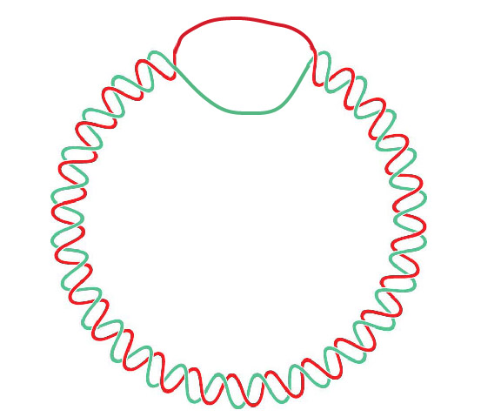
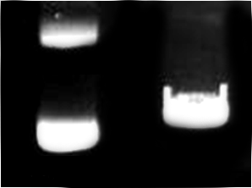
Different Structural Forms
circle
“multimer”
Nicked Circle
Linear
Supercoiled
“nicked-circle”
Different structural forms produce different bands.

Slide 30
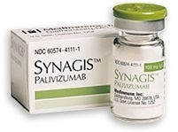
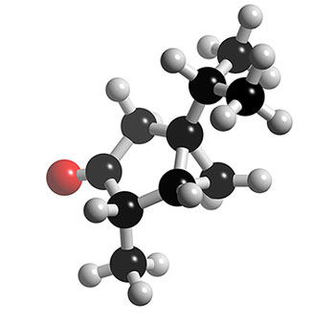
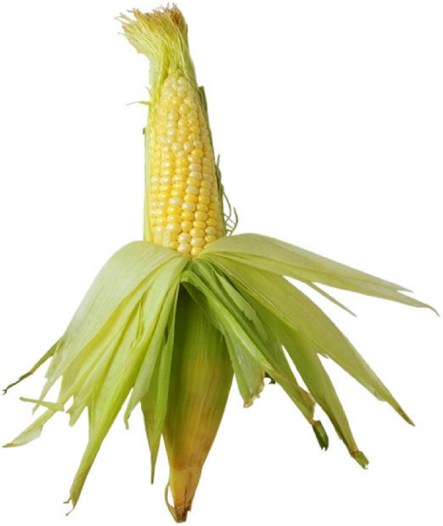
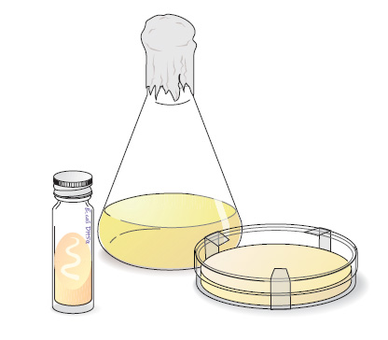
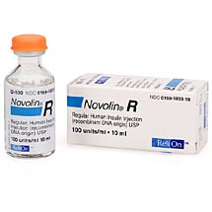
What Are Some Applications of Recombinant DNA Technology?
Bacteria, Yeasts, and Plants can all be modified to produce important pharmaceuticals, enriched foods, and industrial products.
Notes:
Novalin-R (Insulin Regular) is a product of recombinant DNA technology, and helps diabetics to regulate blood sugar.
Synagis (Palivizumab) is a product of recombinant DNA technology and is given to babies who may be at risk of respiratory syncytial virus (RSV).
The flask and dish image is meant to illustrate yeasts modified with recombinant DNA to produce any number of products. The product is produced and then purified out of the growth media.
The corn cob is representative of the Genetically Modified Food Industry, where food crops have been modified to resist certain pests (including insects and fungi), or certain chemicals like Roundup (glyphosphate herbicide), and to reduce costs and improve yields of agricultural crops.

Slide 31
Assignment
Find a product in any of the fields listed in the previous slide and write a short summary to include:
The organism used
The recombinant DNA product
The product’s application
Is the product an improvement compared to similar non-recombinant products (explain)?
Notes:
GREAT WEBSITES TO START WITH:
http://www.ucbiotech.org
http://www.ncbi.nlm.nih.gov/
http://www.whybiotech.com/
http://www.ncbiotech.org/
http://biotech.mtu.edu/

Slide 32
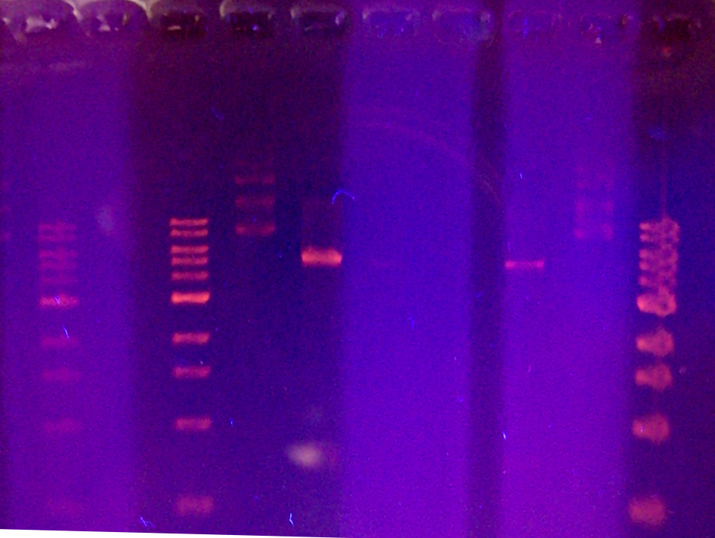
A-
A+
10 Kb Ladder
10 Kb Ladder
10 Kb Ladder
Multimer
Nicked
Super Coiled
5 Kb
Linear Fragment
Linear Fragment
Notes:
This image was taken with a digital camera, zooming, low light settings, and super macro settings. This is NOT an image from the gel imager that was supplied with the kit. This is what the gel will look like when fluoresced under UV light.

