Slide 1
Plant Tissues

Slide 2
Examples of the Different Types of Plant Cells
Parenchyma
Collenchyma
Sclerenchyma
fibers and sclerids
Vessels
Tracheids
Sieve tube members
Companion cells
Egg (ovum)
Sperm
Notes:
Parenchyma:the average plant cell, Lack secondary cell walls: most metabolic functions in the plant, storage and synthesizing various organic products. Fruit= parenchyma cells
Collenchyma: have secondary cell walls, function in structural support, still somewhat elastic, do not inhibit growth; EX. Strings of celery
Sclerenchyma: thick secondary cell walls contain lignin, structural support, occurr in region of plant that has stopped growing in length. Fibers and Sclerids

Slide 3
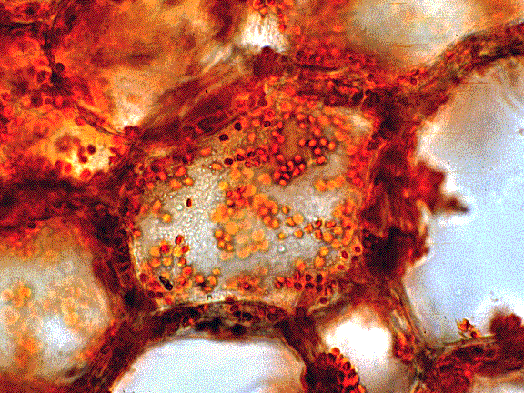
The Parenchyma Cell
The generic plant cell
Most abundant and versatile
Function:
storage
flesh of fruit
storage in roots and seeds
basic metabolism
They can change and become other cells (differentiation)
Alive at maturity
Primary cell wall

Slide 4
The Collenchyma Cell
“glue” cells
Flexible support
Found in growing shoots, stems, & leaves
Differentiate from parenchyma cells
Alive at maturity
Primary and secondary cell walls
Ex: resilient strings found in celery

Slide 5
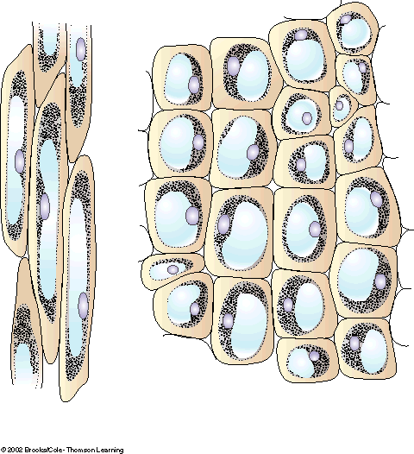
Thickened corner
of cell wall
(b)
Nucleus
Cytoplasm
Vacuole

Slide 6
Sclerenchyma
Rigid cells
Function: support and strengthen non extending regions of a plant like mature stems
Thick, non stretchable secondary cell walls
Dead at maturity
Two Types:
Fibers
long, slender, occur in strands
Cotton
Hemp
Flax (Linen)
Sclerids
short, varying shape, occur in groups
Gristle in pears

Slide 7
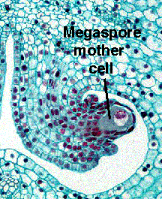
Plants Eggs and Sperm

Slide 8
Cells→Tissues
Like animal cells, plant cells are organized into tissues
Tissues are groups of cells that form a structural and functional unit
Simple tissues have one cell type
Complex tissues have two or more cell types

Slide 9
Tissues→ Tissue System
Tissues are organized into tissue systems
Vascular plants have three tissue systems
Ground tissue
Energy transformation, storage and support
Vascular tissue
Water and nutrient conduction system
Dermal tissue
Covering for the plant body

Slide 10
P
r
i
m
a
r
y
M
e
r
i
s
t
e
m
T
i
s
s
u
e
S
y
s
t
e
m
T
i
s
s
u
e
s
C
e
l
l
s
e
p
i
d
e
r
m
i
s
d
e
r
m
a
l
p
a
r
e
n
c
h
y
m
a
p
e
r
i
d
e
r
m
p
r
o
t
o
d
e
r
m
v
e
s
s
e
l
s
t
r
a
c
h
e
i
d
s
x
y
l
e
m
p
a
r
e
n
c
h
y
m
a
f
i
b
e
r
s
A
p
i
c
a
l
M
e
r
i
s
t
e
m
v
a
s
c
u
l
p
r
o
c
a
m
b
i
a
r
u
m
s
i
e
v
e
t
u
b
e
m
e
m
b
e
r
p
h
l
o
e
m
s
c
o
m
p
a
n
i
o
n
c
e
l
l
s
p
a
r
e
n
c
h
y
m
a
f
i
b
e
r
s
g
r
o
u
n
d
m
e
r
i
s
t
e
m
p
a
r
e
n
c
h
y
m
a
p
a
r
e
n
c
h
y
m
a
g
r
o
u
n
d
c
o
l
l
e
n
c
h
y
m
a
c
o
l
l
e
n
c
h
y
m
a
s
c
l
e
r
e
n
c
h
y
m
a
s
c
l
e
r
e
i
d
s
C
e
l
l
D
i
f
f
e
r
e
n
t
i
a
t
i
o
n
i
n
P
l
a
n
t
s
f
i
b
e
r
s

Slide 11
Building a House
Foundation is laid
Construction of the frame
Installation of plumbing, heating, etc
Waterproof walls and roof
Food stored in appropriate places
Building a plant
Meristems give rise to all tissues
Three tissue systems give rise to the major organs of a plant
Installation of the vascular tissue (plumbing)
Installation of dermal tissues
covering, skin
Installation of ground tissue
parenchyma

Slide 12
Meristems
Meristems are regions of cell division
Main difference between animals and plants
Birds and mammals stop growing at maturity, although certain cells get replenished (skin)
Plants have the ability to keep growing their entire lives
Meristems make it possible to grow a new plant from a cutting
Growth in plants is the counterpart (to some extent) to movement in animals

Slide 13
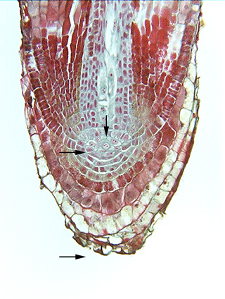
Apical Meristems
Shoot apical meristem
Root apical meristem
Found at the tips of roots and shoots
Increase the length of a plant

Slide 14
Apical meristems give rise to:
Three primary meristems
Ground meristem
Give rise to ground tissues
Protoderm
Give rise to “skin” coverings
Procambium
Give rise to plumbing of the plant

Slide 15
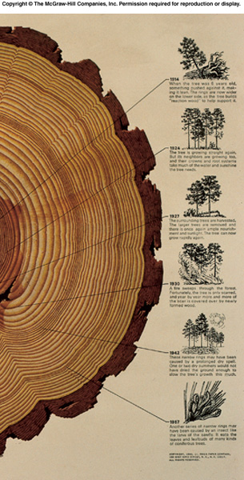
Other Meristems: Lateral meristems
Secondary Growth
Add girth (width) by producing wood and bark

Slide 16
Other Meristems: Intercalary Meristems
Why grass keeps growing back after you cut it.
Grasses and related plants do not have lateral meristems
Intercalary meristems add to the plants length

Slide 17
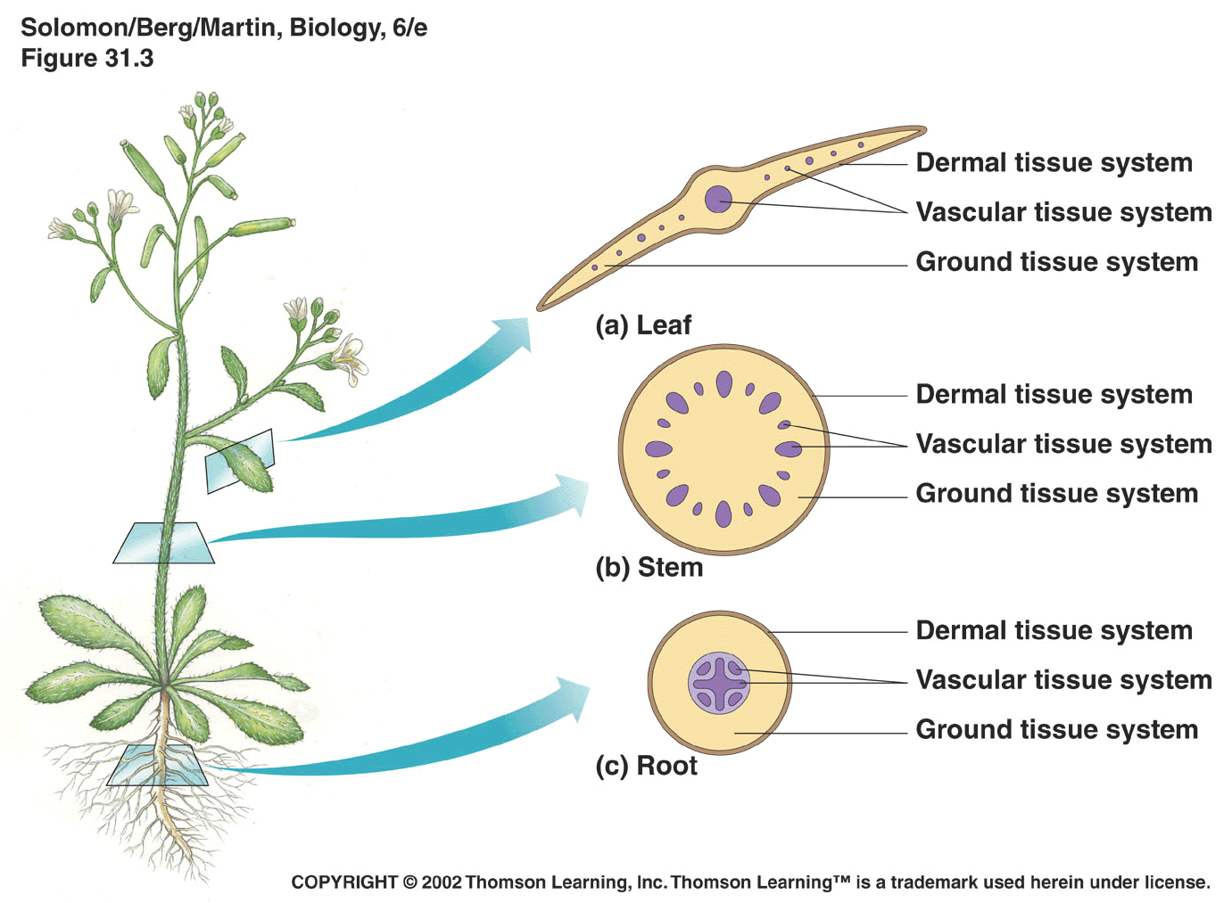
The Tissue Systems Give Rise to the Organs of a Plant

Slide 18
Ground Tissue
Tissues that “ground” the plant
Fundamental tissues of a plant
parenchyma
collenchyma
sclerenchyma

Slide 19
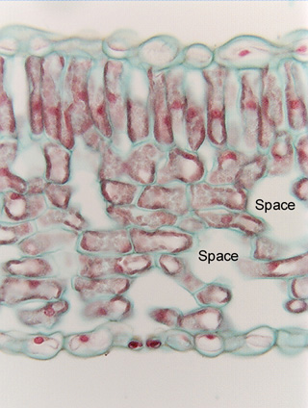
Ground Tissues: Parenchyma
cells assume various shapes and sizes
contain starch grains or other storage granules
oils
tannins (tanning or dyeing substances)
crystals
various other secretions

Slide 20
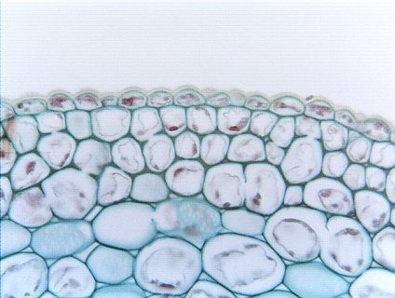
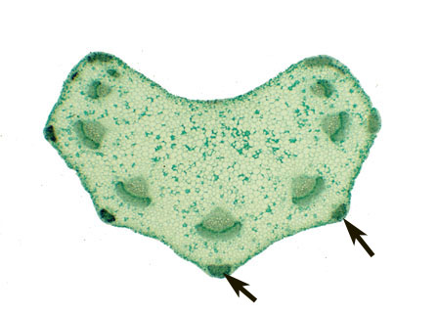
Ground Tissues: Collenchyma
are alive at maturity
cell walls are thicker and more uneven
typically longer than wide
tend to be found under the epidermis
provide flexible support
Collenchyma
Parenchyma

Slide 21
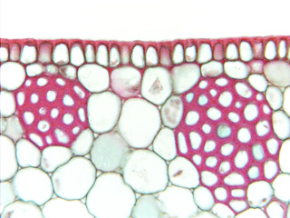
Sclerenchyma
Tissues (cells) have thick, tough secondary cell walls made of lignin
Dead at maturity
Function in support
sclerids
fibers

Slide 22
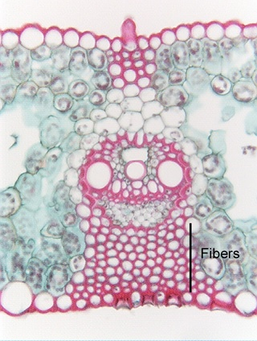
Fibers are used for clothing
Cotton
Linen
Bamboo
Hemp

Slide 23
The Dermal and Vascular Tissue Systems are made of Complex Tissues
Tissues that are made of more than one cell type
Dermal Tissues
epidermis
endodermis
Vascular tissues
Xylem
Phloem

Slide 24
Dermal Tissues
dermal tissues cover the organs of a plant. They are analogous to skin.
epidermis
outermost layer of cells
usually one cell layer thick
epidermal cells have a layer of cutin (cuticle)
resistant to bacteria and other disease organisms

Slide 25
Cuticle Wax
Wax Myrtle
Myrica cerifera
waxes obtained from boiling the leaves is used to make bayberry candles

Slide 26
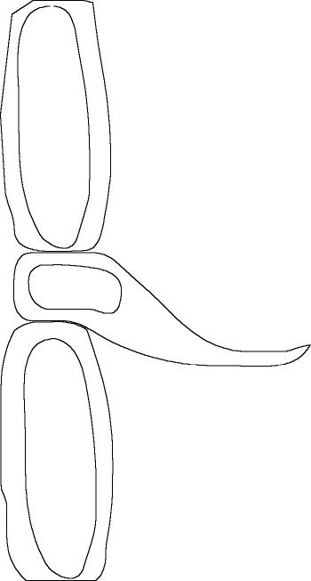
Epidermis is made of many types of cells
Guard cells form stomata
Trichomes
Outgrowths – ‘hairs’
Some leaf trichomes use to keep animals away
Some used to eliminate salt
Some thought to increase reflection to reduce stem/leaf temperature
Root hairs are a type of trichome, increase surface area to increase uptake of nutrients
Glands

Slide 27
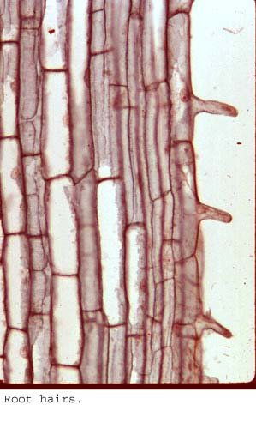
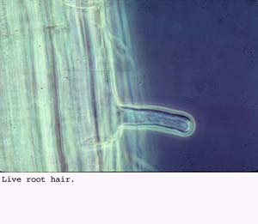
Root Hairs are extensions of epidermal cells

Slide 28
Dermal Tissues: Epidermis
Glands secrete substances that protect the plant
secrete nectar
digestive glands
Sundews
trigger hairs of a Venus Flytrap

Slide 29
Prickles grow out of the epidermis

Slide 30
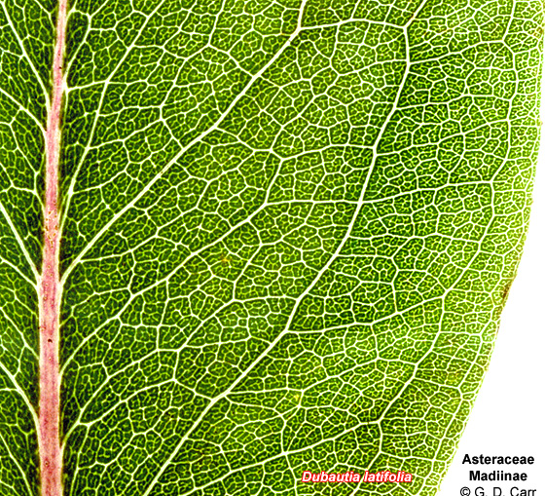
Complex Tissue: Vascular Tissues
Xylem Tissue
transports water and dissolved substances through the plant to all its organs
parenchyma cells
fibers
tracheids
vessels
rays

Slide 31
Xylem
Tracheids
Have thick secondary cell walls
dead at maturity
tapered at the end
contain pits
areas where no 2° cell wall is laid down

Slide 32
Xylem
Vessels
Have thick secondary cell walls
dead at maturity
long tubular cells with grate-like openings at the end
contain pits
areas where no 2° cell wall is laid down

Slide 33
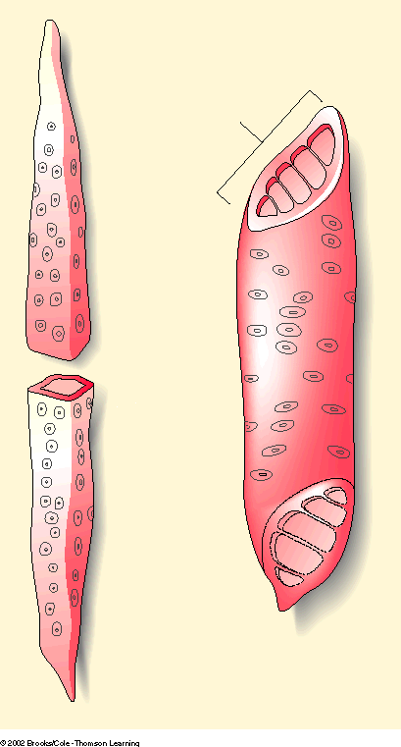
End wall with
perforations
Tracheid
Vessel
Pits
Cell wall
Lumen
(a)
(b)

Slide 34
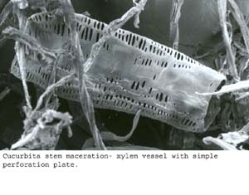
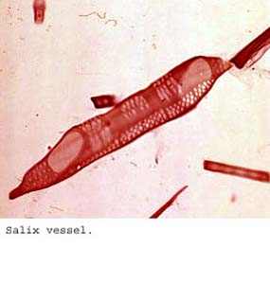
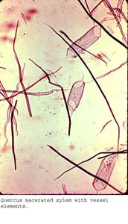
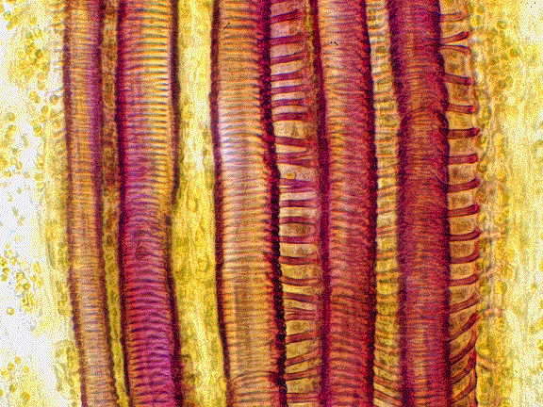

Slide 35
Many cone bearing trees and other non-flowering plants
Xylem is made of tracheids only
soft wood of pines
tracheids often have spiral thickenings on them
Vessels make the wood of flowering trees “hard” wood

Slide 36
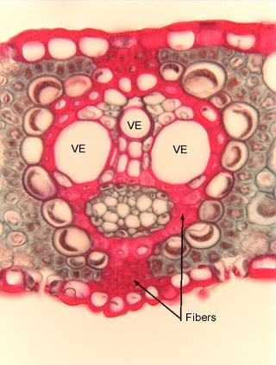
Complex Tissue: Vascular Tissues
Phloem Tissue
transports dissolved food (sugars) through the plant to all its organs
sieve tube members
companion cells
parenchyma
fibers
rays
phloem

Slide 37
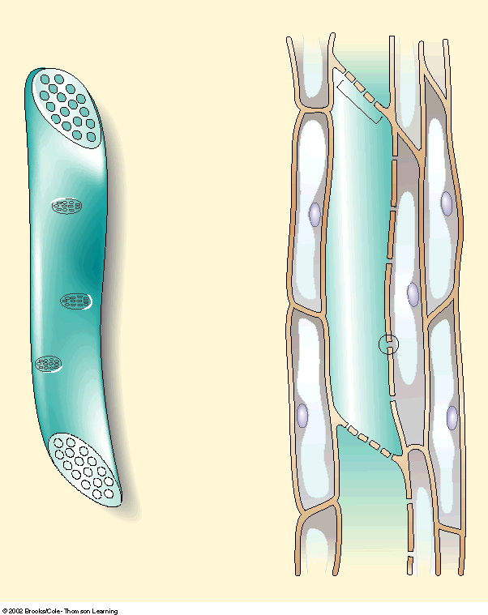
Sieve plate
Sieve tube
member
Phloem
parenchyma
cells
Lateral sieve
area
Plasmodesma
Companion cell
Phloem
tissue
Sieve Tube Member
(c)
(d)
Notes:
Sieve Tube Member

Slide 38
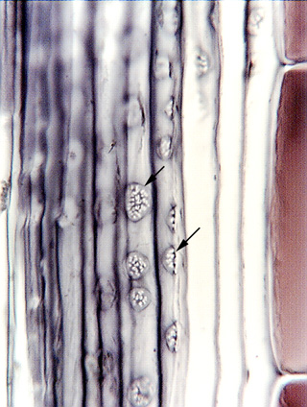
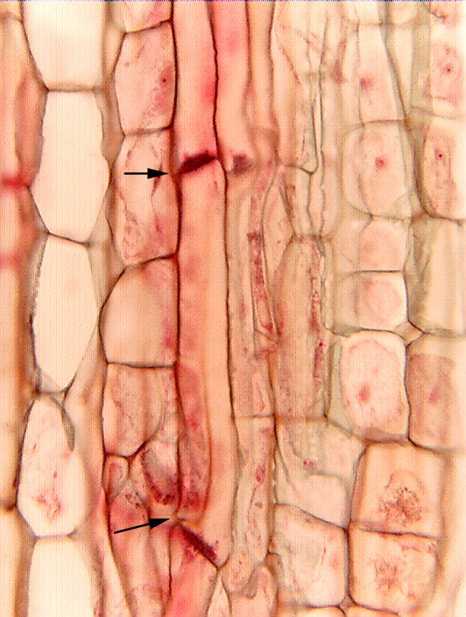
Sieves and Sieve tube cells

Slide 39
Phloem: Companion cells
Companion cells are “companions” to sieve tube cells
Because sieve tube cells have no nuclei, the companion cells provide all the nutrients to the sieve tube cell

Slide 40
Two other sclerenchyma cells, fibers and sclereids, are specialized entirely in support.
Fibers are long, slender and tapered, and usually occur in groups.
Those from hemp fibers are used for making rope and those from flax for weaving into linen.
Sclereids, shorter than fibers and irregular in shape, impart the hardness to nutshells and seed coats and the gritty texture to pear fruits.

Slide 41
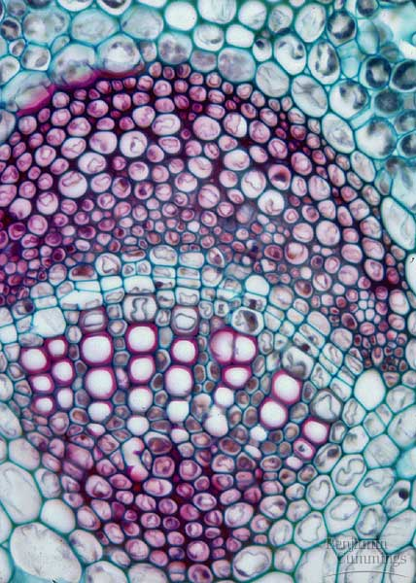
Fiber Cells

Slide 42
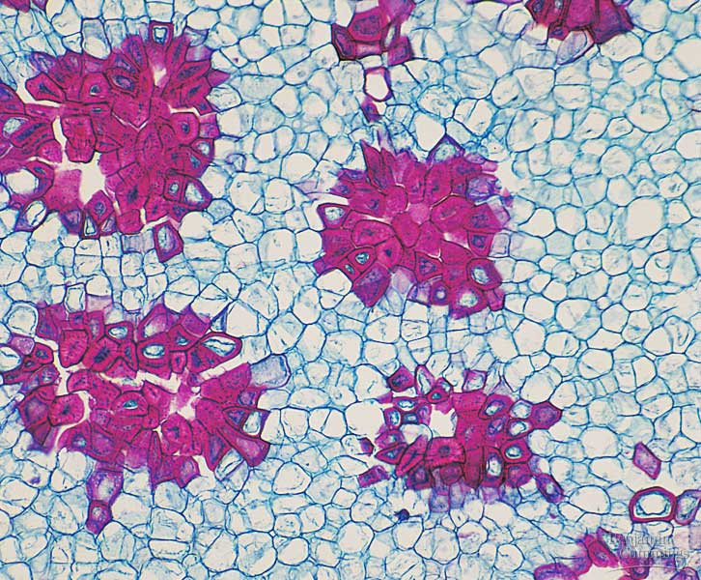
Sclereids

