Slide 1
THE GENETIC BASIS OF CANCER
0
11.15 Cancer results from mutations in genes that control cell division
Cancer cells, which divide uncontrollably
Result from mutations in genes whose protein products affect the cell cycle

Slide 2
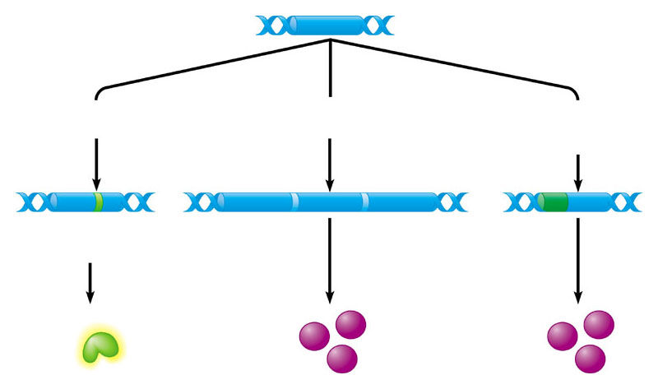
0
Proto-Oncogenes
A mutation can change a proto-oncogene (a normal gene that promotes cell division)
Into an oncogene, which causes cells to divide excessively
Proto-oncogene DNA
Mutation within the gene
Multiple copies of the gene
Gene moved to new DNA locus, under new controls
Oncogene
New promoter
Hyperactive growth- stimulating protein in normal amount
Normal growth- stimulating protein in excess
Normal growth- stimulating protein in excess
Figure 11.16A

Slide 3
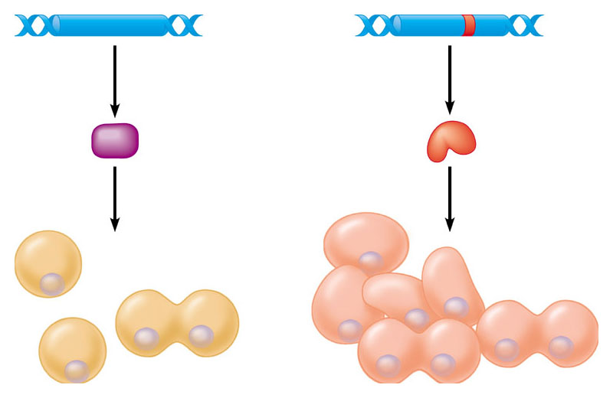
0
Tumor-Suppressor Genes
Mutations that inactivate tumor suppressor genes
Have similar effects as oncogenes
Tumor-suppressor gene
Mutated tumor-suppressor gene
Normal growth- inhibiting protein
Defective, nonfunctioning protein
Cell division under control
Cell division not under control
Figure 11.16B

Slide 4
0
11.17 Oncogene proteins and faulty tumor-suppressor proteins can interfere with normal signal transduction pathways

Slide 5
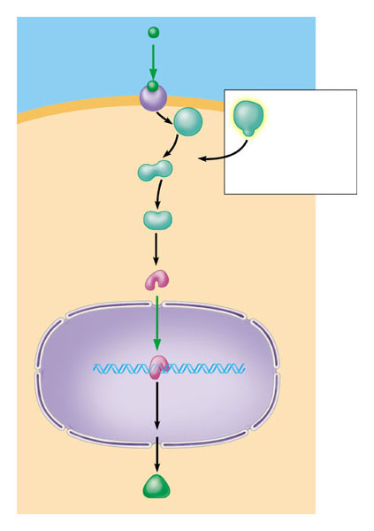
0
Oncogene proteins
Can stimulate signal transduction pathways
Growth factor
Receptor
Target cell
Normal product of ras gene
Hyperactive relay protein (product of ras oncogene) issues signals on its own
Relay proteins
Transcription factor (activated)
DNA
Nucleus
Transcription
Protein that stimulates cell division
Translation
Figure 11.17A

Slide 6
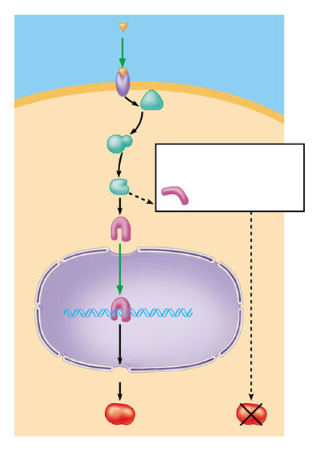
0
Tumor-suppressor proteins
Can inhibit signal transduction pathways
Growth-inhibiting factor
Receptor
Relay proteins
Nonfunctional transcription factor (product of faulty p53 tumor-suppressor gene)
cannot trigger transcription
Transcription factor (activated)
Normal product
of p53 gene
Transcription
Protein that inhibits cell division
Translation
Protein absent (cell division not inhibited)
Figure 11.17B

Slide 7
0
11.18 Multiple genetic changes underlie the development of cancer
Cancers result from a series of genetic changes in a cell lineage

Slide 8
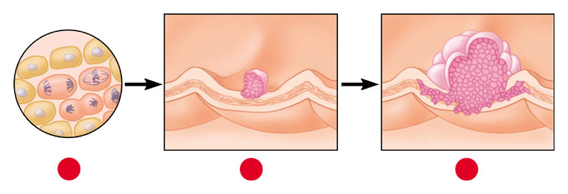
0
Colon cancer
Develops in a stepwise fashion
Colon wall
1
2
3
Cellular changes:
Increased cell division
Growth of polyp
Growth of malignant tumor (carcinoma)
DNA changes:
Oncogene activated
Tumor-suppressor gene inactivated
Second tumor- suppressor gene inactivated
Figure 11.18A

Slide 9
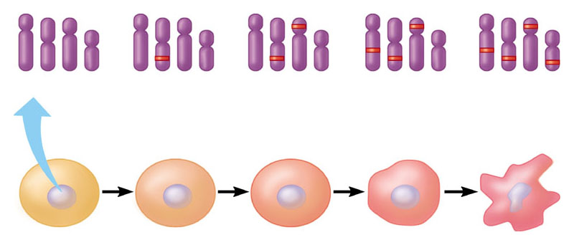
0
Accumulation of mutations
Can lead to cancer
Chromosomes
1
2
3
4
mutation
mutations
mutations
mutations
Normal cell
Malignant cell
Figure 11.18B

Slide 10
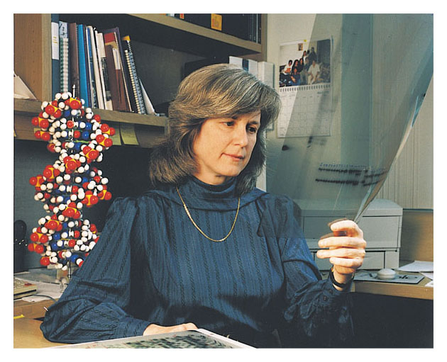
TALKING ABOUT SCIENCE
0
11.19 Mary-Claire King discusses mutations that cause breast cancer
Researchers have gained insight into the genetic basis of breast cancer
By studying families in which a disease-predisposing mutation is inherited
Figure 11.19

Slide 11
CONNECTION
0
11.20 Avoiding carcinogens can reduce the risk of cancer
Reducing exposure to carcinogens (which induce cancer-causing mutations)
And making other lifestyle choices can help reduce cancer risk

Slide 12
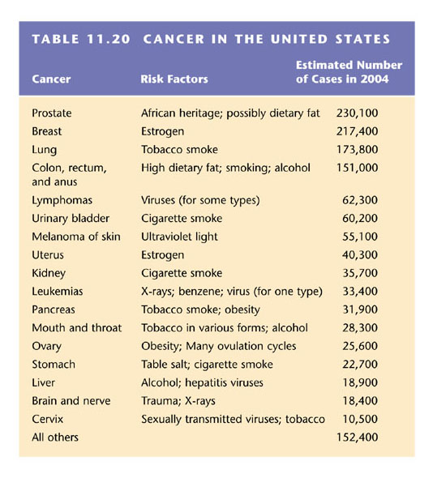
0
Cancer in the United States
Table 11.20

