Slide 1
Scientists call this the:
DNA
DNA
Central Dogma of Molecular Biology!
RNA
RNA
Protein
Protein

Slide 2
How do we know that all of our genetic information comes from DNA?
What type of experiment would you design to determine that DNA is the source of all genetic information?

Slide 3
Griffith’s Experiment with Pneumonia and the accidental discovery of Transformation
Frederick Griffiths was a bacteriologist studying pneumonia
He discovered two types of bacteria:
Smooth colonies
Rough colonies
CONCLUSION:
The smooth colonies must carry the disease!

Slide 4
Griffith’s Experiment with Pneumonia and the accidental discovery of Transformation
When heat was applied to the deadly smooth type…
And injected into a mouse…
The mouse lived!

Slide 5
Griffith’s Experiment with Pneumonia and the accidental discovery of Transformation
Griffith injected the heat-killed type and the non-deadly rough type of bacteria.
The bacteria “transformed” itself from the heated non-deadly type to the deadly type.

Slide 6
Griffith’s Experiment did not prove that DNA was responsible for transformation
How would you design an experiment to prove that DNA was responsible for transformation?

Slide 7
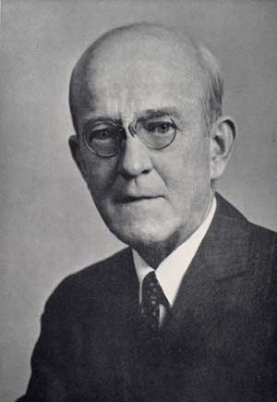
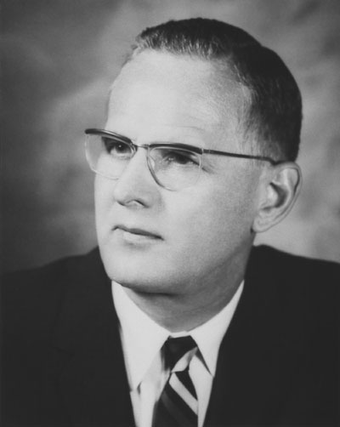
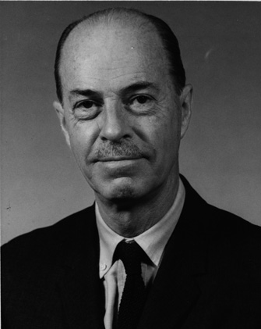
Avery, McCarty, and MacLeod Repeated Griffith’s Experiment
Oswald Avery
Maclyn McCarty
Colin MacLeod

Slide 8
Avery, McCarty, and MacLeod Added the non-deadly Rough Type of Bacteria to the Heat-Killed Smooth Type
To the Heat-Killed Smooth Type, added enzymes that destroyed…
Carbohydrates
Lipids
Proteins
RNA
DNA

Slide 9
S-Type Carbohydrates Destroyed
S-Type Lipids Destroyed
S-Type Proteins Destroyed
S-Type RNA Destroyed
S-Type DNA Destroyed
Conclusion:
DNA was the transforming factor!

Slide 10
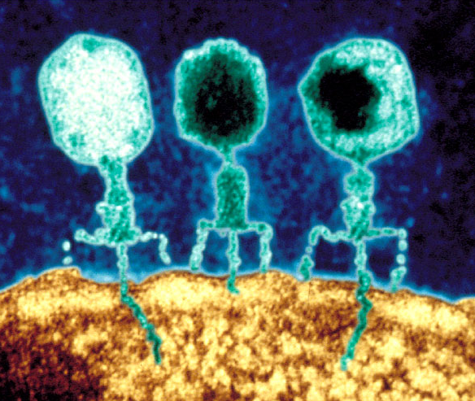
The Hershey-Chase Experiment
Protein coat
Alfred Hershey & Martha Chase worked with a bacteriophage:
A virus that invades bacteria. It consists of a DNA core and a protein coat
DNA

Slide 11
Protein coats of bacteriophages labeled with Sulfur-35
Phage
Hershey and Chase mixed the radioactively-labeled viruses with the bacteria
Bacterium
Phage
The viruses infect the bacterial cells.
Bacterium
DNA of bacteriophages labeled with Phosphorus-32

Slide 12
Protein coats of bacteriophages labeled with Sulfur-35
Separated the viruses from the bacteria by agitating the virus-bacteria mixture in a blender
DNA of bacteriophages labeled with Phosphorus-32

Slide 13
Protein coats of bacteriophages labeled with Sulfur-35
Centrifuged the mixture so that the bacteria would form a pellet at the bottom of the test tube
Measured the radioactivity in the pellet and in the liquid
DNA of bacteriophages labeled with Phosphorus-32

Slide 14
The Hershey-Chase results reinforced the Avery, McCarty, and MacLeod conclusion:
DNA carries the genetic code!
However, there were still important details to uncover…

Slide 15
How did DNA: 1. Store information? 2. Duplicate itself easily?
These questions would be answered by discovering DNA’s structure

Slide 16
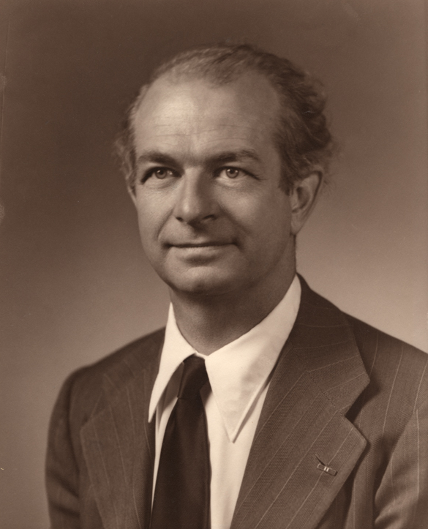
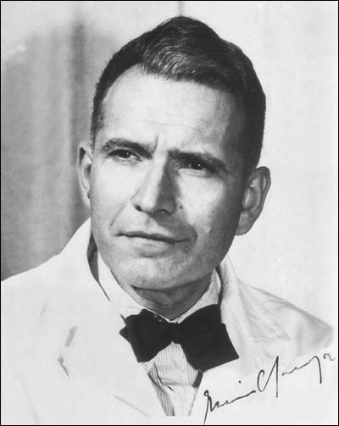
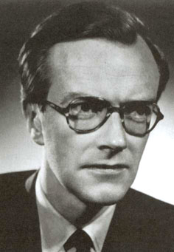
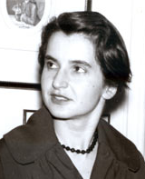
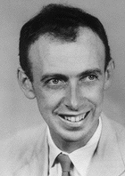
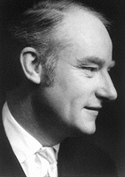
The Race to Discover DNA’s Structure

Slide 17
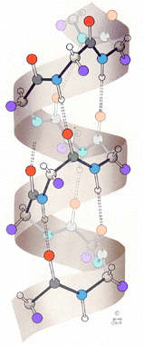
The Race to Discover DNA’s Structure
Linus Pauling
1940s
Discovered the alpha-helical structure of proteins.

Slide 18
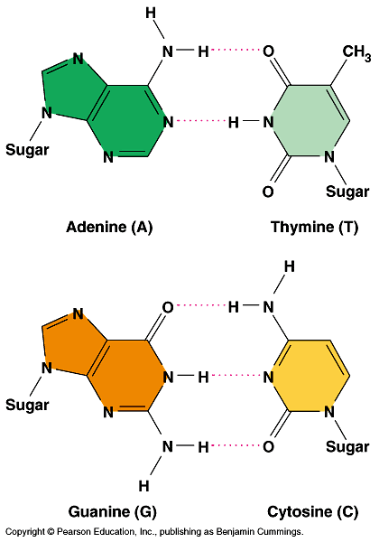
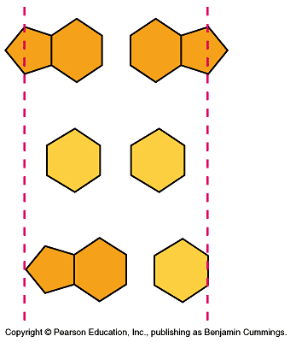
The Race to Discover DNA’s Structure
Why do you think the bases match up this way?
1950
Chargaff’s Rule: Equal amounts of Adenine and Thymine, and equal amounts of Guanine and Cytosine
Purine + Purine = Too wide
Pyrimidine + Pyrimidine = Too Narrow
Erwin Chargaff
Purine + Pyrimidine = Perfect Fit from X-ray data

Slide 19
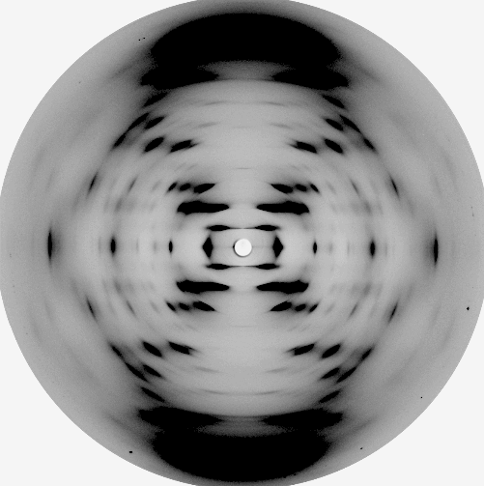
The Race to Discover DNA’s Structure
X-Ray diffraction image of DNA taken by Franklin in 1951
Maurice Wilkins
Rosalind Franklin

Slide 20
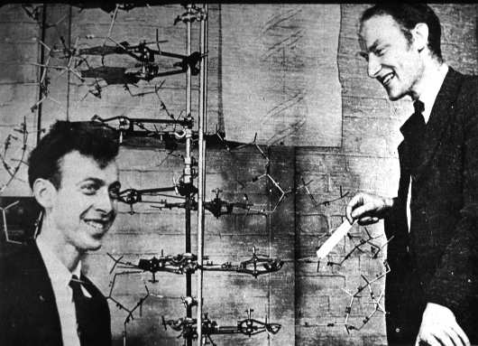
The Race to Discover DNA’s Structure
1953
Compiled data from previous scientists to build a double-helical model of DNA
James Watson
Francis Crick

Slide 21
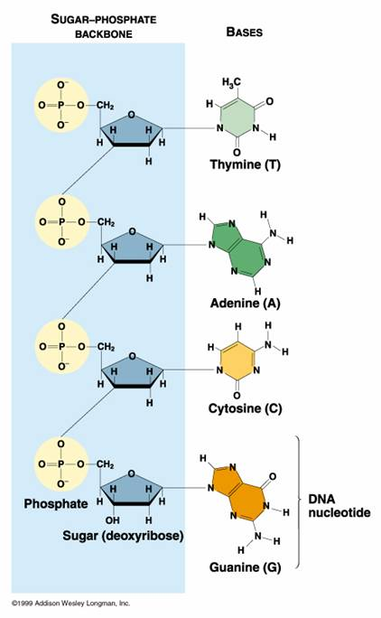
The Race to Discover DNA’s Structure was Over
DNA is made up of:
Four nucleotides: Adenine, Thymine, Guanine and Cytosine
These follow the rules of base-pairing:
Adenine bonds with Thymine
Guanine bonds with Cytosine
A sugar-phosphate backbone
DNA is arranged in an double-helix

Slide 22
DNA Replication
The double helix did explain how DNA copies itself
We will study this process, DNA replication, in more detail

Slide 23
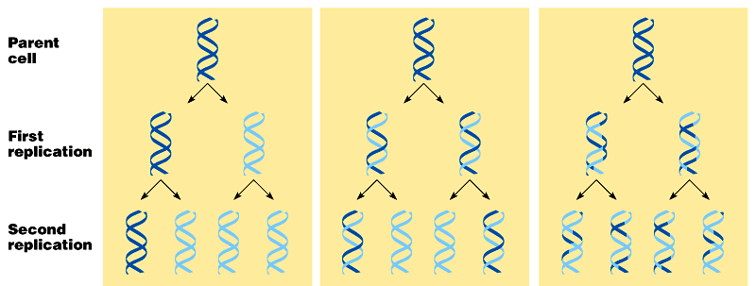
How does DNA replicate?
Hypotheses:
Conservative
Semi-Conservative
Dispersive
Notes:
Have students stand in one of three corners in the lab: Conservative; Semi-Conservative and Dispersive. Have them design an experiment that would prove their point.

Slide 24
Meselson-Stahl Experiment
Bacteria cultured in medium containing a heavy isotope of Nitrogen (¹⁵N)

Slide 25
Meselson-Stahl Experiment
Bacteria transferred to a medium containing elemental Nitrogen (¹⁴N)

Slide 26
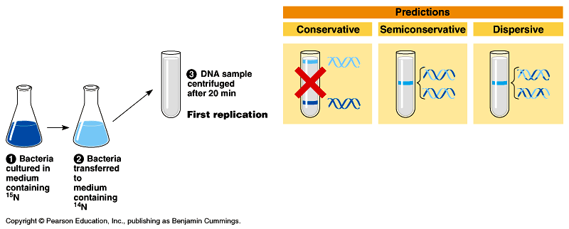
Meselson-Stahl Experiment
DNA sample centrifuged after First replication

Slide 27
Meselson-Stahl Experiment
DNA sample centrifuged after Second replication

Slide 28
DNA Replication
The “parent” molecule has two complementary strands of DNA.
Each is base paired by hydrogen bonding with its specific partner:
A with T
G with C

Slide 29
DNA Replication
The first step in replication is the separation of the two strands.

Slide 30
DNA Replication
Each parental strand now serves as a template that determines the order of the bases along a new complementary strand.

Slide 31
DNA Replication
The nucleotides are connected to form the sugar-phosphate backbones of the new strands.
Each “daughter” DNA molecule consists of one parental strand and one new strand.

Slide 32
The Race to Replicate DNA
Two teams: A and B
Individually, each team member will run to the board to add a nucleotide to the “unzipped” strand of DNA.
The first team to finish base-pairing their DNA correctly will win the game.
Notes:
Run to the board game

