Slide 1
DNA Structure and Analysis
Chapter 4: Background

Slide 2
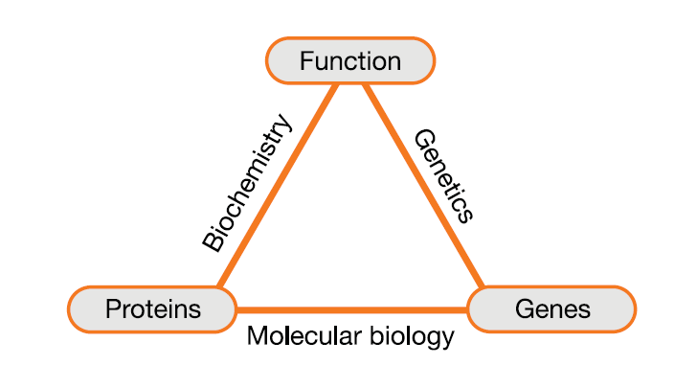
Molecular Biology
Three main disciplines of biotechnology
Biochemistry
Main focus on proteins and their function
Genetics
Main focus on genes and their function
Molecular Biology
Main focus on genes and the proteins they make

Slide 3
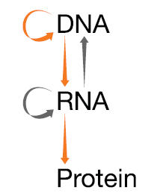
Central Dogma
DNA→RNA→Protein→Trait
The main flow of protein synthesis in a cell
Exceptions to Central Dogma
Reverse Transcription
RNA is reverse transcribed by an enzyme reverse transcriptase (from retroviruses) to DNA
The new DNA is referred to as cDNA or complementary DNA
DNA is replicated from a DNA template
RNA can be replicated from a template

Slide 4
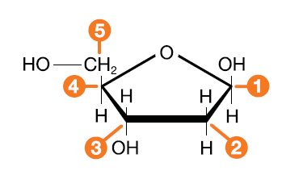
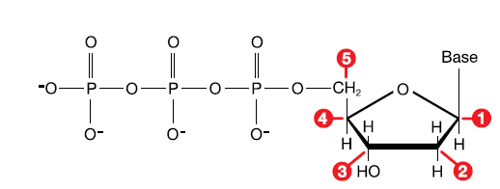
DNA Structure
Deoxyribonucleic Acid
Made of deoxyribose sugar
Phosphate group linked to the 5 prime (5') carbon
Nitrogenous base linked to the 1 prime (1') carbon
Ribonucleic acid is similar, but has a hydroxyl group on the 2 prime (2') carbon
OH

Slide 5
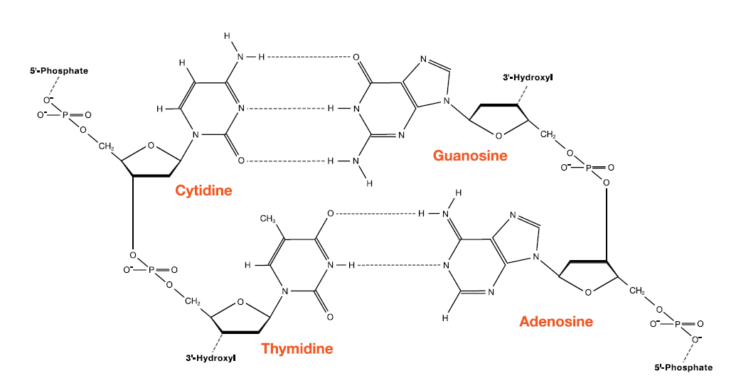
DNA Structure
5' to 3' direction
Antiparallel
Purine to pyrimidine
AT
CG
Number of hydrogen bonds
AT = 2
CG = 3

Slide 6
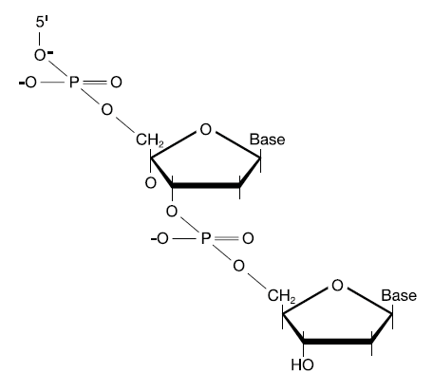
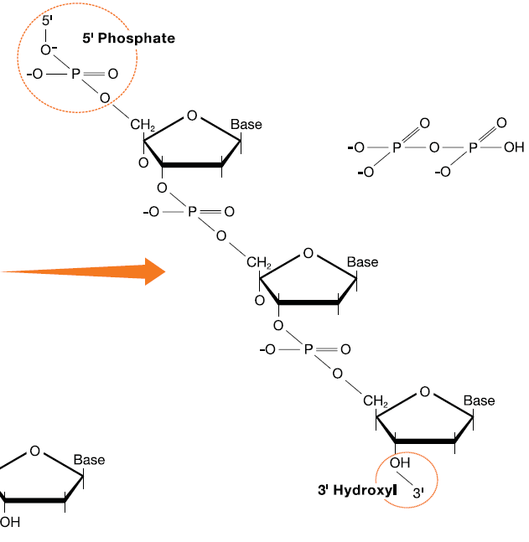
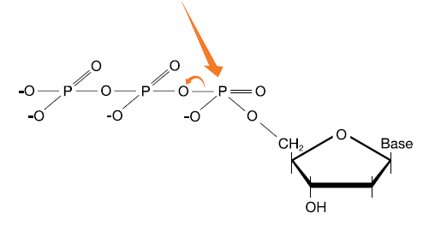
Adding Nucleotides

Slide 7
Restriction Enzymes
Formed in bacteria to resist infection by viral DNA
Recognize a particular nucleotide pattern
Cut in either a blunt or staggered pattern

Slide 8
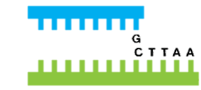
Restriction Enzymes
Formed in bacteria to resist infection by viral DNA
Recognize a particular nucleotide pattern
Cut in either a blunt or staggered pattern

Slide 9
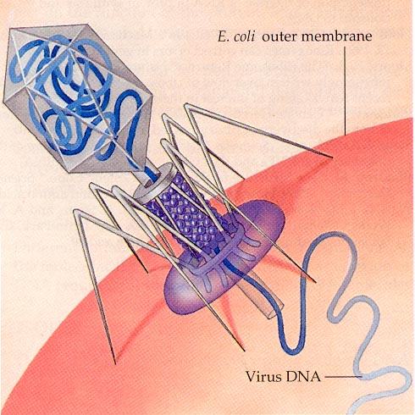
Naming Restriction Enzymes
EcoRI
E = Escherischia genus
co = coli species
R = strain RY13
I = first isolated
PstI
P = Providencia
St = stuartii
I = first isolated

Slide 10
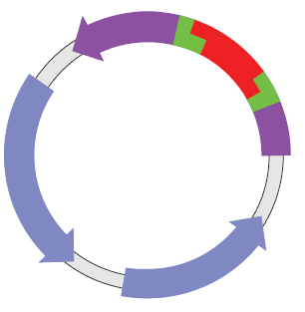
Using Restriction Enzymes
Cut source DNA and plasmid DNA with the same enzyme or enzymes
Mix the fragments
Add DNA ligase to reform sugar phosphate bonds

Slide 11
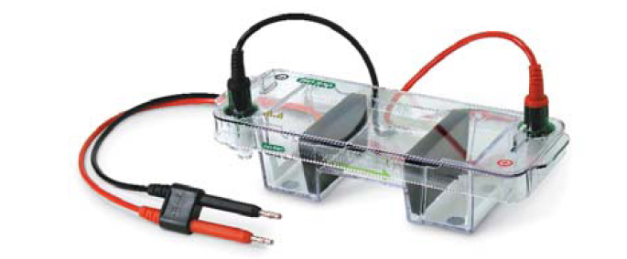
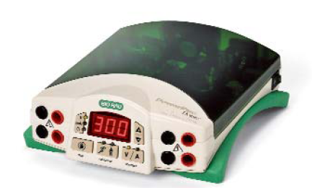
Electrophoresis

Slide 12
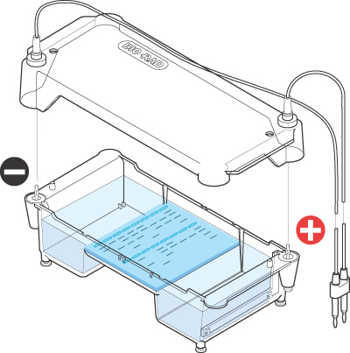
Electrophoresis

Slide 13
Running an Agarose Gel
Play video: Agarose Gel Electrophoresis

Slide 14
How the Gel Box Works
When gel box is running, water is separated into hydrogen and oxygen gas
Buffers ensure that the pH remains constant

Slide 15
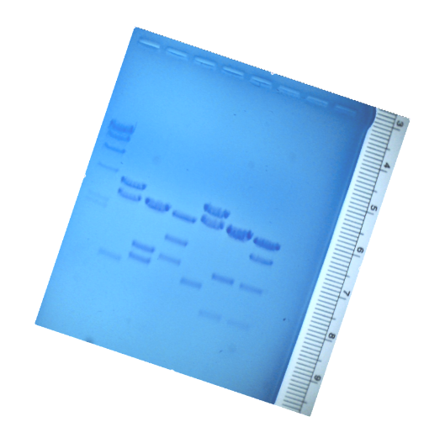
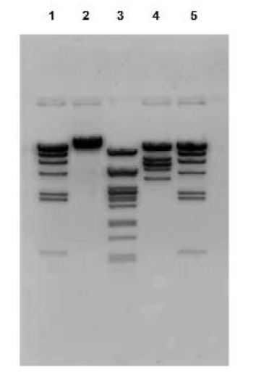
Gel Imaging and Size Estimation
FAST Blast™ DNA Stain
SYBR® Safe
Inverted image

Slide 16
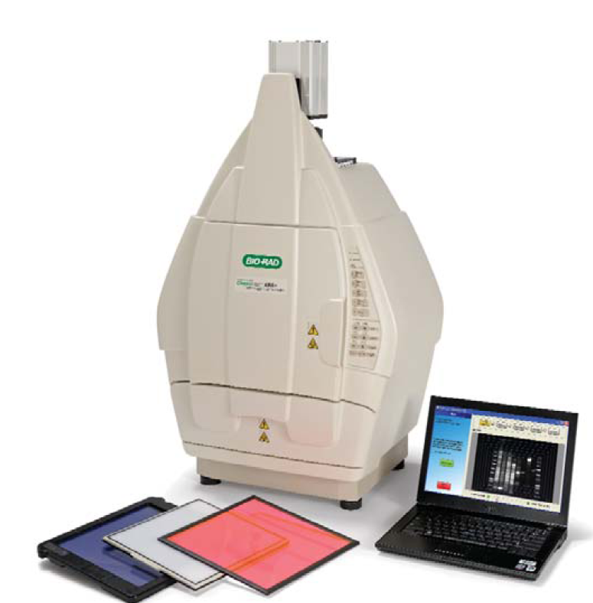
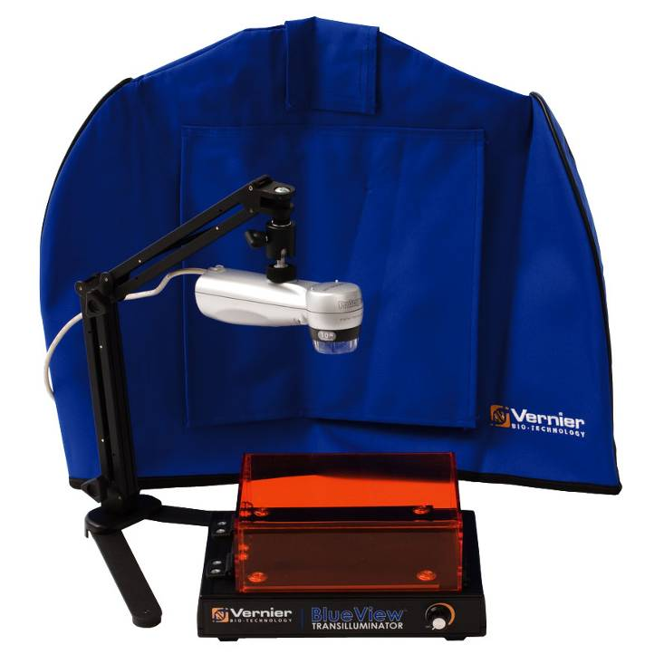
Gel Documentation Systems

Slide 17
Size Estimation
Size (bp) Distance (mm)
23,000 11.0
9,400 13.0
6,500 15.0
4,400 18.0
2,300 23.0
2,000 24.0

Slide 18
Chapter 4 Summary
Background
Disciplines of Biotechnology
Central Dogma
DNA
DNA Structure
Nucleotide Additions
Restriction Enzymes
Restriction Enzymes and Uses
Electrophoresis

