Slide 1
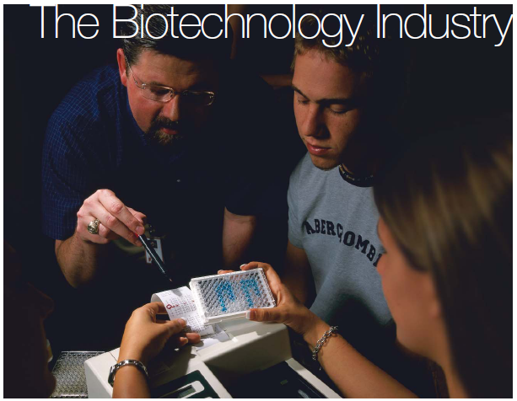
The Biotechnology Industry
Chapter 1: Background

Slide 2
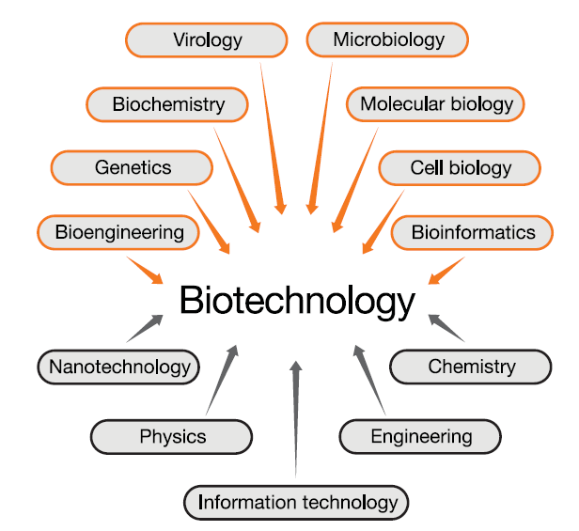
What Is Biotechnology?
Biotechnology = technology based on biology in the broadest definition
Any technological application that uses biological systems, living organisms, or derivatives thereof, to make or modify products or processes for specific uses.
United Nations Convention on Biological Diversity (1992, 2003)
Orange boxes are biological sciences and gray boxes are other scientific disciplines.

Slide 3
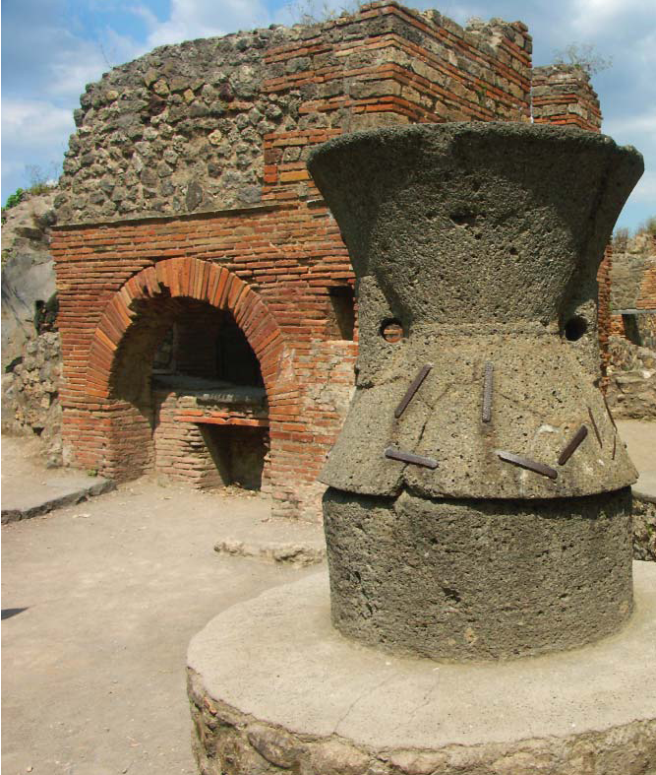
Historical Uses of Biotechnology
4,000-2,000 BC: Egyptians use yeast to ferment beer and leaven bread
500 BC: Chinese use moldy soybeans to treat boils, the first use of antibiotics
1914: Bacteria are used to treat sewage for the first time in England
1962: Green fluorescent protein (GFP) is isolated by Osamu Shimomura, who won the Nobel Prize in 2008
1980: U.S. Supreme Court approves the principle of patenting an organism, allowing Exxon to patent an oil eating bacteria
Ancient bakery in Pompeii

Slide 4
Historical Uses of Biotechnology
1983: Kary Mullis invents the polymerase chain reaction (PCR)
1986: first field trials for genetically modified crop (herbicide- resistant tobacco in the U.S. and France)
1990: CHY-MAX, an enzyme used in cheese making is the first product of recombinant DNA technology to be used in the U.S. food industry
1997: Ian Wilmut creates Dolly the sheep, the first animal cloned from an adult cell
2002: first draft of the human genome is released
2010: first synthetic cell created by Craig Venter

Slide 5
Systems Biology and “-omics”
Systems biology = an approach that shifts from looking at a single gene or protein to exploring how whole cells, organisms, or ecosystems function on the molecular level
Omics are disciplines using the systems biology approach
Genomics investigates the whole genome
Proteomics studies the proteome, or the entire protein complement of a cell or organism
Transcriptomics studies the transcriptome or the part of the genome that is transcribed
Metabolomics investigates the metabolome or all of the metabolites in a cell or organism

Slide 6
Bioinformatics
Bioinformatics is the use of information technology for biological applications. This can include:
Storing data
Sorting and searching data sets
Analyzing and comparing data
Predicting structures
Modeling the interaction of molecules

Slide 7
Uses of Biotechnology
Health Care/Pharmaceutical
Drug discovery
Utilizes high throughput tools and techniques
Microarrays are used to screen thousands of drug candidates by binding them on a microscope slide and incubating them with the target protein
Drug development
Chemical engineering, cell cultures, and animal models are used to test whether the drug works as expected
Transgenic animals are often used that have been engineered to express the specific gene or genes and these can be inhibited or deleted if desired
Nanotechnology is also used to help deliver drugs to their targets. These are devices and particles that are nanometers in size

Slide 8
Uses of Biotechnology
Health Care/Pharmaceutical
Clinical trials
Controlled tests to see if the drugs work in humans
Phase I: a small group of healthy individuals, usually less than 100, are given the drug to test for safety and dosage levels. This is often used to see how long it will remain active in the bloodstream
Phase II: the trial is expanded to between 100 and 300 participants to investigate whether the drug helps people suffering from the disease
Phase III: is a large trial that expands to serve 1,000 to 5,000 patients. The patients are monitored for effectiveness and side effects
In 2009 there were 587 phase III human trials being conducted in the U.S.

Slide 9
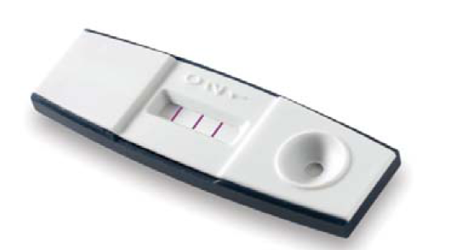
Uses of Biotechnology
Health Care/Pharmaceutical
Personalized medicine
Also referred to as phamacogenomics. The adjustment of treatment of a patient by determining which drugs or treatments that would best suit the patient’s genotype or expressed differences
Herceptin is a drug that is prescribed for patients that have breast cancers that are HER2 positive. HER2 is a specific protein that is overexpressed
Clinical diagnostics
The development of tests for the diagnosis of disease. Some of these tests are done at the molecular level, such as with antibodies.
HIV testing, Lyme disease, SARS
Bio-Rad’s Genie II HIV1/HIV2™ assay

Slide 10
Uses of Biotechnology
Agriculture
Genetically modified crops
Pest-resistance: Bt corn
Herbicide-resistance: Roundup Ready cotton
Production of human proteins: SemBioSys conducted phase I and II clinical trials on safflower that produces recombinant insulin. This would reduce costs for insulin production
Genetically modified animals
Increased milk production: rBST or recombinant bovine somatotropin (cow growth hormone)
Pharming: use of farm animals to produce therapeutic drugs
Animals are being explored as potential sources for organ transplant

Slide 11
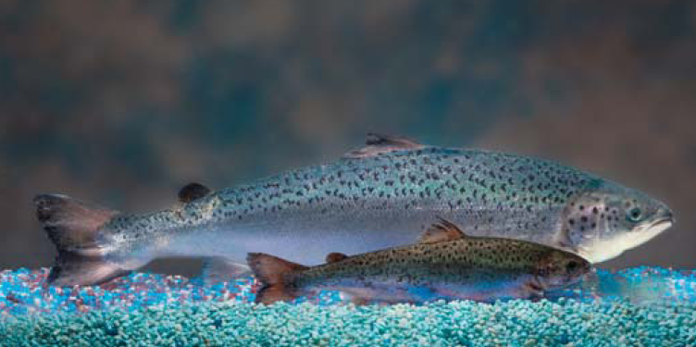
Uses of Biotechnology
Food
Biotechnology is used to improve the quality and nutritional content of basic food staples. This is a direct link to agricultural biotechnology
Golden rice: genetically engineered to express beta-carotene, which helps to prevent vitamin A deficiency which leads to blindness
Increased growth rates: AquAdvantage salmon grow at much faster rate for meat production
Increased nutritional value: pigs have been developed that express higher levels of omega-3 fatty acids
As of 2010, genetically modified animals have not been approved for sale as food
AquAdvantage salmon as compared to a non-transgenic Atlantic salmon. Photo courtesy of AquaBounty Technologies.

Slide 12
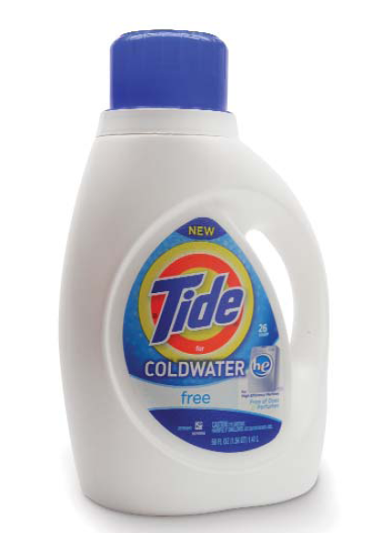
Uses of Biotechnology
Industrial manufacturing
Textile industry
Biotechnology has helped to improve efficiency, increase yields, and reduce environmental impacts from manufacturing industries
Laundry detergent has enzymes derived from cold water microorganisms that work at cold temperatures
Stone washing of jeans is now done with enzymes and greatly decreases the time and effort required to stone wash jeans
Plastics
Plant-based plastics take fewer resources to produce and are biodegradable
Tide Coldwater laundry detergent

Slide 13
Uses of Biotechnology
Biofuels
Used to develop alternative energy sources
Conversion of left over plant stover (stalks and parts of plants left over after harvest) to ethanol
U.S. Energy Independence and Security Act provides billions of dollars to biofuel development
Mining
Use of microorganisms to leach minerals out of mine waste piles (tailings). This bioprocessing can reduce pollution and increase yield from a pre-existing source

Slide 14
Uses of Biotechnology
Pollution monitoring and waste management
Biosensors
Biotechnological instruments that convert the action of a biological molecule or organism into an electrical signal. These can use many different mechanisms such as antibodies, enzymes, and PCR
Bioremediation
Use of microorganisms to convert hazardous waste into a less hazardous form
Oil-eating bacteria were used to help clean up the BP oil spill in the Gulf of Mexico

Slide 15
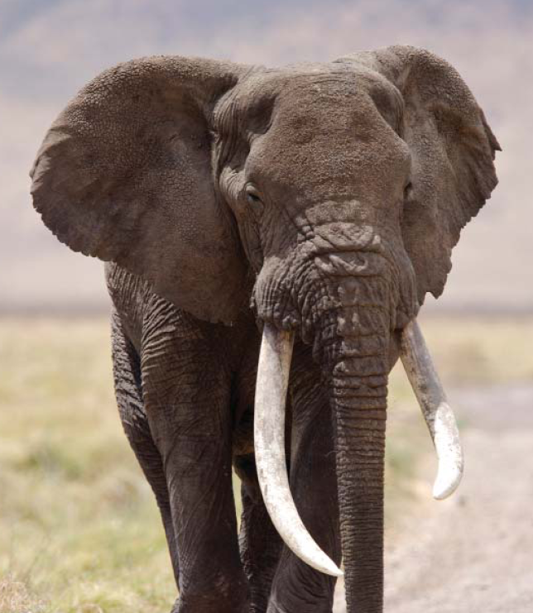
Uses of Biotechnology
Conservation
Wildlife protection
DNA profiling is used map endangered species and is used to track the origins of contraband ivory and identify elephant populations that are being poached
Consortium for the Barcode of Life (CBOL)
Catalog every living organism by generating a genetic barcode

Slide 16
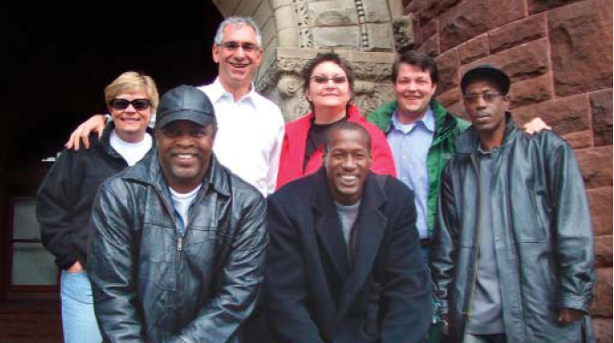
Uses of Biotechnology
Biodefense
Protection from attack using biological weapons.
Biosensors
Vaccine production
Remediation to attack
Epidemiology for tracing back to source
Forensics
Criminal evidence
The Innocence Project
Front row are inmates exonerated by DNA evidence. Photo courtesy of Greg Hampikian

Slide 17
Uses of Biotechnology
Human origins
Genetic analysis is used to map the movement and origins of human populations on the earth
The National Geographic Society has funded the Genographic Project to create detailed map of human migration

Slide 18
Biotechnology Industry and Research
Began in the 1970s
Categorized as either pharmaceutical companies (big pharma) or biotechnology companies
Biotechnology
Genentech was founded in 1976 and the first drug produced was Humulin, a recombinant human insulin
Pharmaceutical
Pfizer produces many drugs and products and has annual revenues around $50 billion dollars

Slide 19
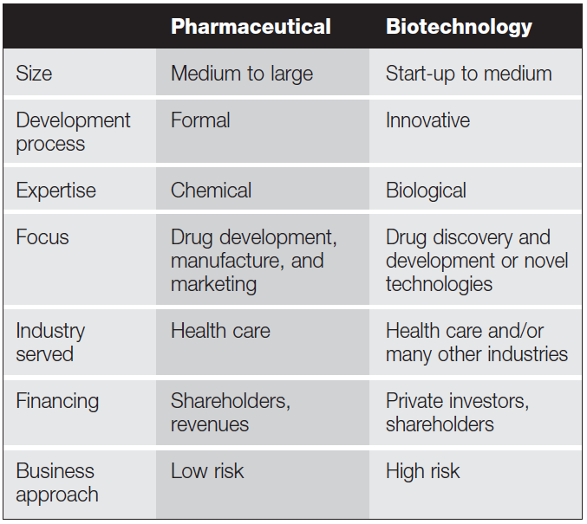
Biotechnology Industry and Research
Differences between biotech and big pharma

Slide 20
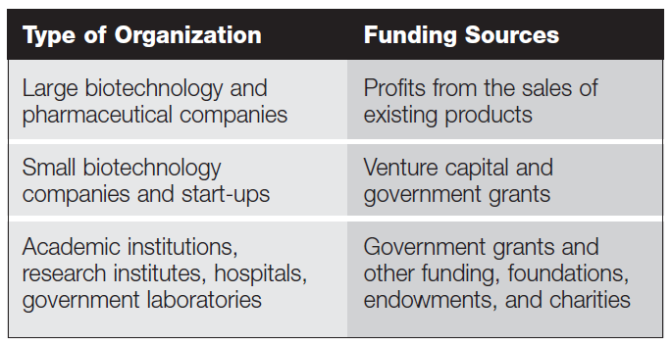
Biotechnology Industry and Research
How different organizations fun biotech research

Slide 21
Sharing of Scientific Information
Peer-reviewed publications
Most traditional method used by scientists to share their work
Reviewed by other scientists in the same field to determine if the research is of sufficient quality for publication
Conferences, meetings, seminars, and posters
Less formal ways to share information
Often posters are where junior scientists get to stand by their posters to explain their findings
Patents
Allows inventors a set time period (often 20 years) to make back the money they invested in developing invention
In exchange, the invention must be disclosed to the scientific community
If others wish to use the process they have to negotiate with the patent holder for permission to use or license the invention

Slide 22
Governmental Regulation of Biotechnology
Main U.S. agencies involved:
FDA or Food and Drug Administration
Responsible for ensuring that food and beverages are safe for human consumption
EPA or Environmental Protection Agency
Responsible to protect human health and the environment
OSHA or Occupational Safety and Health Administration
Responsible for regulating the safety of workers in the workplace

Slide 23
Industry Practices
Companies often adhere to a set of industry rules and standards
Organisation for Economic Co-operation and Development (OECD) or International Organization for Standardization (ISO)
Ensures products are researched, developed, and manufactured correctly and consistently
Certifies that business processes, practices, and products adhere to a specific set of standards called a quality system or quality management system
Companies choose to which standards they will adhere to
Requires records be maintained such as laboratory notebooks

Slide 24
Industry Practices
Standard operating procedures (SOP)
A single way to perform a common task or process
For example, the task may be a lab procedure or method used to calibrate lab equipment. They are often referred to as SOPs
Good laboratory practice (GLP)
Governmental organizations may require the preclinical trials and products be produced under certain standards
GLP is a quality system used for non-clinical health and environmental safety studies
Basic principles of GLP are the basis for sound lab work and require a quality assurance (QA) program be in place
Used to develop test data on the properties and safety of chemicals, biological molecules, or organisms so they can be relied upon with confidence among countries

Slide 25
Industry Practices
GLP Requirements
The responsibilities of all individuals involved in the study, from management to laboratory workers, need to be stated and the qualifications and training required for personnel to conduct the study need to be recorded
SOPs are required to state how samples, materials, and controls will be received, labeled, and stored; how apparatus will be maintained and calibrated; and how computer systems will be validated and backed up
A detailed plan needs to be written prior to the start of the study outlining the purpose of the study, detailed test methods and how the results will be reported. Laboratory notebooks are an integral part of how results are reported
The results and data generated by the study need to be properly stored and archived in case follow-up experiments are required

Slide 26
Industry Practices
Good manufacturing practices (GMP)
Is similar to GLP, but is a set of principles for ensuring the quality and safety of manufactured products used in health care, such as therapeutic drugs and diagnostic and medical devices
GLP and GMP should be followed only when the health or environmental effects of the product are important. It is costly and results in a more expensive product
Often biotech companies follow the ISO9001 standards. They are close to the GLP standards

Slide 27
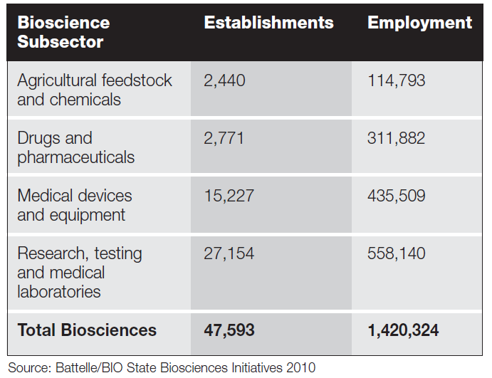
Careers in Biotechnology
Employment base of the bioscience industry in 2008

Slide 28
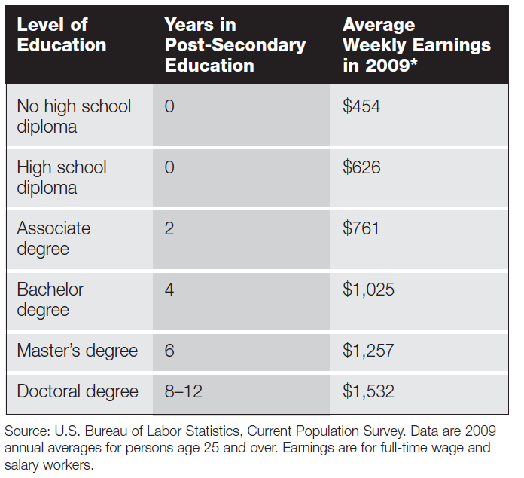
Careers in Biotechnology
The effect of education on earnings

Slide 29
Careers in Biotechnology
Laboratory technician
Associate’s or bachelor’s degree
Works under the supervision of a scientist and is responsible for carrying out the hands-on work involved in laboratory work
Setting up assays
Using instruments
Recording data
Research associate
Bachelor’s or master’s degree
Similar to a technician, however research associates have more responsibility and have a larger role in experimental design and data analysis

Slide 30
Careers in Biotechnology
Research and development scientist
Generally a doctoral degree (Ph.D.) is required, but often a master’s degree with experience can be sufficient
Study how biological processes work
Develop methods to investigate biological processes
Use knowledge to develop products and processes for industry
Design experiments, analyze data, and draw conclusions
Train and supervise technicians and research associates

Slide 31
Careers in Biotechnology
Clinical scientist
Bachelor’s degree, graduate degree, or a specialized certification
Perform all levels of work from analyzing blood samples to overseeing clinical trials for a pharmaceutical company
Responsible for proper handling of medical samples ensuring the proper testing of the samples
Train and supervise clinical technologists and technicians

Slide 32
Careers in Biotechnology
Engineer
Bachelor’s degree required, but often graduate degrees are desired
Biological engineers are often called biomedical or bioengineers
Use science and math to solve biological problems
Have formal training in life science and engineering
Biotechnology industry employs biological, agricultural, chemical, mechanical, electrical and computer engineers

Slide 33
Careers in Biotechnology
Non-laboratory careers
The majority of jobs in biotechnology are not in a lab
Bachelor’s, master’s, MBA, Ph.D. could all be appropriate for these positions
Administrators Logistics experts
Technical writers Quality assurance
Graphic designers Buyers
Sales representatives Accountants
Marketing specialists Biostatisticians
Public relations specialists Project managers
Lawyers

Slide 34
Chapter 1 Summary
Background
What Is Biotechnology
Historical Uses
Uses of Biotechnology
Health and Pharma
Agriculture
Careers
Laboratory Technicians
Scientists
Systems Approach
Food
Forensics, etc.
Biotech Industry
Research Associates
Non-Laboratory Careers
Biotechnology vs. Pharma
Sharing Information
Regulations

