Slide 1
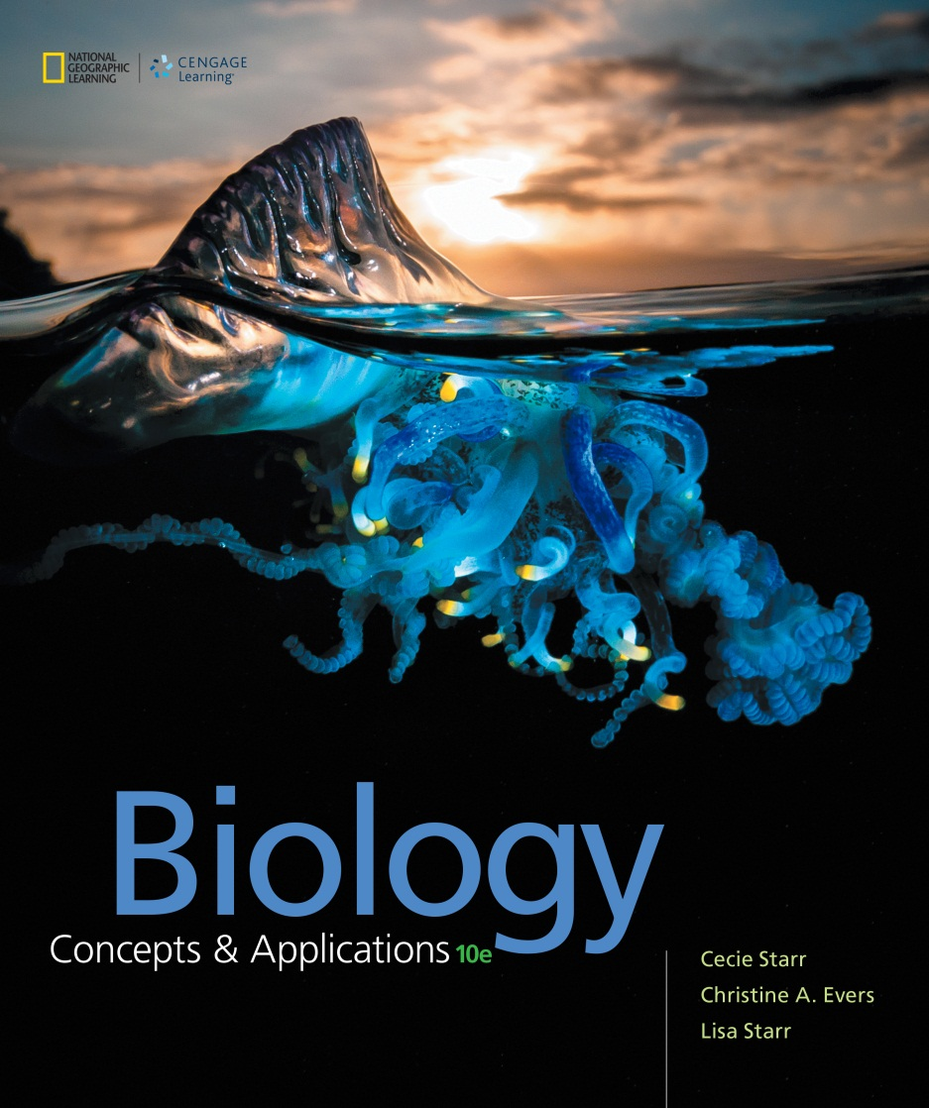
Biology Concepts & Applications
10 Edition
Chapter 8
DNA Structure and Function
Copyright © 2018 Cengage Learning. All Rights Reserved. May not be copied, scanned, or duplicated, in whole or in part, except for use as permitted in a license distributed with a certain product or service or otherwise on a password-protected website for classroom use.

Slide 2
8.1 The Discovery of DNA’s Function
The substance we now call DNA was first described in 1869 by Johannes Miescher
Miescher determined that DNA is not a protein, and that it is rich in nitrogen and phosphorus
  He never learned of its function

Slide 3
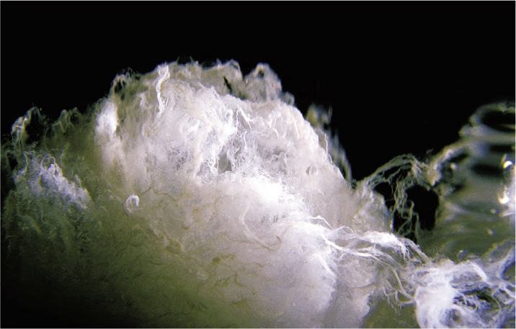
DNA
Notes:
Figure 8.1 DNA, the substance, extracted from human cells.

Slide 4
Early Clues
Sixty years after Miescher’s work, Frederick Griffith unexpectedly uncovered a clue about DNA’s function
  Heat destroyed the ability of lethal S bacteria to cause pneumonia, but it did not destroy their hereditary material
  The hereditary material could be transferred from dead S cells to live R cells

Slide 5
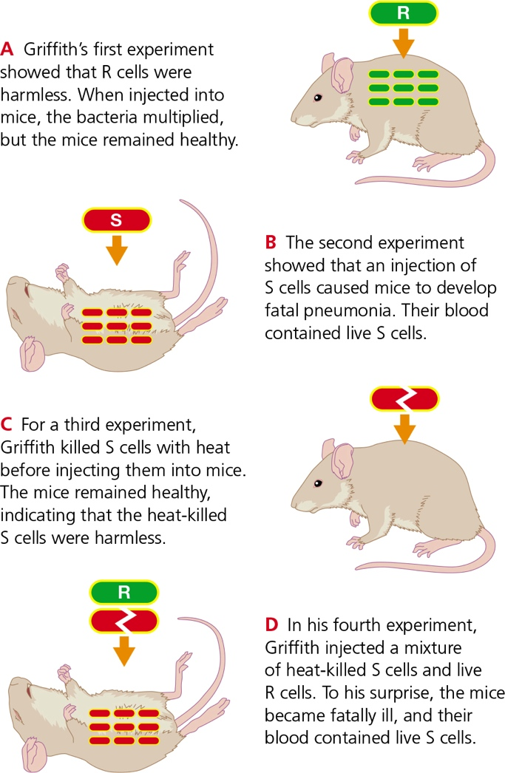
Griffith’s Experiments
Notes:
Figure 8.2 Fred Griffith’s experiments.
Griffith discovered that hereditary information passes between two strains of bacteria (R and S).

Slide 6
A Surprising Result
In 1940, Oswald Avery and Maclyn McCarty identified that the “transforming principle” was a nucleic acid
  Lipid- and protein-destroying enzymes did not block the S cell’s transformation of R cells
  DNA-degrading enzymes, but not RNA-degrading enzymes, prevented transformation
  They concluded that DNA must be the transforming principle

Slide 7
Final Pieces of Evidence (1 of 2)
In the late 1940s, Alfred Hershey and Martha Chase established that DNA transmits a full complement of hereditary information
  They established that bacteriophages (viruses that infect bacteria) injects DNA, not protein, into bacteria

Slide 8
Final Pieces of Evidence (2 of 2)
In 1948, André Boivin and Roger Vendrely established that body cells of any individual of a species contain precisely the same amount of DNA
Daniel Mazia’s laboratory discovered that DNA content does not change over time
  Established that DNA is not involved in metabolism

Slide 9
Essential Properties of Hereditary Material
Evidence showed DNA met all the essential properties of hereditary material
  A full complement of hereditary information must be transmitted along with the molecule
  An equal amount of hereditary material must be found in each cell of a given species
  The hereditary material must not change
  The hereditary material must be capable of encoding the enormous amount of information required to build a new individual

Slide 10
8.2 Discovery of DNA’s Structure
Building blocks of DNA
  DNA is a polymer of nucleotides, each with a five-carbon sugar, three phosphate groups, and one of four nitrogen-containing bases

Slide 11
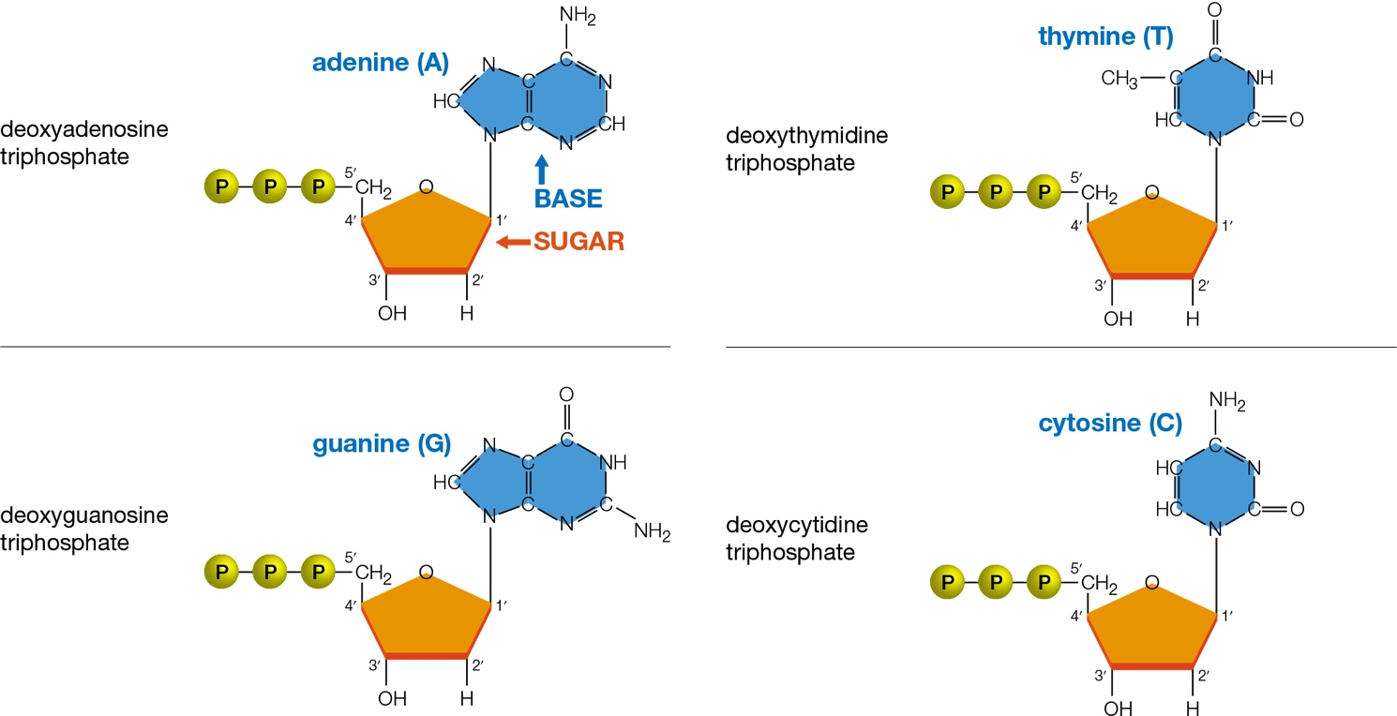
Nucleotides of DNA
Notes:
Figure 8.4 The four nucleotides that make up DNA.
Each of the four DNA nucleotides has three phosphate groups, a deoxyribose sugar (orange), and a nitrogen-containing base (blue) after which it is named. Biochemist Phoebus Levene identified the structure of these bases and how they are connected in nucleotides in the early 1900s.
Adenine and guanine bases are purines; thymine and cytosine, pyrimidines. Numbering the carbons in the sugars allows us to keep track of the orientation of nucleotide chains (compare Figure 8.6).

Slide 12
Building Blocks of DNA (1 of 4)
1950: Erwin Chargaff made two important discoveries about DNA
  Chargaff ’s first rule: the amounts of thymine and adenine are identical, as are the amounts of cytosine and guanine (A = T and G = C)
  Chargaff ’s second rule: DNA of different species differs in its proportions of adenine and guanine

Slide 13
Building Blocks of DNA (2 of 4)
1950s: James Watson and Francis Crick suspect that DNA is a helix
  Made models from scraps of metal connected by suitably angled “bonds” of wire
Rosalind Franklin made the first clear X-ray diffraction image of DNA as it occurs in cells
  She calculated that DNA is very long and identified a repeating pattern

Slide 14
Building Blocks of DNA (3 of 4)
Structure of DNA helix
  Two sugar–phosphate chains running in opposite directions, and paired bases inside
  Bonds between the sugar of one nucleotide and the phosphate of the next form the backbone of each chain (or strand)

Slide 15
Building Blocks of DNA (4 of 4)
Structure of DNA helix (cont’d.)
  Hydrogen bonds between the internally positioned bases hold the two strands together
  Only two kinds of base pairings form (supports Chargaff ’s first rule)
    A to T
    G to C

Slide 16
Structure of DNA
Notes:
Figure 8.6 Structure of DNA, as illustrated by a composite of different models (right).
Numbering the carbons in the nucleotide sugars (see Figure 8.4) allows us to keep track of the orientation of each DNA strand. This orientation is important in DNA replication.
1 The 3′ carbon of each sugar is joined by the phosphate group to the 5′ carbon of the next sugar. These links form the sugar–phosphate backbone of each strand.
2 Hydrogen bonds link internally positioned nucleotide bases.

Slide 17
DNA Sequence (1 of 3)
The two strands of DNA match
  The strands are complementary: the base of each nucleotide on one strand pairs with a suitable partner base on the other
  The base-pairing patterns–A to T and G to C–is the same in all molecules of DNA

Slide 18
DNA Sequence (2 of 3)
How can just two kinds of base pairings give rise to the incredible diversity of traits we see among living things?
  The order of nucleotides in a strand of DNA (DNA sequence) varies tremendously among species (explains Chargaff ’s second rule)
Variations in its nucleotide sequence are the foundation of life’s diversity; defines species and distinguishes individuals

Slide 19
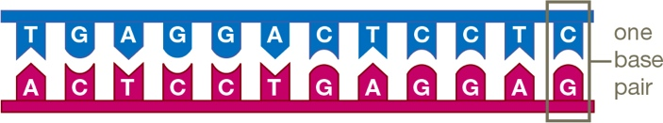
DNA Sequence (3 of 3)

Slide 20
8.3 Eukaryotic Chromosomes
DNA in a single human cell is about 2 meters (6.5 feet) long
How can that much DNA pack into a nucleus that is less than 10 micrometers in diameter?
  Proteins associate with the DNA and help keep it organized

Slide 21
Chromosome Structure (1 of 2)
Chromosome: structure that consists of DNA and associated proteins
  Carries part or all of a cell’s genetic information
Histone: type of protein that structurally organizes eukaryotic chromosomes
Nucleosome: a length of DNA wound twice around a spool of histone proteins

Slide 22
Chromosome Structure (2 of 2)
During most of a cell’s life, each chromosome consists of one DNA molecule
When the cell prepares to divide, it duplicates its chromosomes by DNA replication
  After replication, each chromosome consists of two DNA molecules (sister chromatids) that attach at a centromere region

Slide 23
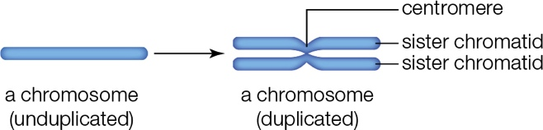
Chromosomes

Slide 24
Chromosome Number (1 of 3)
Each species has a characteristic chromosome number (number of chromosomes in its cells)
Human body cells have two sets of 23 chromosomes—two of each type
  Having two sets of chromosomes means these cells are diploid
Karyotype: an image of an individual’s diploid set of chromosomes

Slide 25
Chromosome Number (2 of 3)
Autosome: a chromosome that is the same in males and females
  Two autosomes of a pair have the same length, shape, and centromere location
  They hold information about the same trait

Slide 26
Chromosome Number (3 of 3)
Members of a pair of sex chromosomes differ between females and males
  The body cells of typical human females have two X chromosomes (XX)
  The body cells of typical human males have one X and one Y chromosome (XY)
Environmental factors (not sex chromosomes) determine sex in some invertebrates and reptiles

Slide 27
8.4 How Does a Cell Copy Its DNA?
In preparation for division, a cell copies its chromosomes so that it contains two sets
  The process by which a cell copies its DNA is called DNA replication

Slide 28
Semiconservative Replication (1 of 5)
Before DNA replication, a chromosome consists of one molecule of DNA (one double helix)
As replication begins, enzymes break the hydrogen bonds that hold the double helix together
  The two DNA strands unwind and separate

Slide 29
Semiconservative Replication (2 of 5)
Another enzyme constructs primers: short, single strands of nucleotides
  Primers serve as attachment points for DNA polymerase, the enzyme that assembles new strands of DNA
  A primer base pairs with a complementary strand of DNA

Slide 30
Semiconservative Replication (3 of 5)
The establishment of base pairing between two strands of DNA is called nucleic acid hybridization
  Hybridization is spontaneous, driven by hydrogen bonding between bases of complementary strands
DNA polymerases attach to the hybridized primers and begin DNA synthesis

Slide 31
Semiconservative Replication (4 of 5)
Each nucleotide provides energy for its own attachment to the end of a growing strand of DNA
  Two of the three phosphate groups are removed when a nucleotide is added to a DNA strand
The enzyme DNA ligase seals any gaps, so the new DNA strands are continuous

Slide 32
Semiconservative Replication (5 of 5)
Both of the two strands of the parent molecule are copied at the same time
As each new DNA strand lengthens, it winds up with its template strand into a double helix
Semiconservative replication produces two copies of a DNA molecule: one strand of each copy is new, and the other is parental

Slide 33
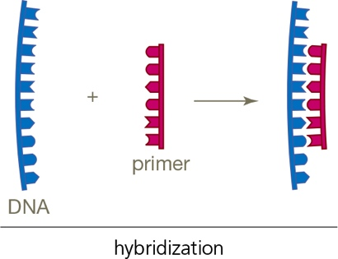
Hybridization Between Primer and DNA

Slide 34
DNA Replication
Notes:
Figure 8.9 DNA replication. Green arrows show the direction of synthesis for each strand. The Y-shaped structure of a DNA molecule undergoing replication is called a replication fork.
As replication begins, enzymes begin to 1 unwind and 2 separate the two strands of DNA.
3 Primers base-pair with the exposed single DNA strands.
4 Starting at primers, DNA polymerases (green boxes) assemble new strands of DNA from nucleotides, using the parent strands as templates.
5 DNA ligase seals any gaps that remain between bases of the “new” DNA.
6 Each parental DNA strand (blue) serves as a template for assembly of a new strand of DNA (magenta). The new DNA strand winds up with its template, so two double-stranded DNA molecules result. One strand of each is parental (conserved), and the other is new, so DNA replication is said to be semiconservative.

Slide 35
Directional Synthesis (1 of 4)
Each strand of DNA has two ends
  The last carbon atom on one end of the strand is the 5′ carbon of a sugar
  The last carbon atom on the other end is the 3′ carbon of a sugar

Slide 36
Directional Synthesis (2 of 4)
DNA polymerase can attach a nucleotide only to a 3′ end
  DNA synthesis proceeds only in the 5′ to 3′ direction
One new strand of DNA is constructed in a single piece during replication
  Synthesis of the other strand occurs in segments that must be joined by DNA ligase

Slide 37
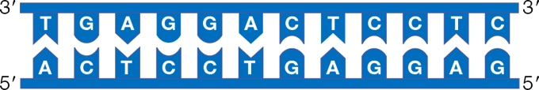
Directional Synthesis (3 of 4)

Slide 38
Discontinuous Synthesis (4 of 4)
Notes:
Figure 8.10 Discontinuous synthesis of DNA.
This close-up of a replication fork shows that only one of the two new DNA strands is assembled in a single piece.
A During DNA synthesis, only one of the two new strands can be assembled in a single piece. The other strand forms in short segments, which are called Okazaki fragments after the two (married) scientists who discovered them. DNA ligase joins Okazaki fragments where they meet.
B DNA synthesis proceeds only in the 5′ to 3′ direction because DNA polymerase catalyzes only one reaction: the formation of a bond between the hydroxyl group on the 3′ carbon at the end of a DNA strand and the phosphate group on a nucleotide’s 5′ carbon.

Slide 39
8.5 Mutations and Their Causes
Mistakes can and do occur during DNA replication
  Examples
    The wrong base is added to a growing DNA strand
    A nucleotide gets lost, or an extra one slips in

Slide 40
Proofreading
Most replication errors occur because DNA polymerases work very fast
Luckily, most DNA polymerases also proofread their work
  They can correct a mismatch by reversing the synthesis reaction to remove the mispaired nucleotide

Slide 41
Mutations
Replication errors may occur after a cell’s DNA gets broken or damaged
  DNA polymerases do not copy damaged DNA very well
When proofreading and repair mechanisms fail, an error becomes a mutation
  A permanent change in the DNA sequence of a cell’s chromosome

Slide 42
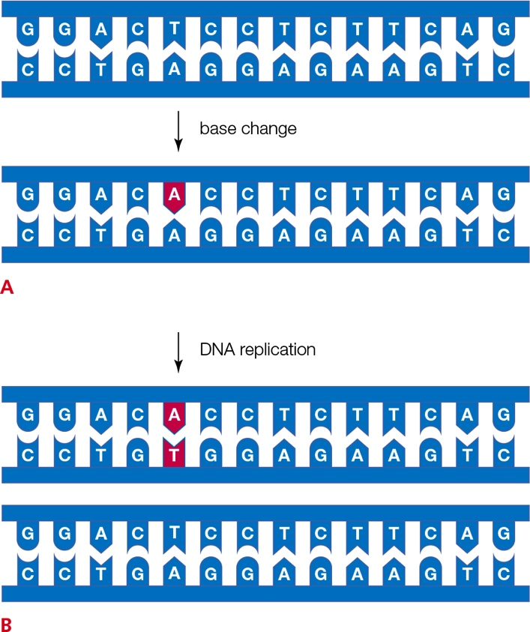
Replication Error to Mutation
Notes:
Figure 8.11 How a replication error becomes a mutation.
A Repair enzymes can recognize a mismatched base (magenta), but sometimes fail to correct it before DNA replication.
B After replication, both strands base-pair properly. Repair enzymes can no longer recognize the error, which has now become a mutation that will be passed on to the cell’s descendants.

Slide 43
Agents of DNA Damage
Ionizing radiation from X-rays, most UV light, and gamma rays may cause DNA damage
  Breaks DNA
  Causes covalent bonds to form between bases on opposite strands
  Fatally alters nucleotide bases
  Causes adjacent nucleotide dimers to form

Slide 44
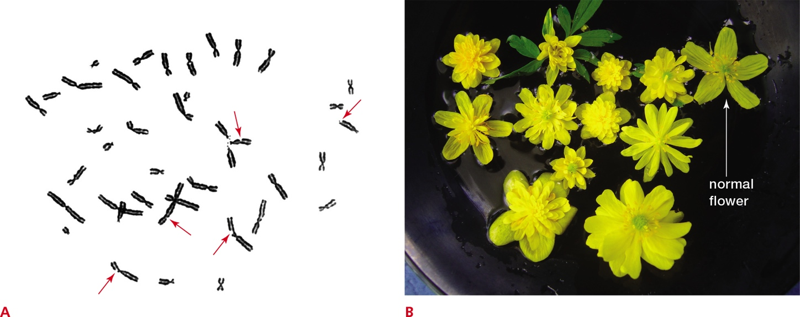
Ionizing Radiation Causes Mutations
Notes:
Figure 8.12 Exposure to ionizing radiation causes mutations.
A Major breaks (red arrows) in chromosomes of a human white blood cell after it was exposed to ionizing radiation. Pieces of broken chromosomes often become lost during DNA replication.
B These Ranunculus flowers were grown from plants harvested around Chernobyl, Ukraine, where in 1986 an accident at a nuclear power plant released a massive amount of radiation. All except one are abnormal—an effect of mutations caused by radiation exposure.

Slide 45
Mutations and Their Impacts
Mutations can form in any type of cell
  Those that occur during egg or sperm formation can be passed to offspring
Mutations that alter DNA’s instructions may have a harmful or lethal outcome
  Most cancers begin with a mutation
Not all mutations are dangerous
  Some give rise to variation in traits; basis for evolution

Slide 46
8.6 Cloning Adult Animals
Cloning: making an identical copy of something
Reproductive cloning: technology that produces genetically identical individuals
  Example: artificial embryo splitting

Slide 47
Cloning Techniques
Somatic cell nuclear transfer (SCNT) can undifferentiate a somatic cell by turning its unused DNA back on
  An unfertilized egg’s nucleus is replaced with the nucleus of a donor’s somatic cell
  The egg’s cytoplasm reprograms the transplanted DNA to direct the development of an embryo, which is then implanted into a surrogate mother

Slide 48
Why Clone?
Animal breeders sometimes want an exact copy of a specific individual
  Use a cloning method where a somatic cell is taken from an adult organism (contains master blueprint for new individual)
  An adult somatic cell will not start dividing to produce an embryo because the cell has already differentiated (obtained specialized characteristics)

Slide 49
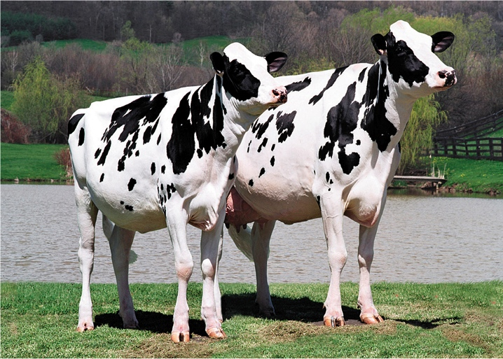
Cloning Champions
Notes:
Figure 8.14 Champion dairy cow Liz (right) and her clone, Liz II (left). Liz II, who was produced by SCNT, had already begun to win championships by the time she was one year old.

Slide 50
Application: A Hero Dog’s Golden Clones
Trakr, who died in 2009, was a hero dog who helped rescuers at the World Trade Center on 9/11
  Through the Golden Clone Giveaway Trakr’s DNA was used to make clones
Cloning animals raises ethical questions about cloning humans
  Is it acceptable to clone a lost child for a grieving parent?

Slide 51
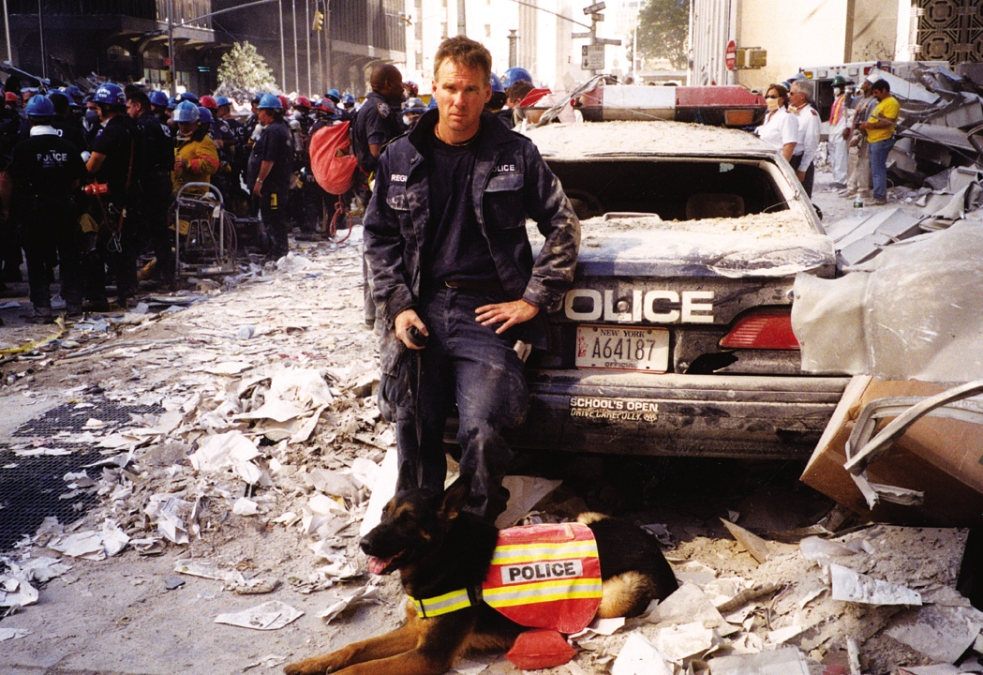
Trakr and James Symington
Notes:
Figure 8.15 James Symington and his dog Trakr assisting in the search for victims at Ground Zero, September 2001.

Slide 52
Discuss
What are some reasons why DNA might be double stranded instead of single stranded?
Why should the term DNA relative replace the more popular term blood relative when referring to human kinship?
What are some advantages of semiconservative replication?

