Slide 1
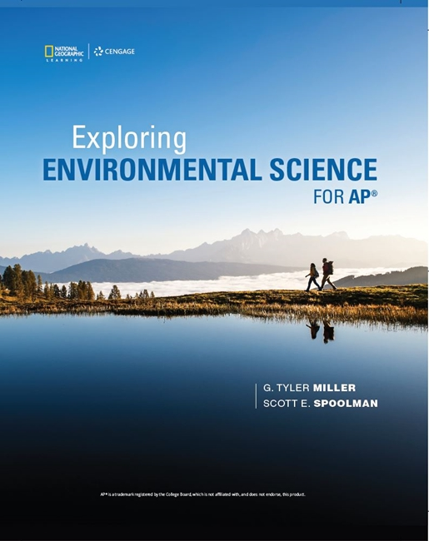
Exploring Environmental Science for AP®
1st Edition
Chapter 7
Species Interactions, Ecological Succession, and Population Control
Copyright © 2018 Cengage Learning. All Rights Reserved. May not be copied, scanned, or duplicated, in whole or in part, except for use as permitted in a license distributed with a certain product or service or otherwise on a password-protected website for classroom use.

Slide 2
Core Case Study: The Southern Sea Otter—A Species in Recovery
Live in giant kelp forests on Pacific coast
Hunted almost to extinction by early 1900s
Partial recovery since listed as endangered in 1977
Reasons to care about sea otters
Keystone species
Ethics
Tourism dollars

Slide 3
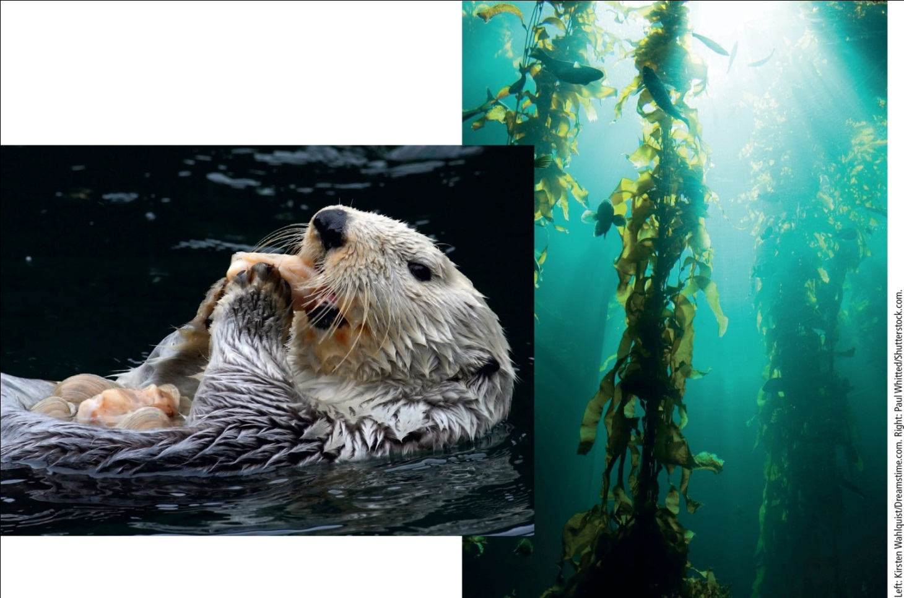
Southern Sea Otter
Notes:
Figure 5.1 An endangered southern sea otter in Monterey Bay, California (USA) uses a stone to crack the shells of clams that it feeds on (left). It lives in a bed of seaweed called giant kelp (right).

Slide 4
7.1 How Do Species Interact?
Five types of species interactions affect resource use and species population sizes in an ecosystem
Competition
Predation
Parasitism
Mutualism
Commensalism

Slide 5
Competition for Resources (1 of 4)
Most common interaction is competition
Interspecific competition
Competition between different species to use the same limited resources

Slide 6
Competition for Resources (2 of 4)
Resource partitioning
Occurs when different species evolve specialized traits that allow them to share the same resources
Species may use only parts of resource
At different times
In different ways

Slide 7
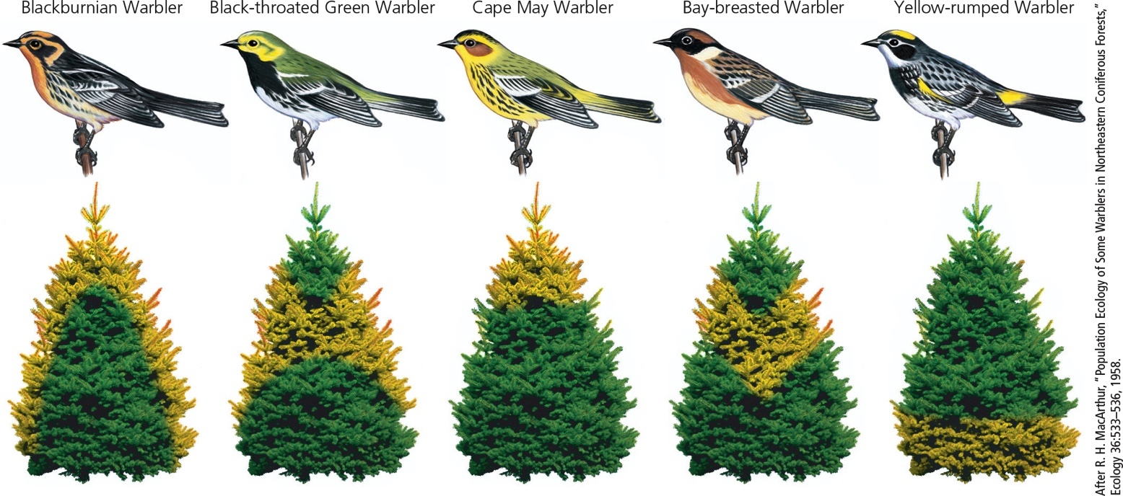
Competition for Resources (3 of 4)
Notes:
Figure 5.2 Sharing the wealth: Resource partitioning among five species of insect-eating warblers in the spruce forests of the U.S. state of Maine. Each species spends at least half its feeding time in its associated yellow-highlighted areas of these spruce trees.

Slide 8
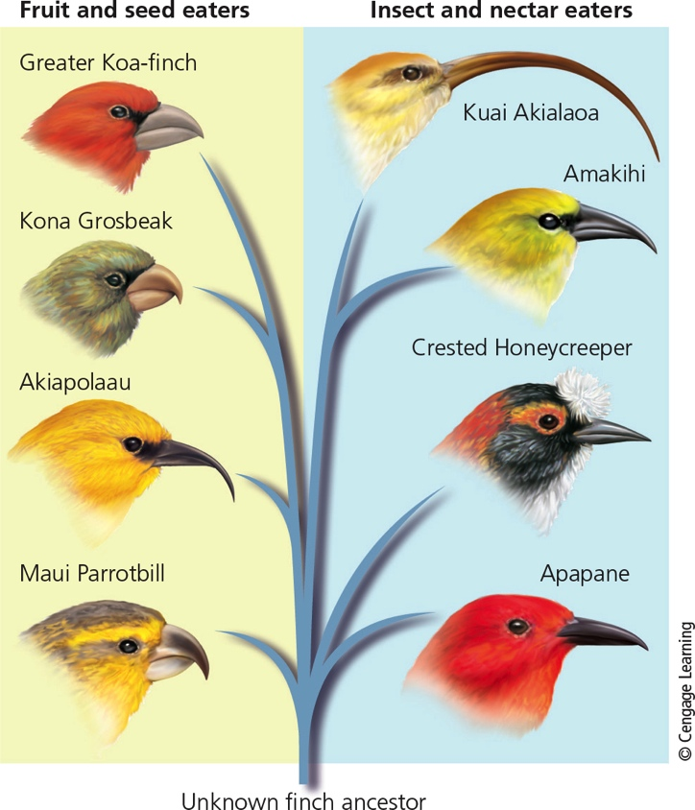
Competition for Resources (4 of 4)
Notes:
Figure 5.3 Specialist species of honeycreepers: Through natural selection, different species of honeycreepers have shared resources by evolving specialized beaks to take advantage of certain types of food such as insects, seeds, fruits, and nectar from certain flowers. Question: Look at each bird’s beak and take a guess at what sort of food that bird might eat.

Slide 9
Predation (1 of 2)
Predator feeds directly on all or part of a member of another species (prey)
Strong effect on population sizes and other factors in ecosystems
Methods of predation
Walk, swim, or fly
Camouflage
Chemical warfare

Slide 10
Predation (2 of 2)
Prey species have evolved ways to avoid predators
Camouflage
Chemical warfare
Warning coloration
Mimicry
Behavioral strategies

Slide 11
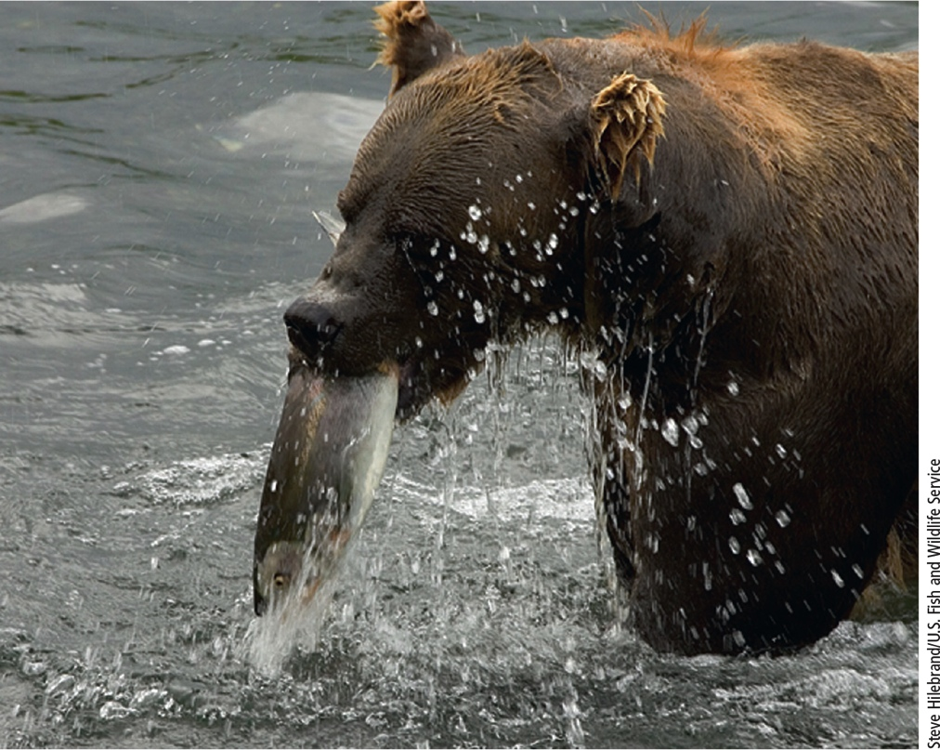
Predator–Prey Relationships (1 of 2)
Notes:
Figure 5.4 Predator-prey relationship: This brown bear (the predator) in the U.S. state of Alaska has captured and will feed on this salmon (the prey).

Slide 12
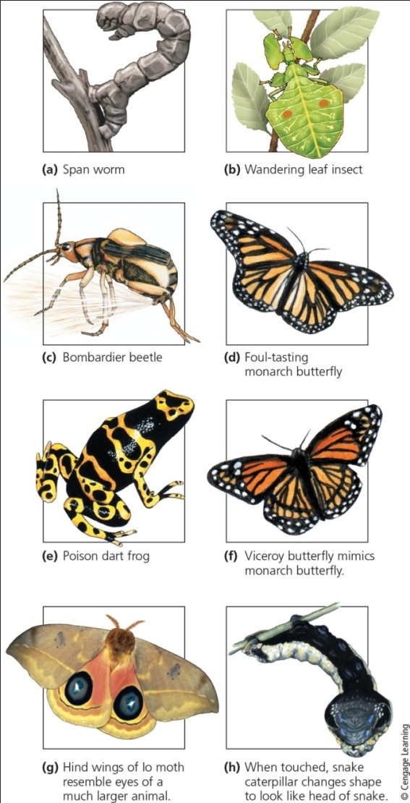
Predator–Prey Relationships (2 of 2)
Notes:
Figure 5.6 These prey species have developed specialized ways to avoid their predators: (a, b) camouflage, (c, d, e) chemical warfare, (d, e, f) warning coloration, (f) mimicry, (g) deceptive looks, and (h) deceptive behavior.

Slide 13
Science Focus 7.1: Threats to Kelp Forests
Giant kelp anchored to ocean floor and grow toward surface
Fast growing
Resistant to storm and wave damage
Support many marine plants and animals
Sea urchins prey on kelp plants
Southern sea otter helps control sea urchin population
Ecosystem threatened by pollutants and climate change
Notes:
Figure 5.A The purple sea urchin inhabits the coastal waters of the U.S. state of California and feeds on kelp.

Slide 14
Coevolution
Predation plays a role in natural selection
Animals with better defenses against predation tend to leave more offspring
Coevolution
Changes in the gene pool of one species can cause changes in the gene pool of the other
Example: bats and moths
Echolocation of bats and sensitive hearing of moths

Slide 15
Parasitism, Mutualism, and Commensalism (1 of 3)
Parasitism
One species (parasite) lives on another organism
Parasites harm but rarely kill the host
Examples: tapeworms, sea lampreys, fleas, and ticks

Slide 16
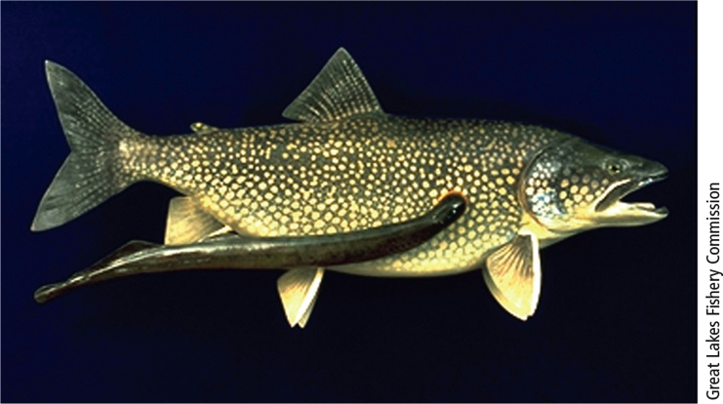
Parasitism
Notes:
Figure 5.7 Parasitism: This blood-sucking, parasitic sea lamprey has attached itself to an adult lake trout from the Great Lakes (USA, Canada).

Slide 17
Parasitism, Mutualism, and Commensalism (2 of 3)
Mutualism
Interaction that benefits both species
Nutrition and protective relationship
Not cooperation—mutual exploitation
Example: clownfish live within sea anemones
Gain protection and feed on waste matter left by anemones’ meals
Clownfish protect anemones from some predators and parasites

Slide 18
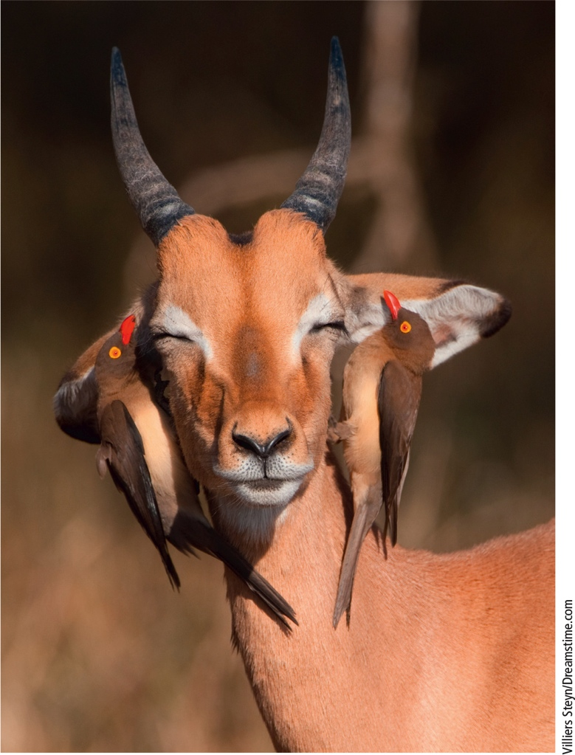
Mutualism
Notes:
Figure 5.8 Mutualism: Oxpeckers feed on parasitic ticks that infest animals such as this impala and warn of approaching predators.

Slide 19
Parasitism, Mutualism, and Commensalism (3 of 3)
Commensalism
Benefits one species and has little effect on the other
Examples:
Epiphytes (air plants) attach themselves to trees
Birds nest in trees

Slide 20
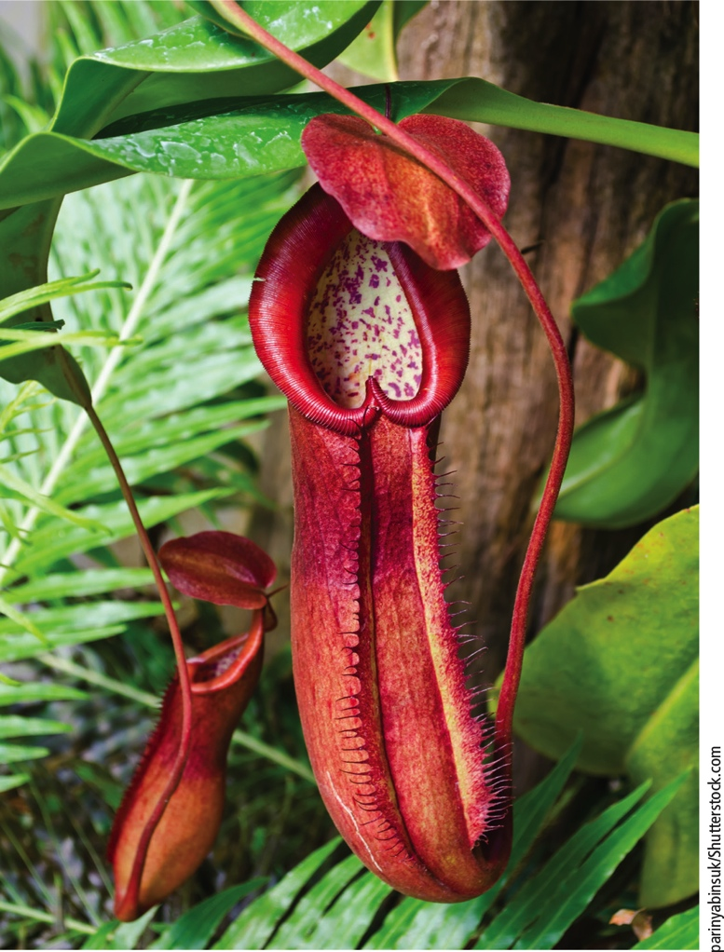
Commensalism
Notes:
Figure 5.9 Commensalism: This pitcher plant is attached to a branch of a tree without penetrating or harming the tree. This carnivorous plant feeds on insects that become trapped inside it.

Slide 21
7.2 How Do Communities and Ecosystems Respond to Changing Environmental Conditions? (1 of 3)
Ecological succession
Normally gradual change in structure and species composition in a given system
Primary ecological succession
Involves gradual establishment of communities in lifeless areas
Need to build up fertile soil or aquatic sediments to support plant community
Pioneer species such as lichens or mosses

Slide 22
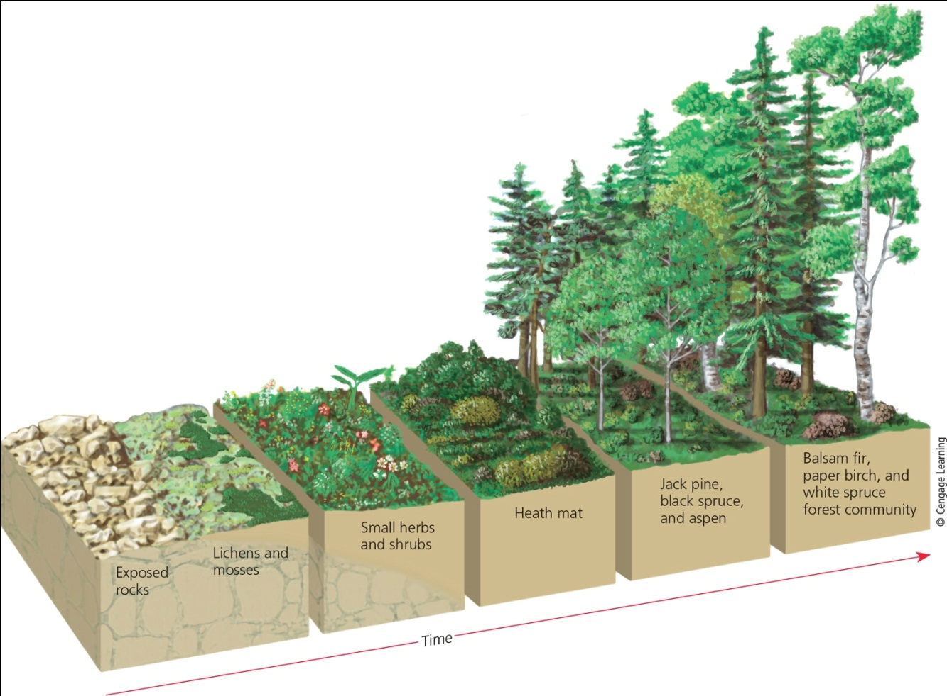
5.2 How Do Communities and Ecosystems Respond to Changing Environmental Conditions? (2 of 3)
Notes:
Figure 5.10 Primary ecological succession: Over almost a thousand years, these plant communities developed, starting on bare rock exposed by a retreating glacier on Isle Royal, Michigan (USA) in western Lake Superior. The details of this process vary from one site to another.

Slide 23
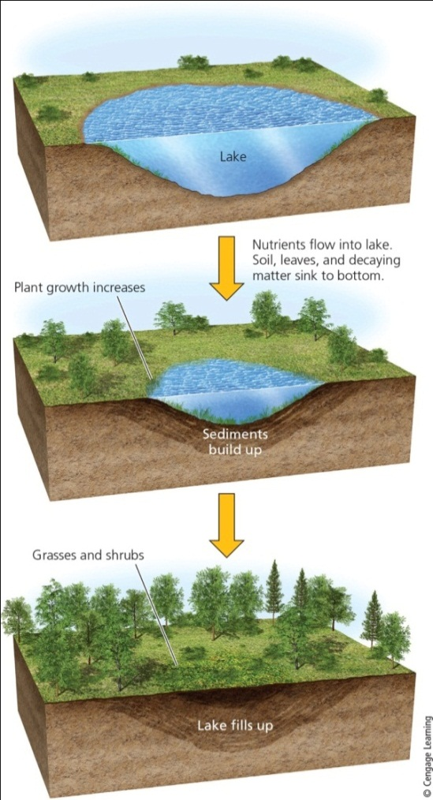
5.2 How Do Communities and Ecosystems Respond to Changing Environmental Conditions? (3 of 3)
Notes:
Figure 5.11 Primary ecological succession in a lake basin in which sediments and plants have been gouged out by a glacier. When the glacier melts, the lake basin begins accumulating sediments and plant and animal life. Over hundreds to thousands of years, the lake can fill with sediments and become a terrestrial habitat.

Slide 24
Ecological Succession Creates and Changes Ecosystems (1 of 2)
Secondary ecological succession
Series of terrestrial communities or ecosystems develop in places with soil or sediment
Examples: abandoned farmland, burned or cut forests, and flooded land
Factors affecting rate
Facilitation of area by one species for another
Inhibition hinders growth

Slide 25
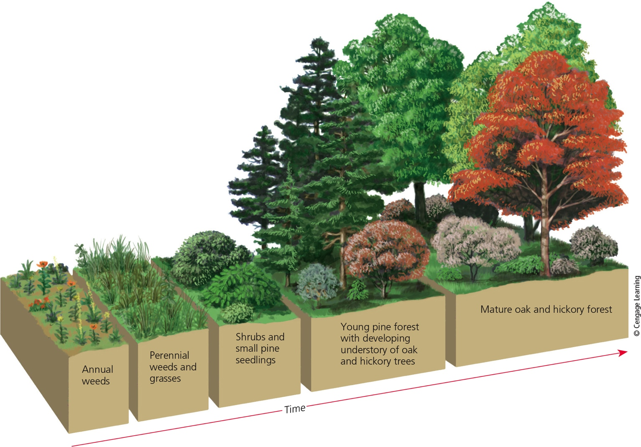
Ecological Succession Creates and Changes Ecosystems (2 of 2)
Notes:
Figure 5.12 Secondary ecological succession: Natural restoration of disturbed land on an abandoned farm field in the U.S. state of North Carolina. It took 150 to 200 years after the farmland was abandoned for the area to become covered with a mature oak and hickory forest..

Slide 26
Is There a Balance of Nature?
Traditional view
Ecological succession proceeds to stable climax communities
Equilibrium called balance of nature
Current view
Succession leads to a more complex, diverse, and resilient ecosystem
Can withstand changes if not too large or too sudden

Slide 27
Living Systems Are Sustained through Constant Change
Inertia
Ability of a living system to survive moderate disturbances
Resilience
Ability of a living system to be restored through secondary succession after a moderate disturbance

Slide 28
7.3 What Limits the Growth of Populations? (1 of 3)
Population
Group of interbreeding individuals of the same species
Population size
May increase, decrease, or remain the same in response to changing environmental conditions
Scientists use sampling techniques to estimate

Slide 29
What Limits the Growth of Populations? (2 of 3)
Population distribution
Most populations live together in clumps or groups
Organisms cluster for resources
Protection from predators
Variables that govern changes in population size
Births, deaths, immigration, and emigration
Age Structure
Distribution of individuals among various age groups
Pre-reproductive, reproductive, and post-reproductive stages

Slide 30
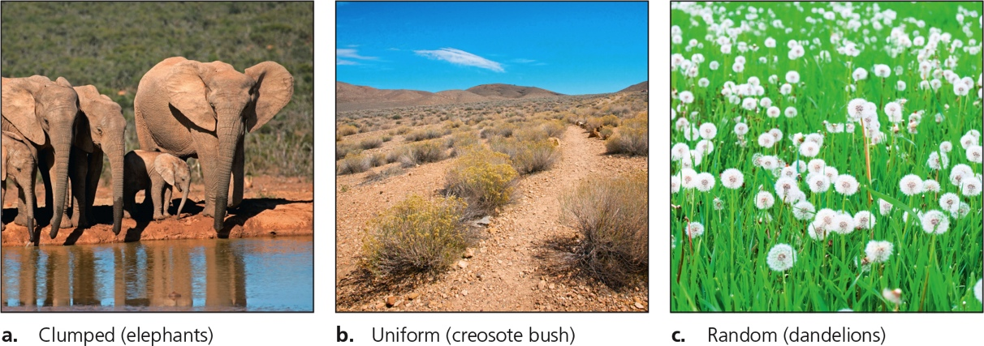
What Limits the Growth of Populations? (3 of 3)
Notes:
Figure 5.14 Three general habitat dispersion patterns for individuals in a population.

Slide 31
Critical Concept: Sampling Populations
Characterization of populations can be qualitative or quantitative
Quadrat sampling can be used to determine abundance, density, and distribution of species
Mark and recapture sampling is used to estimate the size of a population in a defined area

Slide 32
Several Factors Can Limit Population Size (1 of 2)
Each population has a range of tolerance
Variation in physical and chemical environment under which it can survive
Limiting factors
Precipitation (on land)
Water temperature, depth, clarity, and other factors (in aquatic environments)
Population density
Density-dependent factors

Slide 33
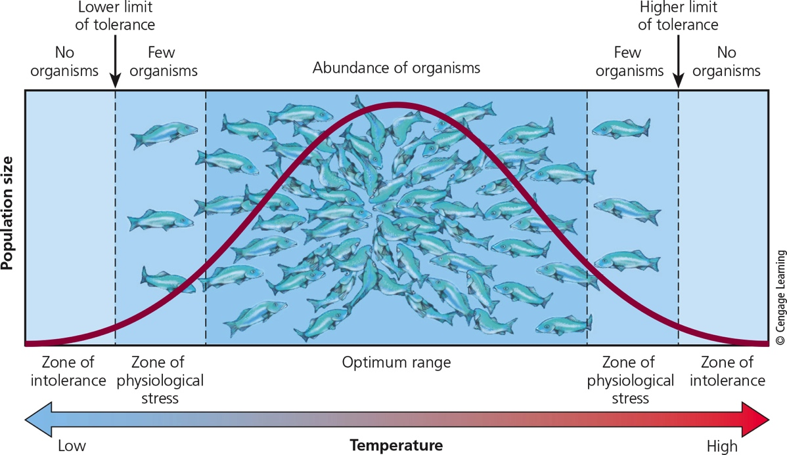
Several Factors Can Limit Population Size (2 of 2)
Notes:
Figure 5.15 Range of tolerance for a population of trout to changes in water temperature.

Slide 34
No Population Can Grow Indefinitely: J-Curves and S-Curves (1 of 4)
Some species can reproduce exponentially
Reproduce at an early age
Have many offspring each time they reproduce
Short intervals in between reproductive cycles
Produces J-shaped curve of growth
Examples: bacteria and many insect species

Slide 35
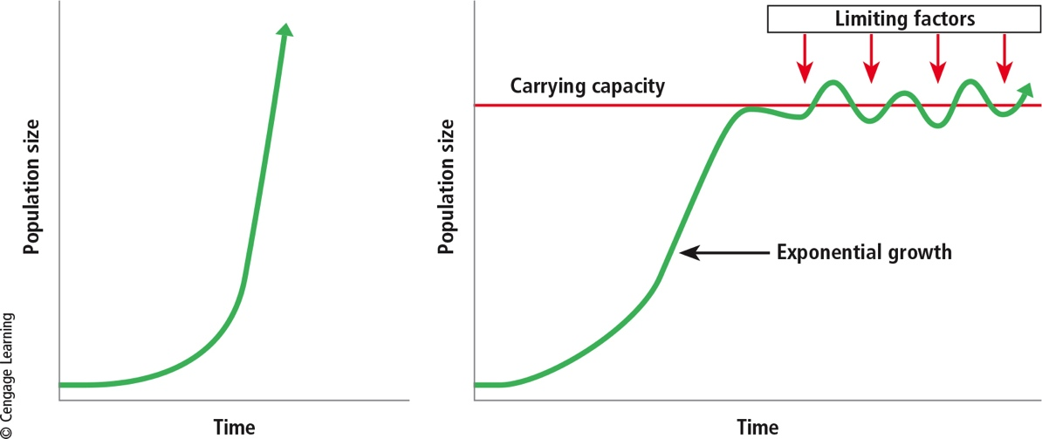
No Population Can Grow Indefinitely: J-Curves and S-Curves (2 of 4)
Notes:
Figure 5.16 Populations of species can undergo exponential growth represented by a J-shaped curve (left) when resource supplies are plentiful. As resource supplies become limited, a population undergoes logistic growth, represented by an S-shaped curve (right), when the size of the population approaches the carrying capacity of its habitat.

Slide 36
No Population Can Grow Indefinitely: J-Curves and S-Curves (3 of 4)
Population growth in nature always limited
Environmental resistance
Sum of all factors that limit population growth
Carrying capacity
Maximum population of a given species that a particular habitat can sustain indefinitely
Overshoot results in population crash

Slide 37
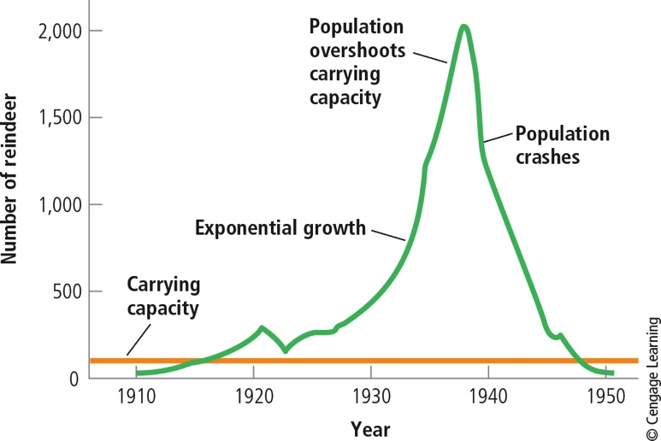
No Population Can Grow Indefinitely: J-Curves and S-Curves (4 of 4)
Notes:
Figure 5.17 Exponential growth, overshoot, and population crash of a population of reindeer introduced onto the small Bering Sea island of St. Paul in 1910. Data Analysis: By what percentage did the population of reindeer grow between 1923 and 1940?

Slide 38
Reproductive Patterns (1 of 3)
r-Selected species
Species with capacity for a high rate of population growth
Examples: algae, bacteria, frogs, most insects, and many fish
May go through irregular and unstable cycles in population sizes

Slide 39
Reproductive Patterns (2 of 3)
K-Selected species
Species that reproduce later in life
Have few offspring
Have long life spans
Examples: large mammals, whales, humans, birds of prey, and long-lived plants
Can be vulnerable to extinction

Slide 40
Reproductive Patterns (3 of 3)
TABLE 5.1 Typical traits of r-selected and K-selected species
Trait | r – Selected Species | K – Selected Species
Reproductive potential | High | Low
Population growth rate | Fast | Slow
Time to reproductive maturity | Short | Long
Number of reproductive cycles | Many | Few
Number of offspring | Many | Few
Size of offspring | Small | Larger
Degree of parental care | Low | High
Life span | Short | Long
Population size | Variable with Crashes | Stable, near carrying capacity
Role in environment | Usually prey | Usually predators

Slide 41
Case Study: Exploding White-Tailed Deer Population in the U.S. (1 of 2)
1900: deer habitat destruction and uncontrolled hunting
1920s–1930s: laws to protect deer
Current deer population explosion in suburban areas
Increased deer-vehicle collisions and Lyme disease
Various methods to control the deer population

Slide 42
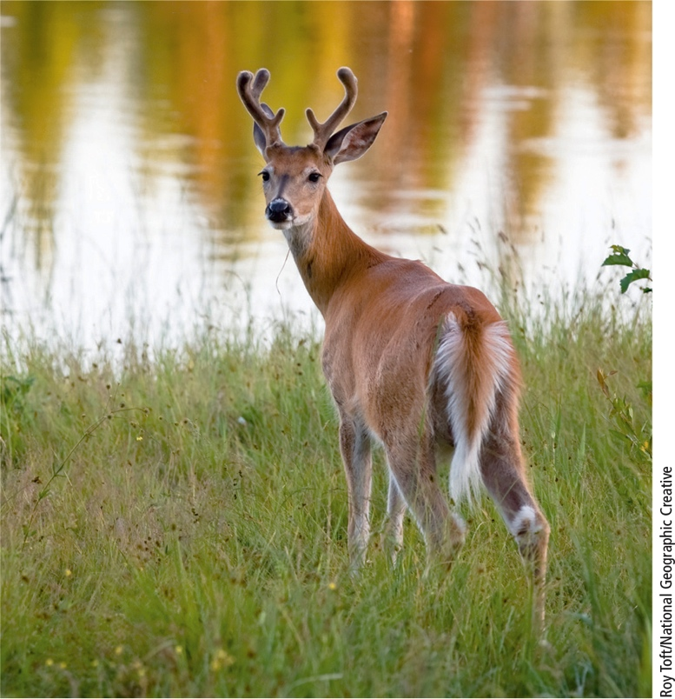
Case Study: Exploding White-Tailed Deer Population in the U.S. (2 of 2)
Notes:
Figure 5.18 White-tailed deer populations in the United States have been growing.

Slide 43
Science Focus 5.2: The Future of California’s Southern Sea Otters
Factors in declining sea otter population
Increased predation by orcas
Toxic algae and pollutants released into the ocean
Low reproductive rate
Rising mortality rate
Other threats: oil spills and fishing traps
Otter population rising in last several years

Slide 44
Species Vary in Their Life Spans (1 of 2)
Survivorship curve
Shows the percentages of members of population surviving at different ages
Late loss (K-selected species)
Early loss (r-selected species)
Constant loss (many songbirds)

Slide 45
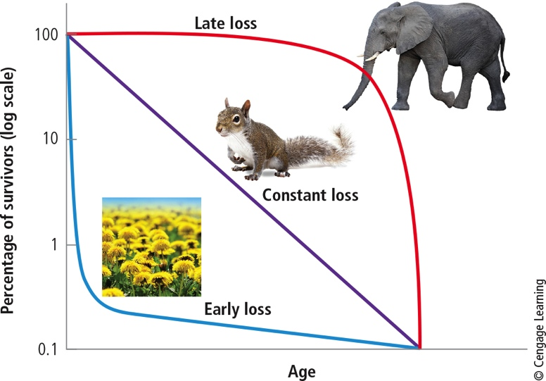
Species Vary in Their Life Spans (2 of 2)
Notes:
Figure 5.19 Survivorship curves for populations of different species, obtained by showing the percentages of the members of a population surviving at different ages.

Slide 46
Humans Are Not Exempt from Nature’s Population Controls
Ireland
Potato crop destroyed by fungus in 1845
Killed one million people
Bubonic plague
Killed 25 million during the 14th century
Technological, social, and cultural changes have expanded earth’s carrying capacity for the human species today

