Slide 1
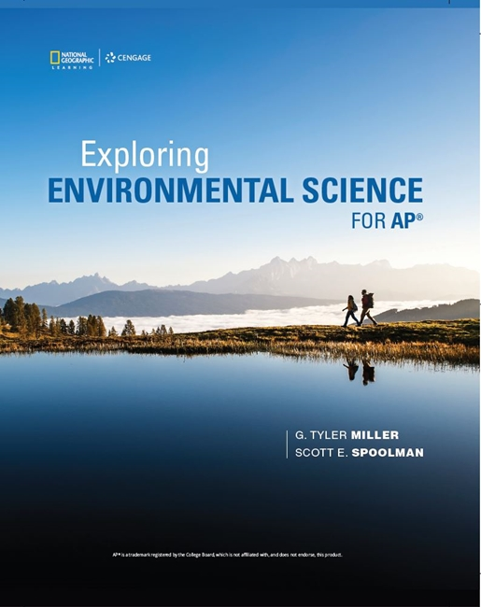
Exploring Environmental Science for AP®
1st Edition
Chapter 4
Biodiversity and Evolution
Copyright © 2018 Cengage Learning. All Rights Reserved. May not be copied, scanned, or duplicated, in whole or in part, except for use as permitted in a license distributed with a certain product or service or otherwise on a password-protected website for classroom use.

Slide 2
Core Case Study: Why Are Amphibians Vanishing?
Frogs are becoming extinct at 10,000 times their historical rates
Amphibians
Sensitive biological indicators
Play important ecological roles in their communities
Skin secretions source of many valuable pharmaceutical products

Slide 3
4.1 What Are the Major Types of Life on the Earth? (1 of 3)
Classification based on cell structure
Prokaryotic (bacterial cells)
No distinct nucleus or internal parts enclosed by membranes
Eukaryotic
All nonbacterial organisms
Species
Group of living organisms with characteristics that distinguish it from other groups of organisms. Must be able to sexually reproduce with another similar individual and produce fertile offspring

Slide 4
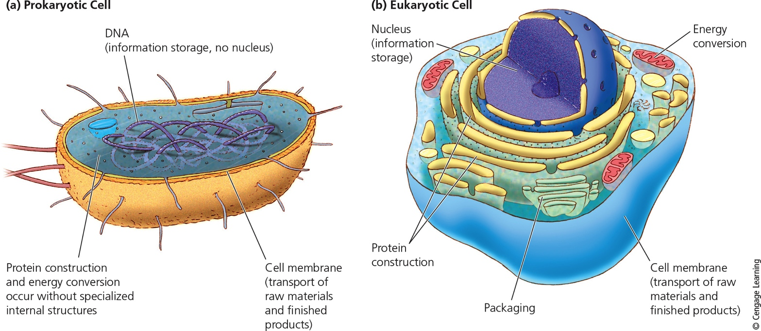
What Are the Major Types of Life on the Earth? (2 of 3)
Notes:
Figure 4.2 Comparison of key components of a prokaryotic cell (left) and eukaryotic cell (right).

Slide 5
Earth’s Organisms Are Many and Varied (3 of 3)
Estimated 7–10 million species exist
About 2 million species have been identified
About half of those are insects
Pollination is a vital ecosystem service performed by insects
Some insect species reproduce rapidly and can produce new genetic traits
Example: pesticide resistance

Slide 6
4.2 What Is Biodiversity and Why Is It Important? (1 of 5)
Biological diversity is the diversity of life on earth
Species diversity
Includes species richness and evenness
Genetic diversity
Variety of genes in a population or species
Ecosystem diversity
Biomes: regions with distinct climates and species

Slide 7
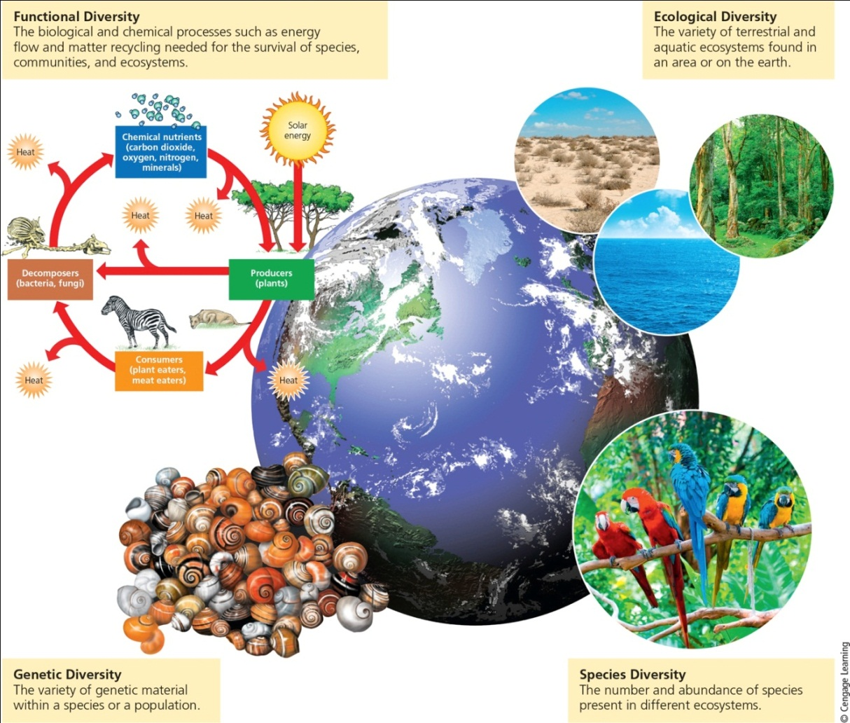
What Is Biodiversity and Why Is It Important? (4 of 5)
Notes:
Figure 4.5 Natural capital: The major components of the earth’s biodiversity—one of the planet’s most important renewable resources and a key component of its natural capital (see Figure 1.3).

Slide 8
What Is Biodiversity and Why Is It Important? (2 of 5)
Forests have core habitat and edge habitat
Edge effect: conditions different from forest interior such as temperature, light, humidity, etc.
As forests are fragmented, there is less core habitat and more edge habitat
Ecotone: transitional area where two different ecosystems merge

Slide 9
What Is Biodiversity and Why Is It Important? (3 of 5)
Functional diversity
Variety of processes within ecosystems
Examples: energy flow and matter cycling
Advantages of biologically diverse ecosystems
Produce more plant biomass to support a greater number of consumer species
Contain species traits that enable them to adapt to changing environmental conditions

Slide 10
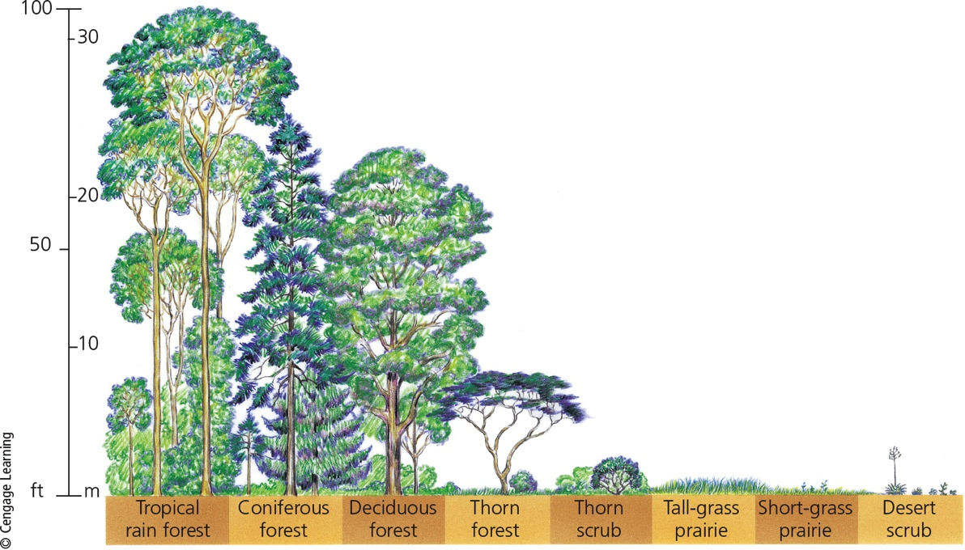
What Is Biodiversity and Why Is It Important? (5 of 5)
Notes:
Figure 4.7 Community structure: Generalized types, relative sizes, and stratification of plant species in communities or ecosystems in major terrestrial biomes.

Slide 11
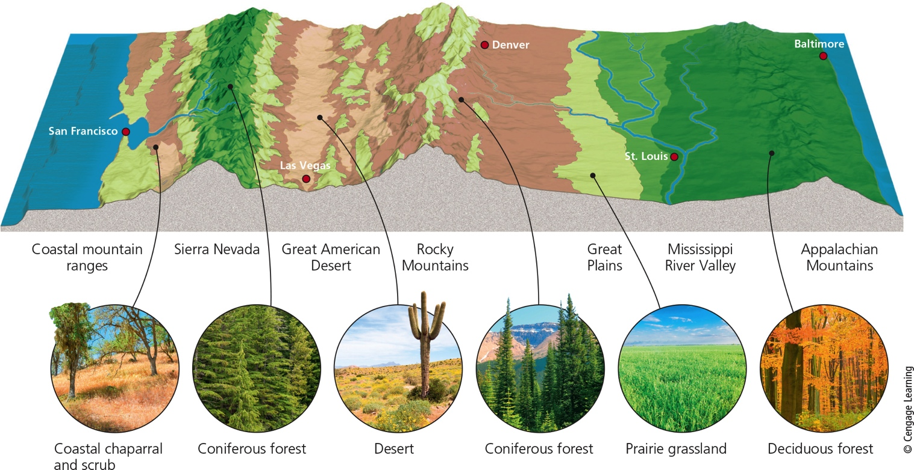
Major Biomes
Notes:
Figure 4.8 The variety of biomes found across the midsection of the United States.

Slide 12
4.3 What Role Do Species Play in Ecosystems? (1 of 2)
Each species plays a specific ecological role called its niche
Includes everything that affects survival and reproduction
Water, space, sunlight, food, and temperatures
Generalist species
Broad niche—wide range of tolerance
Specialist species
Narrow niche—narrow range of tolerance

Slide 13
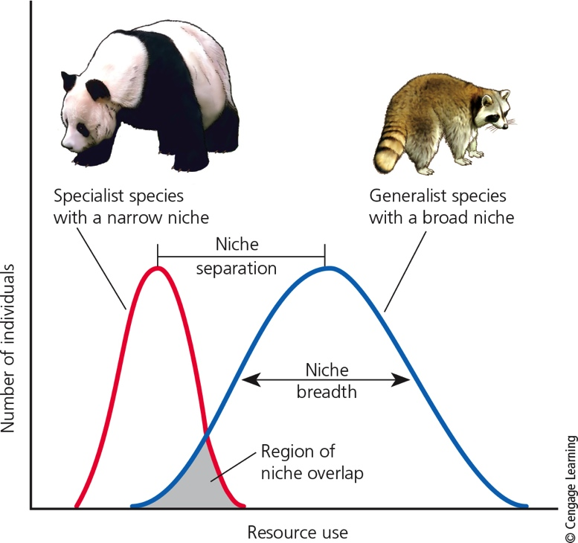
What Role Do Species Play in Ecosystems? (2 of 2)
Notes:
Figure 4.9 Specialist species such as the giant panda have a narrow niche (left curve) and generalist species such as the raccoon have a broad niche (right curve).

Slide 14
There Are Four Major Ecosystem Roles for Species
Native species normally live and thrive in a particular ecosystem
Nonnative species migrate or are accidentally introduced into an ecosystem
Indicator species provide early warnings of environmental changes
Keystone species have a large effect on the types and abundance of other species

Slide 15
Case Study: A Keystone Species that almost Went Extinct
The American alligator
Keystone species in its subtropical wetland ecosystem
Digs gator holes that hold freshwater and serve as a refuge for aquatic life
1930s: hunted for sport, meat, and skin
1967: added to endangered species list
1977: impressive comeback
More than a million alligators today in Florida

Slide 16
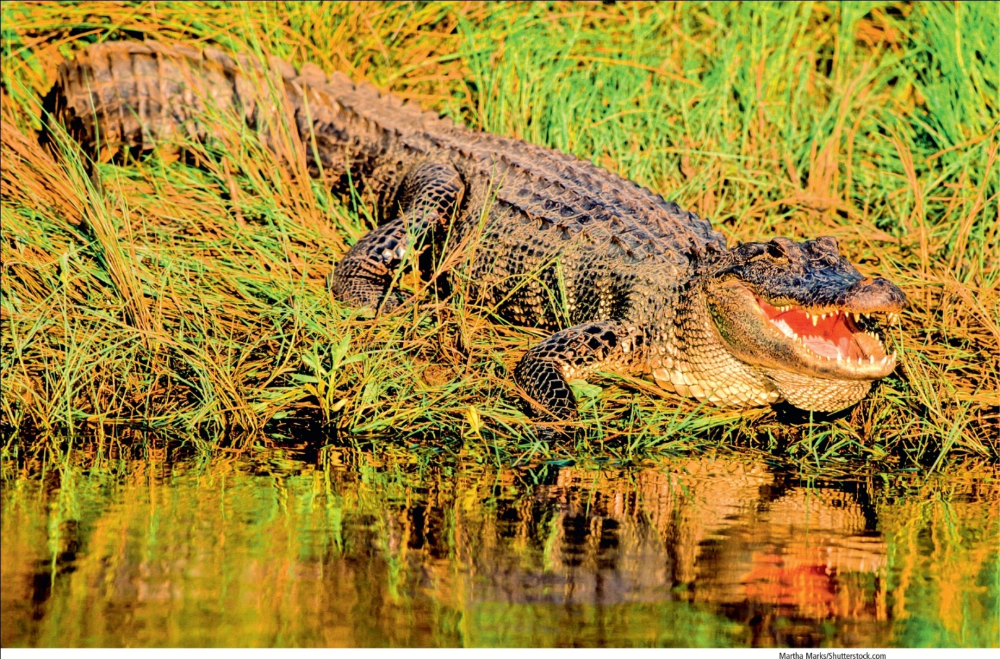
The American Alligator
Notes:
Figure 4.12 Keystone species: The American alligator plays an important ecological role in its marsh and swamp habitats in the southeastern United States by helping support many other species.

Slide 17
Science Focus 4.1: Causes of Amphibian Declines
Factors causing decline and disappearance of reptiles and amphibians
Parasites
Viral and fungal diseases
Habitat loss and fragmentation
Higher levels of UV radiation
Pollution
Climate change
Overhunting

Slide 18
4.4 How Does the Earth’s Life Change over Time?
Biological evolution
Earth’s life forms change genetically over time
Widely accepted scientific theory
Natural selection
Process by which species have evolved from earlier species

Slide 19
Evolution Explains How Organisms Change over Time (1 of 2)
Fossils
Physical evidence of past organisms
Preserved in rocks or ice
Fossil record
Entire body of fossil evidence
Uneven and incomplete
Estimate: fossils found so far represent only 1% of all species that have ever lived

Slide 20
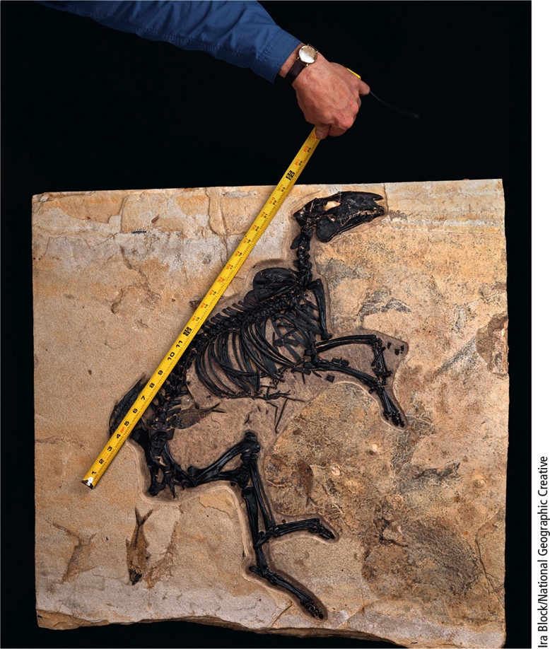
Evolution Explains How Organisms Change over Time (2 of 2)
Notes:
Figure 4.13 This fossil shows the mineralized remains of an early ancestor of the present-day horse. It roamed the earth more than 35 million years ago. Note that you can also see fish skeletons on this fossil.

Slide 21
Evolution Depends on Genetic Variability and Natural Selection (1 of 6)
Darwin and Wallace independently proposed concept of natural selection in 1850s
Genetic variability occurs through mutations
Random changes in DNA
Some can result in heritable traits

Slide 22
Evolution Depends on Genetic Variability and Natural Selection (2 of 6)
Natural selection
Environmental conditions favor increased survival and reproduction of certain individuals in a population
Adaptive trait
Improves the ability of an individual organism to survive and reproduce at a higher rate than other individuals in a population
Given prevailing environmental conditions

Slide 23
Evolution Depends on Genetic Variability and Natural Selection (3 of 6)
Genetic resistance
Example of natural selection at work
Occurs when organisms have genes that can tolerate a chemical designed to kill them
Resistant individuals survive and reproduce
Some disease-causing bacteria have developed resistance to antibacterial drugs (antibiotics)

Slide 24
Evolution Depends on Genetic Variability and Natural Selection (4 of 6)
Stepped Art
Notes:
Figure 4.14 Evolution by natural selection: (a) A population of bacteria is exposed to an antibiotic, which (b) kills all individuals except those possessing a trait that makes them resistant to the drug; (c) the resistant bacteria multiply and eventually (d) replace all or most of the nonresistant bacteria.

Slide 25
Evolution Depends on Genetic Variability and Natural Selection (5 of 6)
Patterns of evolution can be traced and compared using an evolutionary or phylogenetic tree

Slide 26
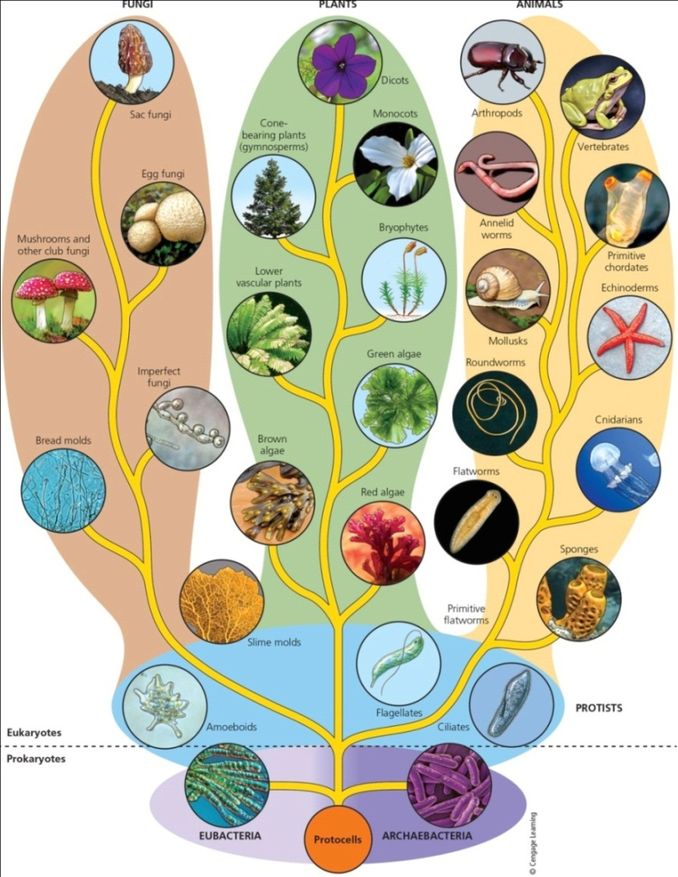
Evolution Depends on Genetic Variability and Natural Selection (6 of 6)
Notes:
Figure 4.16 Simplified phylogenetic tree (or tree of life) diagram showing the hypothesized evolution of life on the earth into six major kingdoms of species.

Slide 27
Limits to Adaptation through Natural Selection
Adaptive genetic traits must precede change in the environmental conditions
A population’s reproductive capacity
Species that reproduce rapidly and in large numbers are better able to adapt

Slide 28
Myths about Evolution through Natural Selection
Five common myths
Survival of the fittest means survival of the strongest
Evolution explains the origin of life
Humans evolved from apes or monkeys
Evolution is part of nature’s grand plan to produce perfectly adapted species
Evolution by natural selection is not important because it is just a theory

Slide 29
4.5 What Factors Affect Biodiversity? (1 of 2)
New species arise in two phases
Geographic isolation
Occurs first
Populations migrate or are separated by some other cause
Reproductive isolation
Mutation and change by natural selection occurs in the geographically isolated groups
Eventually prevents breeding between the groups

Slide 30
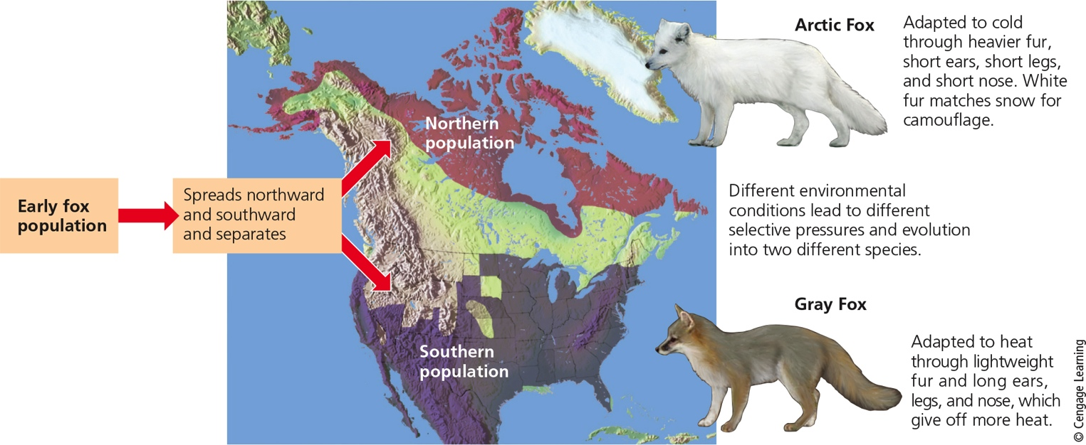
What Factors Affect Biodiversity? (2 of 2)
Notes:
Figure 4.17 Geographic isolation can lead to reproductive isolation, divergence of gene pools, and speciation.

Slide 31
Science Focus 4.2: Geological Processes Affect Biodiversity (1 of 2)
Tectonic plates affect evolution and the distribution of life on earth
Locations of continents and oceans have shifted through geologic time
Species move and adapt to new environments, allowing speciation
Earthquakes can separate and isolate populations
Volcanic eruptions can destroy habitats

Slide 32
Science Focus 4.2: Geological Processes Affect Biodiversity (2 of 2)
Notes:
Figure 4.B Over millions of years, the earth’s continents have moved very slowly on several gigantic tectonic plates. Question: How might an area of land splitting apart cause the extinction of a species?

Slide 33
Artificial Selection, Genetic Engineering, and Synthetic Biology
Artificial selection
Selective breeding (or crossbreeding)
Occurs between genetically similar species
Not a form of speciation
Slow process
Genetic engineering
Way to speed process of artificial selection
Gene splicing

Slide 34
Steps in Genetic Engineering (1 of 3)
Identify a gene with a desired trait in DNA from donor organism
Extract a small DNA molecule (plasmid) from a bacterial cell
Insert the desired gene into the plasmid to form a recombinant DNA plasmid
Insert into the cell of another bacterium that divides and reproduces large numbers of cells with desired trait

Slide 35
Steps in Genetic Engineering (2 of 3)
Transfer the genetically modified bacterial cells to a plant or animal that is to be genetically modified
Result is a genetically modified organism (GMO)
Synthetic biology
Segments of DNA are used to design and create artificial cells, tissues, body parts, and organisms not found in nature

Slide 36
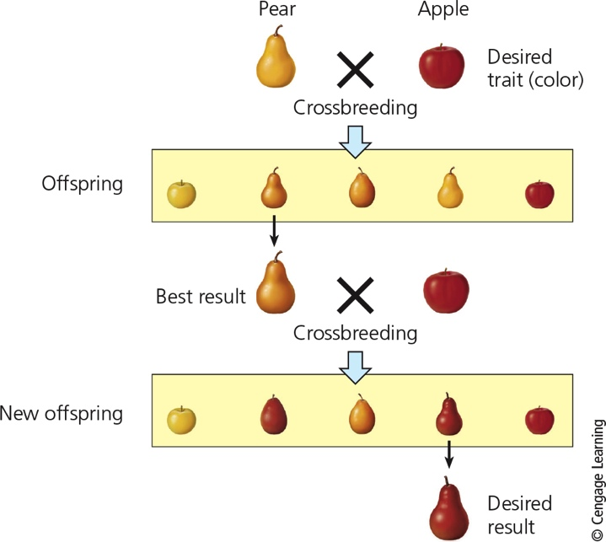
Steps in Genetic Engineering (3 of 3)
Notes:
Figure 4.18 Artificial selection involves the crossbreeding of species that are close to one another genetically. In this example, similar fruits are being crossbred to yield a pear with a certain color.

Slide 37
Extinction Eliminates Species (1 of 3)
Extinction
Process in which an entire species ceases to exist
Endemic species
Found only in one area
Particularly vulnerable to extinction
Background extinction
Typical low rate of extinction
0.0001% of all species per year

Slide 38
Extinction Eliminates Species (2 of 3)
Mass extinction
Significant rise above background level
20–95% of species are eliminated
Causes unknown but could include:
Giant volcanic eruptions
Collisions with meteors or asteroids
Provides opportunity for evolution of new species

Slide 39
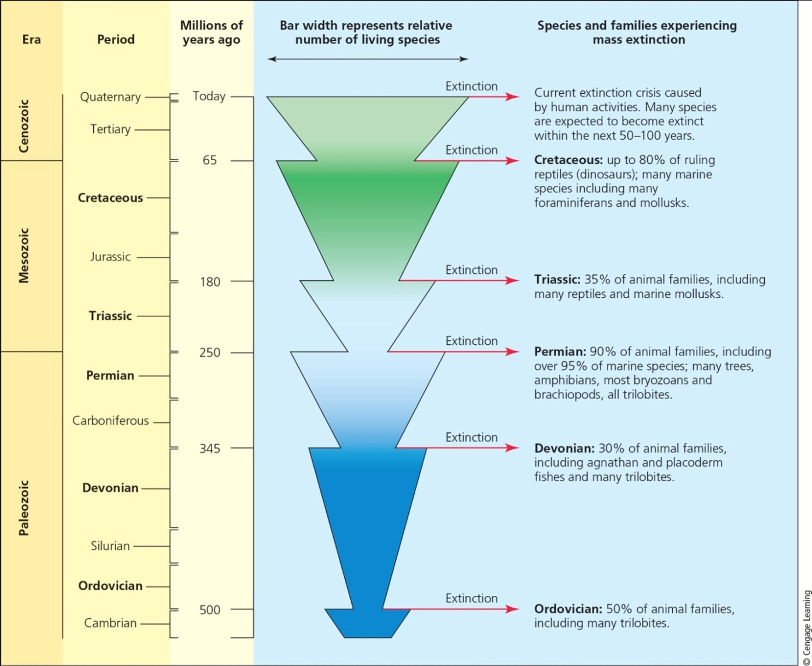
Extinction Eliminates Species (3 of 3)
Notes:
Figure 4.19 Scientific evidence indicates that the earth has experienced five mass extinctions over the past 500 million years and that human activities have initiated a new sixth mass extinction.

Slide 40
Critical Concepts: Adapt, Migrate, or Go Extinct
When the environment changes rapidly, species have only three options
Polar bears reproduce slowly, but environmental conditions they depend on for survival are changing very quickly

