Slide 1

Biology Concepts & Applications
10 Edition
Chapter 42
Ecosystems
Copyright © 2018 Cengage Learning. All Rights Reserved. May not be copied, scanned, or duplicated, in whole or in part, except for use as permitted in a license distributed with a certain product or service or otherwise on a password-protected website for classroom use.

Slide 2
42.1 The Nature of Ecosystems
Ecosystems
  A community of organisms together with the nonliving components of their environment
  Organisms and their environment interact through a one-way flow of energy and a cycling of nutrients
  Nutrients taken up by producers are returned to the environment by decomposers, then taken up again

Slide 3
Producers and Consumers
An ecosystem runs on energy captured by primary producers
  Primary producer (autotroph)
    An organism that obtains energy and nutrients from inorganic sources to build organic compounds
  Primary production
    Rate at which producers capture and store energy
    Varies by ecosystem, season, and nutrient availability

Slide 4
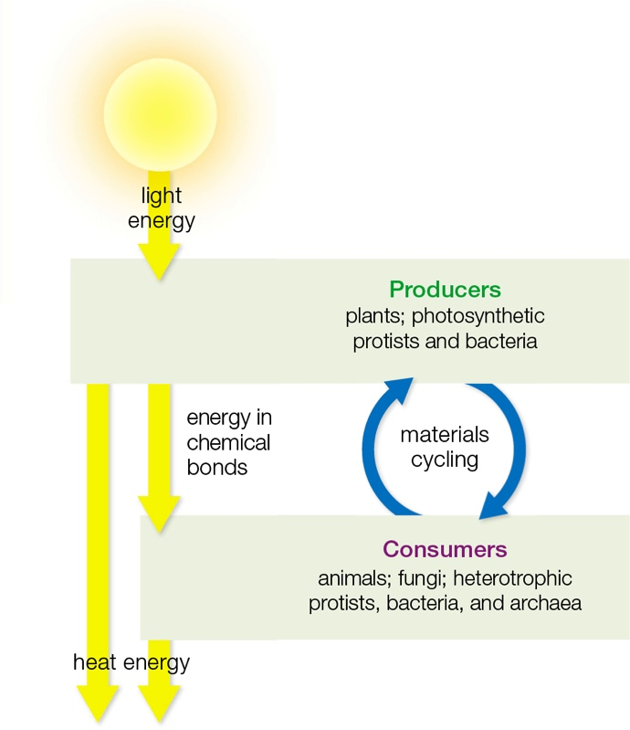
One-Way Flow of Energy
Notes:
Figure 42.1 One-way flow of energy (yellow arrows) and nutrient cycling (blue arrows) in the most common type of ecosystem. All light energy that enters the system eventually returns to the environment as heat energy that is not reused. By contrast, nutrients are continually recycled.

Slide 5
Producers and Consumers
Consumers are described by their diets
  Herbivores: plants
  Carnivores: animal flesh
  Parasites: tissues of a living host
  Omnivores: plants and animals
  Detritivores: detritus, small bits of decaying organic matter
  Decomposers: waste and remains

Slide 6
Energy Flows, Nutrients Cycle (1 of 2)
Energy captured by producers is converted to bond energy in organic molecules
  This energy is released by metabolic reactions that give off heat
  Energy flow through living organisms is a one-way process

Slide 7
Energy Flows, Nutrients Cycle (2 of 2)
Nutrients cycle within an ecosystem
  Producers take up hydrogen, oxygen, and carbon from inorganic sources present in air and water
  They also take up dissolved nitrogen, phosphorus, and other necessary minerals
  Nutrients that producers use to build their bodies are used in turn to build the bodies of the consumers who eat them

Slide 8
Trophic Structure (1 of 2)
Trophic level: position of an organism in a food chain
Food chains
  Transfer of energy to higher trophic levels
  Describe how energy and materials are transferred from one organism to another
  Description of who eats whom in one path of energy in an ecosystem

Slide 9
Trophic Structure (2 of 2)
Limits of food chains
  Energy captured by producers usually passes through no more than four or five trophic levels
  The length of food chains is restricted by the inefficiency of energy transfers
  Only 5–30% of energy in an organism at one trophic level ends up in tissues of an organism at the next trophic level

Slide 10
Food Chain
Notes:
Figure 42.2 Food chain. An example of who eats whom in a tallgrass prairie ecosystem in Kansas. Yellow arrows indicate energy flow. Plants are the main producers. Sunlight energy they capture and store in their tissues supplies the energy that the ecosystem’s consumers require.

Slide 11
42.2 Depicting Trophic Structure
Food chains of an ecosystem cross-connect as a food web
  The food web diagram reflects environmental constraints and the inefficiency of energy transfers among trophic levels

Slide 12
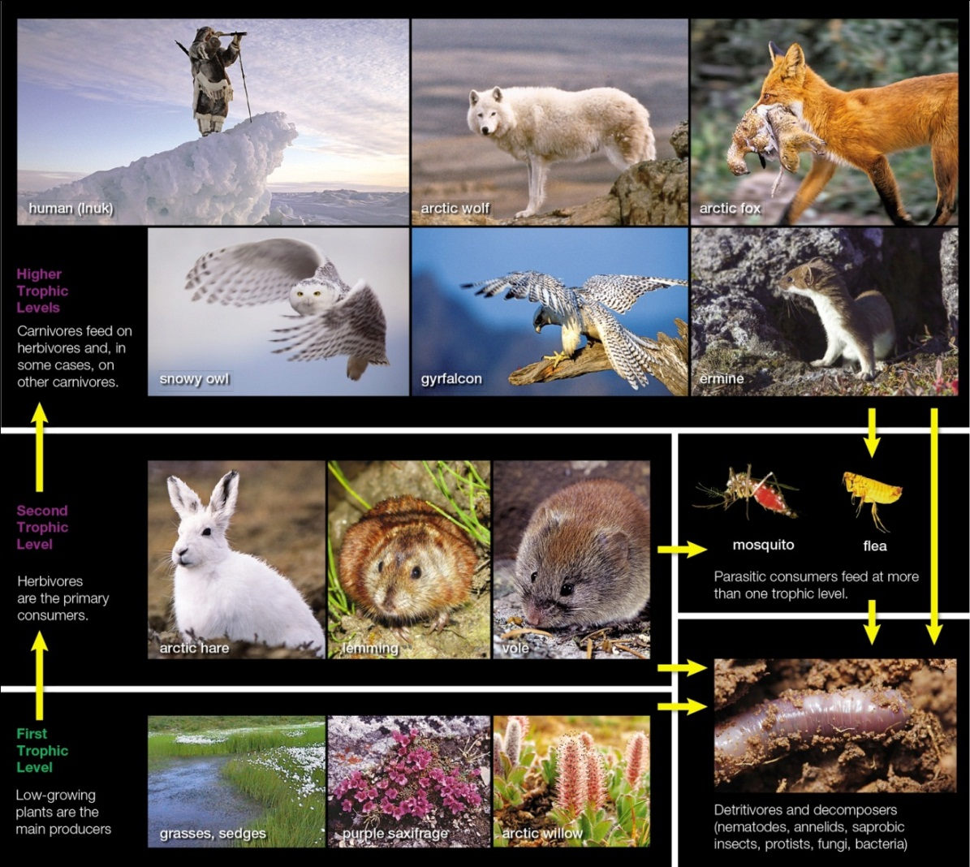
An Arctic Food Web
Notes:
Figure 42.3 Some organisms in an arctic food web. Yellow arrows indicate path of energy flow (point from eaten to eater).

Slide 13
Food Webs
Food webs include two types of interconnecting food chains
  Grazing food chain
    Energy transferred from producers to herbivores (grazers)
  Detrital food chain
    Energy transferred directly from producers to detritivores (worms or insects)
    Major food chain in land ecosystems

Slide 14
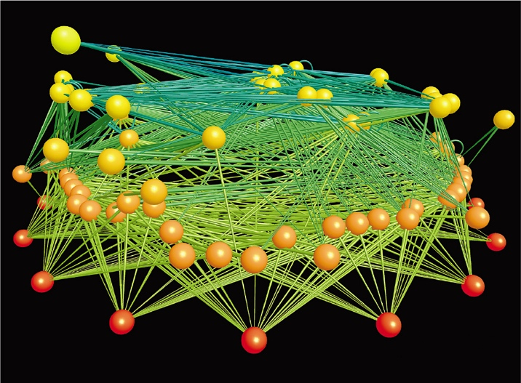
Land Food Web in Colorado
Notes:
Figure 42.4 Computer model for a land food web in East River Valley, Colorado. Balls signify species. Their colors identify trophic levels, with producers (coded red) at the bottom and top predators (yellow) at top. The connecting lines thicken as they go from an eaten species to the eater.

Slide 15
Ecological Pyramids
Ecological pyramids illustrate the inefficiency of transfers between trophic levels
  A biomass pyramid shows the amounts of organic material in bodies of organisms at each trophic level at a specific time
  An energy pyramid shows energy flow through each trophic level in a given interval

Slide 16
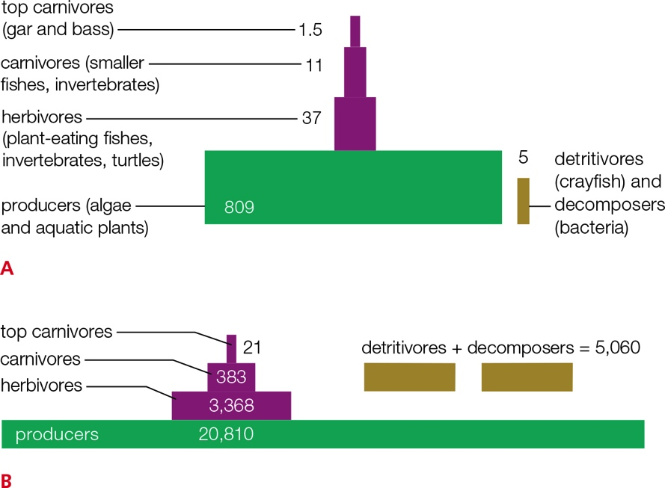
Ecological Pyramids for Silver Springs
Notes:
Figure 42.5 Ecological pyramids for Silver Springs, an aquatic ecosystem.
A Biomass pyramid (grams per square meter).
B Energy pyramid (kilocalories per square meter per year).

Slide 17
42.3 Biogeochemical Cycles (1 of 2)
Elements essential to life move between a community and its environment in a biogeochemical cycle
  A nutrient moves between environmental reservoirs and in and out of food webs
  Chemical and geologic processes move elements to, from, and among environmental reservoirs (rocks, sediments, water, atmosphere)

Slide 18
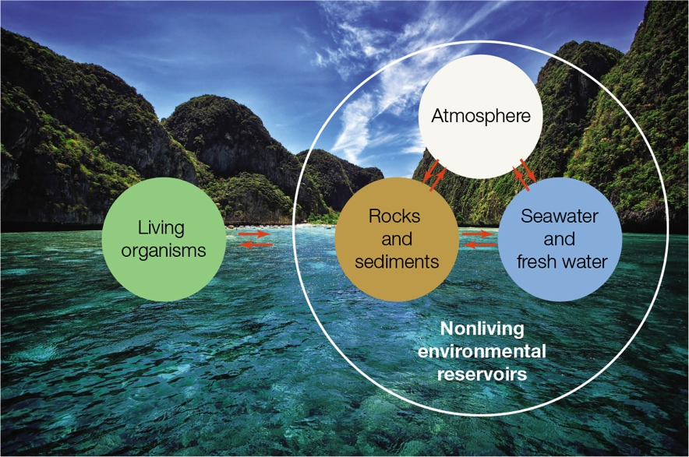
Biogeochemical Cycles (2 of 2)
Notes:
Figure 42.6 Generalized biogeochemical cycle. For any nutrient, the cumulative amount in all environmental reservoirs far exceeds the amount in living organisms.

Slide 19
42.4 The Water Cycle (1 of 3)
Ninety-seven percent of Earth’s water is in its oceans
Sunlight energy drives the water cycle by causing evaporation
  Water vapor in the atmosphere condenses into clouds and returns to Earth’s surface as precipitation

Slide 20
The Water Cycle (2 of 3)
How water moves
  Precipitation that falls on any specific area of land drains into its particular watershed
  Most precipitation seeps into the ground (groundwater)
  Water that drains through soil layers often collects in natural underground reservoirs (aquifers)
  The flow of groundwater and surface water (runoff) slowly returns water to oceans

Slide 21
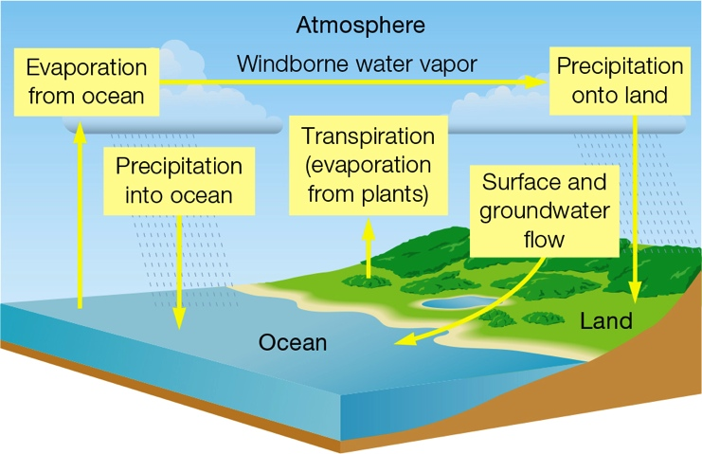
The Water Cycle (3 of 3)
Notes:
Figure 42.7 The water cycle. Water moves from the ocean to the atmosphere, land, and back. Yellow arrows represent processes that move water.

Slide 22
Water Reservoirs
TABLE 42.1
Environmental Water Reservoirs
Reservoir | Volume (10³ cubic kilometers)
Ocean | 1,370,000
Polar ice, glaciers | 29,000
Groundwater | 4,000
Surface water (lakes, rivers) | 230
Atmosphere (water vapor) | 14
Notes:
Table 42.1 Environmental Water Reservoirs

Slide 23
42.5 The Carbon Cycle
Movement flows between the oceans, the atmosphere, and living organisms
  An atmospheric cycle
  Most carbon is stored in rocks
    Enters food webs as gaseous carbon dioxide or bicarbonate dissolved in water

Slide 24
Carbon Reservoirs and Flow (1 of 2)
Carbon enters land food webs when plants use CO₂ from the air in photosynthesis
CO₂ released by aerobic respiration returns to the atmosphere
Carbon diffuses between atmosphere and ocean
  HCO₃ – forms when CO₂ dissolves in seawater

Slide 25
Carbon Reservoirs and Flow (2 of 2)
Marine producers take up HCO₃– for photosynthesis; marine organisms release CO₂ from aerobic respiration
Many marine organisms incorporate carbon into shells, which become part of sediments
Burning fossil fuels derived from ancient remains of plants puts additional CO₂ into the atmosphere

Slide 26
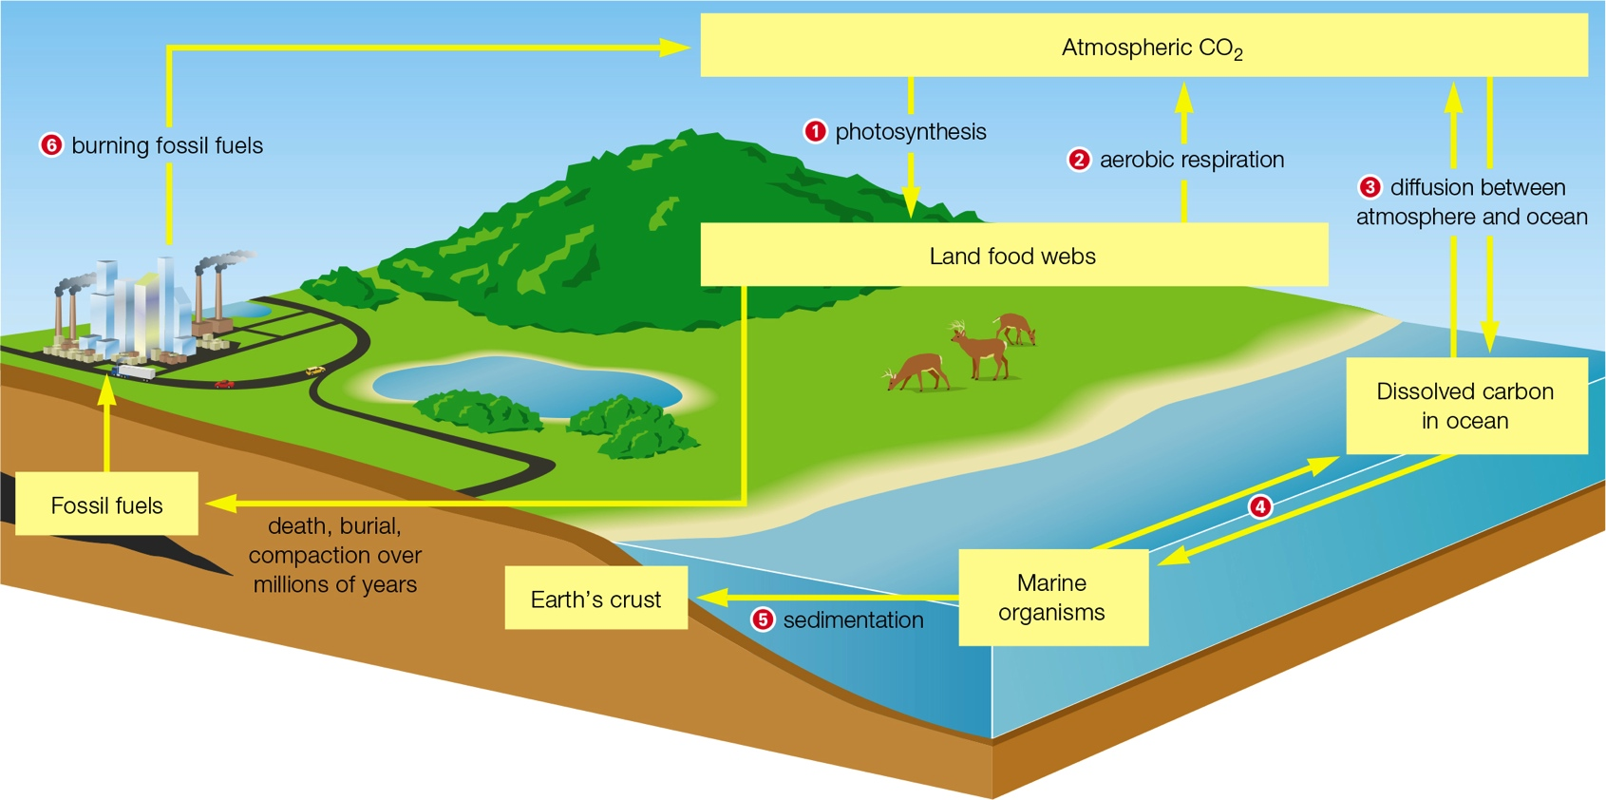
The Carbon Cycle
Notes:
Figure 42.8 The carbon cycle.
1 Carbon enters land food webs when plants take up carbon dioxide from the air for use in photosynthesis.
2 Carbon returns to the atmosphere as carbon dioxide when plants and other land organisms carry out aerobic respiration.
3 Carbon diffuses between the atmosphere and the ocean. Bicarbonate forms when carbon dioxide dissolves in seawater.
4 Marine producers take up bicarbonate for use in photosynthesis, and marine organisms release carbon dioxide from aerobic respiration.
5 Marine organisms incorporate carbon into their shells. After they die, these shells become part of the sediments. Over time, the sediments become carbon-rich rocks such as limestone and chalk in Earth’s crust.
6 Burning of fossil fuels derived from ancient remains puts additional carbon dioxide into the atmosphere.

Slide 27
The Greenhouse Effect (1 of 4)
Warming of Earth’s lower atmosphere and surface as a result of heat trapped by greenhouse gases
Earth’s atmosphere reflects some sunlight energy back into space
Some light energy reaches and warms Earth’s surface

Slide 28
The Greenhouse Effect (2 of 4)
Earth’s warmed surface emits heat energy
  Some escapes into space
  Some is absorbed and emitted in all directions by greenhouse gases

Slide 29
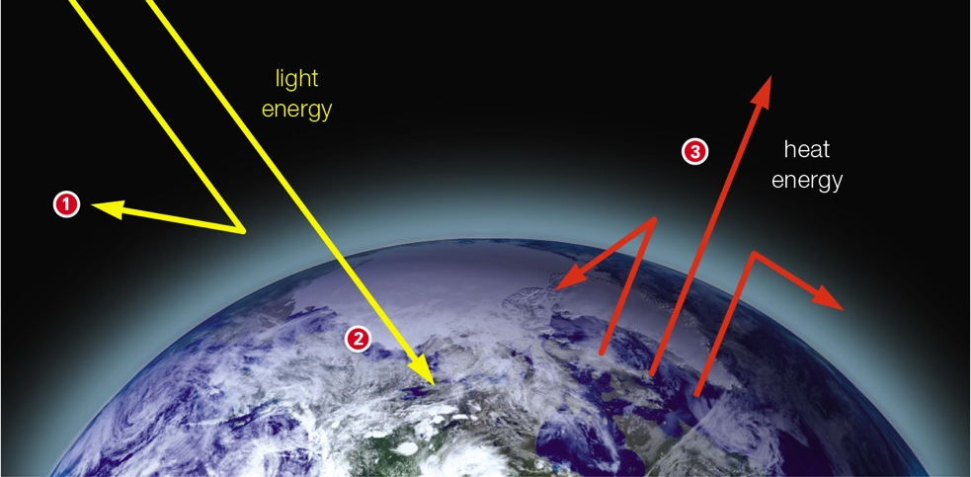
Greenhouse Effect (3 of 4)
Notes:
Figure 42.9 Greenhouse effect.
1 Earth’s atmosphere reflects some sunlight energy back into space.
2 More light energy reaches and warms Earth’s surface.
3 Earth’s warmed surface emits heat energy. Some of this energy escapes through the atmosphere into space. But some is absorbed and then emitted in all directions by greenhouse gases. The emitted heat warms Earth’s surface and lower atmosphere.

Slide 30
The Greenhouse Effect (4 of 4)
Human-induced increase in atmospheric greenhouse gases correlates with global climate change
Current atmospheric CO₂ is the highest in 420,000 years and is still climbing
Global climate change
  A rise in temperature and shifts in other climate patterns

Slide 31
42.6 The Nitrogen Cycle
Nitrogen moves among the atmosphere, soil, and water, and into and out of food webs
  An atmospheric cycle
  Atmospheric nitrogen (N₂ or gaseous nitrogen) is Earth’s main nitrogen reservoir, but most organisms cannot use nitrogen in this form

Slide 32
Nitrogen Reservoirs and Flow (1 of 4)
Certain bacteria can make nitrogen available to other organisms/atmosphere
  Nitrogen fixation
    Use nitrogen gas (N₂) to form ammonia (NH₃)
  Nitrification
    Convert ammonium (NH₄⁺) to nitrates (NO₃–)
  Denitrification
    Convert nitrates or nitrites (NO₂–) to nitrogen gas

Slide 33
Nitrogen Reservoirs and Flow (2 of 4)
Nitrogen-fixing cyanobacteria in soil and water or lichens break bonds in N₂ and form ammonia, which is ionized in water as ammonium (NH₄⁺) and taken up by plants
Another group of nitrogen-fixing bacteria forms nodules on roots of peas and other legumes

Slide 34
Nitrogen Reservoirs and Flow (3 of 4)
Consumers get nitrogen by eating plants or one another; bacterial and fungal decomposers break down wastes and remains and return ammonium to the soil
Nitrification converts ammonium to nitrates
  Ammonia-oxidizing bacteria and archaeans convert ammonium to nitrites (NO₂–)
  Bacteria convert nitrites to nitrates (NO₃–)

Slide 35
Nitrogen Reservoirs and Flow (4 of 4)
Nitrates are taken up and used by producers
Denitrifying bacteria use nitrate for energy and release nitrogen gas into the atmosphere

Slide 36
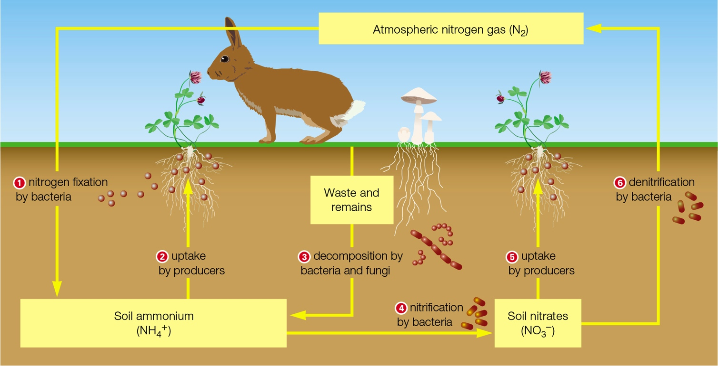
Nitrogen Cycle on Land
Notes:
Figure 42.10 Nitrogen cycle in a land ecosystem.

Slide 37
Alterations to the Cycle
Manufactured ammonia fertilizers increase the concentration of H⁺ and N
  Essential nutrients leach away in soil water
  Nitrogen runoff pollutes aquatic habitats
Burning fossil fuels releases nitrous oxide, a greenhouse gas contributing to acid rain
  Nitrogen in acid rain has the same effects as fertilizers

Slide 38
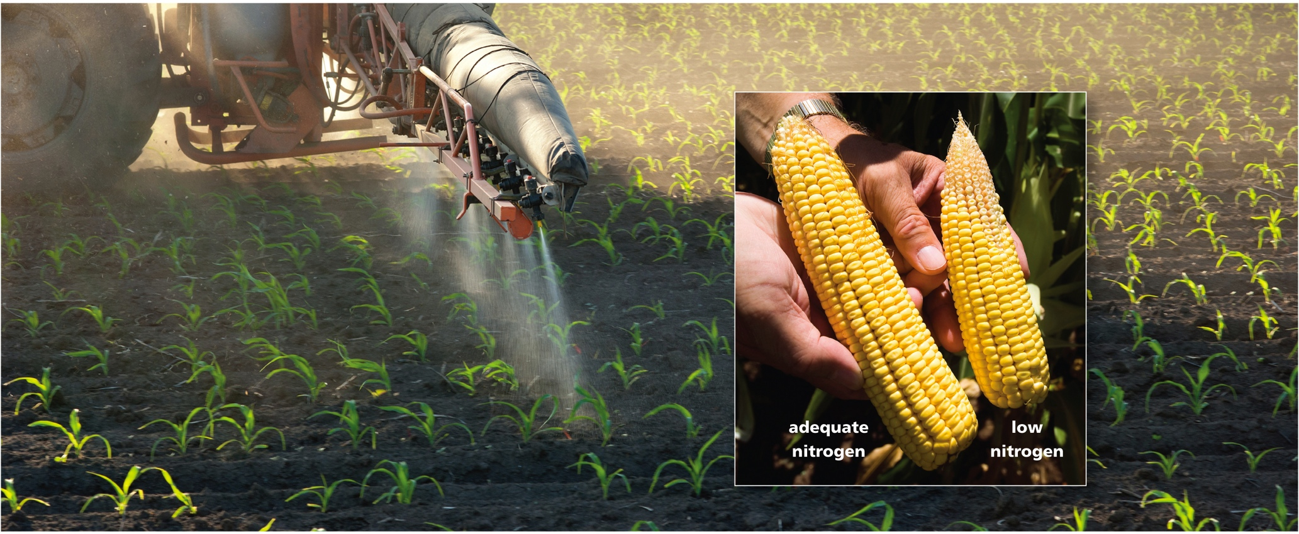
Nitrogen-Rich Fertilizer
Notes:
Figure 42.11 Tractor applying industrially produced, nitrogen-rich fertilizer to a cornfield. Nitrogen is the nutrient that most commonly limits corn growth. The inset photo shows corn grown with adequate nitrogen (left) and in nitrogen-deficient soil (right).

Slide 39
42.7 The Phosphorus Cycle (1 of 6)
Atoms of phosphorus are highly reactive, so phosphorus does not occur naturally in its elemental form
Phosphorus passes quickly through food webs as it moves from land to ocean sediments, then slowly back to land
  A sedimentary cycle

Slide 40
The Phosphorus Cycle (2 of 6)
Weathering and erosion move phosphates from rocks into soil, lakes, and rivers
Leaching and runoff carry dissolved phosphates to the ocean
Phosphorus settles as deposits along continental margins

Slide 41
The Phosphorus Cycle (3 of 6)
Slow movements of Earth’s crust uplift deposits onto land, where weathering releases phosphates from rocks
Land plants take up dissolved phosphate from soil water

Slide 42
The Phosphorus Cycle (4 of 6)
Land animals get phosphates by eating plants or one another; phosphorus returns to soil in wastes and remains
In seas, producers take up phosphate dissolved in seawater
Wastes and remains replenish phosphates in seawater

Slide 43
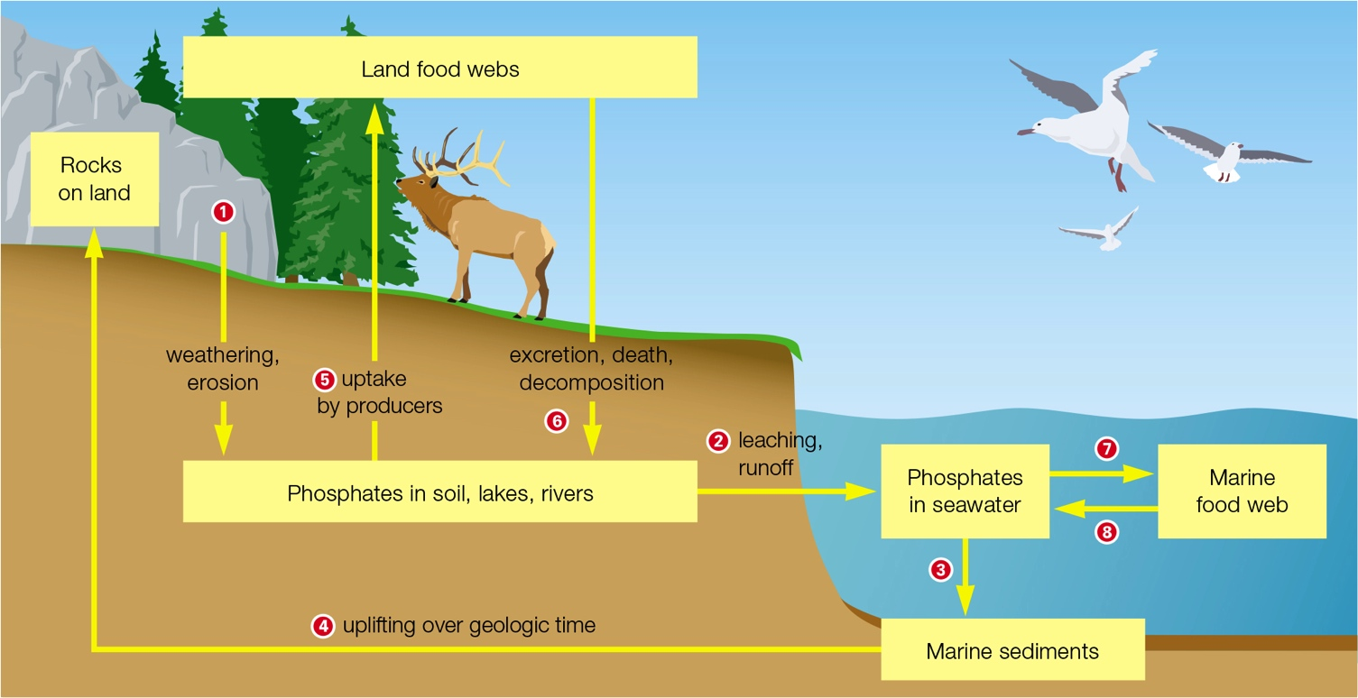
Phosphorus Cycle (5 of 6)
Notes:
Figure 42.12 The phosphorus cycle.

Slide 44
The Phosphorus Cycle (6 of 6)
Phosphorus is often a limiting factor for plant growth
  Phosphate-rich droppings from seabird or bat colonies are used as fertilizer
  Phosphate-rich rock is also mined for this purpose
Water pollution from high-phosphate fertilizers, detergents, or sewage can cause eutrophication

Slide 45
Application: Toxic Transfer (1 of 2)
Bioaccumulation: an organism’s tissues store a pollutant taken up from the environment, so that the concentration of pollutant in the body increases over time
  Nutrients are not the only things that move up food chains
  Pollutants enter food chains and pass from one trophic level to the next
  By the process of biological magnification

Slide 46
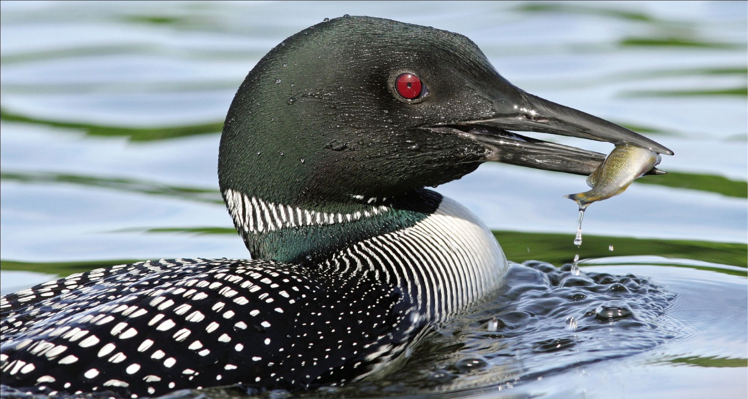
Toxic Transfers (2 of 2)
Notes:
Figure 42.13 Loon with its fish prey. Along with nutrients, the loon takes in any toxic pollutants that accumulated in the fish’s body.

Slide 47
Discuss
What is the one ingredient required by all ecosystems that cannot be recycled?
Why is the term “food chain” rarely used when describing actual ecosystems?
Is it environmentally wise to rely on large quantities of nitrogen-rich fertilizers for crop production? What are some alternatives?

