Slide 1
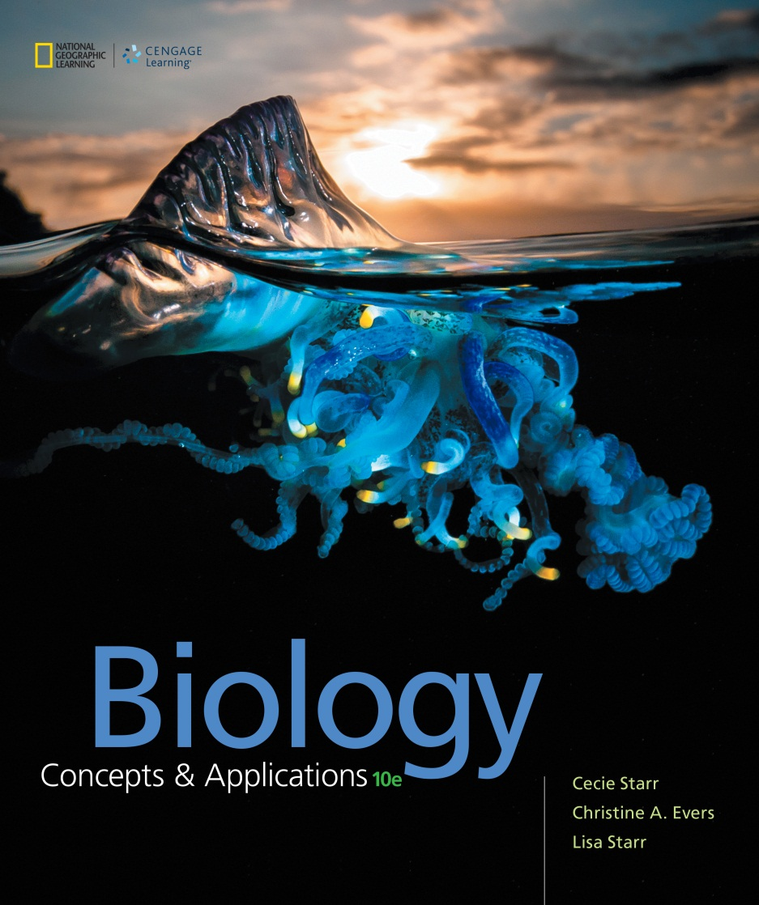
Biology Concepts & Applications
10 Edition
Chapter 41
Community Ecology
Copyright © 2018 Cengage Learning. All Rights Reserved. May not be copied, scanned, or duplicated, in whole or in part, except for use as permitted in a license distributed with a certain product or service or otherwise on a password-protected website for classroom use.

Slide 2
41.1 Factors That Shape Communities
A biological community: all the populations of all species that live in a particular place at the same time
Scale of a community is defined by a human observer
  One community can contain smaller communities or be a component of a larger one

Slide 3
Communities
Communities differ in their species diversity
Species diversity has two components:
  Species richness (number of species)
  Species evenness (relative abundance of each species)
Community structure is dynamic
  Species richness and evenness change over time

Slide 4
Community Structure is Dynamic
Community structure can change:
  As the community forms and ages
  As a result of disturbances
  With changes in physical factors such as climate and resource availability
  Due to various types of species interactions
Each species can only live in a specific habitat, a place with resources it needs and conditions it can tolerate

Slide 5
Species Interactions Within Communities
TABLE 41.1
Direct Two-Species Interactions
Types of Interaction | Effect on Species 1 | Effect on Species 2
Commensalism | Helpful | None
Mutualism | Helpful | Helpful
Interspecific competition | Harmful | Harmful
Predation, herbivory, parasitism, parasitoidism | Helpful | Harmful
Notes:
Table 41.1 Direct Two-Species Interactions

Slide 6
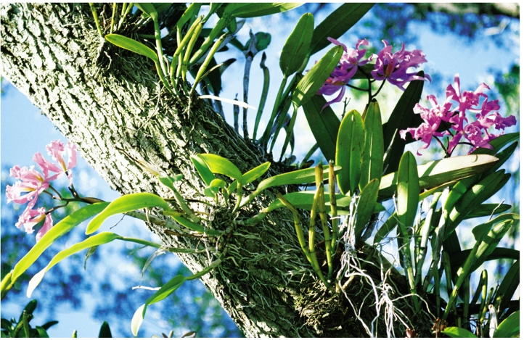
Commensal Orchids
Notes:
Figure 41.1 Commensal orchids on a tree trunk. The orchids benefit by growing on the tree, which is unaffected by their presence.

Slide 7
Long-Term Species Interactions
Symbiosis
  “Living together”
  A relationship in which two species have a prolonged close association
  Two species that interact closely for generations can coevolve–each species acts as a selective agent on the other
  Can be a commensal, mutualistic, or parasitic relationship

Slide 8
41.2 Mutualism (1 of 4)
In a mutualistic interaction, two species benefit by taking advantage of one another
  Example: pollinators eat nectar and pollen, and plants receive pollen from other plants of the same species

Slide 9
Mutualism (2 of 4)
In some mutualisms, neither species can complete its life cycle without the other
  Example: Yucca plants and the moths that pollinate them
    Mouthparts of the female moth are specialized to collect yucca pollen
    Female flies to another flower, pierces its ovary, and lays eggs inside, fertilizing the yucca
    Moth eggs develop into larvae in the ovary of the yucca

Slide 10
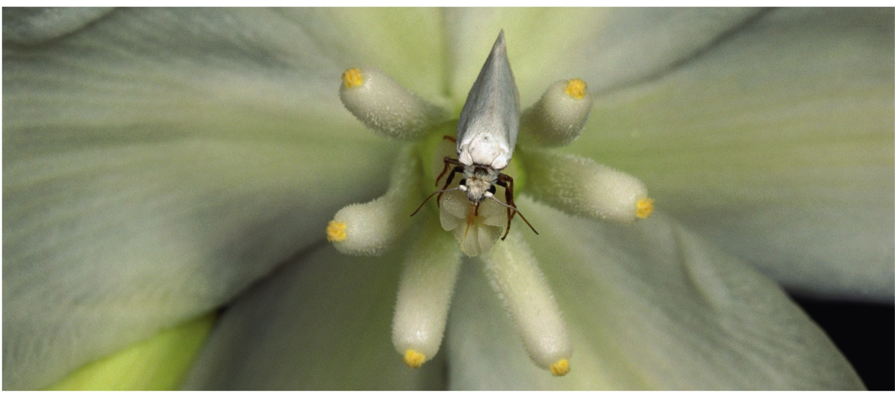
Obligate Mutualists
Notes:
Figure 41.2 Obligate mutualists: a yucca moth on a yucca flower. Yucca moths mate on such flowers. Afterward, the female gathers pollen from one flower and carries it with her to another flower that has not yet begun to produce pollen. She lays her eggs in the second flower’s ovary, then uses the pollen she brought along to fertilize it. By pollinating the flower, she ensures that seeds will form to feed her larvae. Moth larvae eat some seeds, but plenty survive to give rise to new yucca plants.

Slide 11
Mutualism (3 of 4)
For some mutualists, the main benefit is defense
  Example: Sea anemone and anemone fish
    An anemone fish has a mucus layer that shields it from stinging cells (nematocysts) of a sea anemone
    Tentacles of the anemone protect the fish from predators
    The anemone fish chases away the few fishes that are able to eat sea anemone tentacles

Slide 12
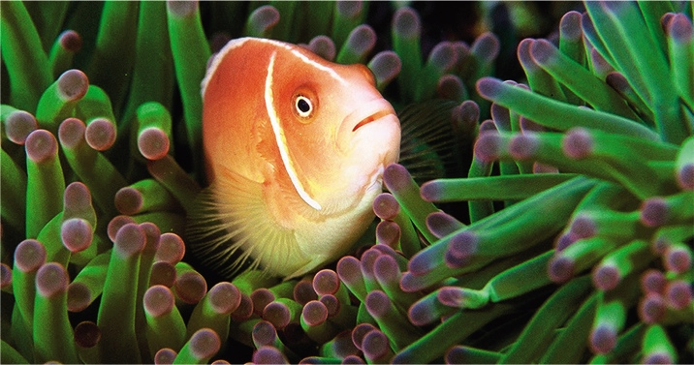
Mutual Protection
Notes:
Figure 41.3 Mutual protection. The stinging tentacles of this sea anemone protect its partner (a pink anemonefish) from fish-eating predators. In return, the anemonefish chases away fish that eat sea anemone tentacles. The anemonefish secretes a special mucus that prevents the anemone from stinging it.

Slide 13
Mutualism (4 of 4)
Mutualistic microorganisms help plants obtain nutrients
  Nitrogen-fixing bacteria on roots of legumes (peas) provide the plant with extra nitrogen
  Mycorrhizal fungi living in or on plant roots enhance a plant’s mineral uptake
  Other fungi interact with photosynthetic algae or bacteria in lichens

Slide 14
41.3 Interspecific Competition
Resources are limited and individuals of different species often compete for access to them (interspecific competition)
Competition adversely affects both species

Slide 15
Types of Competition (1 of 2)
Each species has an ecological niche defined by physical and biological factors; the more similar the niches of two species are, the more intensely they will compete
  An animal’s niches include the temperature range it can tolerate, species it eats, and places it can breed
  A flowering plant’s niche would include its soil, water, light, and pollinator requirements

Slide 16
Types of Competition (2 of 2)
Interference competition
  One species actively prevents another from accessing some resource
    Example: One species of scavenger will often chase another away from a carcass
Exploitative competition
  Two species reduce the amount of resources available to the other by using that resource
    Example: Deer and blue jays compete for acorns

Slide 17
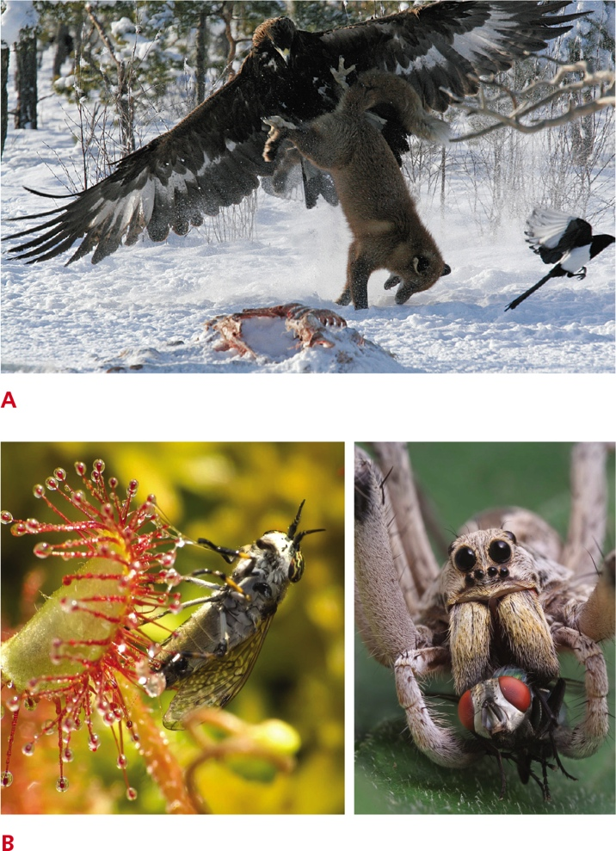
Interspecific Competition
Notes:
Figure 41.4 Interspecific competition.
A Interference competition between scavengers. A golden eagle attacks a fox with its talons to drive the fox away from a resource—the moose carcass in the foreground.
B Exploitative competition between insect eaters. Sundew plants (left) and wolf spiders (right) both feed on insects. The presence of one species reduces the food available to the other.

Slide 18
Competitive Exclusion
Process whereby two species compete for a limiting resource, and one drives the other to local extinction
  Species compete most intensely when a shared resource is the main limiting factor
  The better competitor will drive the less competitive species to extinction in that habitat

Slide 19
Resource Partitioning
Evolutionary process by which different species become adapted to share a limiting resource in a way that minimizes competition
Competition between species can lead to character displacement
  The range of variation for one or more characters shifts in a direction that lessens the intensity of competition for a limiting resource

Slide 20
41.4 Predation and Herbivory
Predation
  One species (the predator) captures, kills, and eats another species (the prey)

Slide 21
Predator and Prey Abundance
The abundance of prey species in a community affects how many predators it can support
  With some predators, such as web-spinning spiders, the proportion of prey killed is constant
  Usually, the number of prey killed depends on the time it takes predators to capture, eat, and digest prey

Slide 22
Predator–Prey Arms Races
Predator and prey exert selection pressure on one another
  Predators exert selection pressure that favors improved prey defenses
  Improved prey defenses in turn exert selection pressure on predators to improve capture skills, and so on

Slide 23
Predator–Prey Cycles
Notes:
Figure 41.6 Predator–prey cycles. The graph shows the abundance of the Canadian lynx (dashed line) and snowshoe hares (solid line), based on counts of pelts sold by trappers to Hudson’s Bay Company from 1845 to 1925.

Slide 24
Predator–Prey Arms Races (1 of 2)
Defensive adaptations of prey
  Hard or sharp parts that make prey difficult to eat
  Chemicals that taste bad or sicken predators
  Tricking or startling an attacking predator
  Warning coloration that predators learn to avoid, such as the black and yellow stripes of stinging wasps and bees

Slide 25
Predator–Prey Arms Races (2 of 2)
In a type of mimicry, prey masquerade as a species that has a defense that they lack
  Example: some flies that cannot sting resemble stinging bees or wasps
Mimicry
  A species evolves traits that make it more similar in appearance to another species

Slide 26
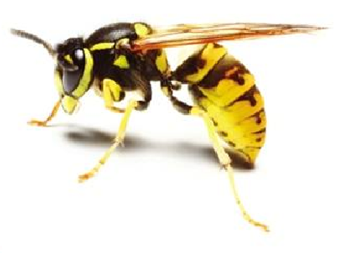
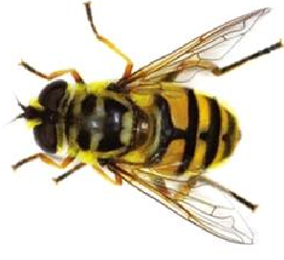
Mimicry
A
Wasp that can inflict a painful sting. Like many stinging bees and wasps, it has a yellow and black pattern.
B
Fly, which lacks a stinger, mimics the color pattern of stinging insects.
Notes:
Figure 41.7 Mimicry.

Slide 27
Predator–Prey Arms Races
Predator adaptations include sharp teeth and claws
  Predators and prey may be coevolved for speed
    Example: cheetah and gazelle
Both predators and prey use camouflage
  A form, patterning, color, or behavior that allows them to blend into their surroundings to avoid detection

Slide 28
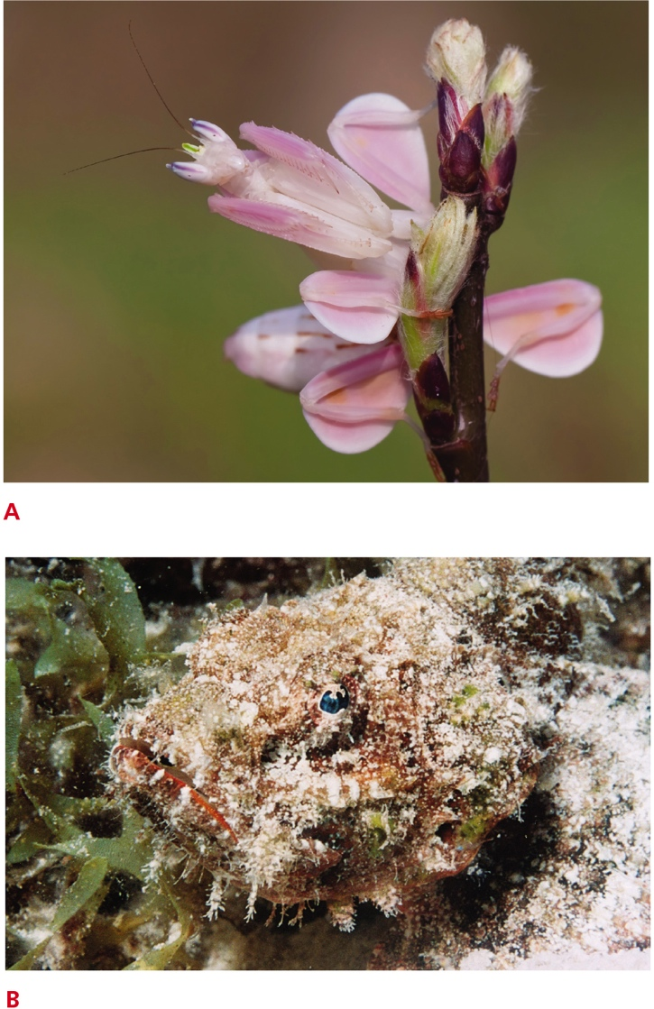
Camouflaged Predators
Notes:
Figure 41.8 Camouflaged predators.
A Pink body parts of a flower mantis help hide it from insect prey attracted to the real flowers.
B Fleshy protrusions give a scorpionfish the appearance of an algae-covered rock. Fish that come close for a nibble end up as prey.

Slide 29
Plant–Herbivore Arms Race (1 of 2)
Herbivory
  An animal feeds on plant parts
  The number and type of plants in a community can influence the number and type of herbivores present

Slide 30
Plant–Herbivore Arms Race (2 of 2)
Two types of defenses against herbivory
  Withstand and recover quickly
  Traits such as spines, tough leaves, or toxins that deter herbivory
Plant defenses favor adaptations in herbivores
  Example: Koalas have special enzymes to break down toxins in eucalyptus

Slide 31
41.5 Parasites and Parasitoids
Parasitism
  One species (the parasite) feeds on another (the host), without immediately killing it
    Endoparasites live and feed inside their host
    Ectoparasites feed while attached to a host’s external surface

Slide 32
Parasites
Notes:
Figure 41.9 Parasites inside and out.
A Endoparasitic roundworms in the intestine of a host pig.
B Ectoparasitic ticks attached to and sucking blood from a finch.
C Ectoparasitic dodder (Cuscuta), also known as strangleweed or devil’s hair. This parasitic flowering plant has almost no chlorophyll. Leafless stems wrap around a host plant, and modified roots absorb water and nutrients from the host plant’s vascular tissue.

Slide 33
Parasitism (1 of 2)
Parasites include a diverse variety of groups
Bacterial, fungal, protistan, and invertebrate parasites feed on vertebrates
  Lampreys attach to and feed on other fish
  Some plants parasitize other plants
Many parasites are pathogens that cause disease in hosts

Slide 34
Parasitism (2 of 2)
Parasites are adapted with traits that allow the parasite to locate hosts and to feed undetected
  Ticks move toward heat and carbon dioxide
Hosts adapt with traits that minimize the negative effects of parasites or fend off parasites

Slide 35
Parasitoids
An insect that lays eggs in another insect, and whose young devour their host from the inside
  Reduce a host population in two ways
    Parasitoid larvae withdraw nutrients and prevent the host from reproducing
    Presence of larvae leads to death of the host
  As many as 15% of all insects may be parasitoids

Slide 36
Biological Pest Control (1 of 2)
Practice of using a pest’s natural enemies to reduce its numbers
  Parasites and parasitoids are commercially raised and released in target areas as biological control agents
  A biological control agent must be adapted to a specific host species
  Introducing a biological control species into a community is risky, as they sometimes go after nontargeted species

Slide 37
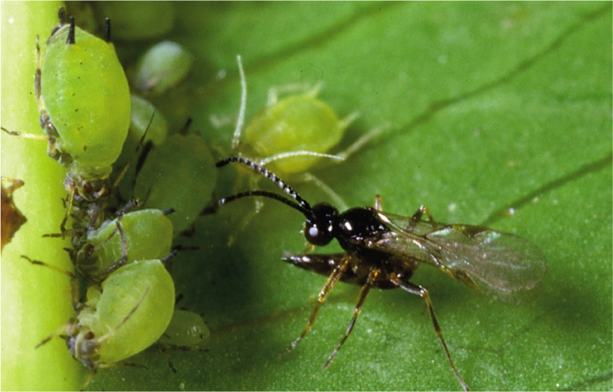
Biological Pest Control (2 of 2)
Notes:
Figure 41.10 Biological pest control. A commercially raised parasitoid wasp about to deposit a fertilized egg in an aphid. This wasp is used to reduce aphid populations. After the egg hatches, a wasp larva devours the aphid from the inside.

Slide 38
Brood Parasitism (1 of 2)
One egg-laying species benefits by having another raise its offspring
Presence of brood parasites, such as North American cowbirds, decreases the reproductive rate of the host species and favors host individuals that detect and eject foreign young
Brood parasitism also evolved in some bee species

Slide 39
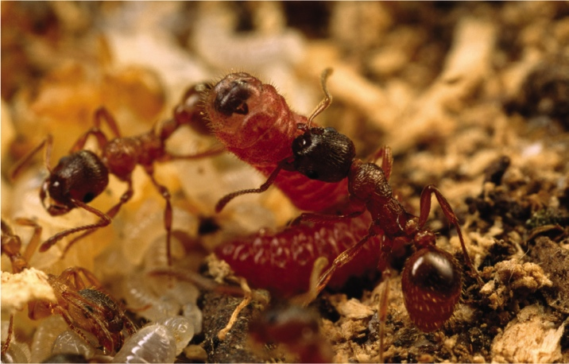
Brood Parasitism (2 of 2)
Notes:
Figure 41.11 Brood parasitism. Ants tending a larva of the Alcon blue butterfly (Phengaris alcon). Worker ants feed the butterfly larva more eagerly than they feed ant larvae and will even feed it ant larvae if food runs short.

Slide 40
41.6 How Communities Change Over Time
Pioneer species
  Species that can colonize a new habitat
    Mosses, lichens, and some flowering annuals
  Species often alter the habitat in ways that allow other species to replace them (ecological succession)
Primary succession takes place in a barren habitat that lacks soil

Slide 41
Ecological Succession (1 of 3)
Pioneer species often have high dispersal rates, grow and mature fast, and produce many offspring
Seeds of later species grow in mats of pioneers
Organic wastes and remains accumulate and help other species take hold
Later successional species often shade and eventually displace earlier ones

Slide 42
Ecological Succession (2 of 3)
Secondary succession
  A new community develops in a site where the soil that supported an old community remains
  In secondary succession, a disturbed area within a community recovers.
  Occurs in abandoned agricultural fields and burned forests

Slide 43
Ecological Succession (3 of 3)
Species composition of a community changes frequently and unpredictably
  Random events can determine the order in which species arrive and affect the course of succession
    Example: 1980 eruption of Mount Saint Helens
      Presence of some pioneers helped later-arriving plants become established
      Other pioneers kept the same late arrivals out

Slide 44
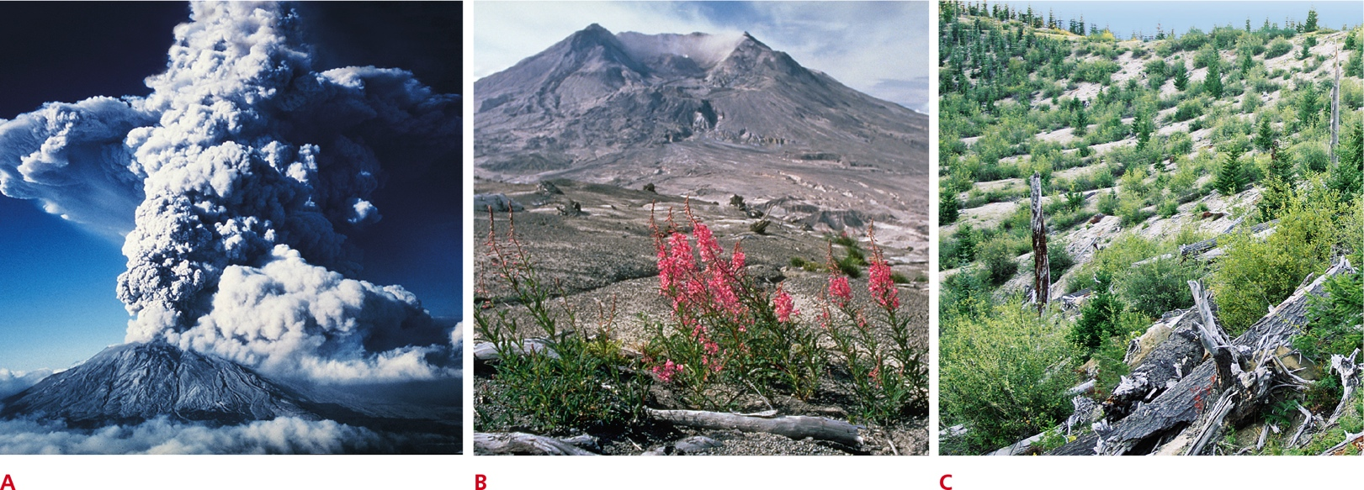
Mount Saint Helens Succession
Notes:
Figure 41.12 An example of succession.
A The community at the base of Mount Saint Helens was wiped out by a volcanic eruption in 1980.
B In less than a decade, pioneer species had arrived and the process of primary succession had begun.
C Twelve years later, seedlings of Douglas firs had taken hold.

Slide 45
Effects of Disturbance (1 of 2)
The magnitude and frequency of disturbances affect communities.
The intermediate disturbance hypothesis states that species richness is greatest when physical and biological disturbances are moderate in their intensity or frequency

Slide 46
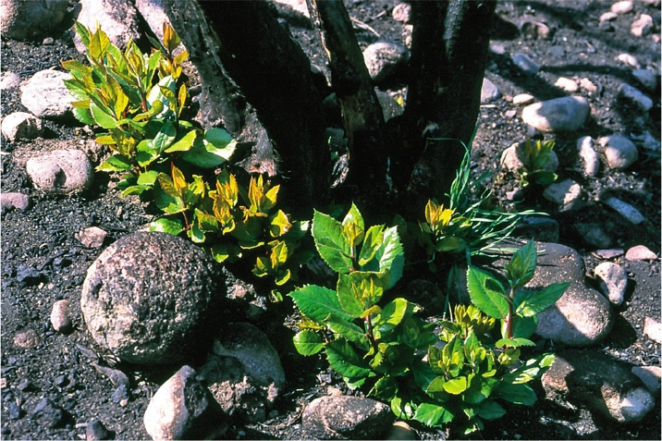
Adapted to Disturbance
Notes:
Figure 41.14 Adapted to disturbance. Some woody shrubs, such as this toyon, resprout from their roots after a fire. In the absence of occasional fire, toyons are outcompeted and displaced by species that grow faster but are less fire resistant.

Slide 47
Effects of Disturbance (2 of 2)
Indicator species are the first to do poorly when conditions change, so they can provide an early warning of environmental degradation
  Example: trout are highly sensitive to pollutants and cannot tolerate low oxygen levels

Slide 48
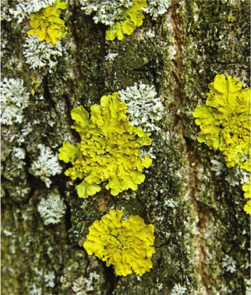
Indicator Species
Notes:
Figure 41.15 Indicator species. Lichens take up nutrients—and pollutants—from airborne dust, so many cannot survive where the level of air pollution is high. The U.S. Forest Service monitors the types and numbers of lichens on tree trunks as part of its program to assess the health of forest communities.

Slide 49
41.7 Single-Species Effects
Keystone species
  A species that has a disproportionately large effect on community structure
  Loss or addition of even one species (keystone species) may destabilize the number and abundances of species in a community
  They are often predators but not always
    Example: beavers

Slide 50
Exotic and Endemic Species (1 of 2)
Endemic species evolved in a particular community and exists nowhere else
Exotic species evolved in one community and later became established in a different one
  Can dramatically alter a natural community
  More than 4,500 exotic species have become established in the United States

Slide 51
Exotic and Endemic Species (2 of 2)
An invasive species is an exotic species that harms members of its new community
  Often have a far greater impact in their new community than they did in the region in which they originated
    Examples:
      Kudzu
      Gypsy moths
      Nutrias

Slide 52
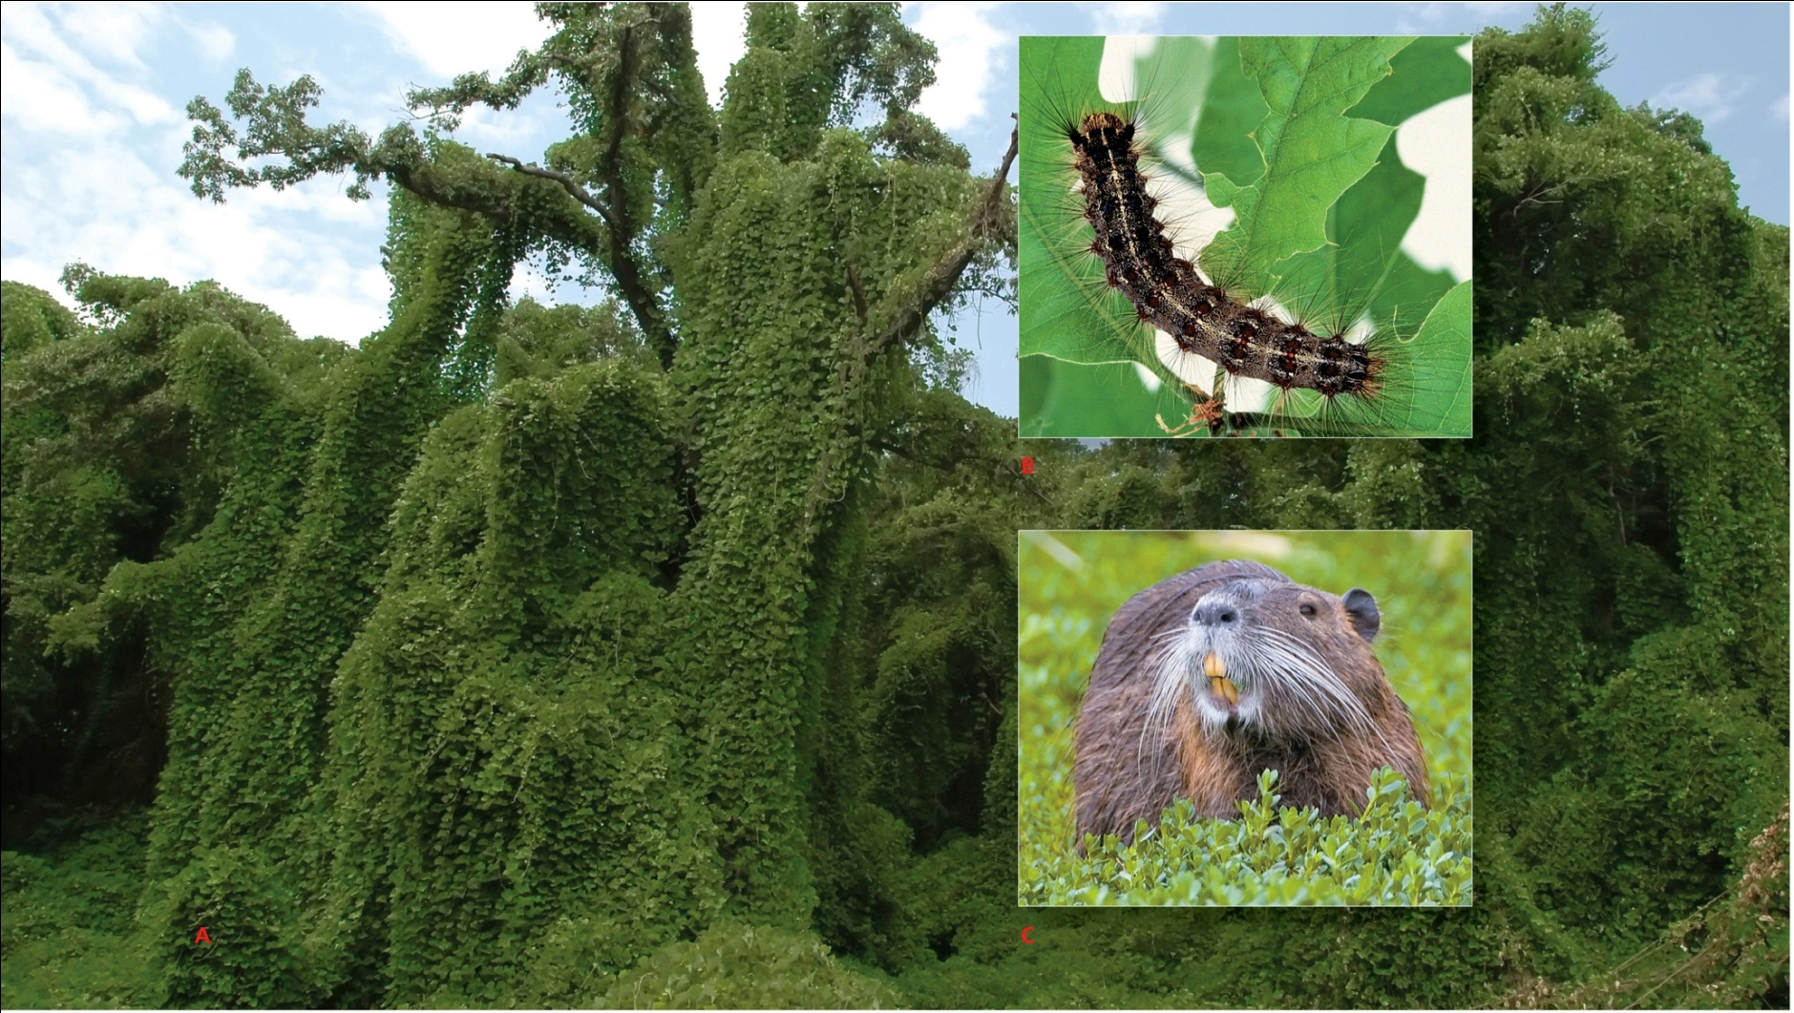
Exotic Species Within the US
Notes:
Figure 41.17 Three exotic species that are altering natural communities in the United States. To learn more about invasive species in the United States, visit the National Invasive Species Information Center online at www.invasivespeciesinfo.gov.
A Kudzu native to Asia is overgrowing trees across the southeastern United States.
B Gypsy moth caterpillars native to Europe and Asia now feed on oaks in much of the United States.
C Nutrias native to South America now abound in freshwater marshes of the Gulf coast states.

Slide 53
41.8 Island Biogeography
Equilibrium model of island biogeography
  The number of species living on any island reflects a balance between immigration rates for new species and extinction rates for established ones
  Colonization rates depend on the distance between an island and a mainland source of colonists (distance effect)
  An island’s size affects species richness (area effect)

Slide 54
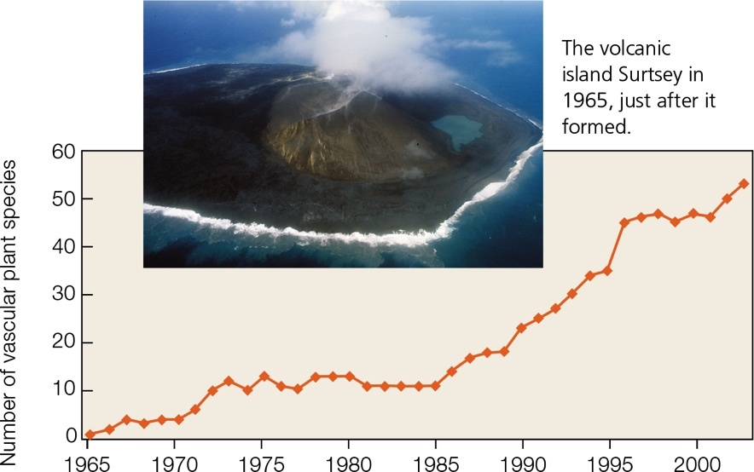
Plant Colonization of Surtsey
Notes:
Figure 41.18 Vascular plant colonization of Surtsey. Seagulls began nesting on the island in 1986.

Slide 55
Application: Fighting Foreign Fire Ants
Red imported fire ants, Solenopsis invicta, have a venomous sting and disrupt native wildlife communities
  Pesticides do not control spread
  Biological control involves phorid flies; the larvae eats its way through the fire ant and undergoes metamorphosis in its head
  Global climate change is expected to help RIFAs extend their range in the United States

Slide 56
Discuss
Would you expect competition between two finches of different species to be less intense or more intense than competition between two finches of the same species? Explain your answer.
How does a shift in niche benefit competing species sharing the same environment?

