Slide 1

Biology Concepts & Applications
10 Edition
Chapter 40
Population Ecology
Copyright © 2018 Cengage Learning. All Rights Reserved. May not be copied, scanned, or duplicated, in whole or in part, except for use as permitted in a license distributed with a certain product or service or otherwise on a password-protected website for classroom use.

Slide 2
40.1 Characteristics of a Population
Population ecology investigates the factors that influence the size, distribution, and other properties of natural populations
  Data can be used to make decisions about managing a species
Studying population ecology often involves the use of demographics
  Statistics that describe a population and often change over time

Slide 3
Size, Density, and Distribution (1 of 3)
Population: group of organisms that interbreed with one another more often than they interbreed with other members of their species
Population size: total number of individuals in population
Population density: number of individuals per unit area or volume

Slide 4
Size, Density, and Distribution (2 of 3)
Population distribution: describes how individuals are distributed
  Clumped distribution
    Individuals are closer to one another than would be predicted by chance alone
    Due to resource distribution, limited dispersal availability, or asexual reproduction

Slide 5
Size, Density, and Distribution (3 of 3)
  Near-uniform distribution
    Individuals are more evenly spaced than would be expected by chance
    Found in breeding colonies and with competition for resources
  Random distribution
    Individuals are distributed randomly when environmental resources are uniformly distributed
    Proximity to others is neither beneficial or detrimental

Slide 6
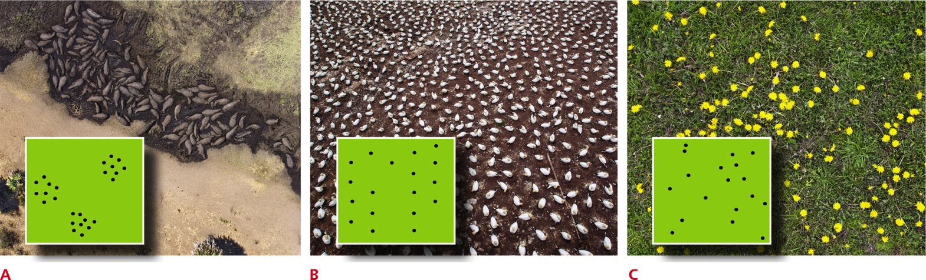
Population Distribution Patterns
Notes:
Figure 40.1 Population distribution patterns.
A Clumped distribution of hippopotamuses.
B Near-uniform distribution of nesting seabirds.
C Random distribution of dandelions.

Slide 7
Sampling a Population (1 of 2)
Biologists frequently use sampling techniques to estimate population size
Plot sampling estimates the total number of individuals in an area based on direct counts in a small portion of that area
  Estimates from plot sampling are most accurate when the organisms counted are not very mobile and conditions across the area they occupy are more or less uniform

Slide 8
Sampling a Population (2 of 2)
Mark-recapture sampling is used to estimate the population size of mobile animals, such as Florida Key deer
  Method of estimating population size of mobile animals by marking individuals, releasing them, then checking the proportion of marks among individuals recaptured at a later time

Slide 9
40.2 Population Size and Exponential Growth
Immigration
  Movement of individuals into a population
  Population increases
Emigration
  Movement of individuals out of a population
  Population decreases
Zero population growth
  Interval in which births equal deaths

Slide 10
Zero to Exponential Growth (1 of 4)
We can measure births and deaths in terms of rates per individual or per capita
Per capita growth rate (r) = per capita birth rate (b) – per capita death rate (d)
  For some interval, the added number of individuals divided by the initial population size

Slide 11
Zero to Exponential Growth (2 of 4)
We calculate population growth, G, based on the per capita growth rate and the number of individuals, N:
Population growth rate, G =
per capita growth rate, r X number of individuals, N

Slide 12
Zero to Exponential Growth (3 of 4)
Exponential growth
  Plot of population increases against time produces a J-shaped curve
  Number of new individuals increases each generation, although per capita growth rate stays the same
  Will occur in any population in which the birth rate exceeds the death rate; in other words, as long as r is greater than zero

Slide 13
Exponential Growth (4 of 4)
Example: 2,000 mice live in the same cornfield:
  1,000 mice are born each month
  Birth rate is 0.5 births per mouse per month (1,000/2,000)
  200 mice die each month
  Death rate is 0.1 deaths per mouse per month (200/2,000)
  r is 0.4 per mouse per month (0.5 – 0.1)

Slide 14
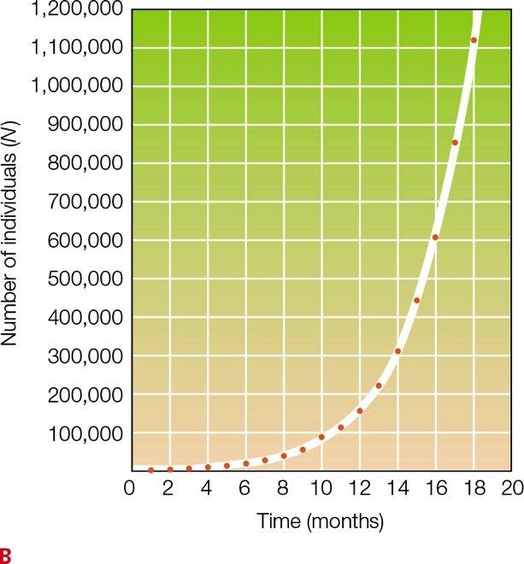
Exponential Growth Curve
Notes:
Figure 40.2 Exponential growth in a hypothetical population of mice with a per capita rate of growth (r) of 0.4 per mouse per month and a population size of 2,000.
B Graphing numbers over time produces a J-shaped curve.

Slide 15
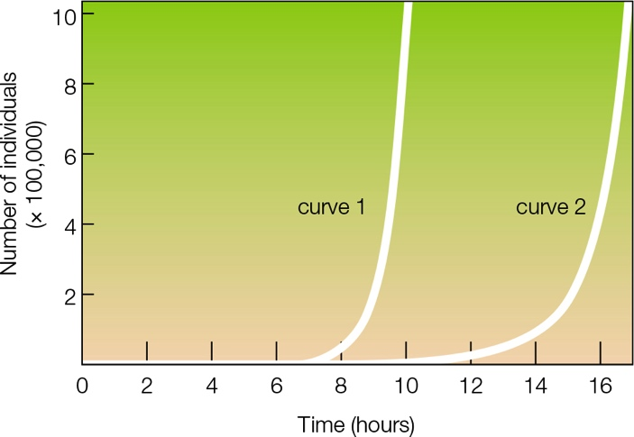
Effect of Death Rate on Population Increase
Notes:
Figure 40.3 Effect of death rate on population increase. Consider two hypothetical populations of bacteria; both start out with one cell and both reproduce asexually every half hour.
Curve 1 shows how population size increases when no cells die between divisions.
Curve 2 shows how population size increases when 25 percent of the cells die between divisions. Note that these deaths slow the rate of increase, but as long as the birth rate exceeds the death rate, exponential growth will continue.

Slide 16
Biotic Potential
Maximum possible population growth rate under optimal conditions
  Under ideal conditions (shelter, food, and other essential resources are unlimited, no predators or pathogens), a population’s growth rate reaches its biotic potential
  Microbes have high biotic potentials
  Large-bodied mammals have low biotic potentials

Slide 17
40.3 Limits on Population Growth
No population can grow exponentially forever
Density-dependent factor
  Factor that limits population growth and has a greater effect in dense populations than less dense ones
    Examples: pathogens and parasites

Slide 18
Density-Dependent Factors
In any natural environment, there are limited resources
An increase in the number of individuals in an area leads to increased intraspecific competition
  Competition for a resource among members of the same species
  Detrimental effect even on winners, because energy they use in competition for resources is not available for reproduction

Slide 19
Logistic Growth
Occurs when density-dependent factors affect population size over time
  Plots out as an S-shaped curve
Carrying capacity
  Maximum number of individuals of a species that an environment can sustain
    Species-specific, environment-specific, and can change over time
  Ultimately, the sustainable supply of resources determines population size

Slide 20
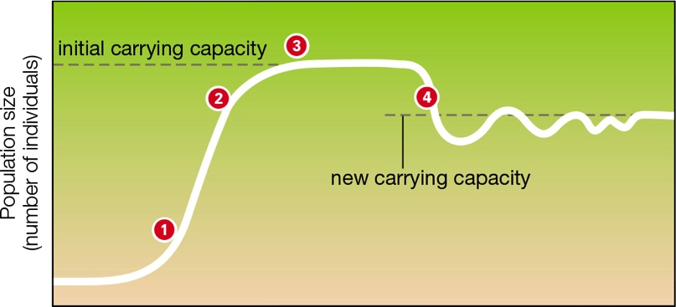
Logistic Growth Pattern
Notes:
Figure 40.5 Logistic growth. Note the initial S-shaped curve.
1 At low density, the population grows exponentially.
2 As crowding increases, density-dependent limiting factors slow the rate of growth.
3 Population size levels off at the carrying capacity for that species.
4 Any change in the carrying capacity will result in a corresponding shift in population size.

Slide 21
Density-Independent Factors
Factor that limits population growth and arises regardless of population density
  Examples: fires and earthquakes
In nature, density-dependent and density-independent factors often interact to determine a population’s size
  Example: St. Matthew Island reindeer population

Slide 22
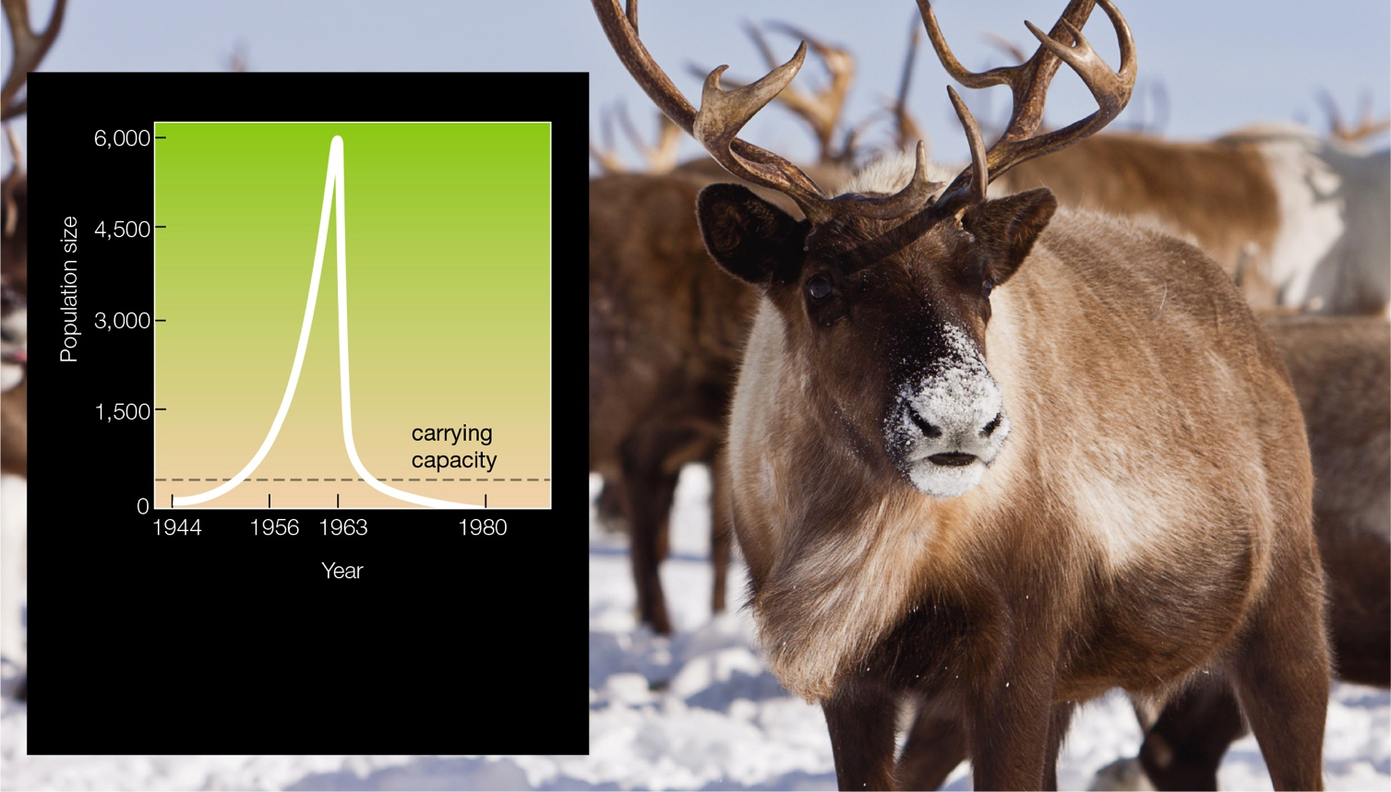
Population Overshoot and Crash
Notes:
Figure 40.6 Overshoot and crash. A reindeer herd introduced to an island in 1944 increased in size exponentially, then crashed after an especially cold and snowy winter in 1963–64.

Slide 23
40.4 Life History Patterns
Life history pattern: manner in which individuals allocate resources to growth, survival, and reproduction over the course of their lifetimes
  Survival: probability of surviving to a given age and of dying at specific ages
  Reproduction: age at which reproduction begins, frequency and number of offspring produced by each reproductive event, and the extent of parental investment in each offspring

Slide 24
Timing of Births and Deaths
One way to investigate life history traits is to focus on a cohort
  Group of individuals born during the same interval
Information about age-specific death rates can also be summarized by a survivorship curve
  How many members of a cohort remain alive over time

Slide 25
Survivorship Curves (1 of 4)
Type I survivorship curve
  Convex shape, indicating that the death rate remains low until relatively late in life
  Elephants have type I survivorship, with low mortality until old age
  Typical of large animals that bear one or few offspring at a time and provide extended parental care

Slide 26
Survivorship Curves (2 of 4)
Type II survivorship curve
  Diagonal, indicating death rate does not vary much with age
  Snowy egrets are type II population, with a fairly constant death rate
  Typical of lizards, small mammals, and large birds

Slide 27
Survivorship Curves (3 of 4)
Type III survivorship curve
  Concave, indicating that death rate peaks early in life
  Sea urchins are type III; mortality is high for larvae and in old age, but low in adults
  Typical of species that produce many small offspring and provide little or no parental care

Slide 28
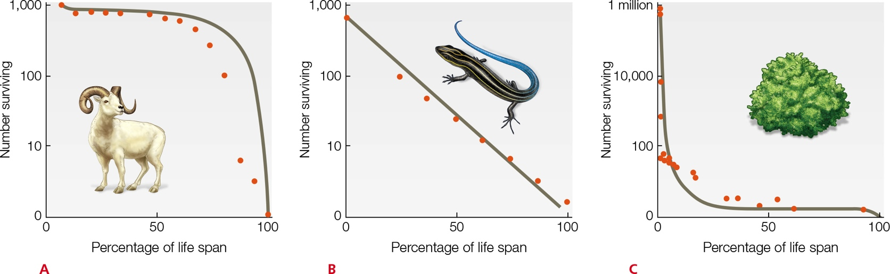
Survivorship Curves (4 of 4)
Notes:
Figure 40.7 Survivorship curves. Gray lines are theoretical curves. Red dots are data from field studies.
A Type I curve. Mortality is highest late in life. Data for Dall sheep (Ovis dalli).
B Type II curve. Mortality varies little with age. Data for five-lined skink (Eumeces fasciatus).
C Type III curve. Mortality is highest early in life. Data for a desert shrub (Cleome droserifolia).

Slide 29
r-Selection and K-Selection
r-selection
  Individuals who produce maximum number offspring as quickly as possible have a selective advantage
  Occurs when population density is low and resources are abundant
K-selection
  Individuals who produce offspring that outcompete others for limited resources have a selective advantage
  Occurs when a population is near carrying capacity

Slide 30
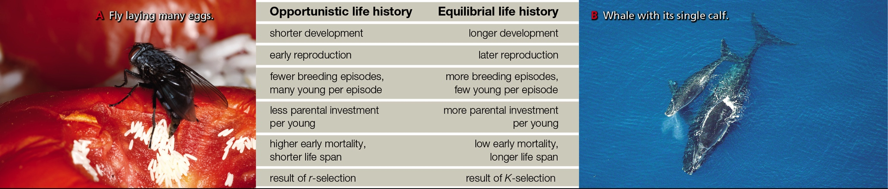
Two Types of Life History
Notes:
Figure 40.8 Two types of life history. Most species have a mix of opportunistic and equilibrial life history traits.

Slide 31
40.5 Predation Effects on Life History (1 of 2)
Several populations of guppies live in a stream with many small waterfalls that serve as natural barriers
  Different guppy populations face different predation pressures
    Some populations live with killifish, a relatively small predator that eats mostly immature guppies
    Other populations live with cichlids, which are larger and tend to eat mature guppies

Slide 32
40.5 Predation Effects on Life History (2 of 2)
Many predators prefer prey of a specific size, and individuals of most prey species change in size over their lifetime
  When predators prefer large prey, prey who reproduce when still small and young are at a selective advantage
  When predators focus on small prey, fast-growing individuals have the selective advantage

Slide 33
An Experimental Study
Guppies hunted by cichlids grow faster, are smaller at maturity, reproduce earlier, have more offspring at a time, and breed more frequently than guppies hunted by killifish
  Researchers found that these differences in life history traits are genetic; the predators acted as selective agents that influenced guppy life history patterns

Slide 34
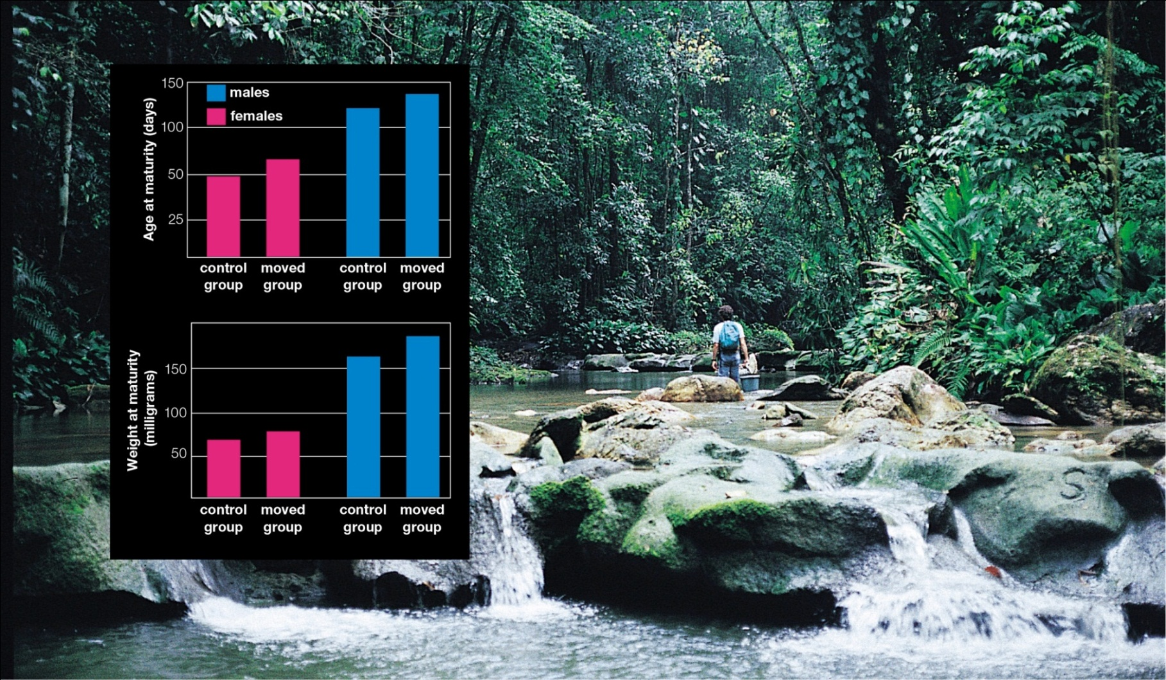
Predation and Guppies
Notes:
Figure 40.9 How predation affects life history traits in guppies. David Reznick (shown above) and John Endler carried out an experiment using wild guppies that had evolved in the presence of a predator (cichlid) that preferentially preys on large guppies. Control group guppies remained in their home pool with cichlids. Other guppies were moved to a guppy-free pool with a predator (killifish) that preferentially eats small guppies. Data at left show the average age and weight at maturity for descendants of both groups 11 years after the study began.

Slide 35
Collapse of a Fishery
Overfishing of cod
  In response to fishing pressure on larger fish, Atlantic codfish began maturing faster and reproducing younger
  A 1992 ban on cod fishing came too late to stop the Atlantic cod population from crashing
  Life history changes were early signs of overfishing; had biologists recognized the signs, they might have been able to save the fishery and more than 35,000 jobs

Slide 36
40.6 Human Population Growth
For most of history, the human population grew very slowly
  In 2009, human population size surpassed 6.8 billion
Growth rate began to increase about 10,000 years ago, then soared during the past two centuries
Three trends promoted the large increases

Slide 37
Expansions and Innovations
Humans were able to migrate into new habitats and expand into new climate zones
Humans developed new technologies that increased the carrying capacity of existing habitats
Humans sidestepped some limiting factors that restrain growth of other species

Slide 38
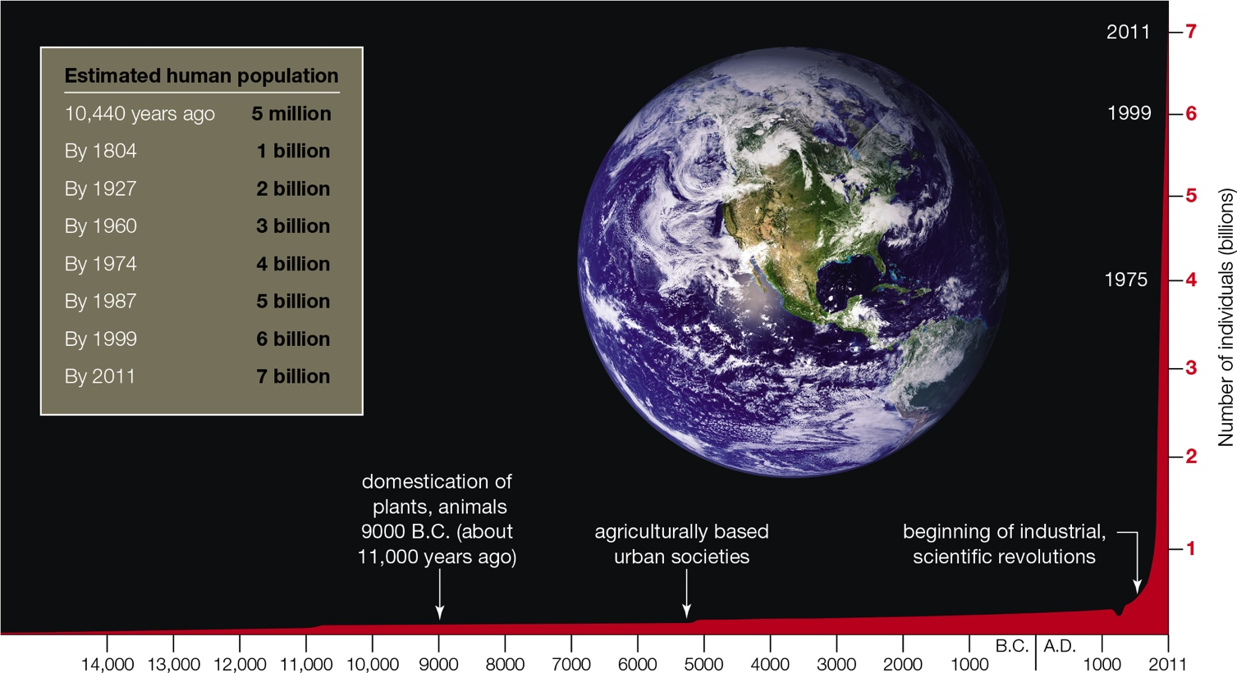
Growth Curve for Global Human Population
Notes:
Figure 40.11 Growth curve (red) for the world human population. The chart shows when 1 billion and multiples thereof were reached.

Slide 39
Fertility and Future Growth (1 of 2)
Total fertility rate of a population = number of offspring a woman would be expected to have during her reproductive years given the current age-specific birth rate
Replacement fertility rate = number of children a woman must bear to replace herself with one daughter of reproductive age, varies among regions

Slide 40
Fertility and Future Growth (2 of 2)
Age structure diagrams show the age distribution of individuals
  The broader the base of an age structure diagram, the greater proportion of young people, and the greater expected growth
  More than 1/3 of the world population is in the broad pre-reproductive base
  World population growth cannot be slowed for many years, because 1.9 billion people are about to enter reproductive age

Slide 41
Age Structure Diagrams
Notes:
Figure 40.12 Age structure diagrams for the world’s three most populous countries. The width of each bar represents the number of individuals in a 5-year age group. The left side of each chart indicates males; the right side, females.

Slide 42
40.7 Economic Effects and Resource Consumption
The most highly developed countries have the lowest birth rates and infant mortality, and the highest life expectancy
High population growth is correlated with low levels of economic development, and low per capita consumption of resources
Negative population growth in some countries also poses challenges

Slide 43
A Demographic Transition
The demographic transition model describes how changes in population growth often unfold in four stages of economic development

Slide 44
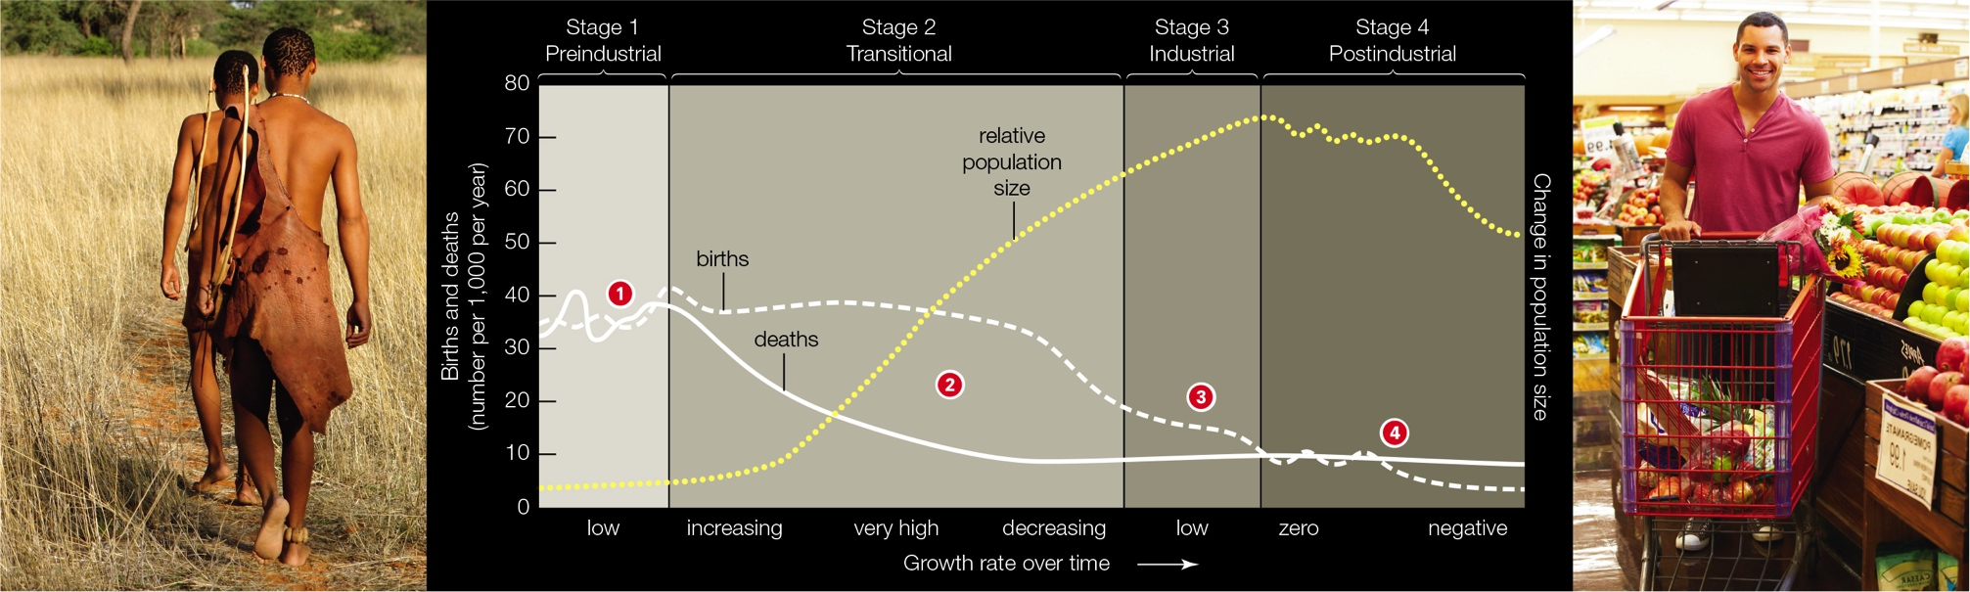
Demographic Transition Model
Notes:
Figure 40.13 Demographic transition model. The model correlates changes in population growth with industrialization.

Slide 45
Development and Consumption
On a per capita basis, people in highly developed countries use far more resources than those in less developed countries and generate more waste and pollution
Ecological footprint
  Area of Earth’s surface required to sustainably support a particular level of development and consumption
  People in China and India consume less than average
  Per capita footprint of the United States is more than three times average

Slide 46
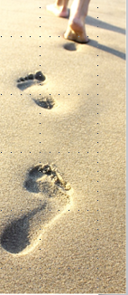
Ecological Footprints
TABLE 40.2`
Eclogical Footprints
Country* | Herctares** per Capital
United States | 8.0
Canada | 7.0
France | 5.0
United Kingdom | 4.9
Japan | 4.7
Mexico | 3.0
Brazil | 2.9
China | 2.2
India | 0.9
*Global Footprint Network
** One hectare=2.47105
Notes:
Table 40.2 Ecological Footprints

Slide 47
Application: Managing Canada Geese
Several different Canada goose populations spend time in the United States; some migrate, some do not
Nonmigratory populations devote more energy to producing young, and their numbers are increasing
Wildlife managers are looking for ways to reduce nonmigratory goose populations, without harming migratory birds

Slide 48
Discuss
Do you think the United States should play a role in disseminating birth control information and supplies to other nations?
How has modern medical care changed the survivorship curve for humans since the turn of the century?
What is the relationship between the size of offspring and their number per reproductive event?

