Slide 1
Chapter 2
0
The Chemical Basis of Life

Slide 2
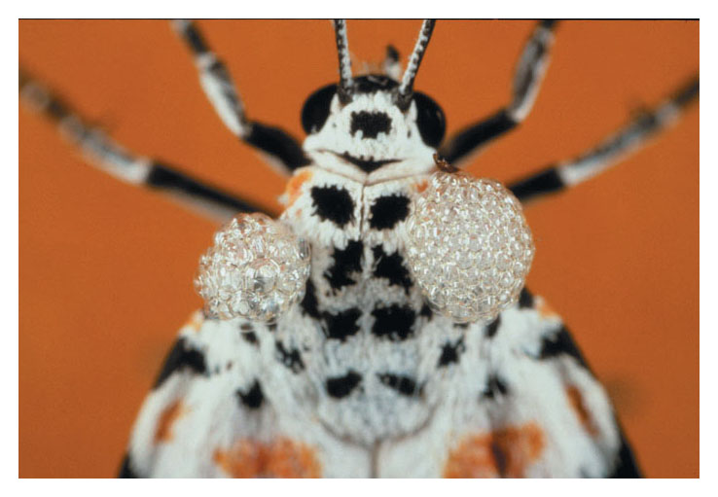
0
Nature’s Chemical Language
The rattlebox moth
Produces chemicals important for mating and defense

Slide 3
0
The compound produced during mating
Allows the moths to communicate using chemicals
Thomas Eisner of Cornell University
Has studied this process in rattlebox moths

Slide 4
0
Chemicals play many more roles in life than signaling
Making up our bodies, those of other organisms, and the physical environment

Slide 5
ELEMENTS, ATOMS, AND MOLECULES
0
2.1 Living organisms are composed of about 25 chemical elements
About 25 different chemical elements
Are essential to life

Slide 6
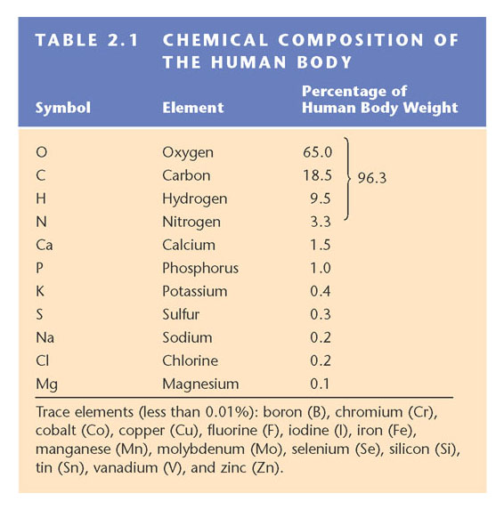
0
Carbon, hydrogen, oxygen, and nitrogen
Make up the bulk of living matter
Table 2.1

Slide 7
0
Trace elements
Are essential to life, but occur in minute amounts

Slide 8
CONNECTION
0
2.2: Trace elements are common additives to food and water
Dietary deficiencies in trace elements
Can cause various physiological conditions
Figure 2.2A

Slide 9
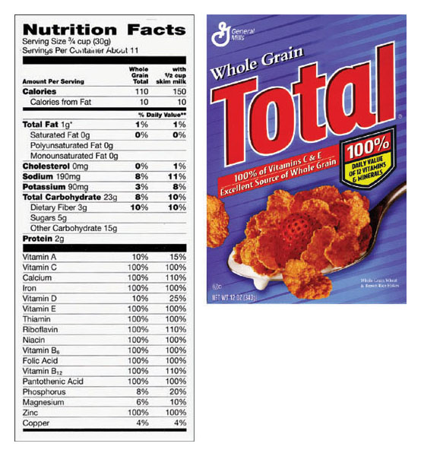
0
Trace elements are essential to human health
And may be added to food or water
Figure 2.2B

Slide 10
0
2.3 Elements can combine to form compounds
Chemical elements
Combine in fixed ratios to form compounds
Sodium
Chlorine
Sodium Chloride
Figure 2.3

Slide 11
0
2.4 Atoms consist of protons, neutrons, and electrons
The smallest particle of matter that still retains the properties of an element is an atom

Slide 12
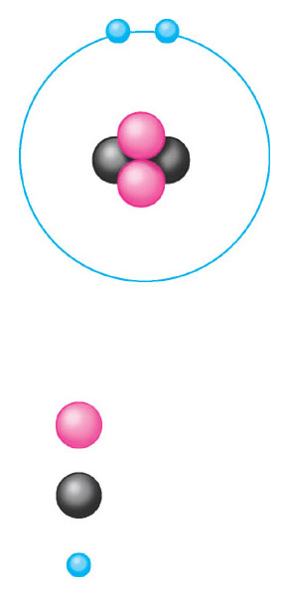
0
Subatomic Particles
An atom is made up of protons and neutrons
Located in a central nucleus
The nucleus is surrounded by electrons
Arranged in electron shells
–
–
Electron
cloud
2e–
+
+
+
+
Nucleus
2
+
Protons
Mass number = 4
2
Neutrons
Figure 2.4A
2
–
Electrons

Slide 13
0
Differences in Elements
Atoms of each element
Are distinguished by a specific number of protons
0
Electron cloud
6e–
+
+
Nucleus
6
+
Protons
Mass number = 12
6
Neutrons
Figure 2.4B
6
–
Electrons

Slide 14
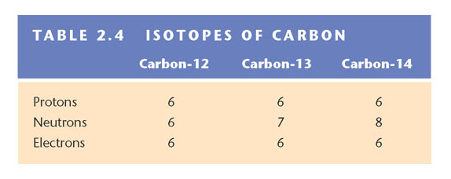
0
Isotopes
The number of neutrons in an atom may vary
Variant forms of an element are called isotopes
Some isotopes are radioactive
Table 2.4

Slide 15
CONNECTION
0
2.5 Radioactive isotopes can help or harm us
Radioactive isotopes are useful as tracers
For monitoring the fate of atoms in living organisms

Slide 16
0
Basic Research
Biologists often use radioactive tracers
To follow molecules as they undergo chemical changes in an organism

Slide 17
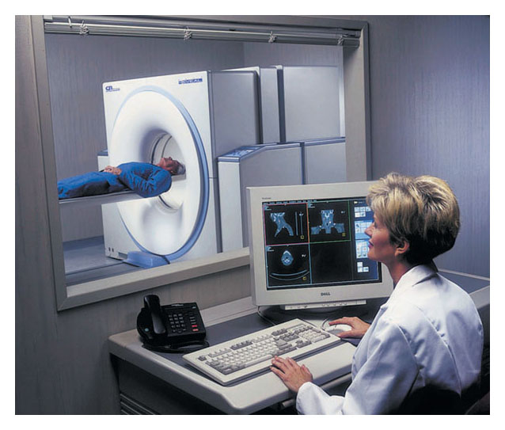
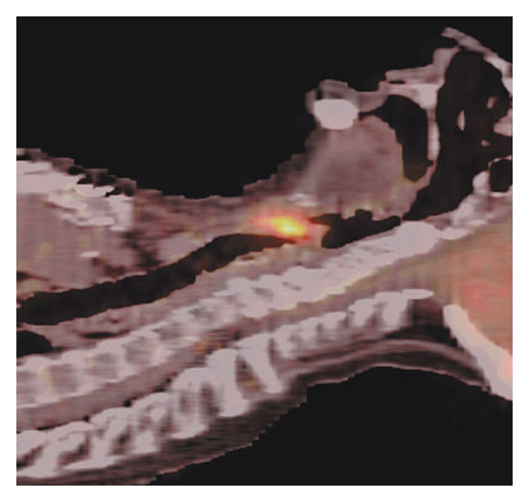
0
Medical Diagnosis
Radioactive tracers are often used for diagnosis
In combination with sophisticated imaging instruments
Figure 2.5A
Figure 2.5B

Slide 18
0
Dangers
Radioactive isotopes have many beneficial uses
But uncontrolled exposure to them can harm living organisms

Slide 19
0
2.6 Electron arrangement determines the chemical properties of an atom
Electrons in an atom
Are arranged in shells, which may contain different numbers of electrons
Outermost electron shell (can hold 8 electrons)
First electron shell (can hold 2 electrons)
Electron
Hydrogen (H)
Atomic number = 1
Carbon (C)
Atomic number = 6
Nitrogen (N)
Atomic number = 7
Oxygen (O)
Atomic number = 8
Figure 2.6

Slide 20
0
Atoms whose shells are not full
Tend to interact with other atoms and gain, lose, or share electrons
These interactions
Form chemical bonds

Slide 21
0
2.7 Ionic bonds are attractions between ions of opposite charge
When atoms gain or lose electrons
Charged atoms called ions are created
–
Transfer of electron
+
–
Na
Cl
Na
–
Cl
Na Sodium atom
Cl Chlorine atom
Na⁺ Sodium ion
Cl– Chloride ion
Figure 2.7A
Sodium chloride (NaCl)

Slide 22
0
An electrical attraction between ions with opposite charges
Results in an ionic bond

Slide 23
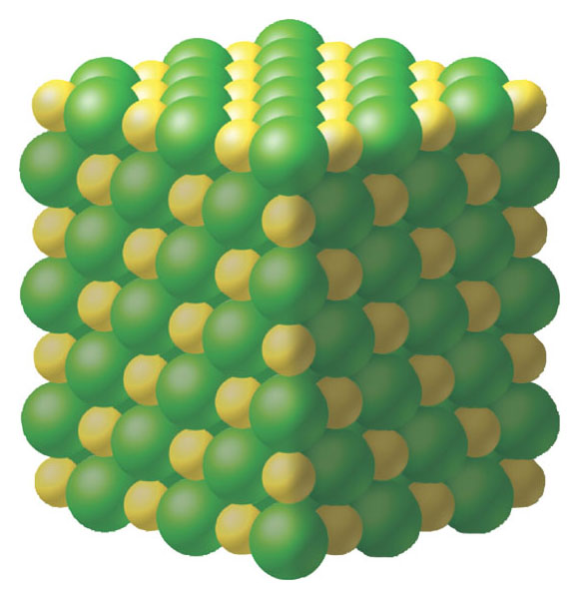
0
Sodium and chloride ions
Bond to form sodium chloride, common table salt
Na⁺
Cl–
Figure 2.7B

Slide 24
0
2.8 Covalent bonds join atoms into molecules through electron sharing
In covalent bonds
Two atoms share one or more pairs of outer shell electrons, forming molecules

Slide 25
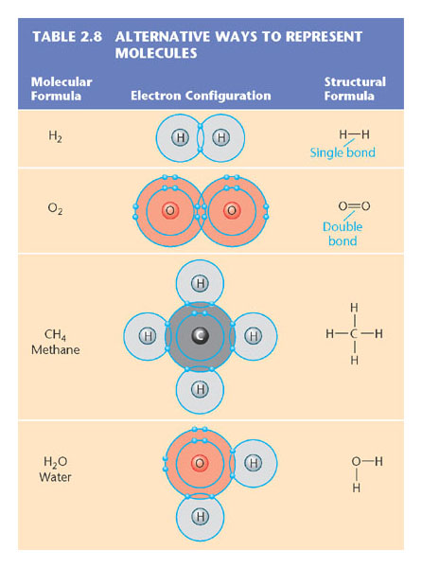
0
Molecules can be represented in many ways
Table 2.8

Slide 26
0
2.9 Unequal electron sharing creates polar molecules
A molecule is nonpolar
When its covalently bonded atoms share electrons equally

Slide 27
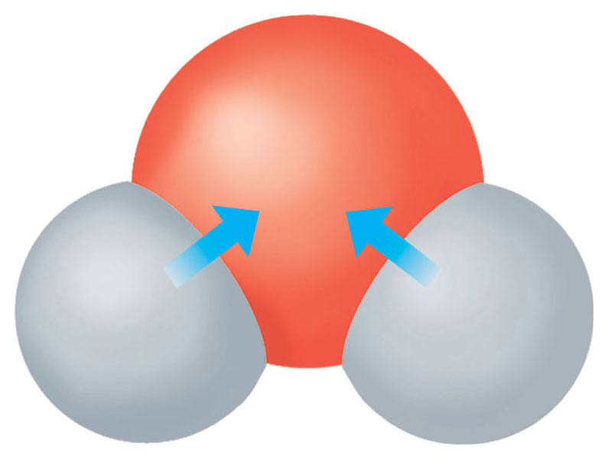
0
In a polar covalent bond
Electrons are shared unequally between atoms, creating a polar molecule
(–)
(–)
O
H
H
Figure 2.9
(+)
(+)

Slide 28
0
2.10 Hydrogen bonds are weak bonds important in the chemistry of life
The charged regions on water molecules
Are attracted to the oppositely charged regions on nearby molecules

Slide 29
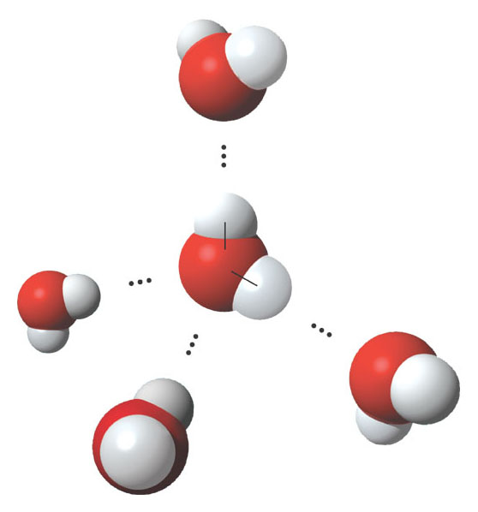
0
This attraction forms weak bonds
Called hydrogen bonds
(–)
Hydrogen bond
(+)
H
(–)
O
(+)
H
(–)
(+)
(–)
(+)
Figure 2.10

Slide 30
WATER’S LIFE-SUPPORTING PROPERTIES
0
2.11 Hydrogen bonds make liquid water cohesive
Due to hydrogen bonding
Water molecules can move from a plant’s roots to its leaves

Slide 31
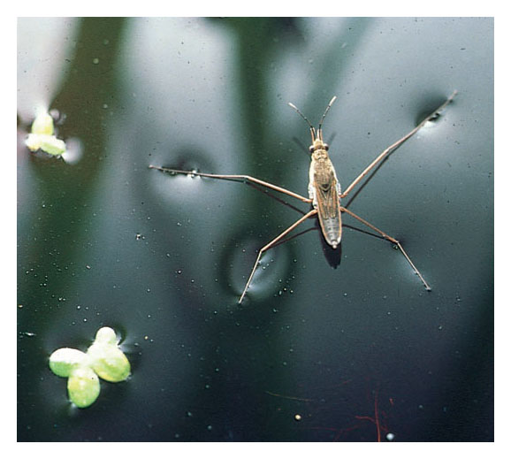
0
Insects can walk on water due to surface tension
Created by cohesive water molecules
Figure 2.11

Slide 32
0
2.12 Water’s hydrogen bonds moderate temperature
Water’s ability to store heat
Moderates body temperature and climate

Slide 33
0
It takes a lot of energy to disrupt hydrogen bonds
So water is able to absorb a great deal of heat energy without a large increase in temperature
As water cools
A slight drop in temperature releases a large amount of heat

Slide 34
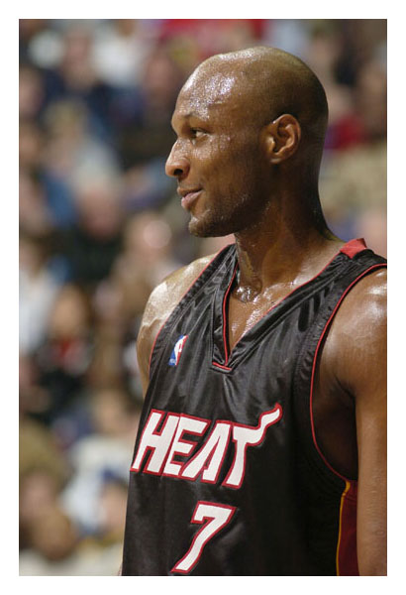
0
A water molecule takes energy with it when it evaporates
Leading to evaporative cooling
Figure 2.12

Slide 35
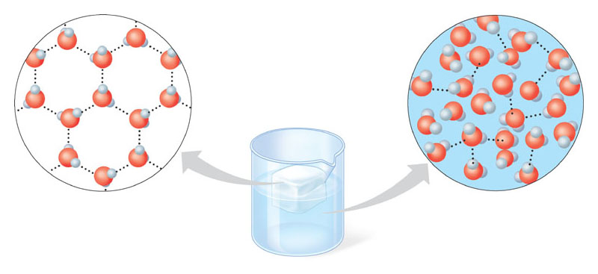
0
2.13 Ice is less dense than liquid water
Hydrogen bonds hold molecules in ice
Farther apart than in liquid water
Figure 2.13
Hydrogen bond
Ice
Hydrogen bonds are stable
Liquid water
Hydrogen bonds constantly break and re-form

Slide 36
0
Ice is therefore less dense than liquid water
Which causes it to float
Floating ice
Protects lakes and oceans from freezing solid

Slide 37
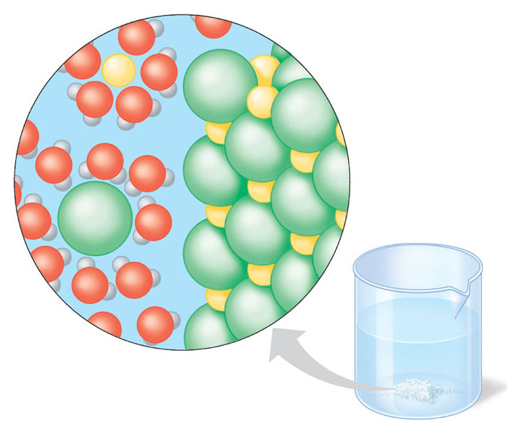
0
2.14 Water is the solvent of life
Polar or charged solutes
Dissolve when water molecules surround them, forming aqueous solutions
Na⁺
–
Na⁺
–
+
Cl–
+
–
–
+
–
Cl–
+
–
+
–
+
–
+
–
–
Ion in solution
Salt crystal
Figure 2.14

Slide 38
0
2.15 The chemistry of life is sensitive to acidic and basic conditions
A compound that releases H⁺ ions in solution is an acid
And one that accepts H⁺ ions in solution is a base
Acidity is measured on the pH scale
From 0 (most acidic) to 14 (most basic)

Slide 39
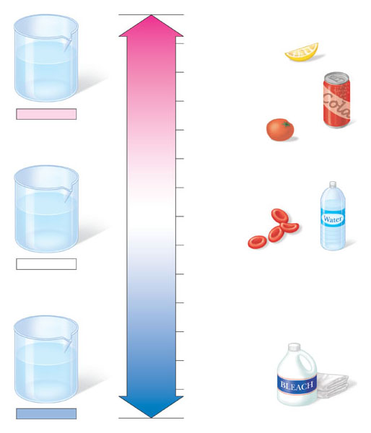
0
The pH scale
pH scale
0
H⁺
1
H⁺
H⁺
OH–
H⁺
2
Lemon juice, gastric juice
OH–
H⁺
H⁺
H⁺
H⁺
Increasingly ACIDIC (Higher concentration of H⁺)
3
Grapefruit juice, soft drink
Acidic solution
4
Tomato juice
5
6
Human urine
OH–
OH–
NEUTRAL [H⁺]=[OH–]
H⁺
H⁺
OH–
7
Pure water Human blood
OH–
OH–
H⁺
H⁺
H⁺
8
Neutral solution
9
Seawater
10
Increasingly BASIC (Lower concentration of H⁺)
Milk of magnesia
11
OH–
OH–
12
Household ammonia
OH–
H⁺
OH–
Household bleach
OH–
OH–
13
H⁺
OH–
Figure 2.15
14
Oven cleaner
Basic solution

Slide 40
0
The pH of most cells
Is kept close to 7 (neutral) by buffers
Buffers are substances that resist pH change

Slide 41
CONNECTION
0
2.16: Acid precipitation threatens the environment
Some ecosystems are threatened by acid precipitation
Acid precipitation is formed when air pollutants from burning fossil fuels
Combine with water vapor in the air to form sulfuric and nitric acids

Slide 42
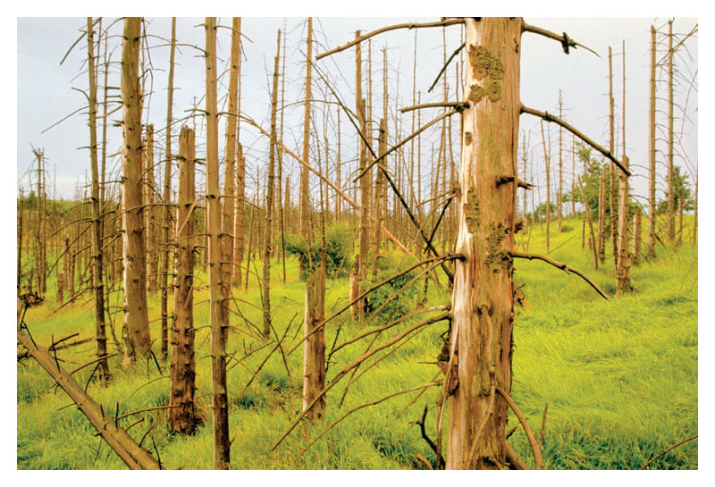
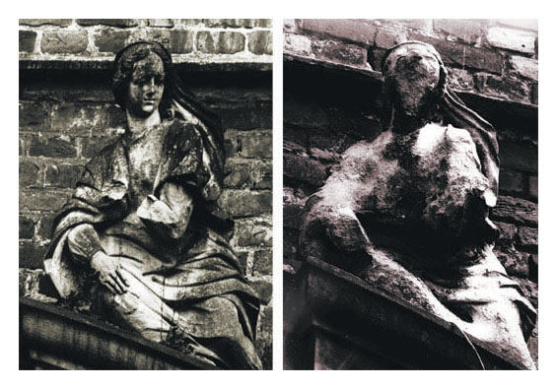
0
These acids
Can kill trees and damage buildings
Figure 2.16A
Figure 2.16B

Slide 43
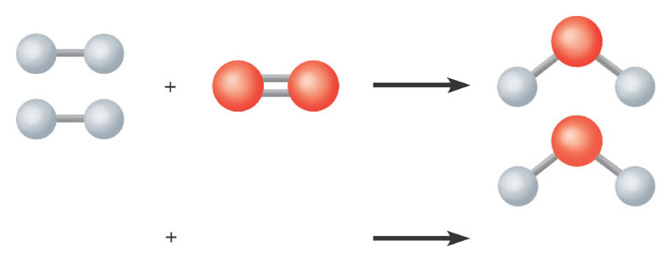
CHEMICAL REACTIONS
0
2.17 Chemical reactions change the composition of matter
In a chemical reaction
Reactants interact, atoms rearrange, and products result
Figure 2.17A
2 H₂
O₂
2 H₂O

Slide 44
0
Living cells carry out thousands of chemical reactions
That rearrange matter in significant ways
CH₃
CH₃
CH₃
CH₃
CH₃
C
CH₂
CH₃
CH₃
CH₃
H
H₂C
C
CH
C
CH
C
CH
CH
CH
CH
CH
C
CH₂
H₂C
C
CH
C
CH
C
C
H
CH₂
C
CH
CH
CH
CH
CH
C
CH
C
CH
C
CH₂
O₂
4H
2
CH₂
C
CH
CH
CH
CH
OH
H₂C
C
CH₃
CH₃
CH₃
H₂C
C
CH₃
CH₃
Beta-carotene
CH₃
CH₃
Vitamin A (2 molecules)
Figure 2.17B

