Slide 1
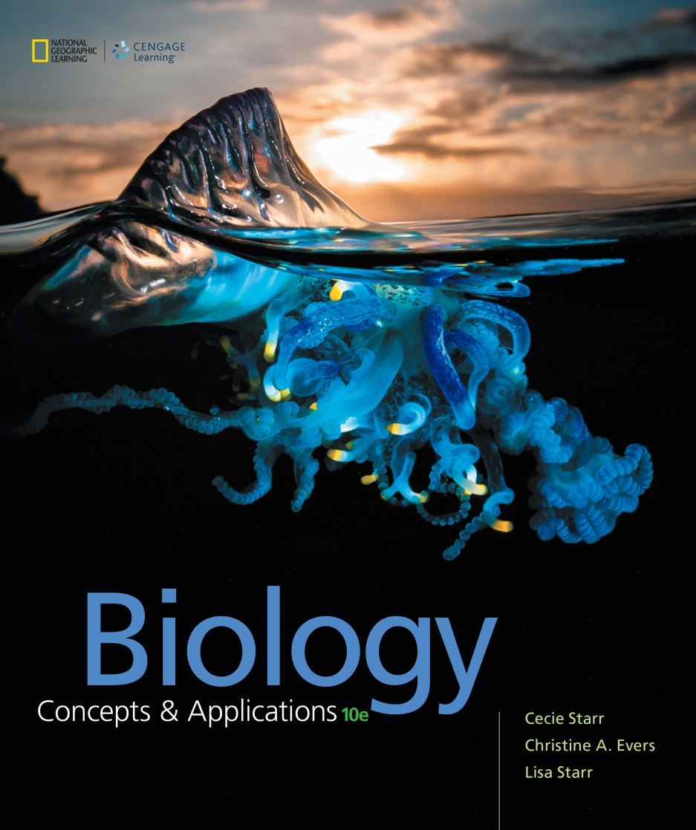
Biology Concepts & Applications
10 Edition
Chapter 28
Animal Tissues and Organ Systems
Copyright © 2018 Cengage Learning. All Rights Reserved. May not be copied, scanned, or duplicated, in whole or in part, except for use as permitted in a license distributed with a certain product or service or otherwise on a password-protected website for classroom use.

Slide 2
28.1 Overview of Animal Body Plans
Tissue found in all vertebrate bodies
Epithelial tissue: covers body surfaces; lines internal cavities
Connective tissue: holds body parts together; provides structural support
Muscle tissue: moves the body or its parts
Nervous tissue: detects stimuli; relays information

Slide 3
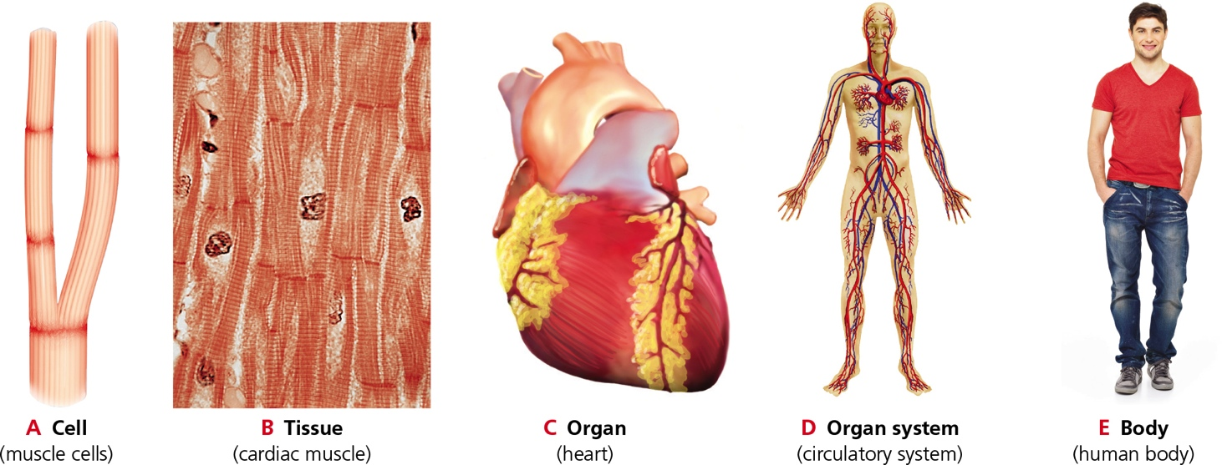
Levels of Organization
Notes:
Figure 28.1 Levels of organization in a vertebrate body.

Slide 4
Fluids of the Animal Body
An animal body consists mainly of water with dissolved salts, proteins, etc.
Most of this fluid resides inside cells
The rest is extracellular fluid: internal environment in which body cells live
In vertebrates, extracellular fluid consists mainly of interstitial fluid: fluid between cells

Slide 5
Evolution of Animal Body Plans
Structural traits (anatomy) evolve in concert with functional traits (physiology)
Physical laws constrain the evolution of body structure

Slide 6
Structure Meets Function
Examples of structure evolving to meet function
Animals with a massive body evolved a mechanism for distributing material–the circulatory system
Land animals evolved a structure for extracting oxygen from air–the lungs

Slide 7
Architectural Constraints
An existing body framework imposes architectural constraints
Example: the ancestors of all modern land vertebrates had a body plan with four limbs
When wings evolved in birds and bats, they did so by modification of existing forelimbs, not by new limbs sprouting

Slide 8
28.2 Epithelial Tissues
Sheetlike tissue consisting of tightly packed cells with little extracellular material between them
One surface of an epithelium faces the environment or some body fluid
The opposite surface is glued to an underlying tissue by a basement membrane
A layer of proteins secreted by the epithelium

Slide 9
Cell Junctions
Tight junctions occur only in epithelial tissue
Join plasma membranes of adjacent cells to prevent fluid from leaking between them
Adhering junctions are present in epithelial tissue that undergoes mechanical stress
Function like snaps to connect adjacent cells but do not form a tight seal

Slide 10
Types of Epithelial Tissue (1 of 3)
Different types of epithelia differ in thickness and cell shapes
A simple epithelium is one cell thick, whereas stratified epithelium has multiple cell layers
Cells in squamous epithelium are flattened or scalelike
Cells of cuboidal epithelium are short cylinders
Cells in columnar epithelium are tall

Slide 11
Types of Epithelial Tissue (2 of 3)
Simple squamous epithelium functions in the exchange of materials
Cells of cuboidal and columnar epithelium function in absorption and secretion
Microvilli: thin projections from the plasma membrane of some epithelial cells; increase the surface area of the cell

Slide 12
Types of Epithelial Tissue (3 of 3)
In some tissues (e.g., upper airways and oviducts), the epithelial surface has cilia
Other epithelia specialize in secretion of substances that function outside the cell
Exocrine gland: secretes milk, sweat, saliva, or some other substance through a duct
Endocrine gland: ductless gland; secretes hormones

Slide 13
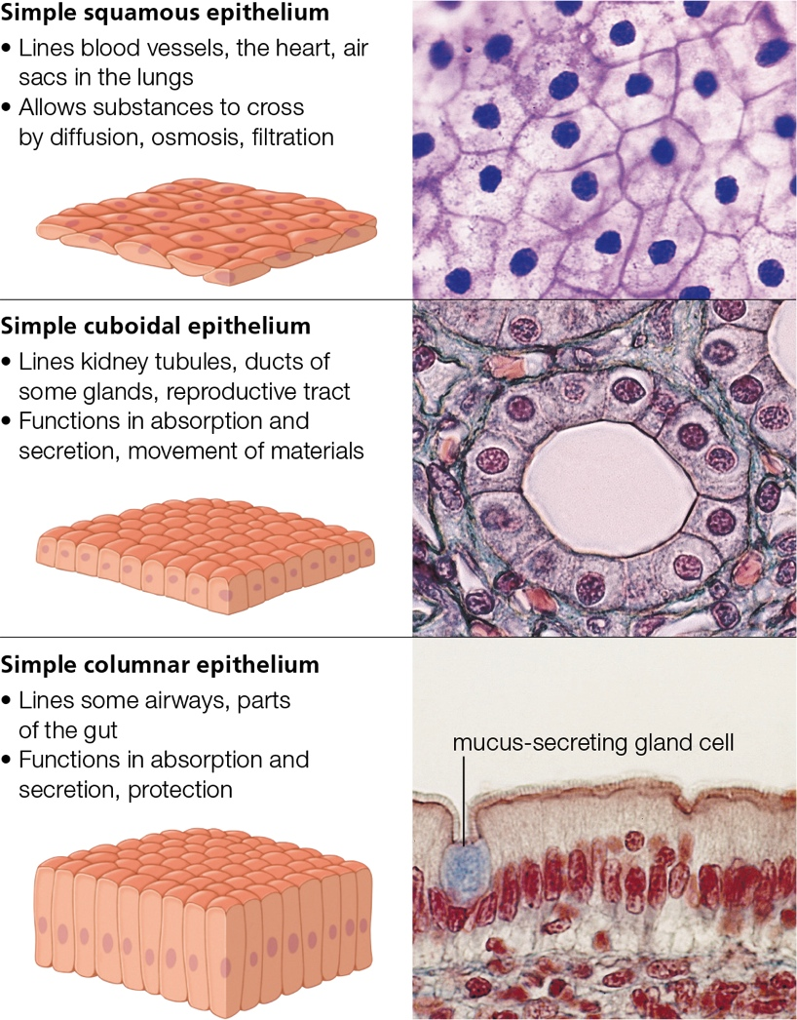
Simple Epithelium
Notes:
Figure 28.3 Types of simple epithelium.

Slide 14
Epithelial Renewal and Cancer
Epithelia is constantly renewed in animals
This renewal requires many cell divisions
Many opportunities for cancer-causing DNA replication errors
Epithelium is therefore the tissue most likely to become cancerous
Carcinoma = epithelial cell cancer

Slide 15
28.3 Connective Tissues
Consist of cells scattered within an extracellular matrix of their own secretions
Most connective tissue contains fibroblasts
These cells secrete an extracellular matrix containing polysaccharides and the proteins collagen and elastin

Slide 16
Types of Connective Tissue (1 of 2)
Loose connective tissue: fibroblasts and fibers scattered in a gel-like matrix
Dense, irregular connective tissue: randomly arranged fibers and scattered fibroblasts
Dense, regular connective tissue: fibroblasts arrayed between parallel arrangements of fibers

Slide 17
Types of Connective Tissue (2 of 2)
Adipose tissue: cells that make and store triglycerides; specialize in fat storage
Cartilage: cells surrounded by a rubbery matrix of their own secretions
Bone tissue: cells surrounded by a mineral-hardened matrix of their own secretions
Blood: plasma and cellular components (red cells, white cells, and platelets)

Slide 18
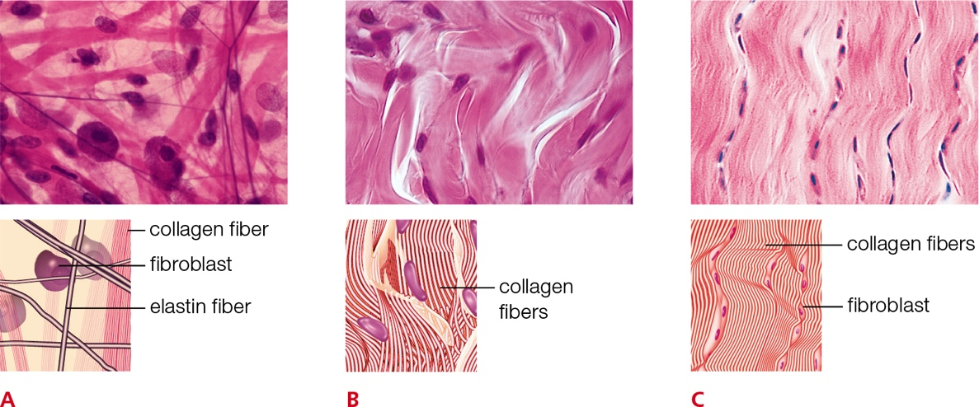
Connective Tissue Types (1 of 2)
Notes:
Figure 28.5 Vertebrate connective tissues.
A Loose connective tissue
• Underlies most epithelia
• Provides elastic support; stores fluid
B Dense, irregular connective tissue
• Deep layer of skin (dermis) and wall of gut, in kidney capsule
• Binds parts together; stretches in all directions
C Dense, regular connective tissue
• Tendons and ligaments
• Fibrous attachment between parts; allows stretching, but in one direction only

Slide 19
Connective Tissue Types (2 of 2)
Notes:
Figure 28.5 Vertebrate connective tissues.
D Adipose tissue
• Under skin and around the heart and kidneys
• Stores energy-rich lipids; insulates the body and cushions its parts
E Cartilage
• Internal framework of ears, nose, airways; covers ends of bones
• Supports soft tissues; cushions, reduces friction at joints
F Bone tissue
• Bulk of most vertebrate skeletons
• Protects soft tissues; functions in movement; stores minerals; produces blood cells
G Blood
• Flows through blood vessels, and the heart
• Distributes essential gases, nutrients to cells; removes wastes from them

Slide 20
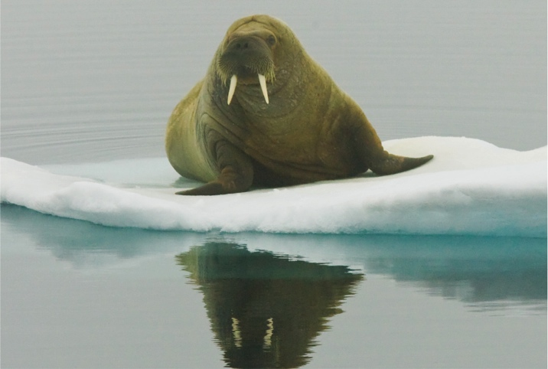
Blubber: Specialized Adipose Tissue
Notes:
Figure 28.6 Blubber-encased walrus resting on ice. Blubber is a special type of adipose tissue that is especially springy because it contains collagen and elastin fibers. It makes a walrus buoyant, helps it swim, and keeps it warm.

Slide 21
28.4 Muscle Tissues (1 of 2)
Cells that contract (shorten) in response to stimulation
Coordinated contractions of layers or rings of muscles move the body or propel material through

Slide 22
Muscle Tissues (2 of 2)
Notes:
Figure 28.7 Muscle tissues.
A Skeletal muscle
• Long, multinucleated, cylindrical cells with conspicuous striping (striations)
• Pulls on bones to bring about movement, maintain posture
• Under voluntary control, but some activated in reflexes
B Cardiac muscle
• Striated, branching cells (each with a single nucleus) attached end to end
• Found only in the heart wall
• Contraction is not voluntary
C Smooth muscle
• Cells with a single nucleus, tapered ends, and no striations
• Found in the walls of arteries, the digestive tract, the reproductive tract, the bladder, and other organs
• Contraction is not voluntary

Slide 23
Skeletal Muscle
Helps move and maintain the positions of the body and its parts
Contains parallel arrays of long, cylindrical muscle fibers
“Voluntary” muscles because most can be contracted purposefully

Slide 24
Cardiac Muscle
Found only in the heart wall
Appears striated
Has branching cells, each with a single nucleus
Contract as a unit
Due to presence of gap junctions

Slide 25
Smooth Muscle
Found in the wall of some blood vessels and soft internal organs (e.g., stomach, uterus, and bladder)
Unbranched cells contain a nucleus at their center and are tapered at both ends
Contractile units are not arranged in a repeating fashion; does not appear striated
“Involuntary” muscle: cannot be contracted at will

Slide 26
28.5 Nervous Tissues
Allows an animal to collect and integrate information about its internal and external environment
Controls the activity of glands and muscles
Main tissue of the vertebrate brain and spinal cord and of the nerves that extend through the body

Slide 27
Two Types of Cells (1 of 2)
Neurons: cells that transmit electrical signals along their plasma membrane and send chemical messages to other cells
Central cell body: contains nucleus and other organelles
Cytoplasmic extensions project from the cell body; function to receive and send electrochemical signals

Slide 28
Two Types of Cells (2 of 2)
Neuroglial cells
Help position neurons
Provide metabolic support to neurons
Wrap around the signal-sending cytoplasmic extensions of neurons
Increases the rate at which electrical signals travel along the neurons

Slide 29
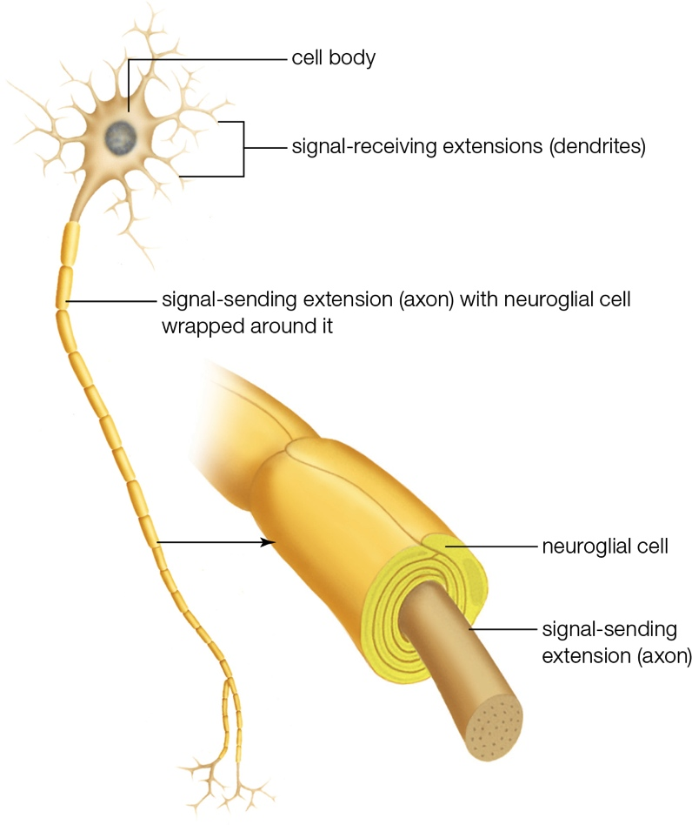
Neuron and Neuroglia
Notes:
Figure 28.8 Neuron and associated neuroglial cell.

Slide 30
Two Types of Nervous Tissue
Brain and spinal cord contain two visually distinct types of tissue
White matter: signal-sending axons of neurons and the neuroglial cells wrapping them
Gray matter: other types of neuroglia and most neuron cell bodies and signal-receiving dendrites

Slide 31
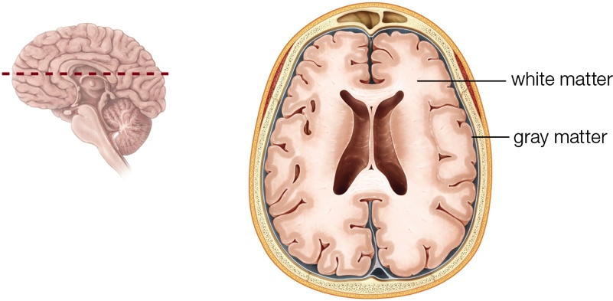
White and Gray Matter
Notes:
Figure 28.9 Two types of nervous tissue in the human brain.
A section through the brain shows the outer layer of gray matter and the inner layer of white matter.

Slide 32
28.6 Organ Systems (1 of 5)
Tissues interact structurally and functionally in organs
Organs in turn interact in organ systems

Slide 33
Organ Systems (2 of 5)
Integumentary system: skin and skin-derived structures (e.g., hair and nails)
Nervous system: body’s main control center (brain, spinal cord, nerves, sensory organs)
Endocrine system: controls other organ systems

Slide 34
Organ Systems (3 of 5)
Muscular system: moves the body and its parts; regulates body temperature
Skeletal system: protects internal organs, stores minerals, and produces blood cells
Circulatory system: heart and blood vessels; delivers oxygen and nutrients and clears wastes

Slide 35
Organ Systems (4 of 5)
Lymphatic system: moves fluid (lymph) from tissues to blood and organs; protects the body against pathogens
Respiratory system: lungs and airways; delivers oxygen from air to blood and expels carbon dioxide
Digestive system: takes in and breaks down food; delivers nutrients to blood and eliminates undigested wastes

Slide 36
Organ Systems (5 of 5)
Urinary system: kidneys, bladder, etc.; removes wastes from blood and adjusts blood volume and solute composition
Reproductive system: gamete-making organs (ovaries or testes)
In females, the uterus is the organ in which offspring develop

Slide 37
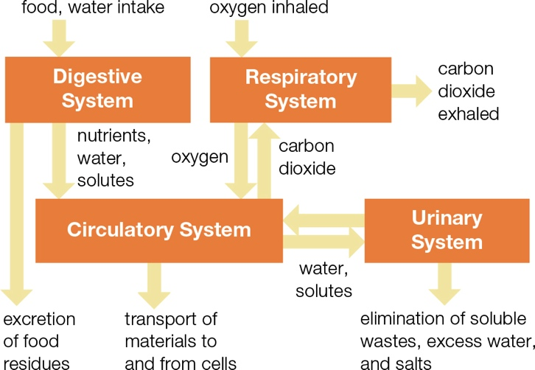
Organ System Interactions
Notes:
Figure 28.11 Organ system interactions that keep the body supplied with essential substances and eliminate unwanted wastes.

Slide 38
Human Organ Systems (1 of 4)
Notes:
Figure 28.10 Human organ systems and their functions.

Slide 39
Human Organ Systems (2 of 4)
Notes:
Figure 28.10 Human organ systems and their functions.

Slide 40
Human Organ Systems (3 of 4)
Notes:
Figure 28.10 Human organ systems and their functions.

Slide 41
Human Organ Systems (4 of 4)
Notes:
Figure 28.10 Human organ systems and their functions.

Slide 42
Body Cavities
Body cavities that hold human organs
Cranial cavity
Spinal cavity
Thoracic cavity
Abdominal cavity
Pelvic cavity

Slide 43
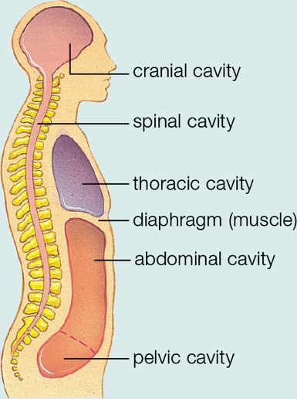
Human Body Cavities
Notes:
Figure 28.12 Body cavities that hold human organs.

Slide 44
28.7 Integument
Components of human skin
Epidermis: stratified squamous epithelium with an abundance of adhering junctions
Human epidermis consists mainly of keratinocytes that make the waterproof protein keratin
Dermis: consists primarily of dense connective tissue with stretch-resistant elastin fibers and supportive collagen fibers
Blood vessels, lymph vessels, and sensory receptors weave through the dermis

Slide 45
Hair
Visible portion of hair is the remains of keratinocytes that divided in the hair follicle
Divide every 24–72 hours
Pushed away from follicle and out of skin as they divide
Die before reaching the surface

Slide 46
Sun and the Skin
Melanin: protects skin by absorbing ultraviolet (UV) radiation
Some UV exposure is a good thing; it stimulates skin to produce a molecule that the body converts to vitamin D
Variations in skin color among human populations probably evolved as adaptations to differences in sunlight exposure

Slide 47
28.8 Negative Feedback in Homeostasis
In vertebrates, homeostasis involves interactions among sensory receptors, the brain, and muscles and glands
Sensory receptor: responds to a specific stimulus (e.g., temperature or light)
Negative feedback mechanism: change causes a response that reverses the change
Important for homeostasis

Slide 48
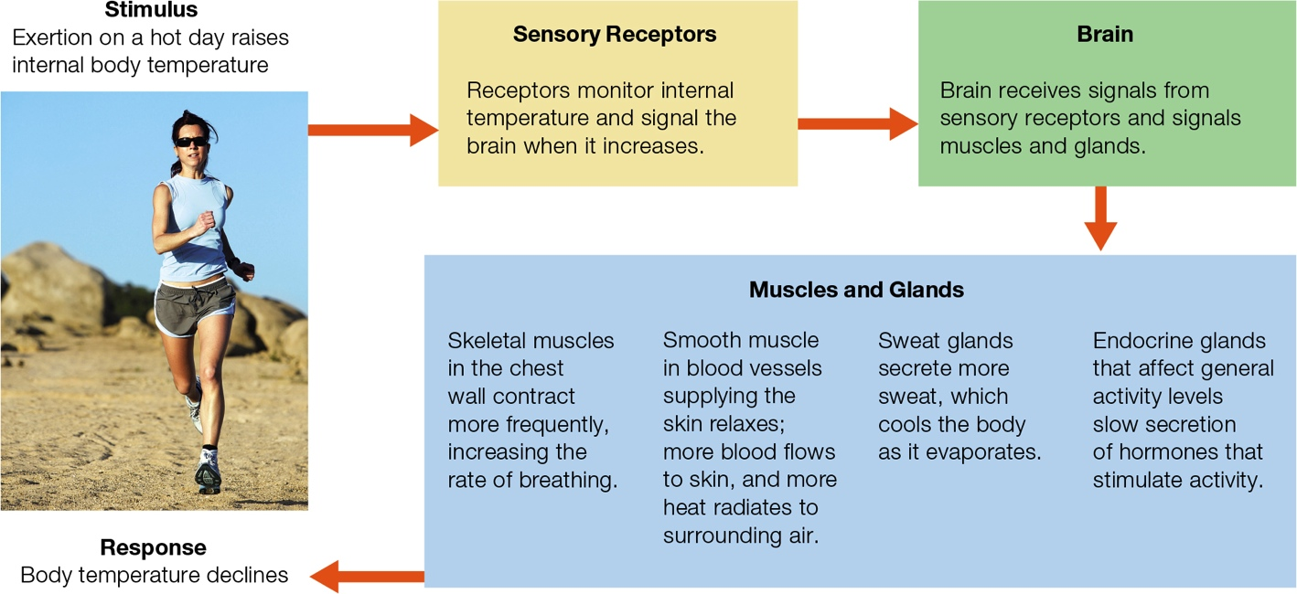
Negative Feedback Mechanism
Notes:
Figure 28.15 Negative feedback mechanism that maintains human body temperature under hot conditions.

Slide 49
Application: Growing Replacement Tissues
Animals commonly replace tissues lost to injury
Invertebrates have the greatest capacity for regeneration
Example: some sea stars can regrow an entire body from a single arm and a bit of the central disk
Stem cells can divide and produce more stem cells or differentiate into specialized cells

Slide 50
Stem Cells
Embryonic stem cells are pluripotent
Can become any of the cells in the human body
Other stem cells are more restricted
Skin and blood are replaced continually from specialized stem cell populations
Induced pluripotent stem cells (IPSCs) are lab made
Function like embryonic stem cells

Slide 51
Sea Star Regenerating
Notes:
Figure 28.16 Regeneration of a sea star. Stem cells in the remaining bit of central disk give rise to replacement parts.

Slide 52
Discuss
Why is blood—a liquid—considered a connective tissue?
What is liposuction? Does it permanently remove adipose tissue from the treated areas? Why is there a limit to the amount of adipose tissue that can be safely removed from the body at one time?
Would the use of IPSCs end the ethical debate about the use of stem cells?

