Slide 1
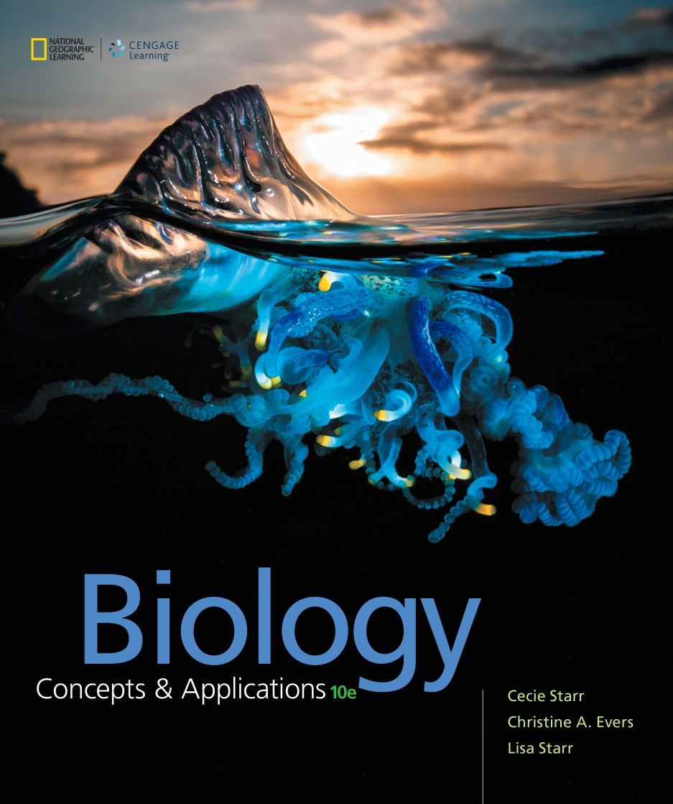
Biology Concepts & Applications
10 Edition
Chapter 1
The Science of Biology
Copyright © 2018 Cengage Learning. All Rights Reserved. May not be copied, scanned, or duplicated, in whole or in part, except for use as permitted in a license distributed with a certain product or service or otherwise on a password-protected website for classroom use.

Slide 2
1.1 Life is More Than the Sum of Its Parts
Life is more than the sum of its parts
Biology: study of life, past and present
Defining “life” is a challenge
Complex properties, including life, emerge from the interactions of simple parts
Emergent property: characteristic of a system that does not appear in any of the system’s component parts

Slide 3
Same Materials, Different Properties
Notes:
Figure 1.1 The same materials, assembled in different ways, form objects with different properties.
The property of “roundness” emerges when the squares are assembled one way, but not the others.

Slide 4
Levels of Life’s Organization
Notes:
Figure 1.2 Levels of life’s organization. New emergent properties appear at each successive level.

Slide 5
1.2 Life’s Unity
TABLE 1.1
Some Key Features of Life
Cellular basis | All living things consist of one or more cells.
Requirement for energy and nutrients | Life is sustained by ongoing inputs of energy and nutrients.
Homeostasis | Living things sense and respond appropriately to change.
DNA is hereditary material | Genetic information in the form of DNA is passed to offspring.
Notes:
Table 1.1 Some Key Features of Life

Slide 6
Energy and Nutrients (1 of 2)
Nutrient: substance that an organism needs for growth and survival but cannot make for itself
Producers: organism that makes its own food using energy and nonbiological raw materials
Photosynthesis: producers use light energy to make sugars from carbon dioxide and water

Slide 7
Energy and Nutrients (2 of 2)
Consumers: organism that gets energy and nutrients by feeding on tissues, wastes, or remains of other organisms
Energy is not cycled
It flows through the world of life in one direction: from the environment through organisms, and back to the environment

Slide 8
Producers and Consumers (1 of 2)
Notes:
Figure 1.3 The one-way flow of energy and cycling of materials through the world of life.

Slide 9
Producers and Consumers (2 of 2)
Notes:
Figure 1.3 The one-way flow of energy and cycling of materials through the world of life.

Slide 10
Homeostasis
Every living thing has the ability to sense and respond to change both inside and outside of itself
Homeostasis: process by which organism keeps its internal conditions within tolerable ranges by sensing and responding to change

Slide 11
DNA is Hereditary Material (1 of 2)
DNA (deoxyribonucleic acid) carries hereditary information that guides:
Development: multistep process by which the first cell of a new multicelled organism gives rise to an adult
Growth: increase in the number, size, and volume of cells
Reproduction: processes by which individuals produce offspring

Slide 12
DNA is Hereditary Material (2 of 2)
Inheritance: transmission of DNA to offspring
All organisms inherit their DNA from one or two parents
DNA is the basis of similarities in form and function among organisms
Small variations in DNA give rise to differences among individuals and among types of organisms

Slide 13
1.3 Life’s Diversity
Biodiversity: scope of variation among living organisms
Organisms can be grouped on the basis of whether they have a nucleus (a sac that encloses and protects a cell’s DNA)
Prokaryote: single-celled organism without a nucleus (now used only informally)
Eukaryote: organism whose cells characteristically have a nucleus

Slide 14
Prokaryotes
Bacteria: most diverse and well-known group of single-celled organisms that lack a nucleus
Archaea: group of single-celled organisms that lack a nucleus but are more closely related to eukaryotes than to bacteria

Slide 15
Bacteria and Archaea
Notes:
Figure 1.5 A few representatives of life’s diversity.
A Bacteria are the most numerous organisms on Earth. Clockwise from upper left, a bacterium with a row of iron crystals that serves as a tiny compass; a common resident of cat and dog stomachs; photosynthetic bacteria; types found in dental plaque.
B Archaea resemble bacteria, but are more closely related to eukaryotes. Left, an archaeon that grows in sulfur hot springs. Right, two types of archaea from a seafloor hydrothermal vent.

Slide 16
Eukaryotes
Protist: diverse group of simple eukaryotes
Fungus: single-celled or multicelled eukaryotic consumer
Breaks down material outside itself, then absorbs nutrients released from the breakdown
Plant: multicelled, typically photosynthetic producer
Animal: multicelled consumer that develops through a series of stages and moves about during part or all of its life

Slide 17
Protists and Fungi
Notes:
Figure 1.5 A few representatives of life’s diversity.
C Eukaryotes are single-celled or multicelled organisms whose DNA is contained within a nucleus. Eukaryotes include protists, plants, fungi, and animals.

Slide 18
Plants and Animals
Notes:
Figure 1.5 A few representatives of life’s diversity.
C Eukaryotes are single-celled or multicelled organisms whose DNA is contained within a nucleus. Eukaryotes include protists, plants, fungi, and animals.

Slide 19
1.4 Organizing Information About Species
Species: unique type of organism
Taxonomy: the science of naming and classifying species
Genus: a group of species that share a unique set of traits
Specific epithet: second part of a species name
Together, the genus name and the specific epithet designate one species

Slide 20
Distinguishing Species
Trait: an observable characteristic of an organism or species
Taxon: group of organisms that share a unique set of traits

Slide 21
Related at Different Levels
Notes:
Figure 1.7 Taxonomy of five species that are related at different levels. Each species has been assigned to ever more inclusive groups, or taxa: in this case, from genus to domain.

Slide 22
The Big Picture of Life
Table 1.2
All of Life in Three Domains
Archaea | Single cells, no nucleus, Evolutionarily closer to eukaryotes than to bacteria.
Eukaraya | Eukaryotic cells(with a nucleus). Includes singlecelled and multicelled species of protists, plants, fungi,and animals.
Bacteria | Single cells , no nucleus
Notes:
Figure 1.8 The big picture of life. This diagram summarizes one hypothesis about how all life is connected by shared ancestry. Lines indicate proposed evolutionary connections between the domains.
Table 1.2 All of Life in Three Domains

Slide 23
One or Two Species?
Biologists use whatever information is available to decide whether organisms belong to different species
Anatomy
Distribution
Biochemical traits
DNA molecules
New information sometimes changes species designations

Slide 24
Four Butterflies, Two Species
Notes:
Figure 1.9 Four butterflies, two species: Which are which?
The top row shows two forms of the species Heliconius melpomene; the bottom row, two forms of H. erato.
H. melpomene and H. erato never cross-breed; DNA comparisons confirmed that they are truly different species. The alternate but similar patterns of coloration evolved as a shared warning signal to predatory birds that these butterflies taste terrible.

Slide 25
1.5 The Science of Nature
Thinking about thinking
Critical thinking: judging information before accepting it
Move beyond the content of new information to consider supporting evidence, bias, and alternative interpretations

Slide 26
The Scientific Method (1 of 6)
Science: systematic study of the observable world
Biology comprises hundreds of specializations
Hypothesis: testable explanation of a natural phenomenon

Slide 27
The Scientific Method (2 of 6)
Inductive reasoning: drawing a conclusion based on observation
Prediction: statement, based on a hypothesis, about a condition that should exist if the hypothesis is correct
Deductive reasoning: using a general idea to make a conclusion about a specific case

Slide 28
The Scientific Method (3 of 6)
Experiment: test designed to support or falsify a prediction
Model: analogous system used for testing hypotheses
Researchers often investigate causal relationships by changing and observing variables
Variable: a characteristic or event that differs among individuals or over time

Slide 29
The Scientific Method (4 of 6)
Independent variable: condition or treatment controlled by the experimenter
Dependent variable: observed result that is influenced by the independent variable
Experimental group: receive a certain treatment or have certain characteristics
Control group: identical to an experimental group, but without exposure to the independent variable

Slide 30
The Scientific Method (5 of 6)
Data (test results) that are consistent with the prediction support the hypothesis
Data inconsistent with the prediction are evidence that the hypothesis is flawed and should be revised
Scientific method: making, testing, and evaluating hypotheses

Slide 31
The Scientific Method (6 of 6)
TABLE 1.4
The Scientific Method
1. Observe some aspect of nature.
2. Think of an explanation for your observation (in other words, form a hypothesis).
3. Evaluate the hypothesis. Make a prediction based on the hypothesis (If . . . then). Test the prediction using experiments or surveys. Analyze the results (data).
4. Decide whether the results support your hypothesis or not (form a conclusion).
5. Report your experiment, data, and conclusion to the scientific community.
Notes:
Table 1.4 The Scientific Method

Slide 32
1.6 Examples of Experiments in Biology
Researchers design experiments in a consistent way
Change one independent variable at a time
Carefully measure the effects of the change on a dependent variable
Research usually raises more questions than it answers, so there is never really an endpoint

Slide 33
Potato Chips and Stomachaches (1 of 2)
Researchers designed an experiment to test the hypothesis that Olestra causes intestinal cramps
Prediction: if Olestra causes cramps, then people who eat Olestra will be more likely to get cramps than people who do not

Slide 34
Potato Chips and Stomachaches (2 of 2)
Notes:
Figure 1.11 The steps in a scientific experiment to determine if Olestra causes cramps. A report of this study was published in the Journal of the American Medical Association in January 1998.

Slide 35
Butterflies and Birds (1 of 2)
Researchers investigated whether certain peacock butterfly behaviors defend them against predatory birds
Initial observations
When a peacock butterfly rests, it folds its wings, so only the dark underside shows
When a butterfly sees a predator approaching, it flicks its wings open, producing a hissing sound and a series of clicks

Slide 36
Butterflies and Birds (2 of 2)
First hypothesis: wing-flicking exposes brilliant spots that resemble owl eyes
Second hypothesis: hissing and clicking sounds may be an additional defense that deters predatory birds

Slide 37
Peacock Butterfly Behaviors
Notes:
Figure 1.12 Testing the defensive value of two peacock butterfly behaviors.
A With wings folded, a peacock butterfly resembles a dead leaf, so it is appropriately camouflaged from predatory birds.
B When a predatory bird approaches, a butterfly flicks its wings open and closed, revealing brilliant spots and producing hissing and clicking sounds.
C Researchers tested whether the wing flicking and sound-making behaviors of peacock butterflies affected predation by blue tits (a type of songbird).
D The researchers painted out the spots of some butterflies, cut the sound-making part of the wings on others, and did both to a third group; then exposed each butterfly to a hungry blue tit for 30 minutes. Results support only the hypothesis that peacock butterfly spots deter predatory birds.

Slide 38
1.7 Analyzing Experimental Results
Sampling error: difference between results obtained from a subset, and results from the whole
Can be a substantial problem with a small subset
Experimenters start with a relatively large sample and repeat their experiments

Slide 39
Demonstrating Sampling Error
Notes:
Figure 1.13 Demonstration of sampling error, and the effect of sample size on it.

Slide 40
Chance vs. Significance
Probability: chance that a particular outcome of an event will occur
Statistically significant: a result is very unlikely to have occurred by chance alone
Variation in data is usually shown as error bars

Slide 41
Error Bars
Notes:
Figure 1.14 Example of error bars in a graph. This graph was adapted from the peacock butterfly research described in Section 1.6. The researchers recorded the number of times each butterfly flicked its wings in response to an attack by a bird.
Dots represent average frequency of wing flicking for each sample set of butterflies. The error bars that extend above and below the dots indicate the range of values—the sampling error.

Slide 42
Bias
Human beings are by nature subjective, and scientists are no exception
Experimenters risk interpreting their results in terms of what they want to find out
To minimize bias, experiments should yield quantitative results
Data that can be measured or gathered objectively

Slide 43
Objectivity
Science does not address:
Subjective questions
Example: “Why do I exist?”
Supernatural
Science neither assumes nor denies that supernatural phenomena occur

Slide 44
Public Perception
Scientists have caused controversy for discovering natural explanations
1540: Nicolaus Copernicus proposed that Earth orbits the sun
1610: Galileo Galilei imprisoned for providing evidence for the Copernican model of the solar system

Slide 45
1.8 The Nature of Science
Scientific theory: hypothesis that has not been disproven after many years of rigorous testing
Consistent with all data ever gathered
Contributes to successful predictions about other phenomena
Law of nature: describes a phenomenon that always occurs under certain circumstances

Slide 46
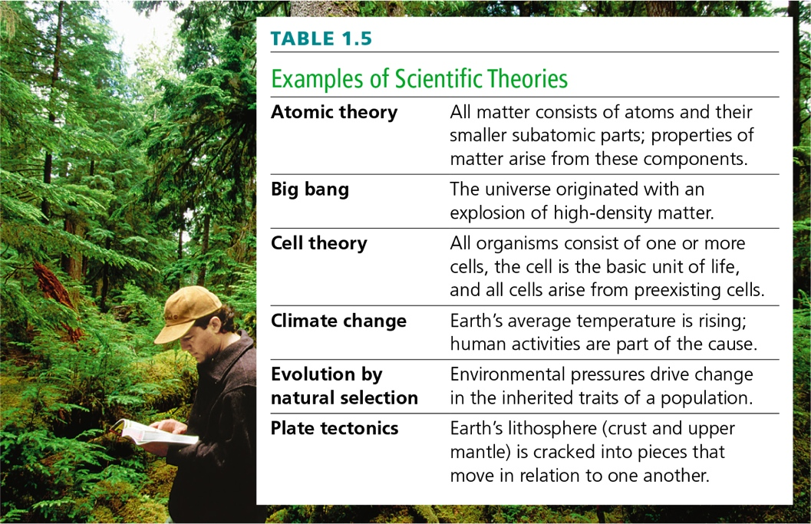
Examples of Scientific Theories
Notes:
Table 1.5 Examples of Scientific Theories

Slide 47
What Science is Not
Table 1.6
How To Tell If a Theory Is Scientific or Not
Does the theory use a natural explanation? Science addresses only the observable, natural world.
Is the explanation the simplest one? All else being equal, the explanation that requires the fewest possible assumptions is most likely to be correct.
Is the theory consistent with other scientific evidence? Scientific theories are consistent with all (or almost all) existing observations and experimental evidence in all scientific fields.
Has the theory been tested? A scientific theory has survived serious efforts to falsify it. Having been tested and confirmed many times, it is supported by a large body of scientific evidence.
Is the theory useful for making predictions? Scientific theories are consistently useful for making valid predictions about a wide range of natural phenomena.
Notes:
Table 1.6 How To Tell If a Theory Is Scientific or Not

Slide 48
Application: The Secret Life of Earth
Many new species and species thought to be extinct, or near extinction, were recently discovered in New Guinea
The current rate of extinctions is about 1,000 times faster than ever recorded
Human activities are responsible for the acceleration
The more we learn about the natural world, the more we realize we have yet to learn

Slide 49
Pinocchio Frog
Notes:
Figure 1.15 The Pinocchio frog. Paul Oliver discovered this tiny tree frog perched on a sack of rice during the first survey of a cloud forest in New Guinea. It was named after the Disney character because the male frog’s long nose inflates and points upward during times of excitement.

Slide 50
Discuss
Those who wish to berate certain scientific principles sometimes say, “It’s only a theory.” Does the use of theory in biology mean the concept is in doubt?
Is it valuable to protect all endangered species, even those with no obvious value to humans?

