Slide 1
Exploring Environmental Science for AP®
1st Edition
Chapter 19
Air Pollution and Ozone Depletion
Copyright © 2018 Cengage Learning. All Rights Reserved. May not be copied, scanned, or duplicated, in whole or in part, except for use as permitted in a license distributed with a certain product or service or otherwise on a password-protected website for classroom use.

Slide 2
Core Case Study: Los Angeles Air Pollution
1950s: Los Angeles air was among dirtiest in the world
Industrial emissions
Motor vehicle emissions
Public protest over smog in the 1950s and 1960s
1970: Congress passed the Clean Air Act
Mandated pollution control measures
Resulted in dramatic improvements in air quality

Slide 3
19.1 What Is the Nature of the Atmosphere?
Innermost layers of the atmosphere
Troposphere
Supports life
Stratosphere
Contains the protective ozone layer

Slide 4
The Atmosphere Consists of Several Layers (1 of 2)
Atmosphere
Thin blanket of gases surrounding the earth
Density
Number of gas molecules per unit of air volume
Decreases with higher altitude
Atmospheric pressure
Force per unit area of a column of air
Decreases with higher altitude

Slide 5
The Atmosphere Consists of Several Layers (2 of 2)
Notes:
Figure 18.2 Natural capital. The earth’s atmosphere is a dynamic system that includes four layers. The average temperature of the atmosphere varies with altitude (red line) and with differences in the absorption of incoming solar energy. Critical thinking: Why do you think most of the planet’s air is in the troposphere?

Slide 6
Air Movement and Chemicals in the Troposphere Affect the Earth’s Weather and Climate
Troposphere
75–80% of the earth’s air mass
Closest to the earth's surface
Composition of gases
78% nitrogen and 21% oxygen
Rising and falling air currents and greenhouse gases play major roles in weather and climate
Greenhouse gases include H₂O, CO₂, CH₄, and N₂O

Slide 7
The Stratosphere Is Our Global Sunscreen
Stratosphere: 17–48 kilometers above the earth’s surface
Similar composition to troposphere except:
Lower volume of water vapor
Higher concentration of ozone (O₃)
Ozone layer
Filters 95% of harmful UV radiation
Allows life to exist on land

Slide 8
19.2 What Are the Major Outdoor Air Pollution Problems?
Industrial smog
Caused primarily by burning coal
Photochemical smog
Caused by emissions from motor vehicles, industrial facilities, and power plants

Slide 9
Air Pollution Comes from Natural and Human Sources (1 of 4)
Air pollution–presence of chemicals in the atmosphere
Concentrations high enough to harm organisms, ecosystems, human-made materials, or alter climate
Natural sources
Wind-blown dust
Pollutants from wildfires or volcanic eruptions
Volatile organics released by plants

Slide 10
Air Pollution Comes from Natural and Human Sources (2 of 4)
Human sources
Mostly in industrialized and urban areas
Stationary sources
Power plants and industrial facilities
Mobile sources
Motor vehicles

Slide 11
Air Pollution Comes from Natural and Human Sources (3 of 4)
Primary pollutants
Emitted directly into the air
Secondary pollutants
Formed from reactions of primary pollutants

Slide 12
Air Pollution Comes from Natural and Human Sources (4 of 4)
Notes:
Figure 18.3 Human inputs of air pollutants come from mobile sources (such as cars) and stationary sources (such as industrial, power, and cement plants). Some primary air pollutants react with one another and with other chemicals in the air to form secondary air pollutants.

Slide 13
Air Pollution Has Harmful Effects
Air pollutants flow north to form arctic haze
Since the 1970s, outdoor air quality has improved in more-developed countries
Fine particles can get lodged in the lungs
Contributes to cancer, asthma, heart attack, and stroke
Study: outdoor air pollution kills 1.4 million people per year in China
645,000 per year in India

Slide 14
Major Outdoor Air Pollutants (1 of 4)
Carbon oxides
Carbon monoxide (CO) and carbon dioxide (CO₂)
Nitrogen oxides and nitric acid
Acid deposition
Role in photochemical smog
Sulfur dioxide and sulfuric acid
Reduce visibility and aggravate breathing problems

Slide 15
Major Outdoor Air Pollutants (2 of 4)
Particulates
Suspended particulate matter
Ozone
Can cause coughing and breathing problems
Volatile organic compounds (VOCs)
Methane
Benzene, dry-cleaning fluids, and various components of gasoline and plastics

Slide 16
Major Outdoor Air Pollutants (3 of 4)
TABLE 18 1 Chemical Reactions that Form Major Air Pollutants
Notes:
Table 18.1 Chemical reactions that form major air pollutants

Slide 17
Major Outdoor Air Pollutants (4 of 4)
Notes:
Figure 18.4 Sulfuric acid and other air pollutants have damaged this statue in Rome, Italy. The nose and part of the forehead have been restored.

Slide 18
Case Study: Lead Is a Highly Toxic Pollutant (1 of 2)
In air, water, soil, plants, and animals
Does not break down in the environment
Impacts human health and environment
Children most vulnerable
Can cause death, brain damage, and paralysis
Lead exposure for adults and children working in e-waste recycling

Slide 19
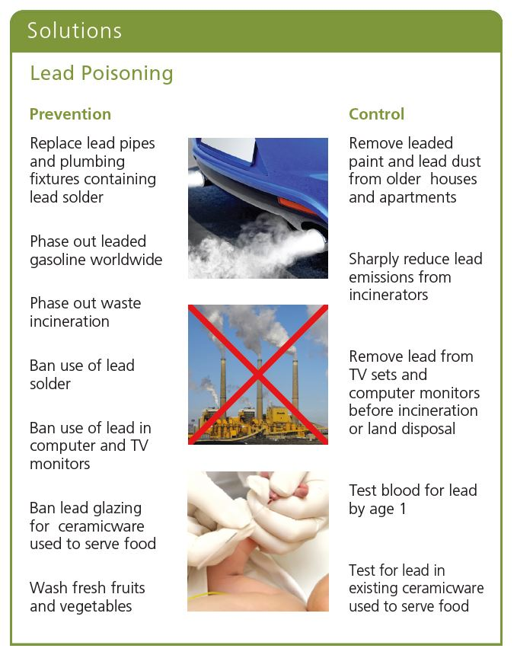
Case Study: Lead Is a Highly Toxic Pollutant (2 of 2)

Slide 20
Burning Coal Produce Industrial Smog (1 of 3)
Chemical composition of industrial smog
Sulfur dioxide, sulfuric acid, and suspended solid particles
Combustion of coal and oil forms carbon monoxide, carbon dioxide, and soot
Common in industrialized urban areas
Examples: China, India, Ukraine
Beijing air quality among world’s worst

Slide 21
Burning Coal Produces Industrial Smog (2 of 3)
Notes:
Figure 18.7 A greatly simplified model of how pollutants are formed when coal and oil are burned. The result is industrial smog.

Slide 22
Sunlight Plus Cars Equals Photochemical Smog
Photochemical smog formed under the influence of sun’s UV radiation
VOCs + NO_{x} + heat + sunlight yields:
Ground level O₃ and other photochemical oxidants
Aldehydes
Other secondary pollutants

Slide 23
Burning Coal Produces Industrial Smog (3 of 3)
Notes:
Figure 18.8 A greatly simplified model of how the pollutants that make up photochemical smog are formed.

Slide 24
Critical Concept: Factors Affecting Outdoor Air Pollution (1 of 3)
Factors that help reduce outdoor air pollution
Gravity allows particulates to settle
Rain and snow
Salty sea spray from the ocean
Winds
Natural chemical reactions remove some pollutants

Slide 25
Several Factors Affect Levels of Outdoor Air Pollution (2 of 3)
Factors that increase outdoor air pollution
Urban buildings
Hills and mountains
High temperatures
VOC emissions from certain trees and plants
The grasshopper effect
Temperature inversion
Warm air above cool air prevents mixing

Slide 26
Several Factors Affect Levels of Outdoor Air Pollution (3 of 3)
Notes:
Figure 18.9 A temperature inversion can take place in either of the two sets of topography and weather conditions shown here. Polluted air can be trapped between mountain ranges and under the inversion layer (left). Or it can be blown by sea breezes and trapped against a mountain range and under the conversion layer (right, see Core Case Study).

Slide 27
19.3 What Is Acid Deposition and Why Is It a Problem?
Caused mainly by coal-burning power plants and motor vehicle emissions
Threatens human health, aquatic life and ecosystems, forests, and human-built structures

Slide 28
Acid Deposition (1 of 3)
Human-generated NO_{x} and SO_{x} in the atmosphere
Wet deposition
Acidic rain, snow, fog, or cloud vapor
Dry deposition
Acidic particles
Substances remain in the atmosphere for 2–14 days

Slide 29
Acid Deposition (2 of 3)
Notes:
Figure 18.11 Natural capital degradation: Acid deposition, which consists of rain, snow, dust, or gas with a pH lower than 5.6, is commonly called acid rain. Critical thinking: What are three ways in which your daily activities contribute to acid deposition?

Slide 30
Acid Deposition (3 of 3)
Notes:
Figure 18.12 This map shows regions where acid deposition is now a problem and regions with the potential to develop this problem. Such regions have large inputs of air pollution (mostly from power plants, industrial facilities, and ore smelters) or are sensitive areas with naturally acidic soils and bedrock that cannot neutralize (buffer) additional inputs of acidic compounds. Critical thinking: Do you live in or near an area that is affected by acid deposition or an area that is likely to be affected by acid deposition in the future?

Slide 31
Harmful Effects of Acid Deposition
Contributes to respiratory disorders
Releases toxic metals from soils and rocks
Bioaccumulation in fish
Lowers pH in aquatic ecosystems
Leaches soil nutrients
Damages forests
Damages statues and buildings

Slide 32
Reducing Acid Deposition (1 of 2)
Prevention is always less costly than cleanup
Using renewable energy sources reduces the impact of acid rain

Slide 33
Harmful Effects of Acid Deposition (2 of 2)
Notes:
Figure 18.14 Ways to reduce acid deposition and its damage. Critical thinking: Which two of these solutions do you think are the best ones? Why?

Slide 34
19.4 What Are the Major Indoor Air Pollution Problems?
Indoor air pollutants
Smoke and soot from burning wood and coal in cooking fires
Mostly in less-developed countries
Cigarette smoke
Chemicals used in building materials and cleaning products

Slide 35
Indoor Air Pollution Is a Serious Problem (1 of 3)
Less-developed countries
Indoor burning of wood, charcoal, dung, crop residues, and coal
Greatest risk to low-income populations
More-developed countries
Tobacco smoke
Formaldehyde
Radioactive radon-222 gas
Very small particles

Slide 36
Indoor Air Pollution Is a Serious Problem (2 of 3)
Notes:
Figure 18.16 Numerous indoor air pollutants are found in most modern homes (concept 18.4). Question: To which of these pollutants are you exposed?

Slide 37
Indoor Air Pollution Is a Serious Problem (3 of 3)
Levels of some common air pollutants
Two to five times higher inside U.S. homes and buildings than outdoors
Sometimes up to 100 times higher
Pollution levels inside cars
Up to 18 times higher than outside levels
Most people in more-developed urban areas spend 70% or more of their time indoors or inside vehicles

Slide 38
Case Study: Radioactive Radon Gas (1 of 2)
Sources
Underground deposits of certain minerals
Human health risks
Decays into polonium-210
Can expose lung tissue to large amounts of radiation
EPA recommendation
Conduct radon tests

Slide 39
Case Study: Radioactive Radon Gas (2 of 2)
Notes:
Figure 18.18 Ways that radon-222 gas can enter homes and other buildings. Question: Has anyone tested the indoor air where you live for radon-222?

Slide 40
19.5 What Are the Health Effects of Air Pollution?
Air pollution can contribute to:
Asthma
Chronic bronchitis
Emphysema
Lung cancer
Heart attack
Stroke

Slide 41
Your Body’s Natural Air Pollution Defenses Can Be Overwhelmed (1 of 4)
Respiratory system protection mechanisms
Hair
Cilia
Mucus
Effects of smoking and prolonged air pollution exposure
Chronic bronchitis
Emphysema

Slide 42
Your Body’s Natural Air Pollution Defenses Can Be Overwhelmed (2 of 4)
Notes:
Figure 18.19 Major components of the human respiratory system can help to protect us from air pollution, but these defenses can be overwhelmed or breached.

Slide 43
Your Body’s Natural Air Pollution Defenses Can Be Overwhelmed (3 of 4)
125,000 people develop cancer in the United States each year from breathing diesel fumes
14% of the U.S. population exposed to excessive particulate pollution levels daily

Slide 44
Your Body’s Natural Air Pollution Defenses Can Be Overwhelmed (4 of 4)
Notes:
Figure 18.20 Distribution of premature deaths from air pollution in the United States, mostly from very small, fine, and ultrafine particles added to the atmosphere by coal-burning power plants. Critical thinking: Why do the highest death rates occur in the eastern half of the United States? If you live in the United States, what is the risk at your home or where you go to school?

Slide 45
19.6 How Should We Deal with Air Pollution?
Legal, economic, and technological tools can help clean up air pollution
Best solution is to prevent it

Slide 46
Laws and Regulations Can Reduce Outdoor Air Pollution (1 of 3)
United States
Clean Air Acts: 1970, 1977, and 1990 created regulations enforced by states and cities
EPA
Established air quality standards for six outdoor pollutants
Carbon monoxide, nitrogen dioxide, sulfur dioxide, suspended particulate matter, ozone, and lead

Slide 47
Laws and Regulations Can Reduce Outdoor Air Pollution (2 of 3)
EPA’s national emission standards for 188 hazardous air pollutants (HAPs)
Toxic Release Inventory (TRI)
New U.S. regulations
Limit CO₂ emissions from coal-fired power plants
New air quality standards in China
Ban on high-sulfur, high-ash-content coal in major cities

Slide 48
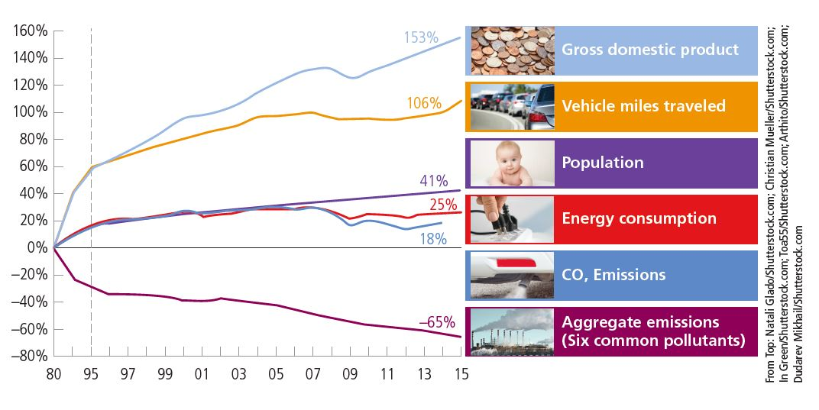
Laws and Regulations Can Reduce Outdoor Air Pollution (3 of 3)
Levels of key air pollutants in the United States dropped sharply between 1980 and 2015, despite increases in other factors.

Slide 49
Using the Marketplace to Reduce Outdoor Air Pollution
Buy and sell air pollution allotments in the marketplace
1990 Clean Air Act authorized emissions trading or cap-and-trade program
Success depends on:
How low initial cap is set
How often it is lowered

Slide 50
Other Ways to Reduce Outdoor Air Pollution (1 of 4)
Technologies used on coal-burning power plants
Electrostatic precipitator
Wet scrubber
Motor vehicle pollution
Prevention and reduction

Slide 51
Ways to Reduce Outdoor Air Pollution (2 of 4)
Notes:
Figure 18.24 An electrostatic precipitator (left) and a wet scrubber (right) are used to reduce particulate and SO₂ emissions from coal-burning power and industrial plants.

Slide 52
Ways to Reduce Outdoor Air Pollution (3 of 4)
Notes:
Figure 18.23 Ways to prevent, reduce, or disperse emissions of sulfur oxides, nitrogen oxides, and particulate matter from stationary sources, especially coal-burning power plants and industrial facilities (Concept 18.6). Critical thinking: Which two of these solutions do you think are the best ones? Why?

Slide 53
Case Study: Revisiting Air Pollution in Los Angeles
Lowest pollution levels since 1999
Largest sources of pollutants
Ports of Los Angeles and Long Beach
Most ships burn diesel fuel
Pollution is trapped by mountain ranges; builds up during thermal inversions

Slide 54
Ways to Reduce Outdoor Air Pollution (4 of 4)
Notes:
Figure 18.25 Ways to prevent or reduce emissions from motor vehicles (Concept 18.6). Critical thinking: Which two of these solutions do you think are the best ones? Why?

Slide 55
Reducing Indoor Air Pollution (1 of 3)
Greater threat to human health than outdoor pollution
What can be done?
Prevention
Cleanup

Slide 56
Reducing Indoor Air Pollution (2 of 3)
Notes:
Figure 18.27 Ways to prevent or reduce indoor air pollution (Concept 18.6). Critical thinking: Which two of these solutions do you think are the best ones? Why?

Slide 57
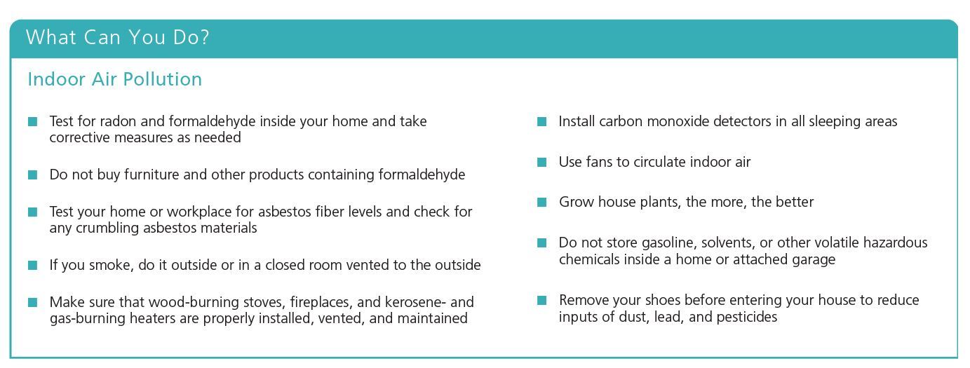
Reducing Indoor Air Pollution (3 of 3)

Slide 58
19.7 How Have We Depleted Ozone in the Stratosphere and What Can We Do About It?
Widespread use of certain chemicals
Reduced ozone levels in the stratosphere
Allowed more harmful ultraviolet radiation to reach the earth’s surface
Actions necessary to reverse ozone depletion
Stop producing ozone-depleting chemicals
Adhere to international treaties banning such chemicals

Slide 59
The Use of Certain Chemicals Threatens the Ozone Layer (1 of 2)
Ozone is thinning over Antarctica and the Arctic
Chlorofluorocarbons (CFCs)
Persistent chemicals that attack ozone in the stratosphere
Tales 11 to 20 years to reach the stratosphere from ground level
CFC molecule attacks O₃ and strips off a free oxygen
Combines with Cl⁻ to form ClO
Each chlorine atom can break down hundreds of O₃ molecules

Slide 60
The Use of Certain Chemicals Threatens the Ozone Layer (2 of 2)
Notes:
Figure 18.29 Natural capital degradation: The colorized satellite image shows ozone thinning over Antarctica during October of 2015 at its annual peak extent. Ozone depletion of 50% or more occurred in the center blue area.

Slide 61
Why Should We Worry About Ozone Depletion?
Ozone protects the earth’s surface from damaging UV radiation
Human health concerns
UV radiation affects plankton, crucial for removing CO₂ from the atmosphere

Slide 62
Reversing Stratospheric Ozone Depletion
Stop producing ozone-depleting chemicals immediately
Will take at least 60 years to recover to 1980 levels
Agreements with a prevention approach
Montreal Protocol
Cut emissions of CFCs
Copenhagen Amendment
Accelerated phase-out of CFCs

Slide 63
Effects of Ozone Depletion

