Slide 1
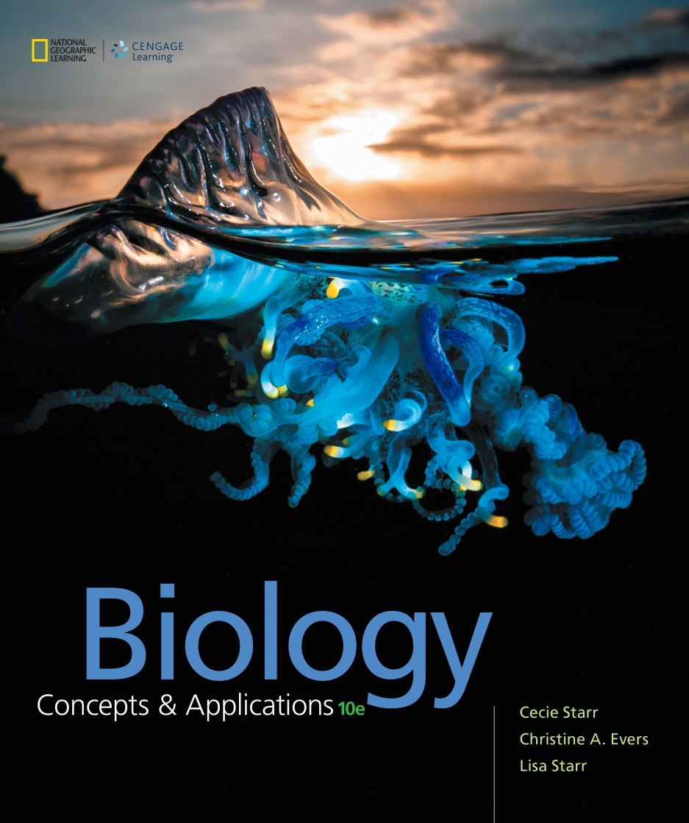
Biology Concepts & Applications
10 Edition
Chapter 18
Life’s Origin and Early Evolution
Copyright © 2018 Cengage Learning. All Rights Reserved. May not be copied, scanned, or duplicated, in whole or in part, except for use as permitted in a license distributed with a certain product or service or otherwise on a password-protected website for classroom use.

Slide 2
18.1 Origin of Life’s Building Blocks (1 of 2)
Conditions on early Earth
Earth formed about 4.6 billion years ago (bya)
Early atmosphere contained little or no oxygen
Presence of water
Volcanic eruptions were common
Constant hail of meteorites

Slide 3
Origin of Life’s Building Blocks (2 of 2)
Formation of simple organic compounds
All life consists of:
Amino acids
Fatty acids
Nucleotides
Simple sugars

Slide 4
Sources of Organic Subunits (1 of 4)
Where did the subunits of the first life come from?
There are several possibilities:
Lightning-fuelled atmospheric reactions
Reactions at deep-sea hydrothermal vents
Meteorites from space

Slide 5
Sources of Organic Subunits (2 of 4)
Miller–Urey experiment
1953, Stanley Miller and Harold Urey showed that reactions in Earth’s early atmosphere could have produced building blocks for the first life
Indirect evidence that organic compounds self-assemble spontaneously under conditions like those in Earth’s early atmosphere

Slide 6
Sources of Organic Subunits (3 of 4)
Hydrothermal vents
Deep underwater openings in ocean where mineral-rich water heated by geothermal energy streams out
Reactions in the hot, mineral-rich water near deep-sea hydrothermal vents also produce organic building blocks
Simulated experiments mimicking conditions produce amino acids and other organic compounds

Slide 7
Sources of Organic Subunits (4 of 4)
Outer Space
Modern-day meteorites reach Earth with amino acids, sugars, and nucleotide bases
The same compounds (or precursors) are also detected in gas clouds surrounding nearby stars
Such materials fell to Earth much more frequently than they do today

Slide 8
Miller–Urey Experiment
Notes:
Figure 18.2 The Miller–Urey experiment. Stanley Miller and Harold Urey used this glass apparatus to test whether organic compounds could have formed by lightning-driven chemical reactions in Earth’s early atmosphere. Water, hydrogen gas (H₂), methane (CH₄), and ammonia (NH₃) circulated through the apparatus as sparks from an electrode simulated lightning.

Slide 9
Black Smoker
Notes:
Figure 18.3 A type of deep-sea hydrothermal vent called a black smoker.

Slide 10
18.2 Polymers to Protocells (1 of 4)
Similarities in structure, metabolism, and replication among all life indicate descent from a common cellular ancestor
Experiments demonstrate how traits and processes seen in all living cells could have begun with physical and chemical reactions among non-living collections of molecules

Slide 11
Polymers to Protocells (2 of 4)
Origin of metabolism
Proteins that speed metabolic reactions might have first formed when amino acids stuck to clay, then bonded under the heat of the sun
Metabolism may have begun in rocks near deep-sea hydrothermal vents when iron sulfide in the rocks donated electrons to dissolved carbon monoxide

Slide 12
Polymers to Protocells (3 of 4)
Origin of the genome
All modern cells have a genome of DNA
Protein synthesis depends on DNA, which is built by proteins
How did this cycle begin?
An RNA world, a time in which RNA was the genetic material, may have preceded DNA-based systems
Ribozymes: RNA functions as an enzyme

Slide 13
Polymers to Protocells (4 of 4)
Protocells
May have preceded cells
Membrane-like structures and vesicles form when proteins or lipids are mixed with water
Membranous sacs that contain interacting organic molecules; hypothesized to have formed prior to the earliest life forms
Origin of the cell membrane

Slide 14
Protocells
Notes:
Figure 18.5 Protocells. Computer models and laboratory experiments help scientists determine how and where protocells could have formed, as well as the protocells’ most likely components.
A Computer model of a protocell with a membrane of fatty acids around strands of RNA.
B Laboratory-formed protocell consisting of fatty acids (green) surrounding RNA-coated clay (red).

Slide 15
18.3 Early Cellular Life
Early divergence separated bacteria from ancestors of archaeans and eukaryotes
An oxygen-releasing, noncyclic pathway of photosynthesis evolved in one bacterial lineage, cyanobacteria
2.5 bya, oxygen released by cyanobacteria began to accumulate in Earth’s sea and air
Cyanobacteria changed Earth’s atmosphere

Slide 16
Traits of the First Cells
All modern life most likely descended from a common ancestor
Likely a prokaryotic cell
Most likely anaerobic
Possibly a heterotroph, or maybe autotroph
Likely not photosynthetic

Slide 17
Searching for Ancient Life
Finding and identifying early cell fossils is difficult
No hard parts to fossilize
Microscopic
Few ancient rocks still available that would have held these fossils
Scientists must constantly evaluate purported fossil finds

Slide 18
Oldest Fossil Cells
Life possibly originated 4 bya
Oldest fossil cells are dated 3.4 bya
These fossils contain iron sulphide and are similar to species that currently live in mudflats
Other fossils from 3.2 bya are similar to filamentous cells that live near modern deep-sea hydrothermal vents

Slide 19
Fossil Cells
Notes:
Figure 18.6 Fossil cells from an ancient beach. Microscopic 3.4-billion-year-old fossils nestle among sand grains in a sandstone. The cells may be relatives of modern bacteria.

Slide 20
Stromatolites
Dome-shaped structures composed of layers of bacterial cells and sediments
Each layer formed when a mat of living cells trapped sediments
Descendant cells grew over the sediment layer, then trapped more sediment, forming the next layer

Slide 21
Fossil Stromatolites
Notes:
Figure 18.7 Fossil stromatolites.
A In cross section, a stromatolite reveals the layered remains of countless photosynthetic bacteria and sediment they captured.
B Cyanobacteria such as those in this 850-million-year-old fossil are the main photosynthetic cells in stromatolites.

Slide 22
A Rise in Oxygen
Effects of increasing oxygen, released by cyanobacteria
Interferes with self-assembly of complex organic compounds
Prevented evolution of new life from non-living molecules
Presence of O₂ gave organisms that thrived in aerobic conditions an advantage
An ozone layer in the atmosphere protected surface from high levels of solar UV radiation

Slide 23
Early Eukaryotes
Fossil features
Generally larger than prokaryotes
Cell walls with complex patterns, spikes, or spines
Certain compounds like steroids
Oldest eukaryotic fossils are about 1.8 billion years old
Simple multicellularity evolved early
Sexual reproduction evolved 1.2 bya

Slide 24
18.4 Origin of Eukaryotes
Scientists study modern cells to test hypotheses about how organelles evolved in the past
By one hypothesis, internal membranes typical of eukaryotic cells may have evolved through infoldings of plasma membrane of prokaryotic ancestors
Existence of some bacteria with internal membranes supports this hypothesis

Slide 25
Evolution of Organelles (1 of 2)
Origin of the nucleus
Internal membranes can be advantageous
Can increase surface area
Hold more enzymes
Protect a genome from physical or biological threats

Slide 26
Evolution of Organelles (2 of 2)
Origin of mitochondria and chloroplasts
Endosymbiont hypothesis
Mitochondria and chloroplasts resemble bacteria
One species lives and reproduces inside another
Over generations, host and guest cells come to depend upon one another for essential metabolic processes

Slide 27
Endosymbiont Theory (1 of 2)
Possible ancestors of mitochondria
Rickettsia prowazekii, an aerobic bacterium that infects human cells
Methanotrophic bacteria, bacteria that feed on methane

Slide 28
Endosymbiont Theory (2 of 2)
Likely ancestor of chloroplasts
Cyanobacteria are the only oxygen-producing photosynthetic bacteria
Genetic similarities confirm this ancestor-descendant relationship
Chloroplasts evolved after mitochondria

Slide 29
Rickettsia prowazekii
Notes:
Figure 18.9 Modern bacteria that may be related to the bacterial ancestors of mitochondria.
A Rickettsia prowazekii, the bacteria that cause typhus.

Slide 30
Methylobacter
Notes:
Figure 18.9 Modern bacteria that may be related to the bacterial ancestors of mitochondria.
B Methylobacter, a methane-feeder with stacked internal membranes.

Slide 31
18.5 Perspective on the Precambrian
Precambrian
Encompasses almost all of Earth’s history
From 4.6 billion years ago to Cambrian (542 mya)
Life arose and diversified
By the close of this period, bacteria, archaea, and eukaryotes lived in the sea

Slide 32
Precambrian Timeline
Notes:
Figure 18.10 Some milestones in the Precambrian and its position in Earth’s history.

Slide 33
Application: Looking for Life
Astrobiologists study properties of the ancient Earth that allowed life to arise, survive, and diversify
Astrobiology
The scientific study of life’s origin and distribution in the universe
Presence of cells in deserts and deep below Earth’s surface suggests life may exist in similar settings on other planets

Slide 34
Exploring Mars
Notes:
Figure 18.11 Exploring Mars. This composite selfie of NASA’s Curiosity Rover was taken in 2015 on Mars, where the Rover is assessing whether conditions support or could have supported life. The inset photo shows the relative sizes of Earth and Mars.

Slide 35
Discuss
Why was no free oxygen (O₂) included in Miller’s experiment? What did the electrical spark simulate?
What distinguishes a nonliving lipid-bound sphere containing nucleic acids and amino acids from a living cell?
Why was aerobic respiration necessary for the evolution of eukaryotes?

