Slide 1
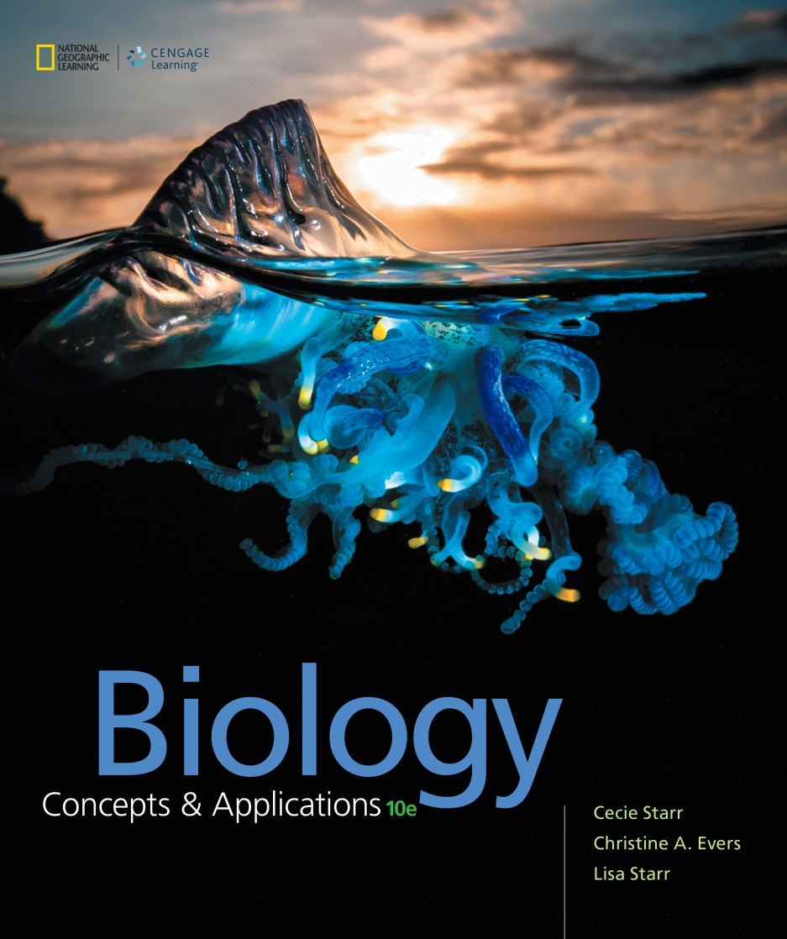
Biology Concepts & Applications
10 Edition
Chapter 17
Processes of Evolution
Copyright © 2018 Cengage Learning. All Rights Reserved. May not be copied, scanned, or duplicated, in whole or in part, except for use as permitted in a license distributed with a certain product or service or otherwise on a password-protected website for classroom use.

Slide 2
17.1 Alleles in Populations (1 of 3)
Individuals of a population share morphological, physiological, and behavioral traits with a heritable basis
Variations within a population arise from different alleles of shared genes
Dimorphic: a trait with only two forms
Polymorphic: traits with more than two distinct forms

Slide 3
Alleles in Populations (2 of 3)
TABLE 17.1
Some Sources of Variation in Shared, Heritable Traits
Genetic Event | Effect
Mutation | Original source of new alleles
Crossing over at meiosis I | Mixes up maternal and paternal alleles on homologous chromosomes for forthcoming gametes
Independent assortment at meiosis I | Randomly distributes homologous chromosomes into gametes
Fertilization | Combines alleles from two individuals
Notes:
Table 17.1 Some Sources of Variation in Shared, Heritable Traits

Slide 4
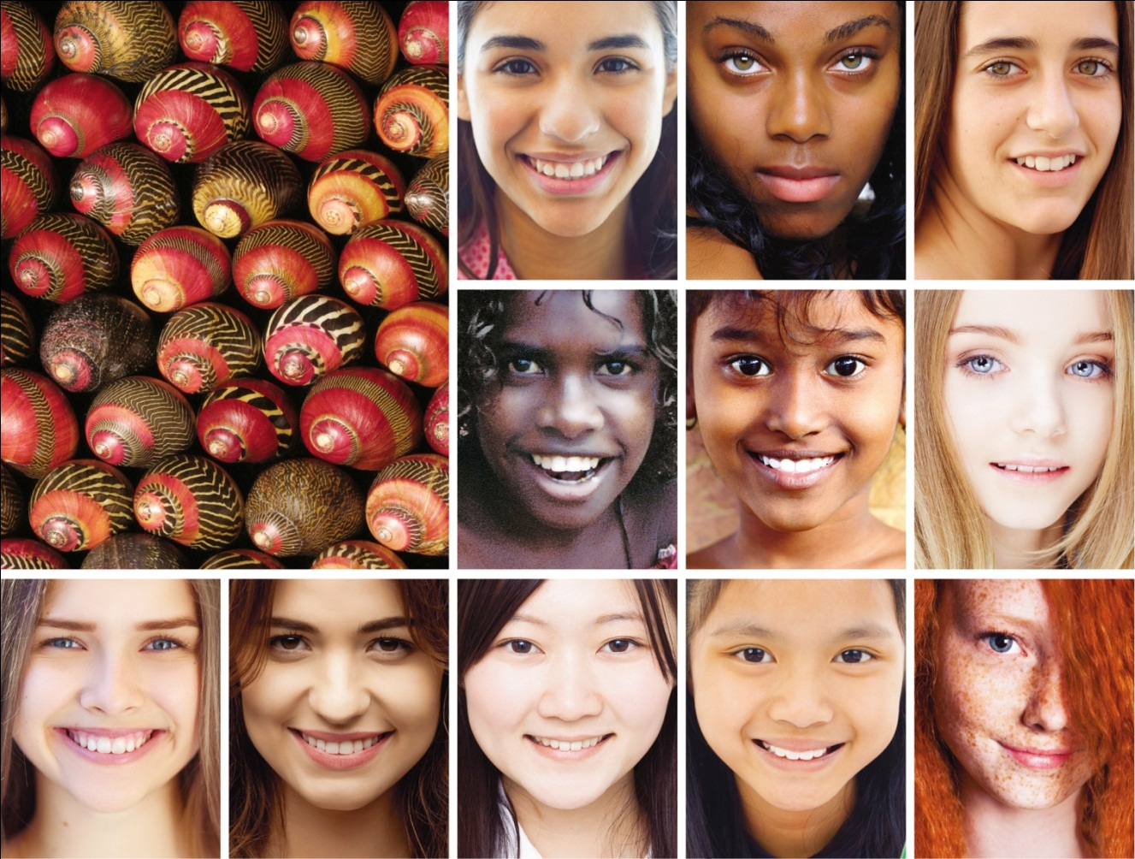
Alleles in Populations (3 of 3)
Notes:
Figure 17.1 Sampling morphological variation among zigzag Nerite snails and humans. Variation in shared traits among individuals is mainly an outcome of variations in alleles that influence those traits.

Slide 5
An Evolutionary View of Mutations (1 of 2)
Mutations
The original source for new alleles
Lethal mutation
Mutation that drastically alters phenotype
Causes death
Neutral mutation
A mutation that has no effect on survival or reproduction

Slide 6
An Evolutionary View of Mutations (2 of 2)
Occasionally, a change in the environment favors a mutation that had previously been neutral or even somewhat harmful
Through natural selection, a beneficial mutation tends to increase in frequency in a population over generations
Mutations are the source of Earth’s staggering biodiversity

Slide 7
Allele Frequency
All alleles in a population form a gene pool
Changes in the allele frequencies of a population are called microevolution
Occurs constantly by:
Mutation
Natural selection
Genetic drift
Gene flow

Slide 8
17.2 Genetic Equilibrium (1 of 2)
Genetic equilibrium
A theoretical reference point
Occurs when the allele frequencies of a population do not change
Requires five conditions that are never met in nature, so natural populations are never in genetic equilibrium

Slide 9
Genetic Equilibrium (2 of 2)
Five theoretical conditions of genetic equilibrium:
Mutations never occur
Population is infinitely large
Population is isolated from all other populations of the species (no gene flow)
Mating is random
All individuals survive and produce the same number of offspring

Slide 10
Hardy–Weinberg Principle
Hardy (mathematician) and Weinberg (physician) independently applied probability to population genetics
Developed a simple formula that can be used to track whether a population of any sexually reproducing species is in a state of genetic equilibrium

Slide 11
Applying the Hardy–Weinberg Principle (1 of 10)
Consider a hypothetical gene that encodes a blue pigment in daisies:
Two alleles of this gene, B and b, show incomplete dominance
A daisy homozygous for the B allele (BB) has dark-blue flowers
A daisy homozygous for the b allele (bb) has white flowers
A heterozygous daisy (Bb) has medium-blue flowers

Slide 12
Applying the Hardy–Weinberg Principle (2 of 10)
The Hardy–Weinberg equilibrium equation
Defines the frequency of one allele (B) and a second allele (b) for a gene that controls a particular trait in a population
Frequencies of B and b must add up to 1.0
Example: If B occupies 90% of the loci, then b must occupy the remaining 10%
No matter what the proportions:
p + q = 1.0

Slide 13
Applying the Hardy–Weinberg Principle (3 of 10)
Hardy–Weinberg
Paired alleles assort into different gametes
The genotypes possible in the next generation are BB, Bb, and bb
The frequencies of the three genotypes add up to 1.0
p² + 2pq + q² = 1.0

Slide 14
Applying the Hardy–Weinberg Principle (4 of 10)
Returning to our daisies:
At genetic equilibrium, the proportions of the flower-color genotypes are:
p²(BB) + 2pq(Bb) + q2(bb) = 1.0
where p = frequency of the allele B and q = frequency of allele b

Slide 15
Applying the Hardy–Weinberg Principle (5 of 10)
Hardy–Weinberg
If 1,000 individuals each produces two gametes:
490 BB individuals make 980 B gametes
420 Bb individuals make 420 B and 420 b gametes
90 bb individuals make 180 b gametes

Slide 16
Applying the Hardy–Weinberg Principle (6 of 10)
Hardy–Weinberg
The frequency of alleles B and b among 2,000 gametes:
B(p) = (980 + 420) ÷ 2,000 alleles = 1,400 ÷ 2,000 = 0.7
B(q) = (180 + 420) ÷ 2,000 alleles = 600 ÷ 2,000 = 0.3

Slide 17
Applying the Hardy–Weinberg Principle (7 of 10)
If the population size stays constant at 1,000, there will be 490 BB, 420 Bb, and 90 bb individuals
Allele frequencies for dark-blue, medium-blue, and white flowers are the same as they were in the original gametes–the population is not evolving

Slide 18
Applying the Hardy–Weinberg Principle (8 of 10)
Researchers use the Hardy–Weinberg formula to estimate the frequency of carriers of alleles that cause genetic traits and disorders
Example: Hereditary hemochromatosis (HH) in Ireland
If the frequency of the autosomal recessive allele that causes HH is q = 0.14, then p = 0.86
The carrier frequency (2pq) is calculated to be about 0.24

Slide 19
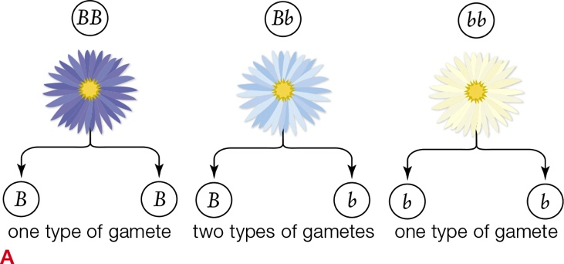
Applying the Hardy–Weinberg Principle (9 of 10)
Notes:
Figure 17.2 Hardy–Weinberg calculations. In this example, two alleles of a gene show incomplete dominance over flower color.
A In this two-allele system, B specifies dark blue flowers; b, white. Plants that are homozygous (B or b) make one kind of gamete. Heterozygous plants (Bb) have light blue flowers and make two kinds of gametes (B and b).

Slide 20
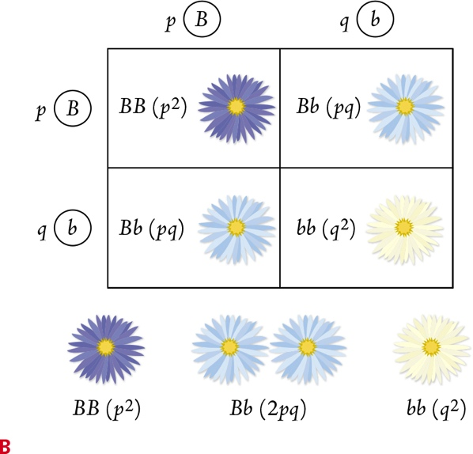
Applying the Hardy–Weinberg Principle (10 of 10)
Notes:
Figure 17.2 Hardy–Weinberg calculations. In this example, two alleles of a gene show incomplete dominance over flower color.
B Say p is the proportion of B alleles in the gene pool, and q is the proportion of b alleles. This Punnett square shows that in each generation, the predicted proportion of offspring that will inherit two B alleles is p x p, or p². Likewise, the proportion that will inherit both alleles is 2pq, and the proportion that will inherit two b alleles is q².

Slide 21
Populations Evolve
Different patterns of natural selection occur based on:
Selection pressures
Chance alone (genetic drift)
Organisms involved (moving in and out of populations)
Three modes of natural selection

Slide 22
17.3 Directional Selection
Directional selection
Shifts an allele’s frequency in a consistent direction
Forms at one end of a range of phenotypic variation
Becomes more common over time
Bell-shaped curves indicate continuous variation in a butterfly wing-color trait

Slide 23
Selection for an Extreme Form
The peppered moth’s coloration camouflages it from predatory birds
When the air was clean, trees were light colored, and so were most peppered moths
When smoke from coal-burning factories changed the environment, predatory birds ate more white moths–selection pressure favored darker moths
By 1850s, dark-colored moths were more common

Slide 24
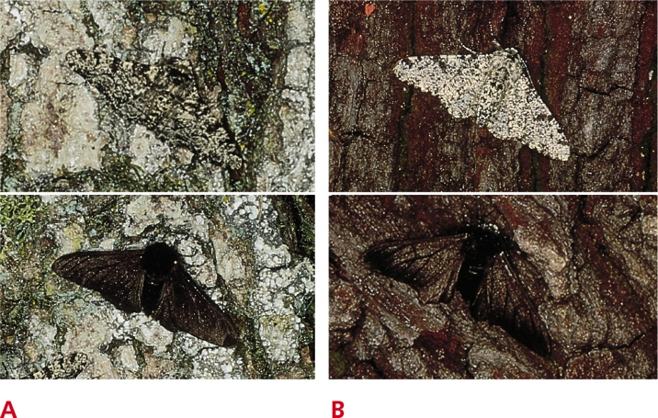
Peppered Moth Color Morphs
Notes:
Figure 17.5 Adaptive value of two color morphs of the peppered moth.
A Light moths on a nonsooty tree trunk (top) are hidden from predators; dark ones (bottom) stand out.
B In places where soot darkens tree trunks, the dark color (bottom) provides more camouflage than the light color (top).

Slide 25
Warfarin-Resistant Rats
Warfarin-resistant rats
Rats thrive where there are people
Warfarin became popular in 1950s
Spreading poison exerts directional selection
Exposure results in 10 percent of urban rats being resistant to Warfarin by 1980s

Slide 26
17.4 Stabilizing and Disruptive Selection (1 of 2)
Stabilizing selection
Also called balancing selection
Tends to preserve the midrange phenotypes in a population
Mode of natural selection in which intermediate forms of a trait are favored over extremes

Slide 27
Stabilizing and Disruptive Selection (2 of 2)
Disruptive selection
Mode of natural selection that favor forms of a trait at both ends of a range
Midrange forms are eliminated
Intermediate forms are selected against

Slide 28
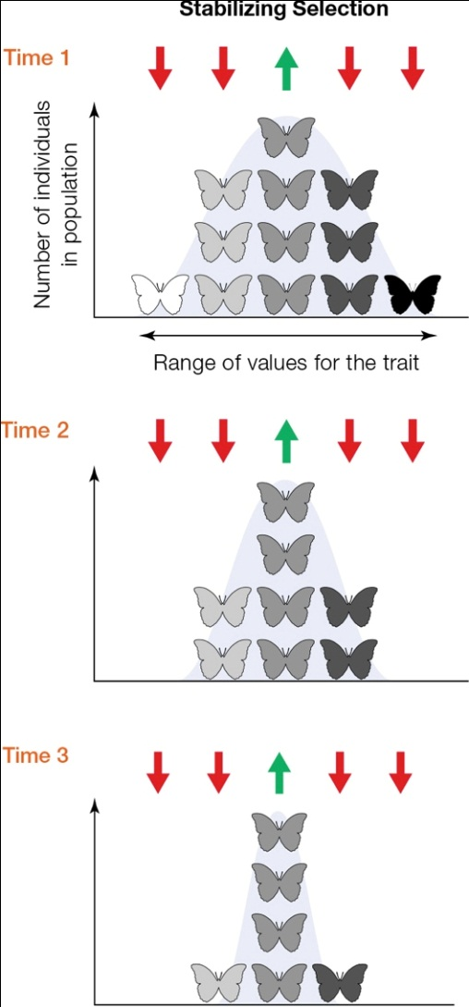
Stabilizing Selection (1 of 2)
Notes:
Figure 17.7 With stabilizing selection, extreme forms of a trait are eliminated, and an intermediate form is maintained. Red arrows indicate which forms are being selected against; green, the form that is adaptive. Compare the data set from a field experiment in Figure 17.8.

Slide 29
Stabilizing Selection (2 of 2)
Sociable weavers
The body weight of sociable weavers is subject to stabilizing selection
Body weight is a trade-off between risks of starvation and predation
Leaner birds do not store enough fat to avoid starvation
Predators capture more birds with higher body fat
Birds of intermediate weight have the selective advantage

Slide 30
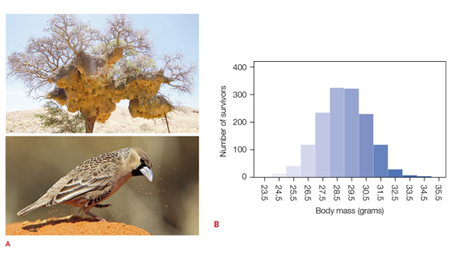
Sociable Weavers
Notes:
Figure 17.8 Stabilizing selection in sociable weavers.
A Sociable weavers live in large communal nests (top) and forage on the open ground for seeds (bottom).
B Number of birds (out of 977) that survived a breeding season.

Slide 31
Disruptive Selection
African seedcrackers
Dimorphism in bill size results from competition for two types of food in the dry season
Small-billed birds are better at opening soft seeds, but large-billed birds are better at cracking hard seeds
Conditions favor birds with bills that are either 12 mm wide or wider than 15 mm
Birds with bills of intermediate size are selected against

Slide 32
17.5 Natural Selection and Diversity
Sexual selection
Mode of natural selection in which some individuals of a population out-reproduce others because they are better at securing mates
The most adaptive forms of a trait are those that help individuals defeat same-sex rivals for mates, or are the ones most attractive to the opposite sex

Slide 33
Survival of the Sexiest
Sexual dimorphism
Males and females are different in size or another aspect of their appearance
Individuals (often males) are more:
Colorful
Larger
More aggressive

Slide 34
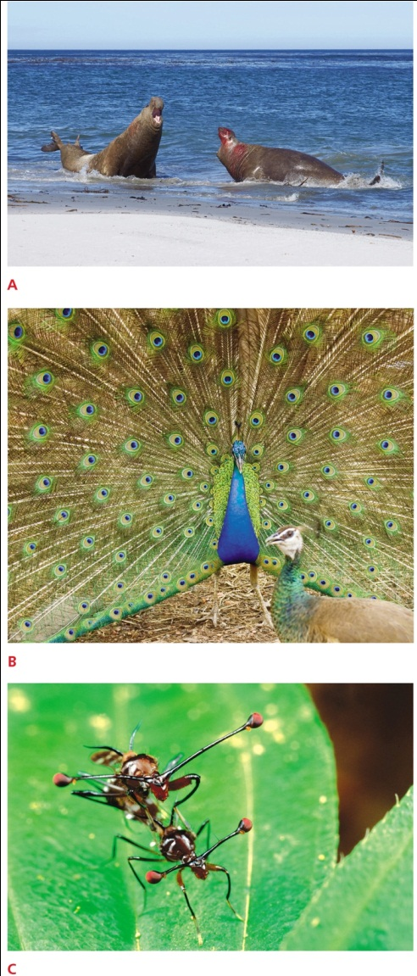
Sexual Selection
Notes:
Figure 17.11 Sexual Selection in action.
A Male elephant seals engaged in combat. Males of this species typically compete for access to clusters of females.
B A male peacock engaged in a flashy courtship display has caught the eye (and, perhaps, the sexual interest) of a female. Females are choosy; a male mates with any female that accepts him.
C Mating stalk-eyed flies. Female stalk-eyed flies prefer to mate with males that have the longest eyestalks, a trait that provides no obvious selective advantage other than sexual attractiveness.

Slide 35
Maintaining Multiple Alleles (1 of 2)
Selection pressures that operate on natural populations are complex; an allele may be adaptive in one circumstance but harmful in another
Any mode of natural selection may maintain two or more alleles in a population

Slide 36
Maintaining Multiple Alleles (2 of 2)
Balanced polymorphism
Maintenance of two or more alleles for a trait at high frequency in a population as a result of natural selection against homozygotes
Example: the mate preferences of female Drosophila flies
Frequency-dependent selection
The adaptive value of a form of a trait depends on its frequency in the population

Slide 37
Balanced Polymorphisms (1 of 2)
Malaria and sickle-cell anemia
A mutation in the normal beta globin chain of hemoglobin (HbA) causes sickle-cell anemia
Individuals homozygous for the mutated HbS allele often die young
The HbS allele persists at high frequencies in tropical regions of Africa because HbA/HbS heterozygotes are more likely to survive than HbA/HbA homozygotes

Slide 38
Balanced Polymorphisms (2 of 2)
Malaria and sickle-cell anemia (cont’d.)
In tropical and subtropical regions mosquitoes transmit the parasitic protist, Plasmodium, that causes malaria
HbA/HbS heterozygotes-infected red blood cells sickle
The abnormal shape brings cells to attention of immune system, which destroys them and the parasites they harbor

Slide 39
17.6 Genetic Drift and Gene Flow
Genetic drift
Random change in allele frequencies
Can lead to loss of genetic diversity by causing alleles to become fixed
An allele for which all members of a population are homozygous
Especially true in small populations
The larger the population, the smaller the impact of random changes in allele frequencies

Slide 40
Genetic Drift
Example: Allele X occurs at a 10% frequency
In a population of 10, only one person carries the allele, and if that person dies, the allele is lost
In a population of 100, all 10 people who carry the allele would have to die for the allele to be lost

Slide 41
Bottlenecks and the Founder Effect (1 of 2)
Genetic drift can be dramatic when a few individuals rebuild a population or start a new one
Example: Hunting reduced an elephant seal population to 20; the population is now homozygous at every gene
Bottleneck
Drastic reduction in population size so severe that it reduces genetic diversity

Slide 42
Bottlenecks and the Founder Effect (2 of 2)
Founder effect and inbreeding
Change in allele frequencies that occurs when a small number of individuals establish a new population

Slide 43
Founding Populations and Inbreeding
Ellis-van Creveld syndrome
Caused by a recessive allele common in the Old Order Amish of Lancaster County, PA
Characterized by dwarfism, polydactyly, and heart defects

Slide 44
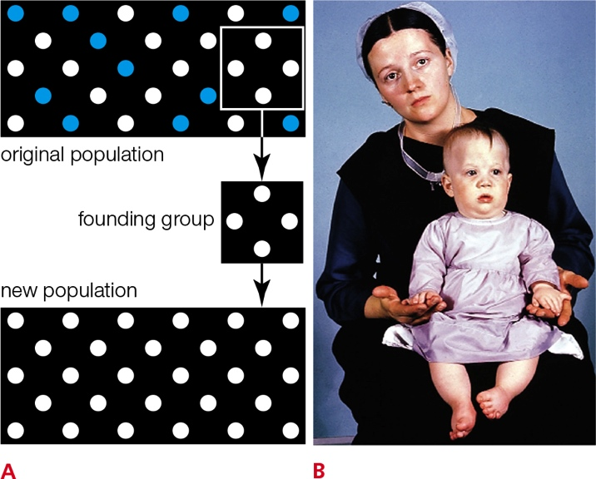
Ellis-van Creveld Syndrome
Notes:
Figure 17.15 The founder effect and one example.
A The founder effect: a group that founds a new population is not representative of the original population. so allele frequencies differ between the new and the old populations.
B An allele that causes Ellis–van Creveld syndrome occurs at high frequency in the gene pool of the Lancaster Amish—a result of the founder effect. Outward indications of the disorder (polydactyly and dwarfism) appear in this Amish baby.

Slide 45
Gene Flow
Gene flow: individuals, along with their alleles, move into and out of populations
Stabilizes allele frequencies, so it counters the effects of mutation, natural selection, and genetic drift that tend to occur within a population
Example: jays move acorns, and their alleles, among populations of oak trees that would otherwise be genetically isolated

Slide 46
17.7 Reproductive Isolation (1 of 2)
Speciation: one of several processes by which new species arise
Reproductive isolation
Absence of gene flow between populations
Always part of speciation

Slide 47
Reproductive Isolation (2 of 2)
In isolated populations:
Different genetic changes accumulate
Differences between diverging populations are reinforced
Types of reproductive isolation
If pollination or mating cannot occur, or if zygotes cannot form, the isolation is prezygotic
If hybrids form but are unfit or infertile, the isolation is postzygotic

Slide 48
Prezygotic Isolation
Temporal isolation: differences in the timing of reproduction can prevent mating
Ecological isolation: different microenvironments in the same region may cause physical separation
Behavioral isolation: behavioral differences can prevent mating
Mechanical isolation: size or shape of reproductive parts prevent mating

Slide 49
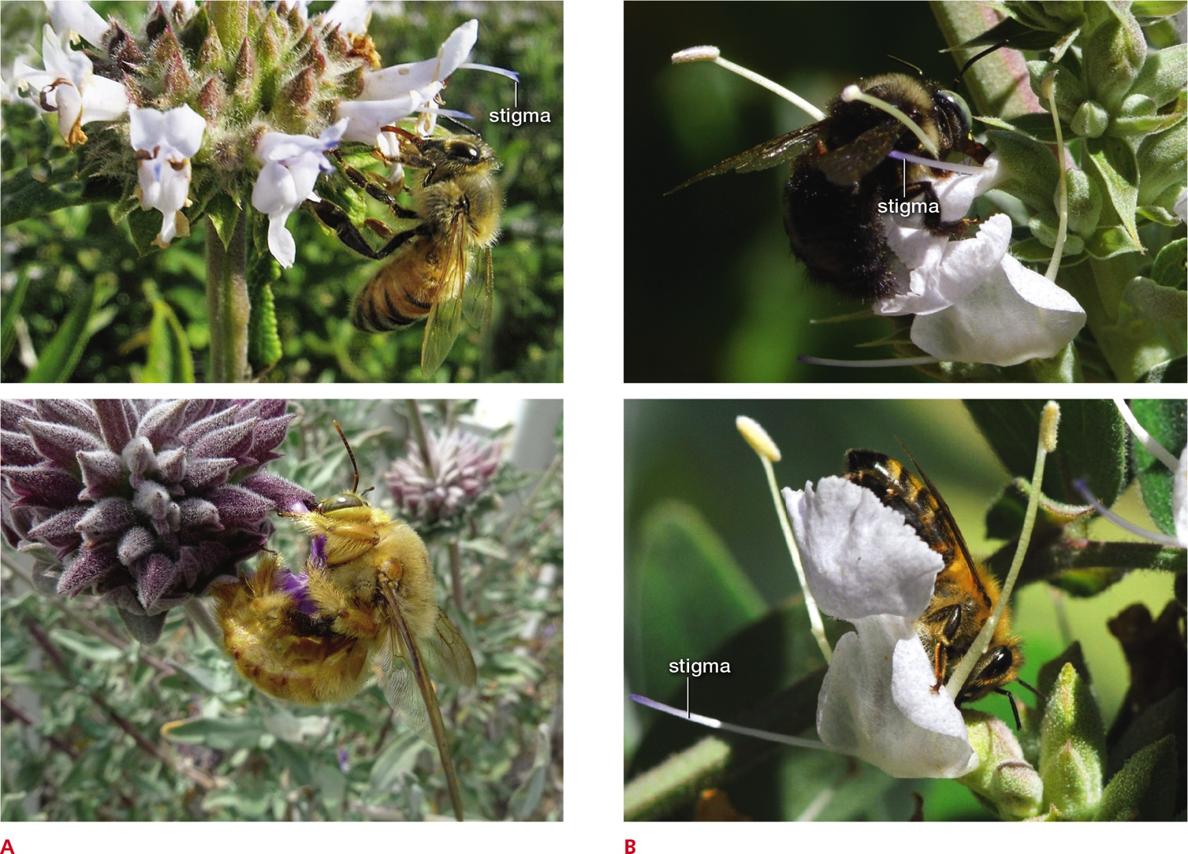
Mechanical Isolation
Notes:
Figure 17.17 Mechanical isolation in sage.
A Black sage is pollinated mainly by small bees and other insects that touch the reproductive parts of the flowers as they sip nectar (top). Larger insects cannot perch on small sage flowers; they access nectar by piercing the petals (bottom), so they do not touch the flower’s reproductive parts (stigma and pollen-bearing stamens).
B Flowers of white sage are pollinated mainly by insects heavy enough to activate a tripping mechanism. When a big insect lands on the flower to sip nectar, it pushes down the large top petal (top). This causes stamens and stigma to move inward and touch the pollinator’s body. Insects that do not weigh enough to trigger this mechanism do not touch the flower’s reproductive parts (bottom).

Slide 50
Postzygotic Isolation
Gamete incompatibility: gametes have molecular incompatibilities that prevent them from fusing
Hybrid inviability: hybrid embryo may die, or hybrid offspring that survive may have reduced fitness (e.g., ligers)
Hybrid sterility: some interspecies crosses produce robust but sterile offspring (e.g., mules)

Slide 51
17.8 Allopatric Speciation (1 of 2)
Speciation pattern in which a physical barrier that separates members of a population ends gene flow between them
Geographic barrier arises
Genetic divergences then give rise to new species

Slide 52
Allopatric Speciation (2 of 2)
Geographic barrier can block gene flow
Depends on how an organism travels
e.g., by swimming, walking, or flying
How it reproduces
e.g., by internal fertilization or by pollen dispersal
Example:
When the Isthmus of Panama formed, it cut off gene flow among populations of aquatic organisms in the Pacific and Atlantic oceans

Slide 53
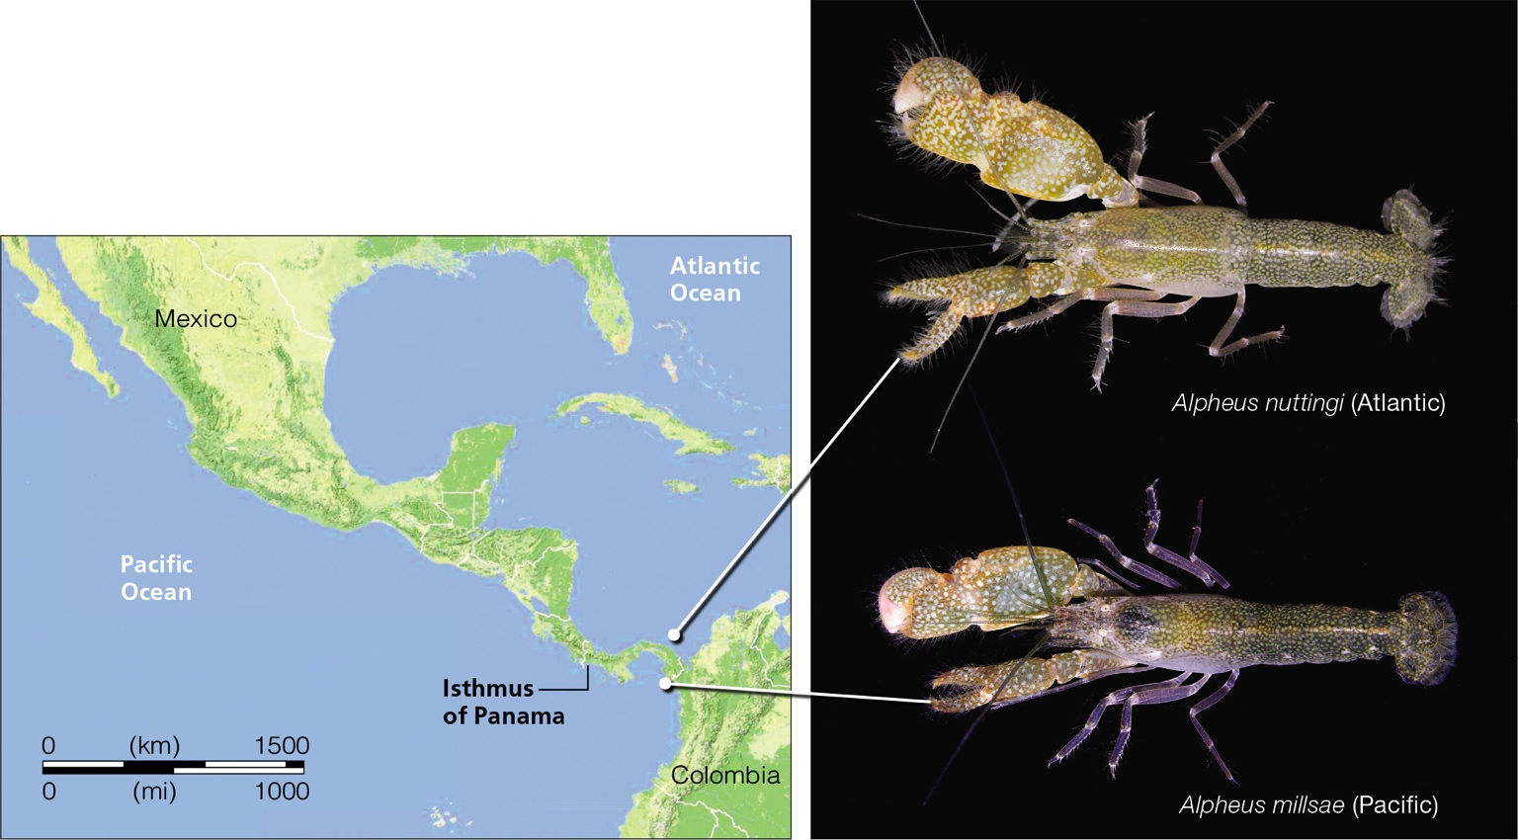
Allopatric Speciation in Snapping Shrimp
Notes:
Figure 17.18 An example of allopatric speciation. When the Isthmus of Panama formed 4 million years ago, it cut off gene flow among ocean-dwelling populations of snapping shrimp. Today, shrimp species on opposite sides of the isthmus are so similar that they might interbreed, but they are reproductively isolated: Instead of mating when they are brought together, they snap their claws at one another aggressively. The photos show two of the many closely related species that live on opposite sides of the isthmus.

Slide 54
Speciation in Archipelagos (1 of 2)
Archipelagos are isolated island chains formed by volcanoes, such as the Hawaiian and Galápagos Islands
Archipelagos were populated by a few individuals of mainland species whose descendants diverged over time
Selection pressures within and between the islands can foster even more divergences

Slide 55
Speciation in Archipelagos (2 of 2)
The first birds to colonize the Hawaiian Islands found a near absence of competitors and predators and an abundance of rich and vacant habitats, which encouraged rapid speciation
Honeycreepers, unique to the Hawaiian Islands, have specialized bills and behaviors adapted to feed on certain insects, seeds, fruits, nectar, or other foods

Slide 56
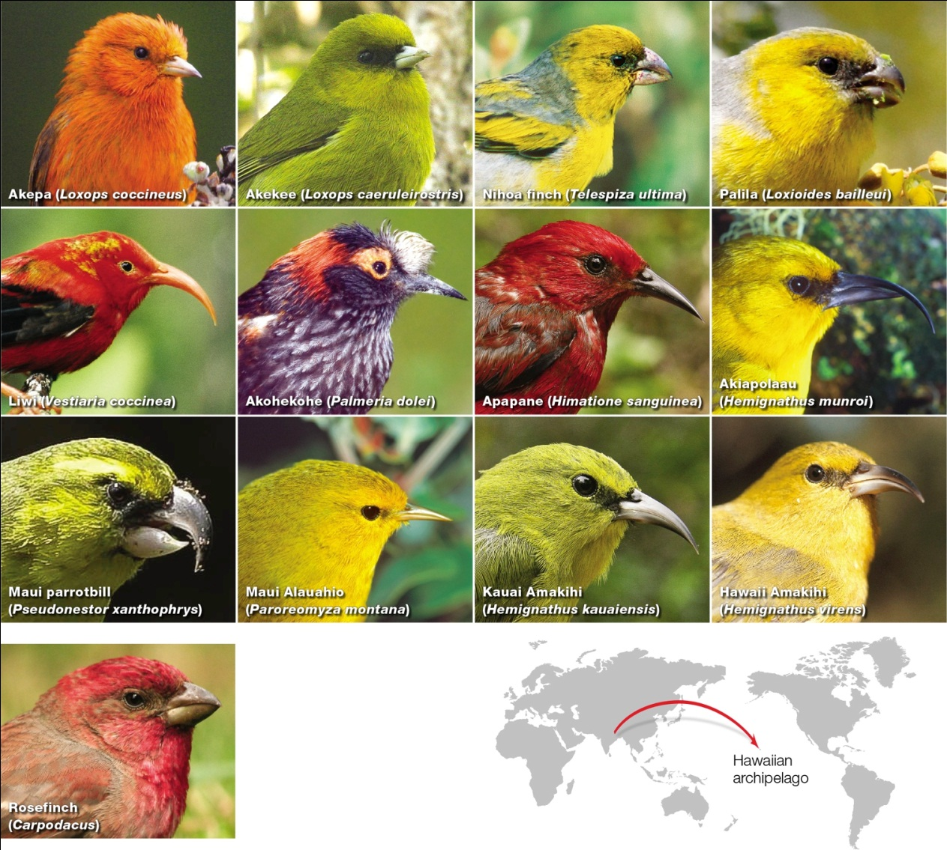
Honeycreepers
Notes:
Figure 17.19 A few Hawaiian honeycreepers (above). The bills of these bird species are adapted to feed on insects, seeds, fruits, nectar in floral cups, or other foods. All Hawaiian honeycreepers descended from a Eurasian rosefinch that probably resembled modern rosefinches (left).

Slide 57
17.9 Other Speciation Models
Sympatric speciation
Populations sometimes speciate even without a physical barrier that bars gene flow between them
Can occur instantly with a change in chromosome number – many plants are polyploid (e.g., wheat)

Slide 58
Sympatric Speciation
Examples of sympatric speciation
Wheat (polyploidy)
Common bread wheat resulted from a hybridization of a diploid and a tetraploid species
Lake Victoria cichlids (sexual selection)
In the same lake, female cichlids of different species visually select and mate with brightly colored males of their own species

Slide 59
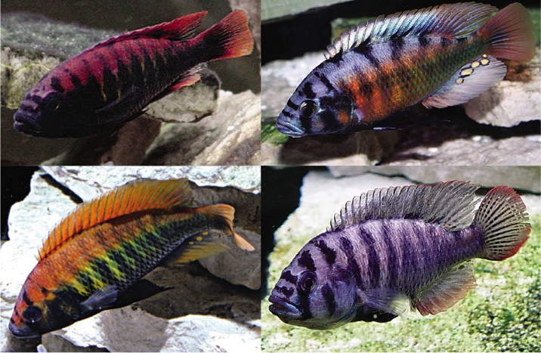
Cichlids
Notes:
Figure 17.21 Red fish, blue fish: Males of four closely related species of cichlid native to Lake Victoria, Africa. Hundreds of cichlid species arose by sympatric speciation in this lake. Mutations in genes that affect females’ perception of the color of ambient light in deeper or shallower regions of the lake also affect their choice of mates. Female cichlids prefer to mate with brightly colored males of their own species.

Slide 60
Parapatric Speciation
Parapatric speciation: may occur when one population extends across a broad region with diverse habitats
Example: Two species of velvet walking worm with overlapping habitats in Tasmania
Where they interbreed, their hybrids are sterile

Slide 61
17.10 Macroevolution
Macroevolution
Evolutionary patterns on a larger scale
There are five patterns of macroevolution
Stasis
Exaptation
Mass extinction
Adaptive radiation
Coevolution

Slide 62
Stasis
A lineage which persists for millions of years with little or no change
Example: Coelacanth
Ancient lobe-finned fish
Thought to be extinct
Rediscovered in 1938

Slide 63
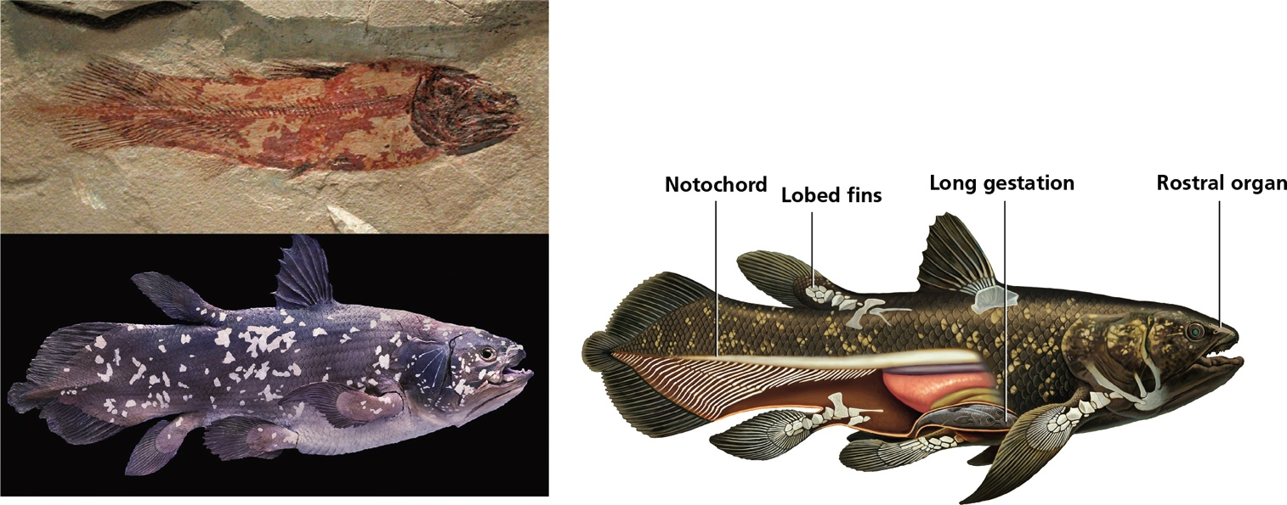
Coelacanth: A Static Species
Notes:
Figure 17.22 An example of stasis. Left, compare a 320-million-year-old coelacanth fossil found in Montana with a live coelacanth.
Right, a few of the coelacanth’s unusual ancestral features that have been lost in almost all other fish lineages over evolutionary time.
Notochord This tough, elastic tube, which is partially hollow and filled with fluid, is ancestral to the spinal cord.
Lobed fins These fleshy fins retain a few of the ancestral bones that gave rise to legs and arms in other lineages.
Long gestation Coelacanths give birth to litters of up to 26 fully developed “pups” after gestation of more than a year.
Rostral organ A sensory organ that perceives electrical impulses in water, it probably helps the fish locate prey in dark ocean depths.

Slide 64
Exaptation
Adaptation of an existing structure for a completely different purpose; a major evolutionary novelty
Example: Feathers on modern bird used for flight evolved from feather on dinosaurs used for insulation

Slide 65
Mass Extinctions
Simultaneous losses of many lineages
Extinct: refers to a species that has been permanently lost
99 percent of all species that have ever lived are now extinct
Fossil record indicated that there have been more than 20 mass extinctions
Five catastrophic events in which the majority of species on Earth disappeared

Slide 66
Adaptive Radiation
Lineage rapidly diversifies into several new species
A burst of genetic divergences
Can occur after individuals colonize a new environment that has a variety of different habitats with few or no competitors
Can involve a key innovation
A new trait that allows its bearer to exploit a habitat more efficiently or in a novel way

Slide 67
Coevolution
Joint evolution of two closely interacting species
Each is a selective agent for traits of the other
Each adapts to changes in the other
Over evolutionary time, two species may become so interdependent that they can no longer survive without one another
e.g., the large blue butterfly (Maculinea arion) and red ant (Myrmica sabuleti)

Slide 68
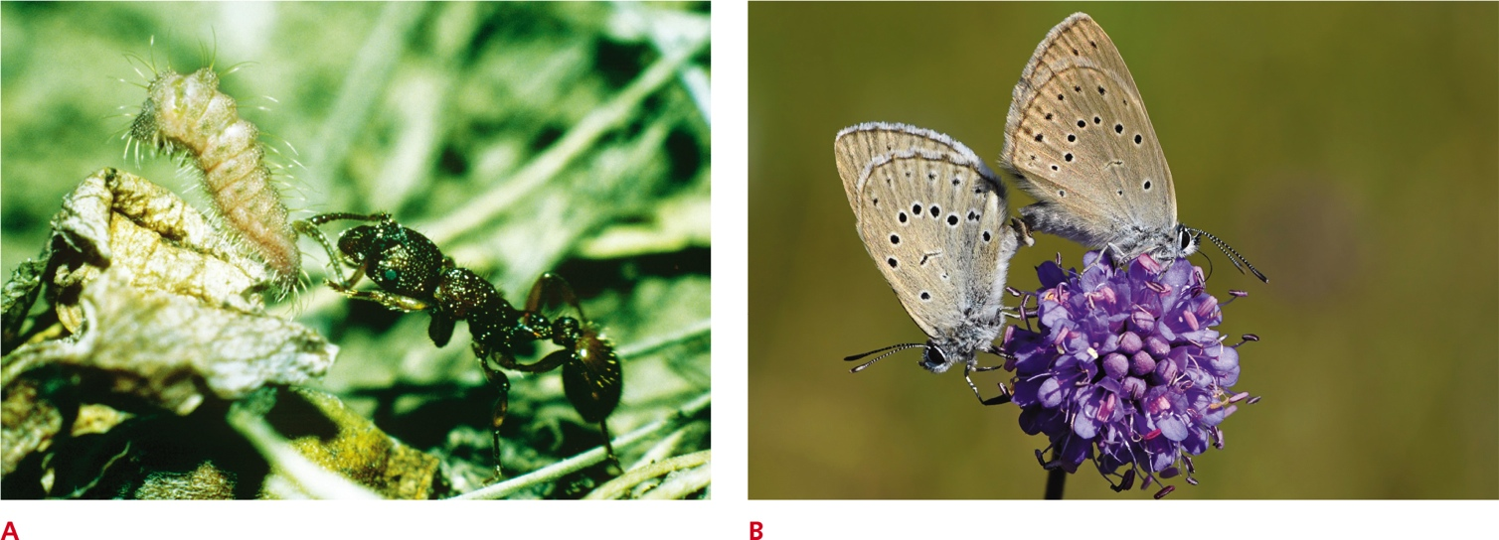
Coevolved Species
Notes:
Figure 17.23 An example of coevolved species: Maculinea arion and Myrmica sabuleti.
A A Maculinea arion caterpillar interacting with a Myrmica sabuleti ant. This beguiled ant is preparing to carry the honey-exuding, hunched-up caterpillar back to its nest, where the caterpillar will feed on ant larvae for the next 10 months until it becomes a pupa.
B Maculinea arion butterflies emerge from pupae to feed, mate, and lay eggs on wild thyme flowers. Larvae that emerge from the eggs will survive only if a colony of Myrmica sabuleti ants adopts them.

Slide 69
Evolutionary Theory
Biologists disagree about how macroevolution occurs
Dramatic jumps in morphology may be the result of mutations in homeotic or other regulatory genes
Macroevolution may be an accumulation of many microevolutionary events, or it may be an entirely different process

Slide 70
17.11 Phylogeny (1 of 2)
Instead of trying to divide the diversity of living organisms into a series of taxonomic ranks, most biologists are now focusing on evolutionary connections
Phylogeny
Grouping species on the basis of their shared characters
Like a genealogy

Slide 71
Phylogeny (2 of 2)
Each species bears traces of its own evolutionary history in its characters
Character: quantifiable, heritable trait
Biologists group species on shared characters
The base of the group is a derived trait, a character present in a group under study but not the group’s ancestors

Slide 72
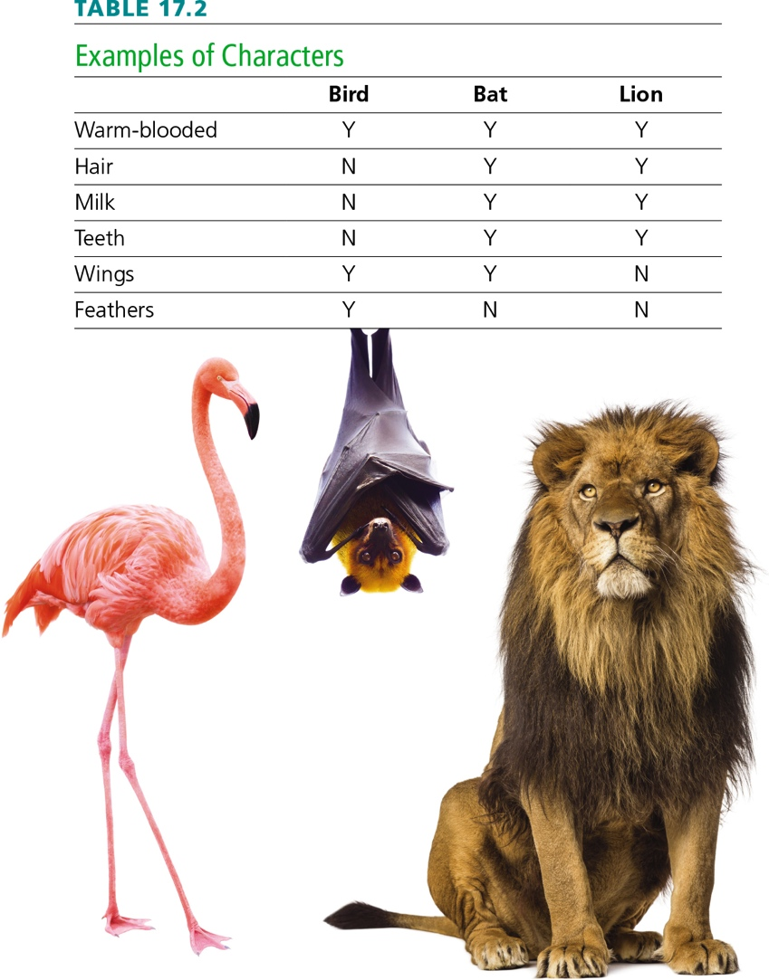
Characters
Notes:
Table 17.2 Examples of Characters

Slide 73
Cladistics
Making hypotheses about evolutionary relationships is the field of cladistics
Relationships are diagramed in evolutionary trees
Cladogram is a visual summary of the hypothesis

Slide 74
Cladistic Trees
Notes:
Figure 17.25 An example of cladistics, using parsimony analysis with the characters in Table 17.2. A, B, and C show the three possible evolutionary pathways that could connect birds, bats, and lions; red indicates the evolution of a derived trait. The pathway most likely to be correct (C) is the simplest—the one in which the derived traits would have had to evolve the fewest number of times in total.

Slide 75
17.12 Applications of Phylogeny
Hawaiian honeycreepers illustrate how evolution works
Isolation that spurred honeycreepers’ adaptive radiations also ensured they had no built-in defences against predators or diseases from the mainland
Specializations became hindrances when habitats suddenly changed or disappeared

Slide 76
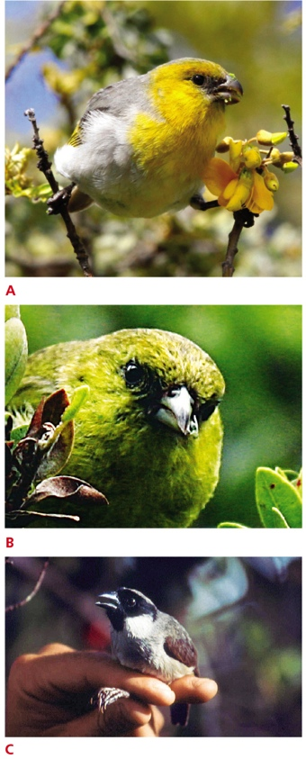
Conservation of Honeycreepers
Notes:
Figure 17.26 Three honeycreeper species: going, going, gone
A The palila has an adaptation that allows it to feed on the seeds of a native Hawaiian plant, which are toxic to most other birds. The one remaining palila population is declining because these plants are being trampled by cows and gnawed to death by goats and sheep.
B The unusual lower bill of the akekee points to one side, allowing this bird to pry open buds that harbor insects.
C This poouli—rare, old, and missing an eye—died in 2004 from avian malaria. There were two other poouli alive at the time, but neither has been seen since then.

Slide 77
Medical Research
Cladistics allows researchers to study the evolution of viruses and infectious agents
H5N1 influenza virus infects birds and other animals
Phylogenetic analysis shows species ‘jumps’ from birds to pigs, with 1 isolates potentially transmittable to humans

Slide 78
Discuss
How does phenotypic variation arise?
Think of examples of human alleles whose frequencies vary from one region to the next.
Why are conservationists concerned when the genetic variation within a population of rare or endangered organisms begins to decrease?

