Slide 1
Exploring Environmental Science for AP®
1st Edition
Chapter 16
Environmental Hazards and Human Health
Copyright © 2018 Cengage Learning. All Rights Reserved. May not be copied, scanned, or duplicated, in whole or in part, except for use as permitted in a license distributed with a certain product or service or otherwise on a password-protected website for classroom use.

Slide 2
Core Case Study: Mercury’s Toxic Effects (1 of 2)
All mercury compounds are toxic
One third in the atmosphere comes from natural sources
Human activities provide the rest
Two main human exposures
Fish contaminated with mercury
Inhalation of vaporized mercury
Can cause birth defects and brain damage

Slide 3
Core Case Study: Mercury’s Toxic Effects (2 of 2)
Notes:
Figure 17.1 Fish are contaminated with mercury in many lakes, including this one in Wisconsin.

Slide 4
16.1 What Major Health Hazards Do We Face?
Major types of hazards that threaten human health
Biological hazards
Chemical hazards
Natural hazards
Cultural hazards
Lifestyle choices

Slide 5
We Face Many Types of Hazards (1 of 5)
Risk
Probability of suffering harm from a hazard
Expressed as ratio or percentage
Risk assessment
Using statistical methods to estimate harm
Risk management
Deciding whether and how to reduce a particular risk

Slide 6
We Face Many Types of Hazards (2 of 5)
Risk assessment
Hazard identification
What is the hazard?
Probability of risk
How likely is the event?
Consequences of risk
What is the likely damage?

Slide 7
We Face Many Types of Hazards (3 of 5)
Risk management
Comparative risk analysis
How does it compare with other risks?
Risk reduction
How much should it be reduced?
Risk reduction strategy
How will the risk be reduced?
Financial commitment
How much money should be spent?

Slide 8
We Face Many Types of Hazards (4 of 5)
Biological hazards
Pathogen
Organism that causes disease in other organisms
Chemical
Harmful chemicals in the air, water, soil, and food
Natural
Fire, earthquakes, volcanic eruptions, floods, tornados, and hurricanes

Slide 9
We Face Many Types of Hazards (5 of 5)
Cultural hazards
Unsafe working conditions, criminal assault, and poverty
Lifestyle choices
Smoking, making poor food choices, and having unsafe sex

Slide 10
16.2 How Do Biological Hazards Threaten Human Health?
The most serious biological hazards we face are infectious diseases
Examples: flu, acquired immune deficiency syndrome (AIDS), tuberculosis, diarrheal diseases, and malaria

Slide 11
Some Diseases Can Spread from Person to Person (1 of 4)
Infectious disease
Pathogen invades the body and multiplies
Viruses, bacteria, and parasites
Transmissible disease
Contagious or communicable disease
Infectious disease transmitted between people
Examples: the common cold, tuberculosis, and gonorrhea

Slide 12
Some Diseases Can Spread from Person to Person (2 of 4)
Nontransmissible disease
Not caused by living organisms
Examples: cardiovascular diseases, most cancers, asthma, and diabetes
Epidemic
Large-scale outbreak of an infectious disease
Pandemic: global epidemic

Slide 13
Some Diseases Can Spread from Person to Person (3 of 4)
Notes:
Figure 17.3 The World Health Organization has estimated that the world’s seven deadliest infectious diseases killed about 8.3 million people per year—most of them poor people in less-developed countries (Concept 17.2). Data analysis: How many people die from all seven of the infectious diseases every year? Every day?

Slide 14
Some Diseases Can Spread from Person to Person (4 of 4)
Infectious disease was the leading cause of death in the world in 1900
Incidence of infectious disease has dropped significantly since then
Still a problem, especially in less-developed countries
Many disease-carrying bacteria have developed genetic immunity to widely used antibiotics
Climate change allows disease vectors to increase their range

Slide 15
Case Study: The Global Threat from Tuberculosis (1 of 2)
Tuberculosis (TB)
Highly contagious bacterial infection of the lungs
Spreading since 1990
Why is tuberculosis on the rise?
Lack of screening and control programs
Genetic resistance to majority of effective antibiotics
Person-to-person contact has increased
Population growth, air travel, urbanization

Slide 16
Case Study: The Global Threat from Tuberculosis (2 of 2)
Notes:
Figure 17.4 Colorized red areas in this chest X-ray show where TB bacteria have destroyed lung tissue.

Slide 17
Critical Concept: World Agencies
United Nations
Promotes dialog between countries with goal of world peace
International health matters
World Health Organization
Improvement of human health by monitoring and assessing health trends
World Bank
Provides technical and financial assistance to developing countries

Slide 18
Viral Diseases and Parasites Are Killers (1 of 2)
Influenza or flu virus
Kills the most worldwide
Human immunodeficiency virus (HIV)
Infects about two million people yearly
Hepatitis B virus (HBV)
Ebola
West Nile virus
Zika virus

Slide 19
Viral Diseases and Parasites Are Killers (2 of 2)
Viruses that move from animals to humans
New field: ecological medicine
Good hygiene can reduce chances of infection
Wash your hands
Do not share razors or towels
Cover cuts and scrapes until healed
Avoid contact with people with viral diseases
Do not touch your eyes, nose, and mouth

Slide 20
Case Study: The Global HIV/AIDS Epidemic (1 of 2)
AIDS
Caused by HIV
Leaves the body vulnerable to infections
Leading cause of death for people ages 15–49 worldwide
No vaccine to prevent or cure AIDS
Costly drugs can slow viral progress

Slide 21
Case Study: The Global HIV/AIDS Epidemic (2 of 2)
Notes:
Figure 17.6 In Botswana, more than 25% of people ages 15–49 were infected with HIV in 2011. This figure shows two projected age structures for Botswana’s population in 2020—one including the possible effects of the AIDS epidemic (red bars), and the other not including those effects (yellow bars). Critical thinking: How might this affect Botswana’s economic development?

Slide 22
Case Study: Malaria–The Spread of a Deadly Parasite (1 of 3)
Malaria
Caused by parasite carried by certain mosquitoes
Tropical and subtropical regions
Spread
Uninfected mosquito bites infected person, later bites an uninfected person
Climate change–expected to spread malaria to warming temperate areas

Slide 23
Case Study: Malaria–The Spread of a Deadly Parasite (2 of 3)
Malaria incidence increasing since 1970
Drug-resistant Plasmodium parasites
Insecticide-resistant mosquitoes
No effective vaccine is available
Insecticide-treated bed nets and window screens
Have saved 6.2 million lives between 2000 and 2014

Slide 24
Case Study: Malaria–The Spread of a Deadly Parasite (3 of 3)
Notes:
Figure 17.8 This baby in Senegal, Africa, is sleeping under an insecticide-treated mosquito net to reduce the risk of being bitten by malaria-carrying mosquitoes.

Slide 25
Reducing the Incidence of Infectious Diseases (1 of 2)
Percentage of worldwide deaths from infectious diseases
Dropped from 35% to 16% from 1970 to 2015
More children being immunized
Average annual deaths from infectious disease in children under age five:
Reduced from 12 million to 4.9 million between 1990 and 2015

Slide 26
Reducing the Incidence of Infectious Diseases (2 of 2)
Notes:
Figure 17.9 Ways to prevent or reduce the incidence of infectious diseases, especially in less-developed countries. Critical thinking: Which three of these approaches do you think are the most important? Why?

Slide 27
16.3 How Do Chemical Hazards Threaten Human Health?
Certain chemicals in the environment:
Can cause cancers and birth defects
Can disrupt the human immune, nervous, and endocrine systems

Slide 28
Some Chemicals Can Cause Cancers, Mutations, and Birth Defects
Toxic chemicals
Carcinogens
Chemicals, types of radiation, or certain viruses that cause or promote cancer
Mutagens
Chemicals or radiation that cause mutations or increase their frequency
Teratogens
Chemicals that cause harm or birth defects to a fetus or embryo

Slide 29
Case Study: PCBs Are Everywhere–A Legacy from the Past (1 of 2)
Class of chlorine-containing compounds
Very stable
Nonflammable
Break down slowly in the environment
Travel long distances in the air
Fat soluble
Biologically magnified in food chains and food webs
Now banned, but found everywhere

Slide 30
Case Study: PCBs Are Everywhere–A Legacy from the Past (2 of 2)
Notes:
Figure 17.10 Biological magnification of polychlorinated biphenyls (PCBs) in an aquatic food chain in the Great Lakes.

Slide 31
Some Chemicals Can Affect Our Immune and Nervous Systems (1 of 2)
Immune system
Protects human body against disease
Arsenic, methylmercury, and dioxins can weaken
Neurotoxins can harm human nervous system
Examples: PCBs, arsenic, lead, and certain pesticides
Methylmercury especially dangerous

Slide 32
Some Chemicals Can Affect Our Immune and Nervous Systems (2 of 2)
Notes:
Figure 17.11 Movement of different forms of toxic mercury from the atmosphere into an aquatic ecosystem where it is biologically magnified in a food chain. Critical thinking: What is your most likely exposure to mercury?

Slide 33
Some Chemicals Affect the Endocrine System (1 of 5)
Endocrine system
Glands that release hormones that regulate bodily systems
Control sexual reproduction, growth, development, learning ability, and behavior
Hormonally active agents (HAA)
Also called endocrine disruptors
Have similar shapes and bind to hormone receptors

Slide 34
Some Chemicals Affect the Endocrine System (2 of 5)
Hormone mimics
Bisphenol A (BPA) mimics estrogen
Hormone blockers
Thyroid disruptors
Perfluorinated chemicals (PFOAs) used to make nonstick cookware linked to thyroid disease, cancer, and birth defects
Polybrominated diphenyl ethers (PBDEs)
In fabrics, furniture, mattresses, and plastics

Slide 35
Some Chemicals Affect the Endocrine System (3 of 5)
Notes:
Figure 17.12 Ways to prevent or control inputs of mercury (Core Case Study) into the environment from human sources—mostly coal-burning power plants and incinerators. Critical thinking: Which four of these solutions do you think are the most important? Why?

Slide 36
Some Chemicals Affect the Endocrine System (4 of 5)
Notes:
Figure 17.13 Each type of hormone has a unique molecular shape that allows it to attach to specially shaped receptors on the surface of, or the inside of, a cell and to transmit its chemical message (left). Molecules of certain pesticides and other synthetic chemicals, called hormonally active agents (HAAs, center and right), have shapes similar to those of natural hormones, allowing them to attach to the hormone molecules and disrupt the endocrine systems of humans and other animals.

Slide 37
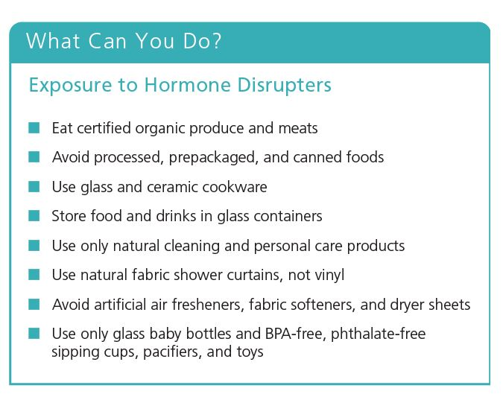
Some Chemicals Affect the Endocrine System (5 of 5)
Notes:
Figure 17.14 Individuals matter: Ways to reduce your exposure to hormone disrupters. Critical thinking: Which three of these steps do you think are the most important ones to take? Why?

Slide 38
16.4 How Can We Evaluate Risks from Chemical Hazards?
Methods to estimate chemical toxicity
Live laboratory animals
Case reports of poisonings
Epidemiological studies
Many health scientists call for much greater emphasis on pollution prevention
To reduce our exposure to potentially harmful chemicals

Slide 39
Many Factors Determine the Toxicity of Chemicals (1 of 2)
Toxicology: study of harmful effects
Dose
Age
Genetic makeup
Multiple chemical sensitivity (MCS)
Solubility
Persistence
Biological magnification

Slide 40
Many Factors Determine the Toxicity of Chemicals (2 of 2)
Synergistic interaction
Effect of two or more agents interacting is greater than the sum of the agents
Response
Acute effect–immediate or rapid
Chronic effect–permanent or long-lasting

Slide 41
Case Study: Protecting Children from Toxic Chemicals
Analysis of umbilical cord blood
180 chemicals found that cause cancers in humans or animals
Infants and children more susceptible
Eat, drink, and breathe more air per unit of body weight than adults
Exposed to toxins in dust and soil when they put objects in their mouths
Less well-developed immune systems

Slide 42
Scientists Use Live Various Tests to Estimate Toxicity (1 of 3)
Studies usually involve mice and rats
Systems similar to human systems
Small, and reproduce rapidly
Dose-response curve–median lethal dose (LD50)
Nonthreshold dose-response model
Threshold dose-response model

Slide 43
Scientists Use Live Various Tests to Estimate Toxicity (2 of 3)
Notes:
Figure 17.16 Dose-response curves. Scientists estimate the toxicity of various chemicals by determining how a chemical’s harmful effects change as the dose increases. Some chemicals behave according to the nonthreshold model (left curve). Others behave according to the threshold model (center curve). Still others are unconventional in how they behave (right curve). For all of these graphs, the curves usually vary from being exactly linear, or straight. Critical thinking: Can you think of commonly used chemicals that fit each of these models? What are they?

Slide 44
Scientists Use Various Tests to Estimate Toxicity (3 of 3)
More humane methods than using animals
Replace animals with other models
Computer simulations
Tissue culture and individual animal cells
Effects of mixtures of potentially toxic chemicals difficult to determine

Slide 45
Are Trace Levels of Toxic Chemicals Harmful? (1 of 2)
Insufficient data for most chemicals
More research needed
We are all exposed to toxic chemicals
Trace amounts

Slide 46
Are Trace Levels of Toxic Chemicals Harmful? (2 of 2)
Notes:
Figure 17.17 A number of potentially harmful chemicals are found in many homes. Critical thinking: Does the fact that we do not know much about the long-term harmful effects of these chemicals make you more likely or less likely to minimize your exposure to them? Why?

Slide 47
Why Do We Know So Little about the Harmful Effects of Chemicals?
There are severe limitations in estimating toxicity levels and risks
Only 10% of over 85,000 registered synthetic chemicals have been thoroughly screened for toxicity
99.5% of chemicals used in the United States are not supervised by government

Slide 48
Pollution Prevention and the Precautionary Principle (1 of 2)
Precautionary principle
Those introducing a new chemical or new technology need to follow new strategies
A new product is considered harmful until proven safe
Existing chemicals and technologies that appear to cause significant harm must be removed
2000: international agreement to ban or phase out the dirty dozen persistent organic pollutants (POPs)

Slide 49
Pollution Prevention and the Precautionary Principle (2 of 2)
2007: European Union enacted REACH
Requires registration of untested substances
Most hazardous substances not approved for use if safer alternatives exist
2011: EPA issued new pollution prevention standards
Mercury emissions from coal-burning plants
Minamata Convention
Goal: reduce global mercury emissions

Slide 50
Case Study: Pollution Prevention Pays
The 3M Company
1975 to 2015, prevented more than 2 million tons of pollutants from reaching the environment
Saved company $1.9 billion
Employee reward program for projects that eliminate or reduce a pollutant

Slide 51
16.5 How Do We Perceive and Avoid Risks?
Ways to reduce risks
Becoming informed
Thinking critically about risks
Making careful choices

Slide 52
The Greatest Health Risks Come from Poverty, Gender, and Lifestyle Choices (1 of 3)
Poverty
Greatest health risk by far
Malnutrition, increased infectious diseases, and unsafe drinking water
Gender
Being born male
Lifestyle choices
Examples: overeating and smoking

Slide 53
The Greatest Health Risks Come from Poverty, Gender, and Lifestyle Choices (2 of 3)
Notes:
Figure 17.19 Estimated deaths per year in the world from various causes (left). Numbers in parentheses represent these death tolls in terms of numbers of fully loaded 200-passenger jet airplanes crashing every day of the year with no survivors. Poverty has several harmful effects (right graph) that make it the leading cause of premature death. Critical thinking: Which three of these causes (left graph) are the most threatening to you?

Slide 54
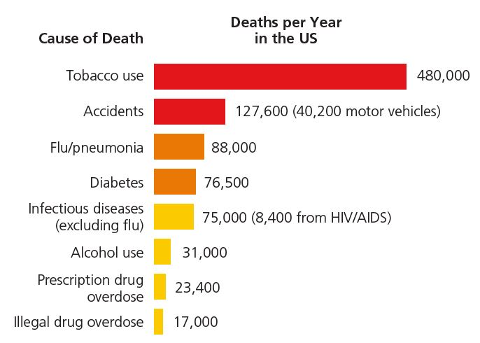
The Greatest Health Risks Come from Poverty, Gender, and Lifestyle Choices (3 of 3)
Leading causes of death in the United States. Some result from lifestyle choices and are preventable.

Slide 55
Case Study: Cigarettes and E-Cigarettes (1 of 2)
Cigarette smoking
Most preventable major cause of suffering and premature death among adults
Killed 100 million people during the 20th century
Study linked to increased dementia and Alzheimer’s disease
Nicotine: highly additive
Secondhand smoke poses health hazards

Slide 56
Case Study: Cigarettes and E-Cigarettes (2 of 2)
Smoking decline in the United States
From more than 50% of adults in the 1950s to 18% in 2013
E-cigarettes
Substitute for tobacco cigarettes
Vapors contain toxic metals
Used by more than 13% of high school students in 2014
European Union banned sales to minors

Slide 57
Estimating Risks from Technologies
Reliability
System reliability (%) = Technological reliability (%) x Human reliability (%)
Human reliability is much lower than technological reliability
Much harder to predict

Slide 58
Most People Do a Poor Job of Evaluating Risks
Factors causing misjudgments in risk
Fear
Degree of control
Whether a risk is catastrophic or chronic
Optimism bias
Instant gratification

Slide 59
Guidelines for Evaluating and Reducing Risk
Compare risks
Determine how much you are willing to accept
Evaluate the actual risk involved
Concentrate on evaluating and carefully making important lifestyle choices

