Slide 1
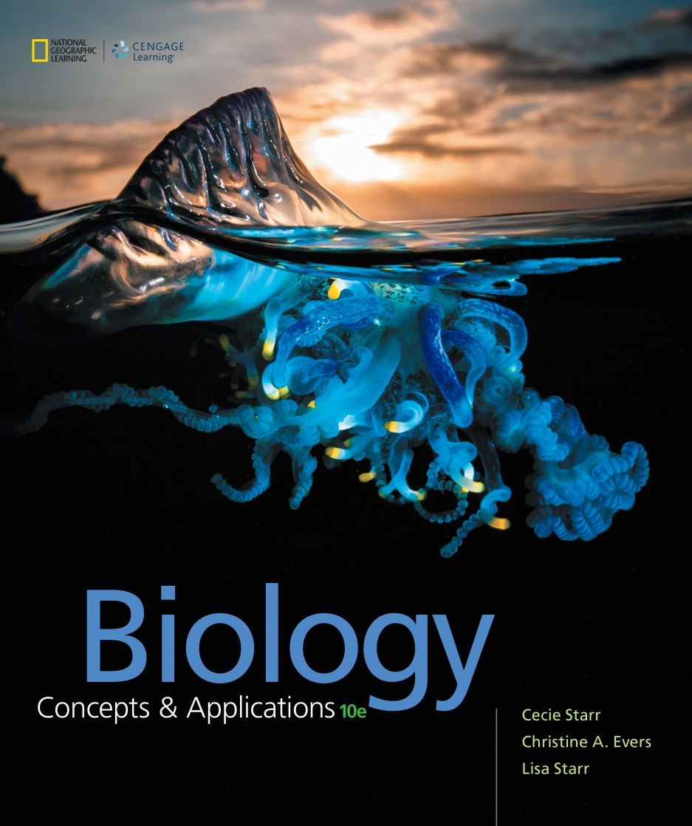
Biology Concepts & Applications
10 Edition
Chapter 12
Meiosis and Sexual Reproduction
Copyright © 2018 Cengage Learning. All Rights Reserved. May not be copied, scanned, or duplicated, in whole or in part, except for use as permitted in a license distributed with a certain product or service or otherwise on a password-protected website for classroom use.

Slide 2
12.1 Why Sex?
In asexual reproduction, a single individual gives rise to offspring that are identical to itself and others
In sexual reproduction, two individuals mix their genetic material

Slide 3
Introducing Alleles (1 of 2)
Somatic (body) cells of sexually reproducing eukaryotes contain pairs of homologous chromosomes
One from the mother and one from the father
Homologous chromosomes
Carry genes (one from the mother and one from the father) of the same characteristics
Different forms of the same gene are called alleles

Slide 4
Introducing Alleles (2 of 2)
Paired genes on homologous chromosomes may vary in DNA sequences as alleles
Arise by mutation
Are the basis of differences in shared traits
Offspring of sexual reproducers inherit new combinations of parental alleles
Results in new combinations of traits

Slide 5
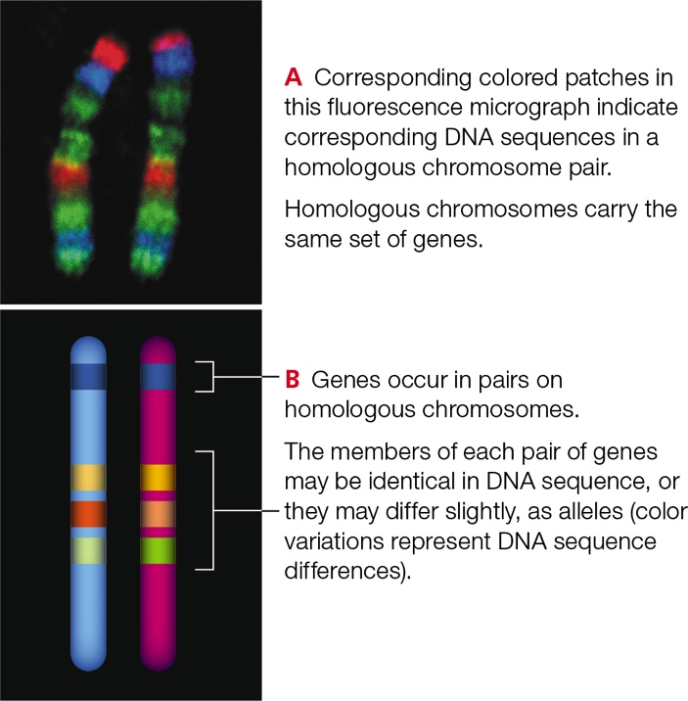
Genes on Homologous Chromosomes
Notes:
Figure 12.1 Genes on homologous chromosomes. Different forms of a gene are called alleles.

Slide 6
On the Advantages of Sex
Sex mixes up the genes of two parents, so offspring have unique combinations of traits
Diversity offers a better chance of surviving environmental change than clones

Slide 7
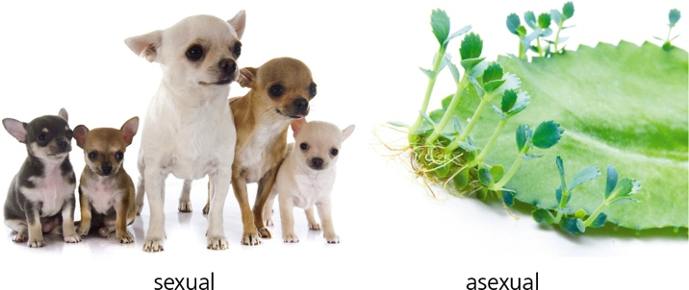
Different Modes of Reproduction
Notes:
Figure 12.2 Different species use different modes of reproduction. Left, offspring of sexual reproducers differ from one another and from their parents. Right, asexual reproduction, which is not unusual in plants, gives rise to genetically identical offspring.

Slide 8
Red Queen Hypothesis
In reference to Lewis Carroll’s book Through the Looking Glass
Queen of Hearts tells Alice, “It takes all the running you can do, to keep in the same place”
Organisms must constantly adapt and evolve in an ever-changing environment
Used to explain the evolution of sexual reproduction

Slide 9
12.2 Meiosis in Sexual Reproduction
Sexual reproduction mixes up alleles from two parents
Involves the fusion of gametes, mature reproductive cells
Meiosis: a nuclear division mechanism that occurs in reproductive cells of eukaryotes

Slide 10
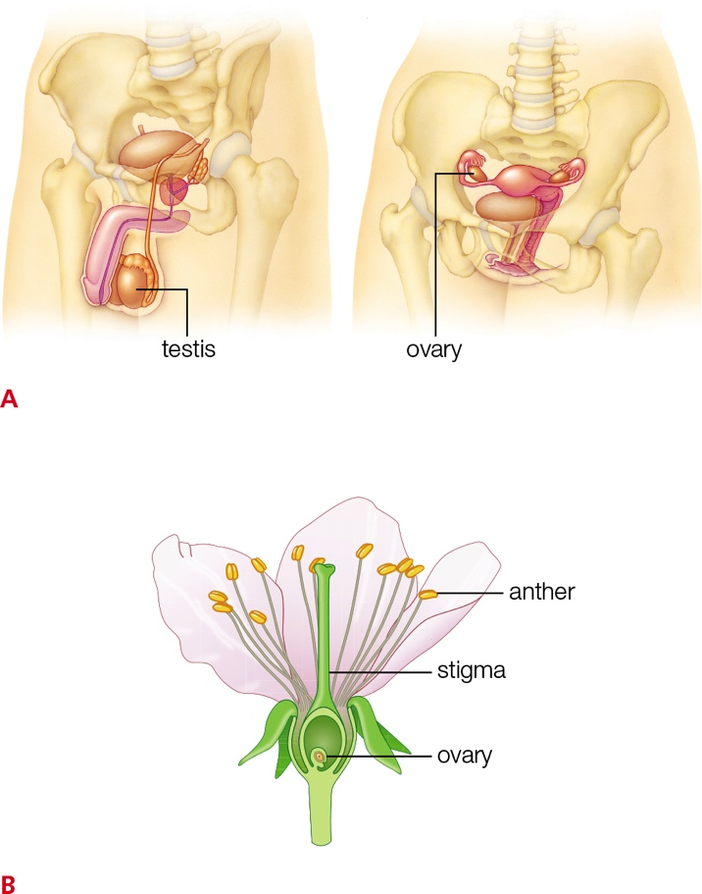
Reproductive Organs
Notes:
Figure 12.3 Examples of reproductive organs in A animals and B plants.
A Reproductive organs of humans. Meiosis in germ cells inside testes and ovaries produces gametes (sperm and eggs).
B A flower is an organ used for sexual reproduction in many plants. Meiosis produces haploid male germ cells inside anthers, and haploid female germ cells in ovaries. Male and female gametes form when germ cells divide by mitosis.

Slide 11
Meiosis Halves the Chromosome Number (1 of 2)
Gametes are specialized cells that are the basis of sexual reproduction
Derive from germ cells (immature reproductive cells)
All gametes are haploid (n), but they differ in other details
Gamete formation differs among plants and animals

Slide 12
Meiosis Halves the Chromosome Number (2 of 2)
Haploid germ cells form by meiosis
Gametes form when these cells divide by mitosis
Eggs = female gametes
Sperm = male gametes

Slide 13
Two Consecutive Nuclear Divisions
Interphase
DNA replication
Meiosis I
prophase I
metaphase I
anaphase I
Telophase I
Meiosis II
prophase II
metaphase II
anaphase II
Telophase II
Notes:
The two consecutive nuclear divisions are called meiosis I and meiosis II.

Slide 14
How Meiosis Works (1 of 3)
Nuclear division that halves the chromosome number in the reproductive cells
Ensures that offspring have the same number of chromosomes as the parents

Slide 15
How Meiosis Works (2 of 3)
Occurs in germ cells to produce gametes (mature reproductive cells)
Gametes are haploid (n)
Their chromosome number is half of the diploid (2n) number
Meiosis is a nuclear division

Slide 16
How Meiosis Works (3 of 3)
DNA replication occurs prior to meiosis:
The nucleus is diploid (2n) with two sets of chromosomes, one from each parent
During meiosis, chromosomes of a diploid nucleus become distributed into four haploid nuclei
Meiosis halves the diploid (2n) chromosome number to the haploid (n) chromosome number for forthcoming gametes

Slide 17
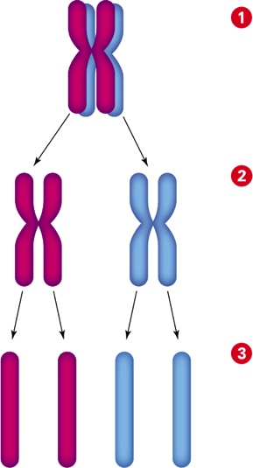
How Meiosis Halves the Chromosome Number
Notes:
Figure 12.4 How meiosis halves the chromosome number. DNA replication occurs before meiosis begins, so each chromosome consists of two identical molecules of DNA (sister chromatids). After meiosis, each chromosome consists of one molecule of DNA.
1 During meiosis I, each chromosome in the nucleus pairs with its homologous partner. The nucleus contains two of each chromosome, so it is diploid (2n).
2 Meiosis I separates homologous chromosomes and packages them in separate nuclei. Each new nucleus contains one of each chromosome, so it is haploid (n). The chromosomes are still duplicated.
3 Meiosis II separates sister chromatids and packages them into four new nuclei. Each new nucleus contains one of each chromosome, so it is haploid (n). The chromosomes are now unduplicated.

Slide 18
Fertilization Restores the Chromosome Number (1 of 2)
Haploid gametes form by meiosis
The diploid chromosome number is restored at fertilization
When two haploid gametes fuse, a zygote is formed
The first cell of a new individual

Slide 19
Fertilization Restores the Chromosome Number (2 of 2)
If meiosis did not precede fertilization, the chromosome number would double with every generation
Chromosome number changes can have drastic consequences in animals
An individual’s set of chromosomes is like a fine-tuned blueprint that must be followed exactly to have normal functions

Slide 20
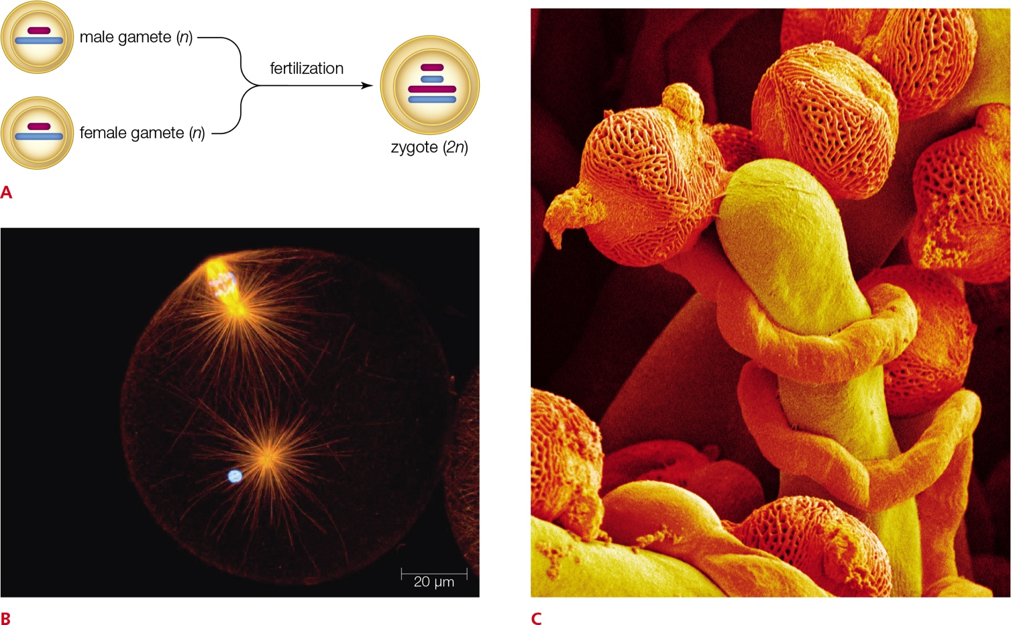
Sexual Reproduction
Notes:
Figure 12.5 Sexual reproduction involves the fusion of two gametes.
A At fertilization, two gametes meet to form a zygote.
B In germ cells of female animals, meiosis pauses at metaphase II, then resumes and finishes after fertilization. This is a freshly fertilized egg of a Cerebratulus worm. Its chromosomes are completing meiosis at the top of the cell; the blue spot is the nucleus of the sperm that fertilized it. Orange shows spindle microtubules; blue, DNA.
C In plants, meiosis completes before fertilization. These pollen grains (orange) are germinating on a stigma (yellow) of a flower. (Germination is growth after a period of metabolic rest.) Pollen tubes with male gametes inside are growing from the grains down into tissues of the ovary, which houses female gametes.

Slide 21
12.3 A Visual Tour of Meiosis
Meiosis I: Prophase I
Homologous chromosomes condense, pair up, and swap segments
Spindle microtubules attach to chromosomes as the nuclear envelope breaks up

Slide 22
A Visual Tour of Meiosis (1 of 7)
Meiosis I: Metaphase I
The homologous chromosome pairs are aligned midway between spindle poles

Slide 23
A Visual Tour of Meiosis (2 of 7)
Meiosis I : Anaphase I
The homologous chromosomes separate and begin heading toward the spindle poles

Slide 24
A Visual Tour of Meiosis (3 of 7)
Meiosis I: Telophase I
Two clusters of chromosomes reach the spindle poles
A new nuclear envelope forms around each cluster, so two haploid (n) nuclei form

Slide 25
A Visual Tour of Meiosis (4 of 7)
Meiosis II: Prophase II
The chromosomes condense
The nuclear envelope breaks up
Spindle microtubules attach to each sister chromatid

Slide 26
A Visual Tour of Meiosis (5 of 7)
Meiosis II: Metaphase II
The (still duplicated) chromosomes are aligned midway between poles of the spindle

Slide 27
A Visual Tour of Meiosis (6 of 7)
Meiosis II: Anaphase II
All sister chromatids separate
The (now unduplicated) chromosomes head to the spindle poles

Slide 28
A Visual Tour of Meiosis (7 of 7)
Meiosis II: Telophase II
A complete set of chromosomes clusters at each spindle pole
A new nuclear envelope encloses each cluster
Four haploid (n) nuclei form

Slide 29
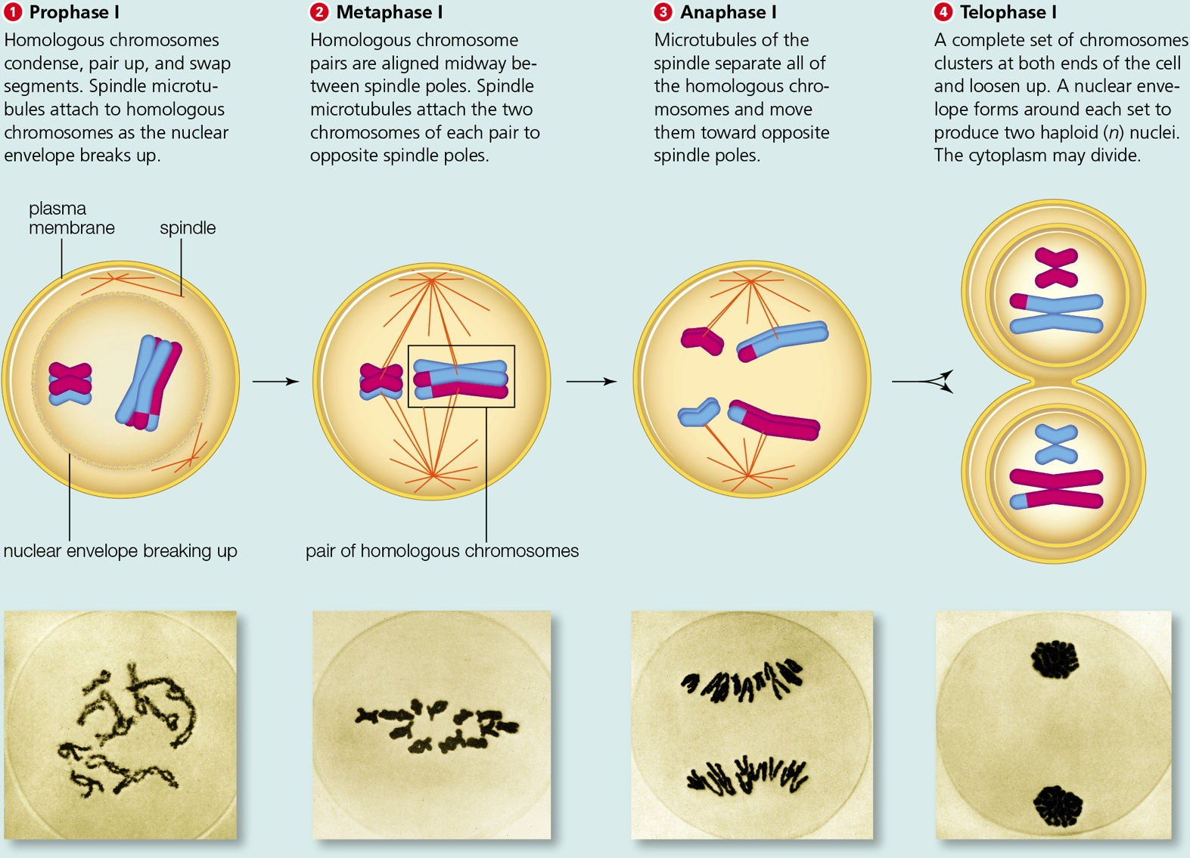
Meiosis I
Notes:
Meiosis I: One diploid nucleus to two haploid nuclei

Slide 30
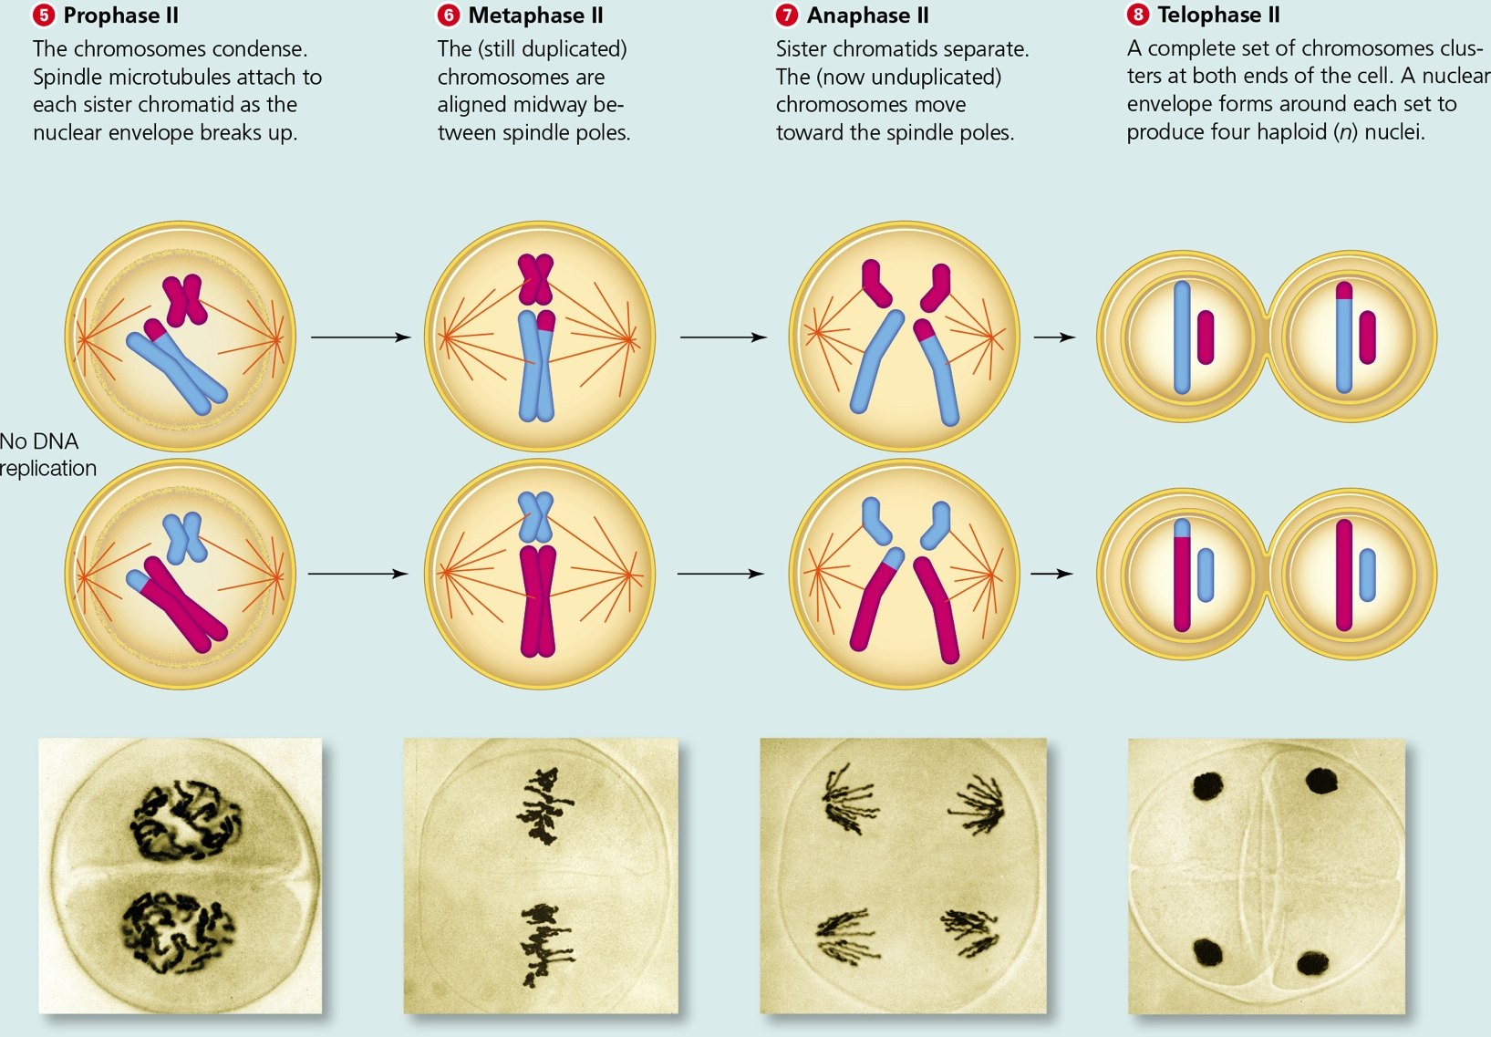
Meiosis II
Notes:
Meiosis II: Two haploid nuclei to four haploid nuclei

Slide 31
12.4 How Meiosis Introduces Variations in Traits
Two events in meiosis introduce novel combinations of alleles into gametes:
Crossing over in prophase I
Segregation of chromosomes into gametes
Along with fertilization, these events contribute to the variation in combinations of traits among the offspring of sexually reproducing species

Slide 32
Crossing Over (1 of 2)
Chromatids of homologous chromosomes condense and align along their length and exchange segments
Introduces novel combinations of traits among offspring

Slide 33
Crossing Over (2 of 2)
Notes:
Figure 12.7 Crossing over. For clarity, we focus on only two genes on one pair of homologous chromosomes. Blue signifies the paternal chromosome, and pink, the maternal chromosome.
A In this example, one gene has alleles A and a; the other gene has alleles B and b.
B Close contact between homologous chromosomes promotes crossing over, in which nonsister chromatids exchange corresponding pieces. Multiple crossovers are not uncommon.
C After crossing over, paternal and maternal alleles have been mixed up on homologous chromosomes.

Slide 34
Chromosome Segregation (1 of 3)
When homologous chromosomes separate in meiosis I, one of each chromosome pair goes to each of the two new nuclei
For each chromosome pair, the maternal or paternal version is equally likely to end up in either nucleus

Slide 35
Chromosome Segregation (2 of 3)
Human gametes have 23 pairs of homologous chromosomes
Each time a human germ cell undergoes meiosis the four gametes that form end up with one of 8,388,608 (or 2²³) possible combinations of homologous chromosomes
Crossing over increases this genetic diversity

Slide 36
Chromosome Segregation (3 of 3)
The chance that the maternal or paternal version of any chromosome will end up in a particular nucleus is 50%
The spindle randomly segregates the homologous chromosome during meiosis I
In prophase I, chromosomes are attached to spindle poles
Each homologous partner becomes attached to opposite spindle poles

Slide 37
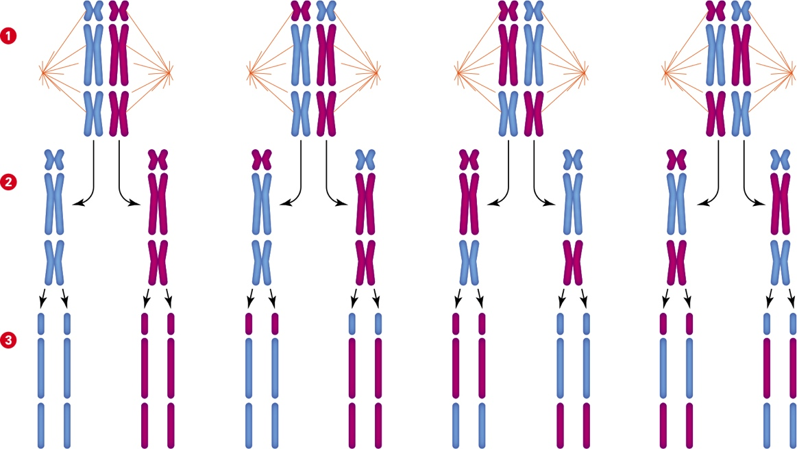
Segregation of Chromosome Pairs
Notes:
Figure 12.9 Segregation of three chromosome pairs during meiosis. Maternal chromosomes are pink in this hypothetical example; paternal chromosomes are blue. For simplicity, we show no crossing over, so all sister chromatids are identical.
1 The homologous chromosomes of three pairs can be divided between two spindle poles in four possible ways.
2 There are eight possible combinations of maternal and paternal chromosomes in the two nuclei that form at telophase I.
3 There are eight possible combinations of maternal and paternal chromosomes in the four nuclei that form at telophase II.

Slide 38
12.5 Mitosis and Meiosis—An Ancestral Connection?
There are striking parallels between the four stages of mitosis and meiosis II
Many more similarities exist at the molecular level
Meiosis may have evolved by remodeling the existing mechanisms of mitosis or for repairing damaged DNA

Slide 39
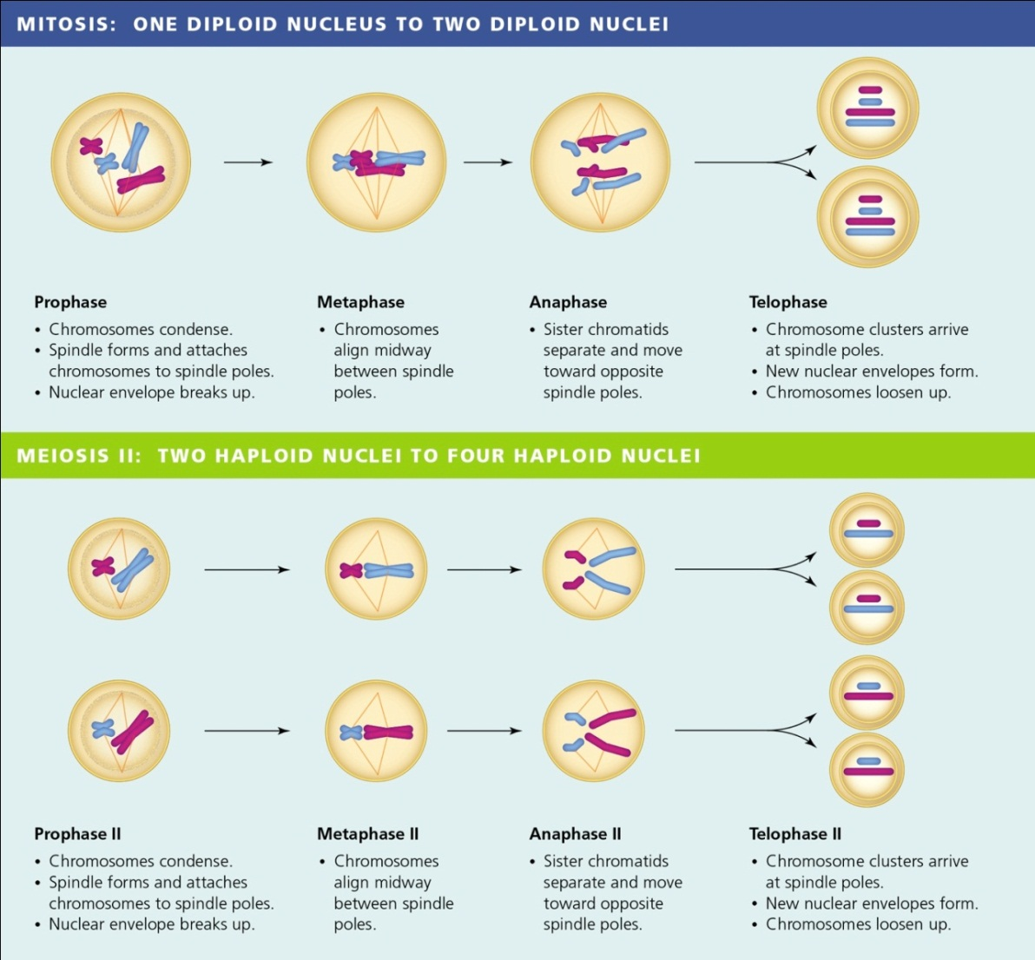
Comparing Meiosis II With Mitosis
Notes:
Figure 12.10 Comparing meiosis II with mitosis.

Slide 40
Meiosis from Mitosis
Evidence for this hypothesis includes a host of shared molecules
Includes the products of the BRCA genes made by all eukaryotes
By fixing the problems with DNA (mismatched base pairs), these molecules maintain integrity of the cell’s chromosomes

Slide 41
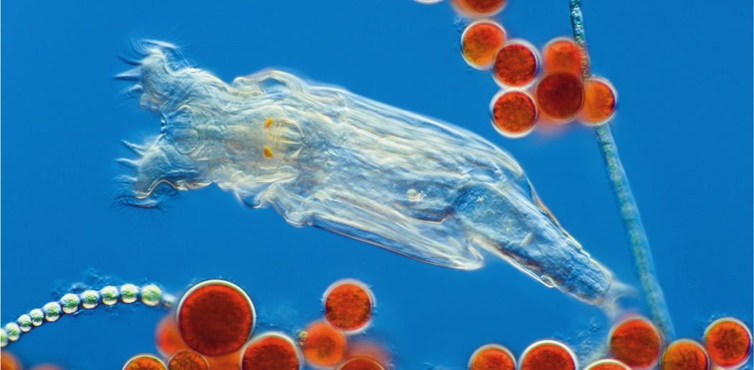
All Female Bdelloid Rotifer
Notes:
Figure 12.12 A bdelloid rotifer. All of these tiny animals are female.

Slide 42
Application: How To Survive 80 Million Years without Sex (1 of 2)
In nature, there are a few all-female species of fishes, reptiles, and birds but not mammals
Females have been reproducing themselves for 80 million years through cloning
Asexual reproduction is a poor long-term strategy because it lacks crossing over that leads to genetic diversity

Slide 43
How To Survive 80 Million Years Without Sex (2 of 2)
Bdelloid rotifers: microscopic animals found in fresh water
Males are not present within the species
Females reproduce by asexual cloning
Have diversified into 360 species
Can import genes from bacteria, fungi, protists, and even plants
About 10% of their active genes have been pilfered from other organisms

Slide 44
Discuss
Do more advanced organisms have more chromosomes than primitive organisms?
Division of the cell cytoplasm is equal during spermatogenesis but unequal during oogenesis. Can you think of at least one reason why?
What would happen in the formation of the zygote if meiosis did not halve the chromosome number?

