Slide 1
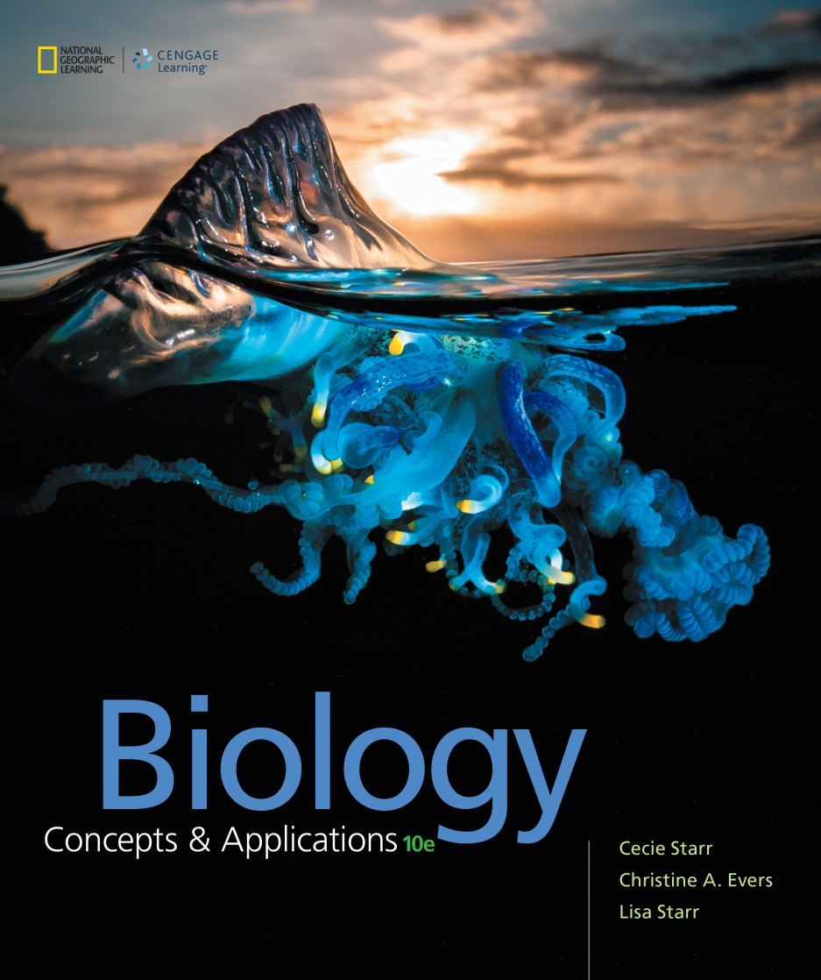
Biology Concepts & Applications
10 Edition
Chapter 11
How Cells Reproduce
Copyright © 2018 Cengage Learning. All Rights Reserved. May not be copied, scanned, or duplicated, in whole or in part, except for use as permitted in a license distributed with a certain product or service or otherwise on a password-protected website for classroom use.

Slide 2
11.1 Multiplication by Division
A life cycle is a collective series of events that an organism passes through during its lifetime
Even single cells of multicellular organisms have a life cycle
Cell cycle: a series of events from the time a cell forms until its cytoplasm divides

Slide 3
The Cell Cycle (1 of 3)
A typical cell spends most of its life in interphase
Interval between mitotic divisions when a cell grows
During interphase, a cell roughly doubles the number of its cytoplasmic components, and replicates its DNA

Slide 4
The Cell Cycle (2 of 3)
Three stages of interphase
G1: metabolic activities
S: DNA synthesis
G2: protein synthesis needed for cell division

Slide 5
The Cell Cycle (3 of 3)
Mitosis: process of nuclear division that maintains chromosome number
Mitosis and cytoplasmic division are the basis of:
Developmental processes (e.g., increases in body size and tissue remodeling)
Replacement of damaged or dead cells
Eukaryotic asexual reproduction (offspring are produced by one parent)

Slide 6
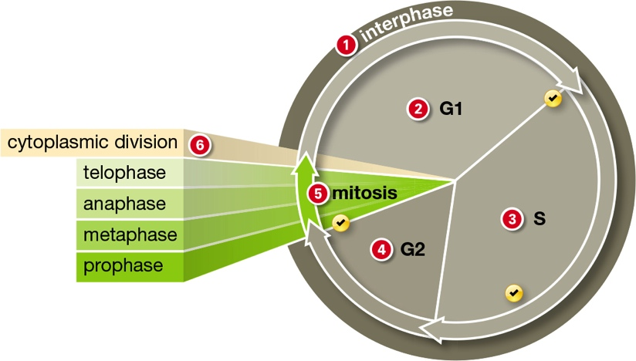
The Eukaryotic Cell Cycle
Notes:
Figure 11.1 The eukaryotic cell cycle.
G1, S, and G2 are part of interphase, and the length of these intervals differs among cells.
1 A cell spends most of its life in interphase, which includes three stages: G1, S, and G2.
2 During G1, each chromosome consists of one DNA molecule. Most cells going about their metabolic business are in G1.
S is the stage of synthesis, during which the cell copies its chromosome(s) by DNA replication.
After DNA replication, each chromosome consists of two sister chromatids attached at the centromere.
4 The cell prepares to divide during G2.
5 The nucleus divides during mitosis.
After mitosis, the cytoplasm may divide. Each descendant cell begins the cycle anew, in G1.
Each chromosome consists of one DNA molecule.
Built-in checkpoints stop the cycle from proceeding until certain conditions are met.

Slide 7
Mitosis Maintains the Chromosome Number (1 of 4)
When a cell divides by mitosis, it produces two descendant cells
Each with the same number and type of chromosomes as the parent
Human body cells are diploid (contain pairs of chromosomes)
With exception, the chromosomes of each pair are homologous: have the same length, shape, and genes

Slide 8
Mitosis Maintains the Chromosome Number (2 of 4)
How are homologous chromosomes distributed to descendant cells?
G1: chromosomes are unduplicated
By the G2 stage, each chromosome consists of two double-stranded DNA molecules called sister chromatids

Slide 9
Mitosis Maintains the Chromosome Number (3 of 4)
During mitosis, the sister chromatids are pulled apart
Each sister chromatid ends up in separate nuclei that are packaged into separate cells

Slide 10
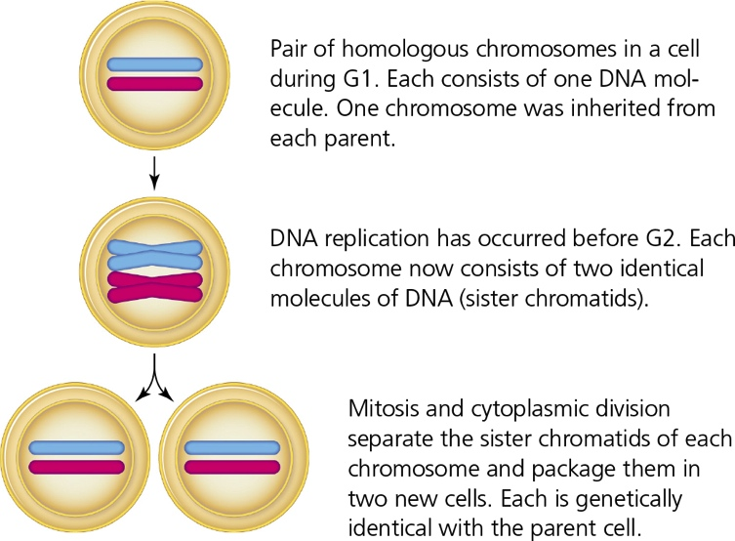
Mitosis Maintains Chromosome Numbers (4 of 4)
Notes:
Figure 11.2 How mitosis maintains chromosome number.
For clarity, only one homologous pair of chromosomes in a diploid cell is shown; most eukaryotic cells have multiple homologous pairs.

Slide 11
Control Over the Cell Cycle
Whether or not a cell divides is determined by mechanisms of gene expression control
“Brakes” on the cell cycle normally keep the vast majority of cells in G1
“Checkpoint genes” monitor:
The completion of DNA copying
DNA damage
Nutrient availability

Slide 12
Why Cells Divide by Mitosis
In multicelled organisms, mitosis and cytoplasmic division are the basis of body formation and increases in size during development
Continuing mitotic divisions of embryonic cells as they differentiate produce tissues and body parts of the embryo
Mitosis is part of asexual reproduction, a reproductive mode of eukaryotes in which offspring are produced by one parent only

Slide 13
11.2 A Closer Look at Mitosis (1 of 3)
Before mitosis
Interphase: chromosomes are loosened to allow transcription and DNA replication
Early prophase: in preparation for nuclear division, the chromosomes begin to pack tightly

Slide 14
A Closer Look at Mitosis (2 of 3)
Prophase (first stage of mitosis)
Chromosomes further condense
One of the two centrosomes move to the opposite end of cell
Microtubules assemble and lengthen, forming a spindle (functions to move chromosomes)
Nuclear envelope breaks up
Sister chromatids are attached to opposite centrosomes

Slide 15
A Closer Look at Mitosis (3 of 3)
Final stages of mitosis
Metaphase: all chromosomes are aligned midway between spindle poles
Anaphase: sister chromatids separate and move toward opposite spindle poles
Telophase: chromosomes arrive at opposite spindle poles and decondense; two new nuclei form

Slide 16
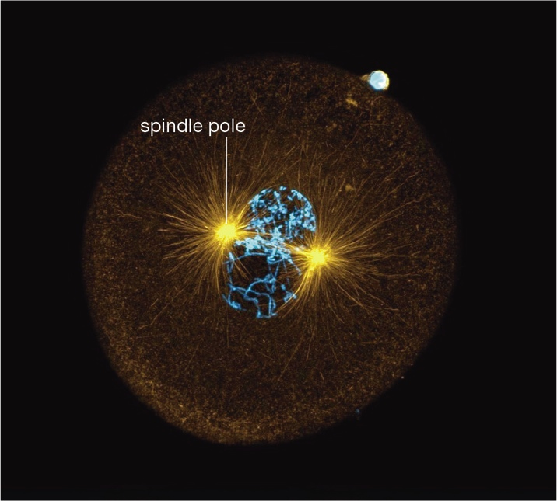
The Spindle
Notes:
Figure 11.5 The spindle.
This cell, a fertilized egg of a worm (Cerebratulus), is undergoing mitosis. Microtubules (yellow) extending from two centrosomes form the spindle. Chromosomes (blue) of each homologous pair will be attached to opposite spindle poles. The bright spot on the edge of the egg is a sperm.

Slide 17
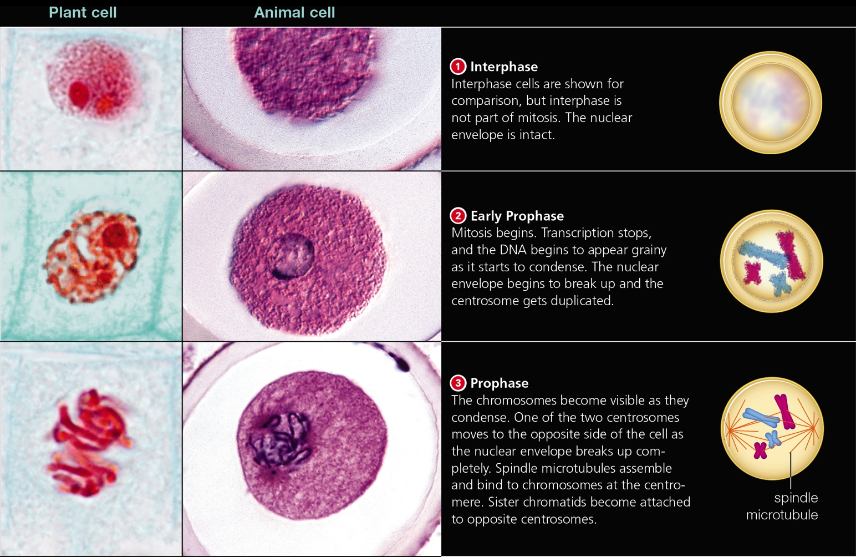
Mitosis (1 of 2)
Notes:
Figure 11.4 Mitosis. Micrographs show plant cells (onion root, left), and animal cells (fertilized eggs of a roundworm, right). A diploid (2n) cell with two chromosome pairs is illustrated.

Slide 18
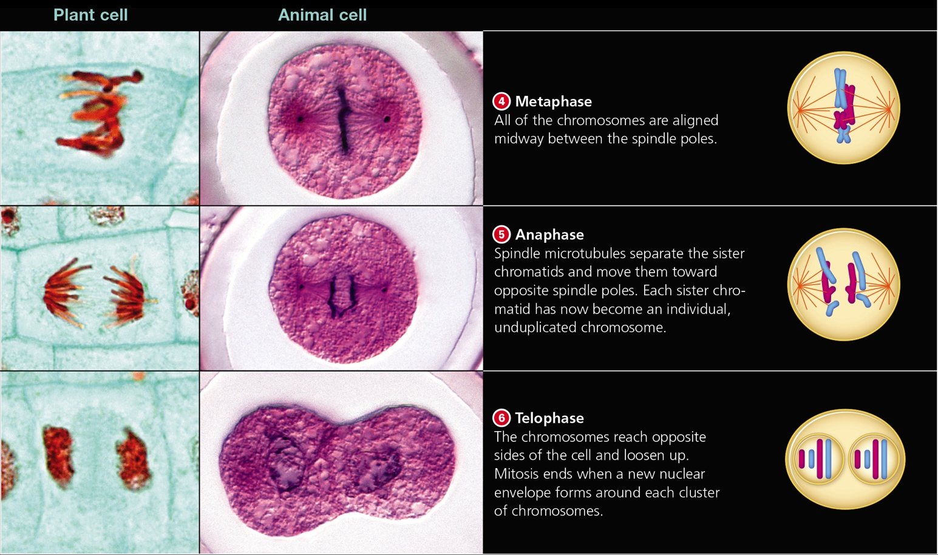
Mitosis (2 of 2)
Notes:
Figure 11.4 Mitosis. Micrographs show plant cells (onion root, left), and animal cells (fertilized eggs of a roundworm, right). A diploid (2n) cell with two chromosome pairs is illustrated.

Slide 19
11.3 Cytoplasmic Division
In most eukaryotes, cytokinesis (cytoplasmic division) occurs between late anaphase and the end of telophase
The process of cytokinesis differs between plant and animal cells

Slide 20
Animal Cell Cytokinesis
Typical animal cells pinch themselves in two after nuclear division ends
The spindle begins to disassemble during telophase
Contractile rings drag the plasma membrane inward
Cleavage furrow (indentation) forms

Slide 21
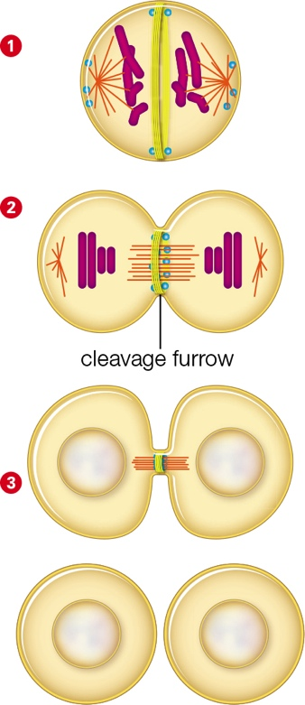
Cytoplasmic Division of Animal Cell
Notes:
Figure 11.6 Cytoplasmic division of an animal cell. The small blue dots are vesicles.
1 A ring of actin filaments and motor proteins (yellow) forms under the plasma membrane during anaphase. This contractile ring wraps around the cell.
2 After telophase, the contractile ring pulls the cell surface inward, forming a cleavage furrow as it constricts. Spindle microtubules guide vesicles to the plane of division.
3 When the contractile ring is at its smallest diameter, spindle microtubules inside of it are cut. Vesicles that fuse to form new membrane partition the two new cells.

Slide 22
Plant Cell Cytokinesis
Dividing plant cells face a challenge because a cell wall surrounds their plasma membrane
By the end of anaphase, short microtubules form on either side of the future plane of division
Disk-shaped structure called the cell plate forms and eventually partitions the cytoplasm
The cell plate forms into two new cell walls

Slide 23
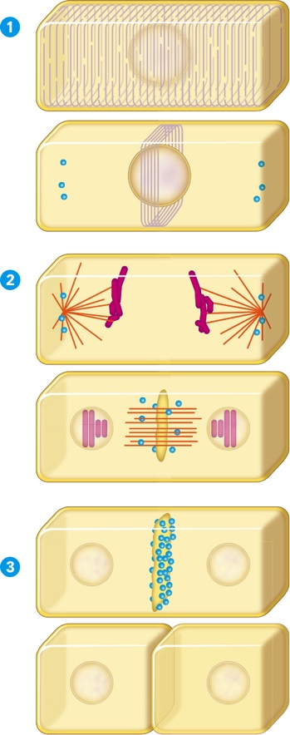
Cytoplasmic Division of Plant Cells
Notes:
Figure 11.7 Cytoplasmic division of a plant cell. The small blue dots are vesicles.
1 A network of parallel microtubules (orange) determines the future plane of division in a plant cell. During G2, this network develops into a dense ring of microtubules around the nucleus at the future plane of division.
2 During mitosis, microtubules of the ring reorganize to form a spindle. The spindle is perpendicular to the former ring. In late anaphase, spindle remnants begin to guide vesicles to the future plane of division. By telophase, the vesicles have begun to fuse and form a cell plate.
3 The cell plate expands along the plane of division as more vesicles merge with it. When the cell plate fuses with the plasma membrane, the cytoplasm is partitioned so two new cells form.

Slide 24
11.4 Marking Time with Telomeres
1997: geneticist Ian Wilmut and his team cloned the first mammal, a lamb named Dolly, from an adult somatic cell
Although Dolly was healthy at first, she showed signs of premature aging
Arthritis, lung disease, etc.

Slide 25
Telomeres (1 of 2)
Dolly’s early demise may have been the result of abnormally short telomeres
Telomeres are noncoding repeat DNA sequences (repeated thousands of times) found at the ends of eukaryotic chromosomes
Telomere sequences provide a buffer against the loss of more valuable internal DNA

Slide 26
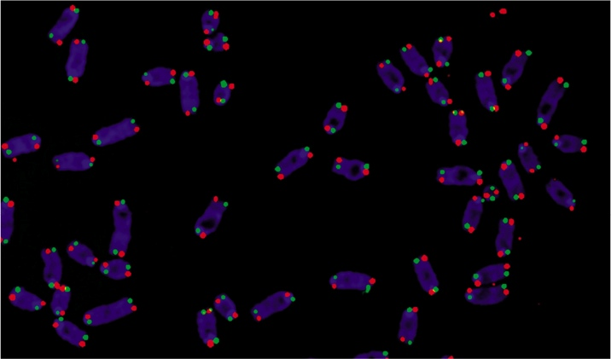
Telomeres (2 of 2)
Notes:
Figure 11.8 Telomeres. The bright dots at the end of each DNA strand in these duplicated chromosomes show telomere sequences.

Slide 27
Telomeres Shorten With Each Division
A telomere buffer is very important
Typically, a eukaryotic chromosome shortens by about 100 nucleotides with each DNA replication
When chromosomes contain telomeres that are too short, checkpoint gene products halt the cell cycle and cell death soon follows
Most body cells can divide only a certain number of times before this happens

Slide 28
Shortened Telomeres Trigger Checkpoints
Telomere-dependent cell division limits may protect against uncontrolled cell division
Keeps “uncontrolled” cells from overrunning the body
Cell division limits vary by species and may set an organism’s life span

Slide 29
Stem Cell Telomeres
A few normal adult cells retain the ability to divide indefinitely, replacing cell lineages that die out
These immortal cells are called stem cells
Stem cells continuously produce enzymes called telomerases
Telomerases reverse the telomere shortening that normally occurs after DNA replication

Slide 30
Telomeres and Aging
Mice genetically engineered to have no telomerase enzymes age prematurely
Life expectancy declines by about half
Introducing telomerase back in these mice rescues their vitality
Decrepit tissue repairs itself and functions normally; reproduction becomes possible

Slide 31
Cause vs. Effect?
Researchers are careful to point out that shortening telomeres may be an effect of aging rather than a cause
Although telomerase holds therapeutic promise for the rejuvenation of aged tissues, it can also be dangerous
Cancer cells characteristically express high levels of telomerase

Slide 32
11.5 Pathological Mitosis
Types of mutations that affect cell cycle:
Checkpoint genes mutate causing the loss-of-function of their protein products
Controls that regulate checkpoint gene expression fail
Cell makes either too much or too little of gene product

Slide 33
The Role of Mutations (1 of 4)
When enough checkpoint mechanisms fail, a cell loses control over its cell cycle
Interphase may be skipped, so division occurs over and over with no resting period
Signaling mechanisms that cause abnormal cells to die may stop working

Slide 34
The Role of Mutations (2 of 4)
Neoplasm: accumulation of abnormally dividing cells
Tumor: neoplasm that forms a lump
Oncogene: gene that helps transform a normal cell into a tumor cell

Slide 35
The Role of Mutations (3 of 4)
Proto-oncogenes: gene that, by mutation, can become an oncogene
Example: growth factors–molecules that stimulate mitosis and differentiation
Most neoplasms carry mutations resulting in an over activity or overabundance of the epidermal growth factor (EGF) receptor

Slide 36
The Role of Mutations (4 of 4)
Checkpoint gene products that inhibit mitosis are called tumor suppressors
Tumors form when checkpoint gene products are missing
Examples:
Mutations in the BRCA1 and BRCA2 checkpoint genes give rise to breast neoplasms
HPV (human papillomavirus) cause cells to make proteins that interfere with tumor suppressors

Slide 37
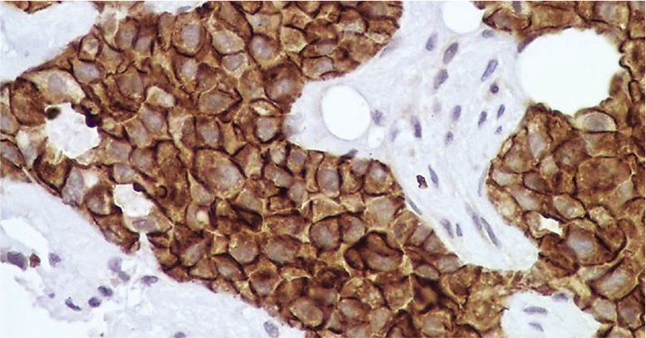
Effects of An Oncogene
Notes:
Figure 11.9 Effects of an oncogene.
In this section of human breast tissue, a brown-colored tracer shows the active form of the EGF receptor. Normal cells are lighter in color. The dark cells have an overactive EGF receptor that is constantly stimulating mitosis; these cells have formed a neoplasm.

Slide 38
Checkpoint Genes in Action
Notes:
Figure 11.10 Checkpoint genes in action.
These are photos of the same nucleus after radiation damaged the DNA inside of it.
A Green dots pinpoint the location of a protein that binds to p53, a checkpoint gene product that pauses the cell cycle in G1 when the DNA is damaged.
B Red dots show the location of the BRCA1 gene product.
C In this overlay, yellow dots show where the red and green dots overlap. Both proteins have clustered around the same chromosome breaks; both function to recruit DNA repair enzymes. The integrated action of these and other checkpoint gene products blocks mitosis until the DNA breaks are fixed.

Slide 39
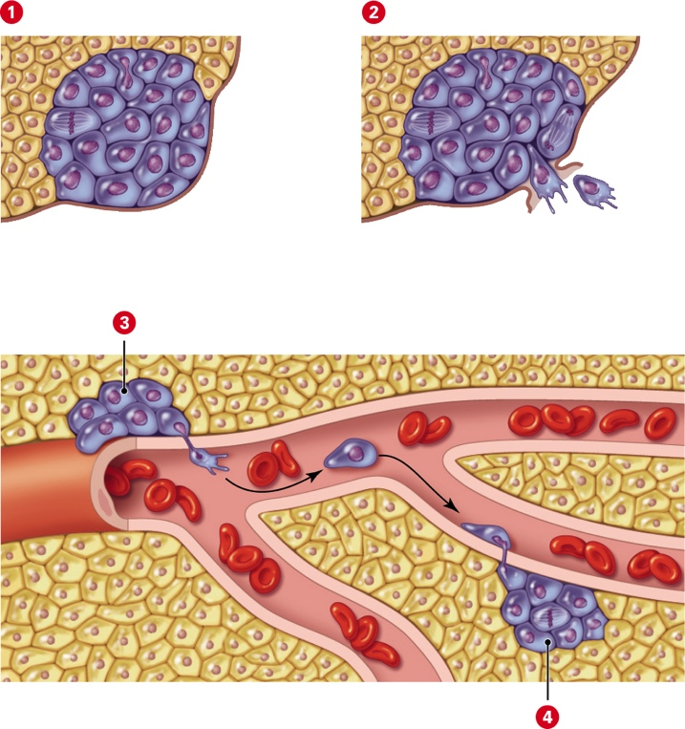
Neoplasms and Malignancy
Notes:
Figure 11.11 Neoplasms and malignancy.
1 Benign neoplasms grow slowly and stay in their home tissue.
2 Cells of a malignant neoplasm can break away from their home tissue.
3 The malignant cells become attached to the wall of a lymph vessel or blood vessel (as shown here). They release digestive enzymes that create an opening in the wall, then enter the vessel.
4 The cells creep or tumble along in the vessel, then exit the same way they got in. Migrating cells may start growing in other tissues, a process called metastasis.

Slide 40
Cancer (1 of 3)
Benign neoplasms such as warts are not usually dangerous
Slow growth
Cells retain plasma membrane adhesion proteins
A malignant neoplasm progressively worsens and is dangerous to health
Characteristics of malignant cells
Abnormal growth and development
Altered cytoplasm and plasma membrane
Cells undergo metastasis: process in which malignant cells spread from one part of the body to another

Slide 41
Cancer (2 of 3)
Cancer: disease that occurs when a malignant neoplasm physically and metabolically disrupts body tissues
Each year, cancer causes 15–20% of all human deaths in developed countries
Mutations in multiple checkpoint genes are required to transform a normal cell into a malignant one
Such mutations may take a lifetime to accumulate

Slide 42
Cancer (3 of 3)
Lifestyle choices can reduce one’s risk of acquiring mutations
Do not smoke
Avoid sun exposure
Some neoplasms can be detected with periodic screening such as gynecological or dermatological exams
If detected early enough, many types of malignant neoplasms can be removed before metastasis occurs

Slide 43
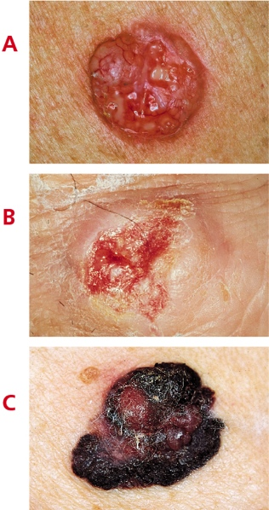
Skin Cancer and Early Screening
Notes:
Figure 11.12 Skin cancer can be detected with early screening.
A Basal cell carcinoma is the most common type of skin cancer. This slow-growing, raised lump may be uncolored, reddish-brown, or black.
B Squamous cell carcinoma is the second most common form of skin cancer. This pink growth, firm to the touch, grows under the skin’s surface.
C Melanoma spreads fastest. Cells form dark, encrusted lumps that may itch or bleed easily.

Slide 44
Application: Henrietta’s Immortal Cells (1 of 2)
Finding human cells that grow in a laboratory took George and Margaret Gey nearly 30 years to find
In 1951, an assistant prepared a cell line that divided vigorously
These cells were named HeLa cells, after Henrietta Lacks, the patient from whom the cells were taken

Slide 45
Application: Henrietta’s Immortal Cells (2 of 2)
Although Henrietta passed away from cervical cancer, her cells lived on in the Geys’ laboratory, aiding in polio studies
HeLa cells are still used today in laboratories all over the world to study cancer and numerous other cellular processes
HeLa cells contributed to the work of Nobel Prize winners

Slide 46
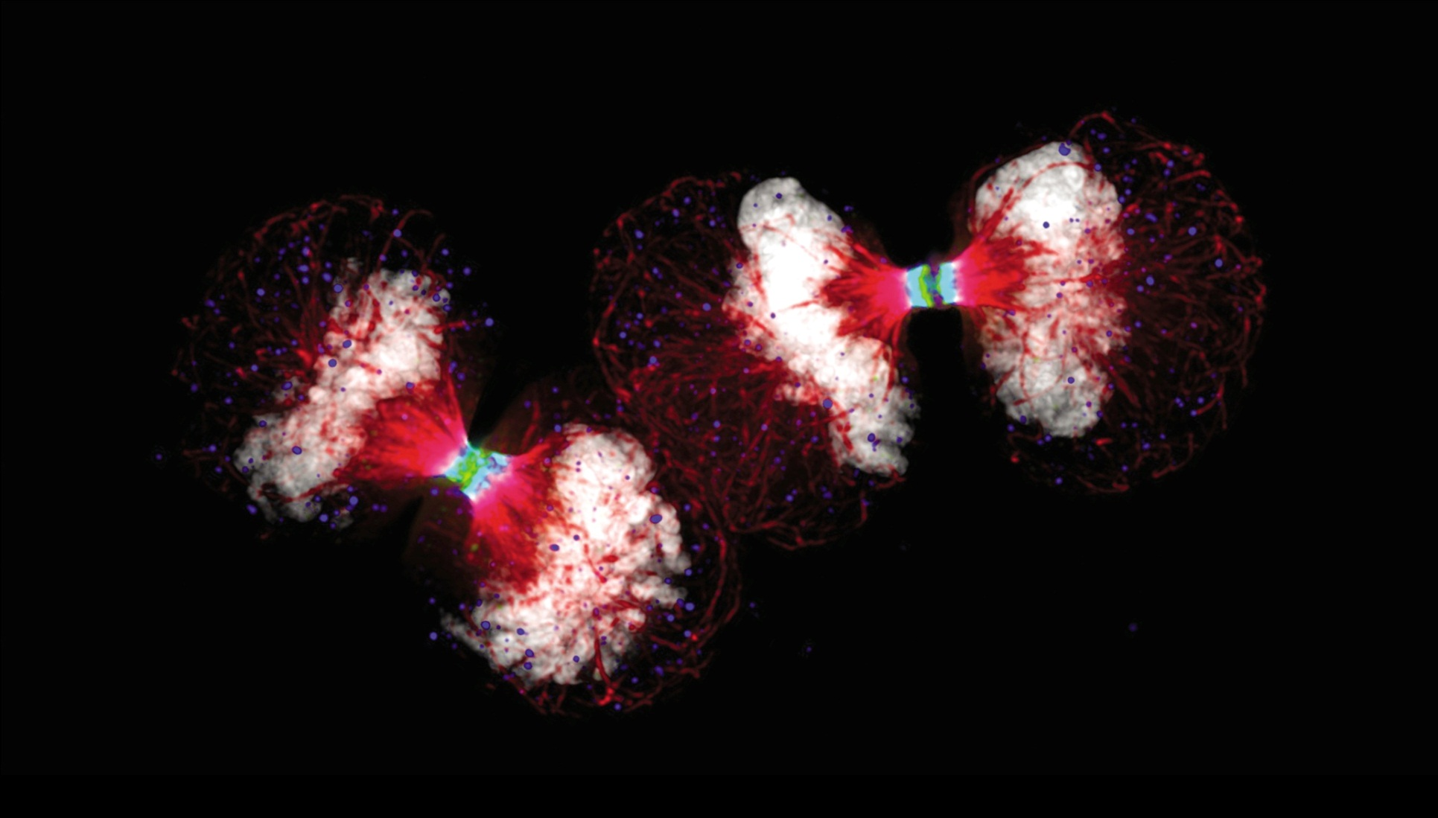
HeLa Cells
Notes:
Figure 11.13 Cellular legacy of cancer victim Henrietta Lacks: HeLa cells. These HeLa cells are undergoing mitosis.

Slide 47
Discuss
Many of the drugs used in chemotherapy cause loss of hair in the individual being treated. Why would such drugs affect hair growth.
Why do the mechanisms of cleavage differ between animal vs. plant cells?

