Slide 1
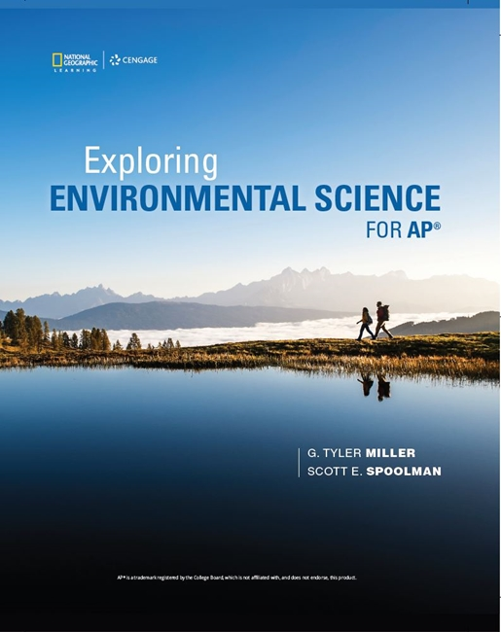
Exploring Environmental Science for AP®
1st Edition
Chapter 11
Geology, Soil, and Mineral Resources
Copyright © 2018 Cengage Learning. All Rights Reserved. May not be copied, scanned, or duplicated, in whole or in part, except for use as permitted in a license distributed with a certain product or service or otherwise on a password-protected website for classroom use.

Slide 2
Core Case Study: The Real Cost of Gold
Harmful effects of gold mining
Massive amounts of rock dug to yield small amounts of gold
Highly toxic cyanide salts used to extract the gold into settling ponds
Toxic to birds and mammals
Threaten underground drinking water supplies
Romanian gold mine dam collapsed in 2000
Contaminated rivers with cyanide and toxic metals

Slide 3
11.1 What Are the Earth’s Major Geological Processes/Mineral Resources?
Dynamic processes within the earth and on its surface produce mineral resources
Mineral resources are nonrenewable
Produced and renewed over millions of years mostly by the earth’s rock cycle

Slide 4
The Earth Is a Dynamic Planet (1 of 3)
Geology
Study of dynamic processes taking place on the earth’s surface and in its interior
Three major concentric zones of the earth
Core
Mantle, including the asthenosphere
Crust
Continental crust
Oceanic crust: 71% of crust

Slide 5
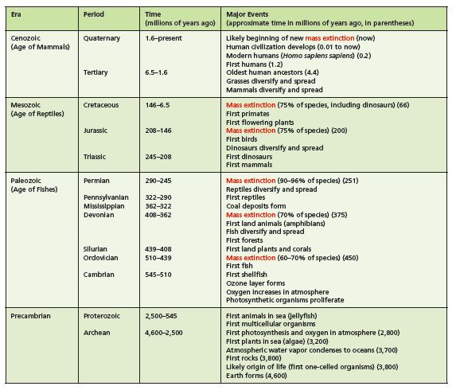
The Earth Is a Dynamic Planet (2 of 3)
Time scale for major geological and biological changes since the earth formed about 4.6 billion years ago.

Slide 6
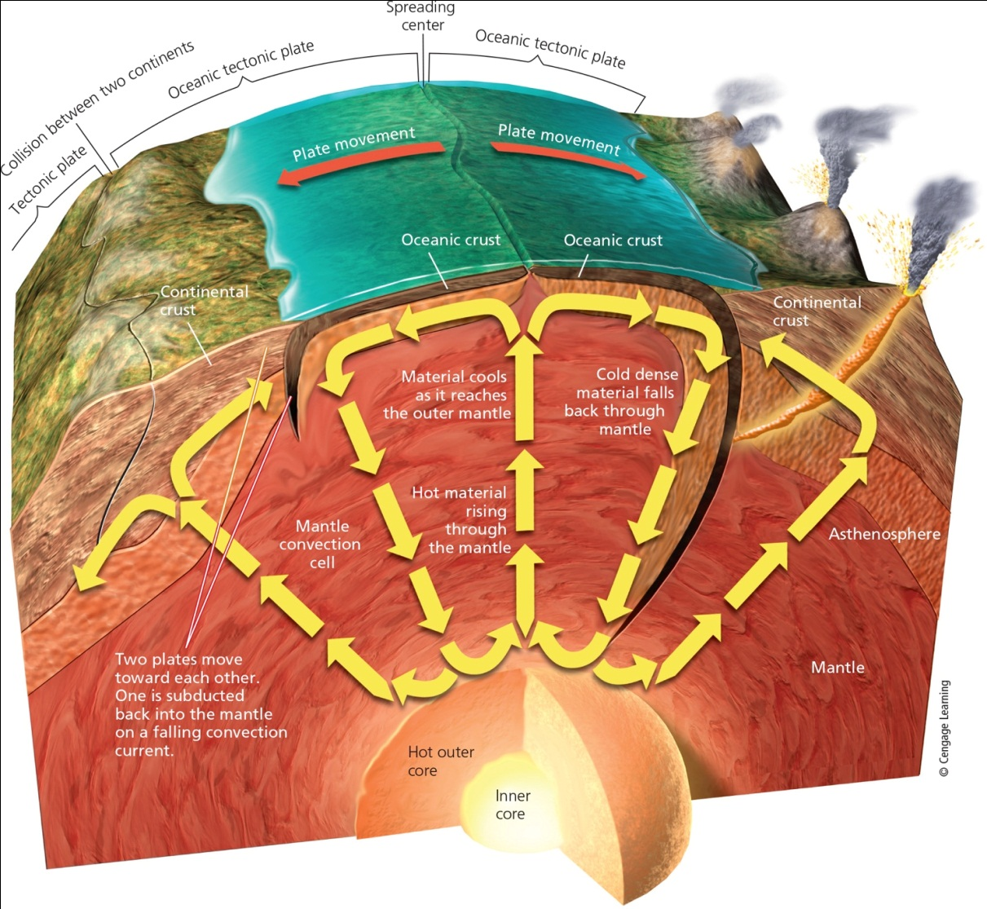
The Earth Is a Dynamic Planet (3 of 3)
Notes:
Figure 14.2 The earth is composed of a core, mantle, and crust, and within the core and mantle, dynamic forces have major effects on what happens in the crust and on the surface.

Slide 7
What Are Minerals and Rocks? (1 of 2)
Mineral
Naturally occurring chemical element or compound that exists as a crystalline solid
Mineral resource
Concentration that we can extract and process into raw materials
Nonrenewable
Rock
Solid combination of one or more minerals

Slide 8
What Are Minerals and Rocks? (2 of 2)
Sedimentary rock
Made of sediments
Dead plant and animal remains
Tiny particles of weathered and eroded rocks
Igneous rock
Forms under intense heat and pressure
Metamorphic rock
Existing rock subjected to high temperatures, pressures, fluids, or a combination

Slide 9
The Earth’s Rocks Are Recycled Slowly (1 of 2)
Rock cycle
Rocks are recycled over millions of years
Erosion, melting, and metamorphism
Slowest of the earth’s cycle processes

Slide 10
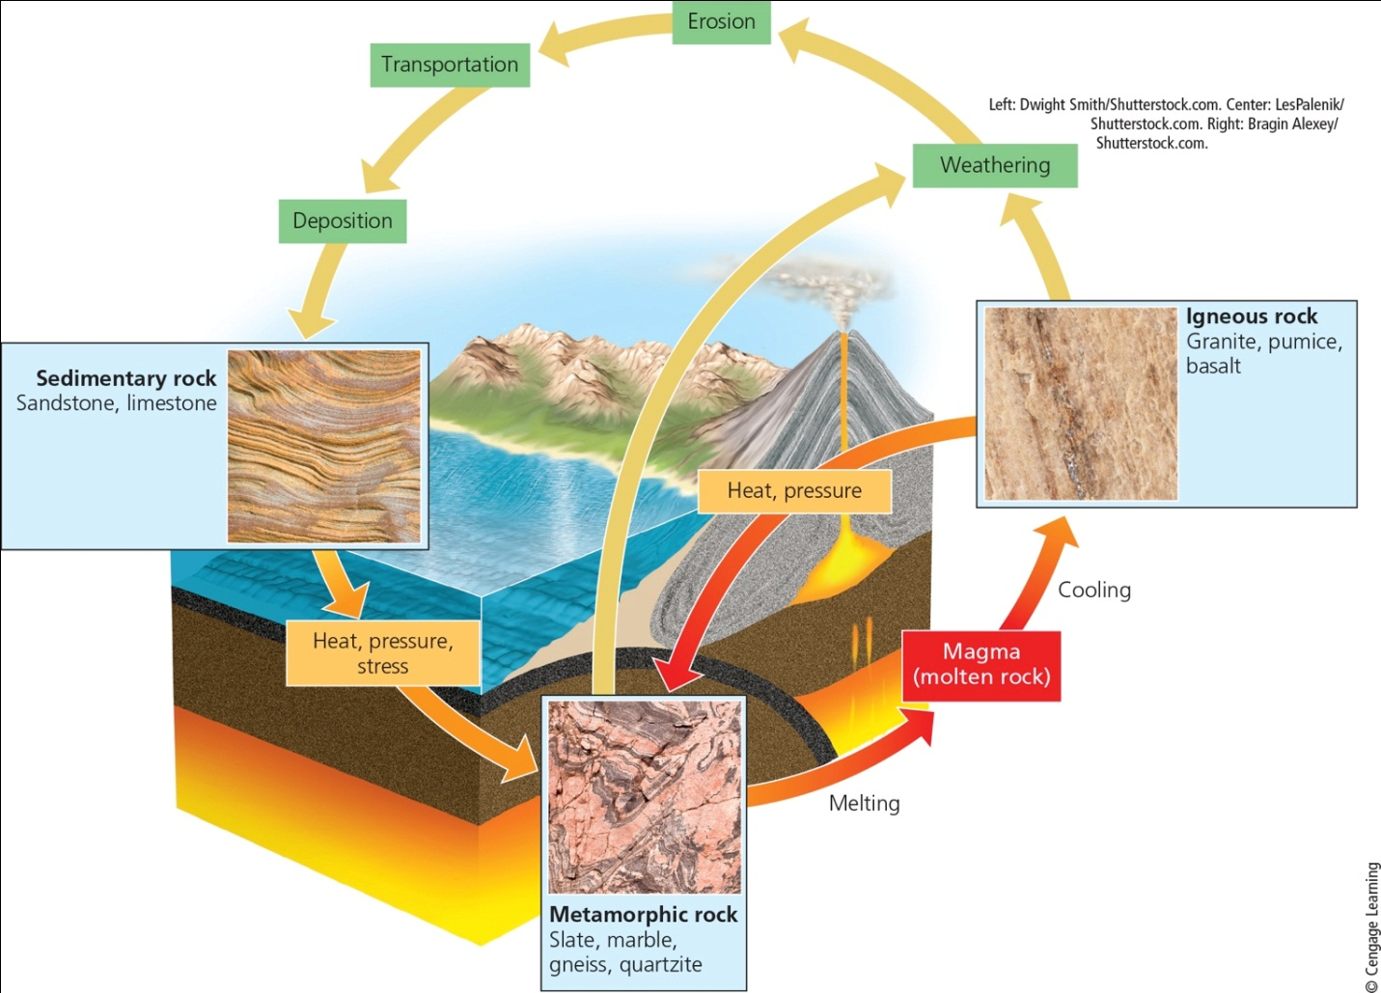
The Earth Is a Dynamic Planet (2 of 2)
Notes:
Figure 14.3 Natural capital: The rock cycle is the slowest of the earth’s cyclical processes.

Slide 11
11.2 What Processes Lead to Soil Formations?
Physical, chemical, and biological processes all contribute to the formation of soil.
Soil is a renewable resource and a key factor in nutrient cycling

Slide 12
Soil Begins from Bedrock (1 of 2)
The process of weathering breaks up parent material that is the foundation of soil.
Lichens secrete acid that breaks down rock, the first step in primary succession
Humus is formed from dead organic material, releasing nutrients and holding moisture
Physical, chemical and biological processes form soil

Slide 13
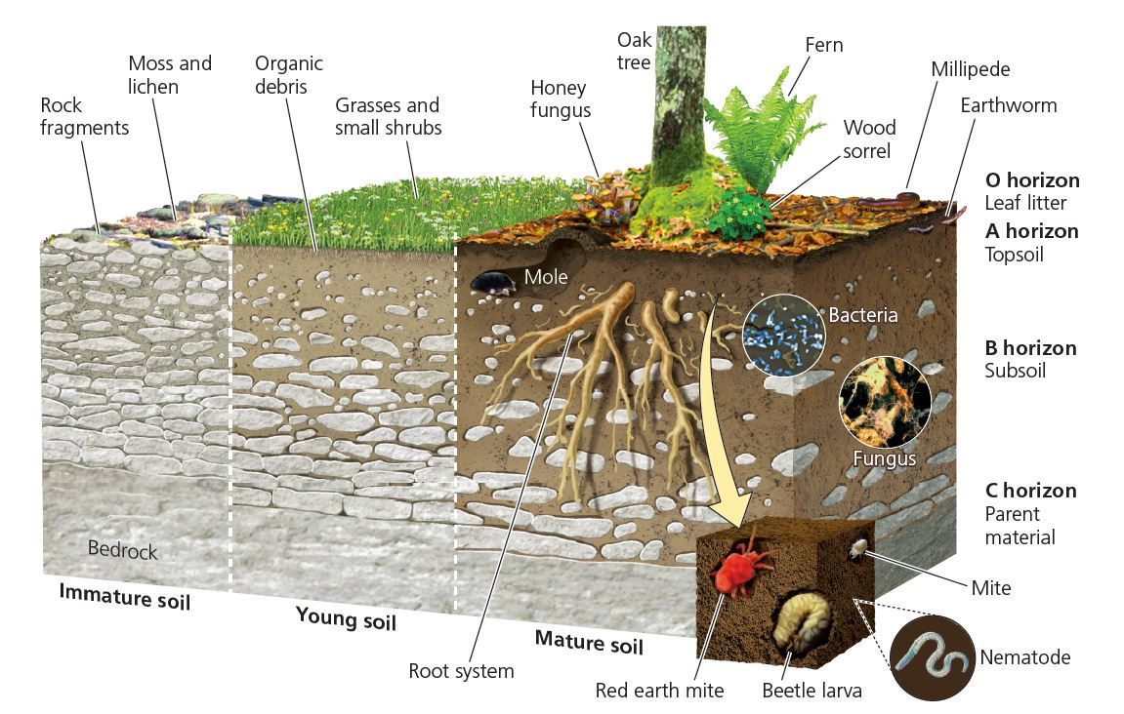
Soil Begins from Bedrock (2 of 2)

Slide 14
Soil is a Renewable Resource (1 of 3)
Living , organisms rely on soil is essential for agriculture, provides the medium for growing timber, and provides ecological services such as purifying water and degrading wastes
Mature soils contain horizons
O (leaf litter)
A (top soil)
B (subsoil)
C (weathered parent material)

Slide 15
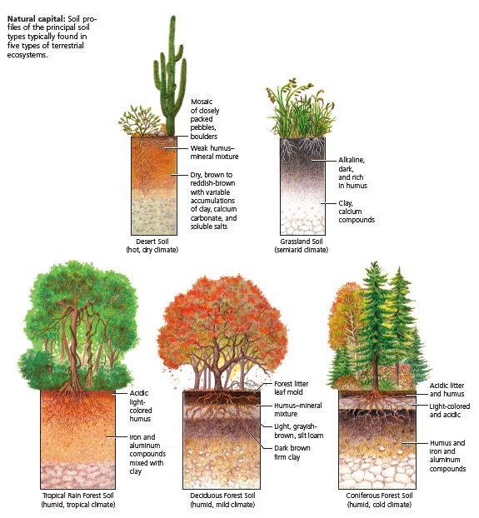
Soil is a Renewable Resource (2 of 3)

Slide 16
Soil is a Renewable Resource (3 of 3)
Several factors influence the formation of soil
Warm and wet environments form soil faster
Tropical rain forest soils have little organic material in soil and are nutrient poor.

Slide 17
The Importance of Soil Nutrients (1 of 2)
Most nutrients in a and O horizons
Fertile soil produces high crop yields with this topsoil and bacteria that convert nitrogen into ions that plants can assimilate
B and C horizons contain most of the soil’s inorganic material
Soil texture determines porosity and permeability

Slide 18
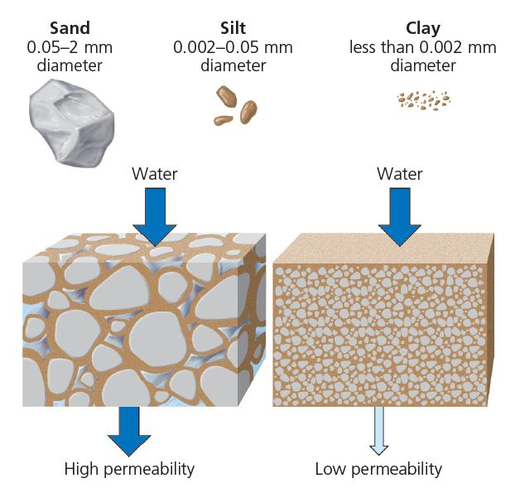
The Importance of Soil Nutrients (2 of 2)
The size, shape, and degree of clumping of soil particles determine the number and volume of spaces for air and water within a soil. Water can flow more easily through soils with more spaces (left) than through soils with fewer spaces (right).

Slide 19
11.3 How Long Might Supplies of Nonrenewable Mineral Resources Last?
Nonrenewable mineral resources exist in finite amounts
Can become economically depleted when it costs more than it is worth to find, extract, and process the remaining deposits
There are several ways to extend supplies of mineral resources
Methods limited by economic and environmental factors

Slide 20
We Depend on a Variety of Nonrenewable Mineral Resources (1 of 2)
Ore
Contains profitable concentration of a mineral
May be high-grade or low-grade
Metallic mineral resources
Aluminum
Steel: a mixture of iron and other elements
Copper
Gold
Molybdenum

Slide 21
We Depend on a Variety of Nonrenewable Mineral Resources (2 of 2)
Nonmetallic mineral resources
Sand
Gravel
Limestone
Phosphate

Slide 22
Supplies of Nonrenewable Mineral Resources Can Be Economically Depleted (1 of 3)
Reserves
Identified deposits from which we can extract the mineral profitably at current prices
Economic depletion
Occurs when extraction costs more than remaining deposits are worth
Depletion time
Time to use a certain portion (usually 80%) of reserves at a given rate of use

Slide 23
Supplies of Nonrenewable Mineral Resources Can Be Economically Depleted (2 of 3)
Options when a resource becomes economically depleted
Recycle or reuse existing supplies
Waste less
Use less
Find a substitute
Do without

Slide 24
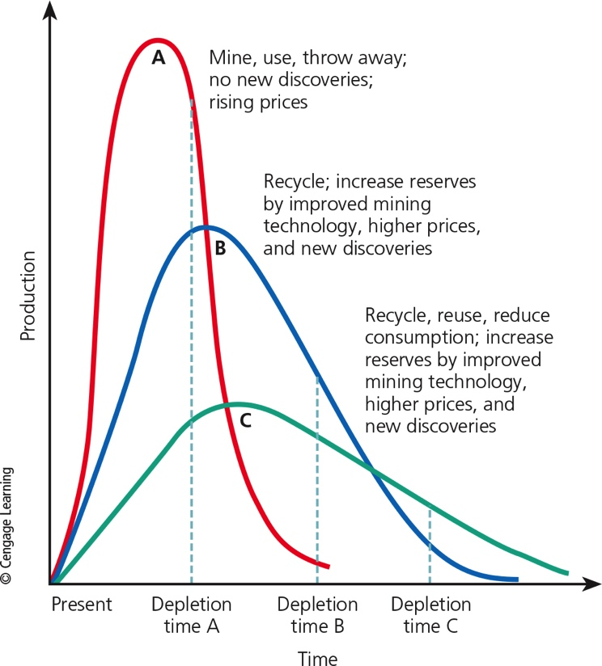
Supplies of Nonrenewable Mineral Resources Can Be Economically Depleted (3 of 3)
Notes:
Figure 14.4 Natural capital depletion: Each of these depletion curves for a mineral resource is based on a different set of assumptions. Dashed vertical lines represent the times at which 80% depletion occurs.

Slide 25
Case Study: The Crucial Importance of Rare Earth Metals (1 of 2)
17 rare earth metals
Important for several widely used technologies
Products made with rare earth metals
LCD flat screens
Compact fluorescent and LED light bulbs
Solar cells
Fiber-optic cables
Batteries and motors for electric cars

Slide 26
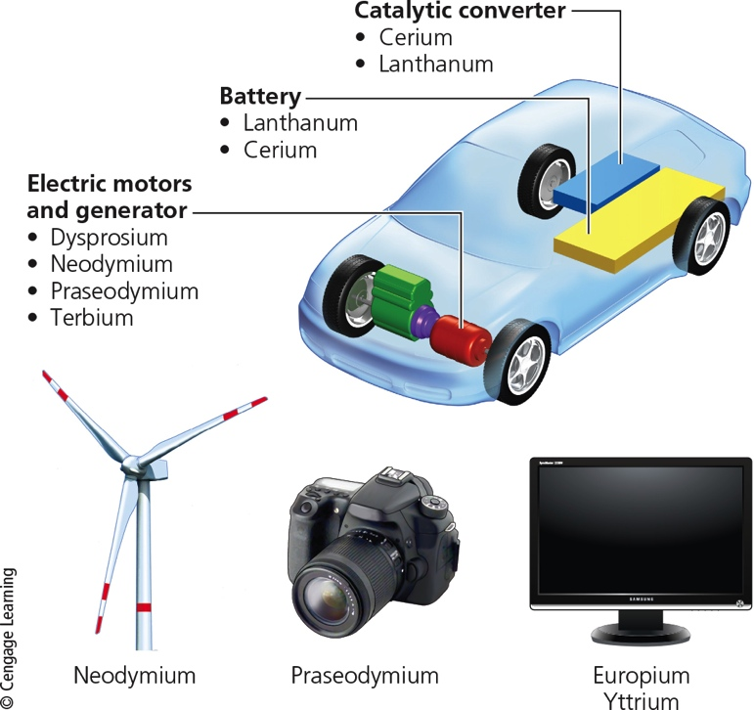
Case Study: The Crucial Importance of Rare Earth Metals (2 of 2)
Notes:
Figure 14.5 Rare-earth metals are used to manufacture all-electric and hybrid-electric cars and many other products.

Slide 27
Market Prices Affect Supplies of Mineral Resources (1 of 2)
Higher prices can:
Encourage exploration for new deposits
Stimulate development of better mining technologies
Make it profitable to mine lower-grade ores
Promote conservation
Promote theft

Slide 28
Market Prices Affect Supplies of Mineral Resources (2 of 2)
Subsidies, tax breaks, and import tariffs control the supply, demand, and prices of key mineral resources
U.S. mining companies receive various subsidies

Slide 29
Can We Expand Reserves by Mining Lower-Grade Ores?
Factors that limit the mining of lower-grade ores
Increased cost and energy to mine and process larger volumes of ore
Availability of freshwater
Environmental impact of land disruption
Improve mining technology
Using microorganisms–biomining
Slow process

Slide 30
Can We Get More Minerals from the Oceans? (1 of 3)
Mineral resources dissolved in the ocean
Low concentrations
Deposits of minerals in sediments along the shallow continental shelf and near shorelines

Slide 31
Can We Get More Minerals from the Oceans? (2 of 3)
Hydrothermal ore deposits
Hot water vents in the ocean floor
Metals from the ocean floor
Manganese nodules
What is the effect of mining on aquatic life?

Slide 32
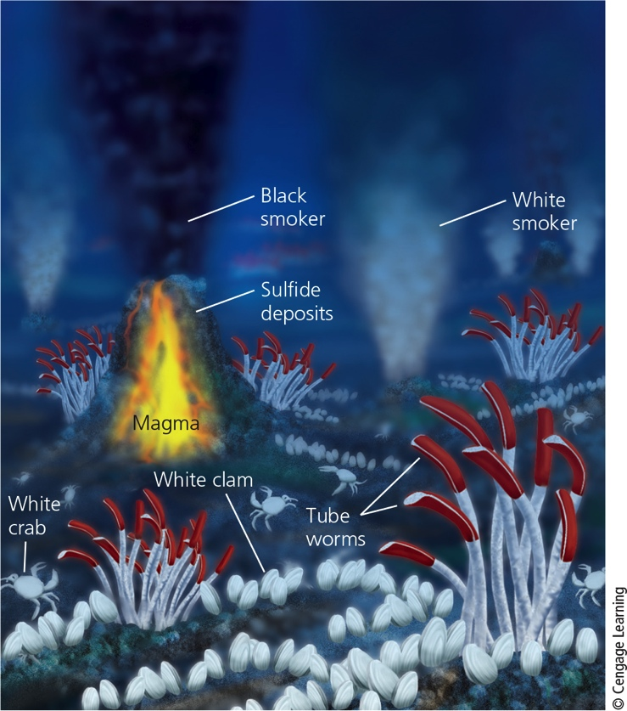
Case Study: The Crucial Importance of Rare Earth Metals (3 of 3)
Notes:
Figure 14.6 Natural capital: Hydrothermal deposits, or black smokers, are rich in various minerals.

Slide 33
11.4 What Are The Environmental Effects of Using Nonrenewable Mineral Resources?
Extracting minerals from the earth’s crust and converting them into useful products:
Disturbs the land
Erodes soils
Produces large amounts of solid waste
Pollutes the air, water, and soil

Slide 34
Extracting Minerals Can Have Harmful Environmental Effects (1 of 8)
Metal product life cycle
Mining, processing, manufacture, and disposal
Environmental impacts
Determined by an ore’s grade
Percentage of metal content

Slide 35
Extracting Minerals Can Have Harmful Environmental Effects (2 of 8)
Notes:
Figure 14.7 Each metal product that we use has a life cycle.

Slide 36
Extracting Minerals Can Have Harmful Environmental Effects (3 of 8)
Surface mining
Removes shallow deposits
Overburden deposited into spoils
Waste material
Open-pit mining
Strip mining
Area strip mining
Contour strip mining

Slide 37
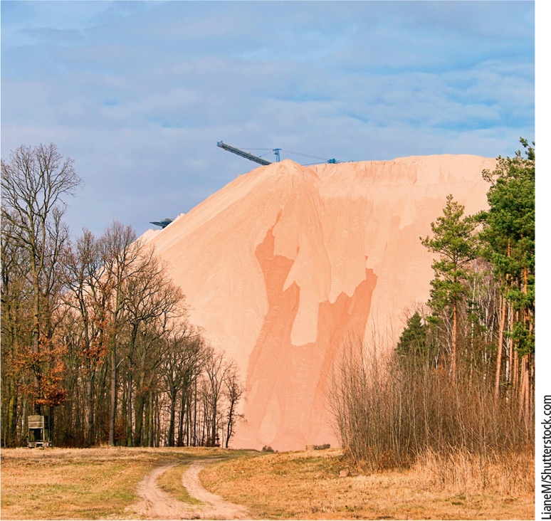
Extracting Minerals Can Have Harmful Environmental Effects (4 of 8)
Notes:
Figure 14.8 Natural capital degradation: This spoils pile in Zielitz, Germany, is made up of waste material from the mining of potassium salts used to make fertilizers.

Slide 38
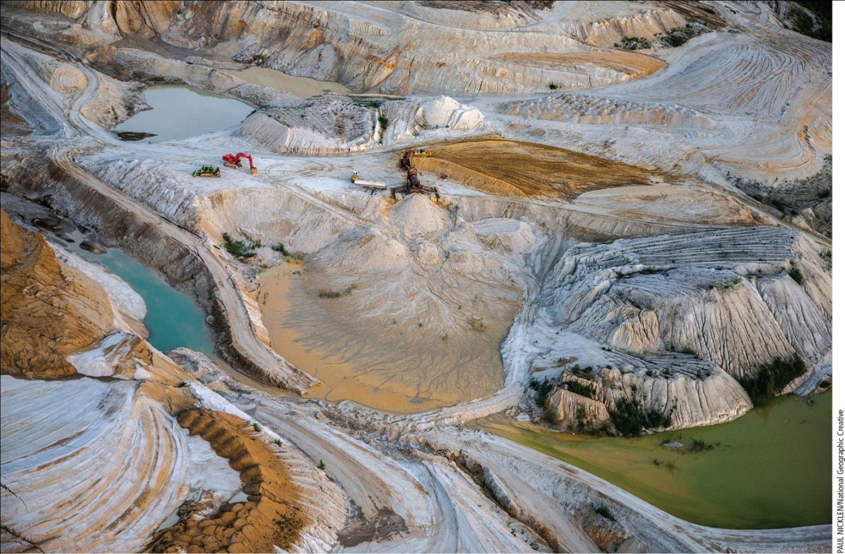
Extracting Minerals Can Have Harmful Environmental Effects (5 of 8)
Notes:
Figure 14.9 Natural capital degradation: Area strip mining for gold in Yukon Territory, Canada

Slide 39
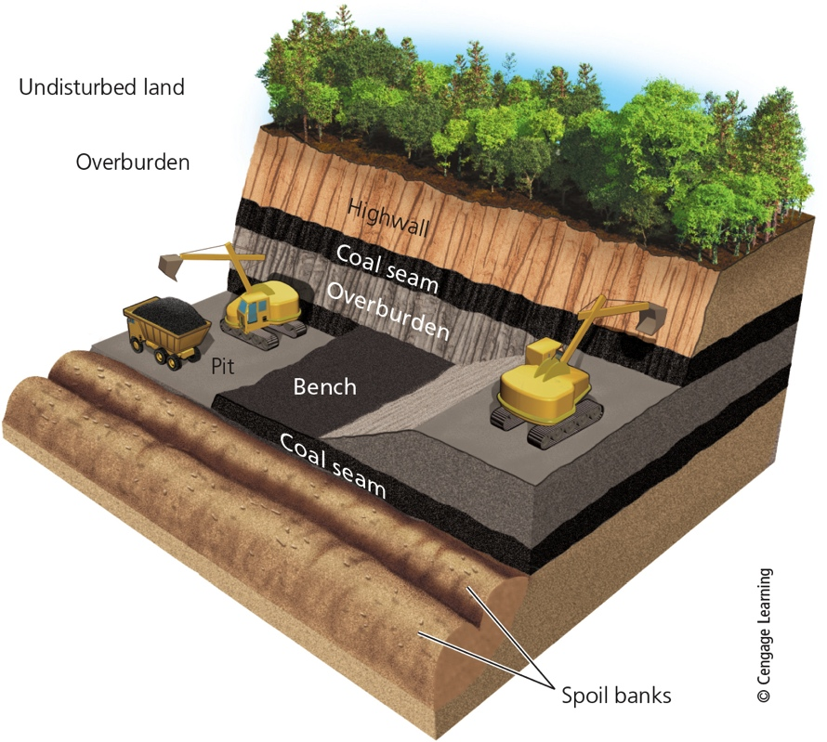
Extracting Minerals Can Have Harmful Environmental Effects (6 of 8)
Notes:
Figure 14.10 Natural capital degradation: Contour strip mining is used in hilly or mountainous terrain.

Slide 40
Extracting Minerals Can Have Harmful Environmental Effects (7 of 8)
Mountaintop removal
Subsurface mining
Deep deposits
Potential problems
Subsidence
Health hazards for miners
Acid mine drainage

Slide 41
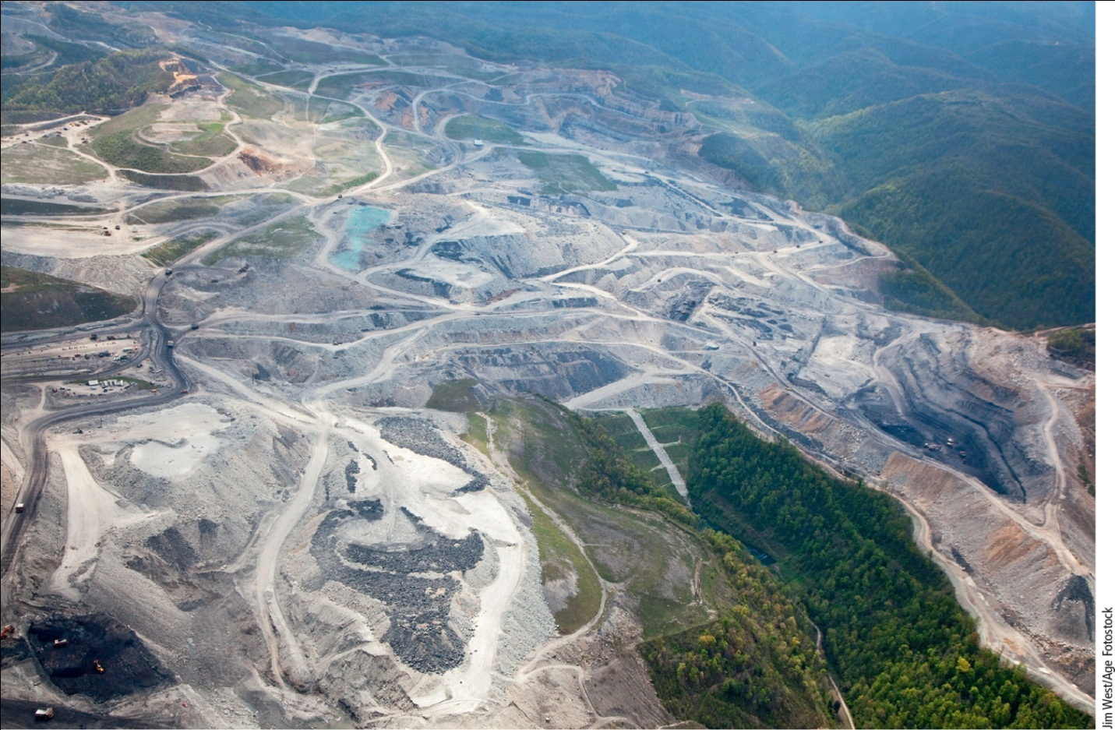
Extracting Minerals Can Have Harmful Environmental Effects (8 of 8)
Notes:
Figure 14.11 Natural capital degradation: Mountaintop removal coal mining near Whitesville, West Virginia.

Slide 42
Critical Concept: Life Cycle of a Product
The life cycle of a product traces the impacts of each step of a product’s existence from harvesting or mining the materials to produce it, its use, and how it is discarded, as well as the energy invested at each step.

Slide 43
Critical Concept: External, or Hidden Costs (1 of 2)
External costs are those costs to the environment or human health not included in the price of the product.

Slide 44
Critical Concept: External, or Hidden Costs (1 of 2)

Slide 45
Removing Metals from Ores Has Harmful Environmental Effects (1 of 2)
Ore extracted by mining
Ore mineral
Tailings–waste material (gangue)
Smelting using heat or chemicals causes:
Air pollution
Water pollution
Poverty-stricken miners in less-developed countries have cleared tropical forests
Use mercury to separate gold from its ore

Slide 46
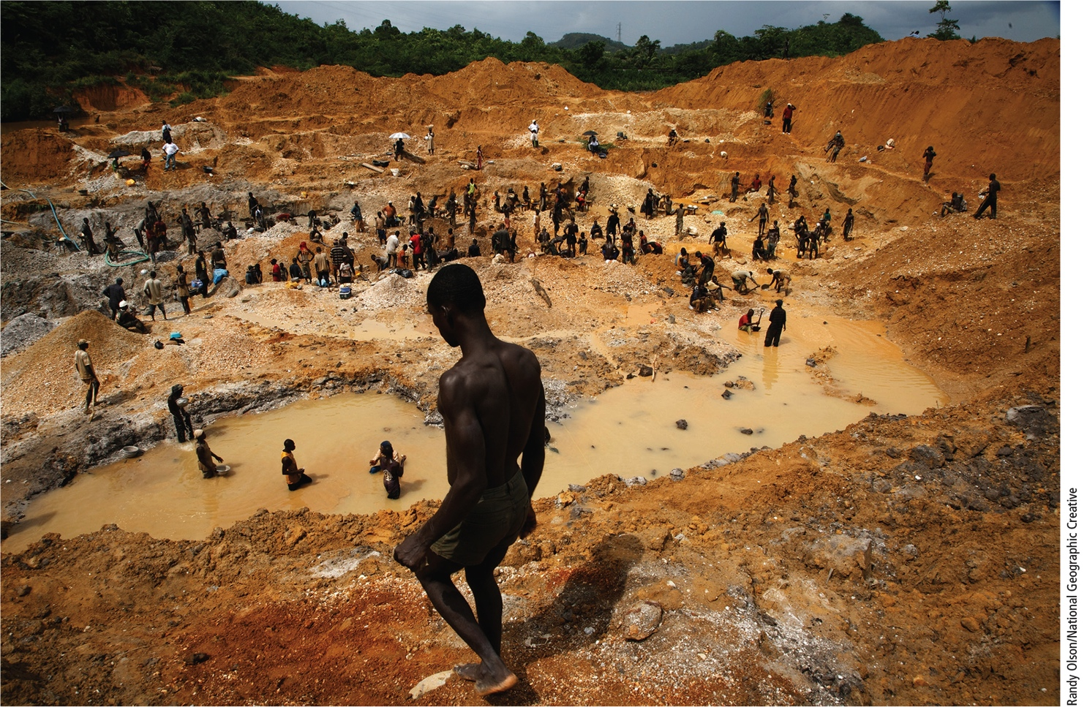
Removing Metals from Ores Has Harmful Environmental Effects (2 of 2)
Notes:
Figure 14.13 Illegal gold mining on the banks of the Pra River in Ghana, Africa.

Slide 47
14.4 How Can We Use Mineral Resources More Sustainability?
Methods for more sustainable mineral use
Try to find substitutes for scarce resources
Reduce resource waste
Recycle and reuse minerals

Slide 48
Find Substitutes for Scarce Mineral Resources
Materials revolution
Silicon replacing some metals for common uses
New technologies
Nanotechnology and high-strength plastics
Graphene and phosphorene
Substitution doesn’t always work
Platinum–industrial catalyst

Slide 49
Case Study: Graphene and Phosphorene - New Revolutionary Materials
Graphene is made from graphite
Light, flexible, stretchable, very strong
Excellent conductor of electricity
Can make stronger and lighter plastics
Phosphorene is a single layer of black phosphorus molecules
More efficient semiconductor than silicon

Slide 50
Use Mineral Resources More Sustainably (1 of 2)
Recycling and reuse
Lower environmental impact than mining and processing metals from ores
Extract valuable metals from electronic waste
Find substitutes without heavy environmental impacts
Lithium
Supplies unevenly distributed worldwide

Slide 51
Use Mineral Resources More Sustainably (2 of 2)
Notes:
Figure 14.15 We can use nonrenewable mineral resources more sustainably (Concept 14.4). Critical thinking: Which two of these solutions do you think are the most important? Why?

Slide 52
11.6 What Are the Earth’s Major Geological Hazards?
Dynamic processes move matter within the earth and on its surface
Cause volcanic eruptions, earthquakes, tsunamis, erosion, and landslides

Slide 53
The Earth Beneath Your Feet Is Moving (1 of 2)
The earth’s crust is broken into tectonic plates
“Float” on the asthenosphere
Slow movement of continenets is called continental drift
Much geological activity takes place at plate boundaries
Divergent boundary
Convergent boundary
Transform plate boundary

Slide 54
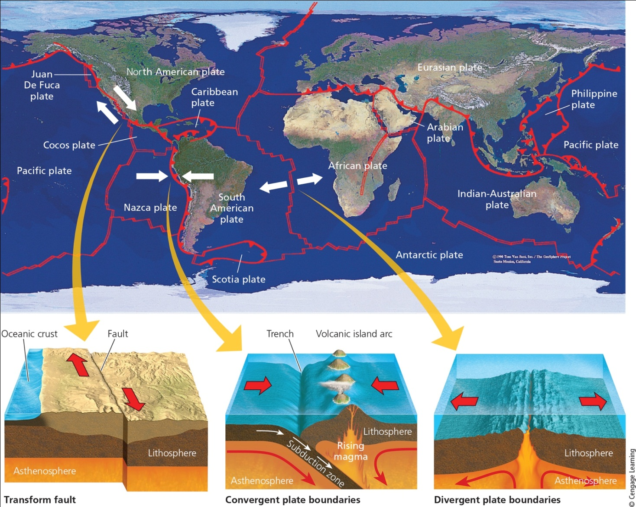
The Earth Beneath Your Feet Is Moving (2 of 2)
Notes:
Figure 14.16 The earth’s crust has been fractured into several major tectonic plates. White arrows indicate examples of where plates are colliding, separating, or grinding along against each other in opposite directions. Question: Which plate are you riding on?

Slide 55
Volcanoes Release Molten Rock from the Earth’s Interior (1 of 2)
Volcano
Magma rising through the lithosphere reaches the earth’s surface through a crack (fissure)
Eruption–release of lava, hot ash, and gases into the environment
Volcanos form majestic mountain ranges and lakes
Formed Hawaiian islands
Can also cause destruction

Slide 56
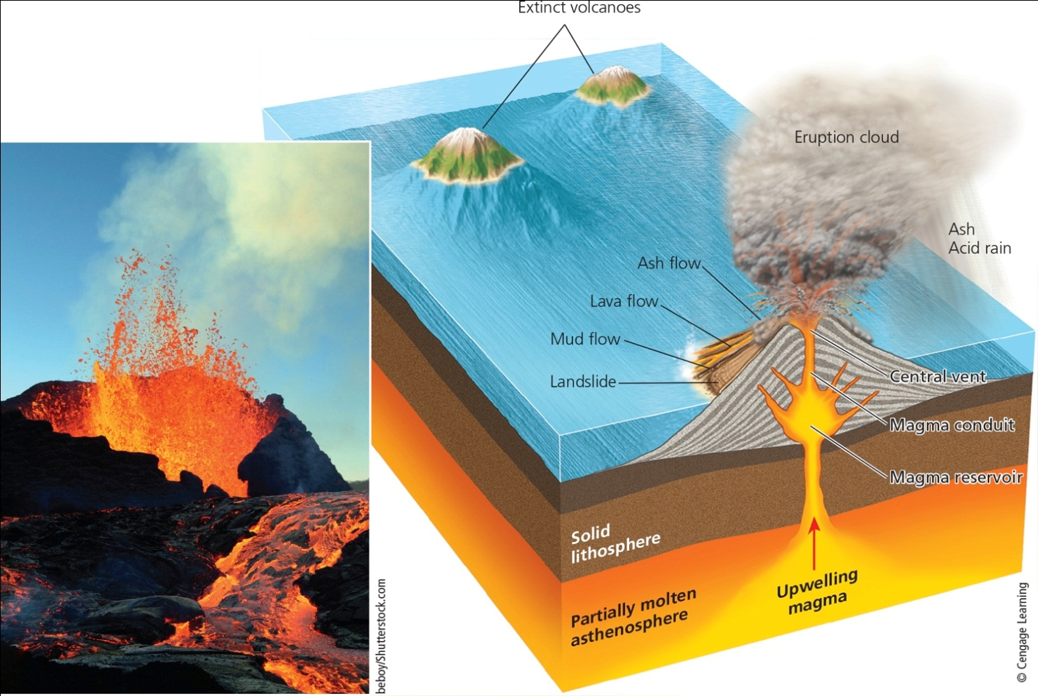
Volcanoes Release Molten Rock from the Earth’s Interior (2 of 2)
Notes:
Figure 14.18 Sometimes, the internal pressure in a volcano is high enough to cause lava, ash, and gases to be ejected into the atmosphere (photo inset) or to flow over land, causing considerable damage.

Slide 57
Earthquakes Are Geological Rock-and-Roll Events (1 of 4)
Earthquake
Breakage and shifting of rocks
Occurs at a fault
Seismic waves
Vibrations in the crust
Focus–origin of earthquake
Magnitude–severity of earthquake
Amplitude–size of the seismic waves

Slide 58
Earthquakes Are Geological Rock-and-Roll Events (2 of 4)
Richter scale
Insignificant: <4.0
Minor: 4.0–4.9
Damaging: 5.0–5.9
Destructive: 6.0–6.9
Major: 7.0–7.9
Great: >8.0
Largest recorded: 9.5 in Chile, 1960

Slide 59
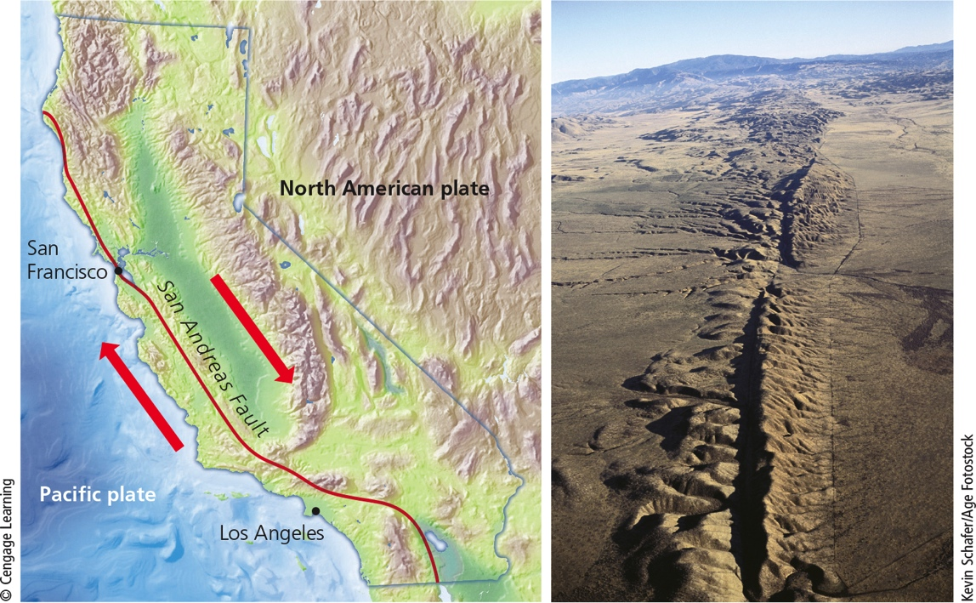
Earthquakes Are Geological Rock-and-Roll Events (3 of 4)
Notes:
Figure 14.17 The San Andreas Fault, created by the North American Plate and the Pacific Plate sliding very slowly past each other, runs almost the full length of California (see map). It is responsible for earthquakes of various magnitudes, which have caused rifts on the land surface in some areas (photo).

Slide 60
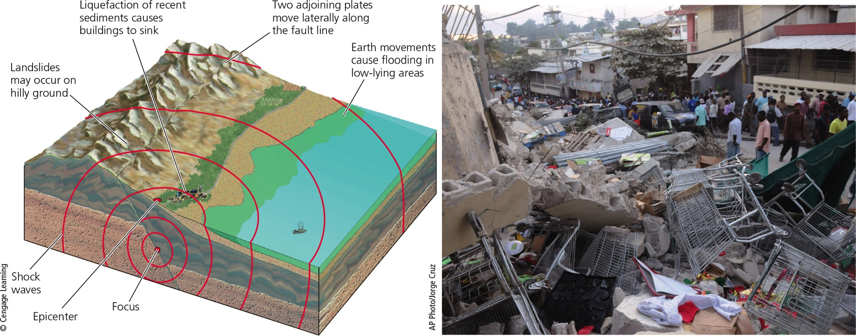
Earthquakes Are Geological Rock-and-Roll Events (4 of 4)
Notes:
Figure 14.19 An earthquake (left) is one of nature’s most powerful events. The photo shows damage from a 2010 earthquake in Port-au-Prince, Haiti.

Slide 61
Earthquakes on the Ocean Floor Can Cause Tsunamis (1 of 3)
Tsunami
Series of huge waves generated when ocean floor suddenly rises or drops
Travels several hundred miles per hour
Slows down as it approaches coastline
December 2004–Indian Ocean tsunami
Magnitude 9.15 earthquake
Over 230,000 people lost their lives
No warning system in place

Slide 62
Earthquakes on the Ocean Floor Can Cause Tsunamis (2 of 3)
2011–Japan tsunami
Killed almost 19,000 people
Damaged Fukushima nuclear reactors
Detection of tsunamis
Buoys in open ocean
Pressure recorders on the ocean floor

Slide 63
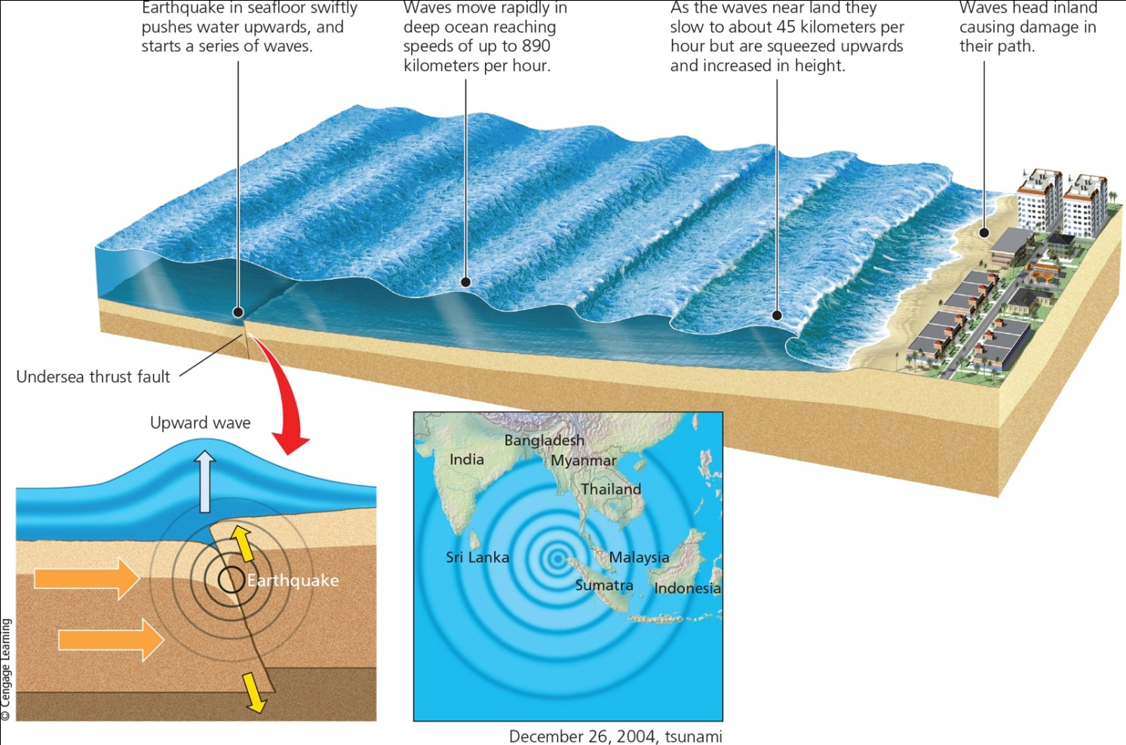
Earthquakes on the Ocean Floor Can Cause Tsunamis (3 of 3)
Notes:
Figure 14.20 Formation of a tsunami. The map shows the area affected by a large tsunami in December 2004—one of the largest ever recorded.

