Slide 1
Karyotyping A CellServ PowerPoint Instructional Program by Mark S. Nardone & Roland M. Nardone, Ph.D. Foundation for Advanced Education in the Sciences, Inc. At the National Institutes of Health Bethesda, MD

Slide 2
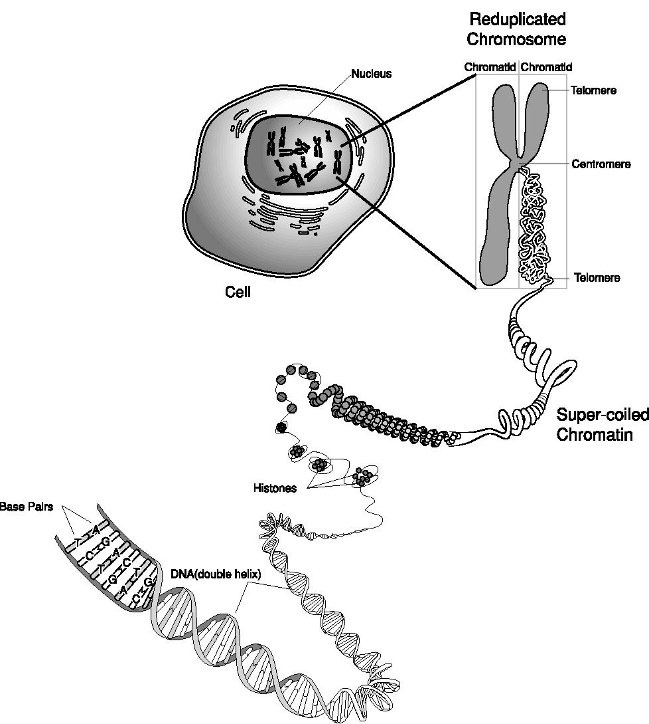
Karyotyping
Source: National Human Genome Research Institute

Slide 3
Karyotyping Defined
Morphological characterization of chromosomes
Description of the size and shapes of a diploid set of chromosomes
A photomicrograph of a set of chromosomes arranged according to a standard classification approach thereby providing the viewer with an image of the sizes and shapes of all the chromosomes

Slide 4
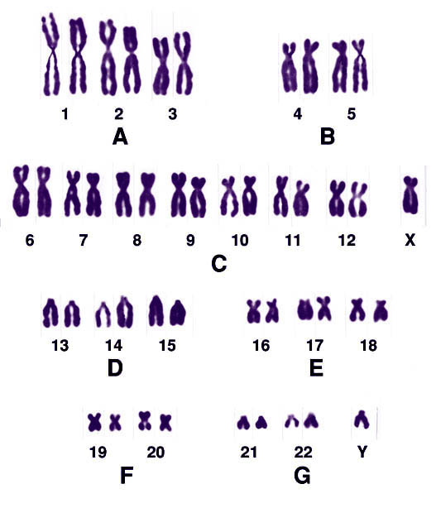
Human Karyotype (male)

Slide 5
Karyotyping serves many areas of basic biology and medicine, including
Species Identification
Gene Mapping
Genetic Disease Analysis

Slide 6
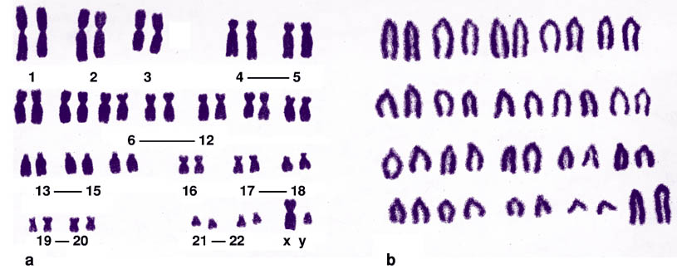
Species Identification:
Each species has a characteristic karyotype.
Human
Mouse

Slide 7
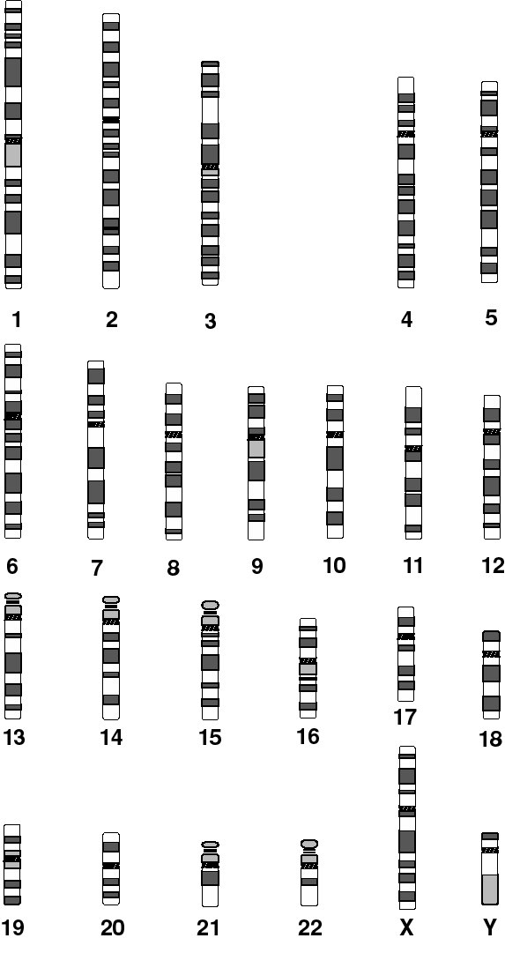
Banded Chromosomes are Used for Gene Mapping

Slide 8
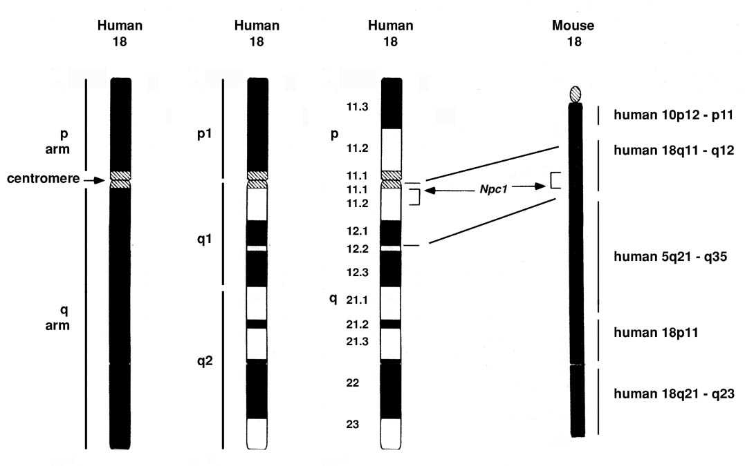
Comparative Mapping: Human and Mouse Chromosome 18

Slide 9
Many inherited diseases arise from numerical or structural chromosome aberrations.

Slide 10
Chromosome abnormalities are responsible for more than 60 identifiable syndromes.
Cancer: 43 types | About 150 non-random chromosome changes involving all chromosomes except Y chromosome.
Cri du Chat Syndrome (Microcephaly, retardation, etc.) | Deletion of short arm of chromosome 5
Fragile X Syndrome | Fragile site on long arm of X chromosome
Down Syndrome (Dysmorphic features: mental retardation) | 3 copies of chromosome 21

Slide 11
Human karyotypes are often used as part of prenatal or postnatal medical diagnoses.

Slide 12
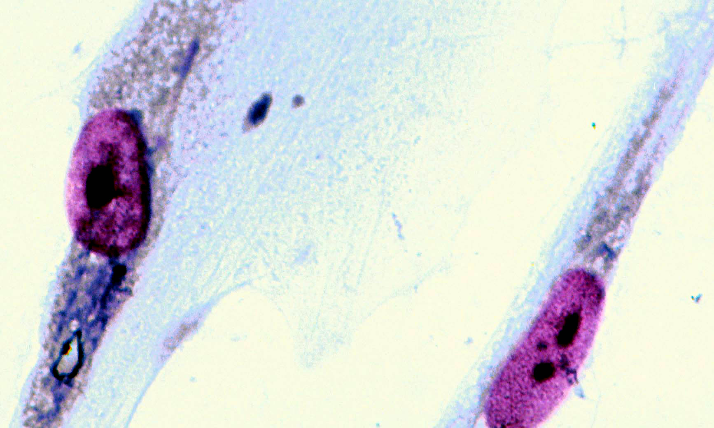
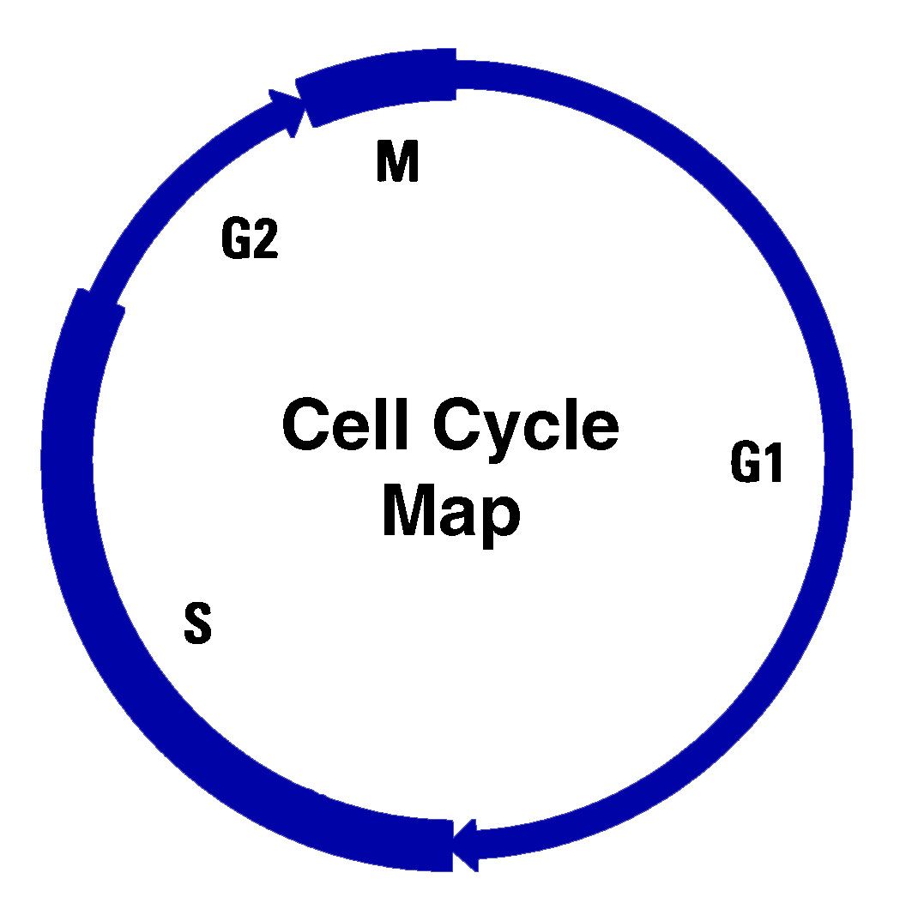
Cell Cycle Map - Interphase
No chromosomes evident Nuclear membrane intact Nucleolus visible DNA synthesis map: G₁- no DNA synthesis S - DNA and chromosome reduplication occur G₂ - Second discontinuity: no DNA synthesis Interphase lasts 95% of cell cycle time

Slide 13
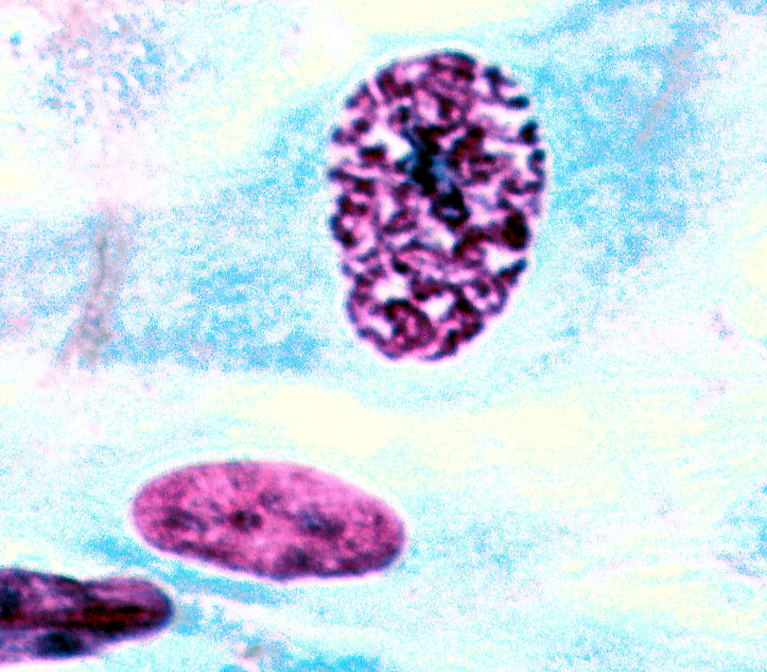
Cell Cycle Map: Stages of Mitosis
Prophase: Onset of prophase is marked by chromosome condensation making reduplicated chromosomes visible. Metaphase: Chromosome alignment in middle of cell during metaphase; chromosome condensation is maximal.

Slide 14
Anaphase: Separation of sister chromatids of reduplicated chromosomes and their migration to opposite ends of cell; chromosome decondensation begins. Telophase: Decondensation continues. Nuclear membranes begin to form around the two sets of chromosomes at opposite poles.

Slide 15
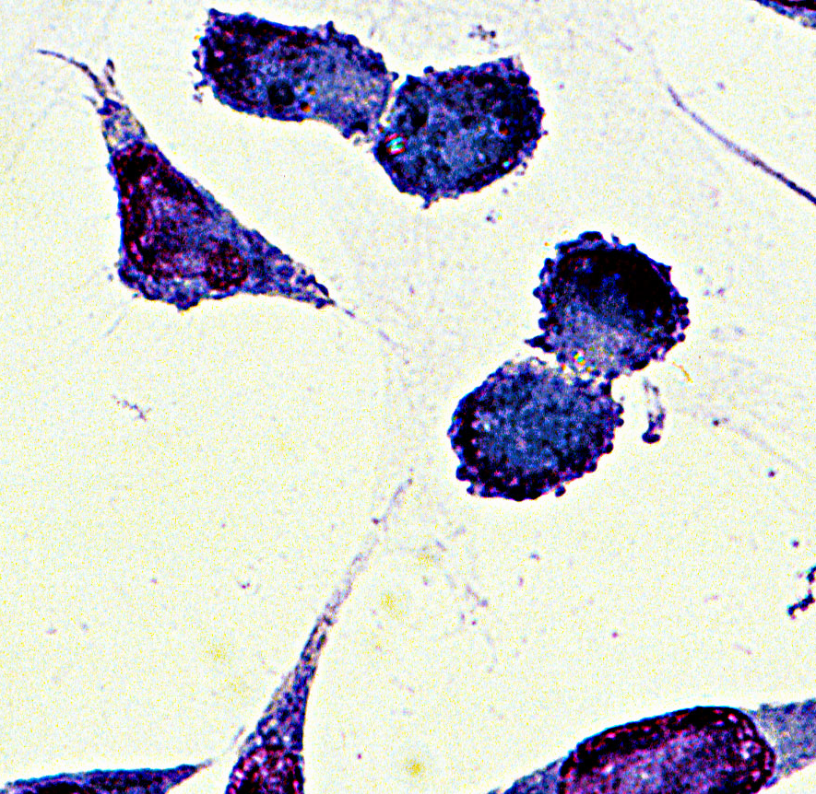
Cytokinesis - the pinching in of the cytoplasm to divide the cell into two daughter cells. May begin in telophase.

Slide 16
Karyotyping – The Process
Cell Culture Phase
Cell Treatment Phase
Slide Preparation Phase
Preparation of Karyotype

Slide 17
Preparation of Chromosome Spreads for Karyotyping Metaphase Blockade: log phase mammalian cell culture in colchicine (0.06 μg/ml) for 3-4 hours CMF-PBS Rinse; Detach Cells with Trypsin Rinse, Pellet Cells by Centrifugation Swell Cells with Hypotonic (0.075M) KCl; Pellet Fix with Methanol: Glacial Acetic Acid (3:1) Stain Search for Ideal Chromosome Spread

Slide 18
Cell Culture Phase Growth of mammalian cells in culture

Slide 19
Cell Cultures: A Crucial Component
Provides a ready supply of cells in mitosis
Can be manipulated to increase frequency of cells in metaphase
Can be manipulated to enhance the degree of chromosome spreading. This allows for easier counting, identification of chromosomes and recognition of structural aberrations
Lends itself to cytological examination; chromosomes can be stained with a variety of stains for different purposes

Slide 20
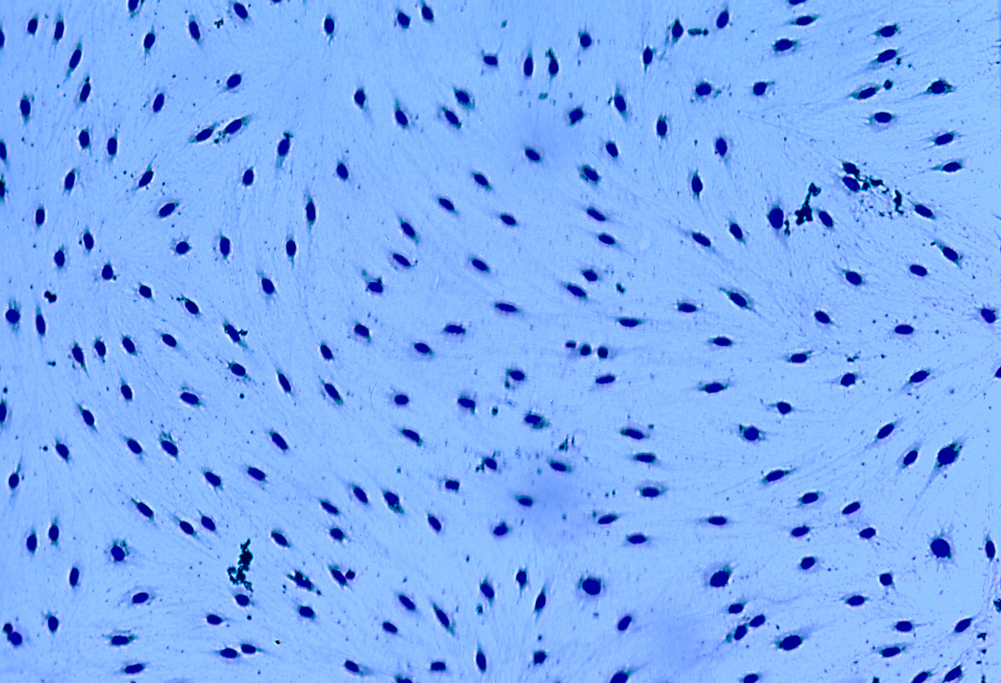
A Normal Mouse Embryo Cell Culture

Slide 21
Sources of Cultured Cells for Karyotyping.
Source | Purpose
Lymphocytes from peripheral blood | Clinical Diagnosis
Cultured fibroblasts collected by amniocentesis or chorionic villus sampling | Prenatal Diagnosis
Established cell lines from human or rodent: IMR 90 Human Lung Fibroblast Chinese Hamster Ovary Cells T3 Mouse Prostate Cells | Research

Slide 22
Metaphase Blockade
Objective - to increase the number of cells in metaphase.
Colchicine or colcemid is used to block cells from going from metaphase to anaphase.
Drug inhibits assembly of microtubules needed for mitotic spindle formation and movement of chromosomes. Hence cells accumulate in metaphase.

Slide 23
Hypotonic Treatment of Metaphase Blocked Cells
Hypotonic salt solution (0.075M KCl).
Causes cell swelling, cells are more fragile, rupture easily when splattered onto slides.

Slide 24
Fixation of Cells
Carnoy's Fixative - 3 parts methyl alcohol to 1 part glacial acetic acid - almost universally is the fixative of choice for chromosome structural studies
The fixative is freshly prepared immediately before use

Slide 25
Application of Fixed Cells to Slide
Dispense cell suspension, dropwise, from a fine bore pipette onto a clean slide.
The pipette tip should be several inches to 12 inches above the slide.
The slide may be flat on the table or propped up at a 45^{O} angle.
Allow slide to air dry.
Spreading of chromosomes is enhanced by the evaporation of the fixative.

Slide 26
Staining Slides of Chromosome Spreads
Solid staining (non-banding) with giemsa stain is the most common stain for routine preparations, such as for chromosome counting.
Such staining is not infallible for precise identification of some chromosomes of similar size and/or centromere localization. Among those that may be misidentified because of size and shape similarities are chromosomes 4 and 5, 10, 11, and 12, and 21 and 22.
Typically, solid staining entails fixation with methanol: glacial acetic acid (3:1), air drying, staining with giemsa, rinsing, air drying and if desired, mounting with permount.

Slide 27
Search for Ideal Chromosome Spread No overlapping chromosomes Chromosomes easily counted Position of centromere is evident Arms of reduplicated chromosomes readily visualized Make photographs of chromosome spread

Slide 28
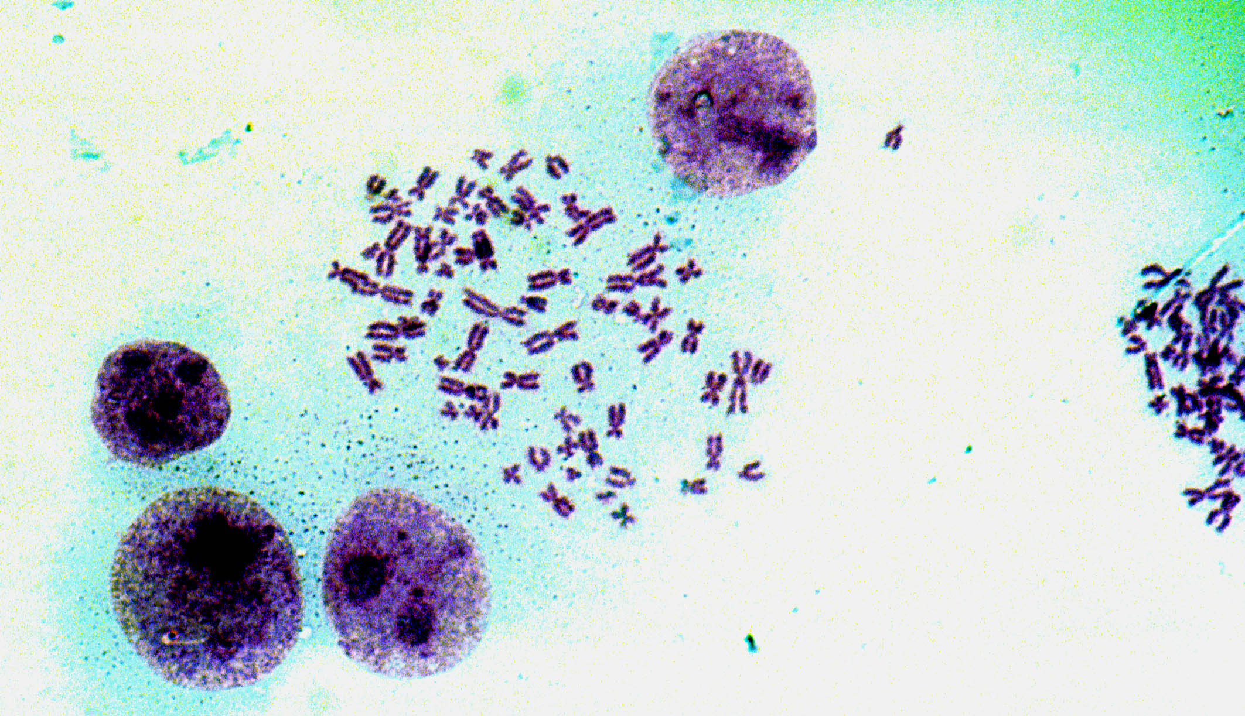
Human Chromosome Spread

Slide 29
Preparation of Idiogram Examine Ideal Chromosome Spreads (400X - 1000X) Photograph Enlarge Print Cut out Chromosomes Arrange Homologous Pairs Assign Chromosome Numbers Based on Chromosome Size and Centromere Position Rearrange as Needed

Slide 30
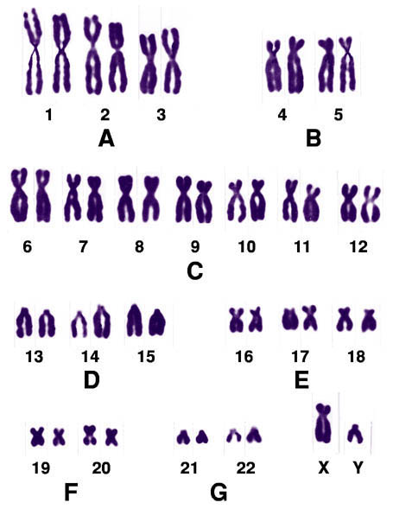

Slide 31
Chromosome Identification
The centromere area is the primary constriction. The arm above the centromere is designated as the p arm and the one below the centromere is designated as the q arm. Identification is based on chromosome length and position of the centromere. Chromosomes are Metacentric (centromere in middle), Submetacentric (centromere is slightly off center), Acrocentric (centromere is far off center), Telocentric (centromere is at end of chromosome) .

Slide 32
Chromosome Classification
Metacentric Subcentric Acrocentric Telocentric

Slide 33
Classification of Human Chromosomes
Metacentric | 1, 3, 16, 19, 20
Submetacentric | 2, 4, 5, 6, 7, 8, 9, 10, 11, 12, 17, 18, X
Acrocentric | 13, 14, 15, 21, 22, Y
Telocentric | No Telocentric Human Chromosomes

Slide 34
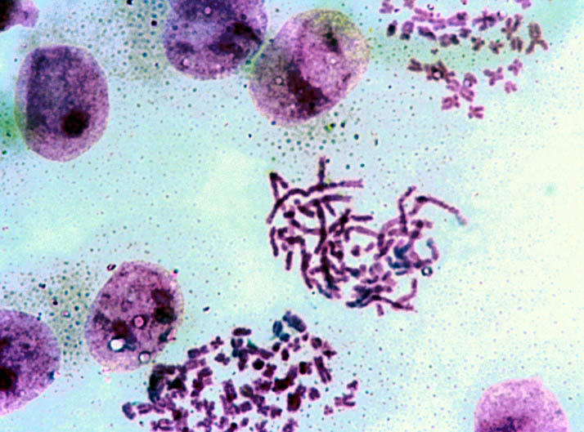
HeLa – A human cancer cell. View shows three degrees of chromosome condensation. Degree of condensation of metaphase chromosomes varies with the amount of time the metaphase cell has been in colchicine

Slide 35
Satellites
A chromatin mass of the short arm of a chromosome; formed by a secondary constriction.
The thin stalk of chromatin connection between the satellite and the rest of the p arm contains the genes for ribosomal RNA.
Acrocentric chromosomes 13, 14, 15, 21 and 22 have satellites.

Slide 36
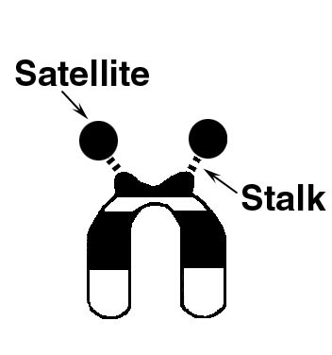
Structure of a reduplicated acrocentric chromosome showing the primary (centromere) and secondary (stalk/satellite) constrictions

Slide 37
Chromosome Banding
Eliminates any ambiguity in chromosome identification
Defined bands appear darker or lighter when stained by Q, G, R and C banding methods
Allows further scientific analysis in gene mapping, identification of fragile sights, structural changes such as translocations, and comparative chromosome analysis

Slide 38
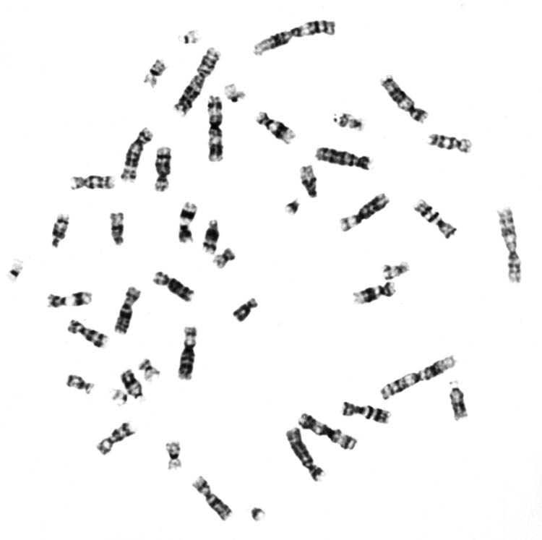
Photograph of G Banded Human Chromosome

Slide 39
Banding Techniques
Q (quinocrine fluorescent) banding
G (giemsa) banding
R (reverse) banding
C (centromere) banding

Slide 40
Summary
Karyotyping has several important roles in biology and medicine ranging from gene mapping, to species identification, to clinical diagnosis, to evaluation of potentially harmful chemicals in the environment.
Key improvements in technique have contributed to its usefulness. These include the use of proliferating cell cultures, the enrichment of the frequency of metaphase cells by metaphase blockade, the separation of chromosomes and swelling of cells with a hypotonic solution and development of banding techniques which assist in an accurate identification of the chromosomes and in resolving structural Aberrations.

