Slide 1
Copyright © Dean Madden, 2010

Slide 2
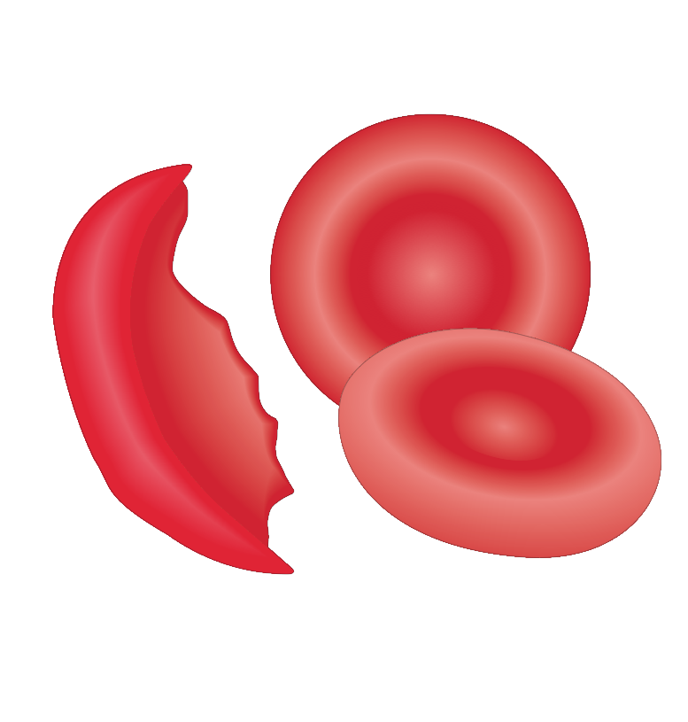
Normal red blood cells
Sickle cell

Slide 3
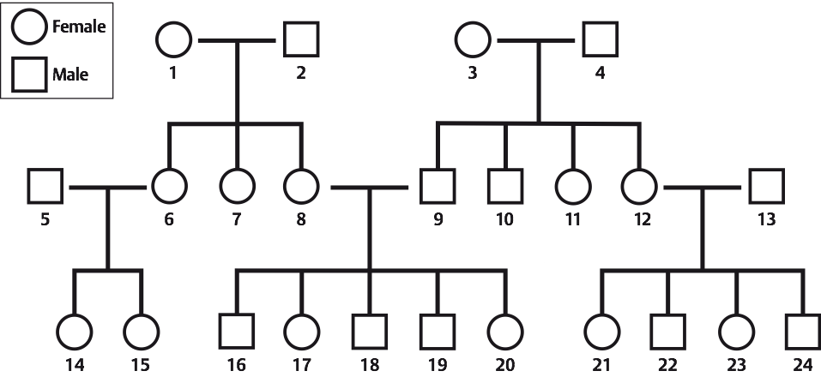

Slide 4
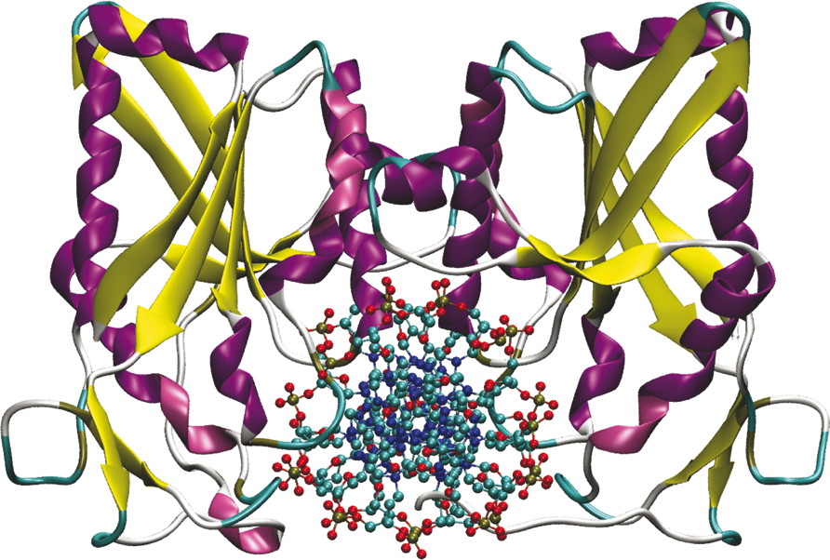

Slide 5
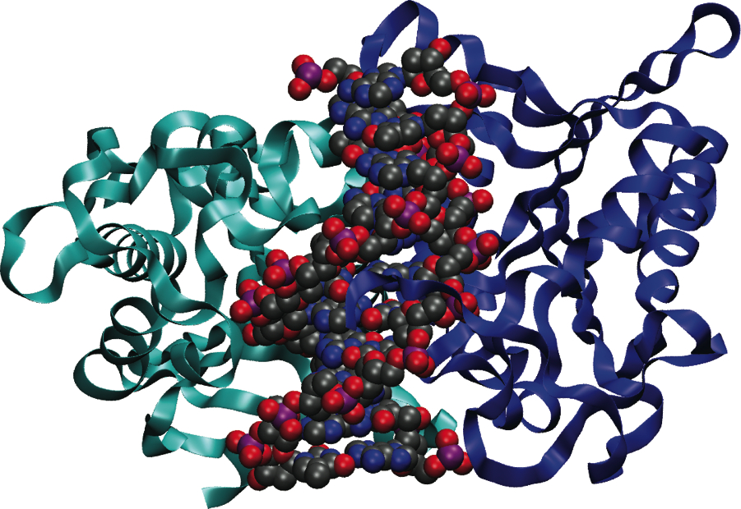

Slide 6
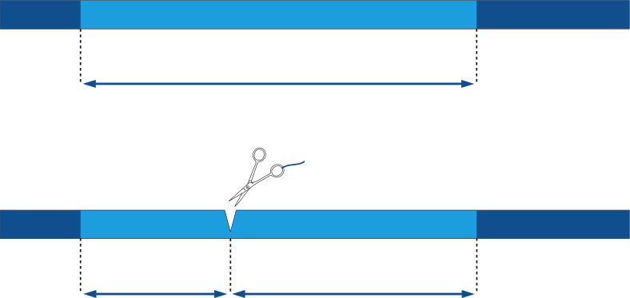
Dominant allele (D)
DNA remains uncut
6500 base-pairs (bp)
Restriction
enzyme
Recessive allele (d)
DNA is cut
2500 bp
4000 bp

Slide 7
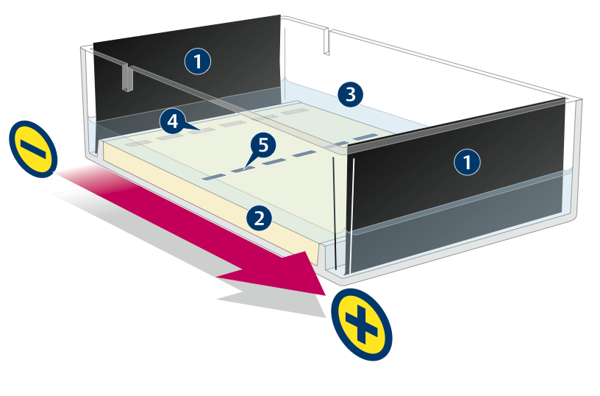

Slide 8
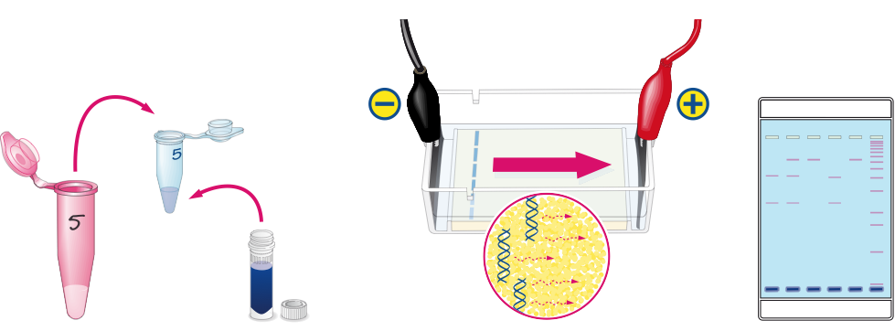
Summary of procedure
Enzyme
DNA
Loading dye

Slide 9
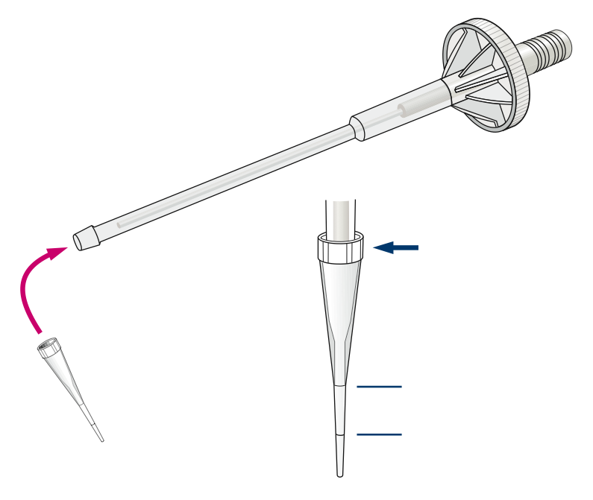
Microsyringe
HOLD HERE
Do not touch the point!
Graduated tip
10 µL
2 µL

Slide 10
Mass
A microgram is one millionth of a gram
1 000 micrograms (µg) = 1 milligram (mg)
1 000 milligrams = 1 gram (g)
Volume
A microlitre is one millionth of a litre
1 000 microlitres (µL) = 1 millilitre (mL)
1 000 millilitres = 1 litre (L)

Slide 11
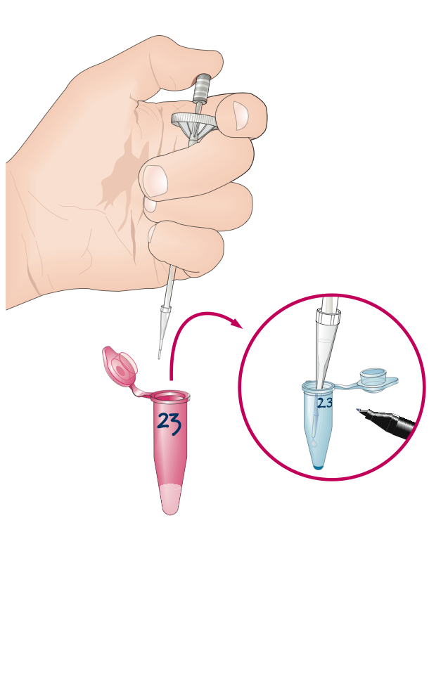
IMPORTANT
Mix well after dispensing
20 µL
Label the tube twice (on the side and on the lid)
Numbered DNA sample
Dried restriction enzyme in tube

Slide 12
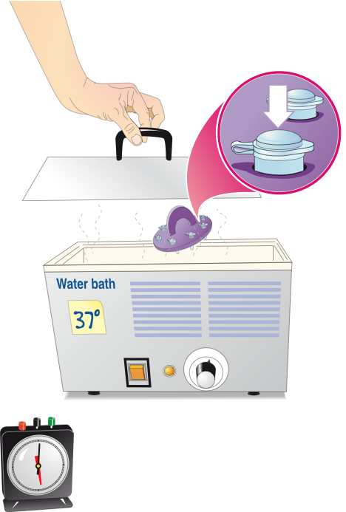
Close the tubes and push them firmly into the foam floater
Incubate for 30–45 minutes at 37°C

Slide 13
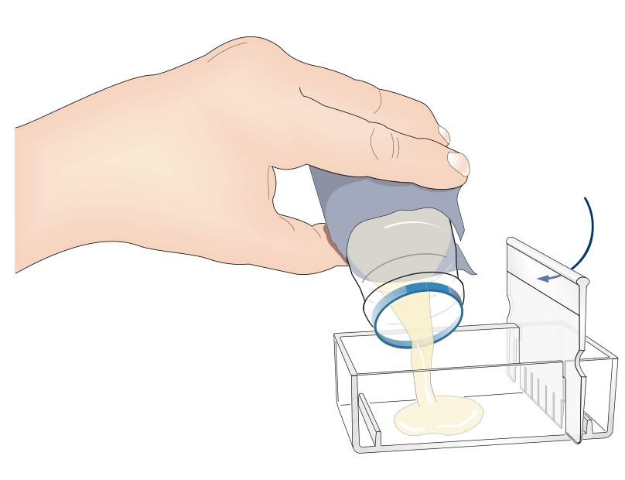
Frosted panel on this side
Molten agarose
55–60 °C

Slide 14
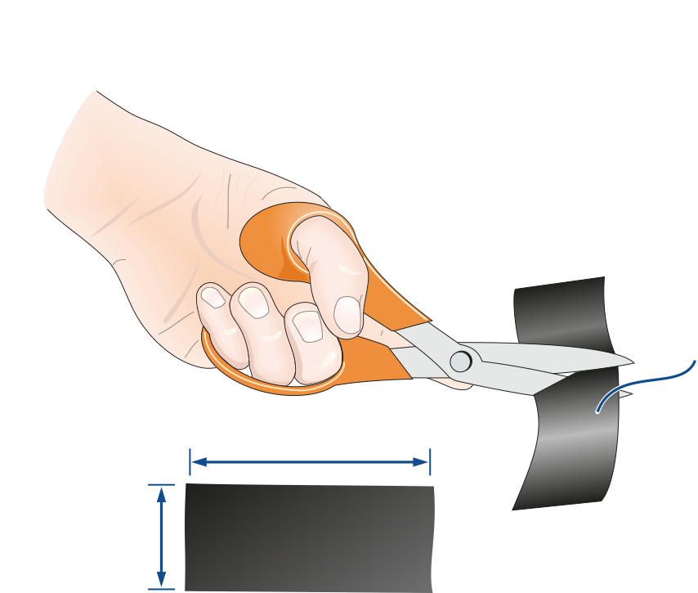
Carbon fibre
tissue
42 mm
22 mm
Cut two electrodes

Slide 15
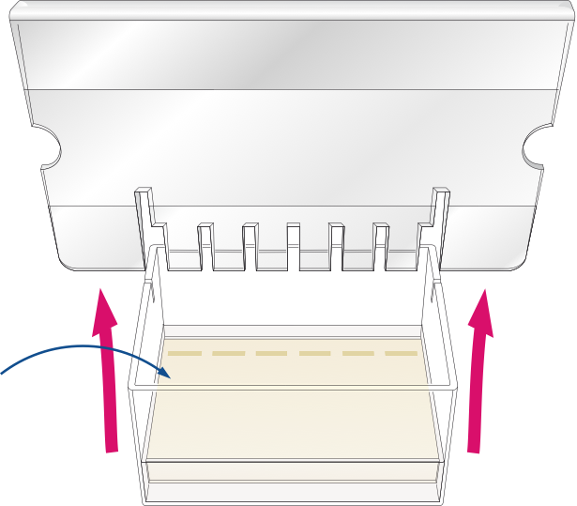
Pour 2–3 mm depth of buffer over the gel before you ease the comb out

Slide 16
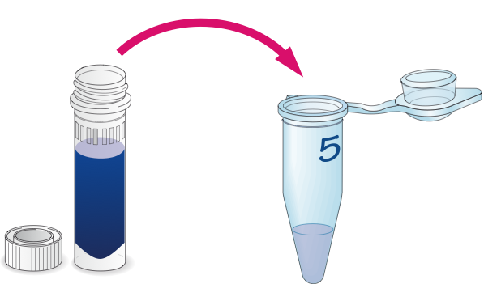
Mix loading dye into each DNA sample
2 µL
Bromophenol blue loading dye
Cut DNA sample

Slide 17
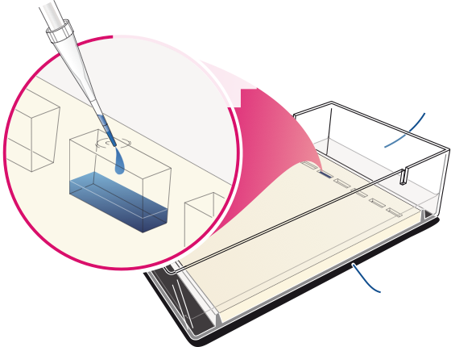
Load the DNA through the buffer, taking care not to puncture the wells as you do so
Label the end of the tank to show the contents of each well
Black card under the tank reveals the wells for loading

Slide 18
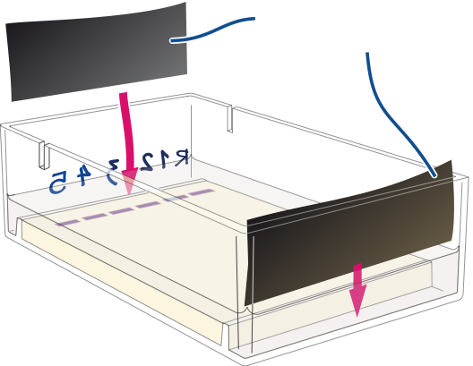
Electrodes

Slide 19
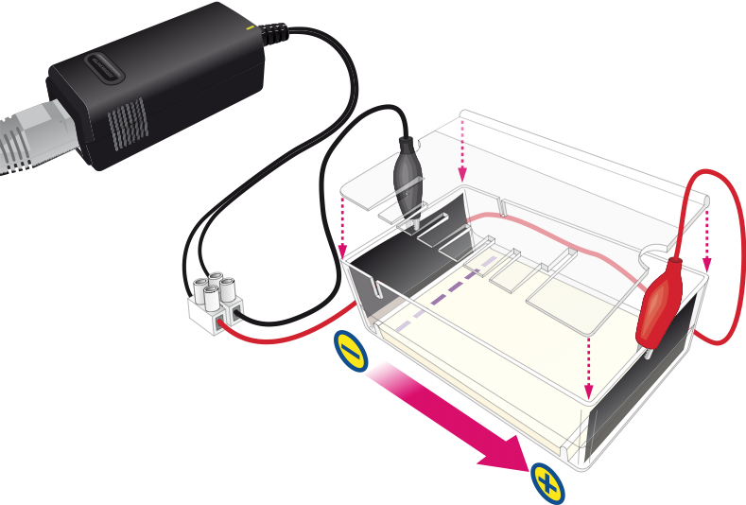
Place a comb over the tank to reduce evaporation
Direction of DNA movement

Slide 20
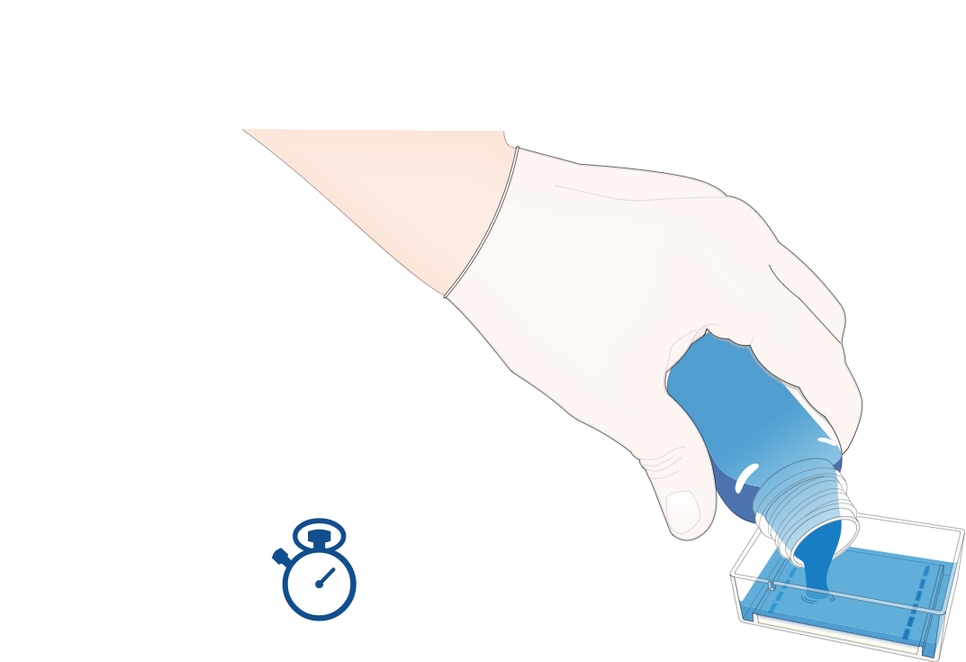
Azure A stain
Leave the stain on for 4 minutes only

Slide 21
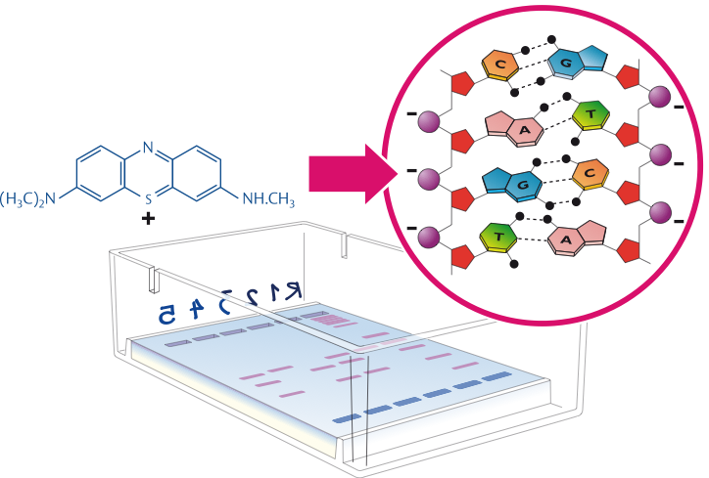
Positively-charged Azure A binds to the negatively-charged phosphate groups of the DNA
DNA

Slide 22
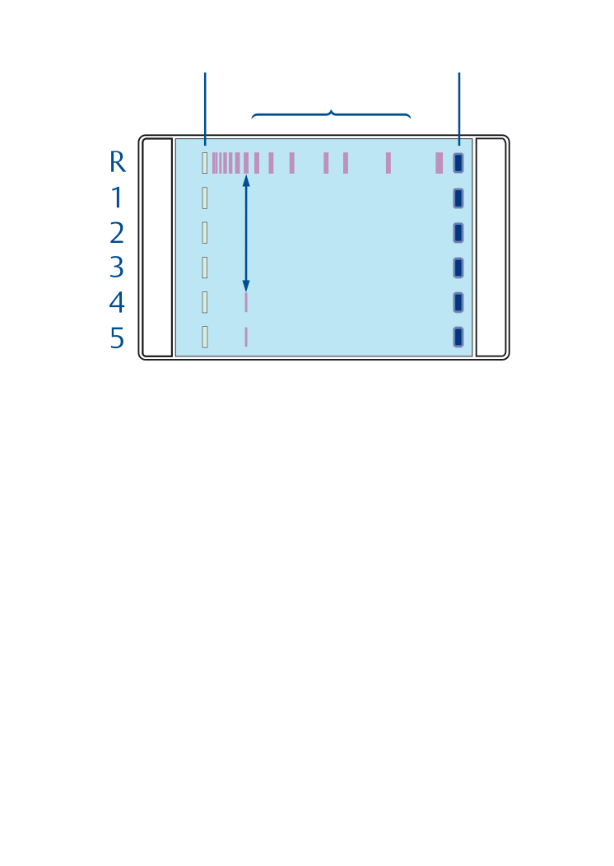
Loading dye
Wells
Area with DNA bands
Compare each band from each DNA sample with bands of known sizes in the DNA ‘ruler’

Slide 23
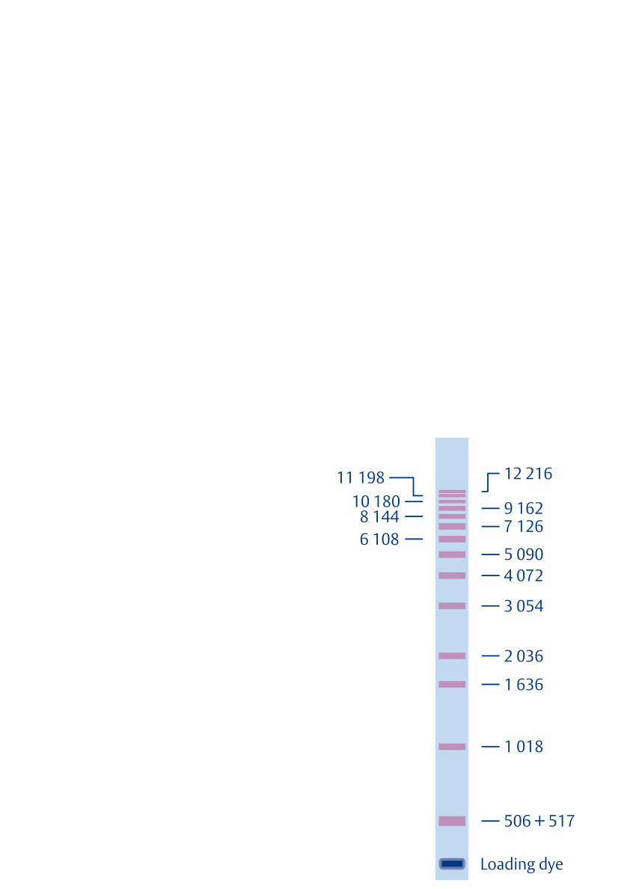
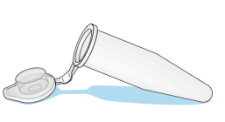
DNA ‘ruler’ or ‘ladder’

Slide 24
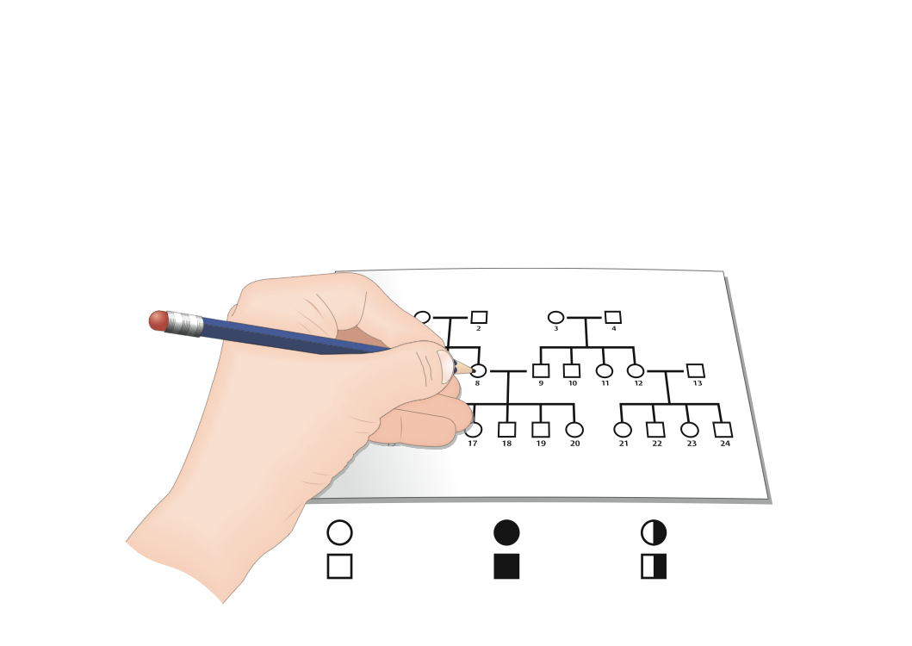
Unaffected
Affected
Carrier

