Slide 1
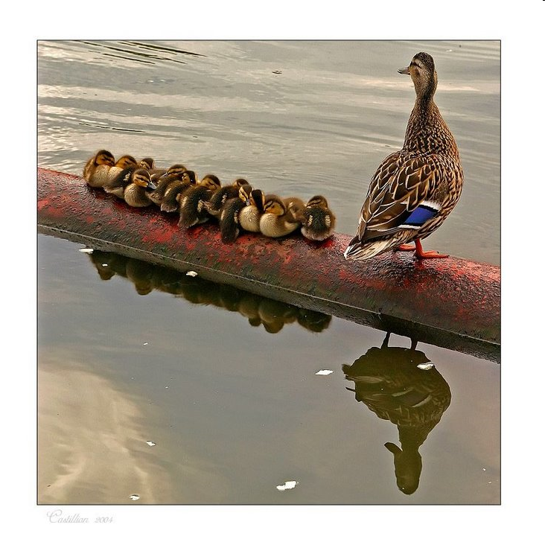
Population Dynamics
Notes:
No more for you mrs. Willie!!

Slide 2
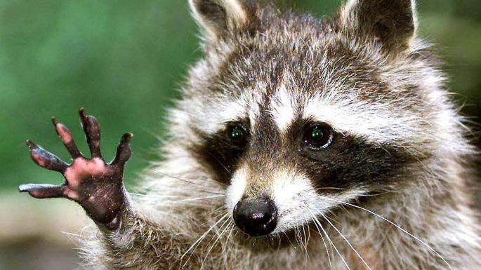
Generalists vs Specialist Species
G: Broad niches, live in wide variety of habitats, use variety of resources
S: narrow niches, live in specific places.

Slide 3
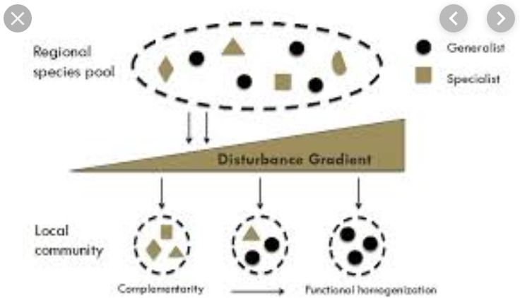
Habitats
S: Tend to be in constant habitats (little env. change)
G: Tend to succeed in changing environments.

Slide 4
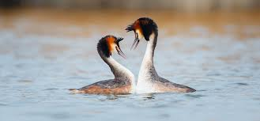
Reproductive strategies

Slide 5
R Selected vs K Selected
R-selected
Many small offspring
Little/no care of offspring
Most offspring die before reaching reproductive age
High population growth rate
Generalists
K-selected
Fewer, larger offspring
High parental care
Most offspring reach reproductive age
Lower population growth rate
Specialists

Slide 6
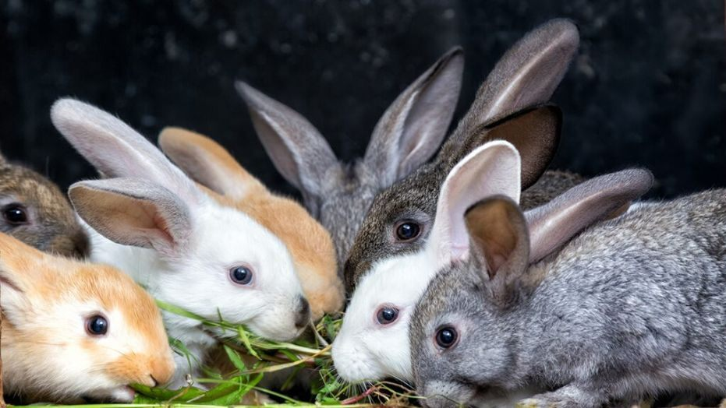
R

Slide 7
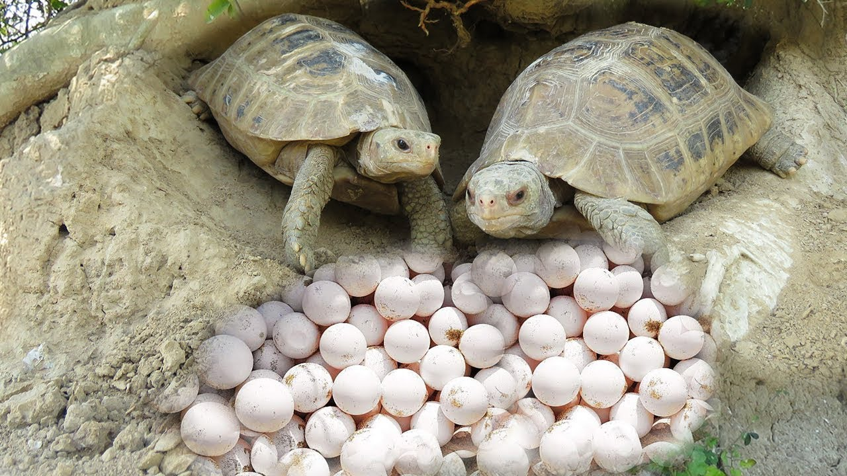
R

Slide 8
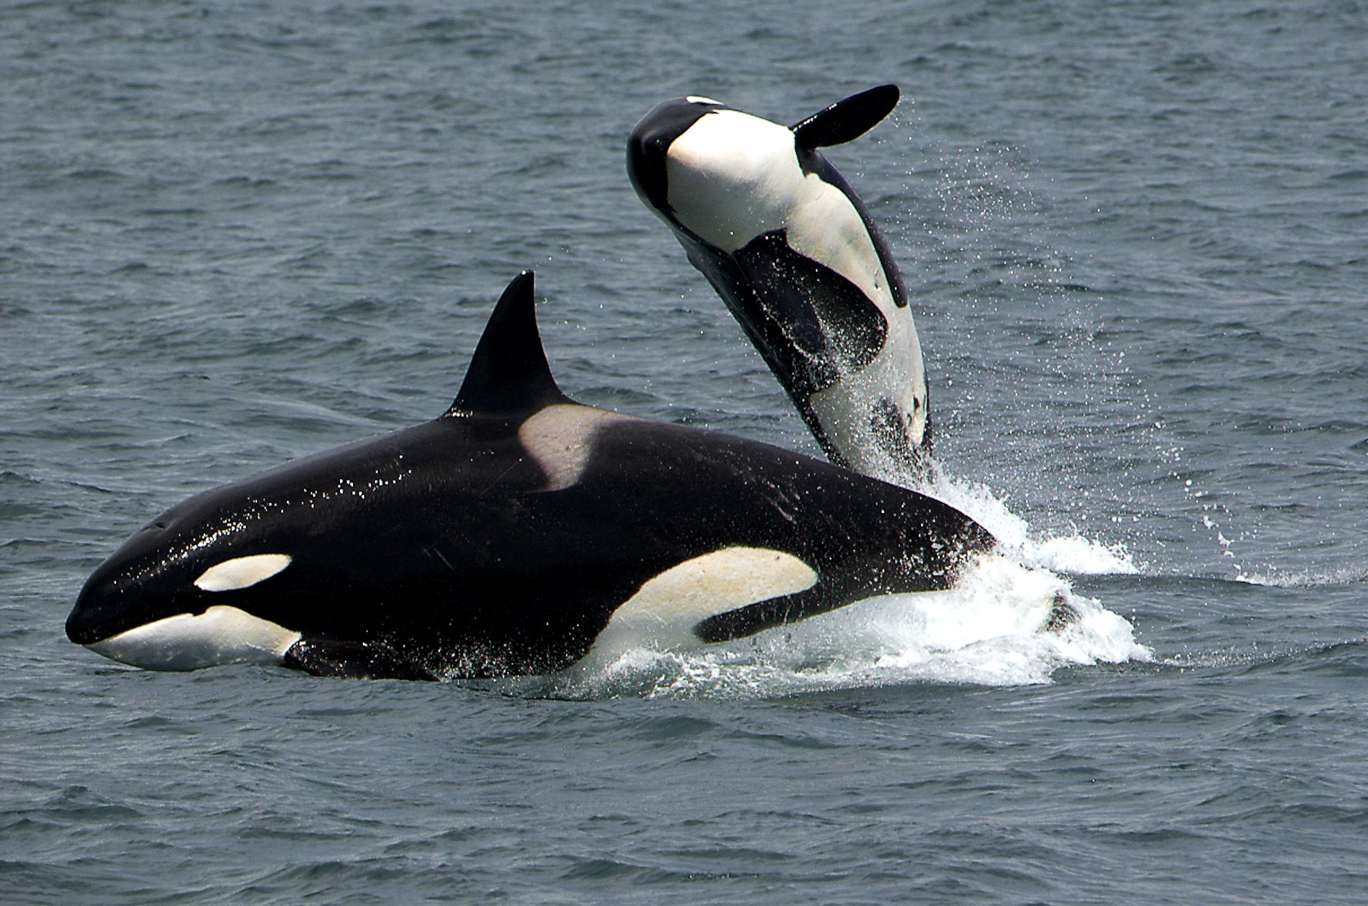
K

Slide 9
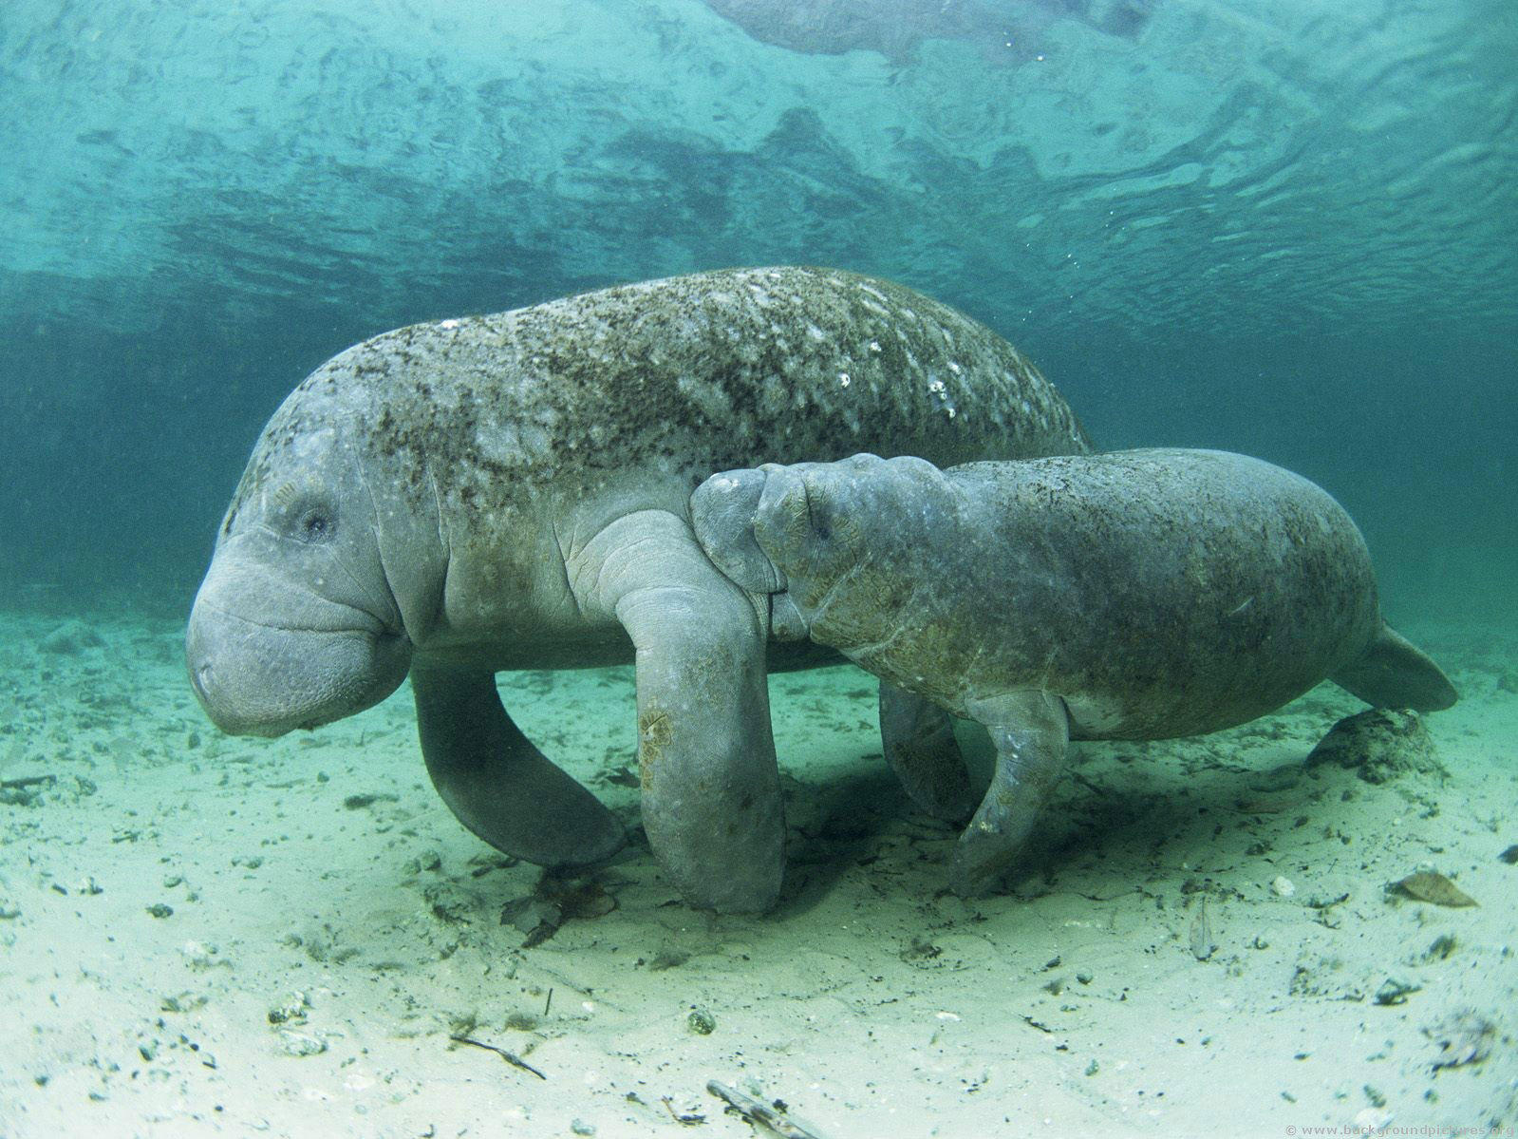
K

Slide 10
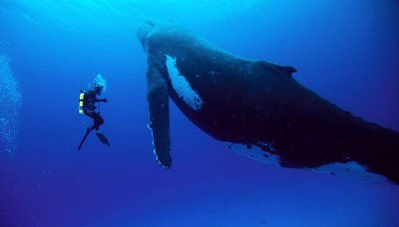
What Advantages do R Selected Species have? What about K? Which would you rather be???

Slide 11
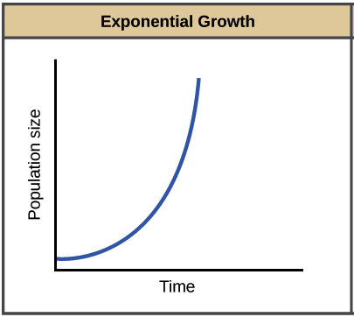
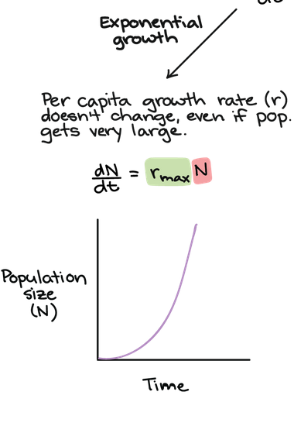
R selected Grow Exponentially

Slide 12
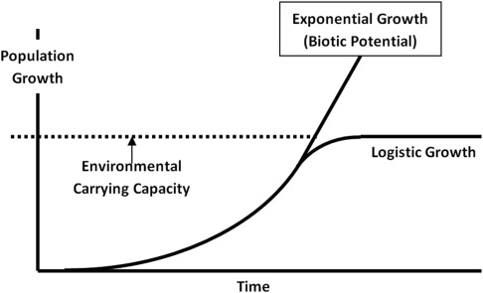
Biotic Potential
Maximum reproduction rate of a population in ideal conditions

Slide 13
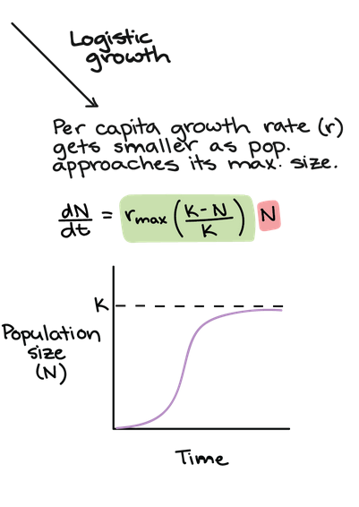
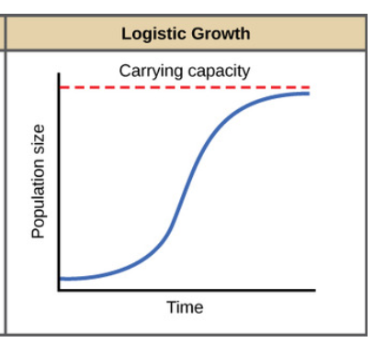
K selected Grow Logistically

Slide 14
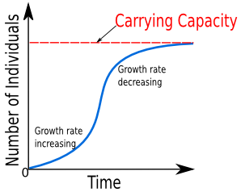
Carrying Capacity
Max. pop. of a species that a habitat can support. (K)
Can change due to env.
What happens when you go over K?

Slide 15
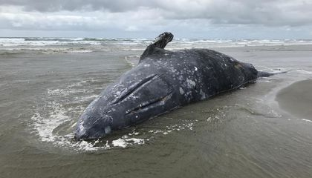
When Resources Decline…
Increased mortality
Decreased fecundity
→ Leads to pop shrinking, goes under K.

Slide 16
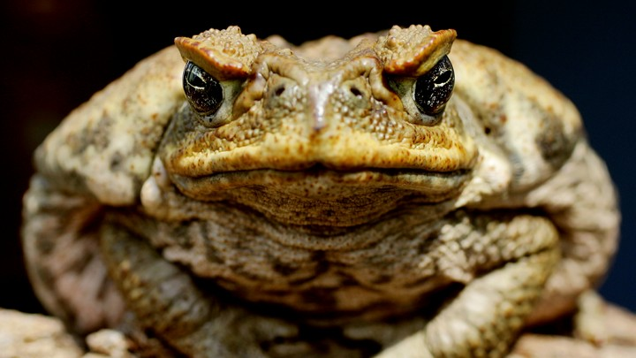
Invasive Species…
…Tend to be r-selected

Slide 17
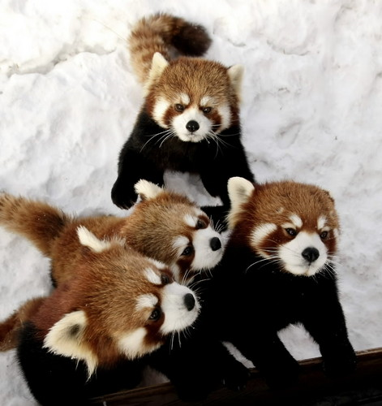
Survivorship
Proportion of a pop. to survive to breeding age
Type I= Late loss: K-strategists.
Type II = Constant loss: intermediate reproductive strategists
Type III = Early loss: R-strategists

Slide 19
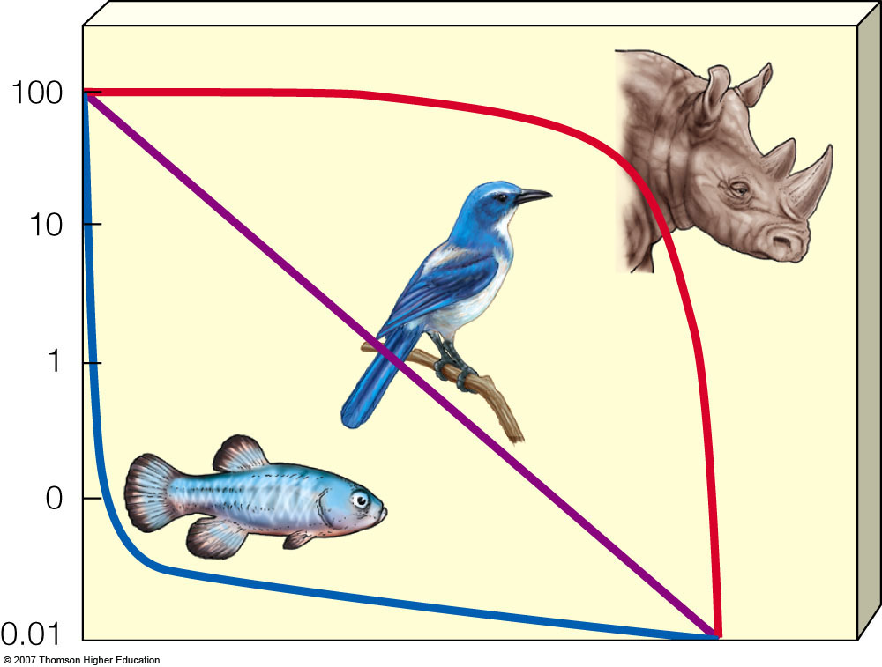

Slide 20
Density Dependence
Population growth can be affected by:
-Density-independent factors: major storms, fires, heat waves, or droughts
-Density-dependent factors: access to clean water and air, food availability, disease transmission, or territory size.

Slide 21
Around the World…
China: 1.4 billion
India: 1.3 billion
US: 330 million
Indonesia: 260 mill.
Brazil: 205 million
World Population:
7.7 billion
Notes:
http://www.census.gov/popclock/

