Slide 1
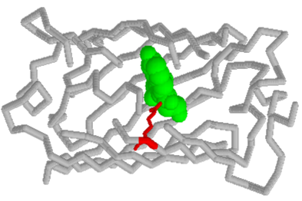
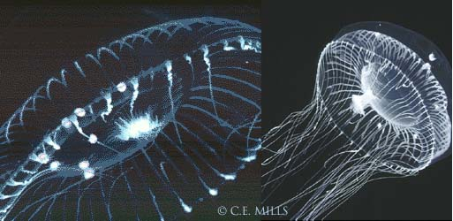
pGLOTM Bacterial Transformation
Aequorea victoria
Two views of the hydromedusa Aequorea victoria from Friday Harbor, Washington, copyright Claudia .E. Mills 1999
Notes:
http://faculty.washington.edu/cemills/Aequorea.html
Visit this site for information about this jellyfish…
You will transform bacteria with a gene that codes for Green Fluorescent Protein (GFP). The real-life source of this gene is a jellyfish. GFP causes certain areas of the jellyfish to glow in the dark. After you transform the bacteria, they will express their new jellyfish gene and produce the fluorescent protein. It causes them to glow a brilliant green color under ultraviolet light.

Slide 2
pGlo Concepts
Genetic Transformation
Gene Regulation
Genetic Selection
DNA
RNA
Protein
Trait
Notes:
Transformation: Students will learn about the process of moving genes from one organism to another with the aid of a plasmid
Regulation:
Allows for adaptation to various conditions and prevents unneeded production of proteins.
Gene expression in all organisms is carefully regulated to allow for adaptation to differing conditions and to prevent wasteful overproduction of unneeded proteins. The genes involved in the breakdown of different food sources are good examples of highly regulated genes. For example, the simple sugar arabinose is both a source of energy and a source of carbon for
bacteria. The bacterial genes that make digestive enzymes to break down arabinose for food are not expressed when arabinose is not in the environment. But when arabinose is present, these genes are turned on. When the arabinose runs out, the genes are turned off again.
Selection:
Colonies can be selected for their ability to grow in various conditions.

Slide 3
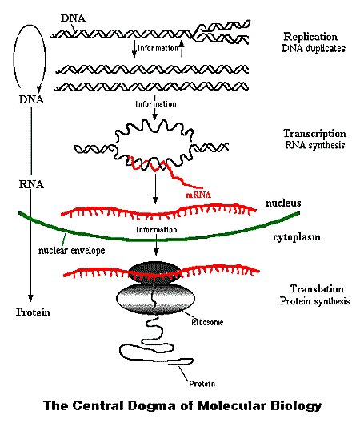
The Central Dogma of Molecular Biology
Advantages
The DNA can retain integrity
The RNA step allows amplification
Multiple steps allow multiple points of control
Notes:
By copying the message and taking it to the cytoplasm the DNA can remain pristine. It is also shielded from the chemicals in the cytoplasm.

Slide 4
What is transformation?
Uptake of foreign DNA, often a circular plasmid
Plasmid
Cell wall
Bacterial
chromosomal
DNA
Notes:
Genetic transformation is taking genes from one organism and putting them in another. A gene is a piece of DNA that gives the instructions for making a protein. This protein gives an organism a certain trait. A gene is inserted into an organism in order to change the organism’s trait. Genetic transformation is used in many areas of biotechnology. In agriculture, genes coding for traits such as frost, pest, or spoilage resistance can be inserted into plants. In medicine, gene therapy treats diseases caused by defective genes by inserting healthy copies of the defective gene in a sick person’s cells.

Slide 5
What is a plasmid?
The most simple bacterial vector: a DNA molecule used to insert foreign DNA into a host cell
A circular piece of autonomously replicating DNA
Plasmids are like mini-chromosomes
Originally evolved by bacteria
May express antibiotic resistance gene or be modified to express proteins of interest
ori
bla
Notes:
You will learn about the process of moving genes from one organism to another with the aid of a plasmid, a small circular piece of DNA. Bacteria have one large chromosome and, usually, one or more plasmids. Plasmids usually contain genes for traits that may help the bacteria survive. In nature, bacteria can transfer plasmids back and forth allowing them to share these beneficial genes. This process allows bacteria to adapt to new environments.

Slide 6
Plasmids
Differ from chromosomes
Range in size from 1,000—200,000 bp (base pairs)
One or more copies per cell, “stringent” vs. “relaxed” : <12 is normal, but can range from ~5 to 700 copies per cell
Not all bacteria have plasmids
Functions
Cryptic – no known function
Phenotypic – antibiotic resistance, conjugative, virulence, etc.
Notes:
Plasmids classified as “stringent” only replicate once per cell division, and the copy number remains low. “Relaxed” plasmids replicate independently from the bacterial chromosome, and accumulate in many copies per cell.
How is copy number significant?
A “relaxed” plasmid would produce large quantities of a specific DNA sequence or allow expression of a foreign gene in a host cell.

Slide 7
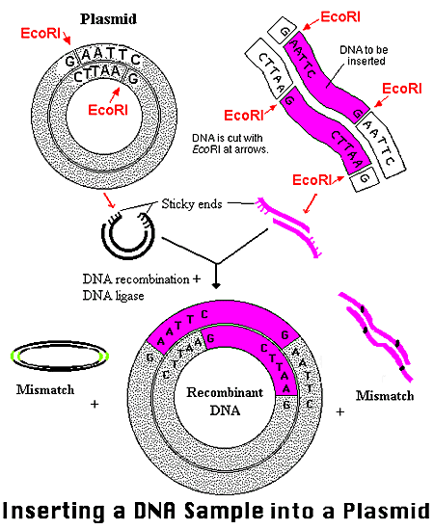
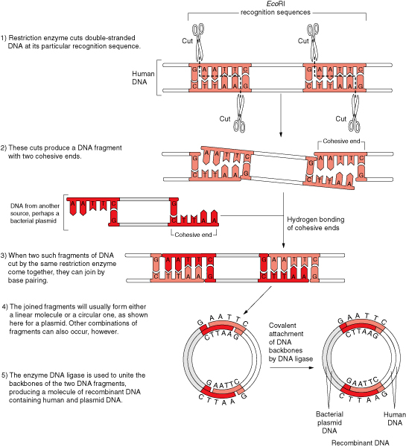
Inserting DNA into a Plasmid

Slide 8
The pGlo plasmid
Beta Lactamase
Ampicillin resistance
araC regulator protein
Regulates GFP transcription
Green Fluorescent Protein
Aequorea victoria jellyfish gene
araC
ori
pGLO
GFP
bla
Notes:
Green Fluorescent Protein (GFP) was originally isolated from the bioluminescent jellyfish, Aequorea victoria. The gene for GFP has recently been cloned. The unique three-dimensional conformation of GFP causes it to resonate when exposed to ultraviolet light and give off energy in the form of visible green light.
Bio-Rad’s pGLO plasmid has three special genes: one for GFP, a gene for antibiotic resistance, and a gene regulation system. This system can be used to control when the bacteria produce fluorescent protein. The gene for GFP can be switched on in transformed cells by adding the sugar arabinose to the cells’ food source. Transformed cells will appear white on plates not containing arabinose, and fluorescent green when arabinose is included in the nutrient agar medium. Also, we can test that cells have been transformed with pGLO DNA by growing them on antibiotic plates.

Slide 9
Ampicillin Action and Resistance
Antibiotics have various methods of interfering with bacterial growth: inhibiting cell wall biosynthesis or blocking protein synthesis
Ampicillin inhibits peptidoglycan synthesis: the polymer consisting of sugars and amino acids that forms a homogeneous layer outside the plasma membrane of eubacteria.
The pAMP resistance protein, β-lactamase, cleaves the β-lactam ring of ampicillin molecules, which leaves them unable to interfere with peptidoglycan synthesis
Antibiotic resistance genes also have different mechanisms: chemically modifying target antibiotics or preventing transport of antibiotics through the cell membrane

Slide 10
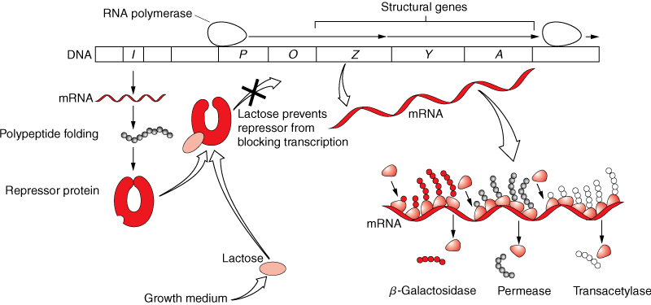
Gene Regulation: Bacterial Operons
The Lactose (Lac) Operon

Slide 11
Arabinose Operon
DNA binding Protein: Represses Transcription
Genes coding for digestive enzymes
A more detailed description of the Arabinose Operon:
http://www.mun.ca/biochem/courses/3107/Topics/Ara_operon.html
araC
B
A
D
Promotor (P_{BAD})
Effector (Arabinose)
araC
B
A
D
RNA Polymerase
Transcription
araC
B
A
D
Notes:
Our bodies contain thousands of different proteins which perform many different jobs. Digestive enzymes are proteins; some of the hormone signals that run through our bodies and the antibodies protecting us from disease are proteins. The information for assembling a protein is carried in our DNA. The section of DNA which contains the code for making a protein is called a gene. There are over 30,000–100,000 genes in the human genome. Each gene codes for a unique protein: one gene, one protein. The gene that codes for a digestive enzyme in your mouth is different from one that codes for an antibody or the pigment that colors your eyes.
Organisms regulate expression of their genes and ultimately the amounts and kinds of proteins present within their cells for many reasons, including developmental changes, cellular specialization, and adaptation to the environment. Gene regulation not only allows for adaptation to differing conditions, but also prevents wasteful overproduction of unneeded proteins which would put the organism at a competitive disadvantage. The genes involved in the transport and breakdown (catabolism) of food are good examples of highly regulated genes. For example, the sugar arabinose is both a source of energy and a source of carbon. E. coli bacteria produce three enzymes (proteins) needed to digest arabinose as a food source. The genes which code for these enzymes are not expressed when arabinose is absent, but they are expressed when arabinose is present in their environment. How is this so?
Regulation of the expression of proteins often occurs at the level of transcription from DNA into RNA. This regulation takes place at a very specific location on the DNA template, called a promoter, where RNA polymerase sits down on the DNA and begins transcription of the gene. In bacteria, groups of related genes are often clustered together and transcribed into RNA from one promoter. These clusters of genes controlled by a single promoter are called operons. The three genes (araB, araA and araD) that code for three digestive enzymes involved in the breakdown of arabinose are clustered together in what is known as the arabinose operon. When arabinose is present in the environment, bacteria take it up. Once inside, the arabinose interacts directly with arabinose operon and the interaction causes the transcription of the three digestive enzyme genes. When the three enzymes are produced, they break down arabinose, and eventually the arabinose runs out. In the absence of arabinose the transcription is shut off.
The DNA code of the pGLO plasmid has been engineered to incorporate aspects of the arabinose operon. The genes which code for break down of arabinose, araB, A and D, have been replaced by the single gene which codes for GFP. Therefore, in the presence of arabinose, GFP is produced. Cells fluoresce brilliant green as they produce more and more GFP. In the absence of arabinose, GFP gene is not transcribed. When GFP is not made, bacteria colonies will appear to have a wild-type (natural) phenotype—of white colonies with no fluorescence.

Slide 12
Ara-GFP Operon
araC
GFP Gene
GFP only produced in the presence of Arabinose
Genes coding for digestive enzymes have been replaced by the GFP gene: no metabolism of arabinose
Promotor (P_{BAD})
Effector (Arabinose)
araC
GFP Gene
RNA Polymerase
Transcription
araC
GFP Gene

Slide 13
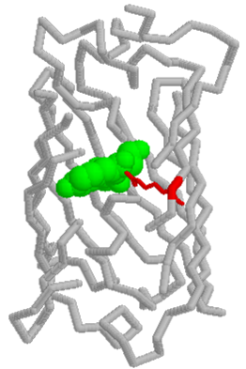
How Does it GLOW?
Unique 3-D Structure of GFP
Resonates when exposed to ultraviolet light
Gives off energy in the form of green fluorescent light
Learn more about GFP:
http://www.conncoll.edu/ccacad/zimmer/GFP-ww/GFP-1.htm
Notes:
A great website for learning about the History, Structure, and Cool Uses of GFP:
http://www.conncoll.edu/ccacad/zimmer/GFP-ww/GFP-1.htm

Slide 14
How does it work?
Transform bacteria with the pGlo plasmid and grow under various conditions
Cell wall
GFP
Bacterial
chromosomal
DNA
Beta lactamase
(ampicillin resistance)
pGlo Plasmids
Notes:
Genetic transformation involves the insertion of some new DNA into the E. coli cells. Bacteria have one large chromosome and one or more plasmids. Plasmids usually contain genes for traits that may help the bacteria survive. Scientists can use a process called genetic engineering to insert genes coding for new traits into a plasmid. In this lab, the pGLO plasmid has the GFP gene that codes for the green fluorescent protein and a gene that codes for a protein that gives the bacteria resistance to an antibiotic. The pGlo plasmid can then be used to transform bacteria to give them this new trait.

Slide 15
Methods of transformation
DNA molecules are too large to easily diffuse or be transported though the cell membrane
Electroporation
Electrical shock makes cell membranes permeable to DNA
Calcium Chloride/Heat Shock
Chemically-competent cells uptake DNA after heat shock
Notes:
Bacterial cells must be in a particular physiological state fore they can be transformed. This state is referred to as COMPETENCY. This state can be achieved naturally as in some species of Haemophilus and Bacillus when levels of nutrients and oxygen are low. Naturally competent organisms have a membrane associated transport complex which binds and transfers certain DNA molecules, from cell that have died and lysed, into the cell where they are incorporated and their genes are expressed.
E. Coli, the organism on which much of the current research is performed, must be artificially induced to make it competent. Competent E. coli cells are very fragile and must be treated carefully.

Slide 16
Electroporation

Slide 17
Transformation

Slide 18
Transformation Procedure: Overview
Suspend bacterial colonies in Transformation Solution
Add pGLO plasmid DNA
Place tubes on ice
Heat shock at 42ºC and place on ice
Incubate with LB nutrient broth
Streak plates
Notes:
Transformation Solution: Used because it is a sterile solutions and it contains calcium chloride which renders bacteria competent and able to uptake the plasmid
Addition of pGlo: students must ensure film of pGlo is on the loop (like blowing bubbles) or not enough plasmid will be used.
Ice→Heat→Incubate: Important to follow timing guidelines to give best results
Streak plates: Follow directions; too much bacteria or insufficient spreading could lead to poor results.

Slide 19
Why perform each step?
Ca⁺⁺
CaCl₂ treatment on ice crytallizes fluid membranes and stabilizes distribution of charged molecules
CaCl₂ Transformation solution provides Ca⁺⁺ cations that neutralize the repulsive negative charges of the phosphate backbone of the DNA and the phospholipids of the cell membrane, allowing the DNA to enter the cells
O
Ca⁺⁺
O
P
O
Base
O
CH₂
O
Sugar
O
Ca⁺⁺
O
P
O
Base
O
CH₂
O
Sugar
OH
Notes:
The bacterial cell membrane is permeable to chloride ions, but is non-permeable to calcium ions. As the chloride ions enter the cell, water molecules accompany the charged particle. This influx of water causes the cells to swell and is necessary for the uptake of DNA. The exact mechanism of this uptake is unknown. It is known, however, that the calcium chloride treatment be followed by heat.

Slide 20
Why perform each step?
Heat-shock increases permeability of cell membrane
Luria-Bertani Nutrient broth incubation allows beta lactamase expression
Cell wall
Bacterial
chromosomal
DNA
Beta lactamase
(ampicillin resistance)
pGlo Plasmids
Notes:
Heat Shock:
When E. coli are subjected to 42degC heat, a set of genes are expressed which aid the bacteria in surviving at such temperatures. This set of genes are called the heat shock genes. The heat shock step is necessary for the uptake of DNA. At temperatures above 42degC, the bacteria's ability to uptake DNA becomes reduced, and at extreme temperatures the bacteria will die.
Incubation:
After the heat shock step, intact plasmid DNA molecules replicate in bacterial host cells. To help the bacterial cells recover from the heat shock, the cells are briefly incubated in LB Nutrient Broth, a solution that provides nutrients for the bacteria. As the cells recover, plasmid genes are expressed, including those that allow the replication of plasmids which will end up in new, dividing bacterial cells.

Slide 21
Gene selection
Grow transformed bacteria and control bacteria under various conditions.
On which plates will colonies grow?
Which colonies will glow?
LB/Amp
LB/Amp/Ara
LB
Notes:
Not all cells will have the plasmid and not all newly produced plasmids will end up in new bacteria cells. So, it is necessary to select for bacterial cells which contain the plasmid. This is commonly performed with antibiotic selection. Some E.coli strains cannot grow in the presence of common antibiotics like ampicillin. Plasmids used for the cloning and manipulation of DNA have been engineered to contain the genes for antibiotic resistance. Thus, if the bacterial transformation is plated onto media containing ampicillin, only bacteria which have the plasmid DNA will have the ability to metabolize ampicillin and form colonies. In this way, bacterial cells containing plasmid DNA are selected.

Slide 22
The pGlo System
A film of plasmid must be on the loop!
Timing is important…be efficient!!
Mix contents before pipetting!!!

Slide 23
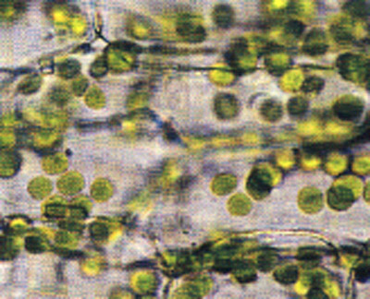
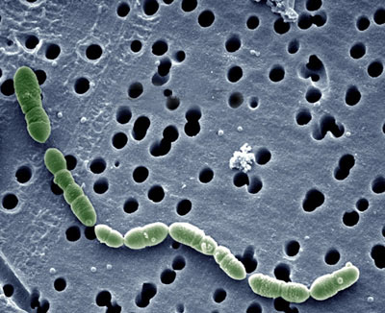
Sterile Technique
Bacteria are UBIQUITOUS…they are found EVERYWHERE!
Sterile technique refers to procedures that reduce the possibility of contamination…these techniques protect YOU, your CULTURES and REAGENTS, and LAB EQUIPMENT

Slide 24
pGlo Lab Considerations
Teacher Considerations
Work surfaces
Hands
Glassware
Agar
Petri plates
Inoculation loops
Solutions/Cultures
Pipettes
Student Considerations
Work surfaces
Hands
E.coli starter plates
Assorted agar plates
Inoculation loops
Solutions/Test tubes
Pipettes

Slide 25
Closing Considerations
ALWAYS decontaminate you work surfaces with a disinfecting solution: 20ml of liquid household bleach in 1L of tap water.
Spray the solution on work surfaces and let stand for 2 minutes and wipe away
ALWAYS thoroughly scrub hands for at least 20 seconds with soap and hot water before leaving the lab area

Slide 26
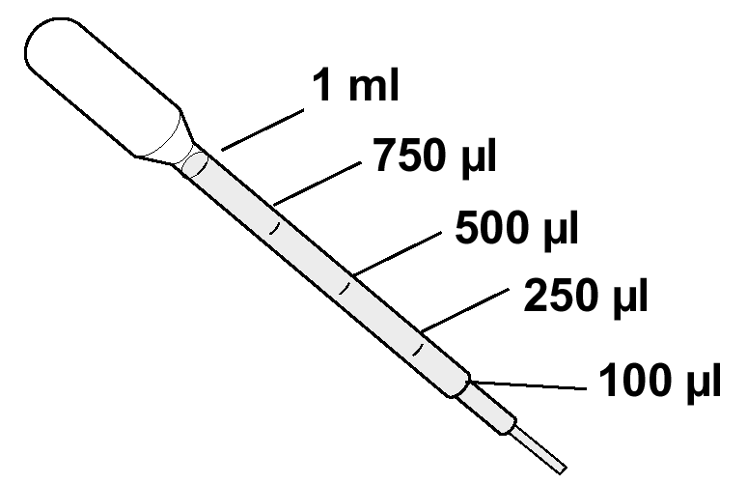
Volume Measurement

Slide 27
Extension Activities
Calculate Transformation Efficiency
This protocol has been determined to have a transformation efficiency between 8.0 x 10² and 7.0 x 10³ (128-1120 transformed colonies)
Students explore reasons for various results

