Slide 1
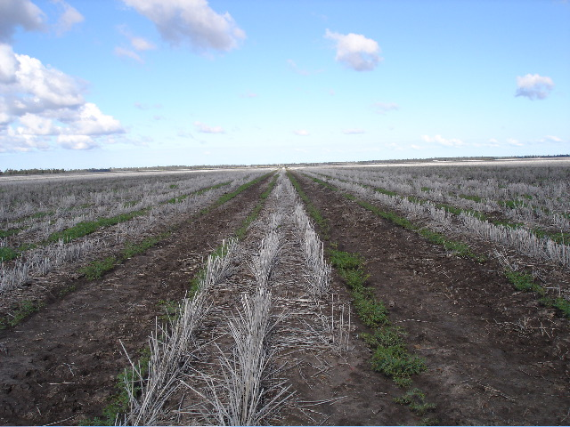
Soils and Farming

Slide 2
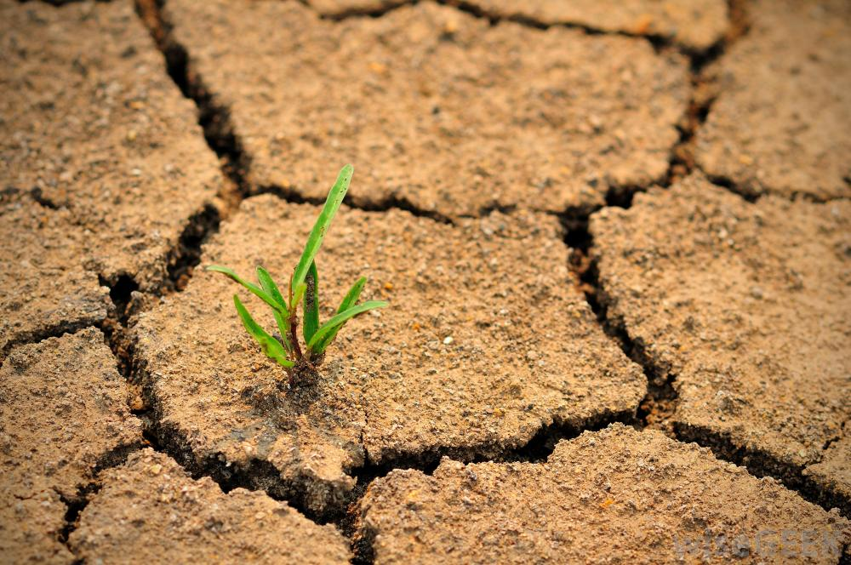
Desertification Intro Video Clip

Slide 3
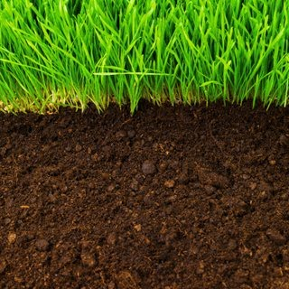
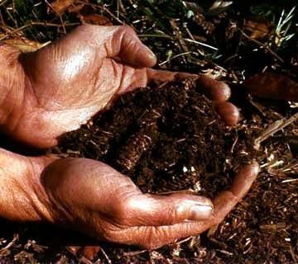
Soil Formation
Soil: complex mix of rock particles, decaying org. matter, air, water, and living orgs.
Rocks add nutrients
Decaying organic matter = dead orgs, leaf litter, etc.

Slide 4
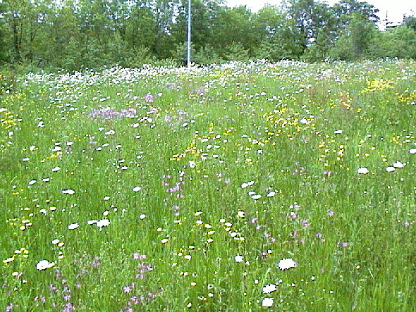
Fertile Soil
Will have many nutrients
Takes 100-1000 yrs to form.

Slide 5
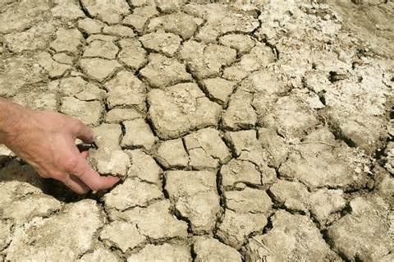
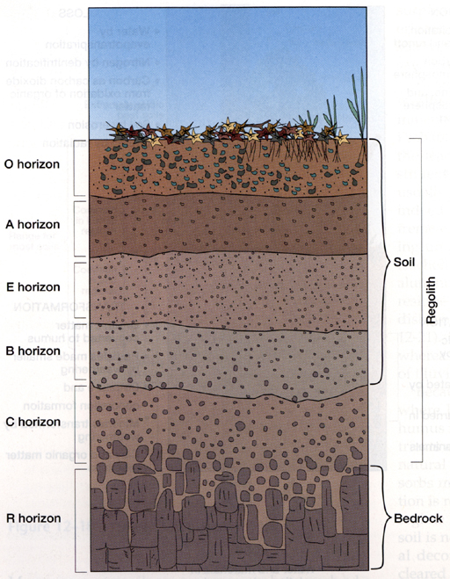
Soil Layers
Layer = horizon
O horizon: fresh leaves, twigs, feces!
Below: A horizon: aka topsoil. Partially decomposed org. matter called humus. Many bugs, nutrients.

Slide 6
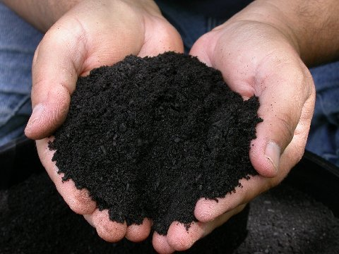
Humus

Slide 7
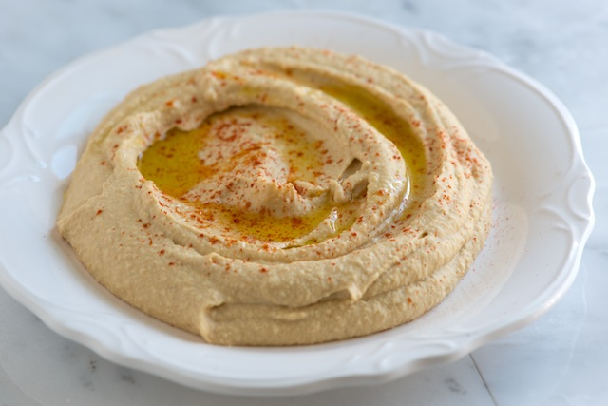
Not Hummus!

Slide 8
Soil Layers
B horizon: aka subsoil: inorganic material
C horizon: rock not broke down.
R horizon = bedrock

Slide 9
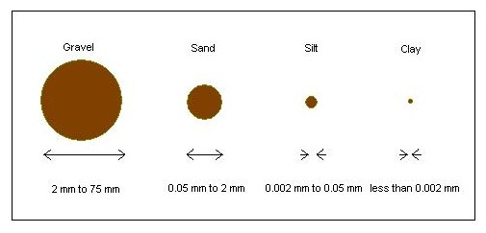
Soil Texture and Porosity
3 diff. sizes of soil particles
Clay: smallest: > 0.002 mm
Silt: 0.05 – 0.002 mm
Sand: biggest, 2 – 0.05 mm

Slide 10
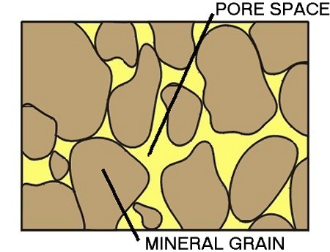
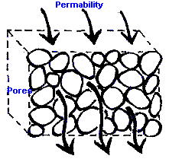
Porosity vs Permeability
Porosity: Measure of spaces per volume of soil → holds more H₂O/air Permeability: how fast H₂O/air move down in soil.

Slide 11
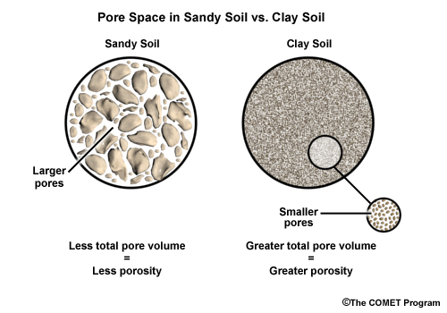

Slide 12
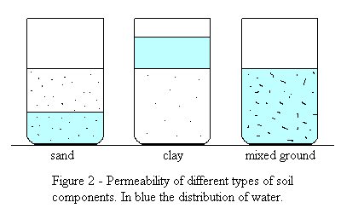

Slide 13
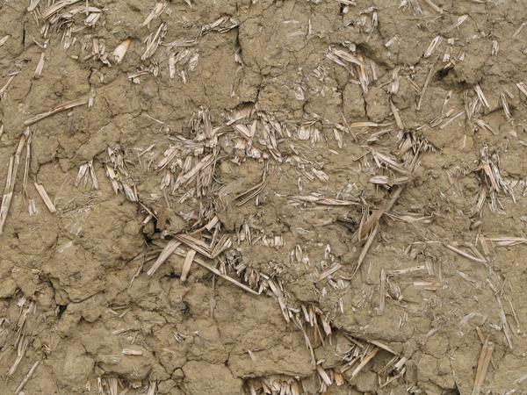
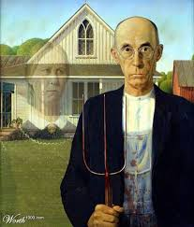
Loam Soils
I Love Loams
Mixes of all sizes of soil.
Medium permeability and porosity

Slide 14
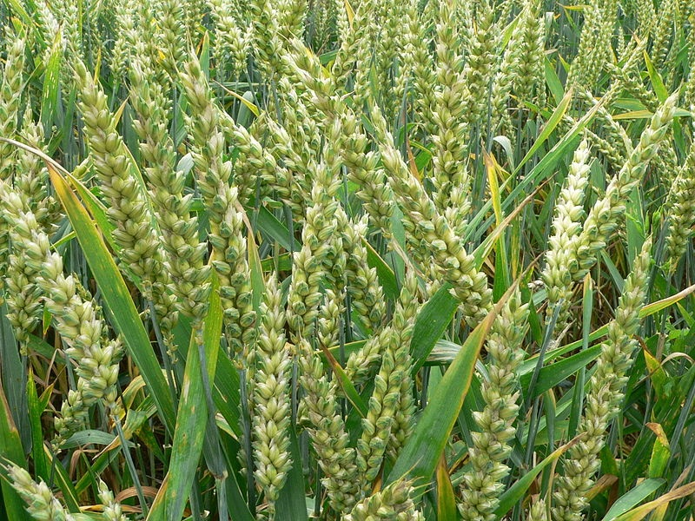
High Input Farming/Tillage
Prod. a lot of food!
Lots of fossil fuels, water, commercial inorganic fertilizers and pesticides used.
Makes 1 type of food (monoculture).

Slide 15
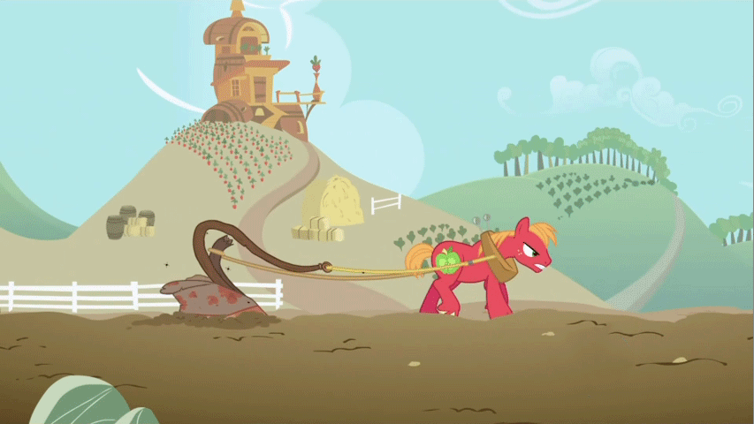
But It Destroys Soil…
Plowing brings up topsoil (A) layer to O layer.
Loose soil is then exposed to wind and water → carried away- soil erosion.

Slide 16
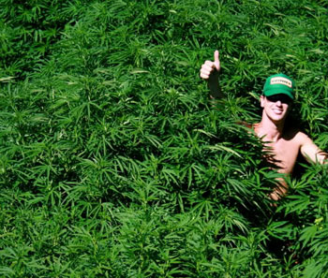
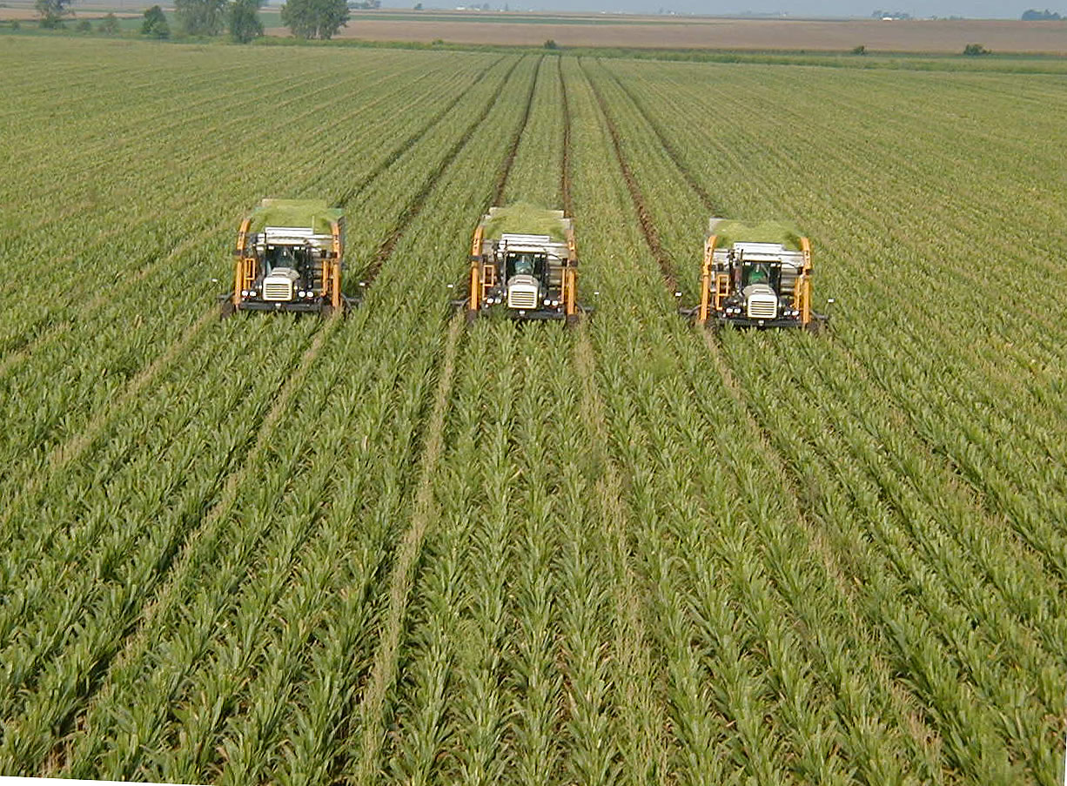
Green Revolution
1950’s
1) Plant monocultures
2) Use much fertilizer, pesticides, and H₂O
3) Increase intensity of planting
PRODUCES A LOT OF FOOD!

Slide 17
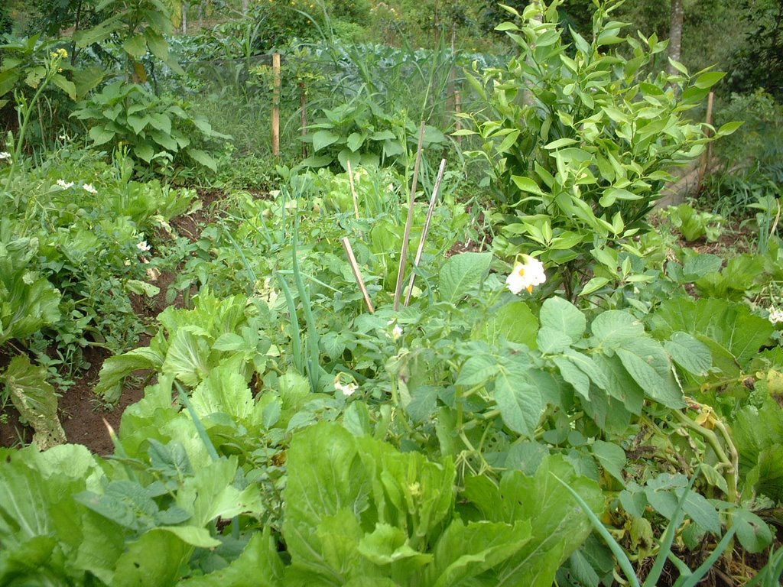
Sustainable/Low Input Agriculture
Reduces irrigation & pesticide use
Uses organic fertilizers.
Soil conservation techs.
Less food

Slide 18
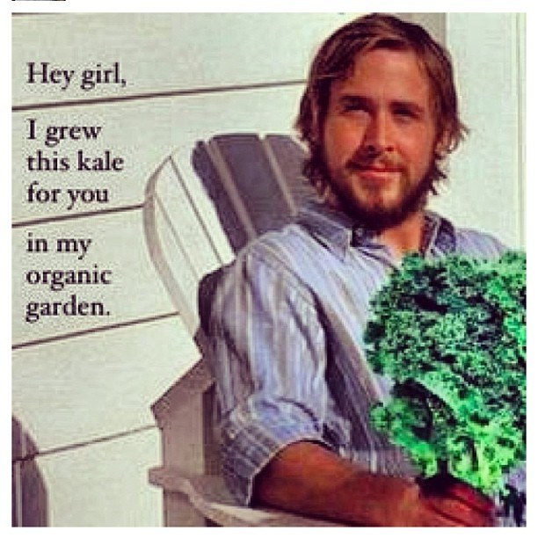
Organic Farming
Low Input Farm
No inorganic fertilizers or chem. pesticides used
No GMOs

Slide 19
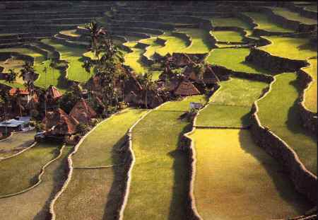
Soil Conservation Tech’s
Terracing: slope converted into broad terraces to retain H₂O and soil

Slide 20
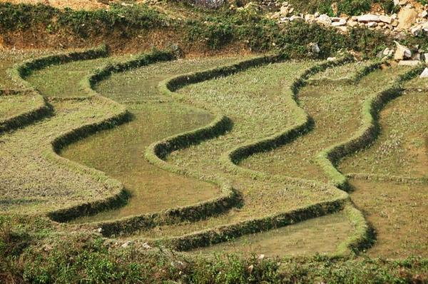
Rice Terracing

Slide 21
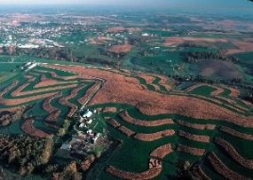
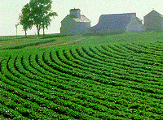
Soil Conservation Tech’s
Contour Farming: plowing and planting in rows across slope of land (slow water and soil runoff)

Slide 22
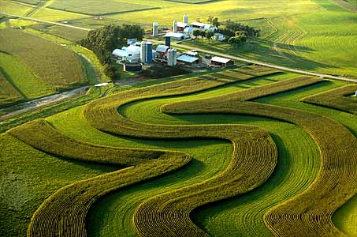
Contour Farming

Slide 23
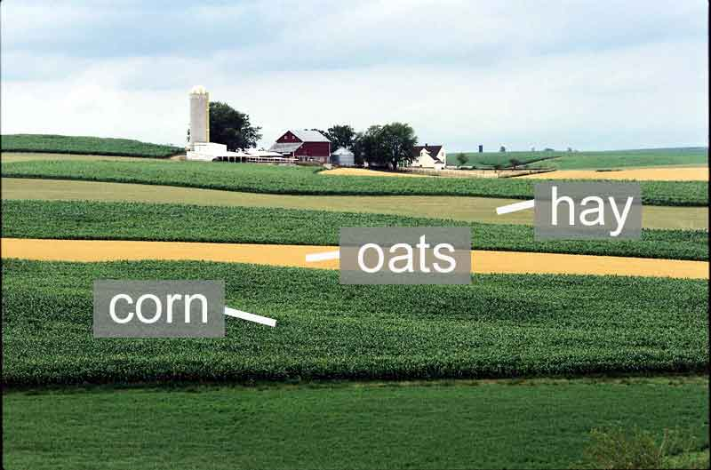
Soil Conservation Tech’s
Strip Cropping: Plant a row of 1 type of plant, then plant a row of another type of plant.

Slide 24
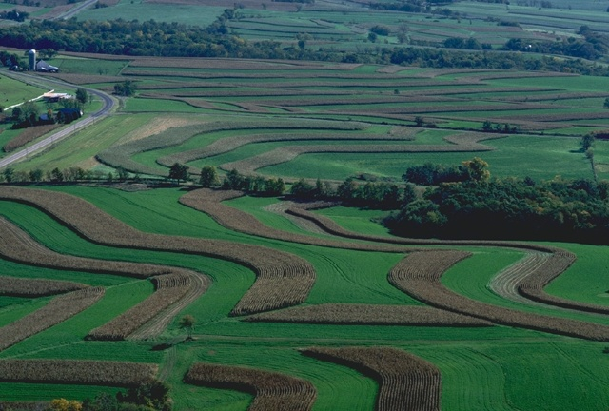
Strip Cropping

Slide 25
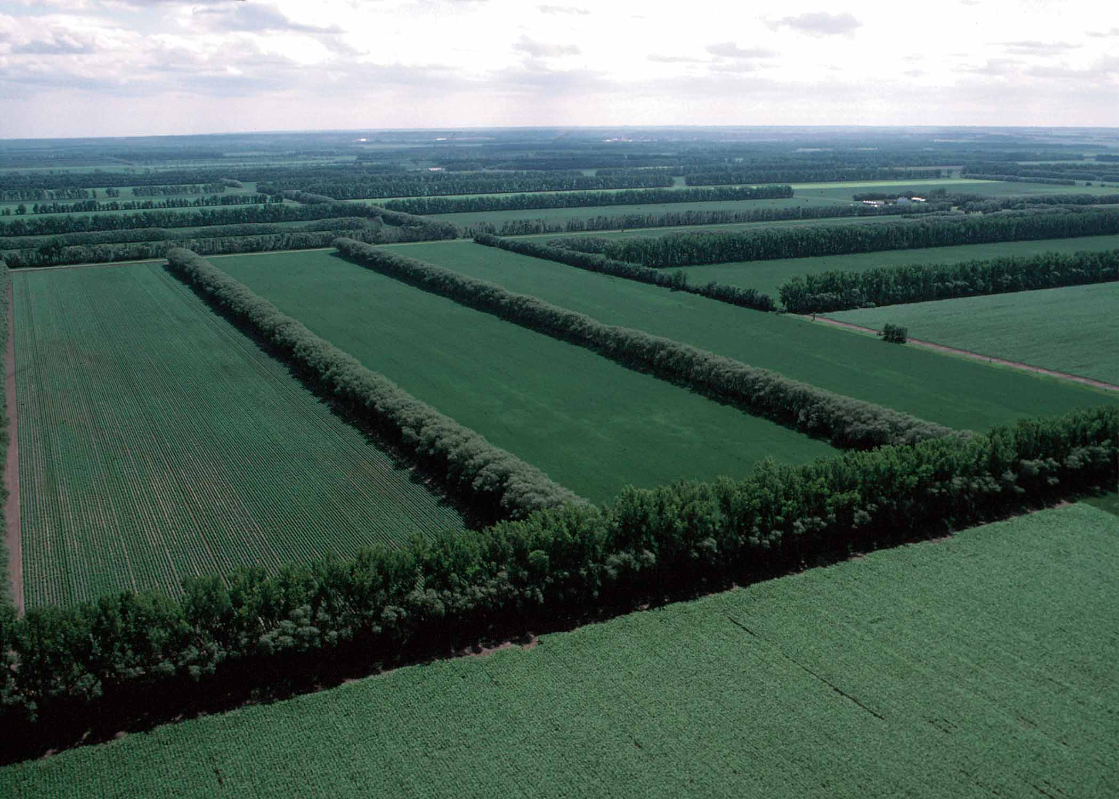
Soil Conservation Tech’s
Windbreaks: slows wind down before it hits farm soil.

Slide 26
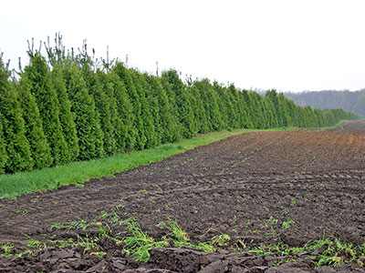
Windbreak

Slide 27
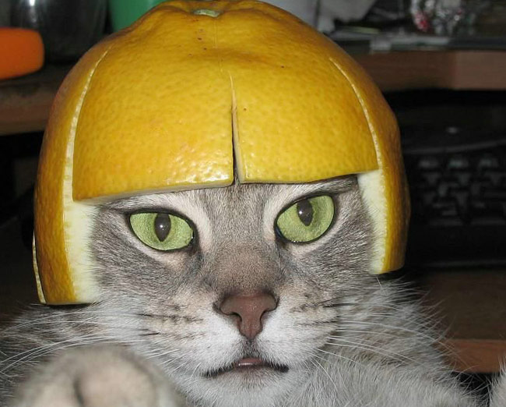
Inorganic Fertilizers
High amounts of NO₃, NH₄, and PO₄. Easily transported, stored, and applied.
Do not add humus, release NOx (greenhouse gas) when applied, eutrophication in streams.

Slide 28
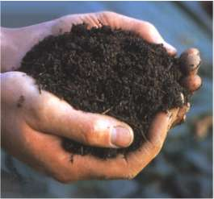
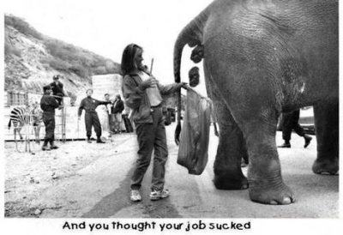
Organic Fertilizers
3 to add nutrients:
1) Animal manure: dung/urine of animals
2) Green manure: plants plowed into soil
3) Compost: semi-broken down org. matter
Compost

Slide 29
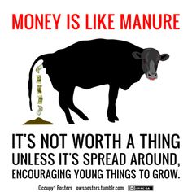

Slide 30
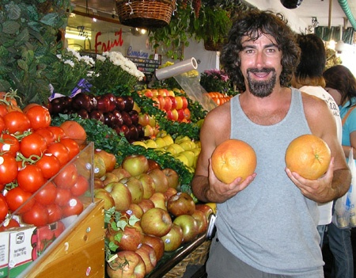
Why do People Go to Farmer’s Markets?
LOCALLY GROWN PRODUCE!

Slide 31
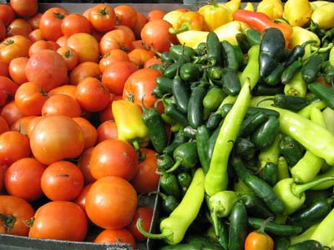
Why Better?
Lower fuel emissions of greenhouse gases
Less gas used
Less transport of pests
Less packaging
Lower costs of produce
Revenues remain local

