Slide 1
Too Many Humans?
7 Billion and Growing….

Slide 2
353,000 babies born each day

Slide 3
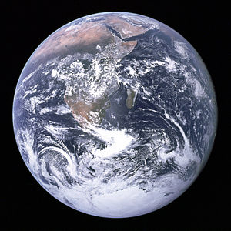
Demographics of Countries
Statistical data relating to population and particular groups within it.
3 Categories: Developed Countries, Moderately Developed (Developing), Less Developed (Developing)
http://www.census.gov/ipc/www/popclockworld.html

Slide 4
US, Europe, Japan
Developed Countries
Highly Industrialized
Low birth rates
Low Baby Mortality
Longest Life Spans
Highest avg. GDP’s

Slide 5
Moderately Developed Countries
Medium-level of Industrialization
Higher birth rates, Higher Infant Mortality Rates,Shorter Life Spans
Lower avg GDP’s
Mexico, Thailand, S. America

Slide 7
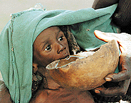
Ethiopia, Laos, Bangladesh
Less Developed Country
Agricultural - low industry
Highest birth rates, Highest Infant Mortality, Shortest Life Spans
Lowest average GDPs

Slide 8
GDP’s of the World
Burundi = $125 per capita
Kenya = $780 per capita
Mexico = $9,000 per capita
US = $45,000 per capita
Luxembourg = $103,000 per capita

Slide 9
Around the World…
China: 1.4 billion
India: 1.25 billion
US: 316 million
Indonesia: 260 mill.
Brazil: 205 million
World Population:
7.3 billion
Notes:
http://www.census.gov/popclock/

Slide 10
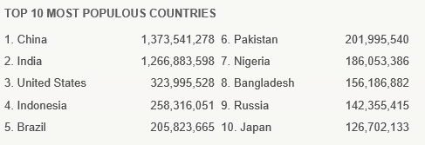

Slide 11
How Does Industrialization Affect Population Size?
The
Demographic
Transition
**Seen during and after Industrial Revolution**

Slide 13
STAGE 1 PRE-INDUSTRIAL
High birth rate (high IMR)
High death rate
Low pop growth

Slide 14
STAGE 2 TRANSITIONAL
Industrialization
>food availability
>Health care
Birth rate stays high
Death rate begins to fall
Pop grows quickly

Slide 15
STAGE 3 INDUSTRIAL
Birth rate falls to near death rate
better jobs and education for women
Decline in IMR
Pop growth rate continues, but is low

Slide 16
STAGE 4 POSTINDUSTRIAL
Birth rate falls more
Birth rate = death rate
ZPG
Then, birth rate declines more; less than death rate = neg. pop growth
Unsustainability to sustainability
Very few countries

Slide 17
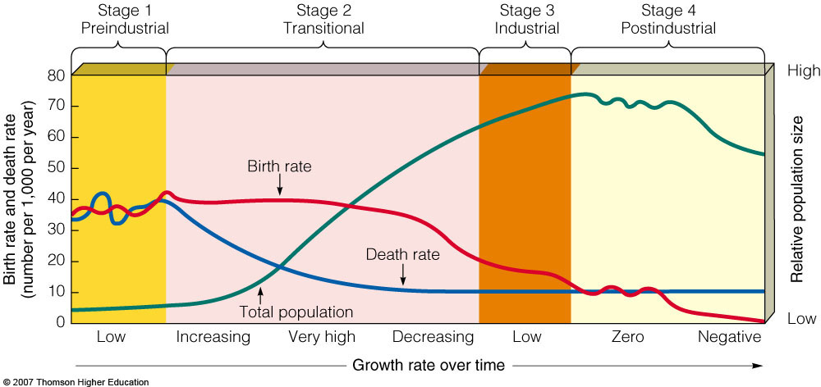

Slide 18
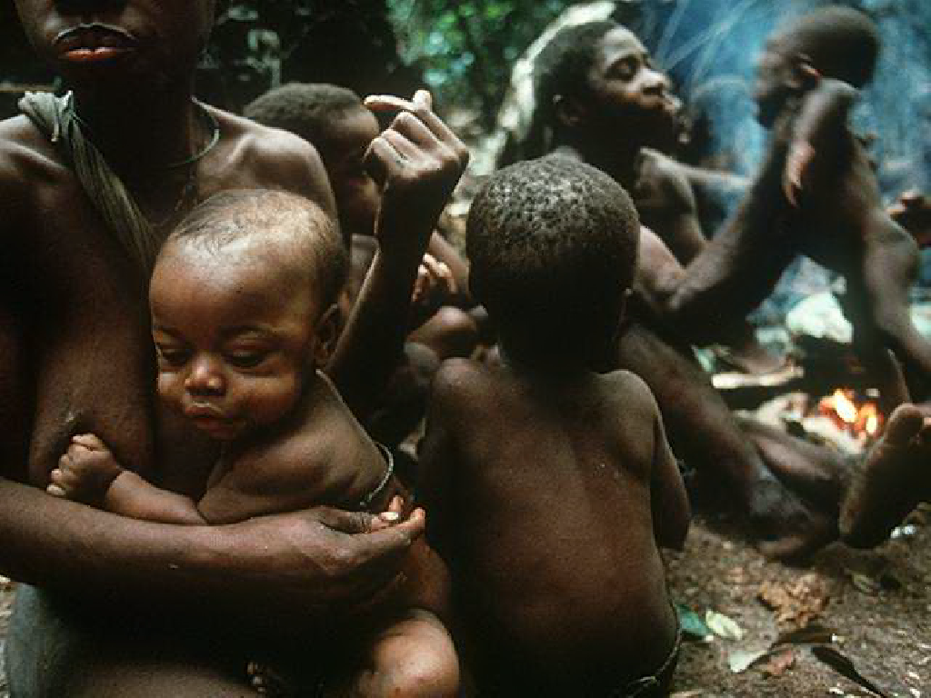
Predicting Population Changes using Age Structure

Slide 19
Comparing Age Structure

Slide 20
Pyramid Age Structure
> people are at/near child-bearing

Slide 21
Rectangular Age Structure
Zero Pop Growth (ZPG): B = D

Slide 22
Inverted Pyramid Age Structure
Not enough reproductive women to replace lost individuals; pop decreases.

