Slide 1
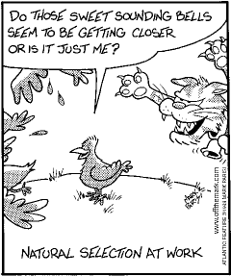
Measuring Evolution of Populations

Slide 4
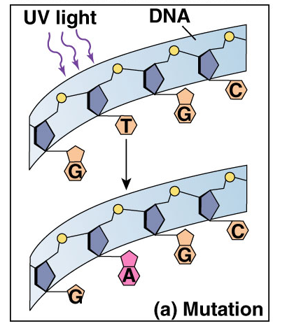
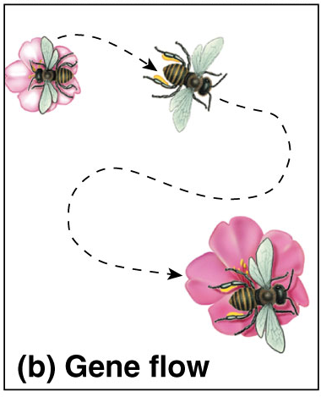
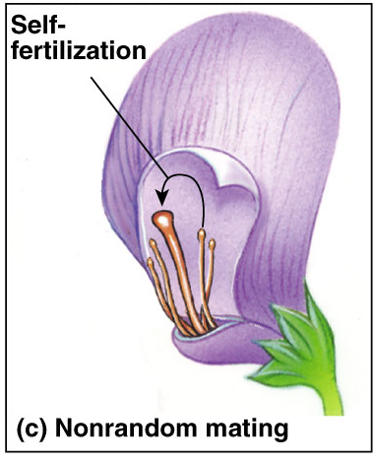
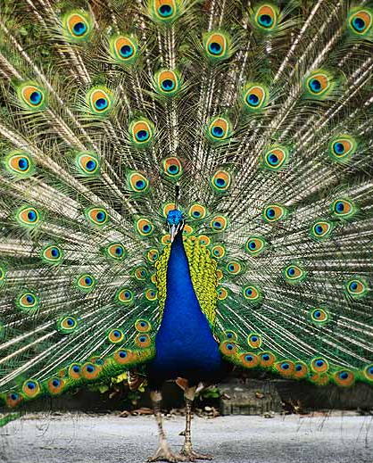
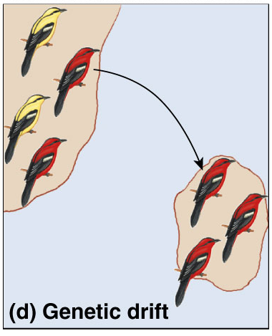
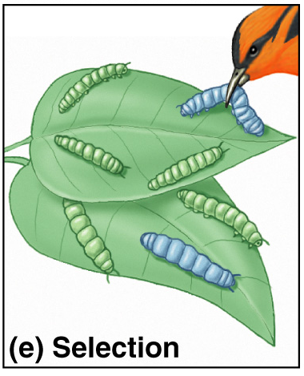
5 Agents of evolutionary change
Mutation
Gene Flow
Non-random mating
Genetic Drift
Selection

Slide 5
Populations & gene pools
Concepts
a population is a localized group of interbreeding individuals
gene pool is collection of alleles in the population
remember difference between alleles & genes!
allele frequency is how common is that allele in the population
how many A vs. a in whole population

Slide 6
Evolution of populations
Evolution = change in allele frequencies in a population
hypothetical: what conditions would cause allele frequencies to not change?
non-evolving population
REMOVE all agents of evolutionary change
very large population size (no genetic drift)
no migration (no gene flow in or out)
no mutation (no genetic change)
random mating (no sexual selection)
no natural selection (everyone is equally fit)

Slide 7
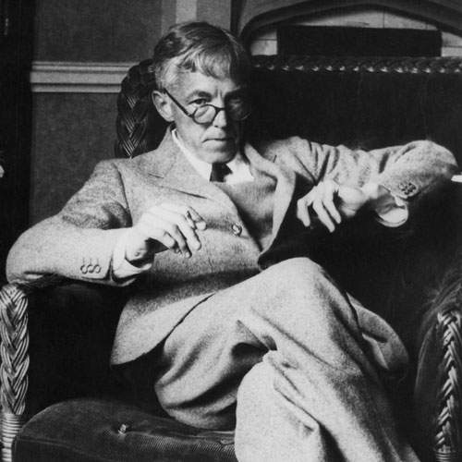
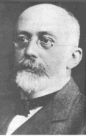
Hardy-Weinberg equilibrium
Hypothetical, non-evolving population
preserves allele frequencies
Serves as a model (null hypothesis)
natural populations rarely in H-W equilibrium
useful model to measure if forces are acting on a population
measuring evolutionary change
G.H. Hardy
mathematician
W. Weinberg
physician
Notes:
G.H. Hardy (the English mathematician) and W. Weinberg (the German physician) independently worked out the mathematical basis of population genetics in 1908. Their formula predicts the expected genotype frequencies using the allele frequencies in a diploid Mendelian population. They were concerned with questions like "what happens to the frequencies of alleles in a population over time?" and "would you expect to see alleles disappear or become more frequent over time?"

Slide 8
Hardy-Weinberg theorem
Counting Alleles
assume 2 alleles = B, b
frequency of dominant allele (B) = p
frequency of recessive allele (b) = q
frequencies must add to 1 (100%), so:
p + q = 1
BB
Bb
bb

Slide 9
Hardy-Weinberg theorem
Counting Individuals
frequency of homozygous dominant: p x p = p²
frequency of homozygous recessive: q x q = q²
frequency of heterozygotes: (p x q) + (q x p) = 2pq
frequencies of all individuals must add to 1 (100%), so:
p² + 2pq + q² = 1
BB
Bb
bb

Slide 10
H-W formulas
Alleles: p + q = 1
Individuals: p² + 2pq + q² = 1
B
b
BB
Bb
bb
BB
Bb
bb

Slide 11
Using Hardy-Weinberg equation
population: 100 cats
84 black, 16 white
How many of each genotype?
q² (bb): 16/100 = .16
q (b): √.16 = 0.4
p (B): 1 - 0.4 = 0.6
p²=.36
2pq=.48
q²=.16
BB
Bb
bb
What are the genotype frequencies?
Must assume population is in H-W equilibrium!

Slide 12
Using Hardy-Weinberg equation
p²=.36
2pq=.48
q²=.16
Assuming H-W equilibrium
BB
Bb
bb
Null hypothesis
p²=.20
p²=.74
2pq=.64
2pq=.10
q²=.16
q²=.16
BB
Bb
bb
Sampled data
How do you explain the data?
How do you explain the data?
Notes:
Sampled data 1:
Hybrids are in some way weaker.
Immigration in from an external population that is predomiantly homozygous B
Non-random mating... white cats tend to mate with white cats and black cats tend to mate with black cats.
Sampled data 2:
Heterozygote advantage.
What’s preventing this population from being in equilibrium.

Slide 13
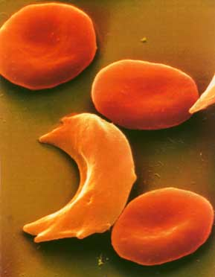
Application of H-W principle
Sickle cell anemia
inherit a mutation in gene coding for hemoglobin
oxygen-carrying blood protein
recessive allele = H^{s}H^{s}
normal allele = H^{b}
low oxygen levels causes RBC to sickle
breakdown of RBC
clogging small blood vessels
damage to organs
often lethal

Slide 14
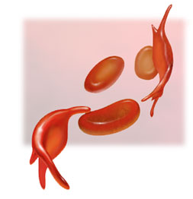
Sickle cell frequency
High frequency of heterozygotes
1 in 5 in Central Africans = H^{b}H^{s}
unusual for allele with severe detrimental effects in homozygotes
1 in 100 = H^{s}H^{s}
usually die before reproductive age
Why is the H^{s} allele maintained at such high levels in African populations?
Suggests some selective advantage of being heterozygous…
Notes:
Sickle Cell:
In tropical Africa, where malaria is common, the sickle-cell allele is both an advantage & disadvantage. Reduces infection by malaria parasite.
Cystic fibrosis:
Cystic fibrosis carriers are thought to be more resistant to cholera:
1:25, or 4% of Caucasians are carriers Cc

Slide 15
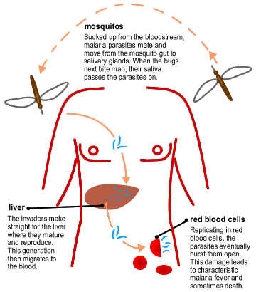
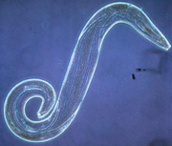
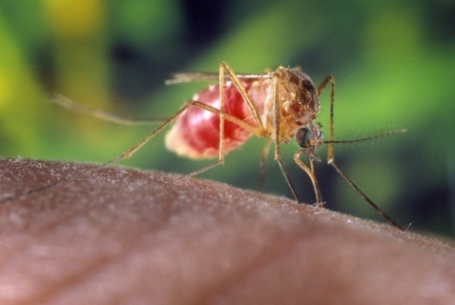
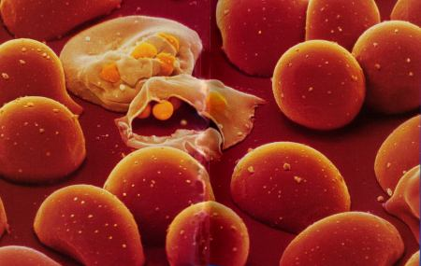
Malaria
Single-celled eukaryote parasite (Plasmodium) spends part of its life cycle in red blood cells
1
2
3

Slide 16
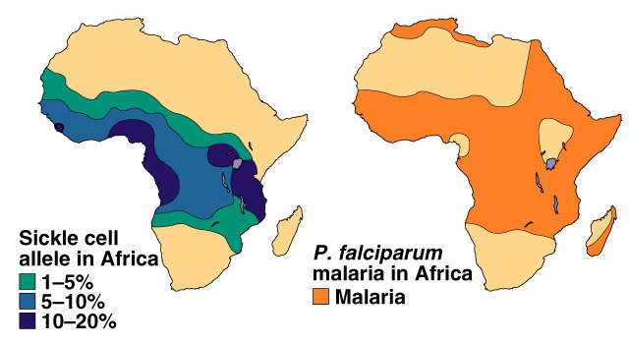
Heterozygote Advantage
In tropical Africa, where malaria is common:
homozygous dominant (normal)
die or reduced reproduction from malaria: H^{b}H^{b}
homozygous recessive
die or reduced reproduction from sickle cell anemia: H^{s}H^{s}
heterozygote carriers are relatively free of both: H^{b}H^{s}
survive & reproduce more, more common in population
Hypothesis:
In malaria-infected cells, the O₂ level is lowered enough to cause sickling which kills the cell & destroys the parasite.
Frequency of sickle cell allele & distribution of malaria

Slide 17
Any Questions??
Any Questions??
Any Questions??

