Slide 1
Ground Tissue
Ground tissue fills the interior of the plant. It contains three basic cell types:
Parenchyma cells
Collenchyma cells
Sclerenchyma cells
Dermal tissue
Ground tissue
Vascular tissue

Slide 2
Parenchyma
Characteristics
least specialized cell type
only thin primary cell wall is present
possess large central vacuole
generally alive at functional maturity
Functions
make up most of the ground tissues of the plant
storage
photosynthesis
can help repair and replace damaged organs by proliferation and specialization into other cells

Slide 3
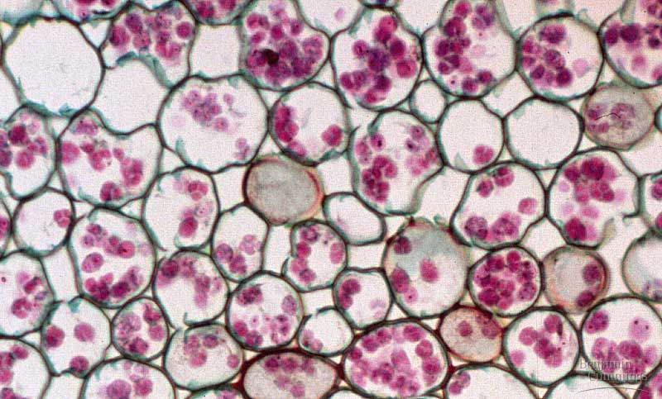
Parenchyma

Slide 4
Collenchyma
Characteristics
possess thicker primary cell walls the that of parenchyma
no secondary cell wall present
generally alive at functional maturity
Functions
provide support without restraining growth

Slide 5
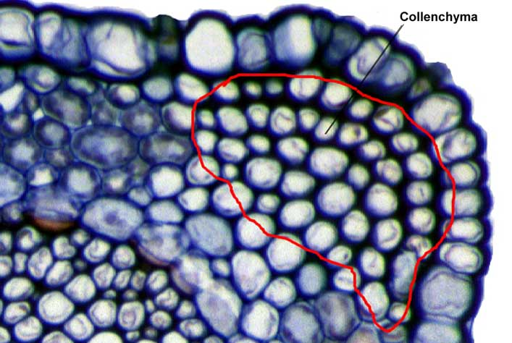
Collenchyma

Slide 6
Sclerenchyma
Characteristics
have secondary cell walls strengthened by lignin
often are dead at functional maturity
two forms: fibers and sclereids
Functions
rigid cells providing support and strength to tissues

