Slide 1
Biotechnology 349
Ch 3.1
DNA
Structure
&
Function

Slide 2
DNA Structure
DNA consists of two molecules that are arranged into a ladder-like structure called a Double Helix.
A molecule of DNA is made up of millions of tiny subunits called Nucleotides.
Each nucleotide consists of:
Phosphate group
Pentose sugar
Nitrogenous base

Slide 3
Nucleotides
Phosphate
Nitrogenous
Base
Pentose
Sugar

Slide 4
Nucleotides
The phosphate and sugar form the backbone of the DNA molecule, whereas the bases form the “rungs”.
There are four types of nitrogenous bases.

Slide 5
Nucleotides
A
T
Adenine
Thymine
C
G
Cytosine
Guanine

Slide 6
Nucleotides
Each base will only bond with one other specific base.
Adenine (A)
Thymine (T)
Cytosine (C)
Guanine (G)
Form a base pair.
Form a base pair.

Slide 7
Nucleotides
Adenine (A)
Guanine (G)
Cytosine (C)
Thymine (T)
Purines
Pyrimidines (think of Y)

Slide 8
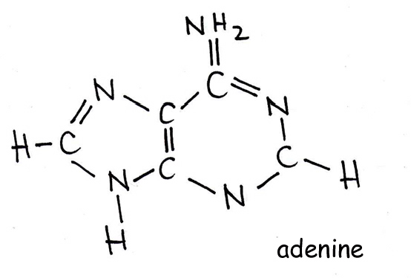
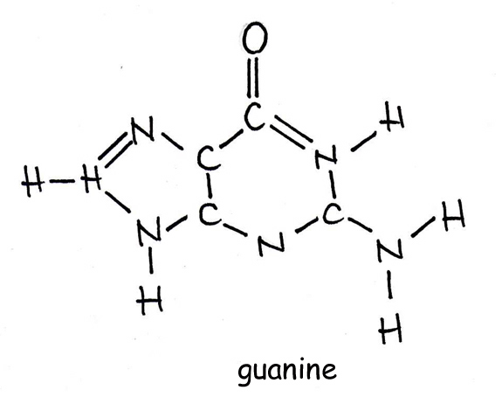
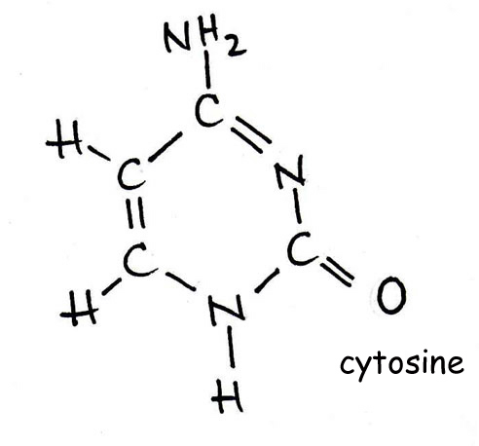
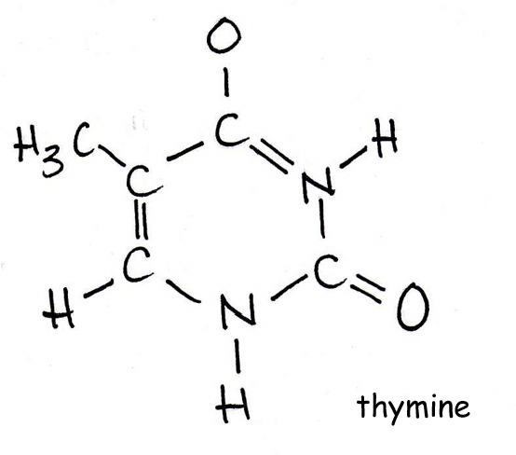
Nucleotides
Adenine (A)
Guanine (G)
Cytosine (C)
Thymine (T)
Purines are a larger molecule than Pyrimidines

Slide 9
DNA Structure
Because of this complementary base pairing, the order of the bases in one strand determines the order of the bases in the other strand.
The amount of Adenine always equals the amount Thymine and the same for C & G
Nucleotides connected together by phosphodiester bonds.
hydrogen bonds exist between nitrogen bases

Slide 10
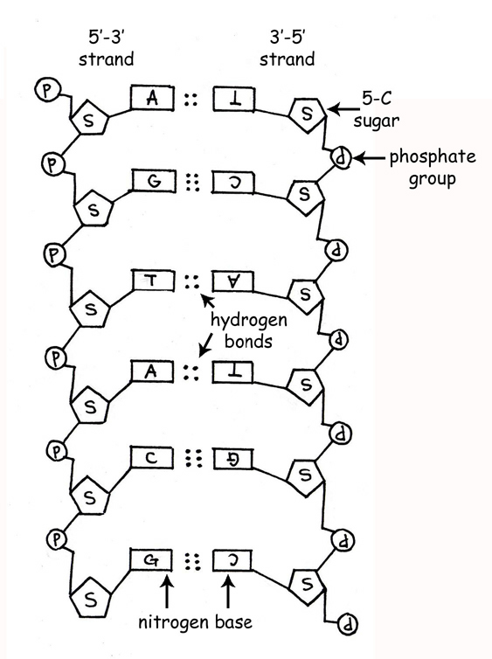
DNA Structure
Each DNA strand is oriented in the opposite direction
one side is oriented up
the other side oriented down
This is called antiparallel

Slide 11
A
T
C
G
T
A
C
G
A
T
G
C
T
A

Slide 12
DNA Structure
To crack the genetic code found in DNA we need to look at the sequence of bases.
The bases are arranged in triplets called codons.
A G G - C T C - A A G - T C C - T A G
T C C - G A G - T T C - A G G - A T C

Slide 13
DNA Structure
A gene is a section of DNA that codes for a protein.
Each unique gene has a unique sequence of bases.
This unique sequence of bases will code for the production of a unique protein.
It is these proteins and combination of proteins that give us a unique phenotype.

Slide 14
DNA Structure
The Nitrogenous bases are 0.34 nm (nanometers) apart. This ensures the DNA shape is constant throughout and ensures enzymes and regulatory molecules to recognize the DNA molecule
So how small is 0.34 nm?
The 5' and 3' mean "five prime" and "three prime", which in turn indicate the carbon numbers in the DNA's sugar backbone. The 5' carbon has a phosphate group attached to it and the 3' carbon a hydroxyl group. This asymmetry gives a DNA strand a "direction". For example, DNA polymerase works in a 5' -> 3' direction, that is, it adds nucleotides to the 3' end of the molecule (the -OH group), thus advancing to that direction.

Slide 15
DNA
Gene
Protein
Trait

Slide 16
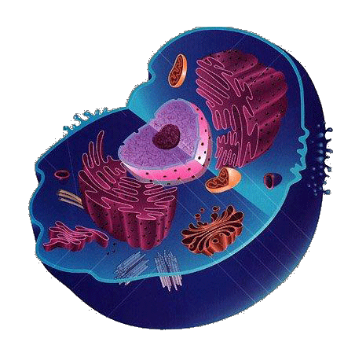
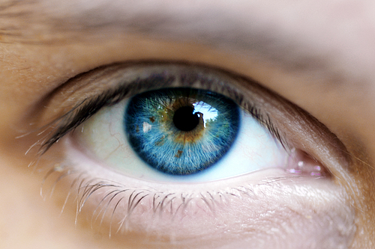
Your Task
Draw a flow chart to show how to get from:

