Slide 1
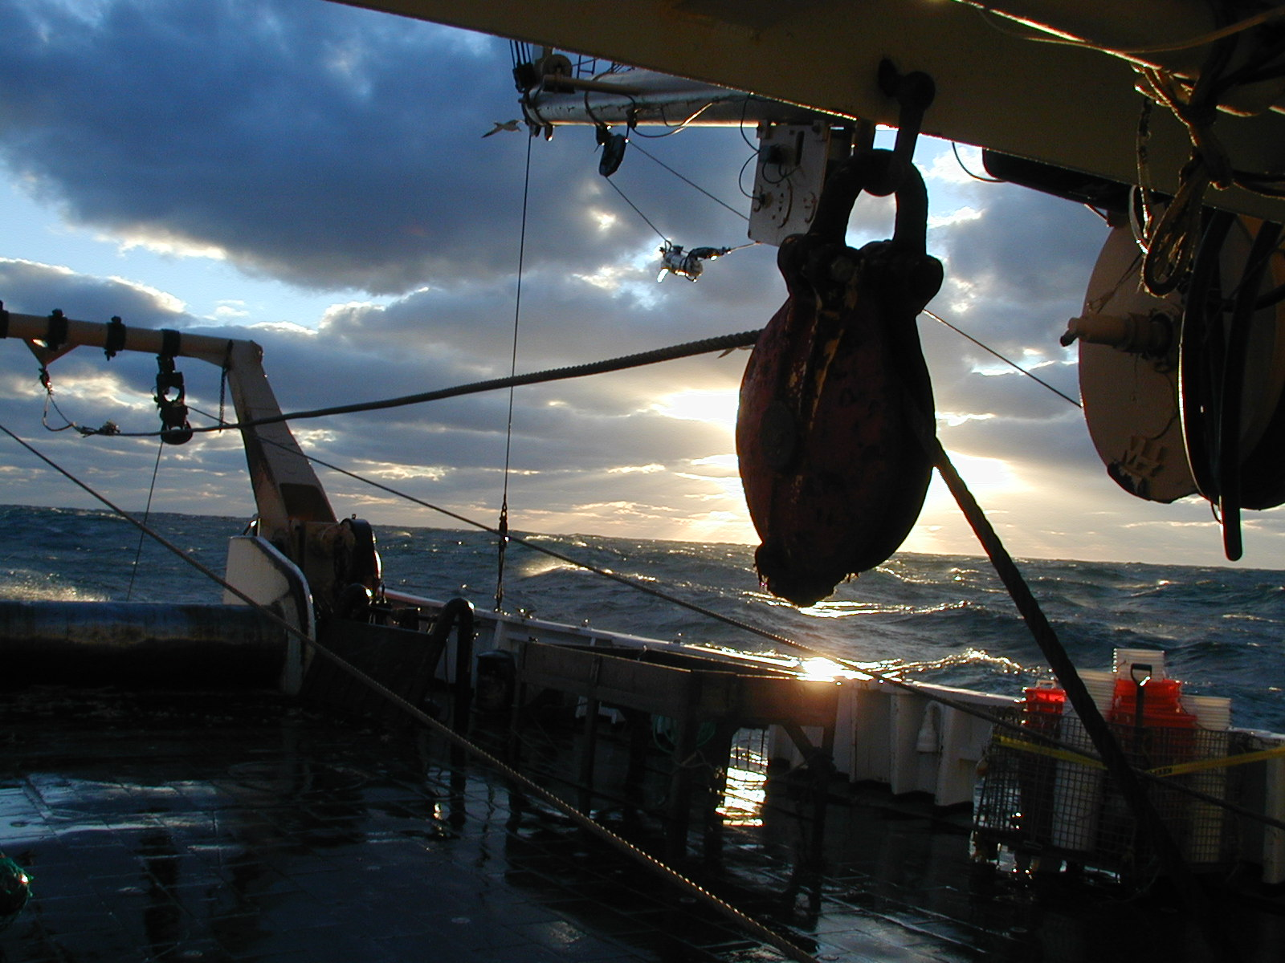
Climate Change
Jonathan Hare
NOAA Fisheries
18 January 2012

Slide 2
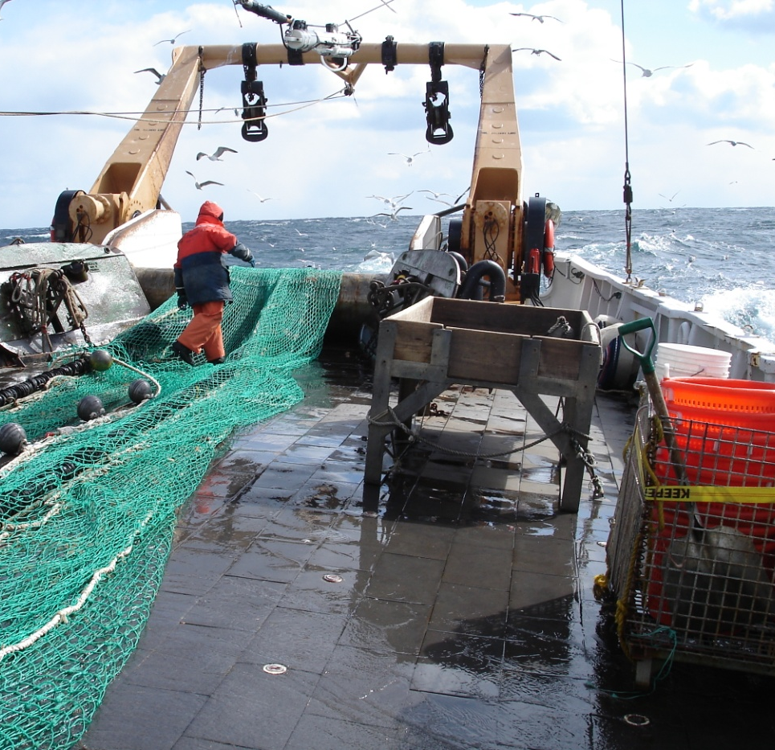
Outline
Introduction
Scientific Hypotheses
Evidence for climate change
Cause of climate change
Climate change and fisheries
What should we do
(and pictures of my job)

Slide 3

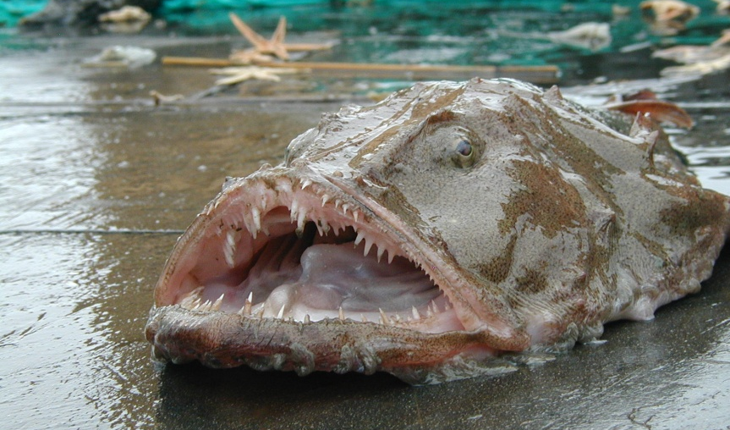
National Oceanic and Atmospheric Administration
Marine Fisheries
Climate Research
National Weather Service
Earth Environmental Satellites
National Marine Sanctuaries and Estuarine Research Reserves

Slide 4
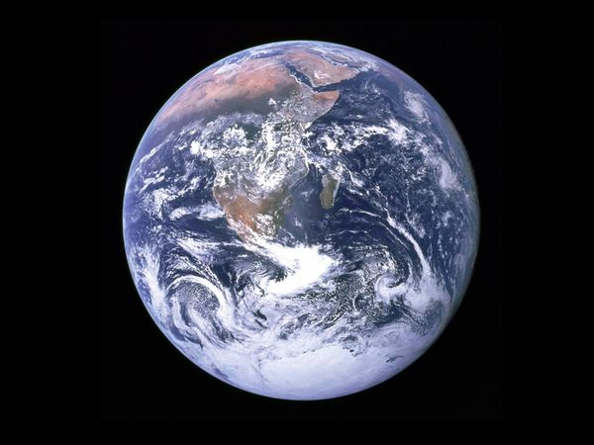
National Oceanic and Atmospheric Administration
Space
Land
Earth’s Interior
Ocean
Atmosphere
http://science.nationalgeographic.com/science/photos/earth-moon-gallery/

Slide 5
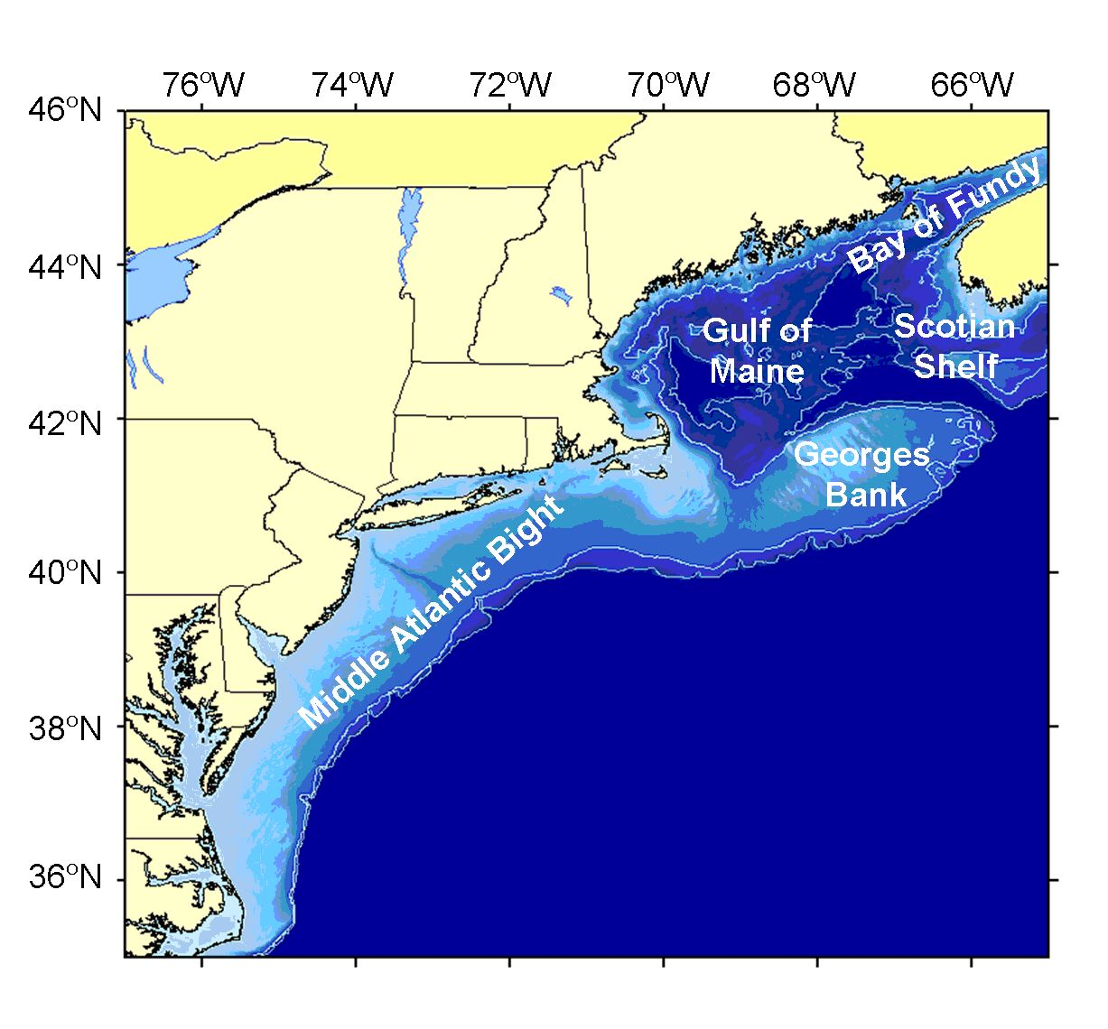
National Oceanic and Atmospheric Administration
Marine Fisheries
Climate Research
National Weather Service
Earth Environmental Satellites
National Marine Sanctuaries and Estuarine Research Reserves
Northeast U.S. Continental Shelf

Slide 6
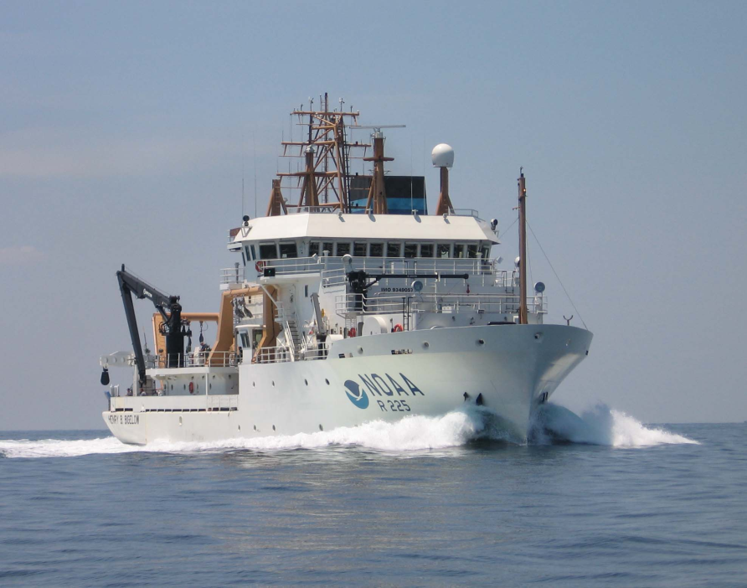
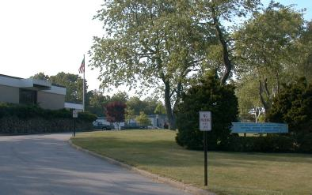
Director of the NOAA Narragansett Laboratory
Ship-based oceanography programs for NOAA in the Northeast
Lead for a Climate Research Program
Teach and advise at URI

Slide 7
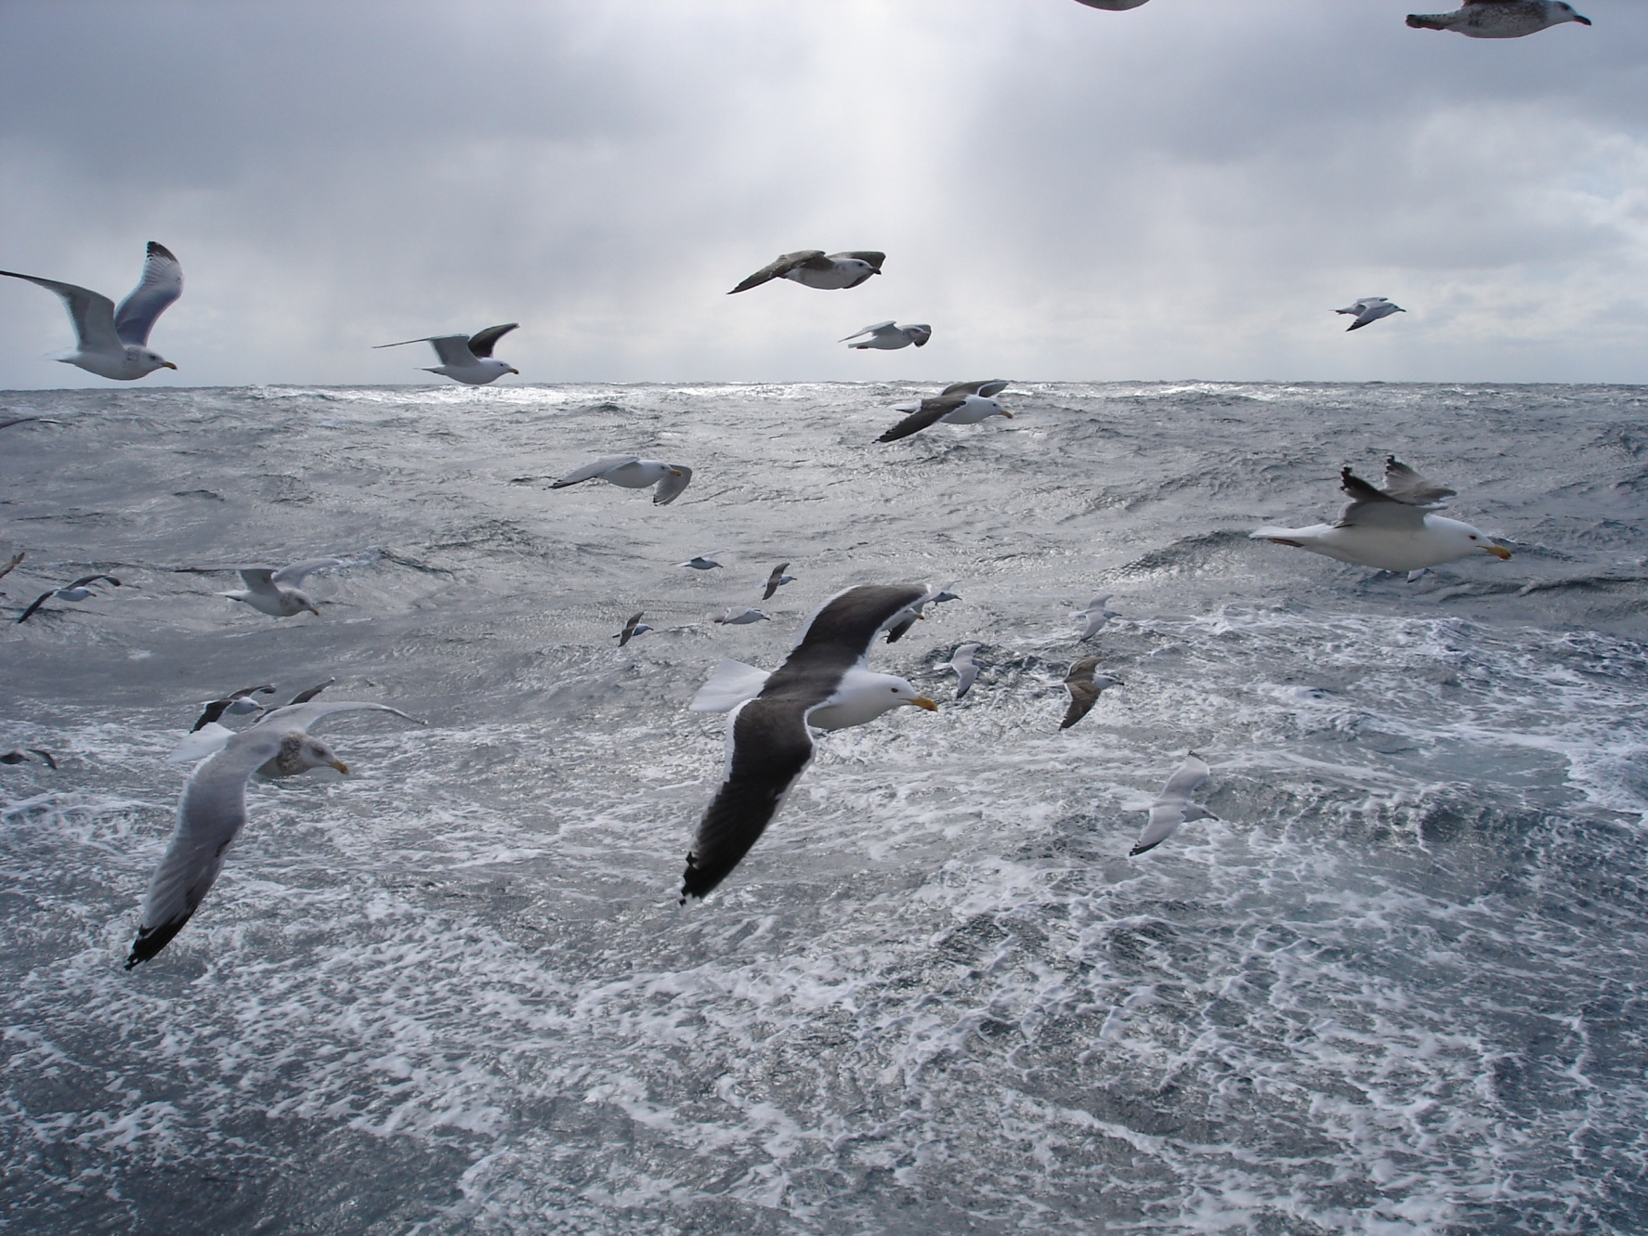
Questions about NOAA?

Slide 8
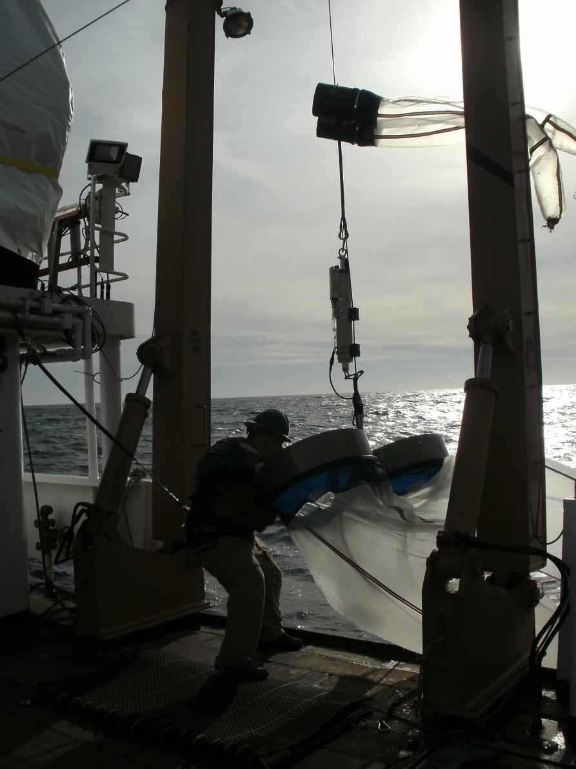
Outline
Introduction
Scientific Hypotheses
Evidence for climate change
Cause of climate change
Climate change and fisheries
What should we do

Slide 9
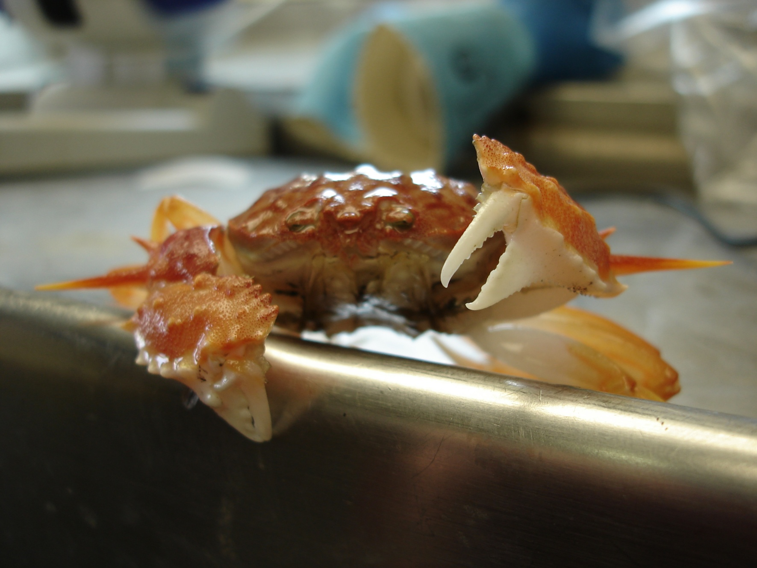
What is a hypothesis?

Slide 10
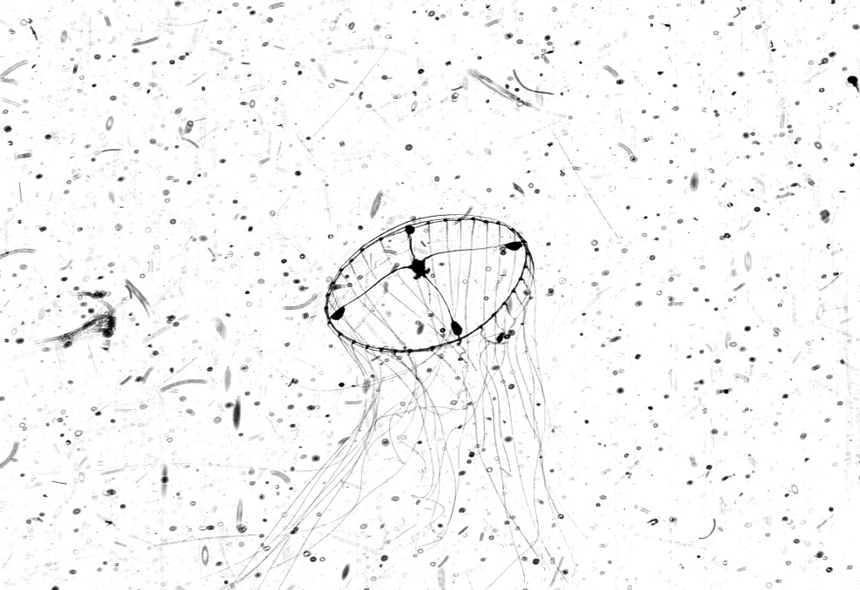
Scientific hypothesis - a proposed explanation for an observation or phenomenon that can be tested

Slide 11
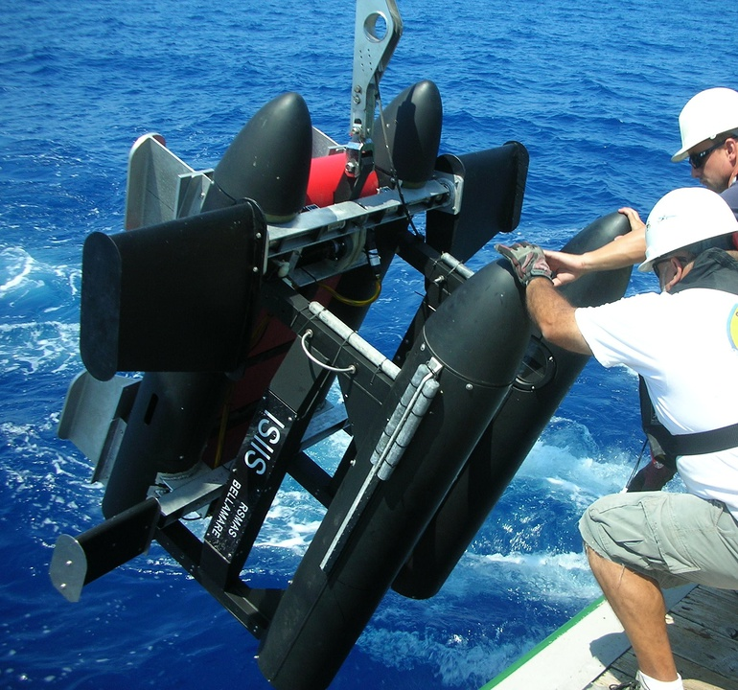
Scientific theory - a hypothesis that has been rigorously tested and repeatedly confirmed through observation and experiment

Slide 12
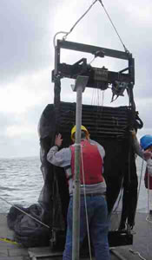
Outline
Introduction
Scientific Hypotheses
Evidence for climate change
Cause of climate change
Climate change and fisheries
What should we do

Slide 13
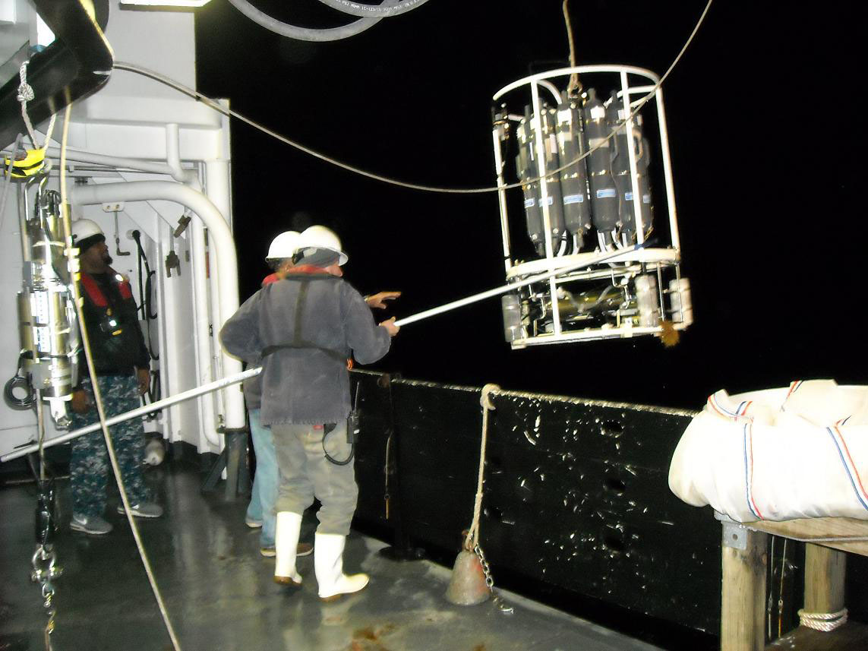
How many of you have heard of climate change?

Slide 14
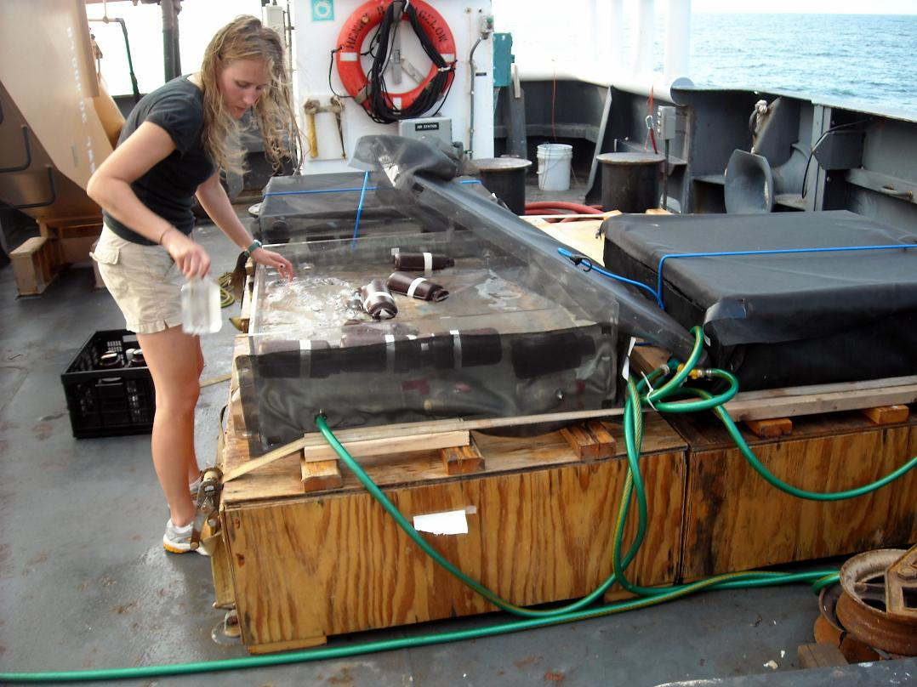
What is climate change?

Slide 15
What is climate change?
Climate – average earth, atmosphere, and ocean conditions (for example temperature, winds, currents)
Change – a difference
Climate change – a long-term difference in the average earth, atmosphere, and ocean conditions

Slide 16
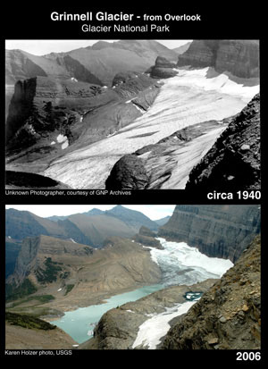
Climate change is a long-term change in:
Temperature
Sea level
Rainfall
Storms
Ocean Acidification
http://nrmsc.usgs.gov/repeatphoto/

Slide 17
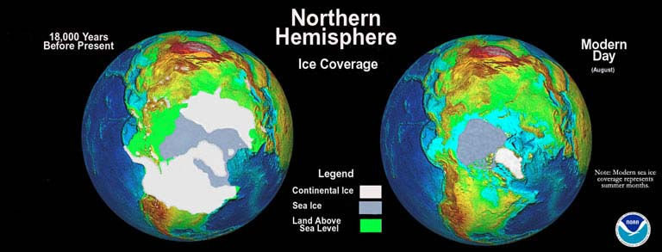
Has climate change happened in the past?
http://www.ncdc.noaa.gov/paleo/slides/slideset/11/11_177_bslide.html

Slide 18
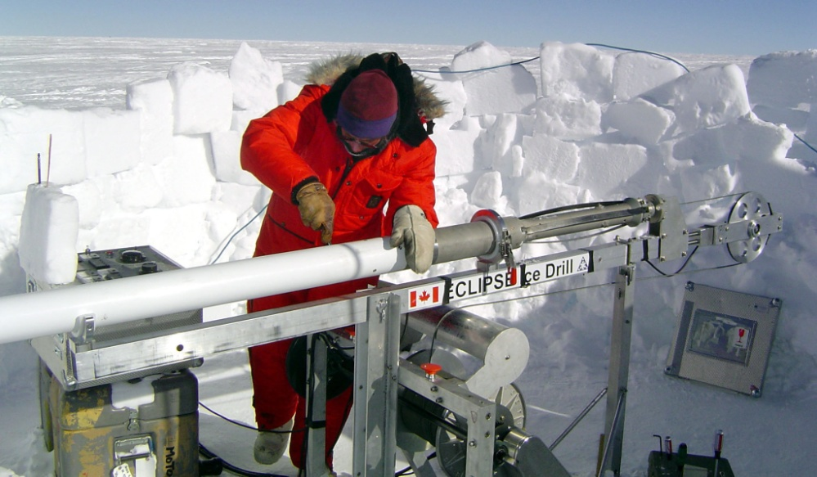
Has climate change happened in the past?
Yes
http://nsidc.org/cryosphere/quickfacts/icesheets.html
http://en.wikipedia.org/wiki/File:Vostok_Petit_data.svg

Slide 19
What caused climate change?
http://en.wikipedia.org/wiki/File:Vostok_Petit_data.svg

Slide 20

What caused climate change?
Orbital variations – distance from sun
Solar output – energy from sun
Volcanism – blocking of sun energy
Plate tectonics – distribution of ocean and land
Human effects – changes in atmosphere

Slide 21
What caused climate change?
Humans
Climate change happens.
Is it happening now?
If so what is the cause?
http://en.wikipedia.org/wiki/File:Vostok_Petit_data.svg

Slide 22
Is climate change happening now?
Hypothesis?
Temperature in the ocean?

Slide 23
Is climate change happening now?
Hypothesis?
Temperature in the ocean?
There is a long-term difference in the average ocean temperatures in the Northeast U.S..

Slide 24
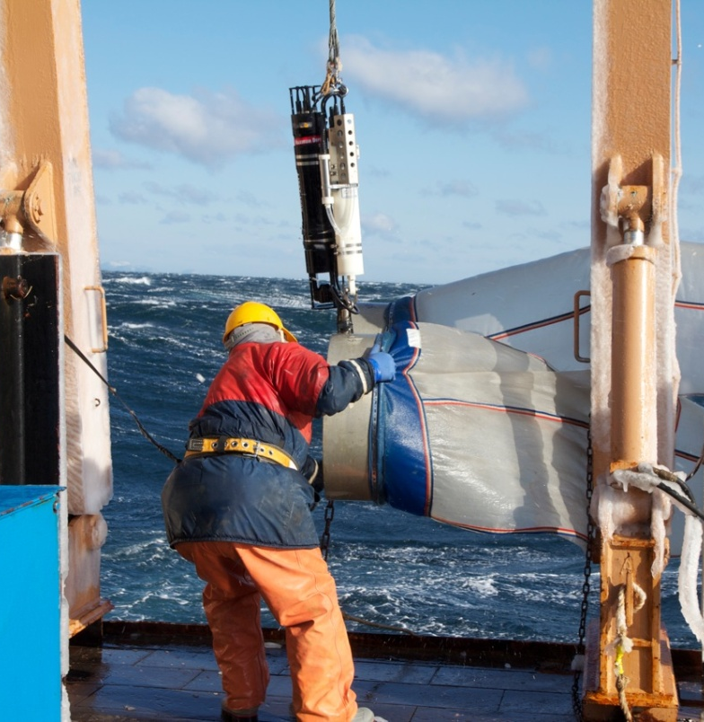
Is there a long-term difference in the average ocean temperatures in the Northeast U.S.?

Slide 25
There is a long-term difference in the average ocean temperatures in the Northeast U.S.
0.0081 ºF / year
158 years
1.27 ºF

Slide 26
There is a long-term difference in the average ocean temperatures in the Northeast U.S.
0.0081 ºF / year
158 years
1.27 ºF
Variability – short term differences

Slide 27
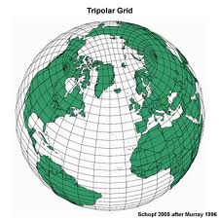
Is there a long-term difference in the average ocean temperatures around the world

Slide 28
Warming observed globally in the ocean and in the atmosphere
Temperature change (ΔºF) over 150 years
Arctic
Antarctica

Slide 29
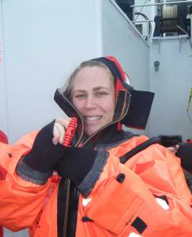
Climate change is happening now
Current climate change supported by multiple observations, studies, and approaches
Temperature rising
Sea level rising
Rainfall changing
Storms changing
Ocean Acidification increasing

Slide 30
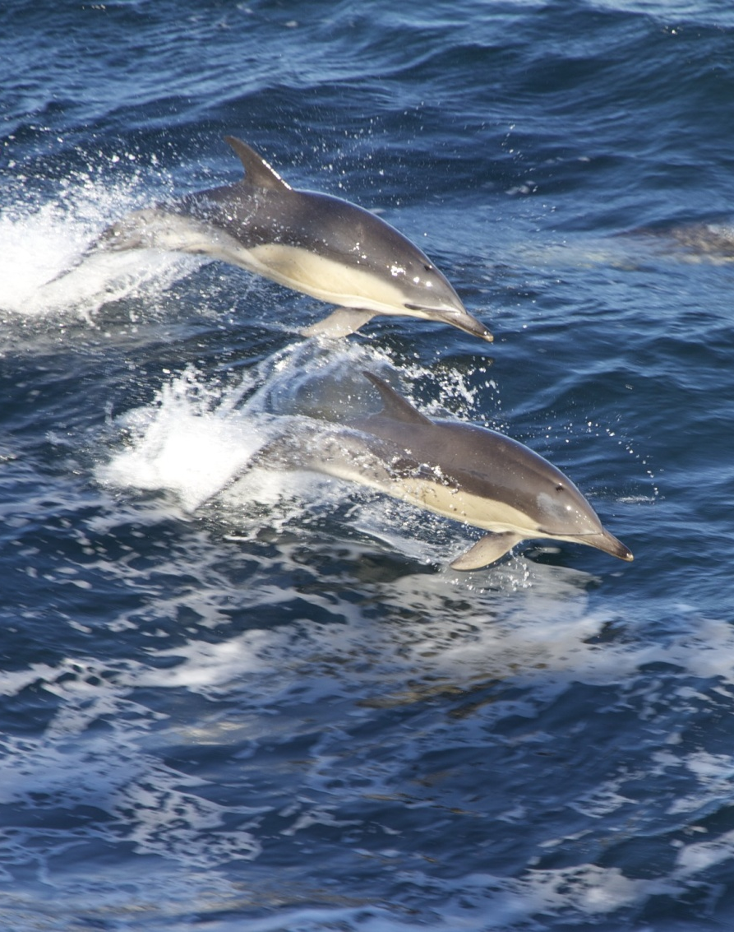
Outline
Introduction
Scientific Hypotheses
Evidence for climate change
Cause of climate change
Climate change and fisheries
What should we do

Slide 31
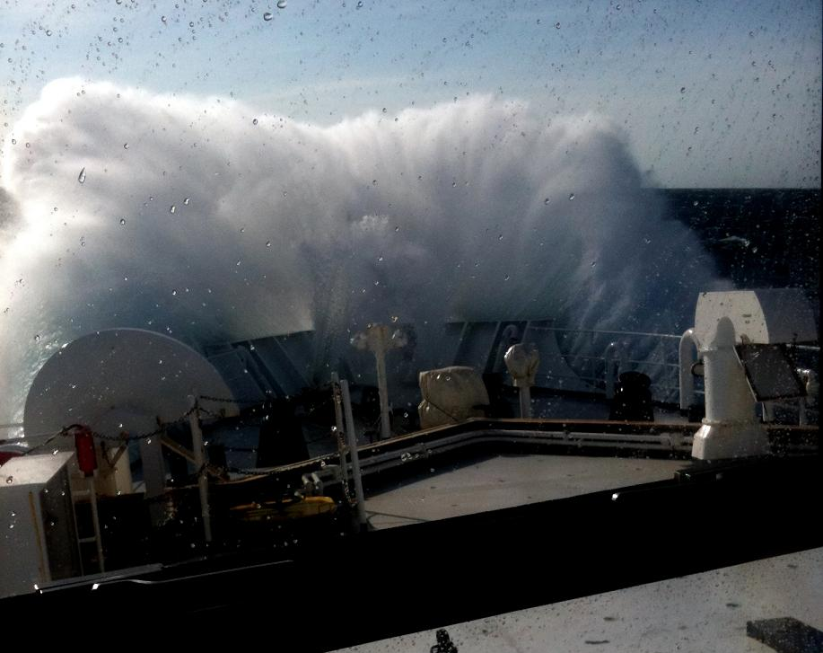
What is causing current climate change?

Slide 32
How do we determine which cause?
Orbital variations – distance from sun
Solar output – energy from sun
Volcanism – blocking of sun energy
Plate tectonics – distribution of ocean and land
Human effects – changes in atmosphere

Slide 33
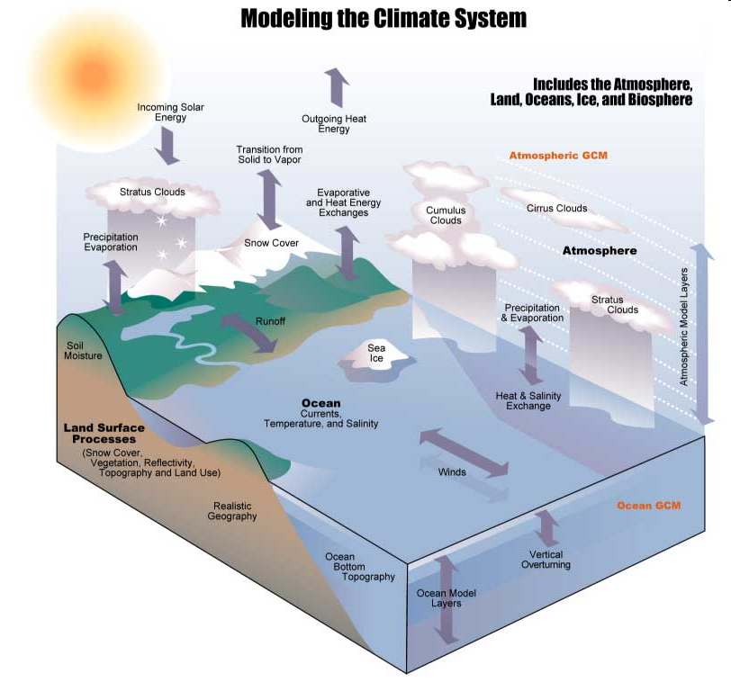
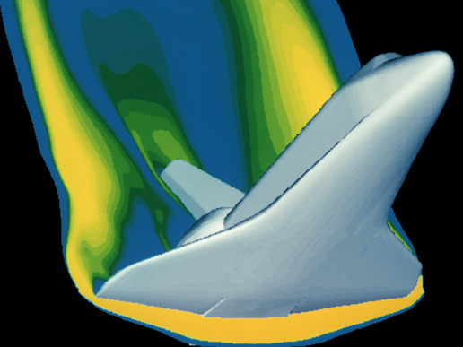
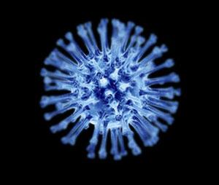
Climate Models
Include elements of the earth system
NASA
Newscientist.com
http://www.usgcrp.gov/usgcrp/Library/nationalassessment/overviewtools.htm

Slide 34
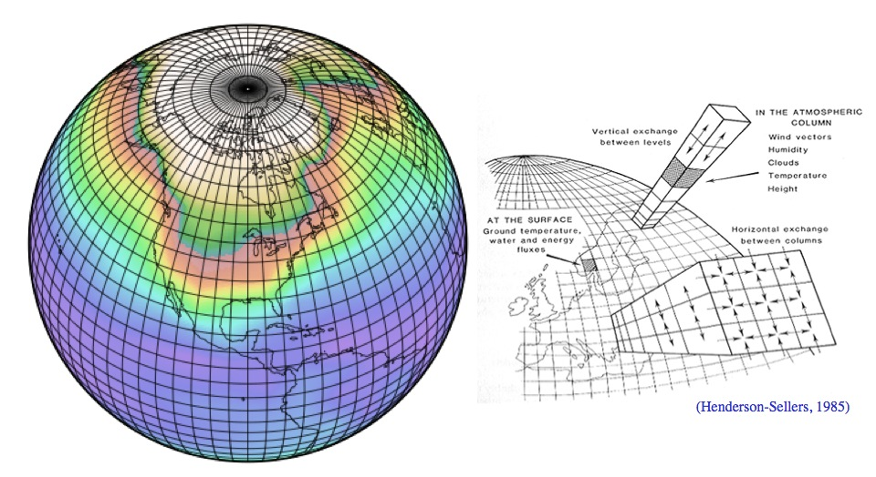
Climate Models
http://serc.carleton.edu/eet/envisioningclimatechange/part_2.html

Slide 35
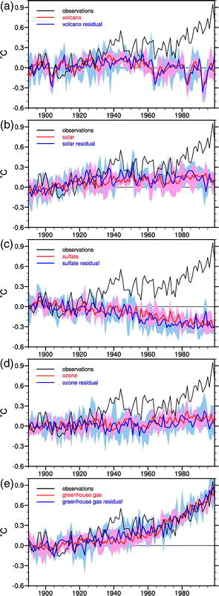
What is causing current climate change?
Orbital variations – time scale wrong (>20K years)
Solar output – likely NO
Volcanism – likely NO
Plate tectonics – time scale wrong
Human effects – likely YES
http://journals.ametsoc.org/doi/abs/10.1175/1520-0442(2004)017%3C3721:CONAAF%3E2.0.CO%3B2

Slide 36
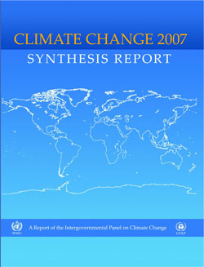
What is causing current climate change?
IPCC Consensus Statement
“[M]ost of the observed warming over the last 50 years is likely to have been due to the increase in greenhouse gas concentrations”.
http://www.ipcc.ch/publications_and_data/publications_ipcc_fourth_assessment_report_synthesis_report.htm

Slide 37
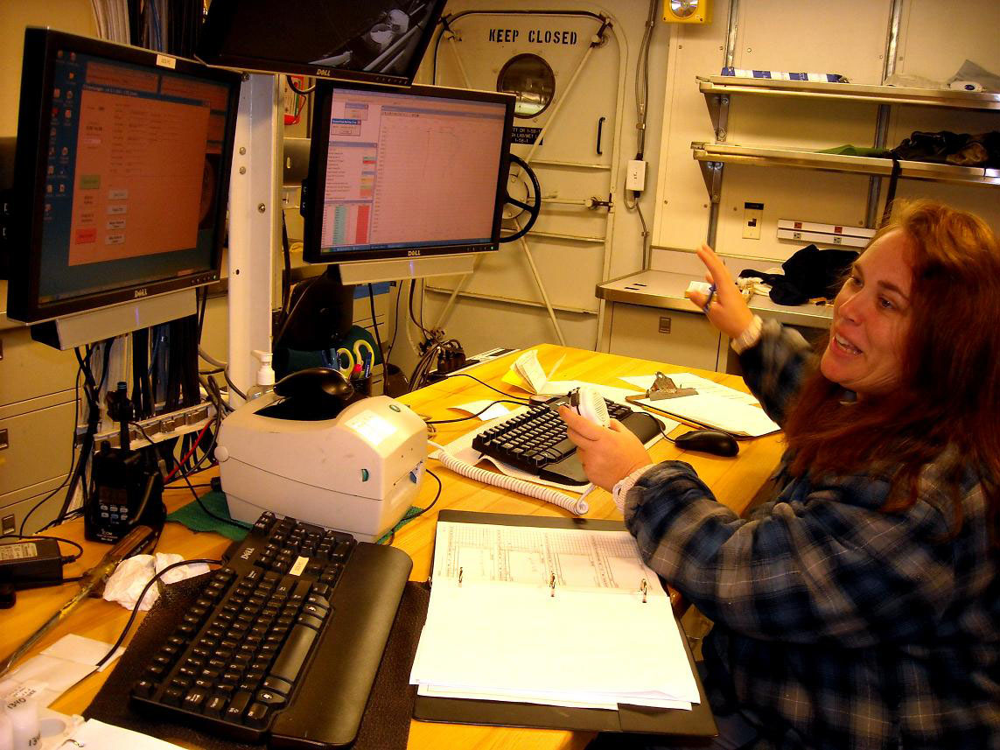
Outline
Introduction
Scientific Hypotheses
Evidence for climate change
Cause of climate change
Climate change and fisheries
What should we do

Slide 38
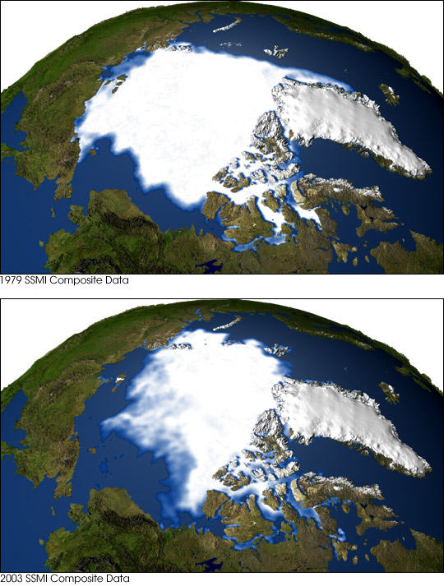
Scientific consensus:
Climate change is happening now
Greenhouse gas emission most likely cause
Hypothesis to theory
Still uncertainty, but that is science
http://earthobservatory.nasa.gov/IOTD/view.php?id=3900

Slide 39
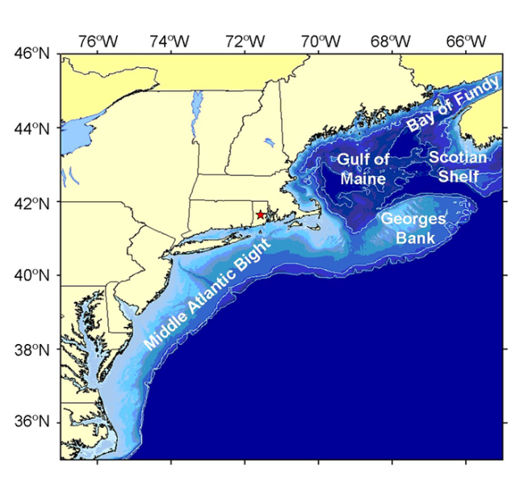
Climate Change and the Northeast

Slide 40
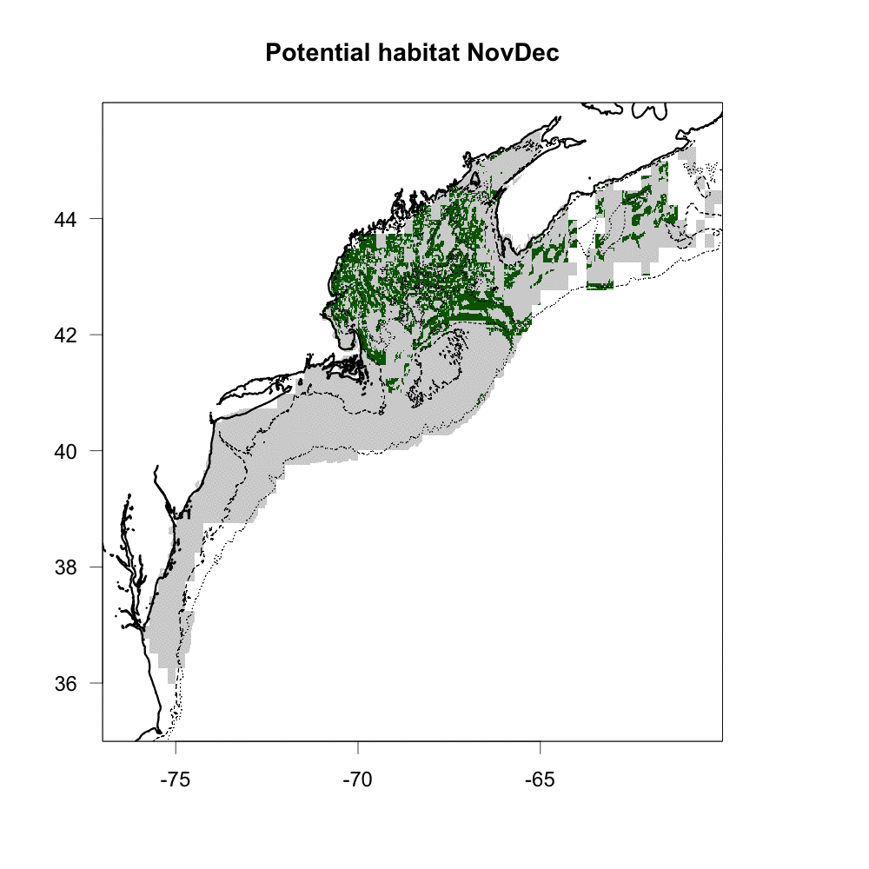
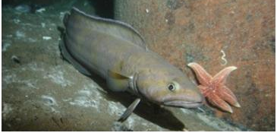
Climate Change and the Northeast

Slide 41
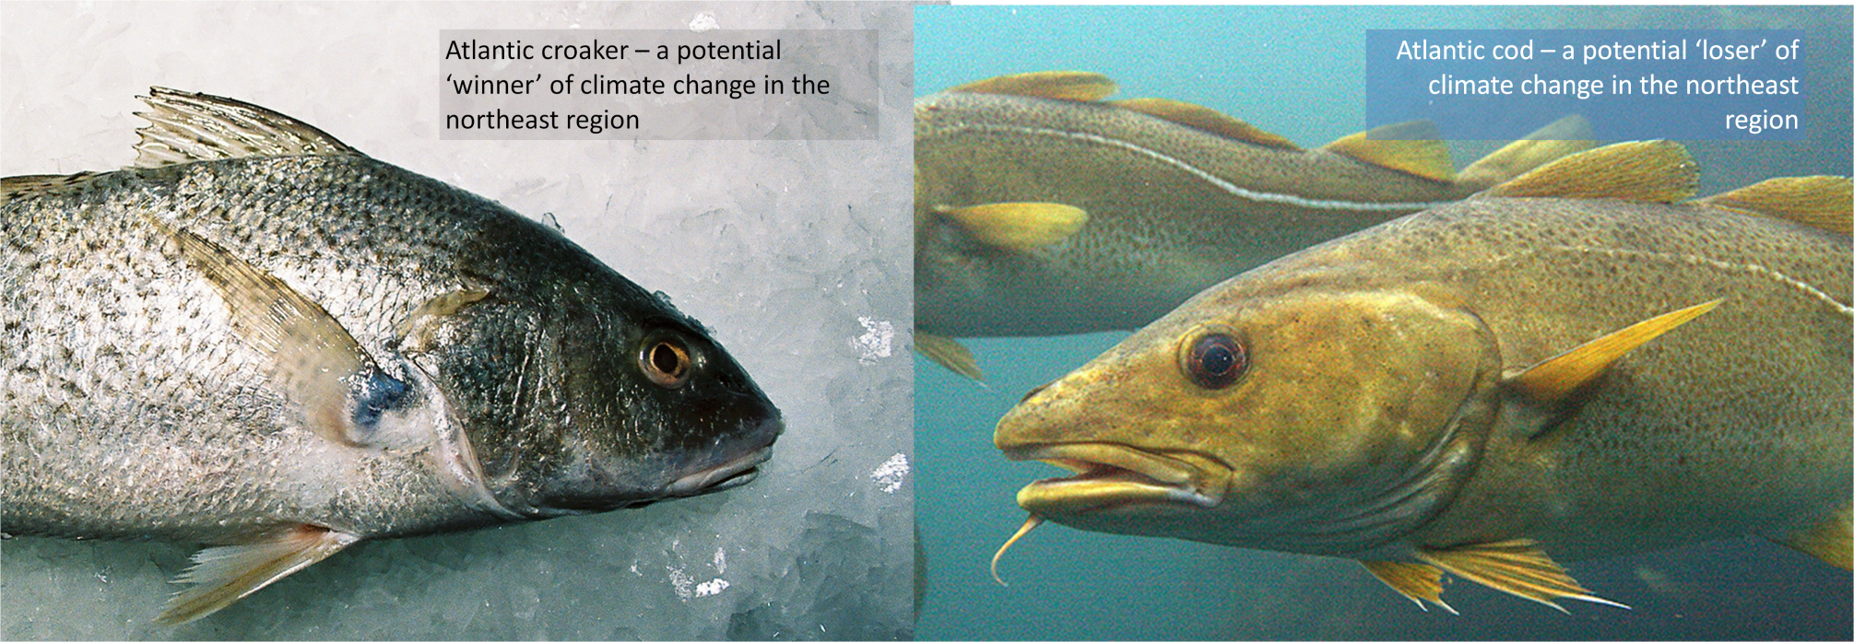
Climate Change and the Northeast
In a region (e.g., northeast),
there will be ‘winners’ and ‘losers’

Slide 42
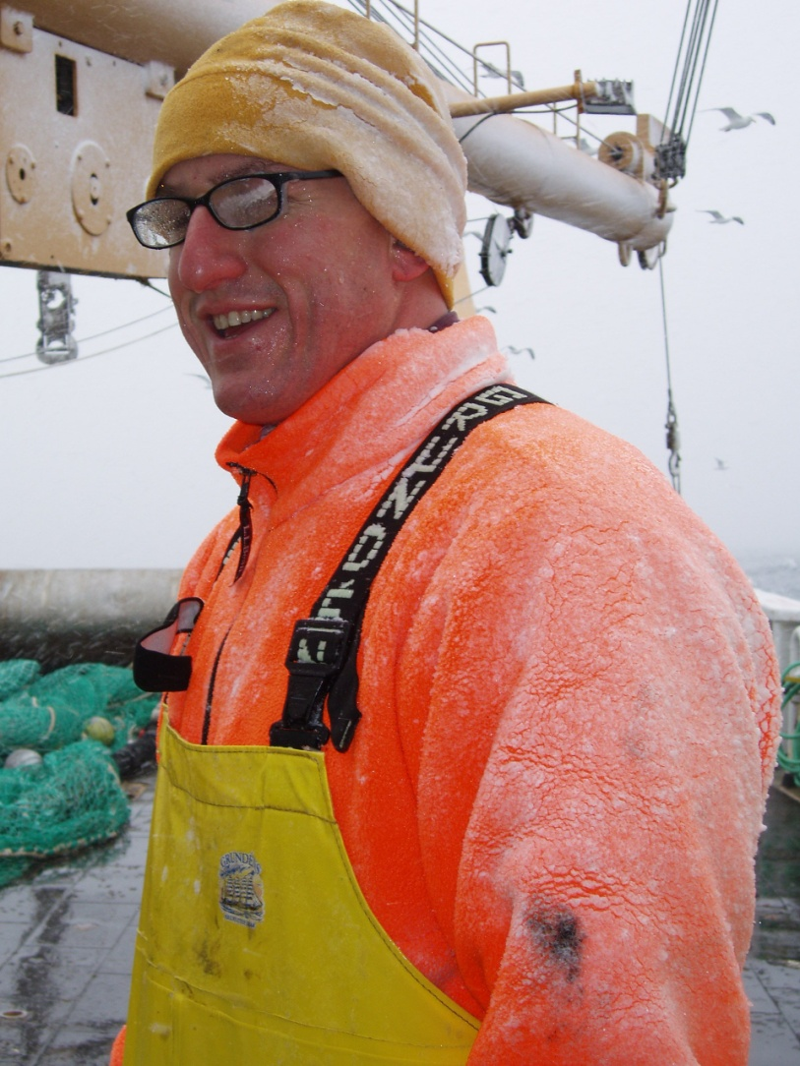
Outline
Introduction
Scientific Hypotheses
Evidence for climate change
Cause of climate change
Climate change and fisheries
What should we do

Slide 43
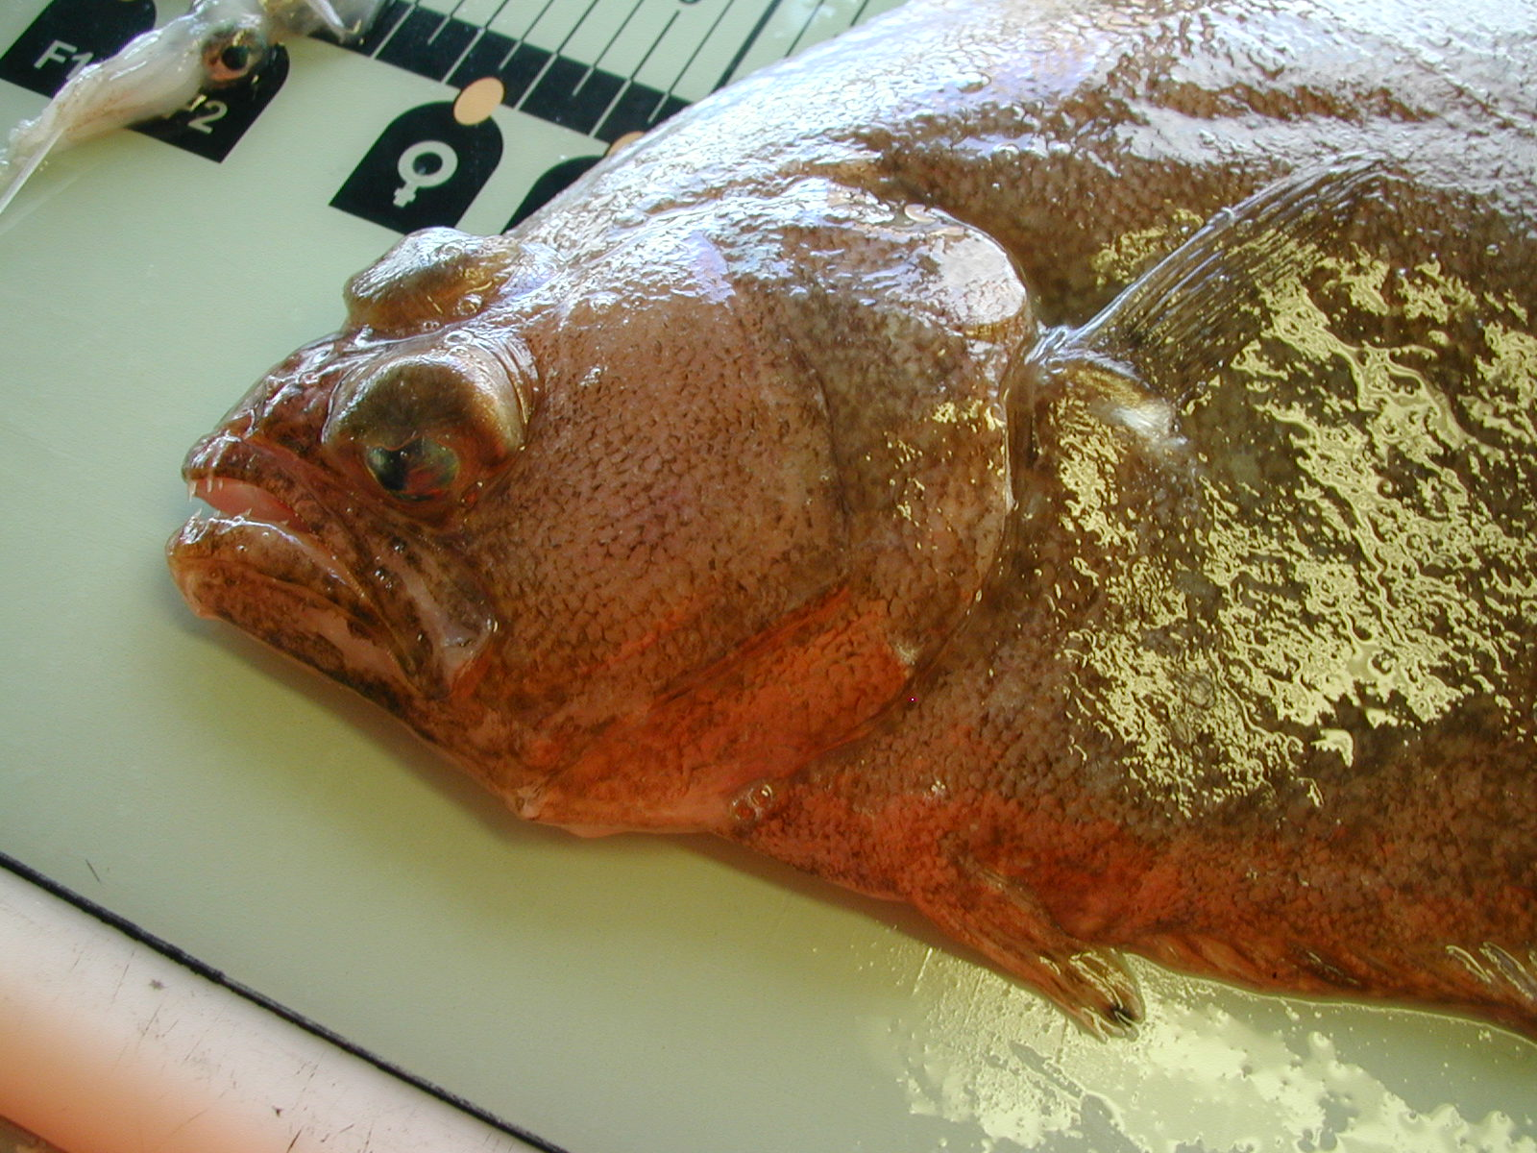
What should we do about climate change?

Slide 44
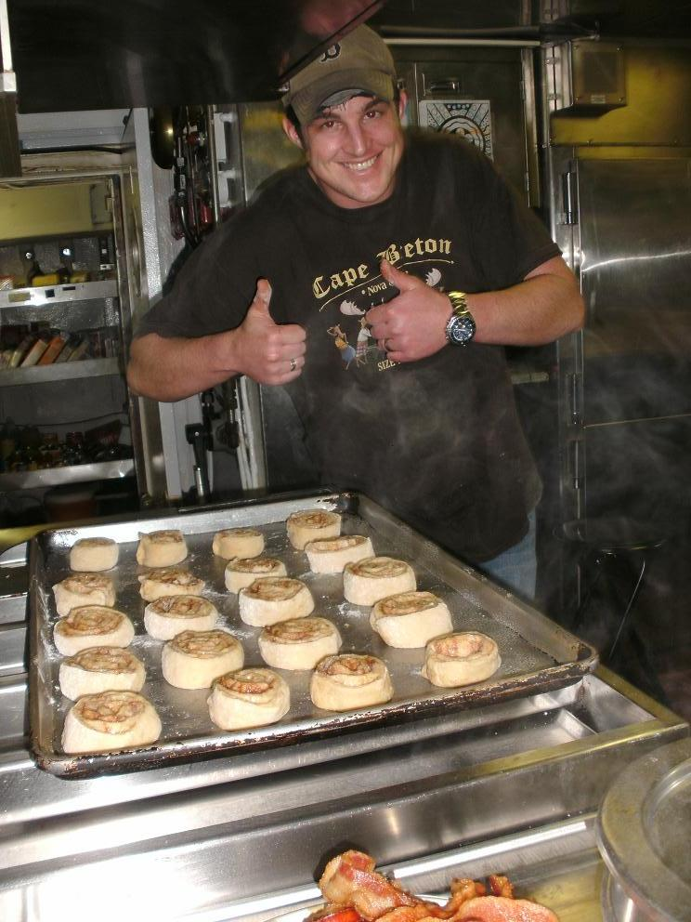
What should we do about climate change?
This is not a science question.
Science can help:
Assess different options
Understand consequences
Science does not dictate policy

Slide 45
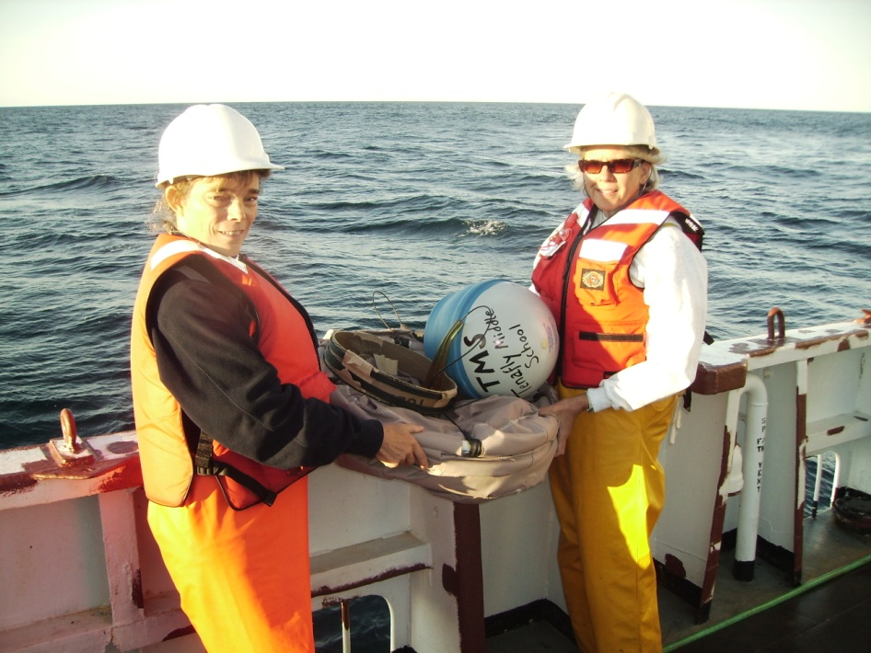
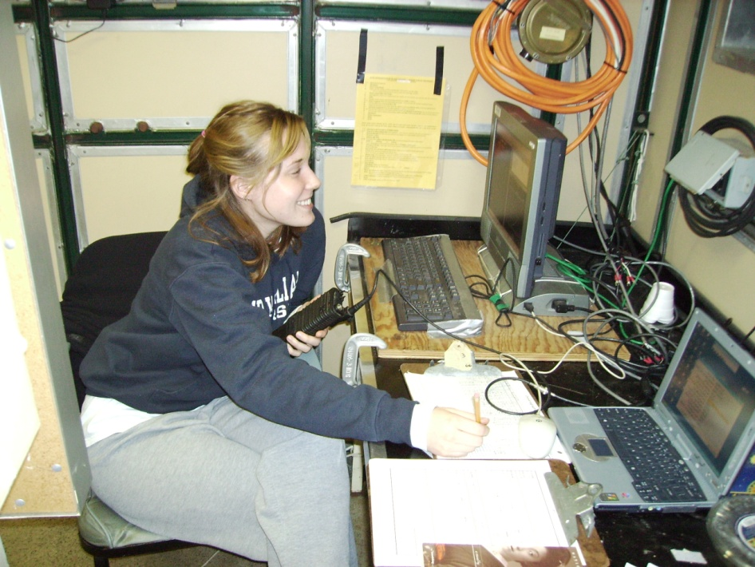
What should we do about climate change?
Personal philosophy: scientists stick to science; policy makers use best available science to make decisions

Slide 46
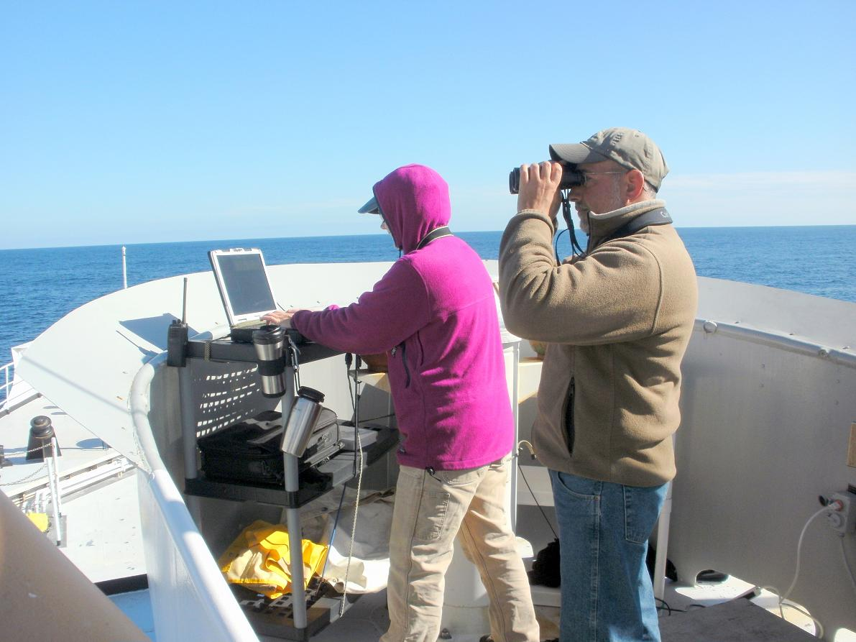
What should we do about climate change?
Who read: Climate Change: 'Hoax' Or Crime Of the Century?
“Shifting gears, let’s assume that the alarmists are right and that man-made CO₂ emissions are making the world warmer. If so, what changes would they hope to accomplish and at what cost?”

Slide 47
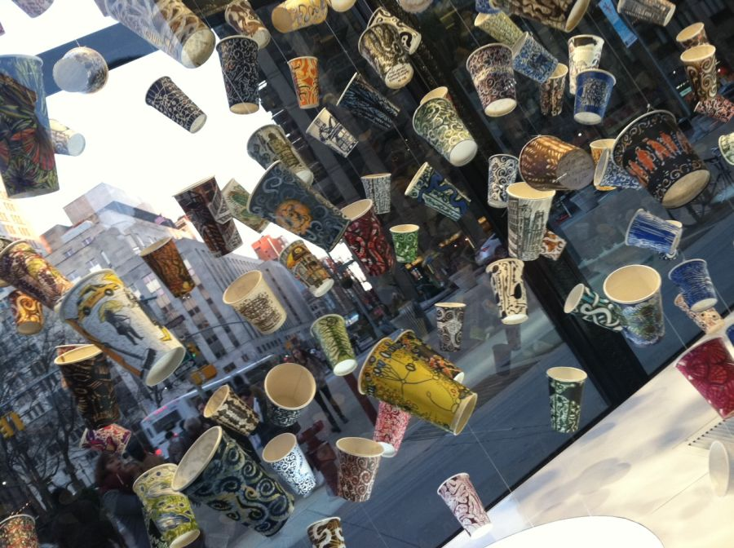
What should we do about climate change?
It is not a science debate; it is a policy debate
Climate change is happening now
Human greenhouse gas emissions are the likely cause
Not fact, but well
supported
hypothesis = theory

Slide 48
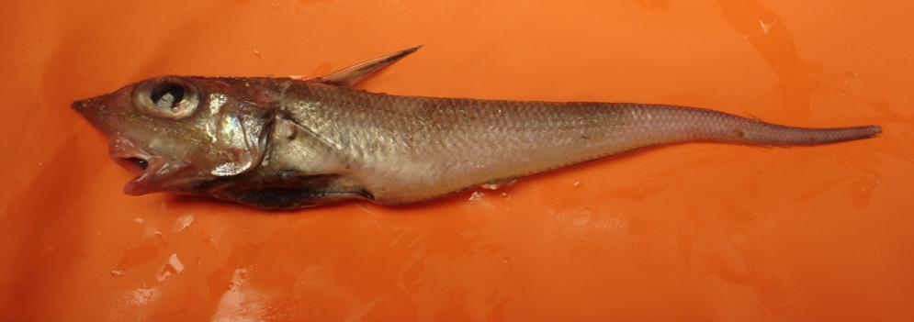
What should we do about climate change?
You must weigh the pro’s and con’s of acting or not acting
Reasonable people may come to different conclusions
Self-interested people will advocate certain positions no matter what

Slide 49
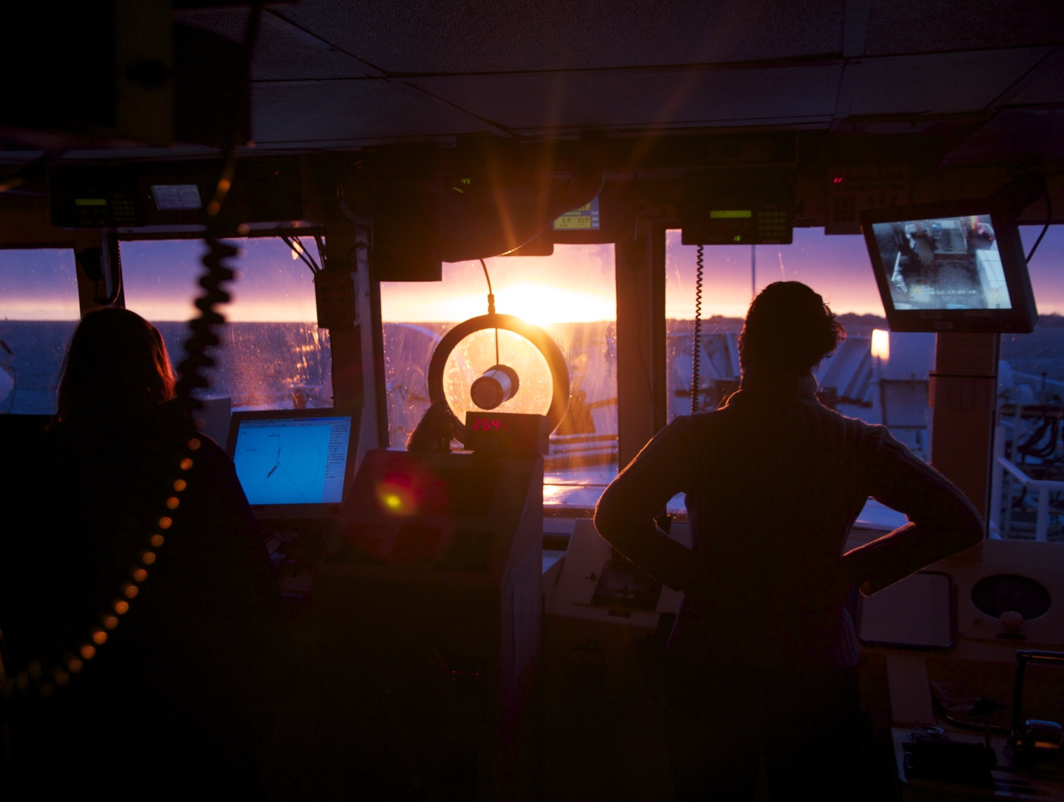
Thank you? Questions? What do you think?

