Slide 1
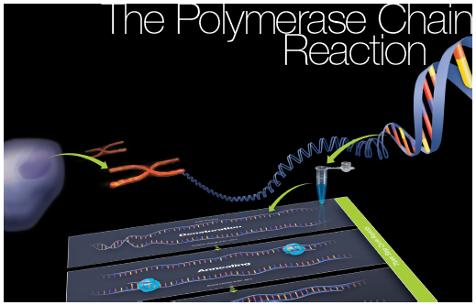
The Polymerase
Chain Reaction
Chapter 6: Background

Slide 2
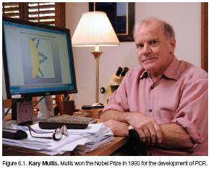
Invention of PCR
Kary Mullis
  Mile marker 46.58 in April of 1983
  Pulled off the road and outlined a way to conduct DNA replication in a tube
  Worked for Cetus, which was purchased by Chiron and is now part of Novartis

Slide 3
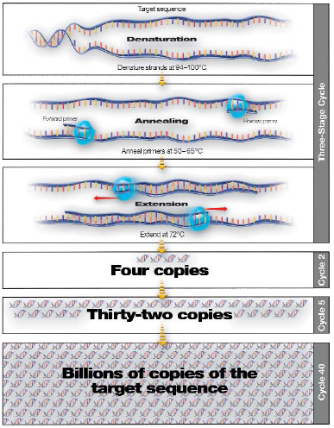
What is PCR?
Polymerase chain reaction or PCR
  Simplified version of bacterial DNA replication
  Copies a specific sequence of DNA
    Target sequence
    PCR products
    Amplicons
  Target is determined by the primers
    Short sequences of single-strand DNA
    To amplify a defined segment, two are required
  Annealing is when the primers bind to the target sequence
  The two primers are referred to as forward and reverse primers

Slide 4
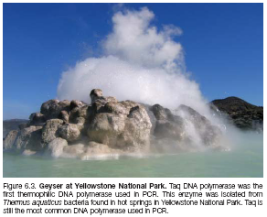
Challenges of DNA Replication in a Tube
Normal replication uses enzymes that are heat sensitive
Using heat to denature the double strands of DNA, would damage the enzymes
Heat-stable DNA polymerases were the key to developing in vitro method of replication
Thermus aquaticus was the bacteria from which the first heat-stable DNA polymerase was isolated and the enzyme was named Taq polymerase

Slide 5
Normal Bacterial Replication
Steps:
  Topoisomerase gradually unwinds the DNA helix ahead of the replication fork. Helicase unzips the strands by breaking hydrogen bonds
  Single-stranded binding proteins prevent DNA from reannealing
  Primase adds RNA nucleotides in the 5'3' direction
  DNA polymerase III adds nucleotides to the ends of the RNA primers
  DNA polymerase I corrects mistakes and removes RNA nucleotides and replaces them with DNA nucleotides
  Ligase links the leading and lagging strands (Okazaki fragments)

Slide 6
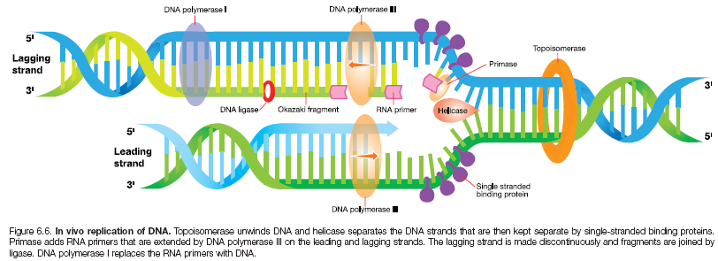
Normal Bacterial Replication

Slide 7
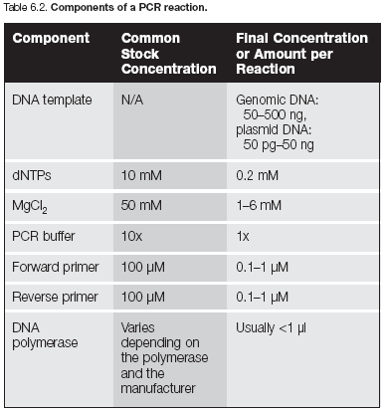
Components of a PCR Reaction
Template DNA
Nucleotides (dNTPs)
PCR buffer
Magnesium chloride (MgCl₂)
Forward and reverse primers
DNA polymerase

Slide 8
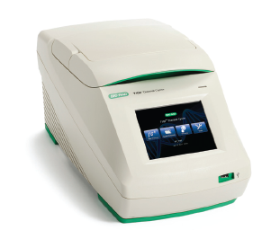
Thermal Cyclers
Initially water baths were used, but that was very labor intensive
Thermal cyclers are electronically controlled heat blocks that can quickly change from one temperature to another
They are programmable and are in many different configurations depending upon their purpose
They most commonly have graphical interfaces that make them very easy to program

Slide 9
Types of PCR
There are many variations of traditional PCR
  Real-time or quantitative PCR (qPCR)
  Reverse transcription PCR (RT-PCR)
  Multiplex PCR
  Degenerate PCR
  Nested PCR
  Random amplification of polymorphic DNA (RAPD)
  Fast PCR

Slide 10
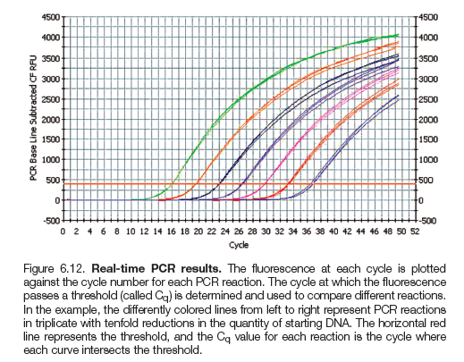
Real-Time PCR
Allows for quantitation of the amount of initial DNA in a sample
The amount of PCR product is measured at the end of each cycle

Slide 11
Reverse Transcription PCR
Uses retroviral enzyme reverse transcriptase to reverse transcribe mRNA into DNA before the PCR begins
When DNA is made this way it is referred to as cDNA
  RT-PCR is often used in combination with real-time PCR to measure levels of gene expression
Reverse transcription
DNA
RNA
Protein
Trait

Slide 12
Other Types of PCR
Multiplex PCR
  Multiple sets of primers are used to target and amplify different sequences
  Often used in GMO detection
Degenerate PCR
  Uses sets of primers that have almost the same sequence as each other differing in only 1–3 bases. They are used when working with closely related species and improve the likelihood of amplification

Slide 13
Other Types of PCR
Nested PCR
  Sometimes PCR is not optimal and two rounds are required. The first set of primers might amplify target and non-target DNA. A second set of primers is used that will bind within the target region using the first round as template DNA
Random Amplification of Polymorphic DNA (RAPD)
  This is a method of DNA fingerprinting that uses a collection of random primers. These primers are 10 base pairs long (decamers) and will randomly amplify products if they bind close enough on the template DNA. Closely related species will have similar products while others might not

Slide 14
Other Types of PCR
Fast PCR
  Total running time for traditional three-cycle PCR is relatively long (2.5–4 hours)
  In Fast PCR, the run time can be 0.5–1.5 hours with new advancements
  This can be achieved by using two steps where the annealing temperature and extension temperature are close to each other
  This type of reaction must be highly optimized and only works for some reactions

Slide 15
PCR Optimization
Each reaction is very different and the components and conditions must be adjusted
Factors that must be taken into account vary with the purpose of the reaction
  If the goal is to clone a gene, then the PCR product should have no errors so no mutations are introduced
    Enzymes with proofreading features are used to ensure accuracy

Slide 16
PCR Optimization
Conditions and factors to optimize:
  Template quality
  Template concentration
  Primer concentration
  Primer design
  Magnesium concentration
  Annealing temperature
  Cycling times

Slide 17
PCR Optimization
Template quality
  If DNA is ancient, usually the template is broken into smaller fragments
  Designing primers to amplify small PCR products should be the goal

Slide 18
PCR Optimization
Template concentration
  Generally there is an optimal concentration of template
  Too little concentration is often an issue depending upon the length of the target being amplified
  Too much template can inhibit a reaction
  Adjusting the concentration to see which concentration yields the best amplification is the goal with template concentration optimization

Slide 19
PCR Optimization
Primer concentration
  The normal range is from 0.1 µM to 1 µM
  Increasing the concentration can lead to
    Nonspecific binding
    Formation of primer dimer
      Primer dimer is when the primers bind to each other

Slide 20
PCR Optimization
Primer design
  The sequence of the primers is crucial to the success of PCR
    Primer sequences must be complementary to each end of the target region
    The melting temperature (T_{m}) of each primer must be within a few degrees of the other primers
  The T_{m} is the temperature at which half of the primers dissociate from the template DNA
  The annealing temperature is usually 3–5ºC lower than the T_{m}

Slide 21
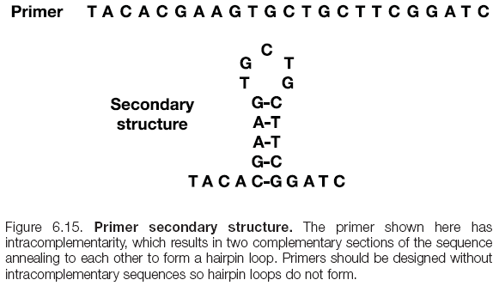
PCR Optimization
Primer design
  Primers should be designed without intra- or intercomplementary sequences

Slide 22
PCR Optimization
Magnesium concentration
  Magnesium is a cofactor for the polymerase enzyme
  The normal concentration used is between 1–6 mM
  This should be adjusted to find which concentration yields the best results

Slide 23

PCR Optimization
Annealing temperature
  The temperature that is used for the primers to bind is called the annealing temperature. These are calculated using the formula:
  Annealing temperatures are often adjusted up and down a few degrees to optimize them. Many thermal cyclers have a gradient function that will allow multiple annealing temperatures to be tested at one time

Slide 24
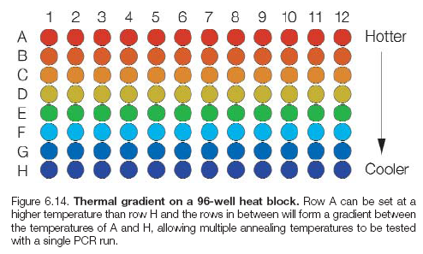
PCR Optimization
Annealing temperature
  Many thermal cyclers have a gradient function that will allow multiple annealing temperatures to be tested at one time

Slide 25
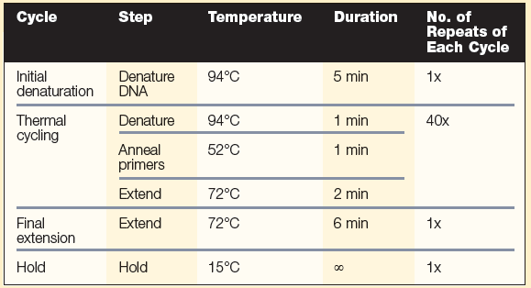
PCR Optimization
Cycling temperatures and times
  The amount of time that each step is held depends on the length of PCR product and the amount of time it would take to amplify that length. Shorter lengths require shorter times
  Generally only the annealing temperature is adjusted

Slide 26
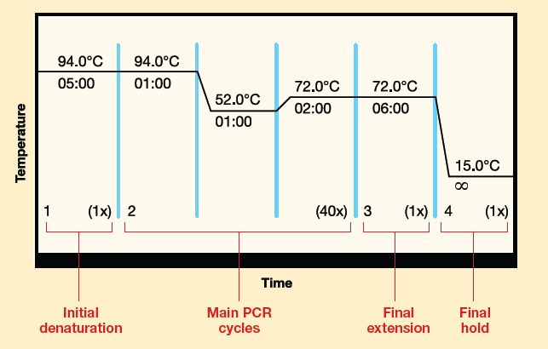
PCR Optimization
Denature DNA
Bind primers
Extend primers
Finish any products
To ensure all DNA is denatured
Hold until ready to remove from thermal cycler
Repeat this 40 times

Slide 27
Techniques Based on PCR
DNA microarrays
  Small spots of identical pieces of DNA are annealed to a slide and arranged in order to determine which spots had a complementary binding event
  The spots of DNA fragments can represent variations in gene sequences, mRNA complementary sequences, viral sequences, bacterial sequences, etc.

Slide 28
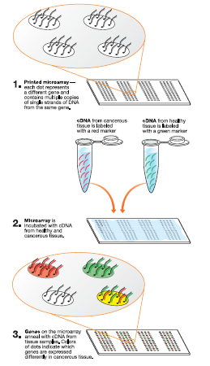
Microarrays
PCR is used to amplify the sequence of interest
They are spotted on a slide
Sequences from other samples that have been amplified with labeled nucleotides are washed
The results are detected

Slide 29
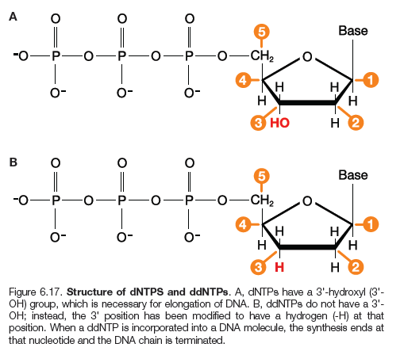
DNA Sequencing
Modern sequencing techniques use PCR to amplify the sequence to be determined
A mixture of terminating and non- terminating nucleotides are used in the reaction
Each terminating nucleotide has a different color dye added to it, a dideoxynucleotide triphosphate (ddNTP). Once the growing chain terminates, the nucleotide will have a unique color associated with it

Slide 30
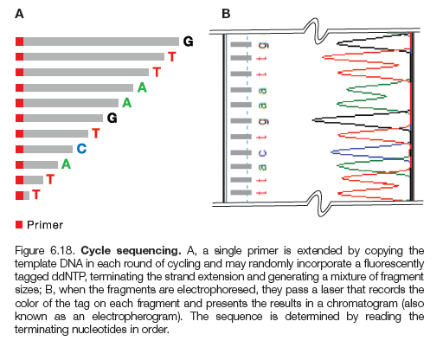
DNA Sequencing
Since the primer is known, each successive terminated fragment should be one nucleotide longer
Automated sequencers read the colors as they electrophorese past a detector

Slide 31
Other Applications of PCR
PCR in medicine
  Detection of disease-causing organisms
    Species-specific primers help isolate genes
  Amplification of disease-causing organisms for quick diagnosis
    Real-time PCR confirmed H1N1 outbreak
  Amplification of genes of interest for cloning
    Roles of genes in cancer can be explored

Slide 32
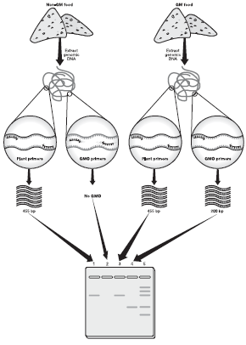
Other Applications of PCR
PCR in agriculture
  GMO detection in foods
  Compliance with reporting requirements
    Can verify levels of genetic modifications in exports
    Can identify percentages of genetic modification to meet various countries’ reporting requirements

Slide 33
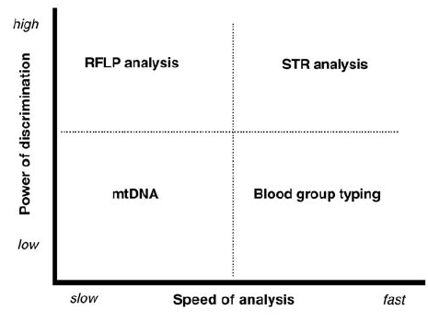
Other Applications of PCR
PCR in forensics
  Short tandem repeats (STR) analysis
    Short tandem repeats are amplified and used as a method of identification
    They have repetitive regions from 2-6 bp
    They are inherited from parents
    They display lots of variety

Slide 34
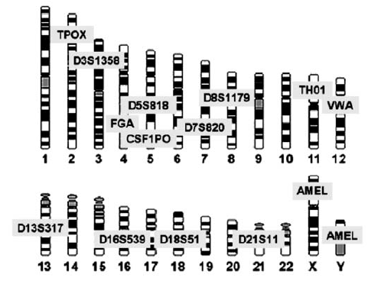
Other Applications of PCR
PCR in forensics
  Allele frequencies
    Vary between different ethic groups
  Combined DNA Index System (CODIS)
    Indexes 13 different STR loci
    Maintains national sample database FBI uses to statistically calculate random match probability

Slide 35
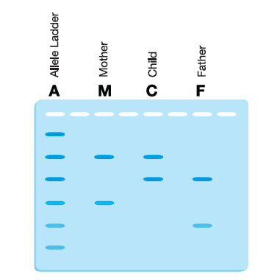
Other Applications of PCR
PCR in paternity
  Samples are amplified using STR analysis
    Children are a combination of parents
    In example, the child is possible from the mother and father shown
    Method is often use to exclude paternity

Slide 36
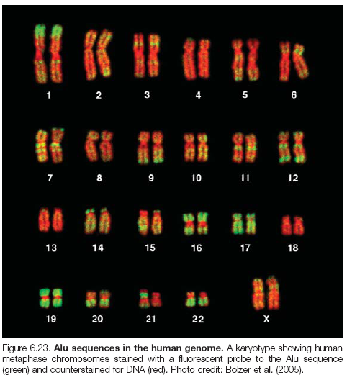
Other Applications of PCR
PCR in human migration
  Short interspersed repetitive elements (SINEs) have been inserted randomly into our human genome over millions of years. Alu is one such element
  PV92 is one specific Alu repetitive element
  Can be used to trace migration of humans

Slide 37
Other Applications of PCR
PCR in wildlife conservation
  Poaching endangers many animals in the world today
  STR analysis can determine legality of animal parts to possess or sell

Slide 38
Chapter 6 Summary
Background
Invention of PCR
What is PCR
PCR
DNA Replication
Components of PCR
Applications
Medical
Optimization
Types of PCR
Agricultural
Real-Time PCR
Reverse Transcription PCR
Other Types
Challenges of PCR
Others

