Slide 1
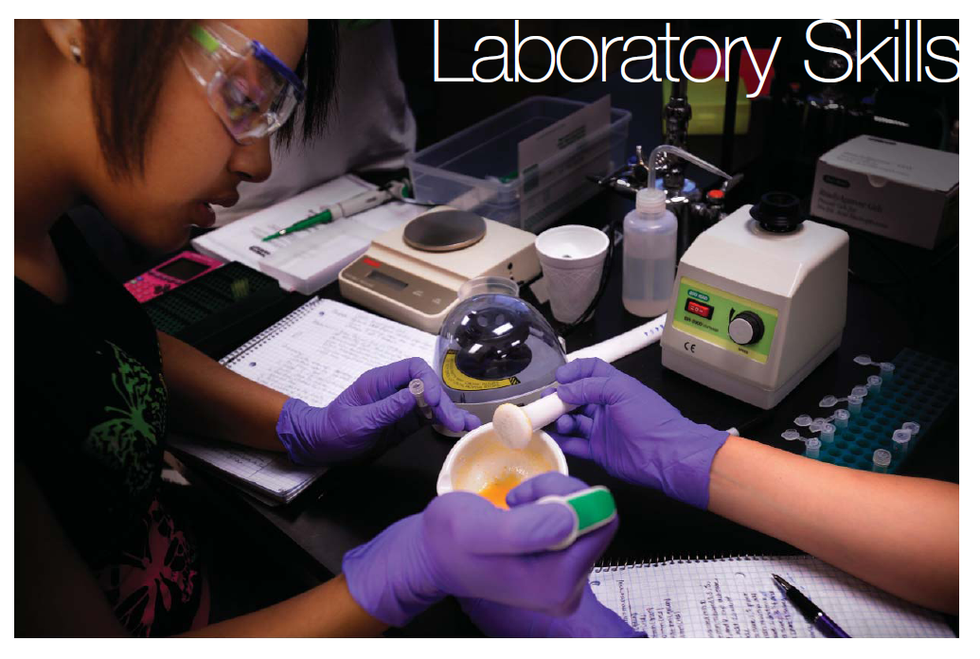
Laboratory Skills
Activity 2.3: Kool-Aid Column
Chromatography

Slide 2
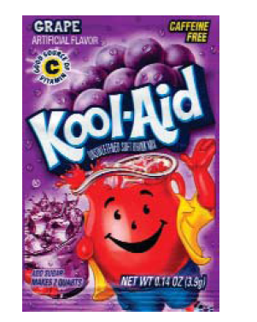
Activity 2.3: Kool-Aid Column Chromatography
Research question:
Can pigments be separated by using differences in their chemical properties?
Objectives:
Make 5% and 25% 2-propanol solutions
Separate Kool-Aid pigments using column chromatography
Write up the experiment in your laboratory notebook

Slide 3
Safety Reminders
Follow all laboratory safety procedures
Alcohol is flammable, take precautions to reduce possibility of ignition
Read/review all MSDS before beginning

Slide 4
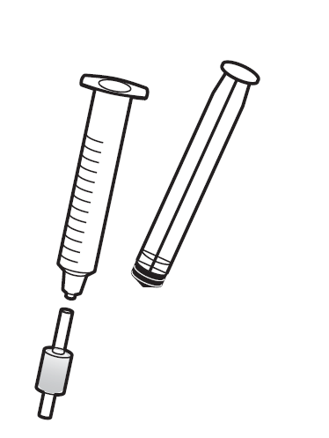
Tips
Make sure to always attach the cartridge to the syringe with the long end
Make sure to remove the cartridge before pulling the syringe plunger out
Press the plunger at a constant rate, not too fast

Slide 5
Separation of Kool-Aid Pigments
Play video: Kool-Aid Chromatography

Slide 6
Skills to Master
Perform calculations using the C₁V₁ = C₂V₂ equation
Follow protocols
Wash glassware properly
Select and use appropriate equipment
Make percent solutions (v/v)
Write label for reagent bottle
Use a Sep-Pak C18 cartridge and syringe
Use graduated cylinders, serological pipets, micropipets
Maintain a laboratory notebook
Interpret results and draw conclusions

Slide 7
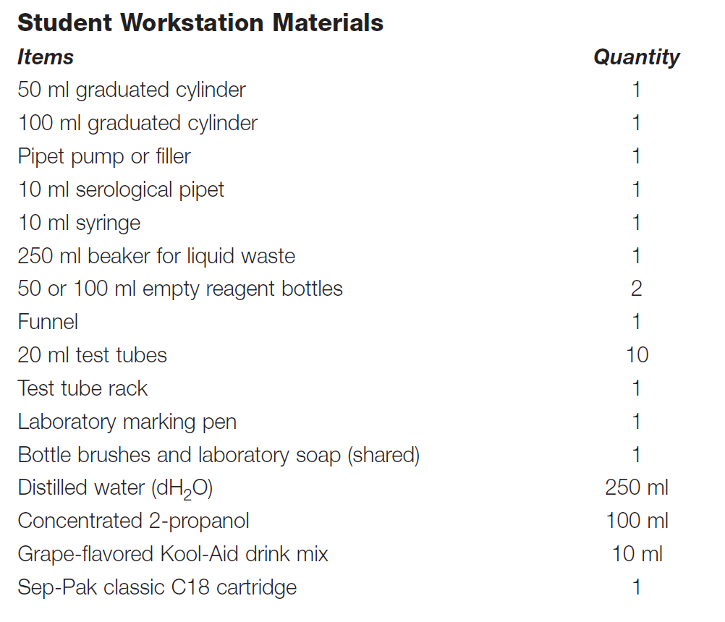
Student Workstation Materials

Slide 8
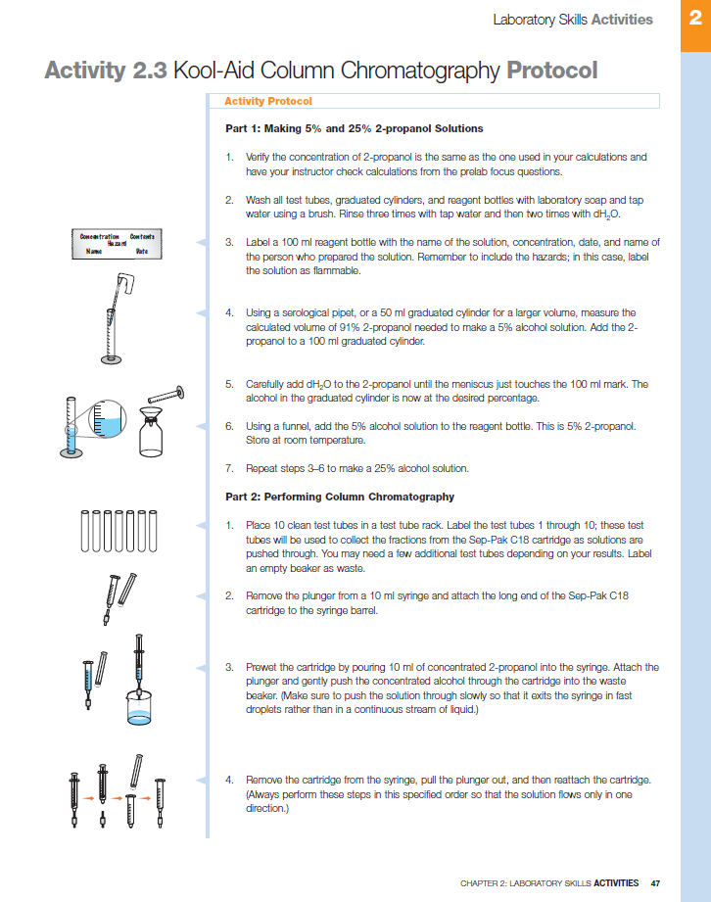
Protocol Highlights/Tips
When calculations are complete for making alcohols, add the concentrated alcohol to the graduated cylinder and then add water to QS to 100 ml
QS is Latin for quantum satis or a sufficient quantity
This means to fill until it reaches the desired volume

Slide 9
Summary
Make sure to:
Record all steps in your notebook following the proper technique
Remember to remove the cartridge as demonstrated
Collect fractions in test tubes
Make detailed observations of cartridge and test tubes after each step
Dispose of alcohols as directed by teacher

