Slide 1
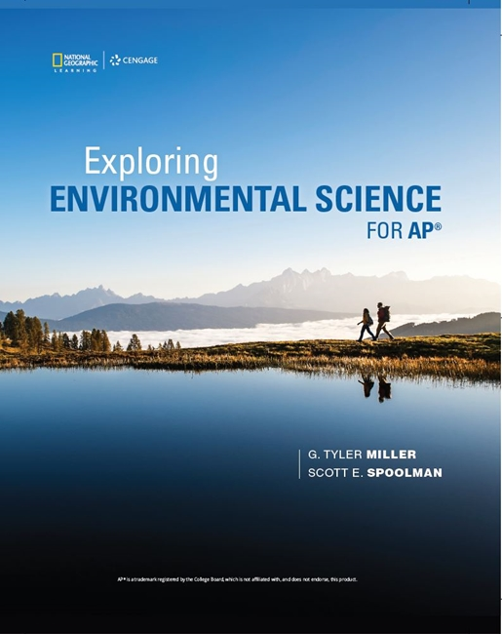
Exploring Environmental Science for AP®
1st Edition
Chapter 9
Sustaining Biodiversity: Saving Species and Ecosystem Services
Copyright © 2018 Cengage Learning. All Rights Reserved. May not be copied, scanned, or duplicated, in whole or in part, except for use as permitted in a license distributed with a certain product or service or otherwise on a password-protected website for classroom use.

Slide 2
Core Case Study: Where Have All the Honeybees Gone?
Bees play a key role in pollination
European honeybees pollinate over 70% of vegetable and fruit crops
Commercial beekeepers truck hives to farms to pollinate different crops
Colony Collapse Disorder
All bees abandon a colony
Affected 23–43% of European honeybees in the U.S. between 2008 and 2015

Slide 3
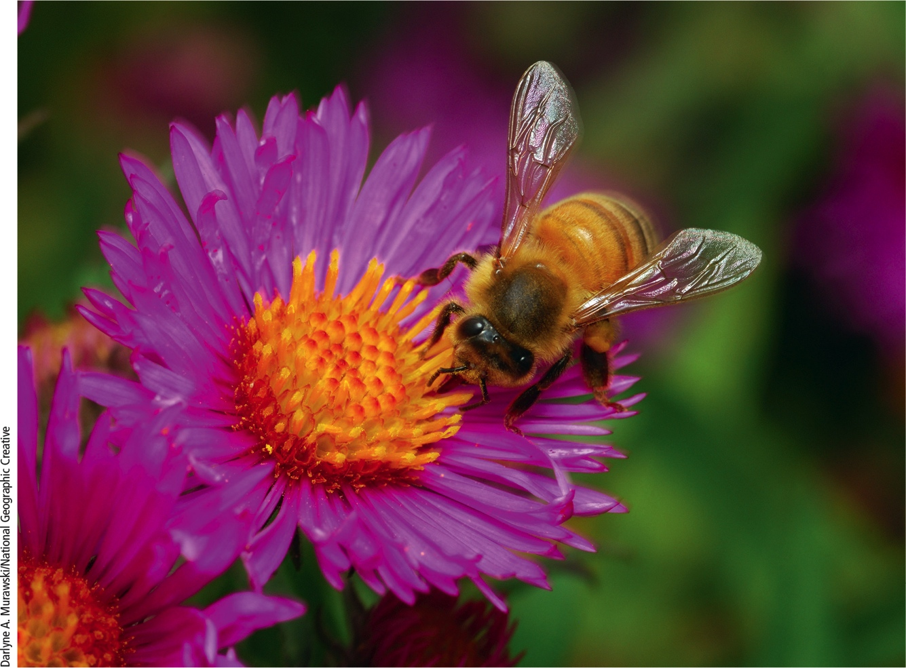
Honeybee
Notes:
Figure 9.1 European honeybee drawing nectar from a flower.

Slide 4
9.1 What Role Do Humans Play in the Loss of Species and Ecosystem Services?
Species are becoming extinct at least 1,000 times faster than the historical rate
By the end of this century, extinction rate is expected to be 10,000 times higher
Biological extinction
Occurs when a species can no longer be found anywhere on earth

Slide 5
Extinctions Are Natural but Sometimes They Increase Sharply (1 of 3)
Extinction is a natural process
Background extinction measures the natural rate
1 extinct species/year/1 million species
Mass extinction
Extinction of many species in a short period of time
Past causes most likely involved global changes in environmental conditions

Slide 6
Extinctions Are Natural but Sometimes They Increase Sharply (2 of 3)
Mass extinction can be an opportunity for species to fill empty ecological niches
Human population has destroyed and degraded habitats
Huge resource consumption and large ecological footprint
Extinction rates have risen recently
Current extinction rate is 1,000 times higher than natural background rate

Slide 7
Extinctions Are Natural but Sometimes They Increase Sharply (3 of 3)
Rate of extinction and threats to ecosystem services likely to rise sharply in the next 50–100 years
Due to harmful human impacts
Extinction is now 1,000 times the natural background rate
Large scale loss of species would greatly impact ecosystem services that humans rely on
Biologically diverse environments are being eliminated or fragmented

Slide 8
Science Focus 9.1: Estimating Extinction Rates
Problems estimating extinction rates
Natural extinction of a species a long process
Difficult to document
We have identified only 2 million of the 7–10 million species on earth
We know little about ecological roles of most identified species
Approach: observe how reductions in habitat area affect extinction rates

Slide 9
Endangered and Threatened Species Are Ecological Smoke Alarms (1 of 3)
Endangered species
So few individuals that the species could soon become extinct
Threatened species (vulnerable species)
Still enough individuals to survive, but numbers declining
May soon be endangered
Many species have characteristics that make them vulnerable to extinction

Slide 10
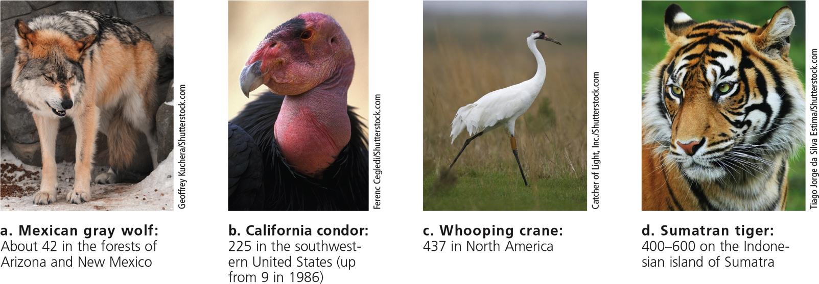
Endangered and Threatened Species Are Ecological Smoke Alarms (2 of 3)
Notes:
Figure 9.2 Endangered natural capital: These four critically endangered species are threatened with extinction, largely because of human activities. The number below each photo indicates the estimated total number of individuals of that species remaining in the wild.

Slide 11
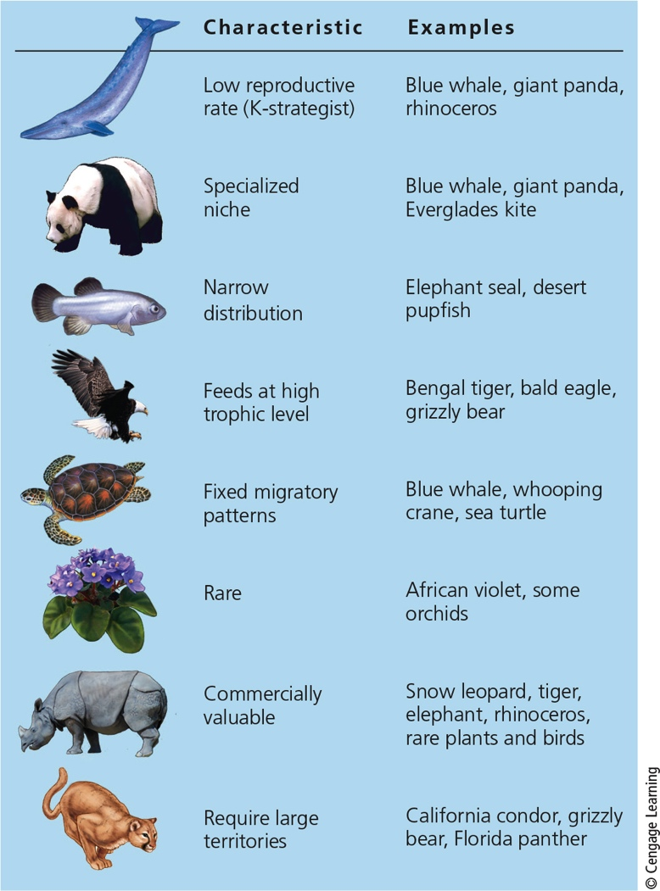
Endangered and Threatened Species Are Ecological Smoke Alarms (3 of 3)
Notes:
Figure 9.3 Certain characteristics can put a species in greater danger of becoming extinct.

Slide 12
9.2 Why Should We Try to Sustain Wild Species and the Ecosystem Services They Provide?
Reasons to avoid hastening the extinction of wild species
They provide valuable ecosystem and economic services
It can take millions of years for nature to recover from large-scale extinctions
Many people believe that species have a right to exist regardless of their usefulness to humans

Slide 13
Species Are a Vital Part of the Earth’s Natural Capital (1 of 5)
Orangutans
Only about 61,000 remain in the wild
Tropical forest habitat being cleared to grow palm oil
They are illegally smuggled and sold
Lowest birth rate of all animals
May disappear within two decades without urgent protective action

Slide 14
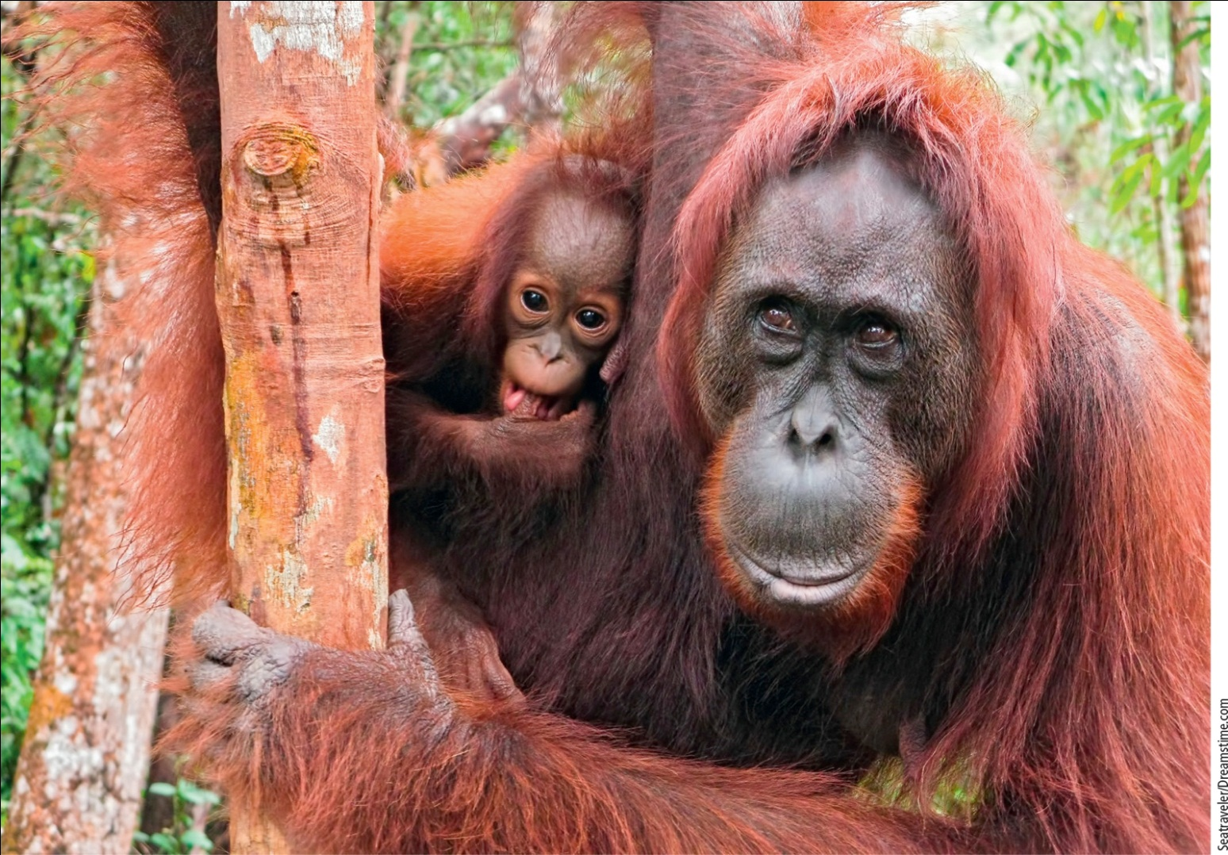
Species Are a Vital Part of the Earth’s Natural Capital (2 of 5)
Notes:
Figure 9.4 Natural capital degradation. These endangered orangutans depend on a rapidly disappearing tropical forest habitat in Borneo. Question: What difference will it make if human activities hasten the extinction of the orangutan?

Slide 15
Species Are a Vital Part of the Earth’s Natural Capital (3 of 5)
Species provide vital ecosystem services
Pollination, pest control, oxygen production
Many plants and animals provide economic value, medicinal drugs
Extinction can hinder speciation
Many people believe species have an intrinsic right to exist
Which species should we protect?

Slide 16
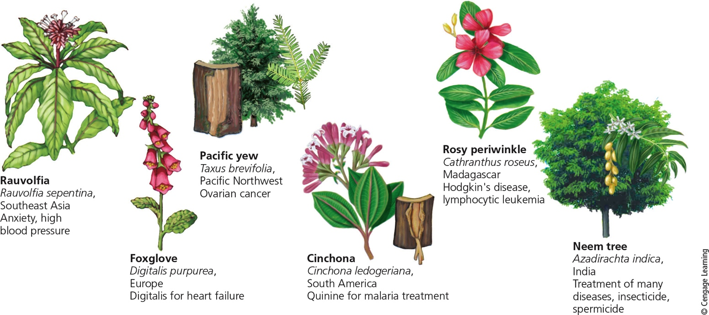
Species Are a Vital Part of the Earth’s Natural Capital (4 of 5)
Notes:
Figure 9.5 Natural capital. These plant species are examples of nature’s pharmacy. Once the active ingredients in the plants have been identified, scientists can usually produce them synthetically. The active ingredients in nine of the ten leading prescription drugs originally came from wild organisms.

Slide 17
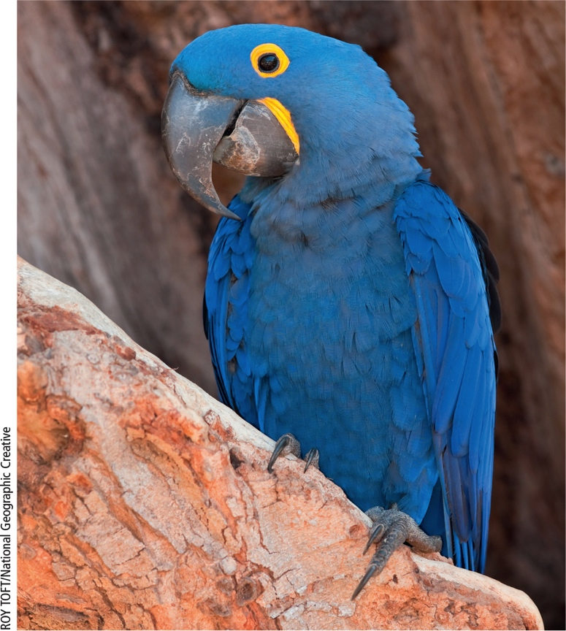
Species Are a Vital Part of the Earth’s Natural Capital (5 of 5)
Notes:
Figure 9.6 Many species of wildlife such as this endangered hyacinth macaw in Mato Grosso, Brazil, are sources of beauty and pleasure. Habitat loss and illegal capture in the wild by pet traders endanger this species.

Slide 18
9.3 How Do Humans Accelerate Species Extinction and Degradation of Ecosystem Services?
Greatest threats to species (acronym HIPPCO)
Habitat loss, degradation, or fragmentation
Invasive (nonnative) species
Population and resource use growth
Pollution
Climate change
Overexploitation

Slide 19
Habitat Destruction and Fragmentation (1 of 3)
Habitat fragmentation occurs when large intact habitat divided into smaller, isolated patches
Caused by roads, logging, crops, and urban development
Barriers limit species ability to disperse and colonize areas, locate food and mates

Slide 20
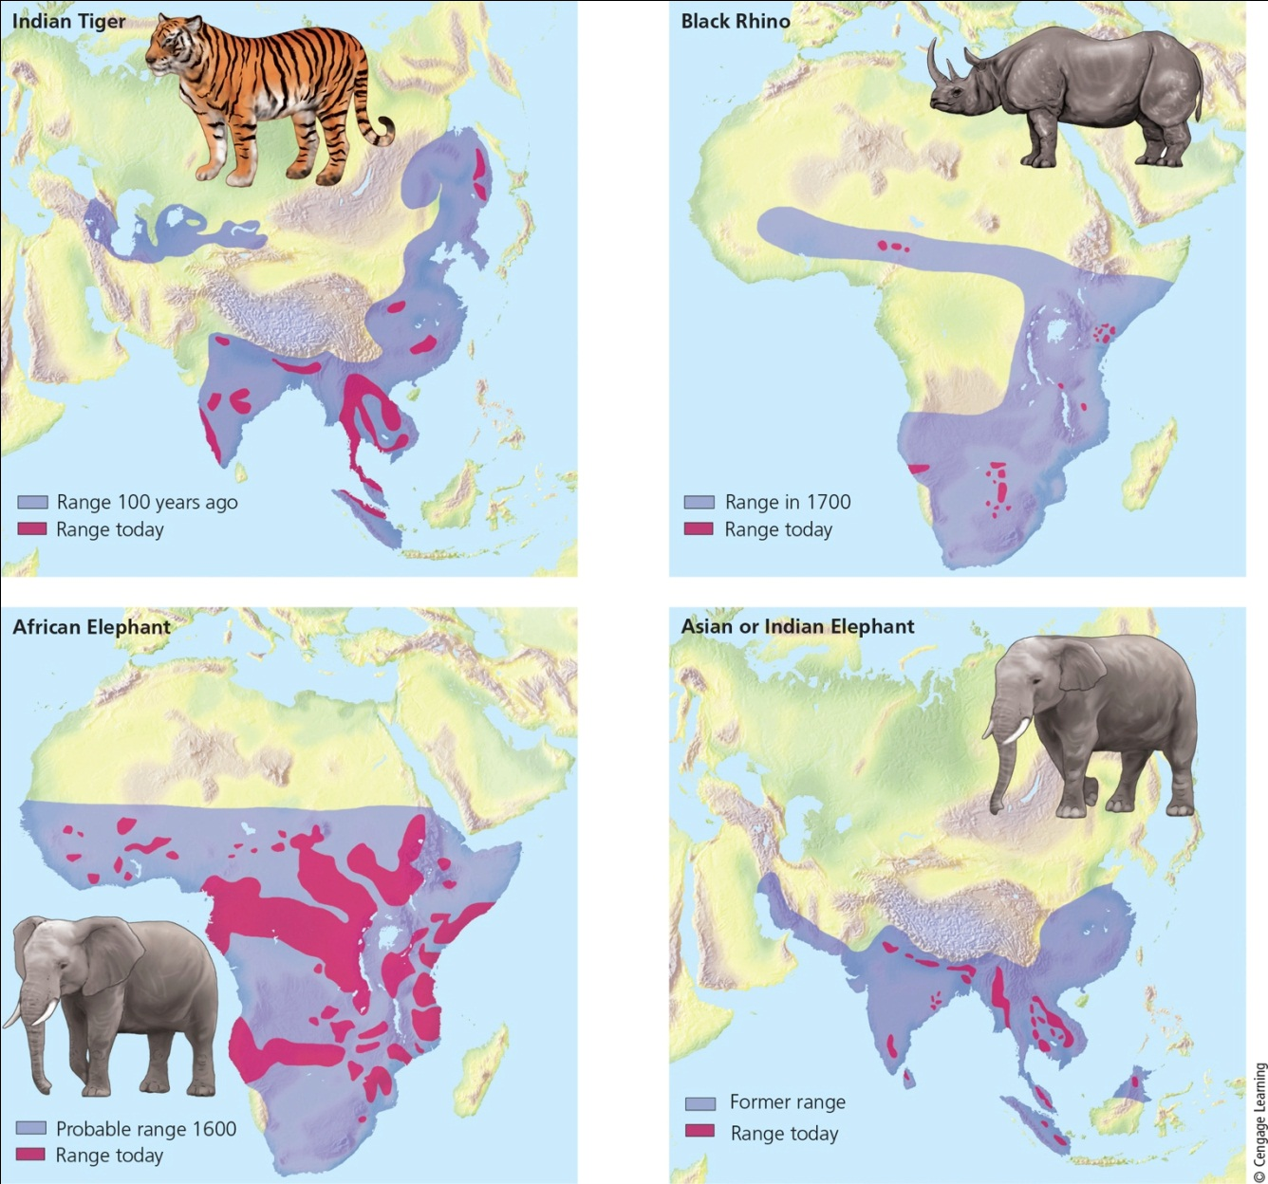
Habitat Destruction and Fragmentation (2 of 3)
Notes:
Figure 9.7 Natural capital degradation: These maps reveal the reductions in the ranges of four wildlife species, mostly as the result of severe habitat loss and fragmentation and illegal hunting for some of their valuable body parts. Question: Would you support expanding these ranges even though this would reduce the land available for human habitation and farming? Explain.

Slide 21
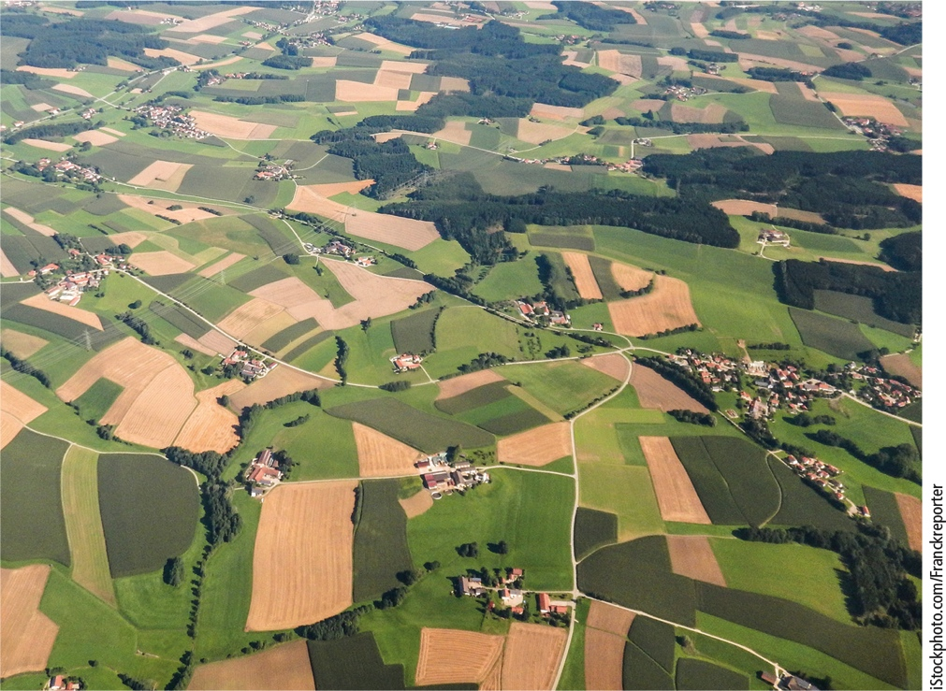
Habitat Destruction and Fragmentation (3 of 3)
Notes:
Figure 9.8 The fragmentation of landscapes reduces biodiversity by eliminating or degrading grassland and forest wildlife habitats and degrading ecosystem services.

Slide 22
Invasive Species (1 of 2)
Many species introductions are beneficial
Nonnative species may have no natural predators, competitors, parasites, or pathogens
Nonnative species can crowd out native species
Viewed as harmful, invasive species

Slide 23
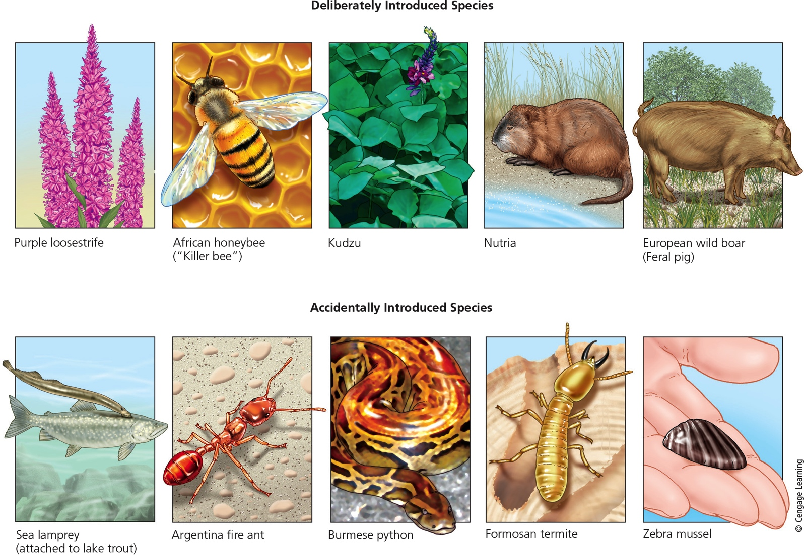
Invasive Species (2 of 2)
Notes:
Figure 9.9 Some of the estimated 7,100 harmful invasive species that have been deliberately or accidentally introduced into the United States.

Slide 24
Case Study: The Kudzu Vine and Kudzu Bugs (1 of 2)
Imported from Japan in the 1930s
Help control soil erosion
Spreads rapidly, taking over land
Very difficult to kill
Common fungus can kill Kudzu vine
Need to investigate harmful side effects
Potential benefits of Kudzu
Medicinal and nutritional uses
Potential uses as paper, biofuel

Slide 25
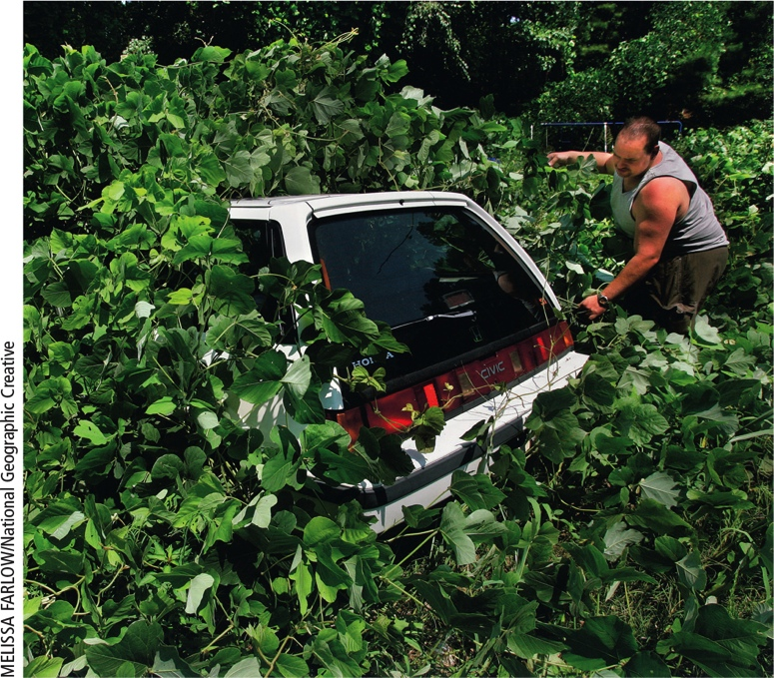
Case Study: The Kudzu Vine and Kudzu Bugs (2 of 2)
Notes:
Figure 9.10 Kudzu has grown over this car in the U.S. state of Georgia.

Slide 26
Some Accidentally Introduced Species Can Disrupt Ecosystems (1 of 2)
Burmese python, African python, and boa constrictor in Florida
Pets imported from Africa and Asia and released into Everglades wetlands
Predation by these animals is altering food webs and ecosystem services

Slide 27
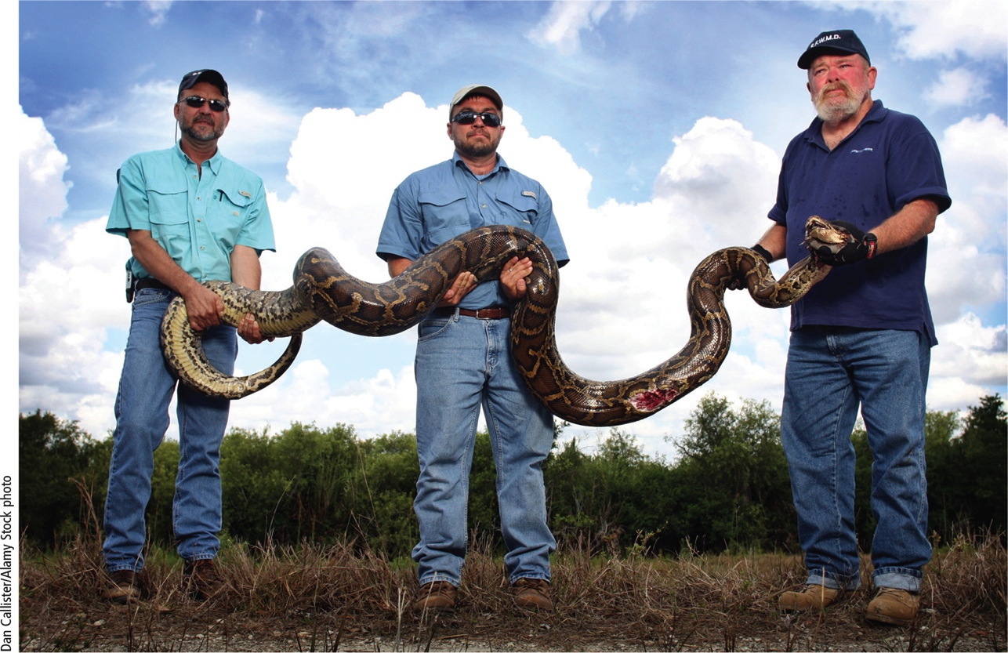
Some Accidentally Introduced Species Can Disrupt Ecosystems (2 of 2)
Notes:
Figure 9.12 Employees of the South Florida Water Management District hunted and captured this invasive Burmese python in the Florida Everglades.

Slide 28
Controlling Invasive Species (1 of 2)
Research programs to identify invaders
Track invasive species with ground surveys and satellite observations
Establish international treaties banning transfer between countries
Public education about releasing exotic pets and plants

Slide 29
Controlling Invasive Species (2 of 2)
Prevention Is the Best Way to Reduce Threats from Invasive Species

Slide 30
Population Growth, High Rates of Resource Use, Pollution, and Climate Change (1 of 2)
Human population growth and rising resource use per person
Degrading wildlife habitat
Pollution
Bioaccumulation occurs in individual organisms
Biomagnification occurs when a chemical becomes more concentrated as it moves up through food chains and webs
Climate change
Will accelerate the sixth extinction
Major loss of diversity and ecosystem services

Slide 31
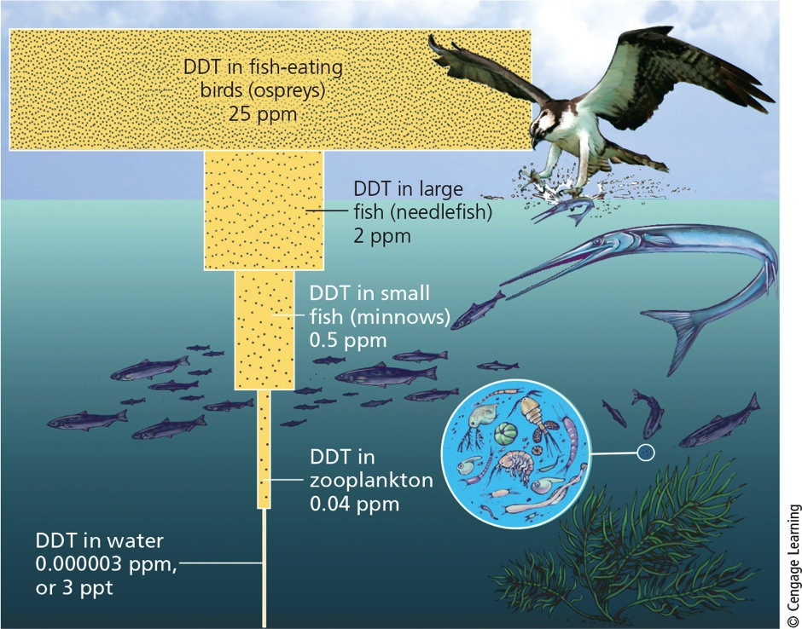
Population Growth, High Rates of Resource Use, Pollution, and Climate Change (2 of 2)
Notes:
Figure 9.14 Bioaccumulation and biomagnification: DDT is a fat-soluble chemical that can accumulate in the fatty tissues of animals. In a food chain or web, the accumulated DDT is biologically magnified in the bodies of animals at each higher trophic level, as it was in the case of a food chain in the U.S. state of New York, illustrated here. Question: How does this story demonstrate the value of pollution prevention?

Slide 32
Science Focus 9.2: Honeybee Losses: A Search for Causes
European honeybee population cut in half over past 50 years
Possible reasons for decline
Parasites
Viruses
Pesticide use
Stress from transportation and overwork
Poor nutrition from pollinating single crops

Slide 33
Illegal Killing, Capturing, and Selling of Wild Species (1 of 2)
Poaching and smuggling of protected animals
Organized crime involved because of huge profits involved
Elephants and rhinos killed for their tusks and horns
Tigers poached for skin and other body parts
Pet trade
Exotic birds, amphibians, reptiles, tropical fish

Slide 34
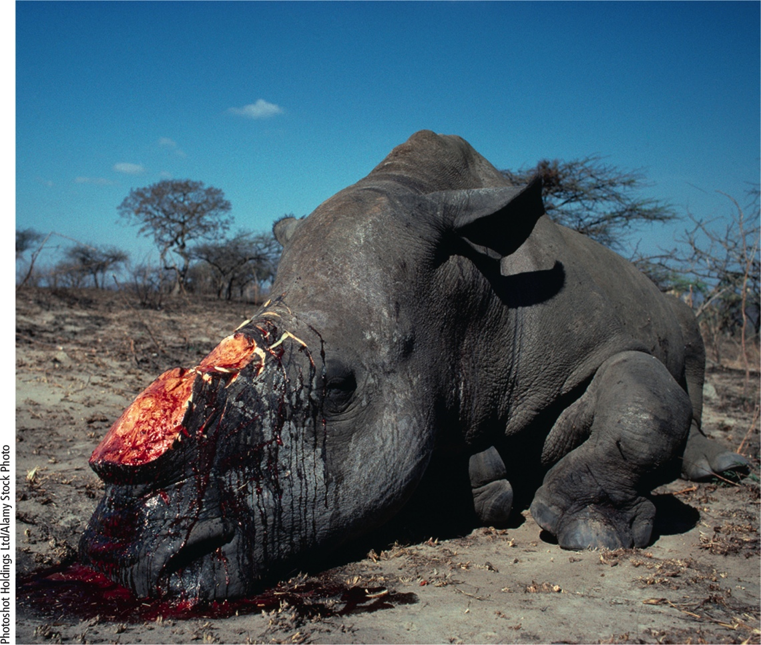
Illegal Killing, Capturing, and Selling of Wild Species (2 of 2)
Notes:
Figure 9.16 A poacher in South Africa killed this critically endangered northern white rhinoceros for its two horns. This species is now extinct in the wild. Question: What would you say if you could talk to the poacher who killed this animal?

Slide 35
Case Study: A Disturbing Message from the Birds (1 of 2)
70% of the world’s bird species are declining
One of eight bird species are threatened with extinction, mostly in tropical forests
Causes
Habitat loss and degradation
Migrating birds
Invasive species
Climate change

Slide 36
Case Study: A Disturbing Message from the Birds (2 of 2)
Exposure to pesticides
Overexploitation
Parrots threatened due to sale as pets
Birds are indicator species
Respond quickly to environmental changes
Birds perform critical ecosystem and economic services
Extinctions could affect many other species

Slide 37
Rising Demand for Bushmeat Threatens Some African Species (1 of 2)
Bushmeat source of food in West and Central Africa
Hunting wildlife has skyrocketed within past three decades
One species of red colobus monkey extinct
Reduced populations of orangutans, gorillas, chimpanzees, elephants, and hippos
USAID introducing methods for breeding alternative sources of protein to villagers

Slide 38
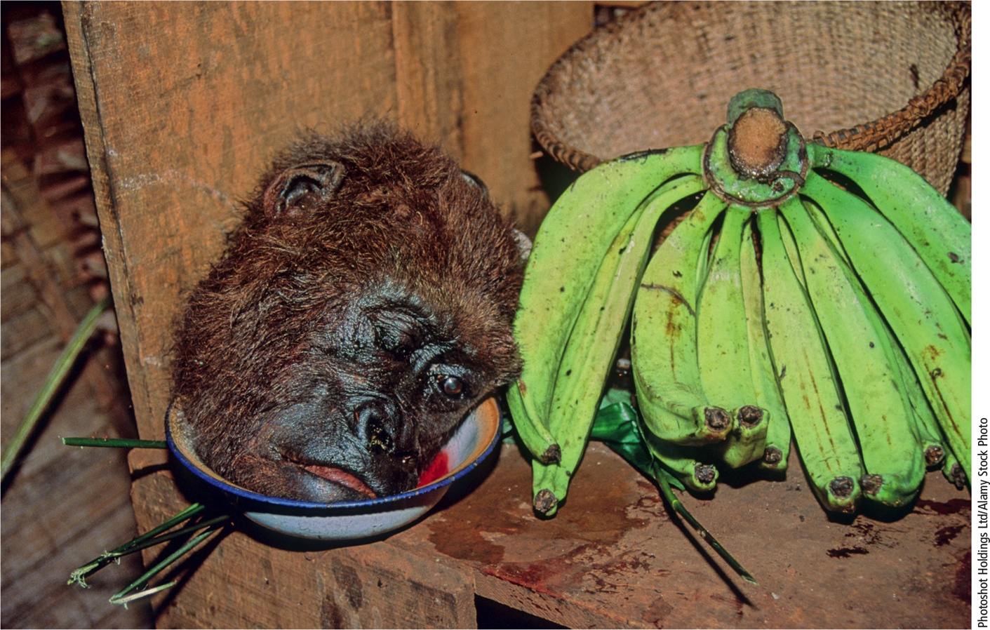
Rising Demand for Bushmeat Threatens Some African Species (2 of 2)
Notes:
Figure 9.18 Bushmeat such as this severed head of an endangered lowland gorilla in the Congo is consumed as a source of protein by local people in parts of West and Central Africa. It is also sold in national and international marketplaces and served in some restaurants, where wealthy patrons regard gorilla meat as a source of status and power. Critical thinking: How, if at all, is this different from killing a cow for food?

Slide 39
9.4 How Can We Sustain Wild Species and The Ecosystem Services They Provide?
Ways to reduce species extinction and sustain ecosystem services
Establishing and enforcing national environmental laws and international treaties
Creating protected wildlife sanctuaries

Slide 40
Treaties and Laws Can Help Protect Species
1975–Convention on International Trade in Endangered Species of Wild Fauna and Flora (CITES)
Signed by 181 countries
Convention on Biological Diversity (BCD)
Commits governments to reduce the rate of biodiversity loss
Ratified by 196 countries (not by the U.S.)
Law lacks enforcement mechanisms

Slide 41
Case Study: The U.S. Endangered Species Act (1 of 2)
Endangered Species Act (ESA)–1973 and amended several times
Identify and protect endangered species in the U.S. and abroad
Creates recovery programs for listed species
National Marine Fisheries Service for ocean species
U.S. Fish and Wildlife Service for all others

Slide 42
Case Study: The U.S. Endangered Species Act (2 of 2)
ESA (cont’d.)
Forbids federal agencies (except Defense) from funding projects that jeopardize endangered or threatened species
Requires commercial shipments of wildlife come through certain ports
In 2015, 1,591 species officially listed
90% of ESA-protected species are recovering at projected rate

Slide 43
Critical Concepts: Environmental Policy and How It’s Made
Begins when citizens, interest groups, or corporations seek solutions to issues
Policy lifecycle
Identify problem
Research underlying science
Craft a policy solution
Monitor how well it works
Adjust policy as needed

Slide 44
Establish Wildlife Refuges and Other Protected Areas (1 of 2)
In 1903, Theodore Roosevelt established the first federal wildlife refuge
Pelican Island, Florida
Wildlife refuges
Most are wetland sanctuaries
Provide habitats for one-fourth of U.S. threatened or endangered species
Harmful activities such as mining, drilling, and using off-road vehicles legal in most refuges

Slide 45
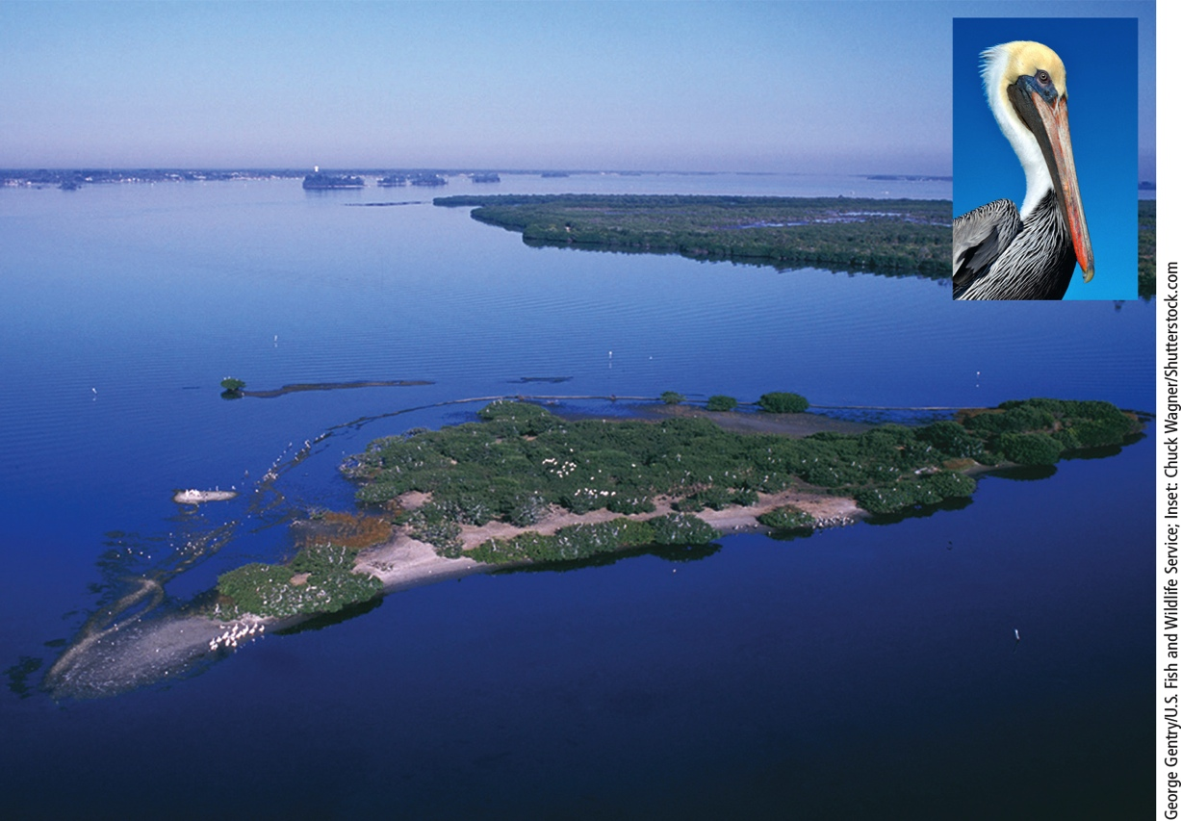
Establish Wildlife Refuges and Other Protected Areas (2 of 2)
Notes:
Figure 9.20 The Pelican Island National Wildlife Refuge in Florida was America’s first National Wildlife Refuge.

Slide 46
Seed Banks, Botanical Gardens, and Wildlife Farms
Seed banks
Preserve genetic material of endangered plants
Botanical gardens and arboreta
Living plants
Farms can raise organisms for commercial sale

Slide 47
Zoos and Aquariums (1 of 3)
Techniques for preserving endangered terrestrial species
Egg pulling
Captive breeding
Artificial insemination
Embryo transfer
Use of incubators
Cross-fostering

Slide 48
Zoos and Aquariums (2 of 3)
Ultimate goal of captive breeding programs
Releasing/reintroducing populations to the wild
Captive population must number 100–500 individuals
Public aquariums provide education
Not effective gene banks due to limited funds

Slide 49
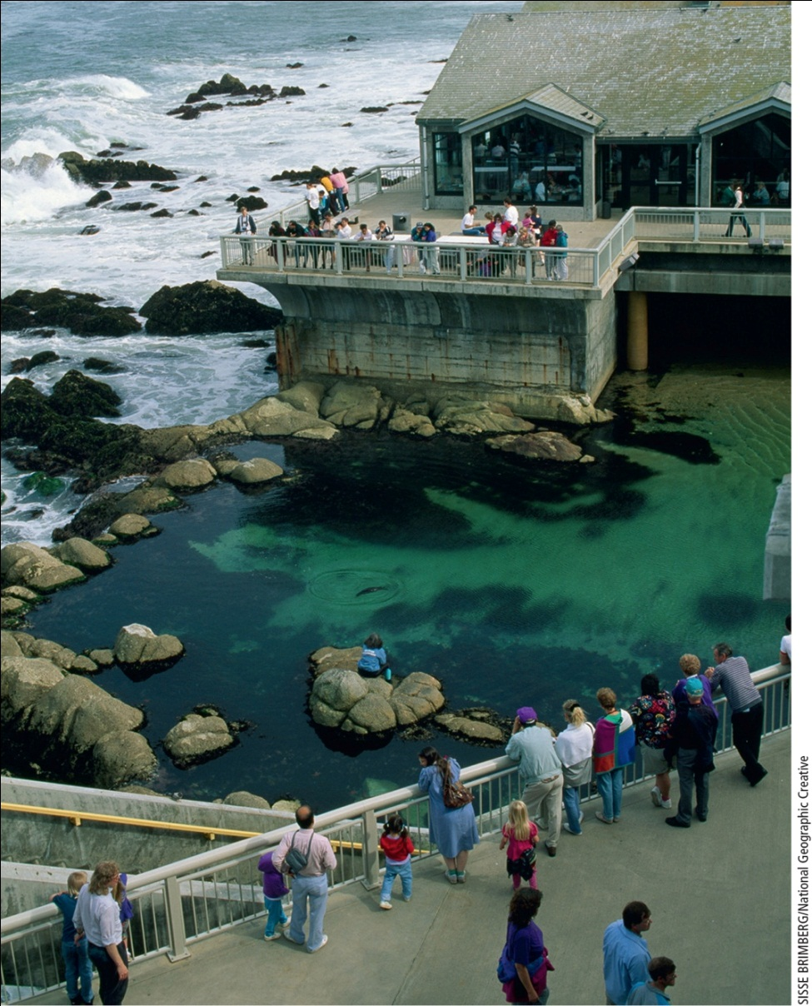
Zoos and Aquariums (3 of 3)
Notes:
Figure 9.21 The Monterey Bay Aquarium in Monterey, California (USA), contains this tidewater pool, which is used to train rescued sea otter pups to survive in the wild.

Slide 50
Precautionary Principle
Precautionary principle
Act to prevent or reduce harm when preliminary evidence indicates acting is needed
Good strategy in other areas
Preventing exposure to harmful chemicals in our air, water, and food
Emphasis on preventing species extinction
Act early rather than when species is nearly extinct

Slide 51
Protecting Species and Ecosystem Services Raises Difficult Questions (1 of 2)
Should we focus on protecting species or ecosystems and services they provide?
How to decide which species get attention?
Protecting species appealing to humans can increase public awareness of the need
How to determine which habitat areas to protect?
How do we allocate resources?

Slide 52
Protecting Species and Ecosystem Services Raises Difficult Questions (2 of 2)

