Slide 1
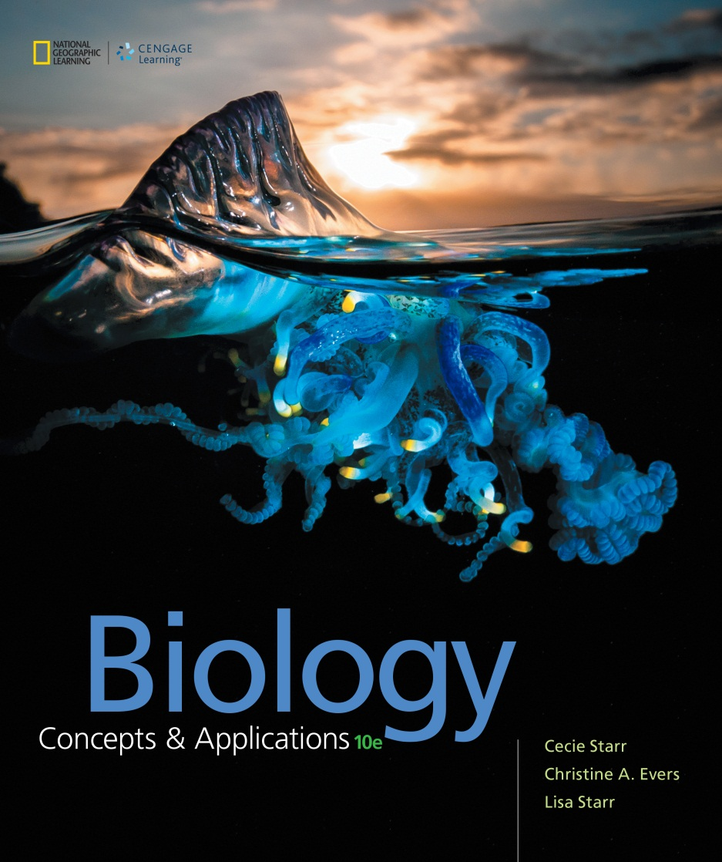
Biology Concepts & Applications
10 Edition
Chapter 9
From DNA to Protein
Copyright © 2018 Cengage Learning. All Rights Reserved. May not be copied, scanned, or duplicated, in whole or in part, except for use as permitted in a license distributed with a certain product or service or otherwise on a password-protected website for classroom use.

Slide 2
9.1 Introducing Gene Expression
DNA to RNA
  The DNA sequence of a gene encodes (contains instructions for building) an RNA or protein product
  Converting the information encoded by a gene into a product starts with transcription (RNA synthesis)
  During transcription, enzymes use the gene’s DNA sequence as a template to assemble a strand of RNA

Slide 3
RNA
RNA is composed of a single-strand chain of nucleotides
An RNA nucleotide has three phosphate groups, a sugar, and one of four bases
  Unlike DNA, the sugar is a ribose
  RNA contains three of the same bases found in DNA (adenine, cytosine, and guanine)
  RNA’s fourth base is uracil, not thymine (as found in DNA)

Slide 4
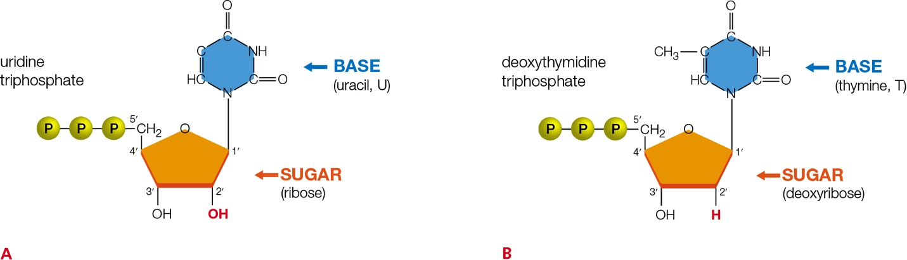
Comparing DNA and RNA
Notes:
Figure 9.1 Comparing nucleotides of DNA and RNA.
A RNA nucleotides (ribonucleotides) have a hydroxyl group (in red) at the 2′ carbon of the sugar. This is uridine triphosphate, one of the four nucleotides in RNA. The other three differ only in their component bases (adenine, cytosine, or guanine).
B DNA nucleotides (deoxyribonucleotides) have a hydrogen atom (in red) at the 2′ carbon of the sugar. This is deoxythymidine triphosphate, one of the four nucleotides in DNA. The other three differ only in their component bases (adenine, cytosine, or guanine).

Slide 5
Types of RNA
Three types
  Ribosomal RNA (rRNA): the main component of ribosomes, which assemble amino acids into polypeptide chains
  Transfer RNA (tRNA): delivers amino acids to a ribosome during protein synthesis
  Messenger RNA (mRNA): contains the protein-building message; specifies amino acid sequence

Slide 6
RNA to Protein (1 of 2)
An mRNA’s protein-building message is encoded by sets of three nucleotides
By the process of translation, the protein-building information in an mRNA molecule is decoded (translated) into a sequence of amino acids
  Results in a polypeptide chain that twists and folds into a protein

Slide 7
RNA to Protein (2 of 2)
Transcription and translation are part of gene expression:
  Multistep process by which information encoded in a gene guides the assembly of an RNA or protein product
  Information flows from DNA to RNA to protein

Slide 8
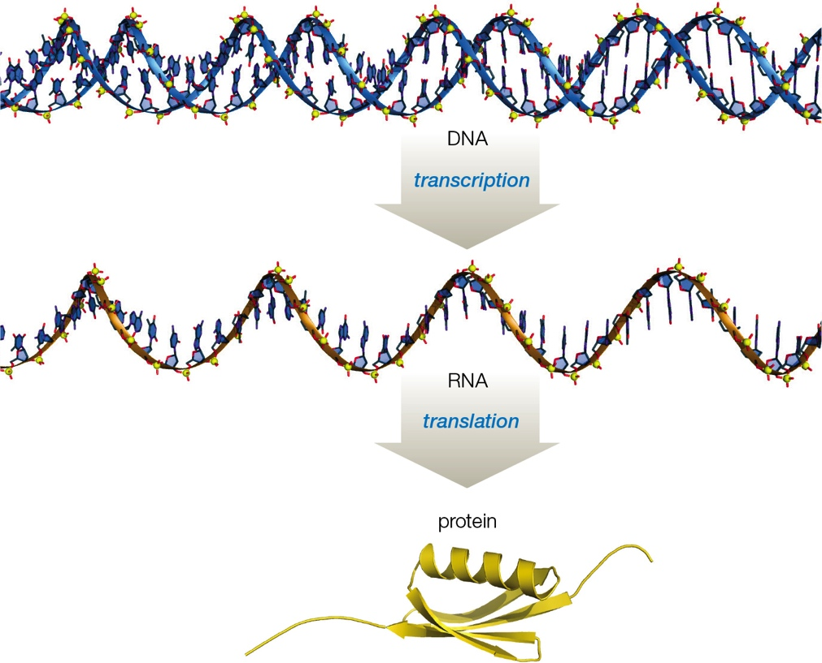
Gene Expression
Notes:
Figure 9.2 The flow of information during gene expression.

Slide 9
9.2 Transcription: DNA to RNA
The same base-pairing rules for DNA also govern RNA synthesis in transcription
  An RNA strand is so similar to a DNA strand that the two can base-pair if their nucleotide sequences are complementary
  G pairs with C, and A pairs with U (uracil)

Slide 10
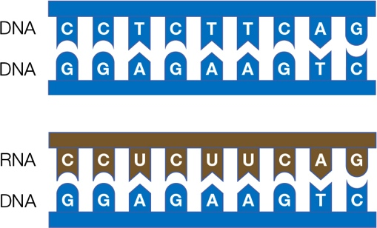
Base-Pairing

Slide 11
Transcription vs. Replication
During transcription, a strand of DNA acts as a template upon which a complementary strand of RNA is assembled from nucleotides
In contrast with DNA replication, only part of one DNA strand, not the whole molecule, is used as a template for transcription

Slide 12
Transcription (1 of 3)
The enzyme RNA polymerase adds nucleotides to the end of a growing RNA molecule
In contrast to DNA replication, transcription produces a single strand of RNA
In eukaryotic cells, transcription occurs in the nucleus; in prokaryotes, it occurs in cytoplasm

Slide 13
Transcription (2 of 3)
Transcription begins when RNA polymerase and regulatory proteins attach to a DNA site called a promoter
  RNA polymerase moves over a gene region and unwinds the double helix a bit so it can “read” the base sequence of the DNA strand
  The polymerase joins free RNA nucleotides into a chain (at 3′ end of strand), in the order dictated by that DNA sequence

Slide 14
Transcription (3 of 3)
When the polymerase reaches the end of the gene region, it releases the DNA and the new RNA
Typically, many polymerases transcribe a particular gene region at the same time, so many new RNA strands can be produced very quickly

Slide 15
Process of Transcription
Notes:
Figure 9.3 Transcription. By this process, a strand of RNA is assembled from nucleotides. A gene region in the DNA serves as the template for RNA synthesis.
1 The enzyme RNA polymerase binds to a promoter in the DNA. The binding positions the polymerase near a gene. Only the DNA strand complementary to the gene sequence will be transcribed into RNA.
2 RNA polymerase begins to move along the gene and unwind the DNA. As it does, it links RNA nucleotides in the order specified by the base sequence of the complementary (noncoding) DNA strand. The DNA winds up again after the polymerase passes.
3 Zooming in on the site of transcription, we can see that RNA polymerase covalently bonds successive nucleotides into an RNA strand. The base sequence of the new RNA strand is complementary to the base sequence of its DNA template strand, so it is an RNA copy of the gene.

Slide 16
Post–Transcriptional Modifications (1 of 3)
Most eukaryotic genes contain intervening sequences called introns
  Introns are removed from a newly transcribed RNA before it leaves the nucleus
Sequences that stay in the RNA are called exons

Slide 17
Post–Transcriptional Modifications (2 of 3)
In a process called alternative splicing, exons can be rearranged and spliced together in different combinations
Further modifications of mRNA include:
  A modified guanine “cap” is added to the 5′ end (helps mRNA bind to a ribosome)
  A poly-A tail (multiple adenines) are added to the 3′ end (enables exportation from the nucleus)

Slide 18
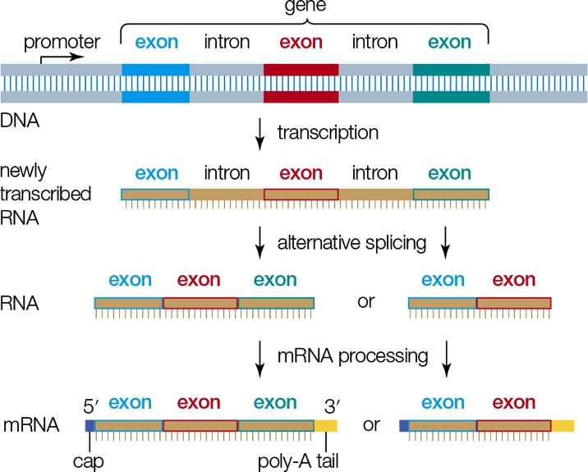
Post–Transcriptional Modification (3 of 3)
Notes:
Figure 9.5 Post-transcriptional modification of RNA. Introns are removed and exons spliced together. Messenger RNAs also get a poly-A tail and modified guanine “cap.”

Slide 19
9.3 RNA and the Genetic Code
The messenger: mRNA
  Codon: an mRNA nucleotide base triplet that codes for an amino acid (or stop signal)
  There are a total of sixty-four mRNA codons that constitute the genetic code
  The sequence of bases in a triplet determines which amino acid the codon specifies
    Example: UUU codes for the amino acid phenylalanine, and UUA codes for leucine

Slide 20
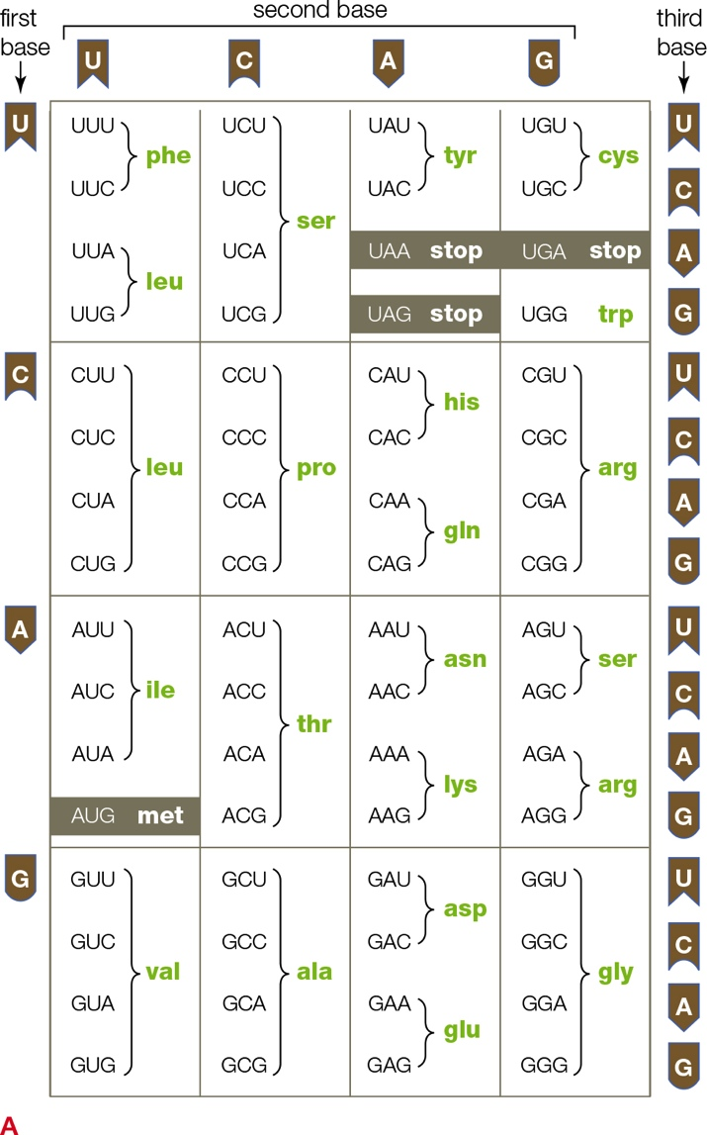
The Genetic Code
Notes:
Figure 9.6 The genetic code.
A Codon table. Each codon in mRNA is a set of three nucleotide bases. A codon’s first base is given to the left of the table; its second, in the top row; and its third, to the right of the table.
Sixty-one of the triplets encode amino acids; one of those, AUG, both codes for methionine and serves as a signal to start translation. Three codons are signals that stop translation.

Slide 21
The Messenger: mRNA
Codons occur one after another along the length of an mRNA
When an mRNA is translated, the order of its codons determines the order of amino acids in the resulting polypeptide

Slide 22
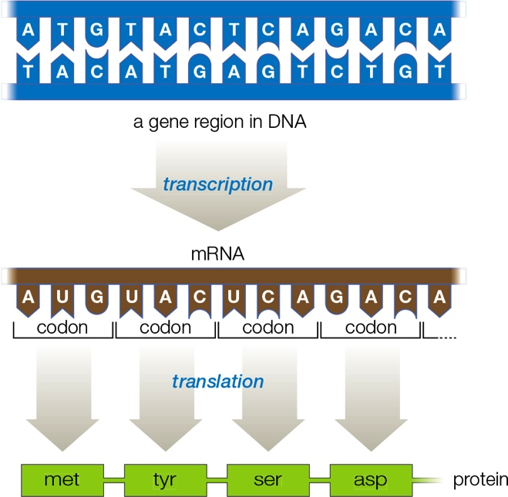
Correspondence Between DNA, RNA, and Protein
Notes:
Figure 9.7 Example of the correspondence between DNA, RNA, and protein. A gene region in a strand of chromosomal DNA is transcribed into an mRNA, and the codons of the mRNA specify a chain of amino acids—a protein.

Slide 23
The Code (1 of 2)
With a few exceptions, twenty naturally occurring amino acids are encoded by the genetic code
  Some amino acids are specified by more than one codon
    Example: the amino acid tyrosine is specified by two codons: UAA and UAC

Slide 24
The Code (2 of 2)
Some codons signal the beginning and end of a protein-coding sequence
  The first AUG in an mRNA: signal to start translation
  UAA, UAG, and UGA: signals that stop translation
The genetic code is highly conserved

Slide 25
The Translators: rRNA and tRNA (1 of 4)
Ribosomes interact with transfer RNAs (tRNAs) to translate the sequence of codons in an mRNA into a polypeptide

Slide 26
The Translators: rRNA and tRNA (2 of 4)
A ribosome has two subunits, one large and one small that consist mainly of rRNA
  During translation, a large and a small ribosomal subunit converge as an intact ribosome on an mRNA
rRNA catalyzes formation of a peptide bond between amino acids as they are delivered to the ribosome

Slide 27
The Translators: rRNA and tRNA (3 of 4)
Each tRNA has two attachment sites:
  Anticodon: a triplet of nucleotides that base-pairs with an mRNA codon
  The other attachment site binds to an amino acid (as specified by the codon)

Slide 28
The Translators: rRNA and tRNA (4 of 4)
During translation, tRNAs deliver amino acids to a ribosome
  One after the next in the order specified by the codons in an mRNA
As the amino acids are delivered, the ribosome joins them via peptide bonds into a new polypeptide

Slide 29
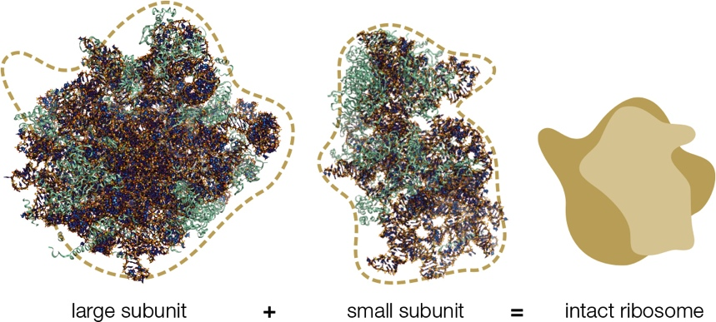
Ribosome Structure
Notes:
Figure 9.8 Ribosome structure. An intact ribosome consists of a large and a small subunit. Protein components of both subunits are shown in the ribbon models in green; rRNA components, in brown.

Slide 30
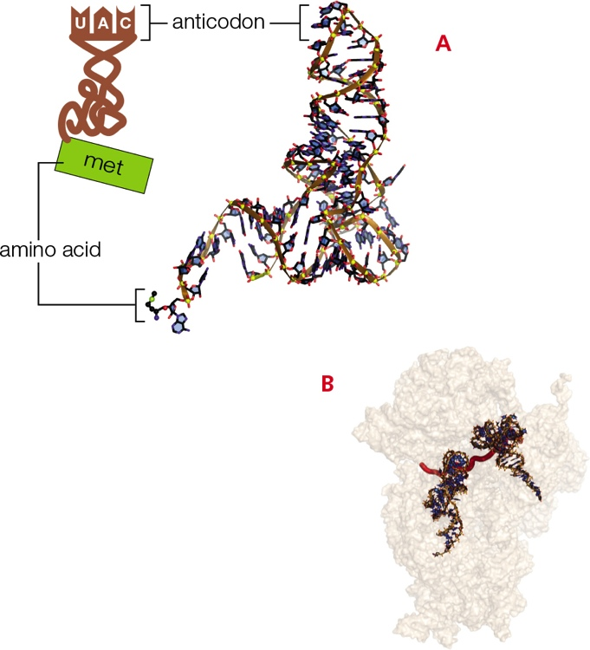
tRNA Structure
Notes:
Figure 9.9 tRNA structure.
A Icon and model of the tRNA that carries the amino acid methionine. Each tRNA’s anticodon is complementary to an mRNA codon. Each also carries the amino acid specified by that codon.
B During translation, tRNAs dock at an intact ribosome (for clarity, only the small subunit is shown, in tan). Here, the anticodons of two tRNAs have base-paired with complementary codons on an mRNA (red). The amino acids carried by the tRNAs are not shown.

Slide 31
9.4 Translation: RNA to Protein
Steps of translation
  Translation begins in the cytoplasm when a small ribosomal subunit binds to the mRNA
  Next, the anticodon of a special tRNA called an initiator base pairs with the first AUG codon of the mRNA
  A large ribosomal subunit joins the small subunit, and the intact ribosome begins to assemble a polypeptide chain as it moves along the mRNA

Slide 32
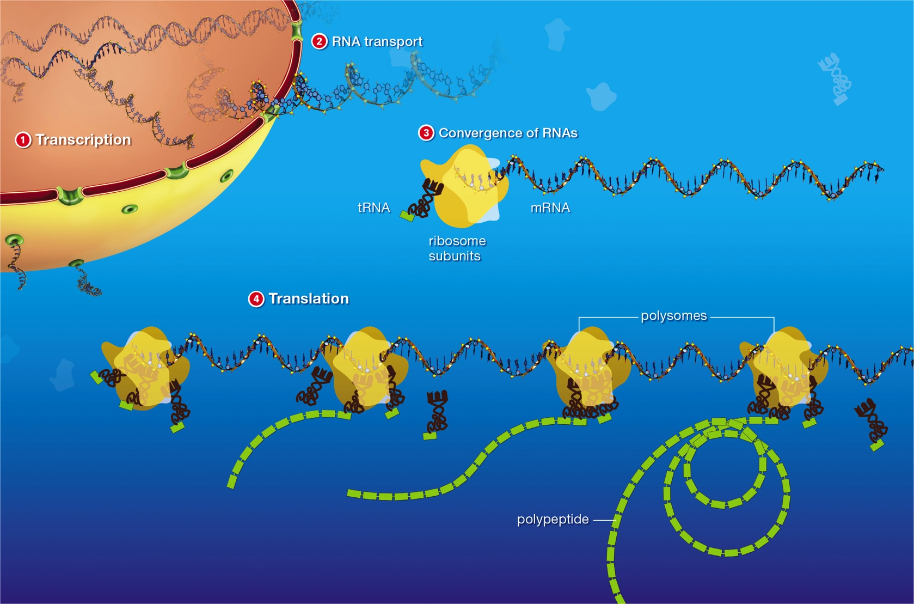
Translation (1 of 2)
Notes:
Figure 9.10 Overview of translation.
In eukaryotes, RNA transcribed in the nucleus moves into the cytoplasm through nuclear pores. Translation occurs in the cytoplasm. Ribosomes simultaneously translating the same mRNA are called polysomes.

Slide 33
Translation (2 of 2)
Steps of translation (cont’d.)
  Initiator tRNAs carry methionine
    The first amino acid of all new polypeptide chains
  Another tRNA joins the complex when its anticodon base-pairs with the second codon
  The ribosome catalyzes formation of a peptide bond between first two amino acids
  As the ribosome moves to the next codon, it releases the first tRNA

Slide 34
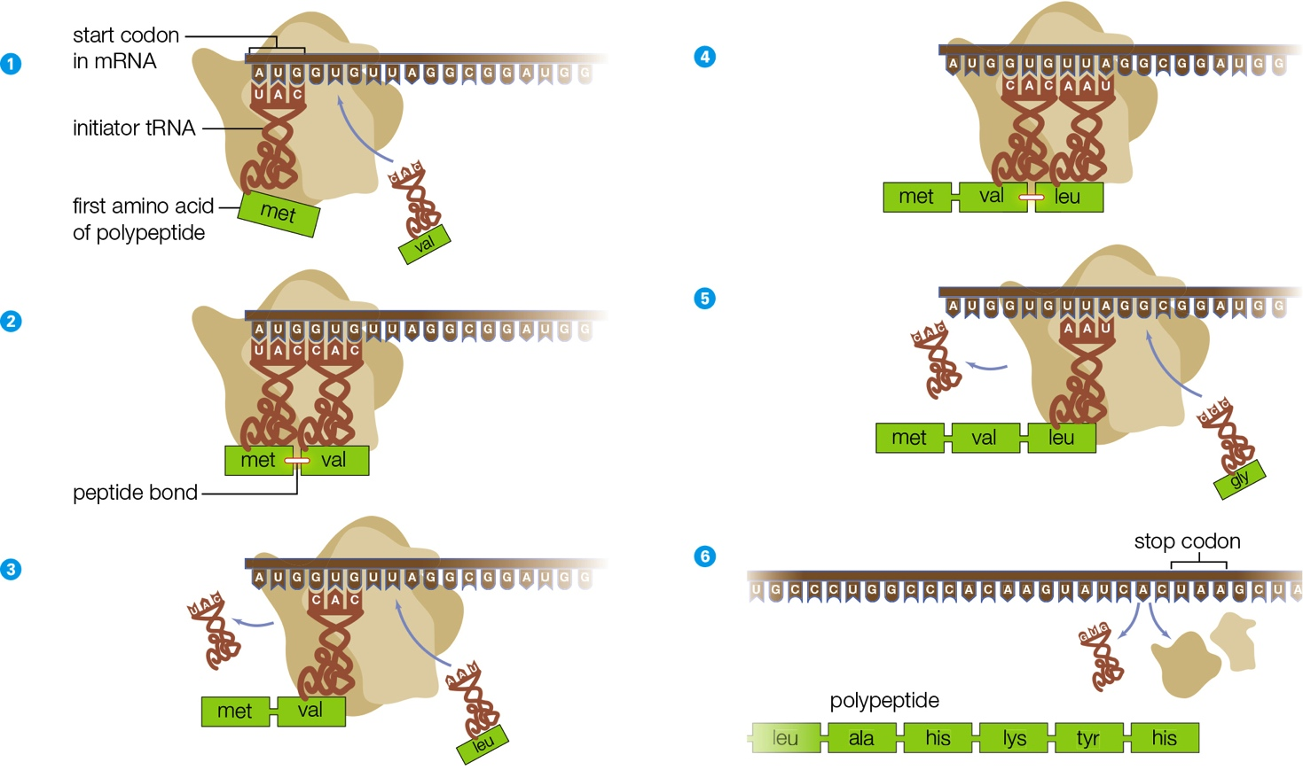
Zooming in on Translation
Notes:
Figure 9.11 Zooming in on translation. Ribosomal subunits and an initiator tRNA converge on an mRNA. Then, tRNAs deliver amino acids in the order dictated by successive codons in the mRNA. As the ribosome moves along the mRNA, it links the amino acids together via peptide bonds, so a polypeptide forms and elongates. Translation ends when the ribosome reaches a stop codon.
1 Ribosomal subunits and an initiator tRNA converge on an mRNA. A second tRNA binds to the second codon.
2 A peptide bond forms between the first two amino acids.
3 The first tRNA is released and the ribosome moves to the next codon. A third tRNA binds to the third codon.
4 A peptide bond forms between the second and third amino acids.
5 The second tRNA is released and the ribosome moves to the next codon. A fourth tRNA brings the next amino acid to be added to the polypeptide chain.
6 The process repeats until the ribosome encounters a stop codon. Then, the new polypeptide is released and the ribosome subunits separate.

Slide 35
9.5 Consequences of Mutations
Types of mutations
  Base-pair substitution: a single base pair changes
  Deletion: one or more nucleotides are lost
  Insertion: one or more nucleotides become inserted into DNA

Slide 36
Mutations (1 of 3)
Mutations are relatively uncommon events in a normal cell
  Chromosomes in a diploid human cell consist of about 6.5 billion nucleotides
    About 175 nucleotides change during DNA replication
    Only about 3 percent of the cell’s DNA encodes protein products
    There is a low probability that any of those mutations will be in a protein-coding region

Slide 37
Mutations (2 of 3)
When a mutation does occur in a protein-coding region, the redundancy of the genetic code offers a margin of safety
  Example: a mutation that changes a CCC codon to CCG may not have further effects, because both of these codons specify the amino acid serine

Slide 38
Mutations (3 of 3)
Other mutations may change an amino acid in a protein or result in a premature stop codon that shortens it
Mutations that alter a protein can have drastic effects on an organism

Slide 39
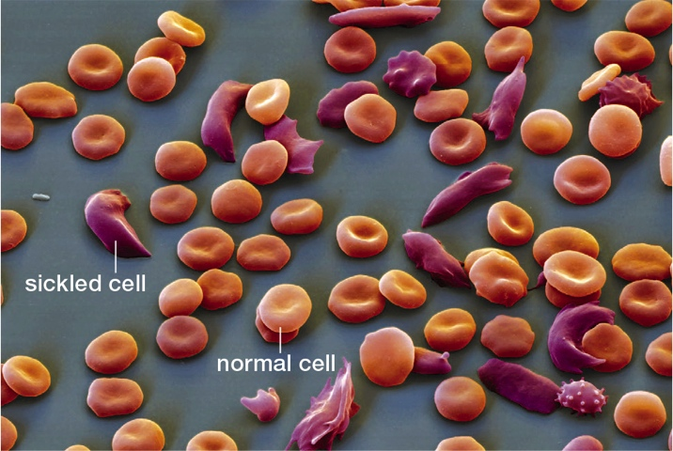
Sickle Cell Anemia
Notes:
Figure 9.14 Sickled red blood cells. A base-pair substitution results in the abnormal beta globin of sickle hemoglobin (HbS).
HbS molecules form rod-shaped clumps that distort normally round blood cells into sickle shapes that get stuck in small blood vessels.

Slide 40
Consequences of Mutations (1 of 4)
Sickle cell anemia
  Occurs because of a base-pair substitution in the beta globin gene of hemoglobin
  Causes hemoglobin molecules to clump together
    Cause red blood cells to form a crescent (sickle) shape
  Sickled cells clog tiny blood vessels, thus disrupting blood circulation throughout the body

Slide 41
Consequences of Mutations (2 of 4)
Beta thalassemia
  Caused by the deletion of the twentieth nucleotide in the coding region of the beta globin gene
    Causes the reading frame of the mRNA codons to shift
  Results in a polypeptide that differs drastically from normal beta globin

Slide 42
Consequences of Mutations (3 of 4)
Beta thalassemia can also be caused by insertion mutations, which, like deletions, often result in frameshifts

Slide 43
Consequences of Mutations (4 of 4)
Gene expression can be altered without affecting codons
  Mutations within promoter or other special nucleotide sequences
  Mutations in introns

Slide 44
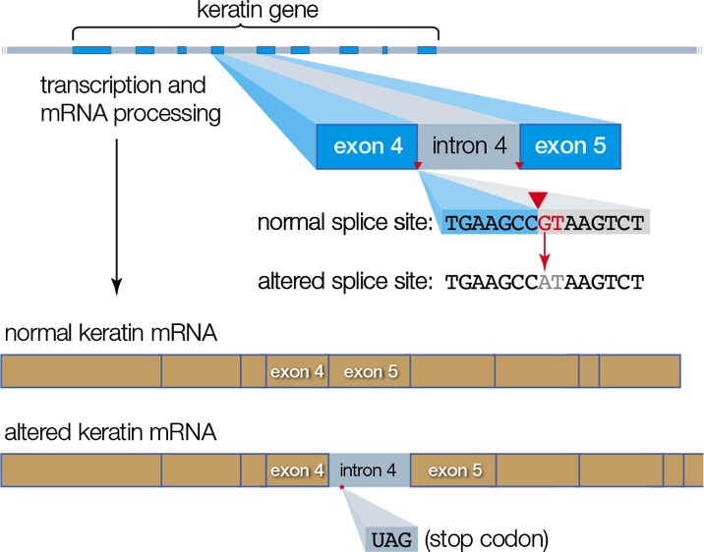
The “Sphynx” Mutation
Notes:
Figure 9.15 How a mutation in an intron affects gene expression. A mutation that causes hairlessness in sphynx cats is a basepair substitution that changes a G to A in an intron–exon splice site. The altered site is no longer recognized during RNA processing, so the finished mRNA ends up with an intron in it. A stop codon in the intron sequence cuts short the protein translated from the mRNA.

Slide 45
Application: The Aptly Acronymed RIPs
A dose of ricin as small as a few grains of salt can kill an adult human
Ricin is a ribosome-inactivating protein (RIP)
  RIPs remove adenine bases from rRNAs in the heavy subunit
  Elongation stops and protein synthesis halts
  Death from ricin exposure occurs in days due to low blood pressure and respiratory failure

Slide 46
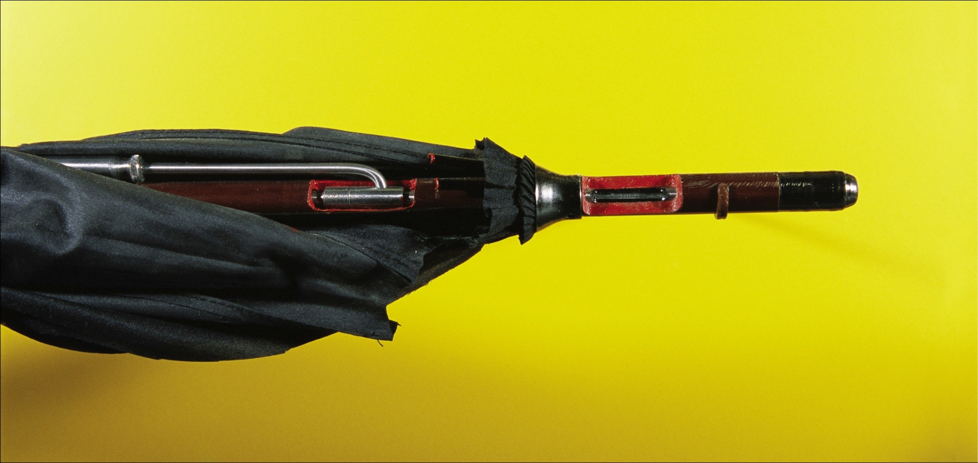
Ricin Injector
Notes:
Figure 9.16 Bulgarian spy’s weapon: an umbrella modified to fire a tiny pellet of ricin into a victim. An umbrella like this one was used to assassinate Georgi Markov on the streets of London in 1978.

Slide 47
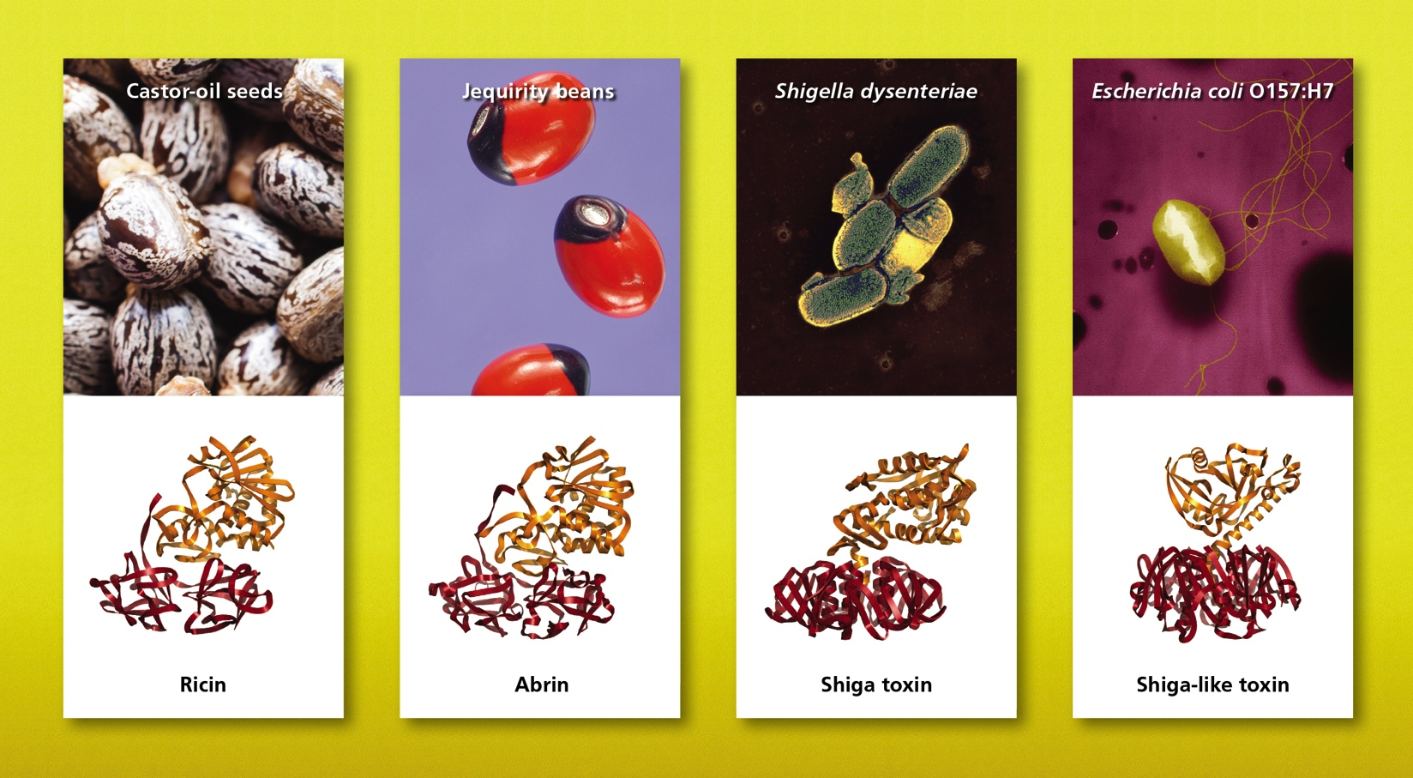
Lethal Lineup
Notes:
Figure 9.17 Lethal lineup: a few toxic ribosome-inactivating proteins (RIPs) and their sources. One polypeptide chain (red) of a toxic RIP helps the molecule cross a cell’s plasma membrane; the other chain (gold) is an enzyme that inactivates ribosomes.

Slide 48
Discuss
Why is transcription necessary? Why don’t cells use their DNA as a direct model for protein synthesis?
Which of the RNAs is “reusable”?
Why do you think DNA has introns, which are transcribed but removed before translation begins?

