Slide 1
Exploring Environmental Science for AP®
1st Edition
Chapter 8
The Human Population
Copyright © 2018 Cengage Learning. All Rights Reserved. May not be copied, scanned, or duplicated, in whole or in part, except for use as permitted in a license distributed with a certain product or service or otherwise on a password-protected website for classroom use.

Slide 2
Core Case Study: Planet Earth: Population 7.5 Billion (1 of 2)
From the evolution of Homo sapiens to a total population of two billion took 200,000 years
It took less than 50 years to add another two billion
It took 25 years to add the third two billion
Eighteen years later, the earth had 7.5 billion people

Slide 3
Core Case Study: Planet Earth: Population 7.3 Billion (2 of 2)
Factors impacting rapid rise of human population
Emergence of agriculture increased food production
Technologies help humans expand into almost all the planet’s climates and habitats
Drop in death rates with improved sanitation and health care
What is a sustainable human population?

Slide 4
8.1 How Many People Can the Earth Support?
Throughout most of history, population rose slowly
Has grown rapidly for last 200 years
China, India, and the United States are the top three countries in terms of population

Slide 5
Human Population Growth (1 of 3)
Rate of population growth has slowed since 1960 to 1.2%
World’s population is still growing
Human population growth is unevenly distributed geographically
2% added to more-developed countries
98% added to less-developed countries
People are moving from rural to urban areas

Slide 6
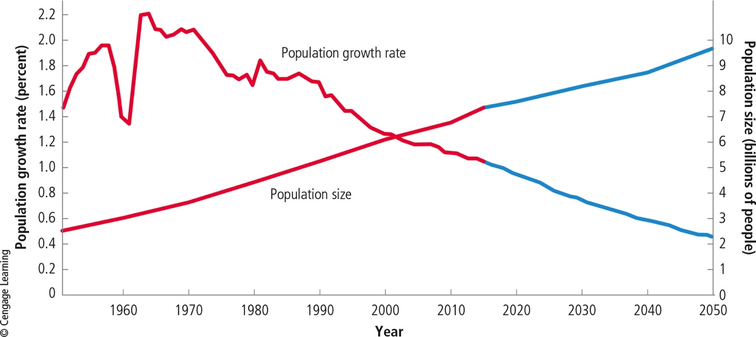
Human Population Growth (2 of 3)
Notes:
Figure 6.2 Global human population growth compared with population growth rate, 1950–2015, with projection to 2050 (in blue). Critical thinking: Why do you think that while the annual growth rate of world population has generally dropped since the 1960s, the population has continued to grow?

Slide 7
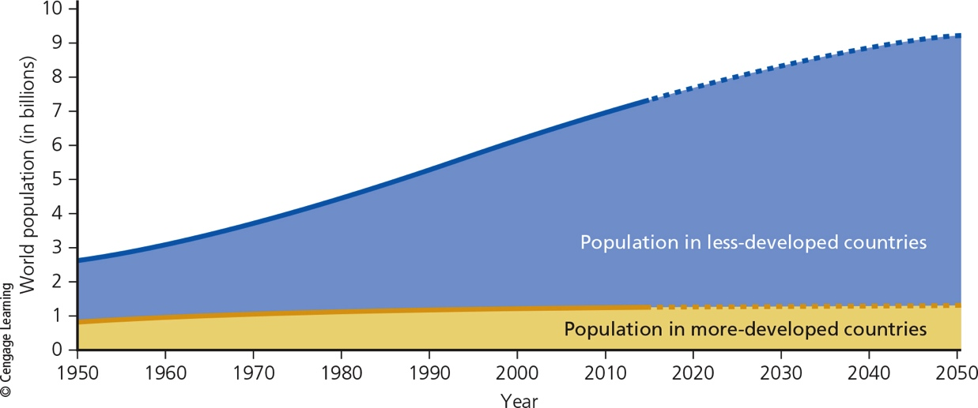
Human Population Growth (3 of 3)
Notes:
Figure 6.3 Most of the world’s population growth between 1950 and 2015 took place in the world’s less-developed countries. This gap is projected to increase between 2015 and 2050.

Slide 8
Science Focus 8.1: How Long Can the Human Population Keep Growing? (1 of 2)
Many differing views
We have already exceeded tipping points, or planetary boundaries
The main problem is the rapidly growing number of people in less-developed countries
The main problem is overconsumption in more-developed countries
Technological ingenuity will help find substitutes to resources we are depleting

Slide 9
Science Focus 8.1: How Long Can the Human Population Keep Growing? (2 of 2)
Proponents of slowing population growth
Basic needs for 1 billion people are not being met
Death rates could increase significantly and a population crash could result
As China, India, and Brazil increase their ecological foot[prints, greater resource use and environmental degradation may result

Slide 10
Human Population Growth and Natural Capital (1 of 2)
As the human population grows, so does the global human ecological footprint
Cultural carrying capacity
Maximum number of people who could live in reasonable freedom and comfort indefinitely, without decreasing the ability of the earth to sustain future generations

Slide 11
Human Population Growth and Natural Capital (2 of 2)
Notes:
Figure 6.4 We humans have altered the natural systems that sustain our lives and economies in at least eight major ways to meet the increasing needs and wants of our growing population (Concept 6.1). Questions: In your daily living, do you think you contribute directly or indirectly to any of these harmful environmental impacts? Which ones? Explain.

Slide 12
8.2 What Factors Influence the Size of the Human Population?
Population size increases through births and immigration
Decreases through deaths and emigration
Key factor that determines population size
Average number of children born to women in a population (total fertility rate)

Slide 13
The Human Population Can Grow, Decline, or Stabilize
Population change = (Births + Immigration) – (Deaths + Emigration)
Crude birth rate
Number of live births per 1,000 people in a population per year
Crude death rate
Number of deaths per 1,000 people in a population per year

Slide 14
Fertility Rates (1 of 2)
Replacement-level fertility rate
Average number of children a couple must bear to replace themselves
Approximately 2.1
Higher than 2 because some children die before reaching reproductive years

Slide 15
Fertility Rates (2 of 2)
Total fertility rate (TFR)
Average number of children born to women of childbearing age in a population
Between 1955 and 2012, the global TFR dropped from 5 to 2.5
To eventually halt population growth, the global TFR must drop to the fertility replacement level of 2.1

Slide 16
Fertility Rates (3 of 3)
Notes:
Figure 6.5 Total fertility rates for the United States between 1917 and 2015. Critical thinking: The U.S. fertility rate has declined and remained at or below replacement levels since 1972. So why is the population of the United States still increasing?

Slide 17
Science Focus 8.2: Projecting Population Change (1 of 2)
Human population size in 2050 is estimated to be between 7.8 billion and 10.8 billion people
Factors influencing the range of estimates
Reliability of current population estimates
Assumptions about trends in fertility
Different organizations who estimate populations use different methods and data

Slide 18
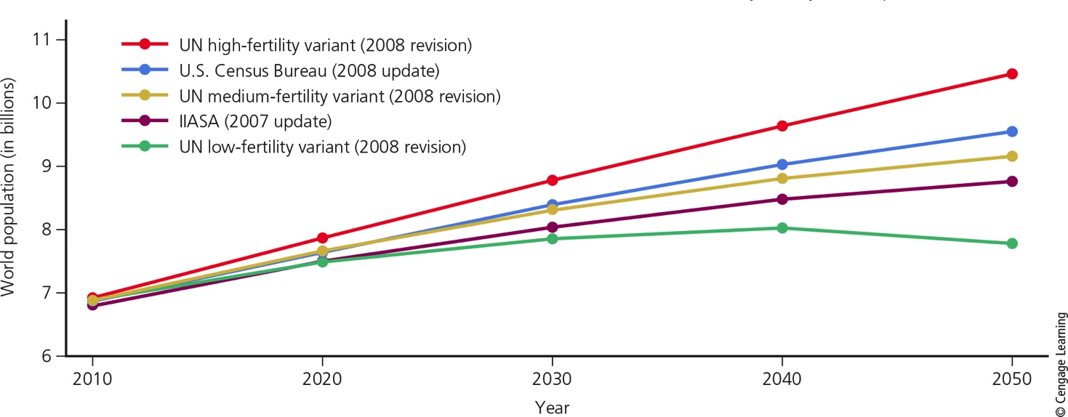
Science Focus 8.2: Projecting Population Change (2 of 2)
Notes:
Figure 6.A World population projections to 2050 from three different organizations: the UN, the U.S. Census Bureau, and IIASA. Note that the uppermost, middle, and lowermost curves of these five projections are all from the UN, each assuming a different level of fertility. Data analysis: What are the ranges (differences between the lowest and highest) in these projections for 2030, 2040, and 2050?

Slide 19
Case Study: The U.S. Population–Third Largest and Growing (1 of 3)
Population still growing
76 million in 1900
322 million in 2015
Drop in TFR in the U.S.
Rate of population growth has slowed
40% of total U.S. population increase in 2015 came from legal immigration
China surpassed Mexico as largest source of new immigrants

Slide 20
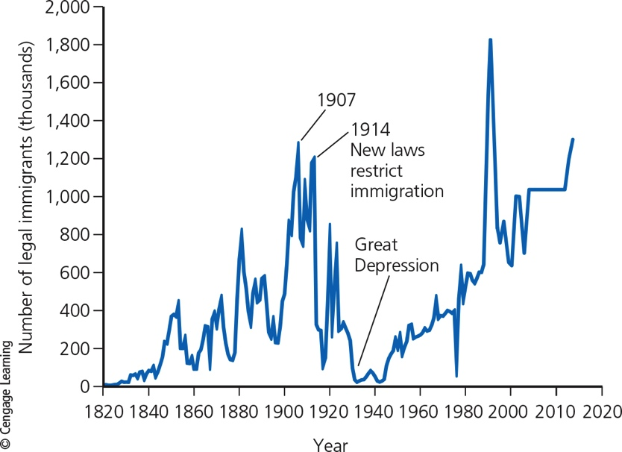
Case Study: The U.S. Population–Third Largest and Growing (2 of 3)
Notes:
Figure 6.6 Legal immigration to the United States, 1820–2013 (the last year for which data are available). The large increase in immigration since 1989 resulted mostly from the Immigration Reform and Control Act of 1986, which granted legal status to certain illegal immigrants who could show they had been living in the country before January 1, 1982.

Slide 21
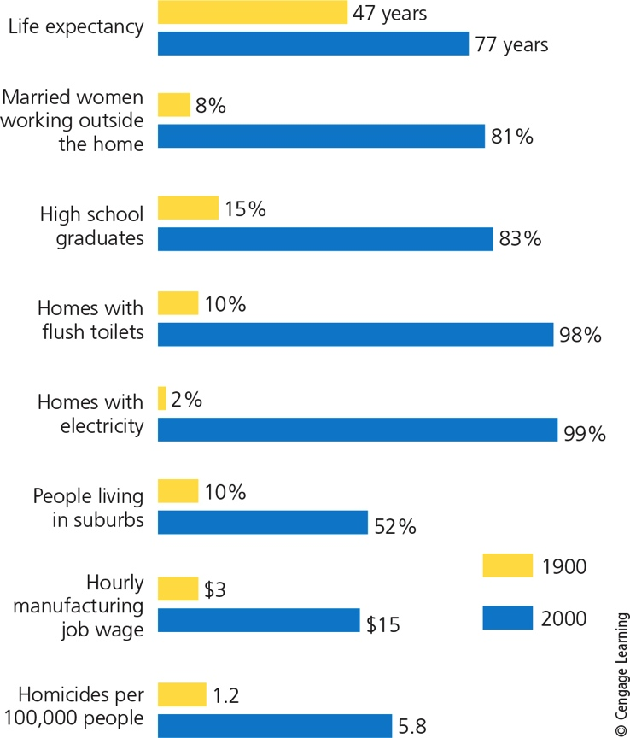
Case Study: The U.S. Population–Third Largest and Growing (3 of 3)
Notes:
Figure 6.7 Some major changes took place in the United States between 1900 and 2000. Critical thinking: Which two of these changes do you think had the biggest impacts on the U.S. ecological footprint?

Slide 22
Factors That Affect Birth and Fertility Rates (1 of 3)
Importance of children as part of the labor force
Especially in less-developed countries
Cost of raising and educating children
Availability of pension systems
Urbanization
Educational and employment opportunities for women

Slide 23
Factors That Affect Birth and Fertility Rates (2 of 3)
Average age at marriage
Availability of reliable birth control methods
Religious beliefs, traditions, and cultural norms

Slide 24
Factors That Affect Birth and Fertility Rates (3 of 3)
Notes:
Figure 6.8 This young boy spends much of his day carrying bricks.

Slide 25
Factors That Affect Death Rates (1 of 2)
Indicators of overall health of people in a country
Life expectancy
Infant mortality rate
Number of babies out of every 1,000 who die before their first birthday
Factors that cause high infant mortality
Insufficient food, poor nutrition, and infectious disease

Slide 26
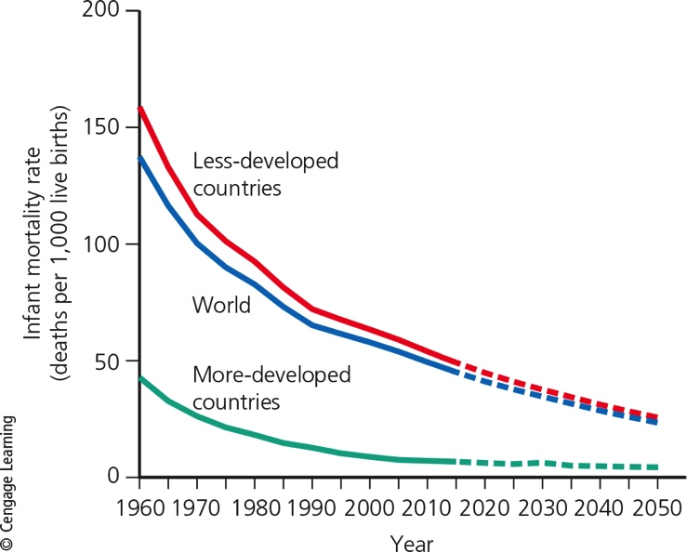
Factors That Affect Death Rates (2 of 2)
Notes:
Figure 6.9 Comparison of infant mortality rates for the world’s more-developed countries and less-developed countries, 1950–2014, with projections to 2050 based on medium population projections.

Slide 27
Migration
The movement of people into and out of specific geographic areas
Reasons for migration
Jobs and economic improvement
Religious persecution or ethnic conflict
Political oppression or war
Environmental refugees

Slide 28
8.3 How Does a Population’s Age Structure Affect Its Growth or Decline?
Age structure
Number and percentages of males and females in young, middle, and older age groups in a population
Important factor in determining how fast a population grows or declines

Slide 29
Age Structure (1 of 2)
Age structure categories
Prereproductive (ages 0–14)
Reproductive (ages 15–44)
Postreproductive (ages 45 and older)
Country with large percentage of people younger than age 15 will experience rapid population growth
Global population of seniors expected to triple between 2015 and 2050

Slide 30
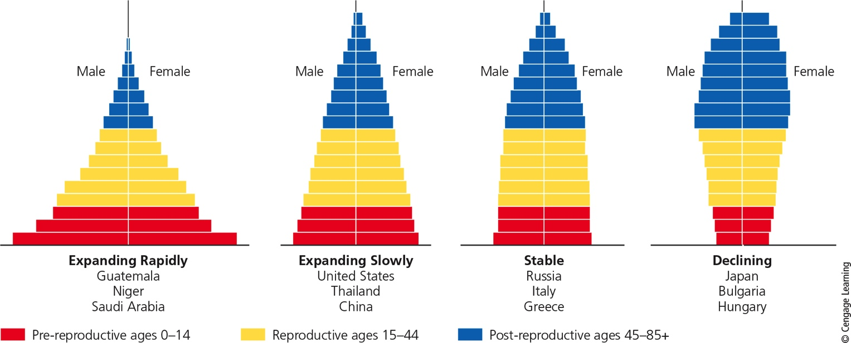
Age Structure (2 of 2)
Notes:
Figure 6.10 Generalized population age-structure diagrams for countries with rapid (1.5–3%), slow (0.3–1.4%), zero (0–0.2%), and negative (declining) population growth rates. Question: Which of these diagrams best represents the country where you live?

Slide 31
Case Study: The American Baby Boom (1 of 3)
79 million people added from 1946–1964
Makes up 25% of the U.S. population
Affect politics and economics
Now becoming senior citizens
“Graying of America”
Millennial generation (Americans born since 1980)
Now largest generation living in the U.S.

Slide 32
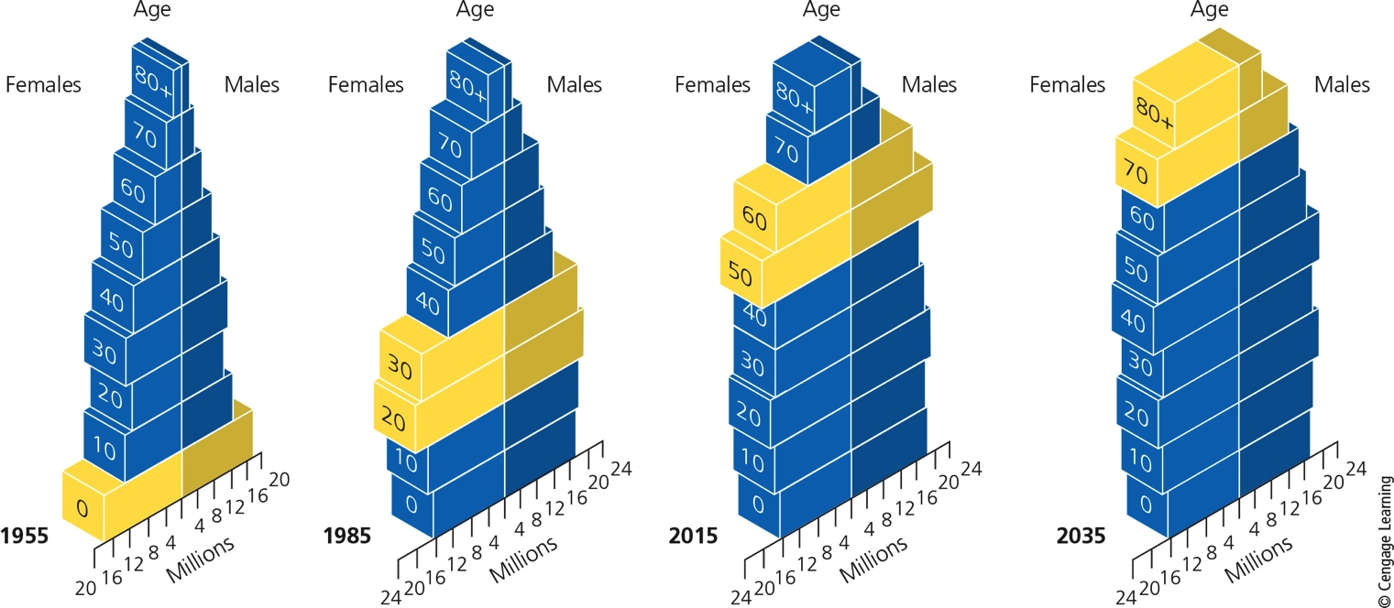
Case Study: The American Baby Boom (2 of 3)
Notes:
Figure 6.11 Age-structure diagrams tracking the baby-boom generation in the United States, 1955, 1985, 2015, and 2035 (projected). Critical thinking: How might the projected age structure in 2035 affect you?

Slide 33
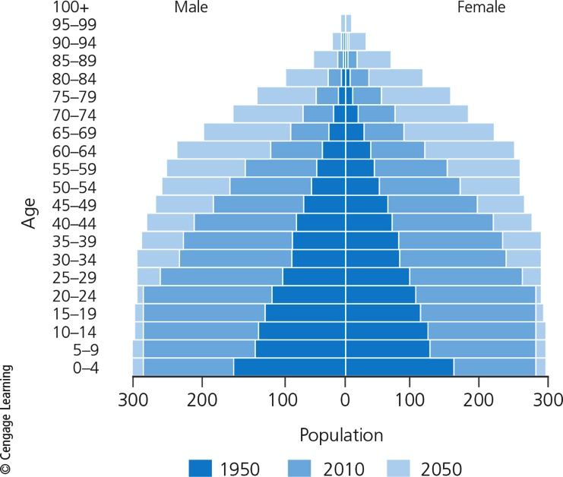
Case Study: The American Baby Boom (3 of 3)
Notes:
Figure 6.12 The world’s age structure 1950, 2010, and 2050 (projected). Critical thinking: How might the projected age structure in 2050 affect you?

Slide 34
Aging Populations Can Decline Rapidly (1 of 2)
Slow decline is generally manageable
Rapid decline leads to economic problems
Proportionally fewer young people working
Labor shortages
Some countries with rapidly declining populations
Japan, Germany, Italy, Bulgaria, Hungary, Romania, Cuba, and Portugal

Slide 35
Aging Populations Can Decline Rapidly (2 of 2)
Notes:
Figure 6.13 Rapid population decline can cause several problems. Critical thinking: Which two of these problems do you think are the most important?

Slide 36
6.4 How Can We Slow Human Population Growth? (1 of 2)
Controversy on whether population growth needs to slow
Ways to slow human population growth
Reducing poverty through economic development
Elevating the status of women
Encouraging family planning

Slide 37
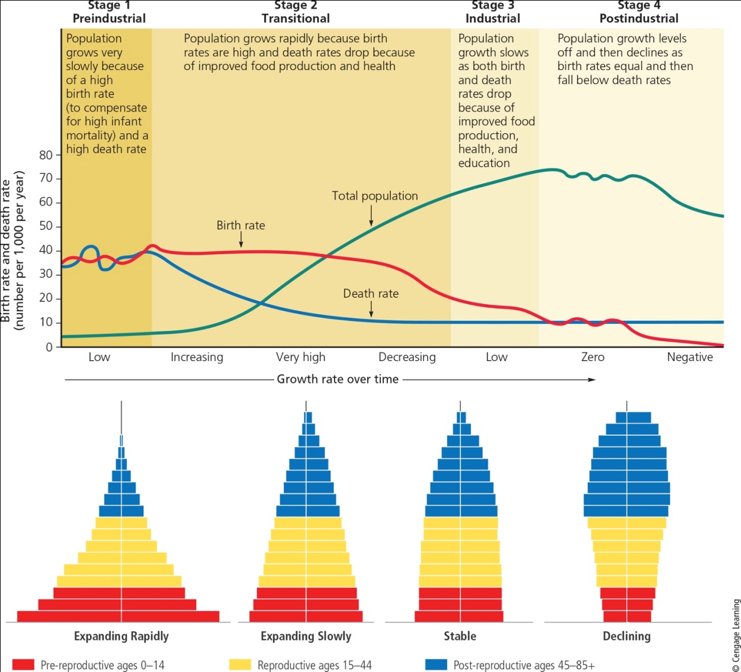
6.4 How Can We Slow Human Population Growth? (2 of 2)
Notes:
Figure 6.14 The demographic transition, which a country can experience as it becomes industrialized and more economically developed, can take place in four stages. Question: At what stage is the country where you live?

Slide 38
Economic Development
Demographic transition
As countries become industrialized, poverty declines
Populations then tend to grow more slowly
Threats to making a demographic transition
Extreme poverty and war
Environmental degradation and resource depletion

Slide 39
Educating and Empowering Women (1 of 2)
Women have fewer children if:
Educated
Able to earn an income
Society does not suppress their rights
Women:
Do most of the domestic work and child care
Provide unpaid health care
Have fewer rights and educational opportunities than men

Slide 40
Educating and Empowering Women (2 of 2)
Notes:
Figure 6.15 This woman in Nepal is bringing home firewood. Typically, she spends two hours a day, two or three times a week, on this task.

Slide 41
Family Planning
Family planning benefits
Reduced unintended pregnancies, births, and abortions
Better maternal and child health care
Reduced rate of infant mortality
Financial benefits
Problems
Lack of access to voluntary contraception
Child marriage customs

Slide 42
Case Study: Population Growth in India (1 of 3)
Population of 1.31 billion in 2015
Problems
Poverty, malnutrition, and environmental degradation
Causes
Most poor couples want many children
Bias toward having male children
Only 47% of couples use modern birth control methods

Slide 43
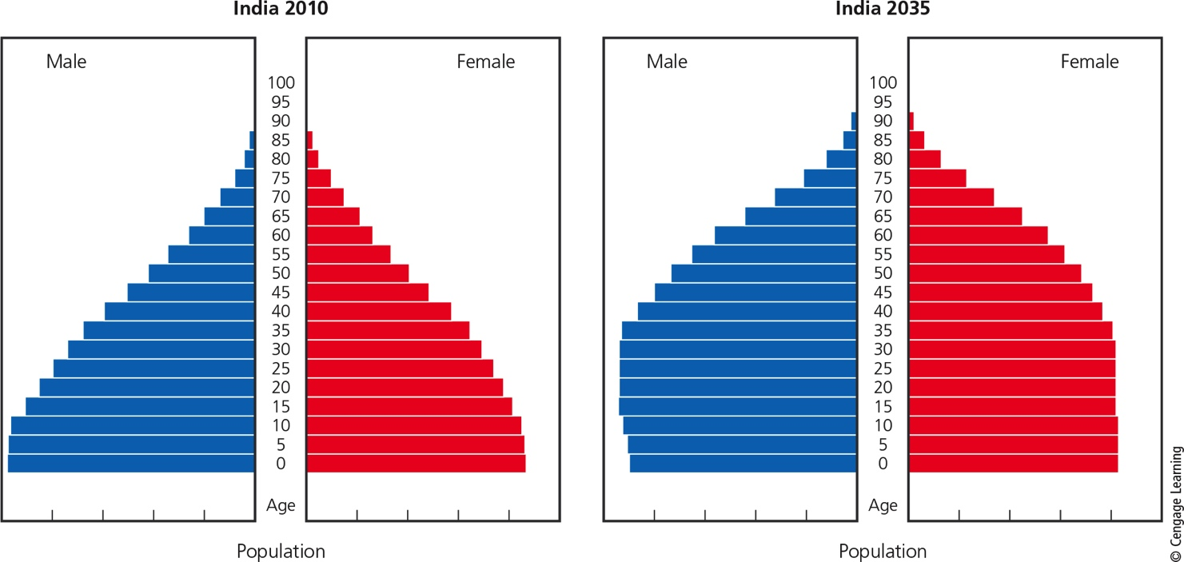
Case Study: Population Growth in India (2 of 3)
Notes:
Figure 6.16 Age structure changes in India 2010 and 2035 (projected). Critical thinking: How might the projected age structure in 2035 affect India’s ability to reduce poverty?

Slide 44
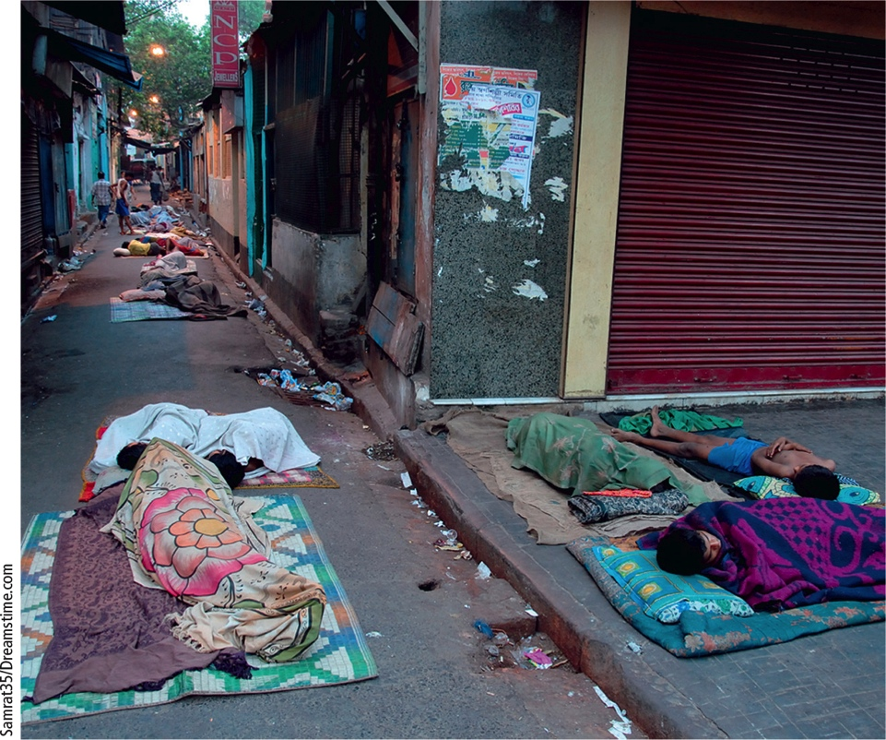
Case Study: Population Growth in India (3 of 3)
Notes:
Figure 6.17 Homeless people in Kolkata, India.

Slide 45
Case Study: Slowing Population Growth in China (1 of 4)
World’s most populous country
Threat of mass starvation in the 1960s
Government established strict family planning and birth control program in 1978
Reduced number of children born per woman from 3 to 1.7
TFR was already declining before 1978 due to increased education and employment opportunities for women

Slide 46
Case Study: Slowing Population Growth in China (2 of 4)
Negative effects of one-child policy
Preference for male children resulted in skewed population: too few females
Average population age increasing at one of the fastest rates ever recorded
By 2030, likely too few young workers to support aging population
2015: Chinese government replaced one-child policy with two-child policy

Slide 47
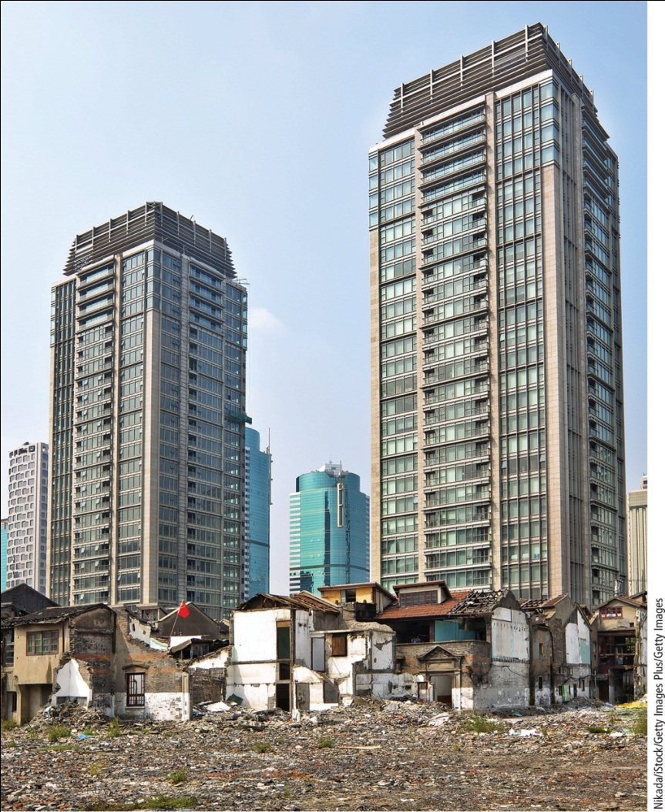
Case Study: Slowing Population Growth in China (3 of 4)
Notes:
Figure 6.18 Old and new housing in heavily populated Shanghai, China in 2015.

Slide 48
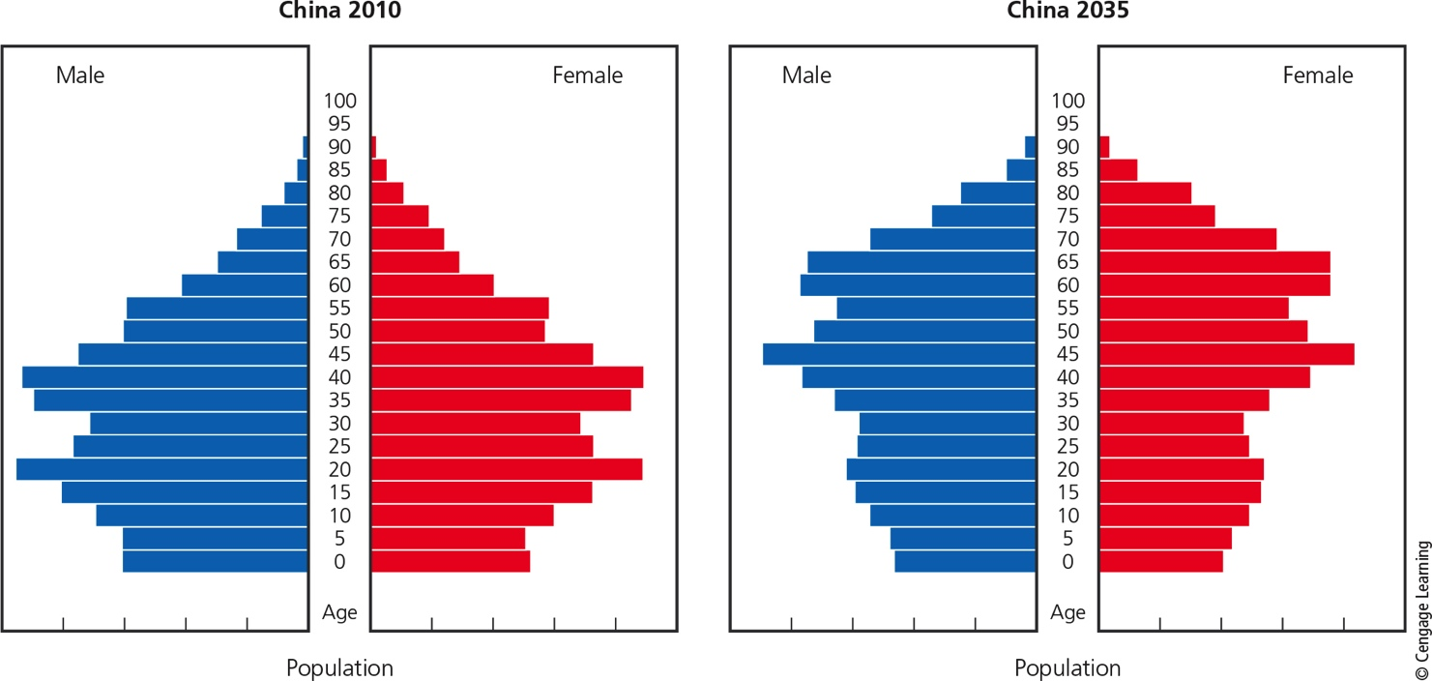
Case Study: Slowing Population Growth in China (4 of 4)
Notes:
Figure 6.19 Age structure in China: 2010 and 2035 (projected). Critical thinking: How might the projected age structure in 2035 affect China’s economy?

Slide 49
Big Ideas (1 of 2)
The human population is growing rapidly
May soon bump up against environmental limits
Combination of population growth and increasing rate of resource use per person is expanding human ecological footprint
Strains the earth’s natural capital

Slide 50
Big Ideas (2 of 2)
We can slow human population growth by reducing poverty, elevating the status of women, and encouraging family planning

Slide 51
Tying It All Together: World Population Growth and Sustainability
Many believe exponential growth is unsustainable in the long run
Employing solar and other renewable technologies can help reduce:
Pollution
Emissions of climate-changing gases
Reuse and recycle materials
Focus on preserving biodiversity

