Slide 1
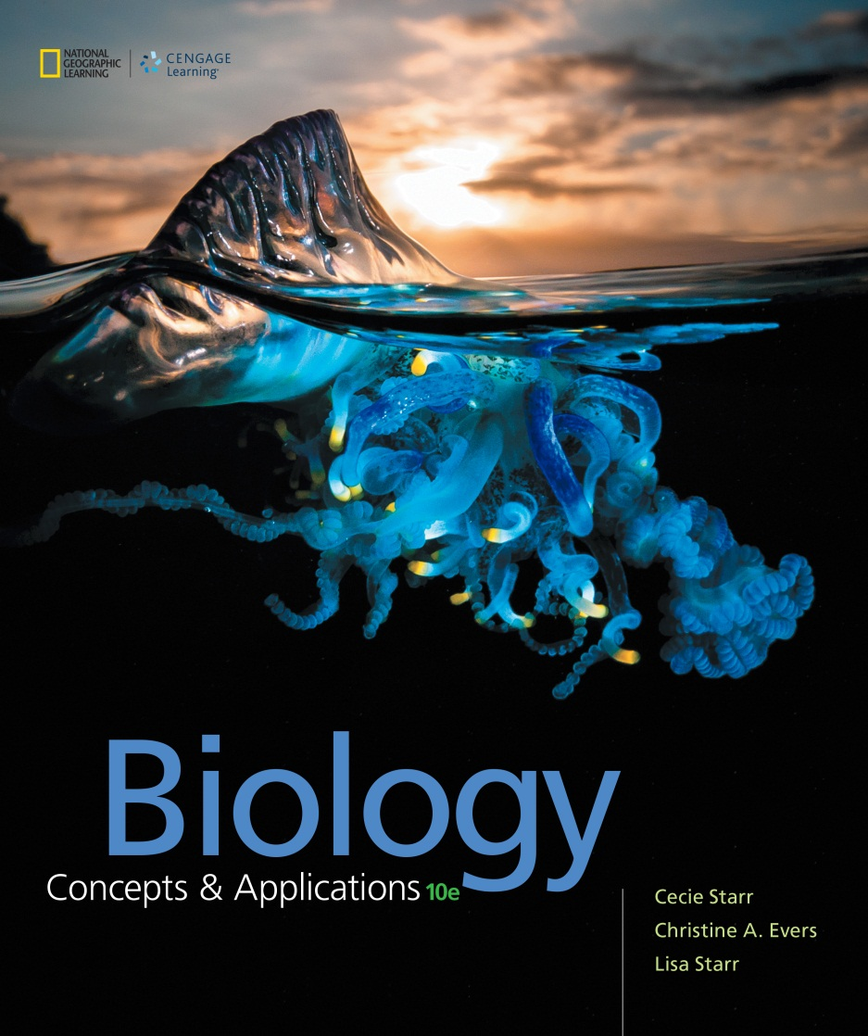
Biology Concepts & Applications
10 Edition
Chapter 7
Releasing Chemical Energy
Copyright © 2018 Cengage Learning. All Rights Reserved. May not be copied, scanned, or duplicated, in whole or in part, except for use as permitted in a license distributed with a certain product or service or otherwise on a password-protected website for classroom use.

Slide 2
7.1 Introduction to Carbohydrate Breakdown Pathways
In order to use the energy stored in sugars, cells must first transfer it to ATP
  Energy transfer occurs when the bonds of a sugar’s carbon backbone are broken, driving ATP synthesis
There are two main mechanisms that organisms use to make ATP
  Aerobic respiration
  Fermentation

Slide 3
Early Life
The first cells we know of appeared on Earth about 3.4 billion years ago
  These ancient organisms did not use sunlight
  They were also anaerobic
Eventually, the cyclic pathway of photosynthesis evolved
  Sunlight offered an unlimited supply of energy

Slide 4
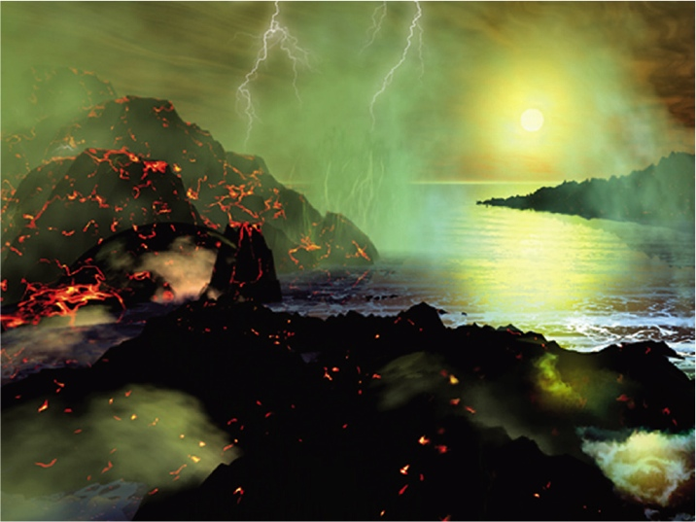
Earth’s Early Atmosphere
Notes:
Figure 7.1 Artist’s view of Earth’s early atmosphere. Earth’s early atmosphere may have been abundant in gases such as methane, hydrogen sulfide, and ammonia. There was no oxygen in the air before the noncyclic pathway of photosynthesis evolved, about 2.5 billion years ago.

Slide 5
Changing Environment
When O₂ first accumulated, it caused catastrophic pollution
  Free radicals form when O₂ reacts with metal cofactors
  Free radicals damage DNA and other biological molecules
  Cells with no way to cope with free radicals quickly died out

Slide 6
Aerobic Organisms
Aerobic organisms were capable of living in the presence of oxygen
Many evolved metabolic pathways that became known as aerobic respiration

Slide 7
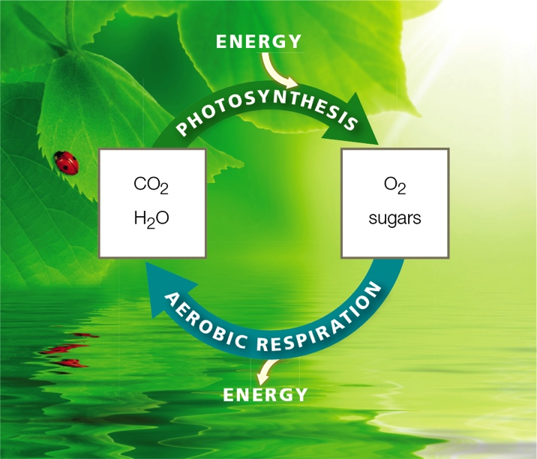
Photosynthesis and Aerobic Respiration
Notes:
Figure 7.2 Substrates and products link photosynthesis with aerobic respiration. Photosynthesis produces sugars and, in most organisms, it also releases oxygen. The breakdown of sugars in aerobic respiration requires oxygen, and it produces carbon dioxide and water —the raw materials from which photosynthetic organisms make the sugars in the first place.

Slide 8
Aerobic Respiration
Requires oxygen to break down sugars to make ATP
  Main energy-releasing pathway in nearly all eukaryotes and some bacteria

Slide 9
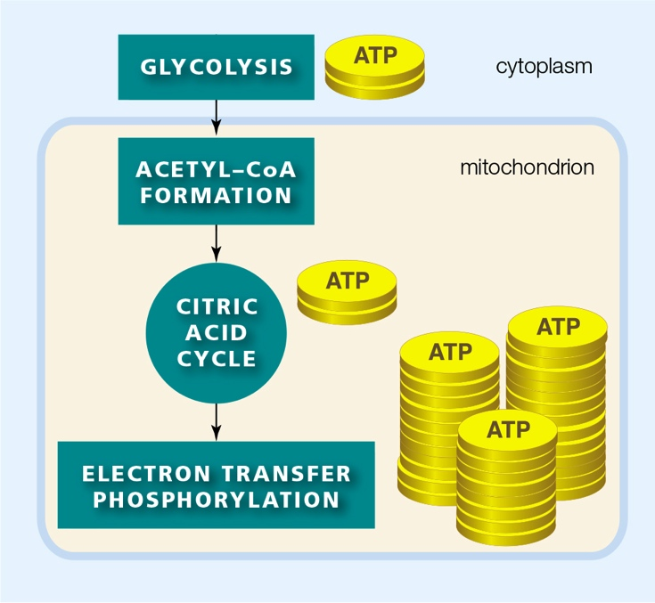
Overview of Aerobic Respiration (1 of 2)
Notes:
Figure 7.3 Overview of aerobic respiration. Left, aerobic respiration consists of four pathways: glycolysis, acetyl–CoA formation, the citric acid cycle, and electron transfer phosphorylation. In eukaryotes only, the last three steps occur in mitochondria. Right, Table 7.1 summarizes the reactants and products of each step.

Slide 10
Overview of Aerobic Respiration (2 of 2)
TABLE 7.1
Inputs and Outputs Linking Steps in Aerobic Respiration
Pathway | Main Reactants | Net Yield
Glycolysis | 1 six-carbon sugar (such as glucose) | 2 pyruvate 2 NADH 2 ATP
Acetyl-CoA formation | 2 pyruvate | 2 acetyl-CoA 2 C0₂ 2 NADH
Citric acid cycle | 2 acetyl-CaA | 4 C0₂ 6 NADH 2 FADH₂ 2 ATP
Electron transfer phosphorylation | 10 NADH 2 FADH₂ o₂ | 32 ATP (approx.) H₂0
Overall | 1 six-carbon sugar o₂ | 6C0₂ H₂0 36 ATP (approx.)
Notes:
Figure 7.3 Overview of aerobic respiration. Left, aerobic respiration consists of four pathways: glycolysis, acetyl–CoA formation, the citric acid cycle, and electron transfer phosphorylation. In eukaryotes only, the last three steps occur in mitochondria. Right, Table 7.1 summarizes the reactants and products of each step.

Slide 11
Reaction Pathways
Fermentation: sugar breakdown pathway that does not require oxygen to make ATP
  Like aerobic respiration, fermentation begins with glycolysis in cytoplasm
  Unlike aerobic respiration, fermentation occurs entirely in cytoplasm and does not include electron transfer chains
  Net yield is two ATP, which provides enough ATP to sustain many single-celled species

Slide 12
7.2 Glycolysis—Sugar Breakdown Begins
Glycolysis: series of reactions that begin the sugar breakdown pathways of aerobic respiration and fermentation
  Convert one six-carbon molecule of sugar (such as glucose) into two molecules of pyruvate: an organic compound with a three-carbon backbone

Slide 13
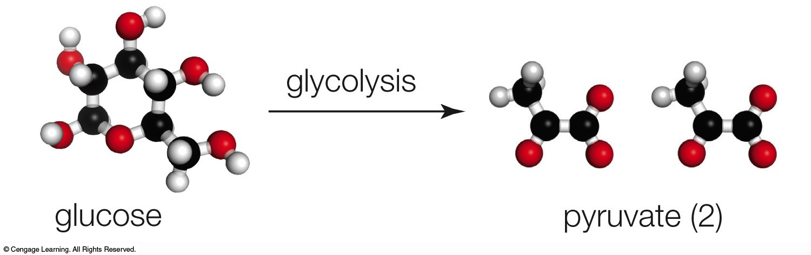
Glycolysis

Slide 14
Glycolysis Reactions (1 of 4)
Steps of glycolysis
  A phosphate group is transferred from ATP to glucose, forming glucose-6-phosphate
  Glucose-6-phosphate accepts a phosphate group from another ATP
    Two PGAL (phosphoglyceraldehyde) form

Slide 15
Glycolysis Reactions (2 of 4)
Steps of glycolysis (cont’d.)
  Each PGAL receives a second phosphate group, and each gives up two electrons and a hydrogen ion
    Two molecules of PGA (phosphoglycerate) form
    The electrons and hydrogen ions are accepted by two NAD⁺, forming NADH (required for third step of aerobic respiration)

Slide 16
Glycolysis Reactions (3 of 4)
Steps of glycolysis (cont’d.)
  A phosphate group is transferred from each PGA to ADP, so two ATP form
    The direct transfer of a phosphate group from a substrate to ADP is called substrate-level phosphorylation
  Glycolysis ends with the formation of two more ATP by substrate-level phosphorylation

Slide 17
Glycolysis Reactions (4 of 4)
Net yield of glycolysis is two ATP per molecule of glucose
  A total of four ATP form, but two ATP were invested to begin the reactions of glycolysis
Glycolysis also produces two three-carbon pyruvate molecules

Slide 18
Reactions of Glycolysis
Notes:
Figure 7.5 Reactions of glycolysis. This first stage of sugar breakdown starts and ends in the cytoplasm of all cells. All reactions are mediated by enzymes. For clarity, we track only the six carbon atoms (black balls) of the glucose molecule that enters the pathway.
Cells invest two ATP to start glycolysis, and two ATP form, so the net yield is two ATP per molecule of glucose. Electrons are also accepted by NADH. Depending on the type of cell and environmental conditions, the pyruvate product of glycolysis may enter the second stage of aerobic respiration or it may be used in other ways, such as in fermentation. Appendix III has more details for interested students.

Slide 19
7.3 Acetyl–CoA Formation and the Citric Acid Cycle
The second stage of aerobic respiration occurs inside mitochondria
  Includes two sets of reactions, acetyl–CoA formation and the citric acid cycle (also called the Krebs cycle)
These pathways break down the pyruvate produced during glycolysis

Slide 20
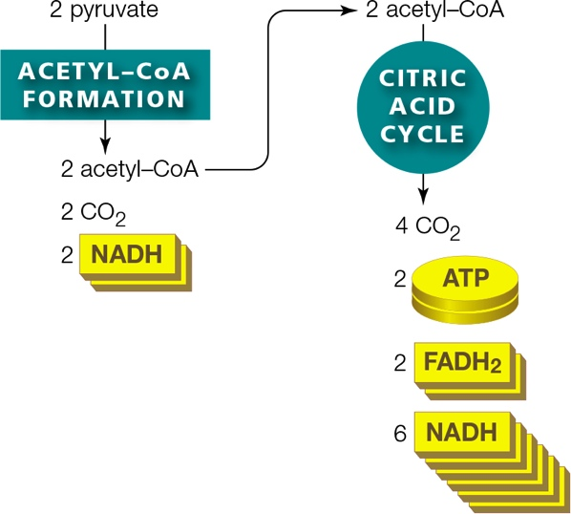
Overview of Acetyl–CoA Formation and the Citric Acid Cycle
Notes:
Figure 7.6 Overview of acetyl-CoA formation and the citric acid cycle.
These two pathways break the bonds of two pyruvate molecules and release their carbon atoms in CO₂. Two ATP form, and many coenzymes are reduced. In eukaryotes only, both pathways occur in mitochondria.

Slide 21
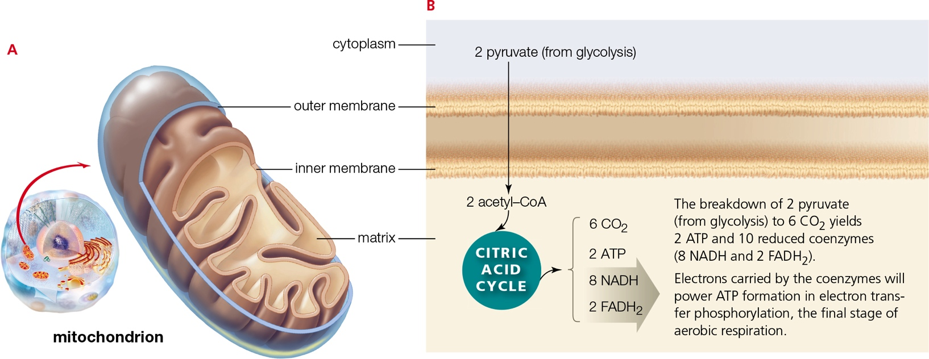
Moving into Mitochondria
Notes:
Figure 7.7 Acetyl–CoA formation and the citric acid cycle in mitochondria.
A An inner membrane divides the interior of a mitochondrion into two compartments. The inner compartment is filled with a gel-like substance called matrix.
The location of this mitochondrion is shown in an animal cell, but all eukaryotic cells have these organelles.
B Pyruvate produced by glycolysis is transported from cytoplasm into a mitochondrion, across both membranes, and into the matrix. Aerobic respiration continues here, in the matrix, with acetyl–CoA formation and the citric acid cycle.

Slide 22
Acetyl–CoA Formation
Steps of acetyl–CoA formation
  Pyruvate is transported into the mitochondrial matrix
  Pyruvate is split into CO₂ and a two-carbon acetyl group (–COCH₃)
  CO₂ diffuses out of the cell and the acetyl group combines with coenzyme A (CoA), forming acetyl-CoA
    Electrons and hydrogen ions released by the reaction combine with NAD⁺, so NADH also forms

Slide 23
The Citric Acid Cycle (1 of 2)
Steps of the citric acid cycle
  Two carbon atoms of acetyl–CoA are transferred to oxaloacetate, forming citrate
  Two CO₂ form and depart the cell
  Two NAD⁺ are reduced when they accept hydrogen ions and electrons, forming two NADH

Slide 24
The Citric Acid Cycle (2 of 2)
Steps of the citric acid cycle (cont’d.)
  ATP forms by substrate-level phosphorylation
  Two coenzymes are reduced: an FAD (flavin adenine dinucleotide) and another NAD⁺
  Oxaloacetate is regenerated

Slide 25
Results of the Citric Acid Cycle
The combined second-stage reactions of aerobic respiration break down two pyruvate to six CO₂
Net yield of second-stage reactions is two ATP
Ten coenzymes (eight NAD⁺ and two FAD) are reduced
  Provides electrons to the third stage of aerobic respiration

Slide 26
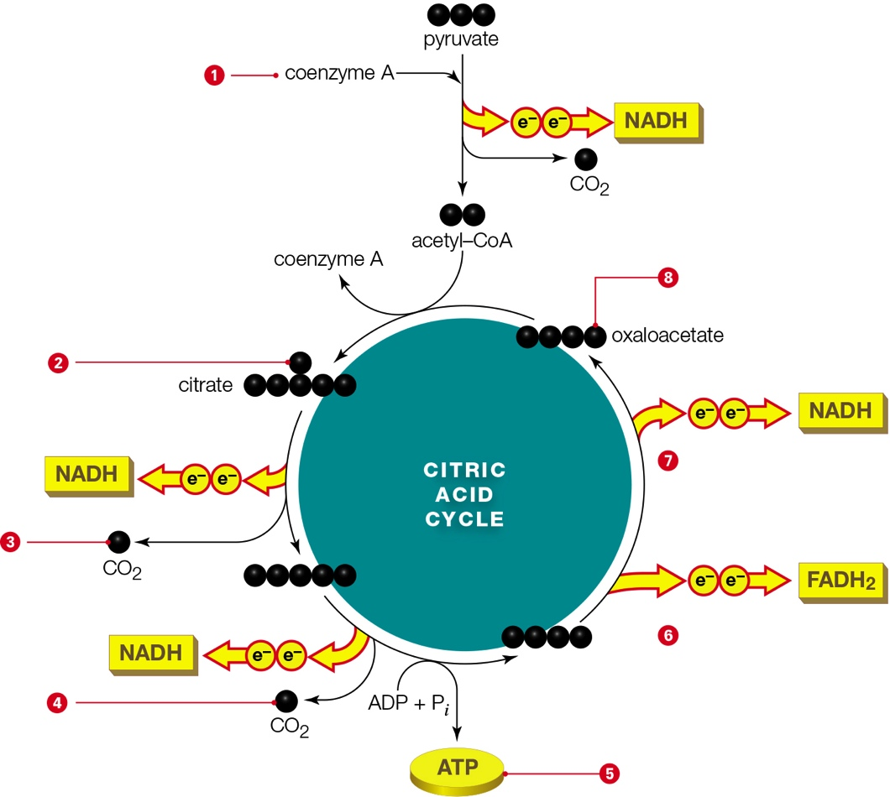
Acetyl–CoA Formation and the Citric Acid Cycle
Notes:
Figure 7.8 Acetyl–CoA formation and the citric acid cycle. Follow the carbons (black balls) to understand the movement of matter; follow the electrons to see the movement of energy. Each time these reactions run, they break down one pyruvate molecule. Thus, it takes two sets of reactions to break down the two pyruvate molecules that formed during glycolysis. Then, all six carbons that entered glycolysis in one glucose molecule have exited the cell, in six CO₂. Electrons and hydrogen ions are released as each carbon is removed from the backbone of intermediate molecules; these combine with ten coenzymes (thus reducing them). Not all reactions are shown; see Appendix III for details.
1 A pyruvate molecule is split into a two-carbon acetyl group and CO₂, releasing electrons and a hydrogen ion that are transferred to NAD⁺, so NADH forms. The acetyl group is transferred to coenzyme A, so acetyl–CoA forms, and the CO₂ leaves the cell.
2 The citric acid cycle starts as two carbon atoms are transferred from acetyl–CoA to oxaloacetate, a four-carbon molecule. Coenzyme A is regenerated, and citrate, a six-carbon molecule, forms.
3 Electrons and a hydrogen ion are transferred from an intermediate to NAD⁺, so NADH forms. Oxidizing the intermediate causes it to lose a carbon atom that leaves the cell in CO₂.
4 A carbon atom is removed from an intermediate, releasing electrons and a hydrogen ion that are transferred to NAD⁺, so NADH forms. The carbon atom leaves the cell in CO₂. Pyruvate’s three carbon atoms have now exited the cell, in CO₂.
5 One ATP forms by substrate-level phosphorylation.
6 Electrons and hydrogen atoms are transferred from an intermediate to the coenzyme FAD, which thereby becomes reduced to FADH₂.
7 Electrons and a hydrogen ion are transferred from an intermediate to NAD⁺, so NADH forms.
8 The product of the final redox reaction is oxaloacetate.

Slide 27
7.4 Aerobic Respiration’s Big Energy Payoff
The third stage of aerobic respiration occurs at the inner mitochondrial membrane
NADH and FADH₂ (produced during the first two stages of aerobic respiration) deliver electrons and hydrogen ions to electron transfer chains

Slide 28
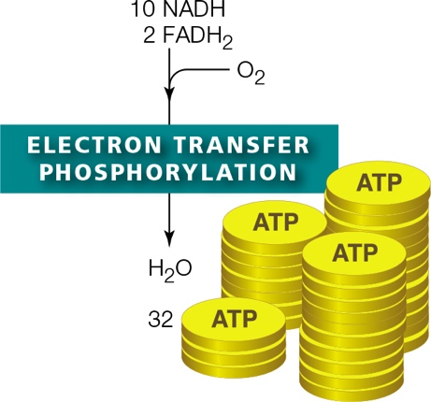
Overview of Electron Transfer Phosphorylation
Notes:
Figure 7.9 Overview of electron transfer phosphorylation in aerobic respiration. In eukaryotes only, this pathway occurs in mitochondria. Coenzymes reduced during the previous stages of aerobic respiration deliver electrons and hydrogen ions to electron transfer chains in the inner mitochondrial membrane. The flow of electrons through these chains sets up a hydrogen ion gradient that powers ATP formation.

Slide 29
Electron Transfer Phosphorylation (1 of 2)
As the electrons move through the chains, they give up energy little by little
Hydrogen ions are actively transported across the inner membrane
  The resulting hydrogen ion gradient causes the ions to flow through the ATP synthase, driving the formation of ATP

Slide 30
Electron Transfer Phosphorylation (2 of 2)
Oxygen accepts electrons at the end of mitochondrial electron transfer chains
  Water is formed as a by-product
About thirty-two ATP form during the third-stage reactions

Slide 31
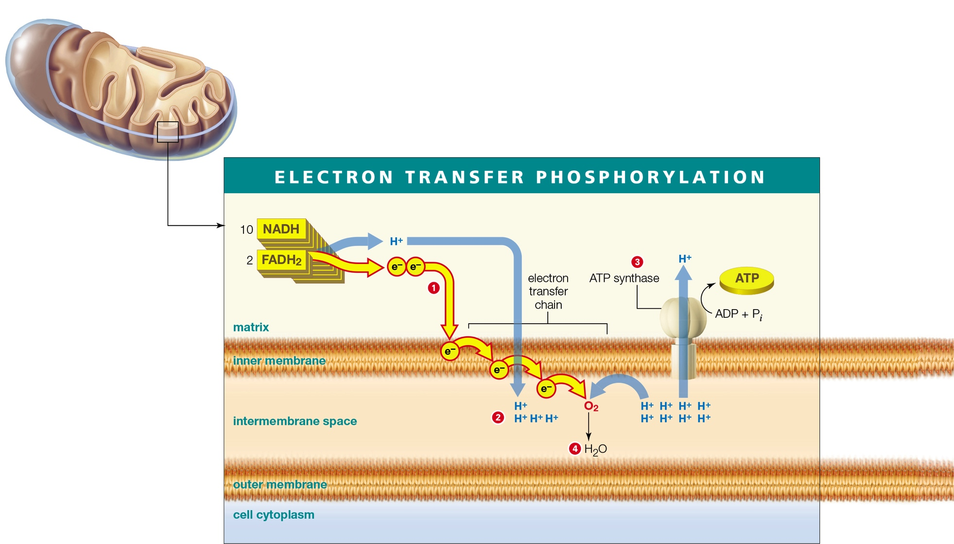
Final Step of Aerobic Respiration
Notes:
Figure 7.10 The final step of aerobic respiration, electron transfer phosphorylation, in a mitochondrion.
1 NADH and FADH₂ deliver electrons and hydrogen ions to electron transfer chains in the inner membrane.
2 Energy lost by electrons moving through electron transfer chains fuels the active transport of hydrogen ions (H⁺) from the matrix to the intermembrane space. A hydrogen ion gradient forms across the inner membrane.
3 Hydrogen ion flow back to the matrix through ATP synthases drives the formation of ATP from ADP and phosphate (P_{i}).
4 Oxygen accepts electrons and hydrogen ions at the end of the electron transfer chains, so water forms.

Slide 32
Summing Up
Summary of aerobic respiration
  For each glucose molecule, four ATP form in the first- and second-stage reactions
  The twelve coenzymes reduced in the first two stages deliver enough electrons to fuel synthesis of about thirty-two additional ATP during the third stage
  Thirty-six net ATP are produced in total

Slide 33
Summary of Aerobic Respiration
Notes:
Figure 7.11 Summary of aerobic respiration in eukaryotes.

Slide 34
7.5 Fermentation Pathways
Like aerobic respiration, fermentation begins with glycolysis in the cytoplasm
  In fermentation, pyruvate is not fully broken down to CO₂
  Electrons do not move through electron transfer chains, so no additional ATP forms
  NAD⁺ is regenerated, allowing glycolysis to continue
  The net yield is two ATP

Slide 35
Alcoholic Fermentation (1 of 3)
Alcoholic fermentation: anaerobic sugar breakdown pathway that produces ATP, CO₂, and ethanol
Steps of alcoholic fermentation
  3-carbon pyruvate is split into carbon dioxide and 2-carbon acetaldehyde
  Electrons and hydrogen are transferred from NADH to the acetaldehyde, forming NAD⁺ and ethanol

Slide 36
Alcoholic Fermentation (2 of 3)
Alcoholic fermentation in a fungus, Saccharomyces cerevisiae, sustains these yeast cells as they grow and reproduce
  Used to produce beer, wine, and bread

Slide 37
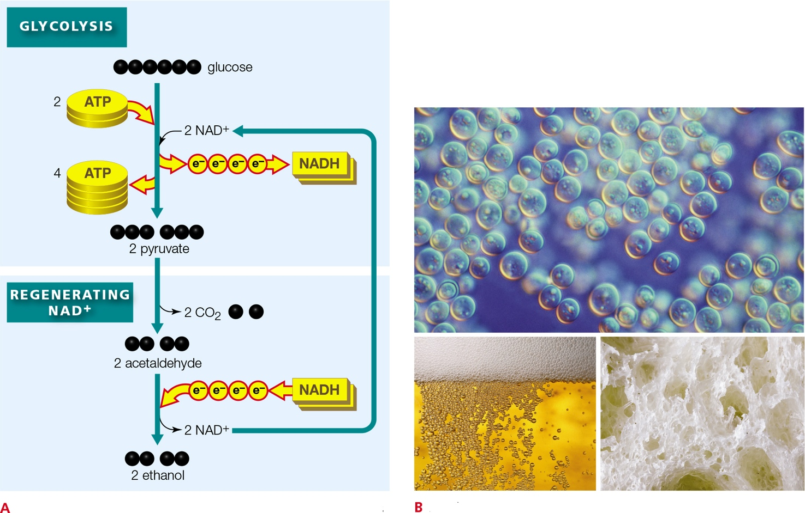
Alcoholic Fermentation (3 of 3)
Notes:
Figure 7.12 Alcoholic fermentation.
A Alcoholic fermentation begins with glycolysis, and the final steps regenerate NAD⁺. The net yield of these reactions is two ATP per molecule of glucose (from glycolysis).
B Saccharomyces cerevisiae cells (top). One product of alcoholic fermentation by this yeast (ethanol) makes beer alcoholic; another (CO₂) makes it bubbly. Holes in bread are pockets where CO₂ released by fermenting yeast cells accumulated in the dough.

Slide 38
Lactate Fermentation (1 of 3)
Lactate fermentation: anaerobic sugar breakdown pathway that produces ATP and lactate
Steps of lactate fermentation
  The electrons and hydrogen ions carried by NADH are transferred directly to pyruvate
  Pyruvate is converted to 3-carbon lactate
  NADH is converted to NAD⁺

Slide 39
Lactate Fermentation (2 of 3)
Animal muscle cells carry out aerobic respiration and/or lactate fermentation
  Intense exercise depletes oxygen faster than it can be replenished
    In these cases, ATP is produced by lactate fermentation
    Lactate does not build up in cells and cause soreness
Some hibernating animals also use lactate fermentation in low oxygen conditions

Slide 40
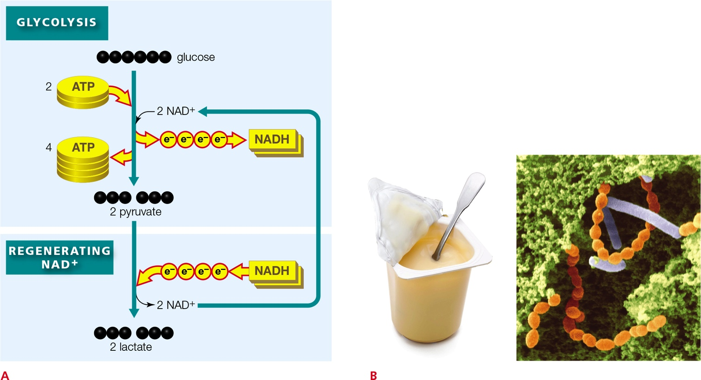
Lactate Fermentation (3 of 3)
Notes:
Figure 7.13 Lactate fermentation.
A Lactate fermentation begins with glycolysis, and the final steps regenerate NAD⁺. The net yield of these reactions is two ATP per molecule of glucose (from glycolysis).
B Yogurt is a product of lactate fermentation by bacteria in milk. The micrograph shows Lactobacillus bulgaricus (red) and Streptococcus thermophilus (purple) in yogurt.

Slide 41
7.6 Food as a Source of Energy
Energy from dietary molecules
  Aerobic respiration generates a lot of ATP by fully oxidizing glucose, completely dismantling it carbon by carbon
    Cells also dismantle other organic molecules by oxidizing them
  Complex carbohydrates, fats, and proteins in food can be converted to molecules that enter glycolysis or the citric acid cycle

Slide 42
Fats
Fats are dismantled by first breaking the bonds that connect the fatty acid tails to the glycerol head
Free fatty acids are oxidized by splitting their backbones into two-carbon fragments
  These fragments are converted to acetyl–CoA, which can enter the citric acid cycle
Glycerol gets converted to PGAL, an intermediate of glycolysis

Slide 43
Complex Carbohydrates
Starches and other complex carbohydrates are broken down into monosaccharides
Sugars are converted to glucose-6-phosphate for glycolysis
  A high concentration of ATP causes glucose-6-phosphate to be diverted away from glycolysis and into the formation of glycogen stores

Slide 44
Proteins
Dietary proteins are split into their amino acid subunits
  Ammonia (NH₃), formed as a waste product, is eliminated in urine
  The carbon backbone is split, and acetyl–CoA, pyruvate, or an intermediate of the citric acid cycle forms
  These molecules enter aerobic respiration’s second stage

Slide 45
Food Enters Aerobic Respiration
Notes:
Figure 7.14 How a variety of organic compounds from food enter the reactions of aerobic respiration.

Slide 46
Application: Mitochondrial Malfunction
Sometimes when oxygen enters an electron transfer chain, it escapes as a free radical
  Free radicals cause damage by oxidizing biological molecules and breaking carbon backbones
Antioxidants in the cytoplasm detoxify free radicals

Slide 47
Mitochondrial Malfunction
A genetic disorder or encounter with a toxin can result in a missing antioxidant or defective electron transfer chain
  Free radicals accumulate and destroy first the function of mitochondria, then the cell
    This tissue damage is called oxidative stress
  Hundreds of incurable disorders are associated with such defects
    Cancer, hypertension, Alzheimer’s disease, and Parkinson’s disease

Slide 48
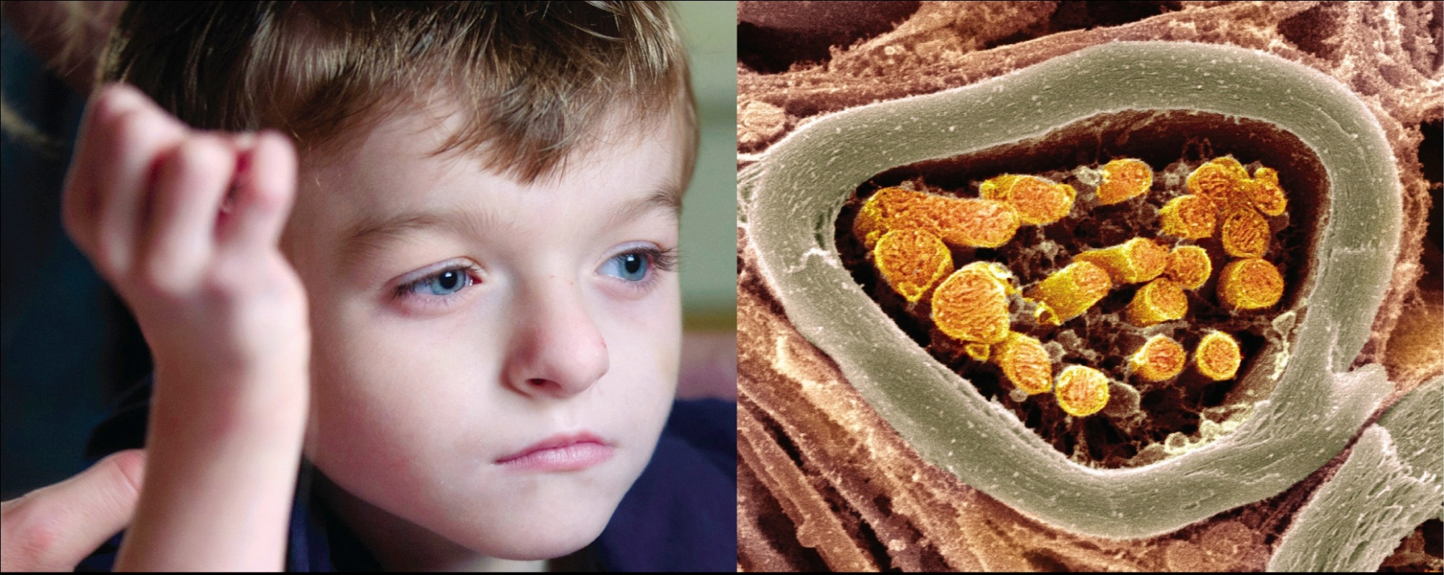
Mitochondrial Disorders
Notes:
Figure 7.15 Mitochondrial disorders. Left, Carter B., one of millions of children with devastating mitochondrial disorders. Right, nerve cells, which are particularly affected by mitochondrial malfunction, are packed with mitochondria (gold).

Slide 49
Discuss
Which type of cells are most affected by mitochondrial free radical production?
Yeast is added to a mixture of malt, hops, and water to brew beer—a product in which alcohol and carbon dioxide are desirable! Why is yeast added to bread dough?
Why is fermentation necessary under anaerobic conditions?

