Slide 1
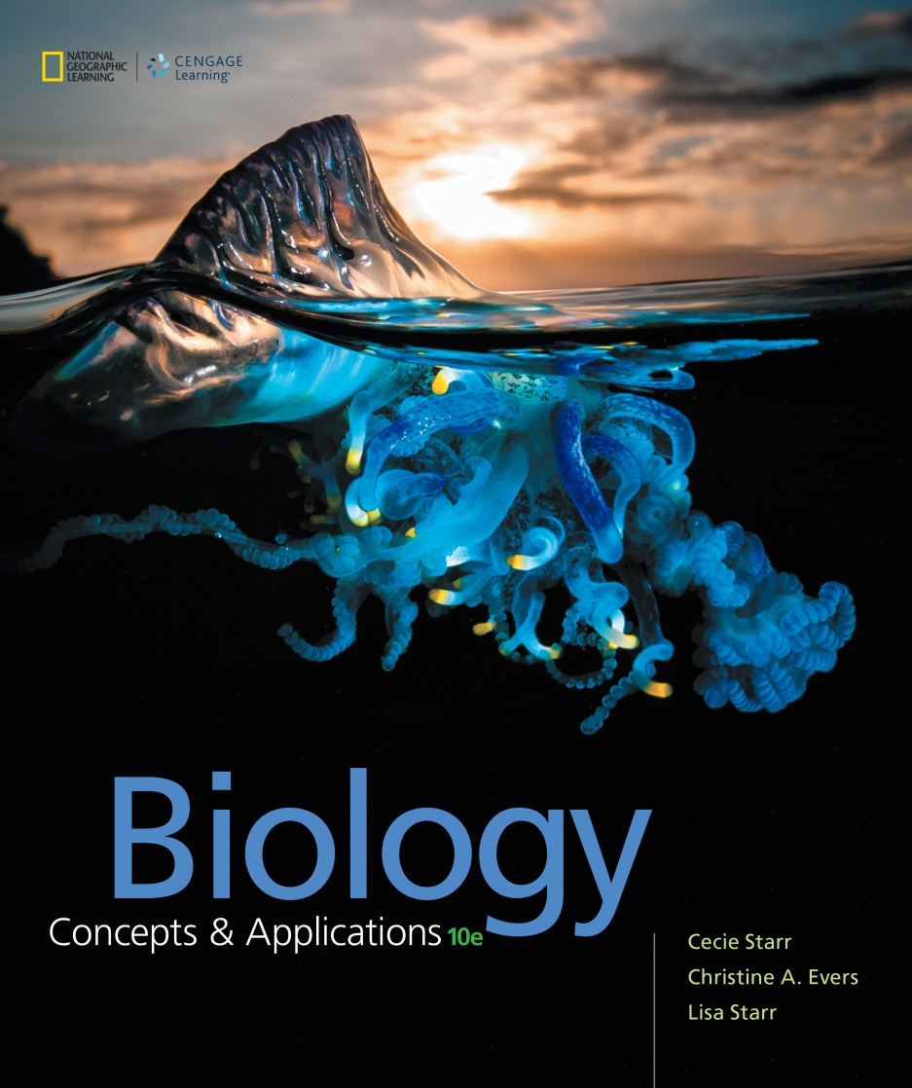
Biology Concepts & Applications
10 Edition
Chapter 6
Where It Starts —Photosynthesis
Copyright © 2018 Cengage Learning. All Rights Reserved. May not be copied, scanned, or duplicated, in whole or in part, except for use as permitted in a license distributed with a certain product or service or otherwise on a password-protected website for classroom use.

Slide 2
6.1 Overview of Photosynthesis
Energy flow through ecosystems begins when photosynthesizers capture sunlight and convert it to chemical energy
Unlike light, chemical energy can power the reactions of life, and can be stored for use at a later time
Photosynthesis summary:

Slide 3
Autotrophs and Heterotrophs
Autotrophs are producers
Make food using energy from environment and carbon from inorganic molecules
Heterotrophs are consumers
Obtain carbon from organic compounds assembled by other organisms

Slide 4
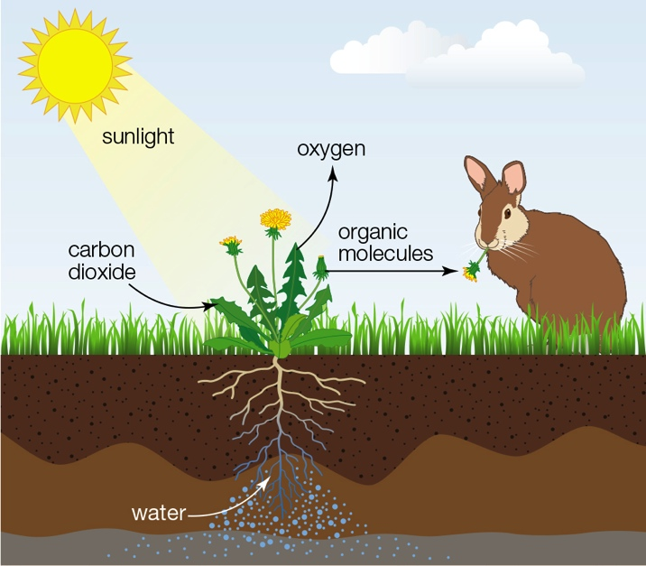
Photosynthesis Sustains Life
Notes:
Figure 6.1 How photosynthesis sustains life. Photosynthetic autotrophs get energy from sunlight, and carbon from carbon dioxide. Most heterotrophs get their energy and carbon from organic molecules assembled by photosynthetic autotrophs.

Slide 5
First Stage of Photosynthesis: Light-Dependent Reactions
First stage of photosynthesis (“photo”)
Driven by light energy
Conversion of light energy to the chemical bond energy of ATP
Splits water (photolysis) to yield H⁺ and electrons to form NADPH; oxygen released

Slide 6
Second Stage of Photosynthesis: Light-Independent Reactions
Second stage of photosynthesis (“synthesis”)
NADPH and ATP generated by light-dependent reactions drive synthesis of sugars from CO₂ and H₂O
NADP⁺ and ADP recycled for use in the light-dependent reactions

Slide 7
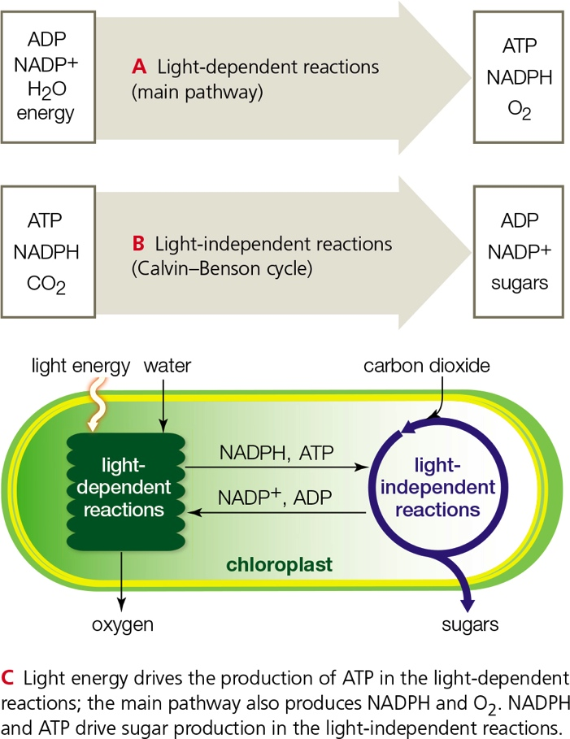
Coenzymes Connect the Reactions of Photosynthesis
Notes:
Figure 6.2 How coenzymes connect the first- and second- stage reactions of photosynthesis. Substrates and products of the main pathways are shown as they occur in chloroplasts. With some variation, cyanobacteria use the same pathways.

Slide 8
Where Photosynthesis Occurs
Chloroplast
Thylakoid membrane
Highly folded into stacks of interconnected thylakoids
Light-dependent reactions
Stroma
Cytoplasm-like fluid inside the chloroplast
Light-independent reactions

Slide 9
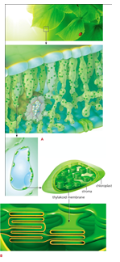
Site of Photosynthesis in a Leaf
Notes:
Figure 6.3 Zooming in on the site of photosynthesis in a leaf.
A Different kinds of cells compose a leaf; air spaces in the interior of the leaf allow gases to circulate around the cells. Photosynthetic cells have chloroplasts.

Slide 10
6.2 Sunlight as an Energy Source
1882: Theodor Engelmann’s photosynthesis experiment
Directed a spectrum of light across individual strands of green algae; added motile, oxygen-requiring bacteria
Used oxygen emission as a measurement of photosynthetic activity
Clustering of bacteria near blue and red light indicated these wavelengths of light are optimal for driving photosynthesis

Slide 11
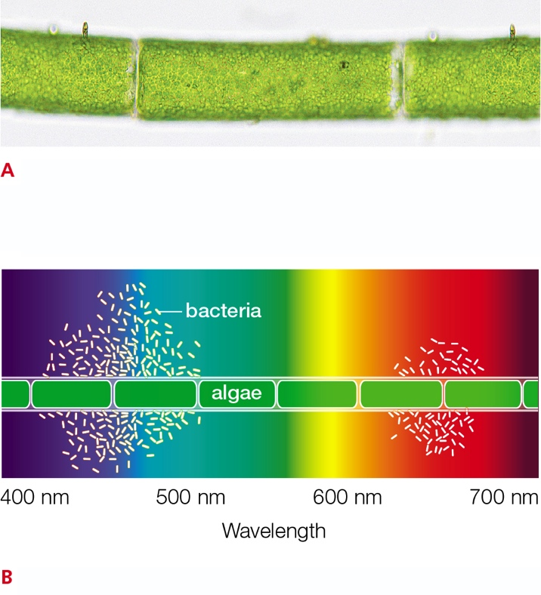
Theodor Engelmann’s Photosynthesis Experiment
Notes:
Figure 6.4 Discovery that photosynthesis is driven by particular wavelengths of light.
A Each cell in a strand of Cladophora is filled with a single chloroplast. Theodor Engelmann used this and other species of green algae in a series of experiments to determine whether some colors of light are better for photosynthesis than others.
B Engelmann directed light through a prism so that bands of colors crossed a water droplet on a microscope slide. The water held a strand of photosynthetic algae, and also oxygen-requiring bacteria.
The bacteria swarmed around the algal cells that were releasing the most oxygen—the ones most actively engaged in photosynthesis. Those cells were under blue and red light.

Slide 12
Light is Electromagnetic Radiation
Light
Electromagnetic radiation
Travels as waves, in energy packets (photons)
Wavelength (nm) = the distance between the crests of two successive waves
Photon’s energy is related to wavelength
The shorter the wavelength, the higher the energy

Slide 13
Visible Light Drives Photosynthesis
Visible light
Main form of energy that drives photosynthesis
Small part of the spectrum of electromagnetic radiation (380 to 750 nm)
We perceive different wavelengths as different colors
Light with all wavelengths combined appears white
White light is separated by prisms

Slide 14
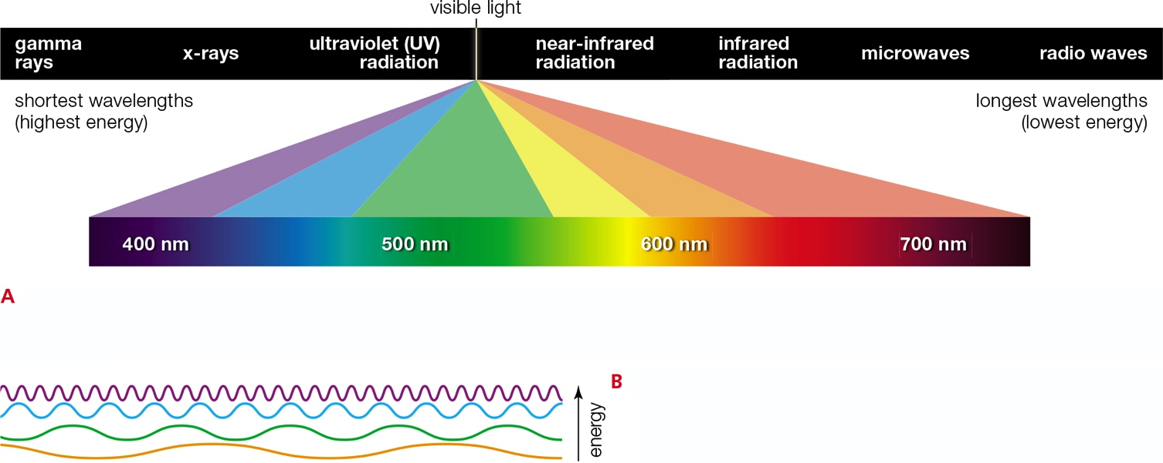
Properties of Light
Notes:
Figure 6.5 Properties of light.
A Electromagnetic radiation moves through space in waves that we measure in nanometers (nm). Visible light makes up a very small part of this energy. Raindrops or a prism can separate visible light’s different wavelengths, which we see as different colors. About 25 million nanometers are equal to 1 inch.
B Light is organized as packets of energy called photons. The shorter a photon’s wavelength, the greater its energy. Thus, photons of violet light carry more energy than photons of blue light, and so on.

Slide 15
To Catch a Rainbow
Photosynthesizers use pigments to capture light of specific wavelengths
Chlorophyll a is the most common photosynthetic pigment
Absorbs violet, red, and orange light
Reflects green light (appears as green)
Accessory pigments
Capture light of other wavelengths
Other functions (attract pollinators; antioxidants)

Slide 16
Accessory Pigments
The combination of photosynthetic pigments differs among species
Photosynthetic species are adapted to the environment in which they evolved
Light that reaches different environments varies in its proportions of wavelengths
Green plants
Appear green due to abundant chlorophyll a
Disassembly of chlorophylls during autumn reveals accessory pigments

Slide 17
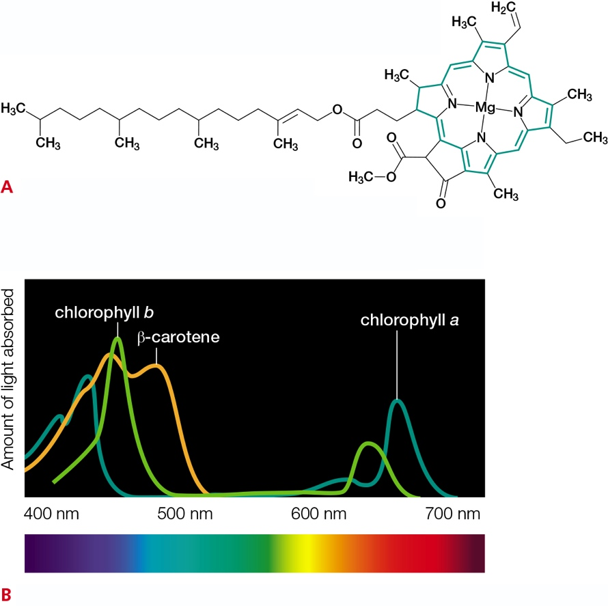
Photosynthetic Pigments
Notes:
Figure 6.6 Photosynthetic pigments.
A Chlorophyll a. The light-trapping region (in green) has a magnesium atom at its center. Chlorophyll b is identical with chlorophyll a except it has an aldehyde group substituted for one of the methyl groups.
B Absorption spectra of three photosynthetic pigments reveal the efficiency with which each absorbs different wavelengths of visible light. Line color indicates the characteristic color of each pigment. Compare Figure 6.4B.

Slide 18
6.3 Light-Dependent Reactions
Light-harvesting complex in thylakoid membrane
Absorbs a photon; one of its electrons jumps to a higher energy level
Extra energy emitted as a photon as electron falls back to lower energy level
Photon passed back and forth between complexes
Photon becomes absorbed by a photosystem

Slide 19
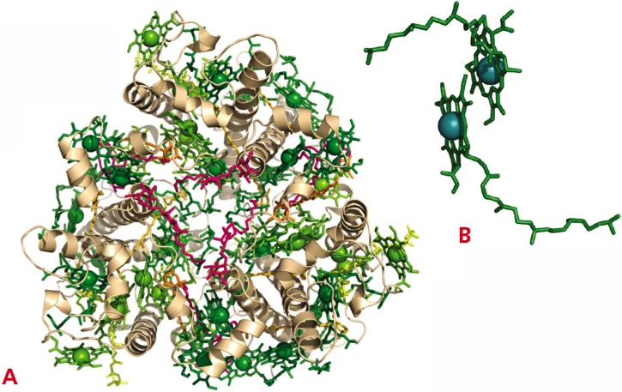
Photosynthetic Pigments in the Thylakoid Membrane
Notes:
Figure 6.7 Special arrangements of pigments in the thylakoid membrane. Chlorophylls are shown in green; beta-carotene and other pigments, in orange and yellow; lipids, in pink.
A A light-harvesting complex from pea (Pisum sativum), top view.
B A “special pair”: two closely associated chlorophyll molecules in the reaction center of a photosystem.

Slide 20
Photosystem
Large complex of molecules in thylakoid membrane
Reaction center (proteins, pigments, and cofactors) surrounded by a ring of light-harvesting complexes

Slide 21
Light-Dependent Reactions: Cyclic and Noncyclic Pathways
Noncyclic pathways
Use photosystems I and II
Produce ATP, O₂, and NADPH
Primary photosynthetic system
Cyclic pathways
Use photosystem I only
Produce ATP
Evolved before noncyclic pathways

Slide 22
Steps of the Noncyclic Pathway: Photosystem II
Photosystem II absorbs a photon, followed by loss of electrons
Photosystem II pulls electrons from water molecules to replace lost electrons
Photolysis: water is broken down to yield H⁺ and O₂
Electrons enter an electron transfer chain in the thylakoid membrane
H⁺ gradient forms across the thylakoid membrane

Slide 23
Steps of the Noncyclic Pathway: Photosystem I
After electrons move through first electron transport chain, they are accepted by photosystem I
Pair of chlorophylls in photosystem I releases electrons, which enter a second electron transfer chain; NADPH forms

Slide 24
Steps of the Noncyclic Pathway: ATP Synthesis
Hydrogen ions in the thylakoid compartment are propelled through ATP synthases
ATP synthases phosphorylate ADP in the stroma to form ATP
Electron transfer phosphorylation
Process by which electron flow through electron transfer chains drives ATP formation

Slide 25
Light-Dependent Reactions, Noncyclic Pathway
Notes:
Figure 6.8 Light-dependent reactions, noncyclic pathway. ATP and oxygen gas are produced in this pathway. Electrons that travel through two different electron transfer chains end up in NADPH. P_{i} is an abbreviation for phosphate group.
1 A photosystem II absorbs a photon and emits electrons.
2 The photosystem pulls replacement electrons from water molecules, which then break apart into hydrogen ions and oxygen. The oxygen leaves the cell as O₂ gas.
3 The electrons enter an electron transport chain in the thylakoid membrane.
4 Energy released by the electrons as they move through the chain is used to actively transport hydrogen ions from the stroma into the thylakoid compartment. A hydrogen ion gradient forms across the thylakoid membrane.
5 A photosystem I absorbs a photon and emits electrons. Replacement electrons come from photosystem II via an electron transfer chain.
6 Electrons emitted from photosystem I move through a different electron transfer chain, then combine with NADP⁺ and H⁺ to form NADPH.
7 Hydrogen ions in the thylakoid compartment follow their gradient across the thylakoid membrane by flowing through the interior of ATP synthases.
8 Hydrogen ion flow causes ATP synthases to phosphorylate ADP, so ATP forms in the stroma.

Slide 26
Steps of the Cyclic Pathway
Photosystem I absorbs a photon and emits electrons
Electrons ejected from photosystem I enter an electron transfer chain
H⁺ gradient forms across thylakoid membrane to drive ATP formation
Electrons that reach the end of the electron transport chain return to photosystem I
NADPH and O₂ do not form

Slide 27
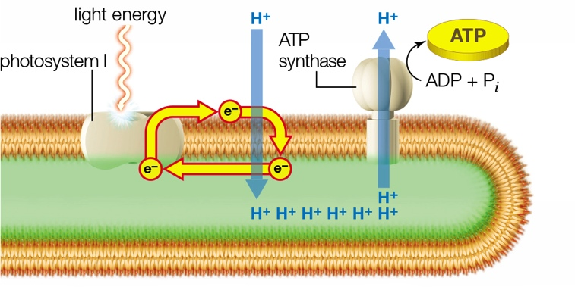
Light-Dependent Reactions, Cyclic Pathway
Notes:
Figure 6.9 Light-dependent reactions, cyclic pathway. Electrons released from photosystem I enter an electron transfer chain, then cycle back to the photosystem. ATP is produced, but not oxygen or NADPH.

Slide 28
Roles of the Cyclic and Noncyclic Pathways
Noncyclic pathway
Has additional photosystem with access to unlimited supply of electrons from water
Electrons stored in NADPH are used to produce sugars from CO₂
Cyclic pathway
Produces O₂ but not NADPH
Not enough ATP is produced in the noncyclic pathway to balance NADPH, so cyclic pathway provides extra ATP

Slide 29
6.4 Light-Independent Reactions
The Calvin–Benson cycle
Builds sugars in the stroma of chloroplasts
Not powered by light energy
Driving force is ATP and NADPH formed by the light-dependent reactions
Uses carbon atoms from CO₂ to make sugars
Carbon fixation
Carbon from an inorganic source is incorporated into an organic molecule

Slide 30
Steps of the Calvin–Benson Cycle
Rubisco fixes carbon by attaching CO₂ to 5-carbon RuBP
The intermediate splits to form two 3-carbon PGA molecules per CO₂ molecule
Six PGA total
Each PGA receives Pi from ATP, plus H⁺ and electrons from NADPH to form six PGAL
Five PGAL regenerate three RuBP
One PGAL is exported to the cytoplasm to combine with another PGAL to form sucrose

Slide 31
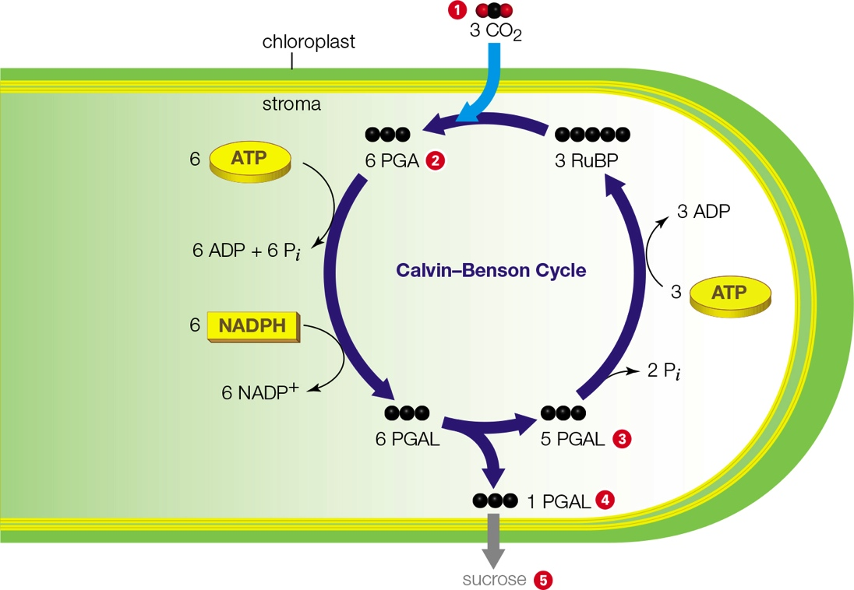
The Calvin–Benson Cycle in a Chloroplast
Notes:
Figure 6.10 The Calvin–Benson cycle in a chloroplast. This is a cross-section of a chloroplast with Calvin–Benson reactions cycling in the stroma. The steps are a summary of three cycles of reactions. Water is also a substrate, but not shown for clarity (Appendix III details the reactions). Black balls signify carbon atoms.
1 Three CO₂ molecules diffuse into a photosynthetic cell, and then into a chloroplast. Rubisco attaches each to a five-carbon RuBP molecule. The resulting intermediates split, so six molecules of three-carbon PGA form.
2 Each PGA gets a phosphate group from ATP, plus hydrogen and electrons from NADPH, so six PGAL form. This phosphorylated sugar is the product of the Calvin–Benson cycle.
3 Five PGAL continue in reactions that regenerate 3 RuBP.
4 The remaining PGAL is usually exported from the chloroplast. In plant cell cytoplasm, PGAL molecules are combined to form sucrose 5.

Slide 32
Stomata
Tiny, closable gaps on the surfaces of leaves and stems
Open stomata
Allow CO₂ to diffuse from the air into the plant cells
Allow O₂ to diffuse out of these cells and into the air
Closed stomata
Conserve water on hot, dry days
Limit the availability of CO₂ for the light-independent reactions; sugar synthesis slows

Slide 33
C3 Plants
Fix carbon only by the Calvin–Benson cycle
Light-dependent and light-independent reactions run during the day
When stomata are closed:
O₂ levels rise and CO₂ levels fall in plant tissues
Both gases are substrates of rubisco and compete for active site

Slide 34
Photorespiration is Inefficient
When O₂ levels rise:
Rubisco attaches O₂ to RuBP (photorespiration) to create substrate for Calvin–Benson cycle
Intermediates must be transported among three organelles
Requires ATP; produces CO₂ and ammonia
CO₂ is lost; ammonia must be detoxified
Photorespiration is therefore inefficient
C3 plants compensate by making lots of rubisco

Slide 35
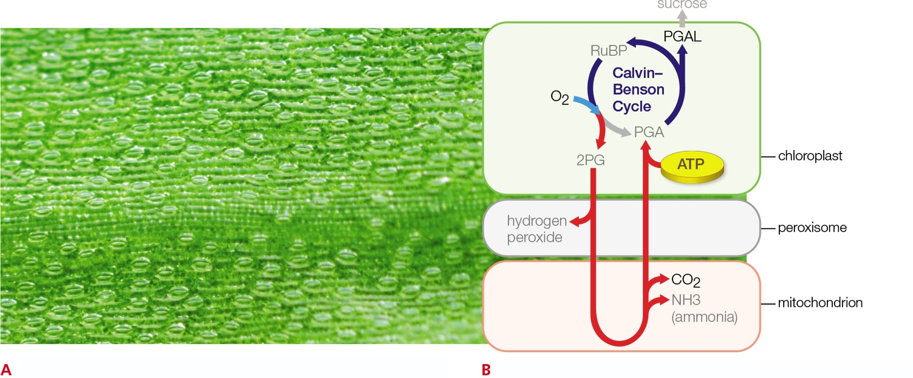
Photorespiration
Notes:
Figure 6.11 Photorespiration.
A Stomata on the surface of a leaf. When these tiny pores are open, they allow gas exchange between the plant’s internal tissues and air. Stomata close to conserve water on hot, dry days, and then gas exchange stops. Oxygen produced by the light-dependent reactions cannot exit the plant, and CO₂ required for the light-independent reactions cannot enter it. Thus, the amount of oxygen rises and the amount of CO₂ declines in photosynthetic tissues.
B Photorespiration occurs when the oxygen/CO₂ ratio increases in photosynthetic tissues, causing rubisco to use oxygen as a substrate. Several reactions are necessary to convert the product of this reaction to a molecule that can reenter the Calvin–Benson cycle. Intermediates are transported from the chloroplast to a peroxisome, then a mitochondrion, a peroxisome again, and back to a chloroplast. The energy required to carry out the extra steps make photorespiration an inefficient way to produce sugars.

Slide 36
6.5 Carbon-Fixing Adaptations of Plants
Some plants have evolved to minimize photorespiration
C4 and CAM plants
Stomata are closed on hot, dry days
Sugar production remains high

Slide 37
Carbon-Fixing Adaptations of C4 Plants
Fixes carbon twice in two cell types
Mesophyll cells
Bundle-sheath cells
This minimizes photorespiration by keeping CO₂ levels high and O₂ levels low near rubisco
Examples
Corn, bamboo

Slide 38
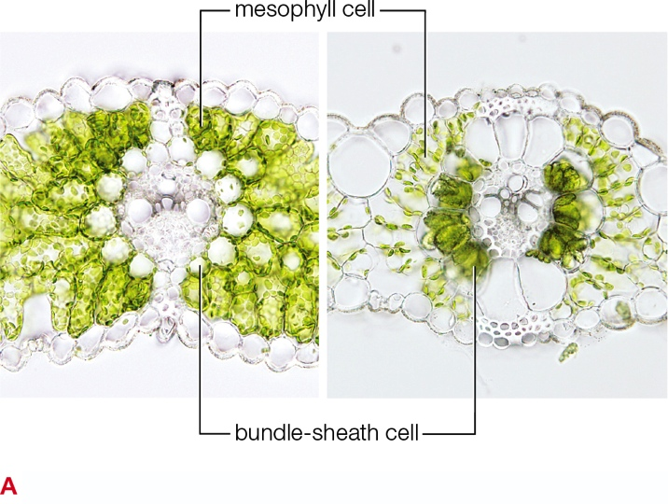
C4 Plants Minimize Photorespiration
Notes:
Figure 6.12 C4 plant adaptations minimize photorespiration.
A In a C3 plant (barley, left), chloroplasts—the sites of carbon fixation—occur mainly in mesophyll cells. A C4 plant (millet, right) has chloroplasts in mesophyll cells and in bundle-sheath cells, so it can carry out photosynthesis in both types of cells. C4 plants minimize photorespiration by fixing carbon twice, in the two cell types.

Slide 39
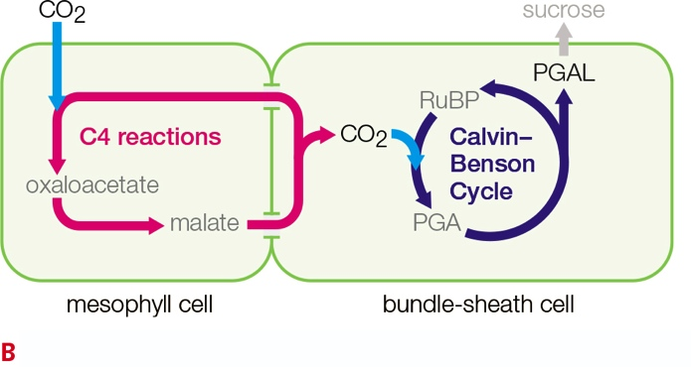
Carbon Fixation in C4 Plants
Notes:
Figure 6.12 C4 plant adaptations minimize photorespiration.
B In C4 plants, as in C3 plants, oxygen builds up when stomata close during photosynthesis. However, C4 plants fix carbon twice, first in mesophyll cells and then in bundle-sheath cells. This strategy minimizes photorespiration because it keeps the CO₂ concentration high and the O₂ concentration low, near rubisco.

Slide 40
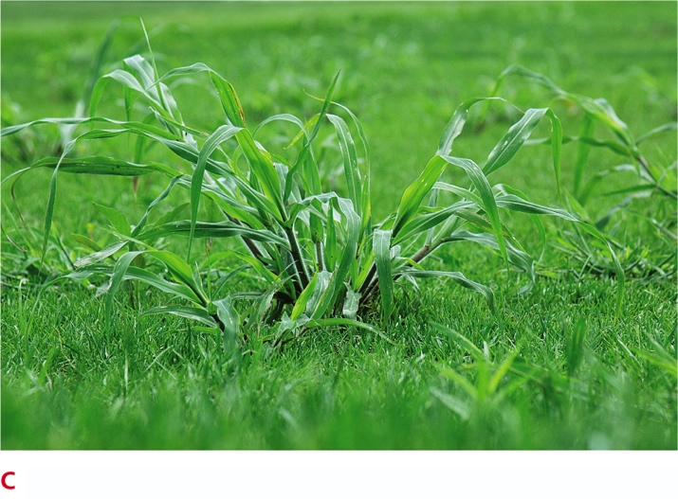
Crabgrass, a C4 Plant
Notes:
Figure 6.12 C4 plant adaptations minimize photorespiration.
C Crabgrass “weeds” overgrowing a lawn. Crabgrasses, which are C4 plants, thrive in hot, dry summers, when they easily outcompete Kentucky bluegrass and other fine-leaved C3 grasses commonly planted in residential lawns.

Slide 41
Carbon-Fixing Adaptations of CAM Plants
Conserve water even in desert regions with extremely high daytime temperatures
Open stomata at night when lower temperatures minimize evaporative water loss
Conserve water by fixing carbon twice, at different times of day

Slide 42
Application: Science & Society—A Burning Concern
Photosynthesis
Removes carbon from the atmosphere and fixes it into organic compounds
These organic compounds fuel heterotrophs, as well as cars, etc.
Both processes release energy by breaking bonds in organic molecules
Both processes release CO₂

Slide 43
Fossil Fuels
Petroleum, coal, and natural gas
Organic remains of ancient organisms
Burning fossil fuels releases CO₂
This adds far more CO₂ into the atmosphere than photosynthesizers can remove

Slide 44
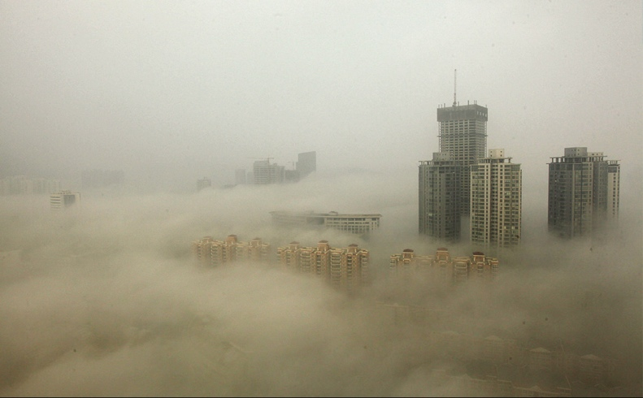
Air Pollution
Notes:
Figure 6.13 Air pollution—smog—from fossil fuel use blankets Lianyungang, China, in December 2013. The brown color of smog comes from a gas (nitric oxide) that is toxic in large amounts. Invisible components include other nitrogen compounds, sulfur compounds, organic molecules, mercury and other heavy metals, and carbon dioxide.

Slide 45
Biofuels
Biofuels are a renewable source of energy
Growing more plants creates more sources of biofuels
Corn and other food crops are rich in oils, starches, and sugars that can be easily converted to biofuels
Starch from corn kernels can be broken down to glucose, which is converted to ethanol by bacteria or yeast

Slide 46
Biofuels from Other Sources
Weeds, wood chips, and agricultural waste
Higher proportion of cellulose
Making biofuels from these sources requires additional steps

Slide 47
Biofuels vs. Fossil Fuels
The processes of burning fossil fuels and biofuels are fundamentally the same
Both release energy by breaking the bonds of organic molecules
Both use oxygen to break those bonds
Both produce carbon dioxide
Biofuels contribute less to global climate
Growing plant matter for fuel recycles carbon that is already in the atmosphere

Slide 48
Engage: Sustainability
Sub-Saharan Africa
Wood burning used for cooking fuel and heat
Forests are destroyed
Scarce, expensive wood
Sanga Moses
Goal is to provide clean, inexpensive cooking energy to all Africans
Farm waste is burned in kilns; char is converted into briquettes for cooking

Slide 49
Discuss
In what ways could the “greenhouse effect” hurt agriculture? In what ways could it possibly help, and in which countries?
Consider the current marketing of compact fluorescent light bulbs. How are these products linked to atmospheric carbon?

