Slide 1
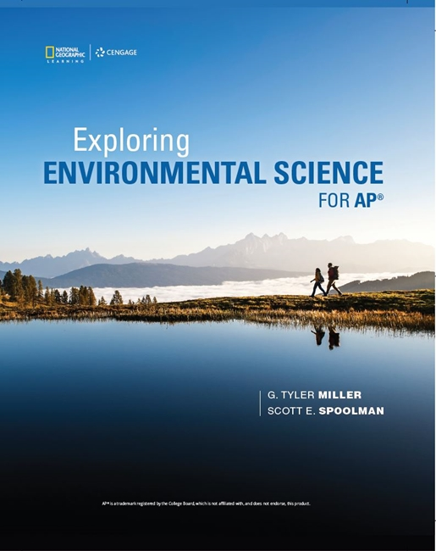
Exploring Environmental Science for AP®
1st Edition
Chapter 5
Climate and Terrestrial Biodiversity
Copyright © 2018 Cengage Learning. All Rights Reserved. May not be copied, scanned, or duplicated, in whole or in part, except for use as permitted in a license distributed with a certain product or service or otherwise on a password-protected website for classroom use.

Slide 2
Core Case Study: African Savanna (1 of 2)
Why do grasslands grow in some areas while forests and deserts form in others?
Climate
Tropical
Polar
Temperate
Savanna
Scattered trees and warm temperatures
Loss of habitat threatens native animals

Slide 3
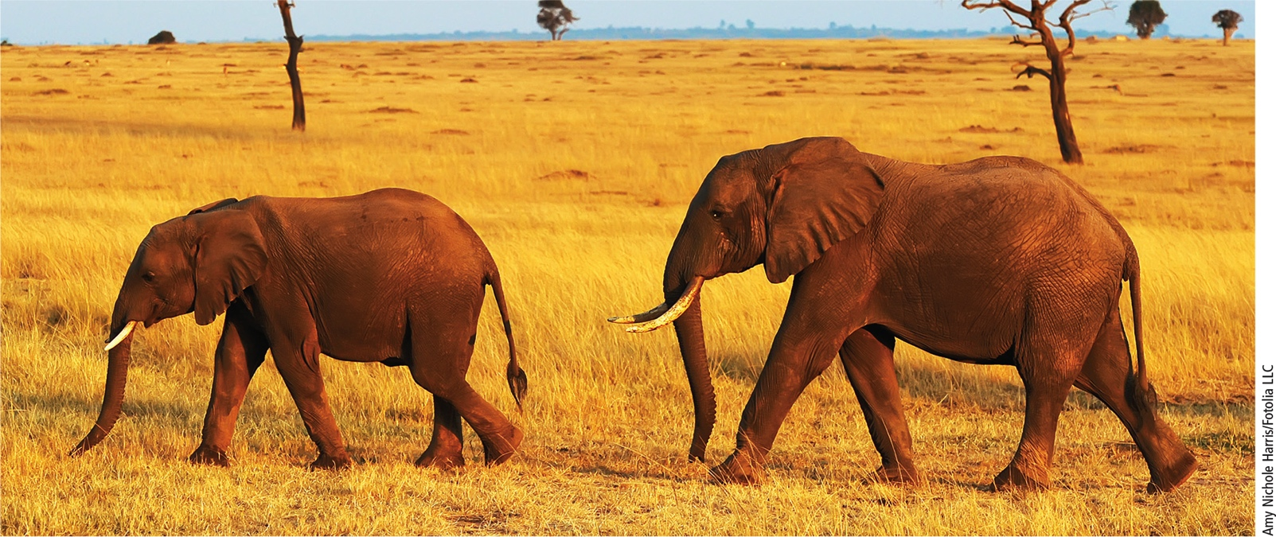
Core Case Study: African Savanna (2 of 2)
Notes:
Figure 7.1 Elephants on a tropical African savanna

Slide 4
7.1 What Factors Influence Weather?
Weather
Set of physical conditions of the lower atmosphere in an area over a period of hours to days
Atmospheric temperature and precipitation
Weather affected by:
Moving masses of warm or cold air
Atmospheric pressure changes
Occasional shifts in major winds

Slide 5
Weather is Affected by Moving Masses of Warm or Cold Air (1 of 2)
Front
Boundary between two air masses with different temperatures and densities
Warm front
Advancing warm air mass rises up over cooler air
Moisture begins to condense
Forms layers of clouds at different altitudes

Slide 6
Weather is Affected by Moving Masses of Warm or Cold Air (2 of 2)
Cold front
Advancing cold air mass stays close to the ground, wedging below warmer air
Produces rapidly moving, towering clouds called thunderheads
Can cause high surface winds and thunderstorms as it passes through

Slide 7
Weather is Affected by Atmospheric Pressure and Wind Patterns (1 of 5)
Atmospheric pressure
Greater near the earth’s surface
High pressure air mass contains cool, dense air
Low pressure air mass contains low-density, warm air
Air rises, expands, and cools
Condenses when temperature drops below dew point

Slide 8
Weather is Affected by Atmospheric Pressure and Wind Patterns (2 of 5)
Notes:
Figure 7.2 Weather fronts: A warm front (left) occurs when a moving mass of warm air meets and rises up over a mass of denser cool air. A cold front (right) forms when a moving mass of cold air wedges beneath a mass of less dense warm air.

Slide 9
Weather is Affected by Atmospheric Pressure and Wind Patterns (3 of 5)
Jet streams
Powerful winds that circle the globe
El Niño-Southern Oscillation (ENSO)
Periodic change in wind patterns in the Pacific Ocean
Results in drier weather in some areas and wetter in others
Can alter conditions over two-thirds of the world

Slide 10
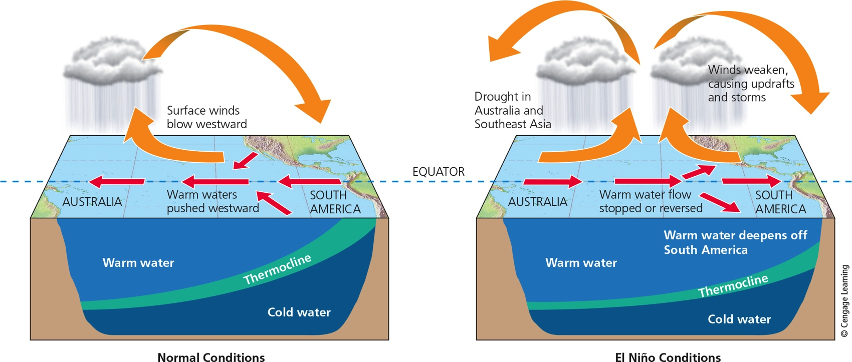
Weather is Affected by Atmospheric Pressure and Wind Patterns (4 of 5)
Notes:
Figure 7.3 El Niño: Normal trade winds blowing east to west cause shore upwellings of cold, nutrient-rich bottom water in the tropical Pacific Ocean near the coast of Peru (left). A zone of gradual temperature change called the thermocline separates the warm and cold water. Every few years, a shift in trade winds known as the El Niño–Southern Oscillation (ENSO) disrupts this pattern (right) for 1 to 2 years.

Slide 11
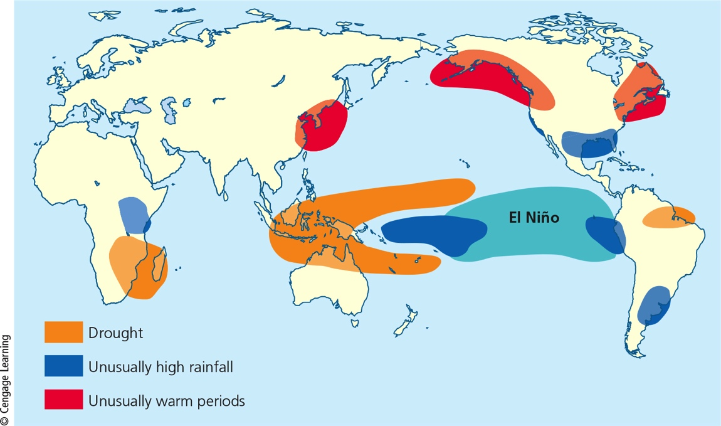
Weather is Affected by Atmospheric Pressure and Wind Patterns (5 of 5)
Notes:
Figure 7.4 Typical global weather effects of an El Niño–Southern Oscillation. Critical thinking: How might an ENSO affect the weather where you live or go to school?

Slide 12
Tornados and Tropical Cyclones Are Violent Weather Extremes (1 of 3)
Tornadoes
Violent weather event that forms over land
Vertical convection currents suck air upward
Most occur in American Midwest in spring
Tropical cyclones
Form over warm ocean waters
Take a long time to form and gain strength
Intensities rated based on wind speeds

Slide 13
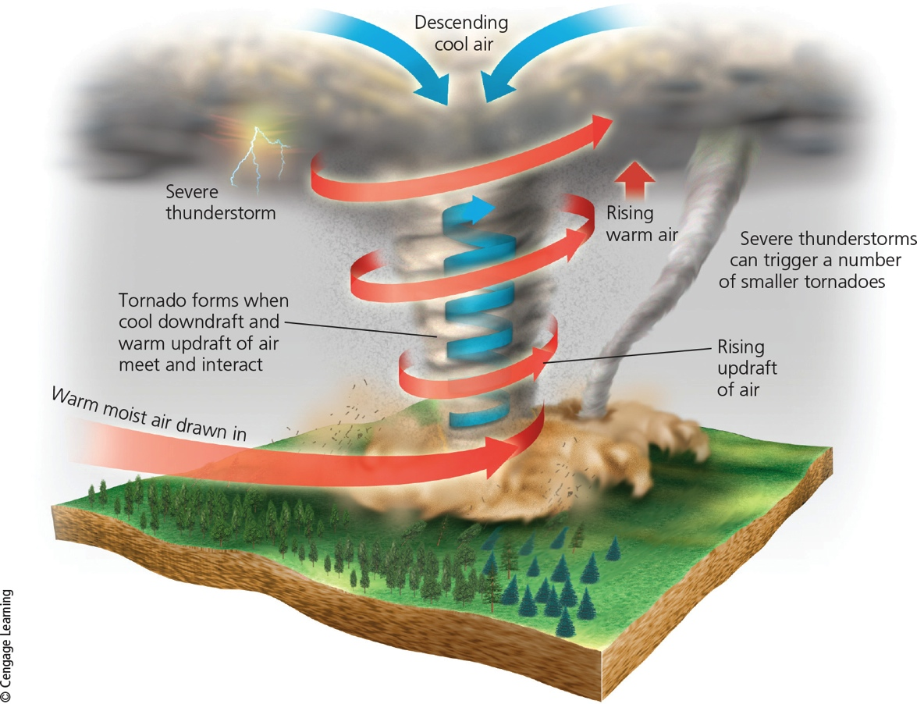
Tornados and Tropical Cyclones Are Violent Weather Extremes (2 of 3)
Notes:
Figure 7.5 Formation of a tornado, or twister. The most active tornado season in the United States is usually March through August.

Slide 14
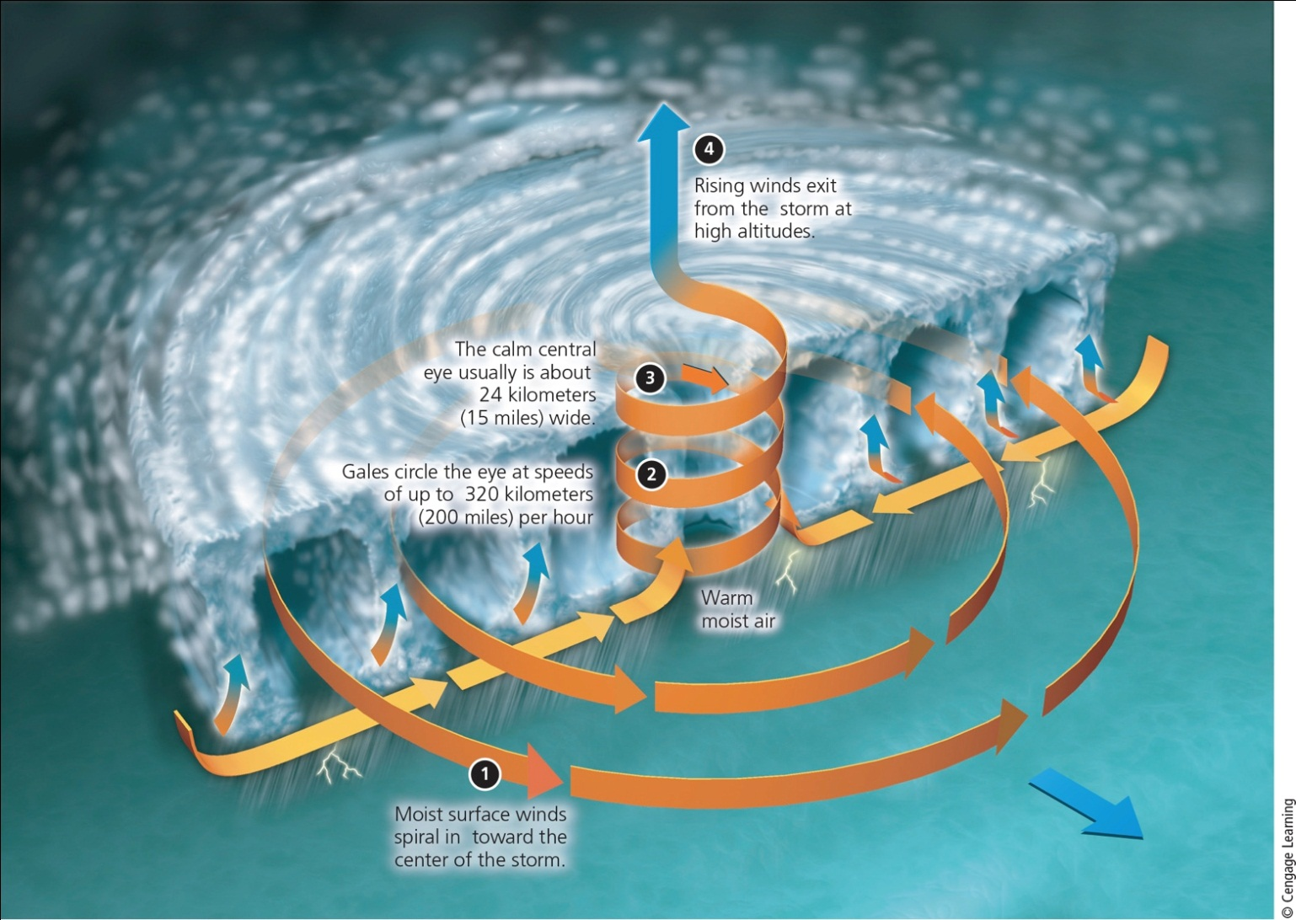
Tornados and Tropical Cyclones Are Violent Weather Extremes (3 of 3)
Notes:
Figure 7.6 Formation of a tropical cyclone. Those forming in the Atlantic Ocean are called hurricanes. Those forming in the Pacific Ocean are called typhoons.

Slide 15
7.2 What Factors Influence Climate?
Key factors that determine an area’s climate
Incoming solar energy
The earth’s rotation
Global patterns of air and water movement
Atmospheric gases
The earth’s surface features

Slide 16
Several Factors Affect Regional Climates (1 of 7)
Weather
Temperature, precipitation, wind speed, and cloud cover
Hours to days
Climate
Area’s general pattern of atmospheric conditions over three decades and longer
Varies among the earth’s different regions

Slide 17
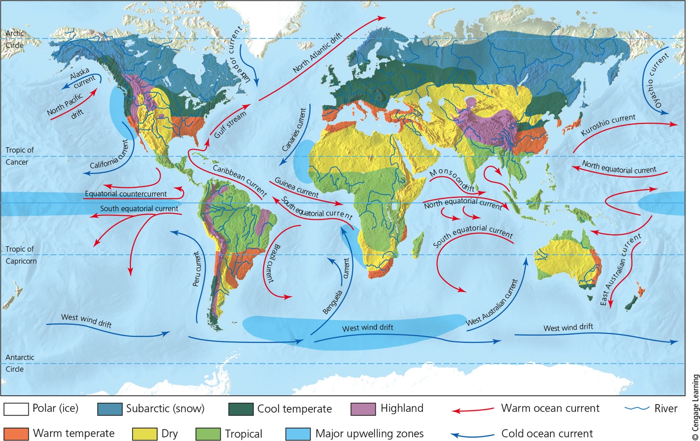
Several Factors Affect Regional Climates (2 of 7)
Notes:
Figure 7.7: Natural capital. This generalized map of the earth’s current climate zones also shows the major ocean currents and upwelling areas (where currents bring nutrients from the ocean bottom to the surface). Question: Based on this map, what is the general type of climate where you live?

Slide 18
Several Factors Affect Regional Climates (3 of 7)
Factors that determine regional climates
Cyclical air movement driven by solar energy
Uneven heating of the earth’s surface by the sun
Varies with latitude
Tilt of earth’s axis and resulting seasonal changes
Rotation of the earth on its axis
Ocean currents help redistribute sun’s heat

Slide 19
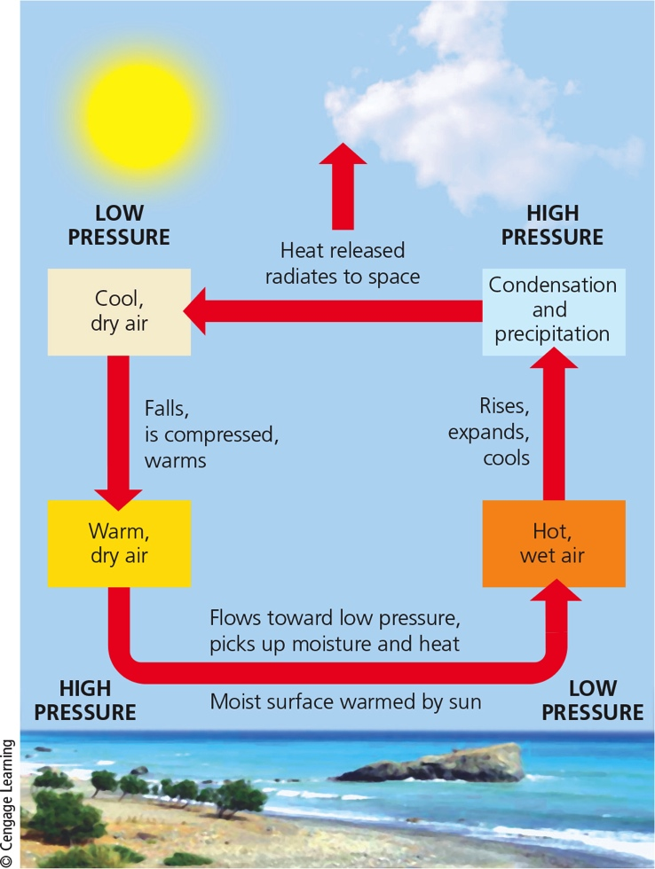
Several Factors Affect Regional Climates (4 of 7)
Notes:
Figure 7.8 Convection cells play a key role in transferring energy (heat) and moisture through the atmosphere from place to place on the planet.

Slide 20
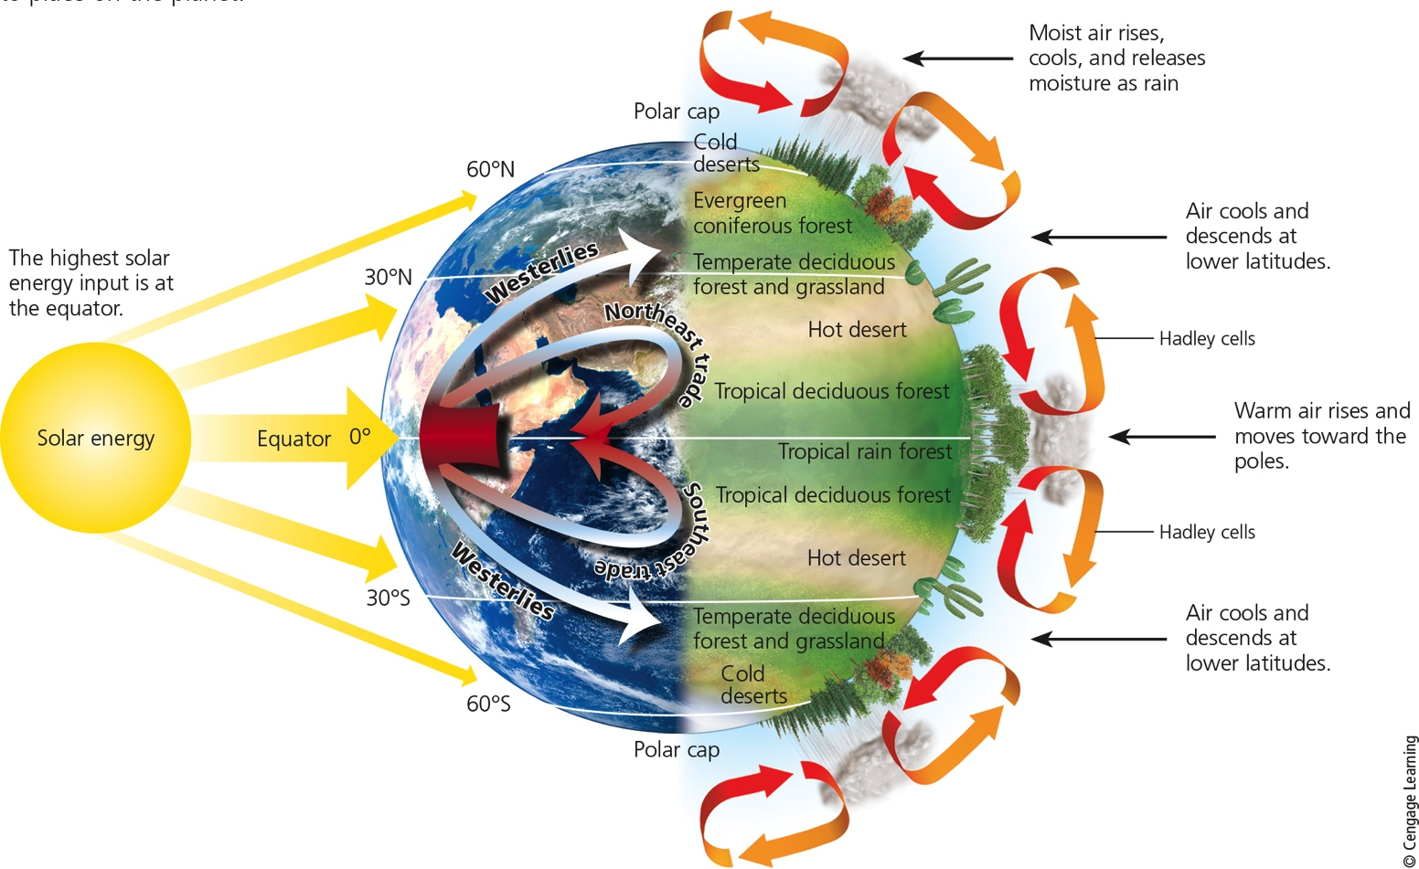
Several Factors Affect Regional Climates (5 of 7)
Notes:
Figure 7.9 Global air circulation: Air rises and falls in giant convection cells (right). Air flowing away from the equator is deflected to the east and air flowing toward the equator is deflected west, due to the Coriolis effect. This creates global patterns of prevailing winds (left) that help to distribute heat and moisture in the atmosphere, which leads to the earth’s variety of forests, grasslands, and deserts (right).

Slide 21
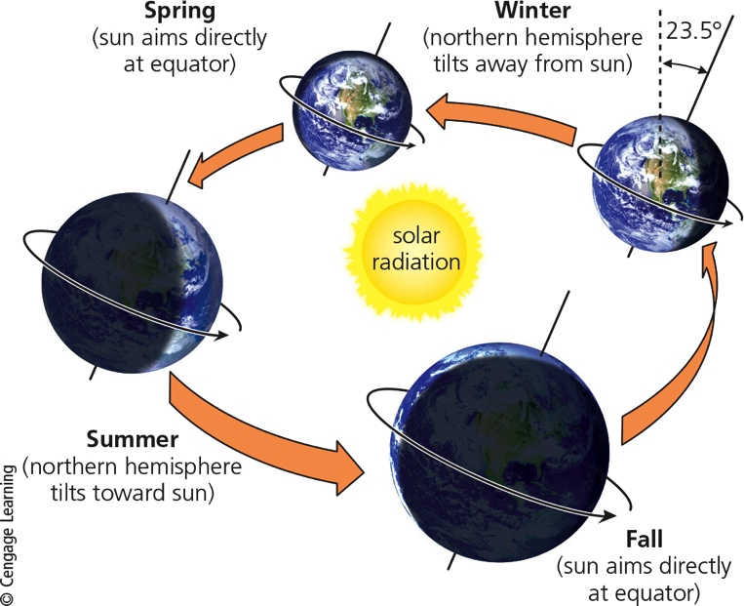
Several Factors Affect Regional Climates (6 of 7)
Notes:
Figure 7.10 The earth’s axis is tilted about 23.5° with respect to the plane of the earth’s path around the sun. The resulting variations in solar energy reaching the northern and southern hemispheres throughout a year result in seasons. Critical thinking: How might your life be different if the earth’s axis was not tilted?

Slide 22
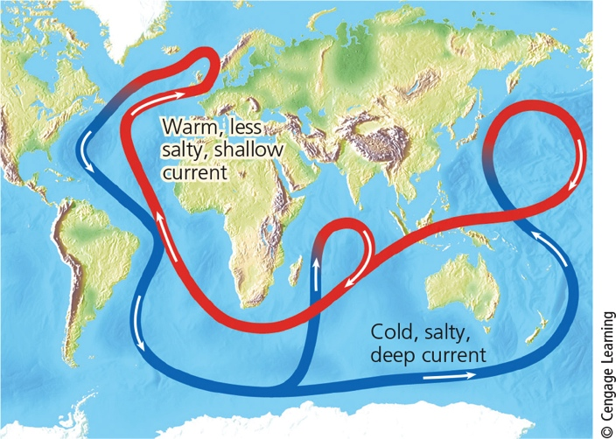
Several Factors Affect Regional Climates (7 of 7)
Notes:
Figure 7.11 A connected loop of deep and shallow ocean currents transports warm and cool water to various parts of the earth.

Slide 23
Greenhouse Gases Warm the Lower Atmosphere
Greenhouse gases
H₂O
CO₂
CH₄
N₂O
Natural greenhouse effect
Gases keep the earth habitable
Human-enhanced global warming

Slide 24
The Earth’s Surface Features Affect Local Climates (1 of 2)
Mountains interrupt flow of prevailing winds
Rain shadow effect
Most precipitation falls on the windward side of mountain ranges
Deserts leeward
Cities create microclimates
Heat islands

Slide 25
The Earth’s Surface Features Affect Local Climates (2 of 2)
Notes:
Figure 7.12 The rain shadow effect is a reduction of rainfall and loss of moisture from the landscape on the leeward side of a mountain. Warm, moist air in onshore winds loses most of its moisture as rain and snow that fall on the windward slopes of a mountain range. This leads to semiarid and arid conditions on the leeward side of the mountain range and on the land beyond.

Slide 26
7.3 How Does Climate Affect the Nature and Locations of Biomes? (1 of 3)
Biomes
Large terrestrial regions
Each characterized by different type of climate and plant life
Not uniform

Slide 27
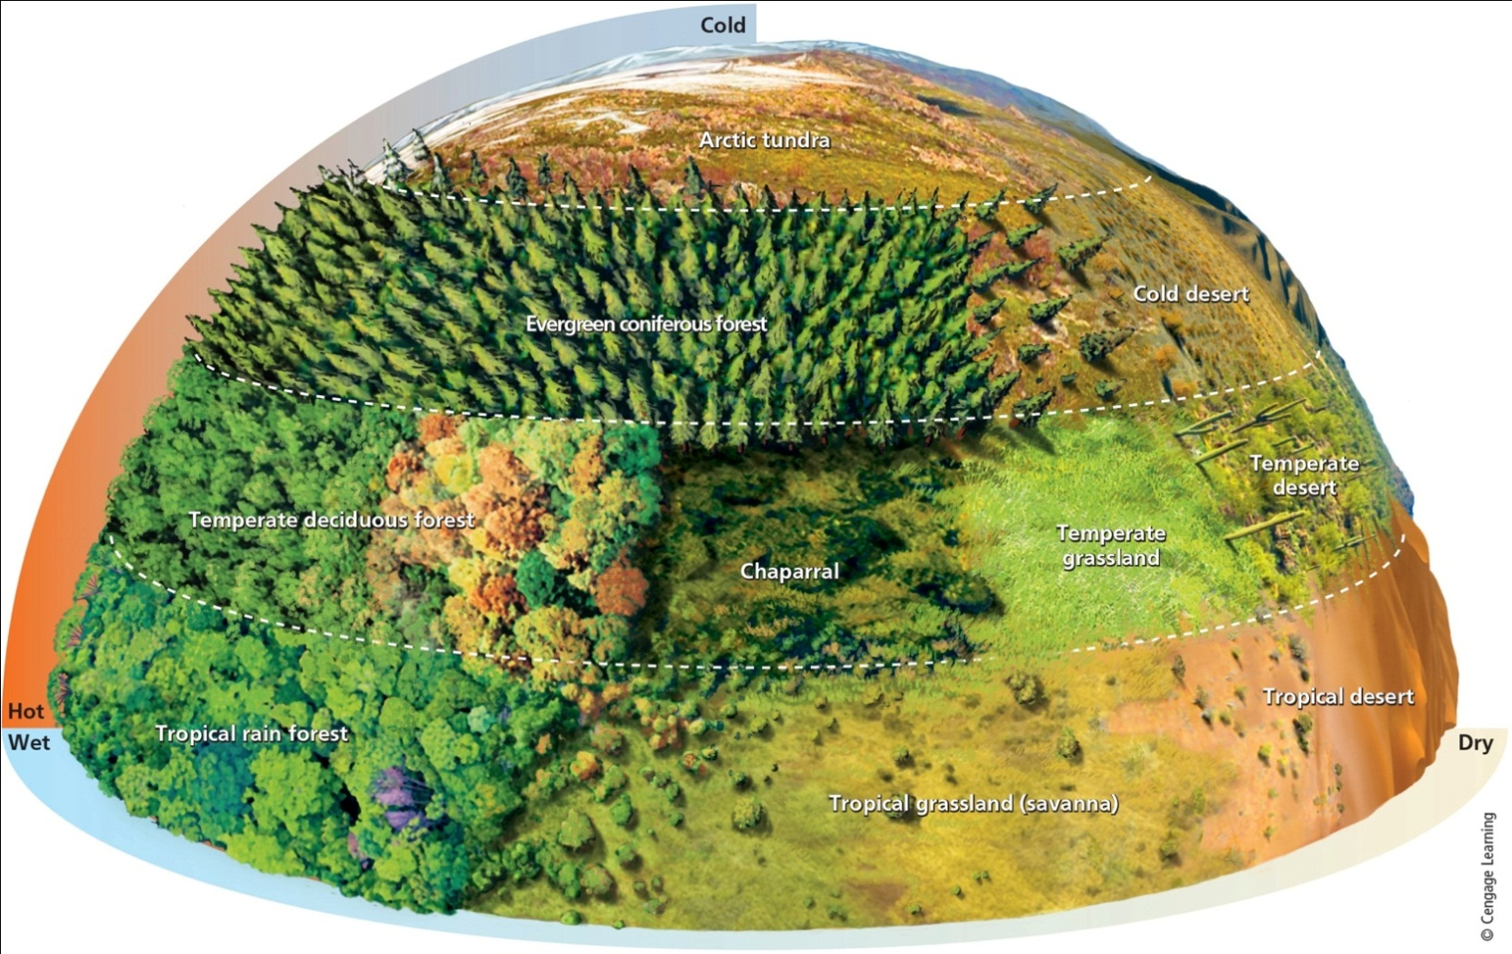
7.3 How Does Climate Affect the Nature and Locations of Biomes? (2 of 3)
Notes:
Figure 7.13 Natural capital. Average precipitation and average temperature, acting together as limiting factors over a long time, help to determine the type of desert, grassland, or forest in any particular area, and thus the types of plants, animals, and decomposers found in that area (assuming it has not been disturbed by human activities).

Slide 28
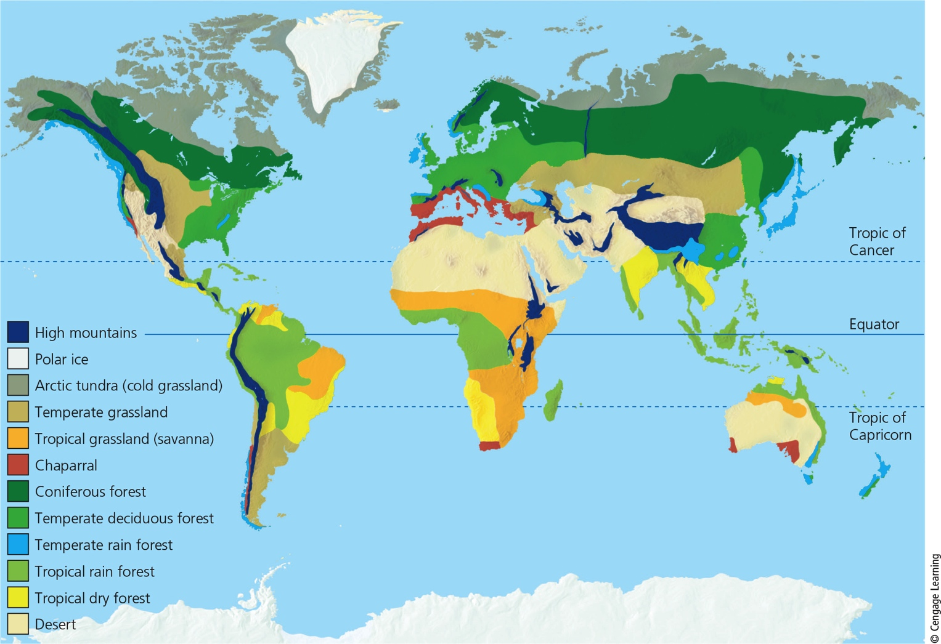
7.3 How Does Climate Affect the Nature and Locations of Biomes? (3 of 3)
Notes:
Figure 7.14 Natural capital. The earth’s major biomes result primarily from differences in climate.

Slide 29
Three Types of Deserts (1 of 4)
Desert – annual precipitation low and scattered unevenly throughout the year
Tropical deserts
Temperate deserts
Cold deserts
Desert ecosystems vulnerable to disruption
Slow plant growth and low species diversity
Slow nutrient cycling

Slide 30
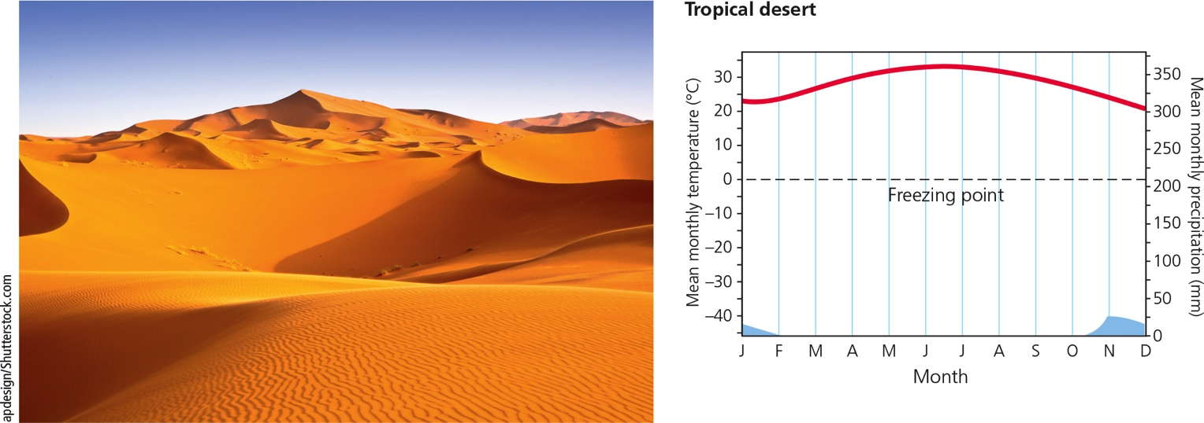
Three Types of Deserts (2 of 4)
Notes:
Figure 7.15a These climate graphs track the typical variations in annual temperature (red) and precipitation (blue) in tropical (savanna), temperate, and cold deserts. Photo: a tropical desert in Morocco. Data analysis: Which month of the year has the highest temperature and which month has the lowest rainfall for each of the three types of deserts?

Slide 31
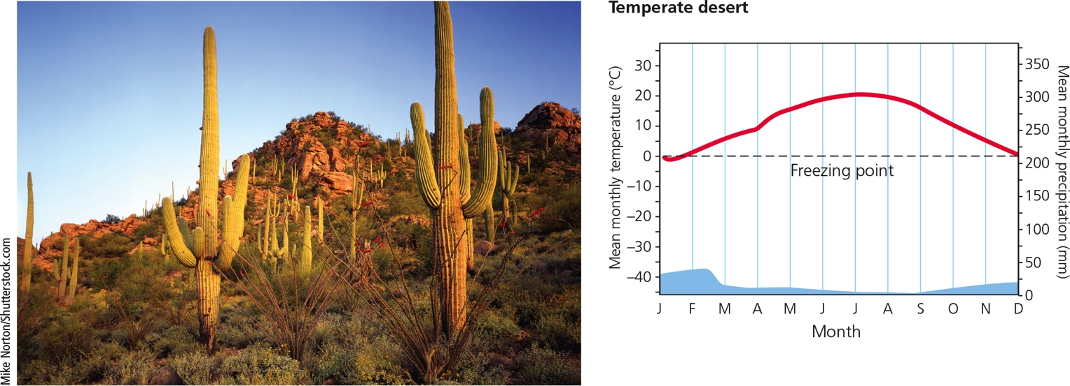
Three Types of Deserts (3 of 4)
Notes:
Figure 7.15b These climate graphs track the typical variations in annual temperature (red) and precipitation (blue) in tropical (savanna), temperate, and cold deserts. Photo: a temperate desert in southeastern California, with saguaro cactus, a prominent species in this ecosystem. Data analysis: Which month of the year has the highest temperature and which month has the lowest rainfall for each of the three types of deserts?

Slide 32
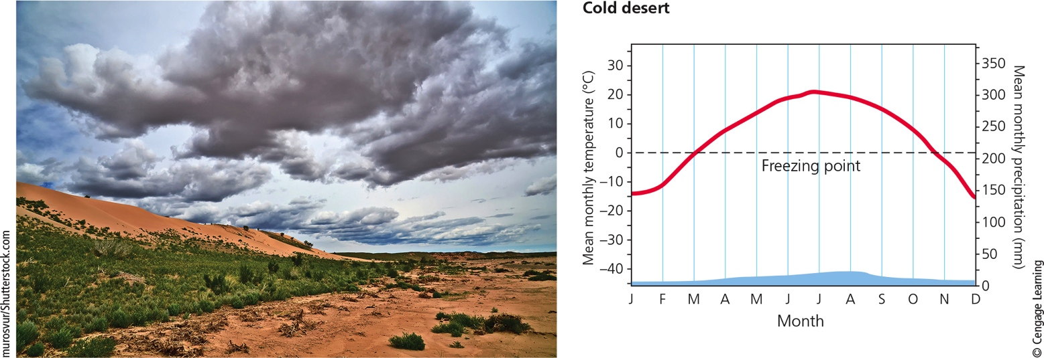
Three Types of Deserts (4 of 4)
Notes:
Figure 7.15c These climate graphs track the typical variations in annual temperature (red) and precipitation (blue) in tropical (savanna), temperate, and cold deserts. Photo: a cold desert, Mongolia’s Gobi Desert. Data analysis: Which month of the year has the highest temperature and which month has the lowest rainfall for each of the three types of deserts?

Slide 33
Science Focus 7.1: Staying Alive in the Desert (1 of 2)
Desert survival adaptations
Plant water conservation
Dormancy
Deep roots
Storing water in leaves
Waxy leaves reduce water loss
Open pores only at night

Slide 34
Science Focus 7.1: Staying Alive in the Desert (2 of 2)
Desert animal adaptations
Hiding in cool burrows or rocky crevices by day
Dormancy
Camels drink massive amounts of water and store
Reptiles’ thick outer coverings minimize water loss

Slide 35
Three Types of Grasslands (1 of 7)
Grasslands exist in continent interiors
Areas too moist for deserts but too dry for forests
Three main types
Tropical
Temperate
Cold (arctic tundra)

Slide 36
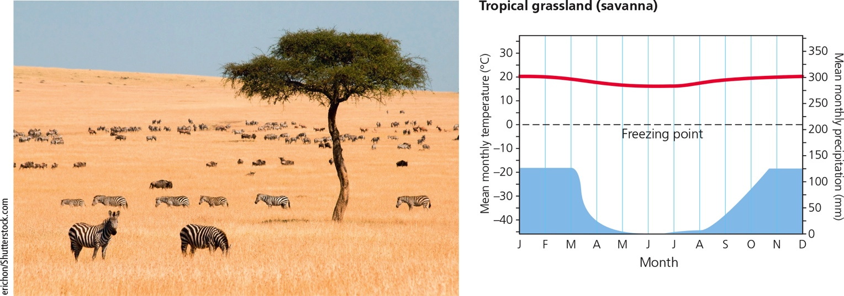
Three Types of Grasslands (2 of 7)
Notes:
Figure 7.16a These climate graphs track the typical variations in annual temperature (red) and precipitation (blue) in tropical, temperate, and cold (arctic tundra) grasslands. Photo: savanna (tropical grassland) in Kenya, Africa, with zebras grazing. Data analysis: Which month of the year has the highest temperature and which month has the lowest rainfall for each of the three types of grassland?

Slide 37
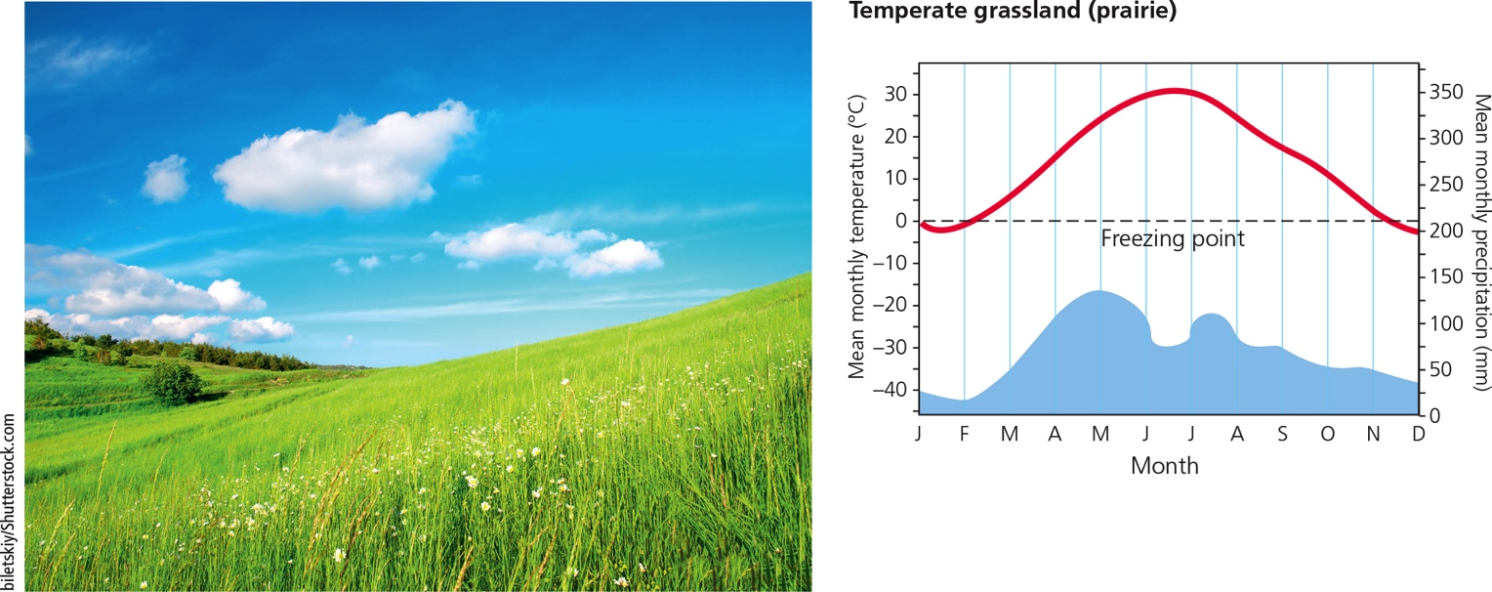
Three Types of Grasslands (3 of 7)
Notes:
Figure 7.16b These climate graphs track the typical variations in annual temperature (red) and precipitation (blue) in tropical, temperate, and cold (arctic tundra) grasslands. Photo: prairie (temperate grassland) in the U.S. state of Illinois. Data analysis: Which month of the year has the highest temperature and which month has the lowest rainfall for each of the three types of grassland?

Slide 38
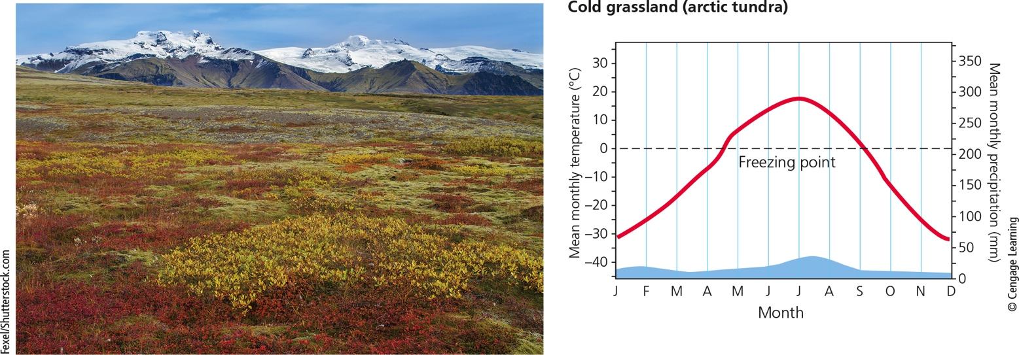
Three Types of Grasslands (4 of 7)
Notes:
Figure 7.16c These climate graphs track the typical variations in annual temperature (red) and precipitation (blue) in tropical, temperate, and cold (arctic tundra) grasslands. Photo: arctic tundra (cold grassland) in Iceland in fall. Data analysis: Which month of the year has the highest temperature and which month has the lowest rainfall for each of the three types of grassland?

Slide 39
Three Types of Grasslands (5 of 7)
Tropical
Savanna
Warm temperatures year-round
Grazing and browsing animals
Temperate
Cold winters and hot, dry summers
Tallgrass prairies
Short-grass prairies
Often converted to farmland

Slide 40
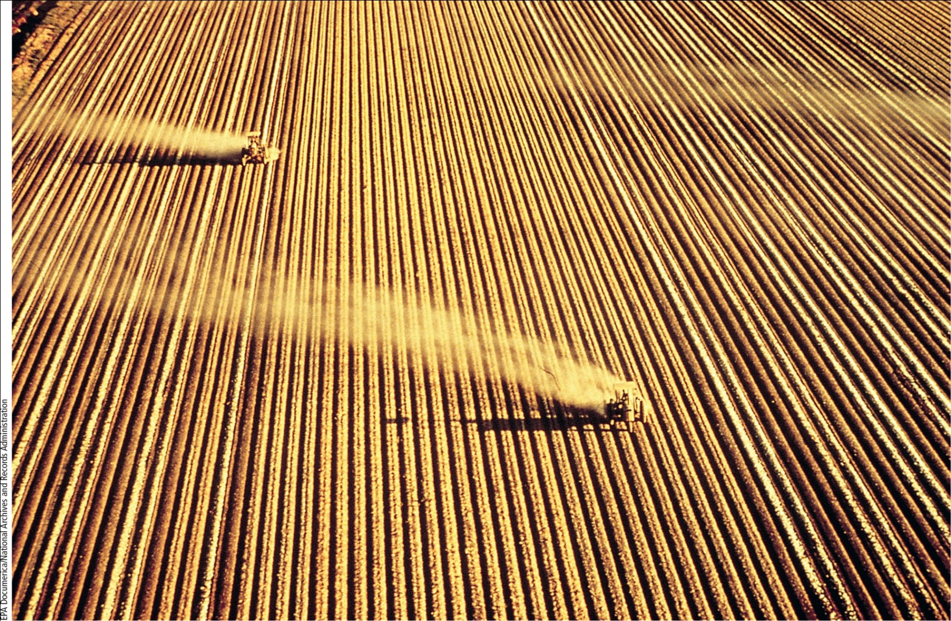
Three Types of Grasslands (6 of 7)
Notes:
Figure 7.17 Natural capital degradation: This intensively cultivated cropland is an example of the replacement of biologically diverse temperate grasslands (such as in the center photo of Figure 7.16) with a monoculture crop.

Slide 41
Three Types of Grasslands (7 of 7)
Arctic tundra
Plants close to ground to conserve heat
Most growth in short summer
Animals have thick fur
Permafrost
Underground soil that stays frozen
Alpine tundra
Above tree line in mountains

Slide 42
Chaparral: A Dry, Temperate Biome (1 of 2)
Occur in coastal regions that border deserts
Dense growths of low growing, evergreen shrubs
Some small trees with leathery leaves
Thin soil
Adapted to and maintained by occasional fires

Slide 43
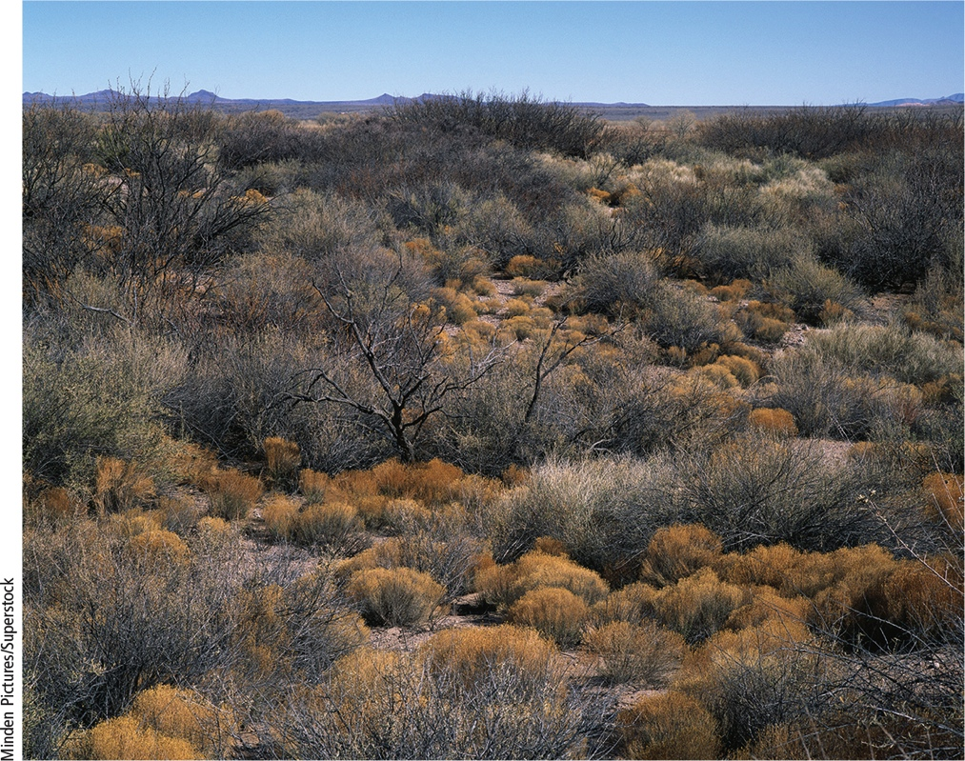
Chaparral: A Dry, Temperate Biome (2 of 2)
Notes:
Figure 7.18 Lowland chaparral in the Rio Grande River Valley, New Mexico (USA).

Slide 44
Three Types of Forests (1 of 9)
Forests – lands dominated by trees
Tropical
Temperate
Cold
Northern coniferous and boreal

Slide 45
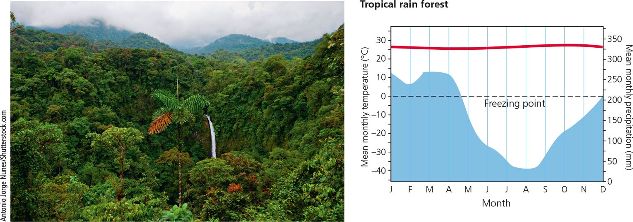
Three Types of Forests (2 of 9)
Notes:
Figure 7.19a These climate graphs track the typical variations in annual temperature (red) and precipitation (blue) in tropical, temperate, and cold (northern coniferous, or boreal) forests. Photo: the closed canopy of a tropical rain forest in Costa Rica. Data analysis: Which month of the year has the highest temperature and which month has the lowest rainfall for each of the three types of forest?

Slide 46
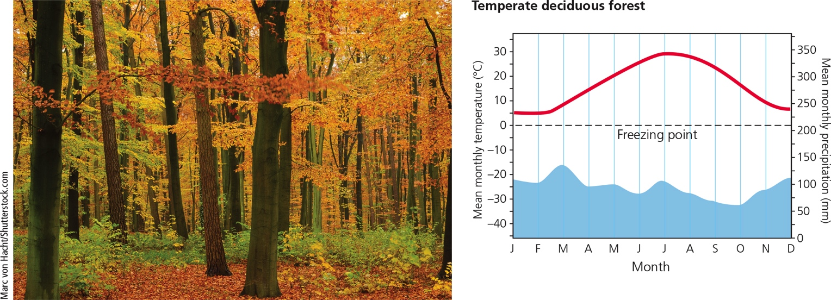
Three Types of Forests (3 of 9)
Notes:
Figure 7.19b These climate graphs track the typical variations in annual temperature (red) and precipitation (blue) in tropical, temperate, and cold (northern coniferous, or boreal) forests. Photo: a temperate deciduous forest near Hamburg, Germany, in autumn. Data analysis: Which month of the year has the highest temperature and which month has the lowest rainfall for each of the three types of forest?

Slide 47
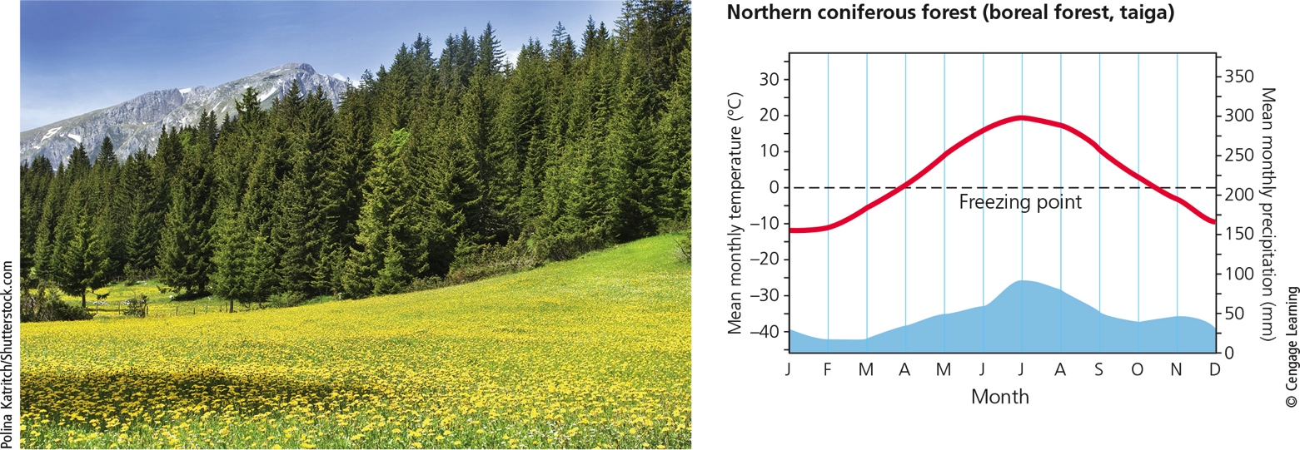
Three Types of Forests (4 of 9)
Notes:
Figure 7.19c These climate graphs track the typical variations in annual temperature (red) and precipitation (blue) in tropical, temperate, and cold (northern coniferous, or boreal) forests. Photo: a northern coniferous forest in Canada. Data analysis: Which month of the year has the highest temperature and which month has the lowest rainfall for each of the three types of forest?

Slide 48
Three Types of Forests (5 of 9)
Tropical rain forests
Hot, high moisture air
Stratification of specialized plant and animal niches
Rapid recycling of scarce soil nutrients
What is the impact of human activities in the rain forest?

Slide 49
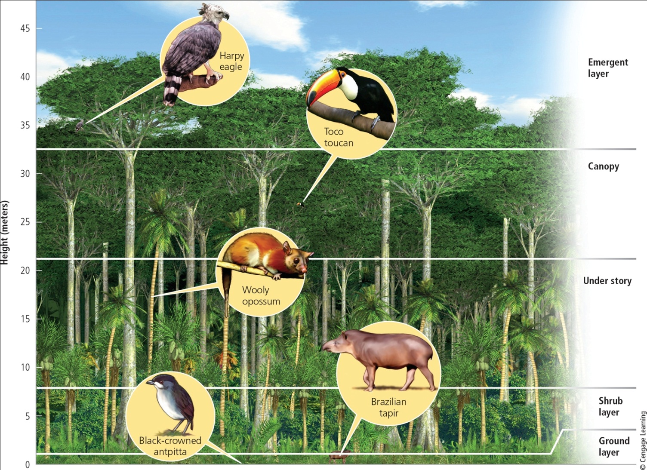
Three Types of Forests (6 of 9)
Notes:
Figure 7.20 Specialized plant and animal niches are stratified, or arranged roughly in layers, in a tropical rain forest. Filling such specialized niches enables species to avoid or minimize competition for resources and results in the coexistence of a great variety of species.

Slide 50
Three Types of Forests (7 of 9)
Temperate deciduous forests
Cooler temperatures, abundant moisture
Broadleaf deciduous trees
Slow rate of decomposition
What is the impact of human activities on temperate forests?

Slide 51
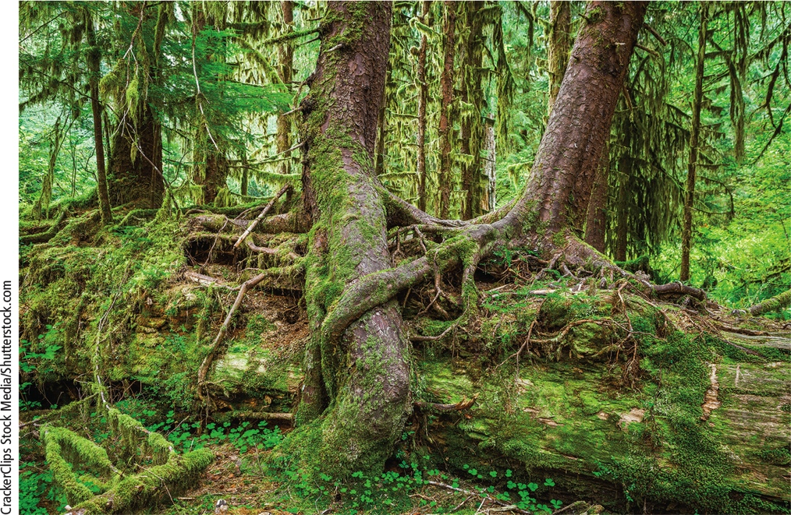
Three Types of Forests (8 of 9)
Notes:
Figure 7.21 Temperate rain forest in Olympic National Park in the U.S. state of Washington.

Slide 52
Three Types of Forests (9 of 9)
Coastal coniferous forest
Also called temperate rain forests
Found in scattered coastal regions
Ample rainfall and moisture from fog
Evergreen coniferous trees
Cold (northern) coniferous forest
Also called boreal forests or taigas
South of arctic tundra
Cold winters and short summers

Slide 53
Mountains Play Important Ecological Roles (1 of 2)
Mountains – steep or high elevation lands
Large portion of world’s forests
Islands of biodiversity
Habitats for endemic species
Help regulate the earth’s climate
Major storehouses of water
Role in hydrologic cycle

Slide 54
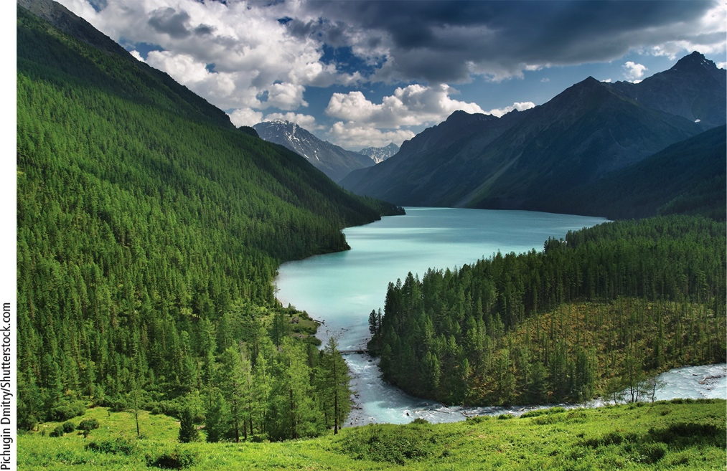
Mountains Play Important Ecological Roles (2 of 2)
Notes:
Figure 7.22 Mountains, such as these surrounding a lake, provide vital ecosystem services.

Slide 55
Critical Concepts: Valuation of Natural Capital (1 of 3)
Robert Costanza and his colleagues estimate the economic value of ecosystem services by the earth’s forests to be $15.6 trillion per year
Far greater in value than the amount of money the felled timber would bring
Underpricing of natural resources when not considering the services they provide leads to unsustainable management.

Slide 56
Critical Concepts: Valuation of Natural Capital (2 of 3)
Important ecosystem services include
Pollination
Clean water
Seed dispersal
Soil fertility
Decomposition of organic waste
Pest control
Flood control
Climate regulation
Cycling of nutrients

Slide 57
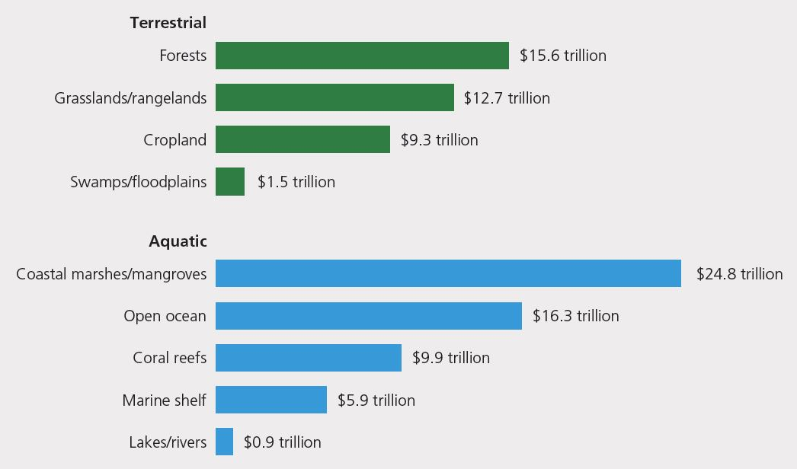
Critical Concepts: Valuation of Natural Capital (3 of 3)

Slide 58
Humans Have Disturbed Much of the Earth’s Land (1 of 2)
About 60% of world’s major terrestrial ecosystems being degraded or used unsustainably
The human ecological footprint is spreading across the globe

Slide 59
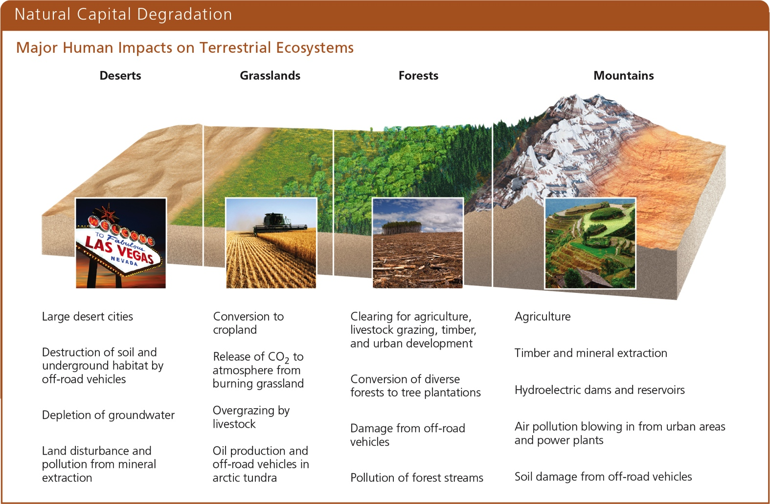
Humans Have Disturbed Much of the Earth’s Land (2 of 2)
Notes:
Figure 7.24 Human activities have had major impacts on the world’s deserts, grasslands, forests, and mountains, as summarized here. Critical thinking: For each of these biomes, which two of the impacts listed do you think are the most harmful? Explain.

