Slide 1
Biology Concepts & Applications
10 Edition
Chapter 44
Human Effects on the Biosphere
Copyright © 2018 Cengage Learning. All Rights Reserved. May not be copied, scanned, or duplicated, in whole or in part, except for use as permitted in a license distributed with a certain product or service or otherwise on a password-protected website for classroom use.

Slide 2
44.1 Threatened and Endangered Species (1 of 2)
All over the world, humans are replacing wildlife habitat with our dwellings, factories, and farms
We also put species at risk
Competing with them for resources
Overharvesting them
Introducing non-native competitors
The rate of species extinctions is rising; many types of biomes are threatened

Slide 3
Threatened and Endangered Species (2 of 2)
A species is considered endangered when one or more of its populations have declined or are declining
Endangered species
A species that faces extinction in all or a part of its range
Threatened species
Species likely to become endangered in the near future

Slide 4
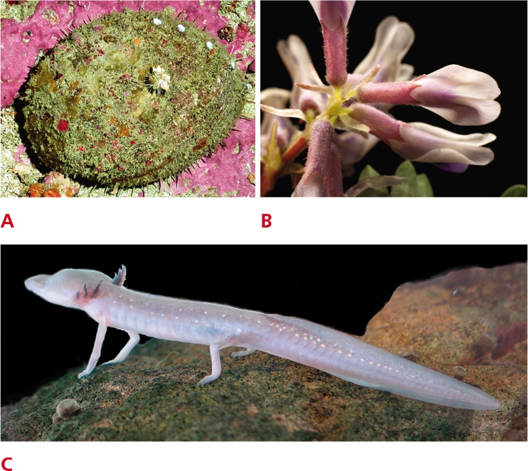
Endangered Species in the United States
Notes:
Figure 44.1 Some endangered species of the United States. To learn more about these and other endangered species, visit the United States Fish and Wildlife Service’s website at www.fws.gov/endangered/.
A White abalone.
B Pyne’s ground plum.
C Texas blind salamander.

Slide 5
Causes of Species Decline
Human activities threaten other species by destroying or degrading habitat
In some cases, people directly reduce a species’ number through overharvesting
Species are overharvested not only as food, but also for use in traditional medicine, for the pet trade, and for ornamentation

Slide 6
Habitat Degradation and Fragmentation (1 of 2)
Humans also harm species indirectly by altering the species’ habitats
Any degradation, fragmentation, or destruction of that habitat reduces population numbers
An endemic species occurs only in the area in which it evolved
Endemic species are more likely to go extinct as a result of habitat degradation than species that have spread to many areas

Slide 7
Habitat Degradation and Fragmentation (2 of 2)
Deliberate or accidental species introductions can be another type of habitat degradation
Habitat fragmentation creates islands of suitable habitat scattered across what was once a continuous range

Slide 8
The Unknown Losses
Estimates of the number of currently living species range as high as 1 trillion, but only about 2 million species have been described and named
Simply put, we do not yet know what we have to lose

Slide 9
44.2 Desertification and Deforestation (1 of 2)
Desertification occurs when plowing or grazing removes plants and exposes topsoil to wind erosion
Fewer plants means less transpiration; rainfall decreases
In a positive feedback cycle, drought encourages desertification, which worsens drought

Slide 10
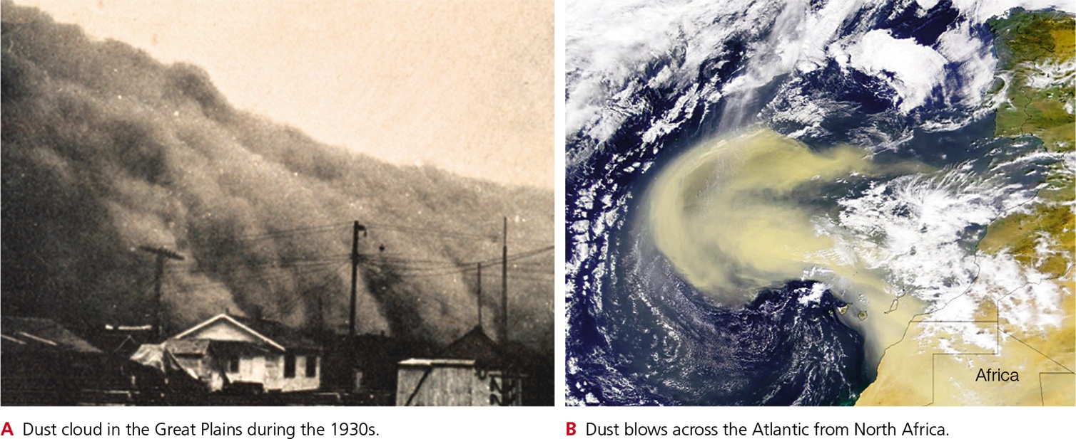
Dust Storms from Desertification (2 of 2)
Notes:
Figure 44.2 Dust storms, one outcome of desertification.

Slide 11
Deforestation (1 of 2)
Tropical forests continue to disappear at an alarming rate
In addition to immediate destruction of forest organisms, deforestation encourages flooding and raises risk of landslides in hilly areas
Deforestation also affects local weather–temperatures rise, and reduced transpiration results in less rainfall

Slide 12
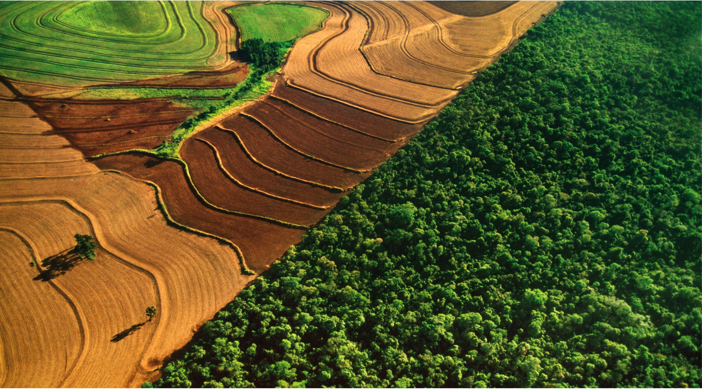
Deforestation for Cropland
Notes:
Figure 44.3 Deforestation. Cropland that once was rainforest extends right up to the edge of Iguaçu national park, a World Heritage site that straddles the border between Brazil and Argentina.

Slide 13
Deforestation (2 of 2)
Forests take up and store huge amounts of carbon, so deforestation also contributes to global climate change
Deforested areas also become nutrient-poor
Experimental deforestation increased runoff of essential soil nutrients such as calcium (compared with undisturbed forest)

Slide 14
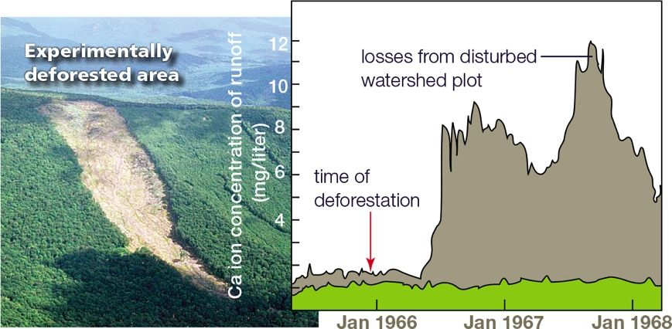
Experimental Deforestation
Notes:
Figure 44.4 Effect of experimental deforestation on nutrient losses from soil. After deforestation, calcium (Ca) levels in runoff increased sixfold (gray). An undisturbed plot in the same forest showed no increase during this time (green).

Slide 15
44.3 Effects of Pollution
Pollutants: natural or synthetic substances released into soil, air, or water in greater than natural amounts
Presence of a pollutant disrupts the physiological processes of organisms that evolved in its absence or that are adapted to lower levels of it

Slide 16
Talking Trash
Trash
When buried in the ground (such as lead from batteries) can contaminate groundwater
When dumped at sea (such as plastics) harms marine life
Plastic and other garbage that enters our coastal waters persists for many years
Avoid buying plastics, or be sure to recycle or dispose of them properly

Slide 17
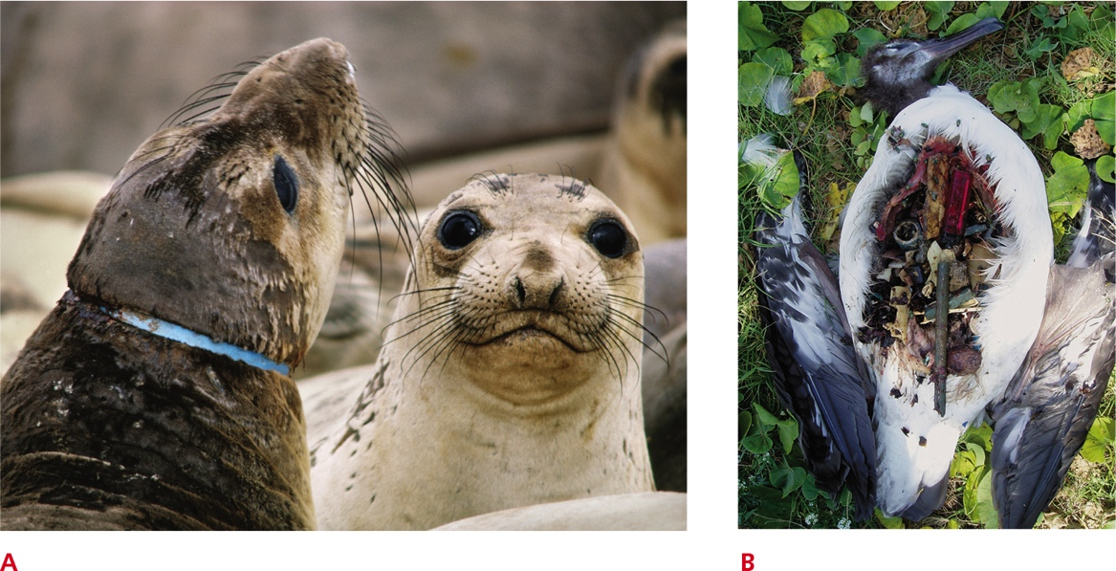
Perils of Plastic
Notes:
Figure 44.5 Perils of plastic.
A Juvenile sea lion with ring of discarded plastic around its neck. As the animal grows, the plastic will cut into its neck, causing a wound and impairing its ability to feed.
B Recently deceased Laysan albatross chick, dissected to reveal the contents of its gut. Scientists found more than 300 pieces of plastic inside the bird. One of the pieces had punctured its gut wall, resulting in its death. The chick was fed the plastic by its parents, who gathered the material from the ocean surface, mistaking it for food.

Slide 18
Atmospheric Deposition
Acid deposition
Dry dust particles coated with airborne sulfur and nitrogen fall to the ground as dry acid deposition
Pollutants combine with water and fall as wet acid deposition or acid rain
Low pH rain that forms when sulfur dioxide and nitrogen oxides mix with water vapor in the atmosphere

Slide 19
Acid Rain (1 of 2)
Acid rain in aquatic habitats
Prevents fish eggs from developing
Kills adult fish
Acid rain in forests
Burns tree leaves
Makes trees more susceptible to insects and pathogens

Slide 20
Acid Rain (2 of 2)
Acid rain alters composition of soils
Positive hydrogen ions displace positive nutrient ions, such as calcium, causing nutrient loss
Acidity causes soil particles to release metals, such as aluminum, that harm plants

Slide 21
Ammonium Deposition
Sulfur dioxides and nitrogen oxides that enter the air can also combine with gaseous ammonia released by fertilizers and animal wastes
When the resulting ammonium salts fall to Earth, they act like fertilizer
Addition of these salts to soil allows plants with high nitrogen needs to thrive where they would otherwise be excluded, thus altering the array of species in an ecosystem

Slide 22
Mercury Deposition
Emissions from coal-burning power plants and factories are the main source of mercury in the atmosphere
When mercury falls to Earth, microorganisms combine it with carbon to form methylmercury, which is toxic to animals
Methylmercury commonly enters aquatic food chains and undergoes biological magnification
Its concentration in organisms increases as it passes from one trophic level to the next

Slide 23
44.4 Ozone Depletion
Ozone is said to be “good up high, but bad nearby”
In the upper atmosphere, the ozone (O₃) layer absorbs most incoming ultraviolet (UV) radiation that damages DNA and causes mutations
Near the ground, it is a harmful pollutant

Slide 24
Depletion of the Ozone Layer
In the mid-1970s, scientists noticed that Earth’s ozone layer (10.5–17 miles above sea level) was thinning, particularly over Antarctica (the “ozone hole”)
In 1987, countries worldwide agreed to phase out production of chlorofluorocarbons (CFCs) and other ozone-destroying chemicals–but existing CFCs break down very slowly

Slide 25
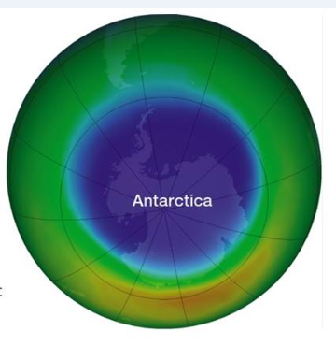
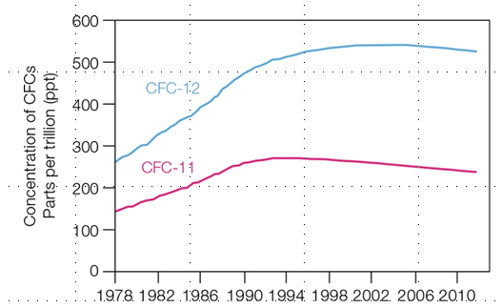
Destruction of the Ozone Layer
A
Ozone levels in the upper atmosphere in September 2012, the Antarctic spring.
Purple indicates the least ozone; blue, green, and yellow indicate increasingly higher levels. Check the current status of the ozone hole at NASA's website (http://ozonewatch.gsfc .nasa.gov/).
B
Concentration of two CFCs in the upper atmosphere. These pol-lutants destroy ozone. A worldwide ban on CFCs has successfully halted the rise in atmospheric CFC concentration.
Notes:
Figure 44.7 Destruction of the ozone layer.

Slide 26
Near-Ground Ozone Pollution
Near the ground, ozone irritates eyes and respiratory tracts of humans and wildlife and interferes with plant growth
Ground-level ozone forms when nitrogen oxides and volatile organic compounds released by burning or evaporating fossil fuels are exposed to sunlight
Warm temperatures speed the reaction

Slide 27
44.5 Global Climate Change (1 of 2)
Climate change is the most widespread threat to habitats worldwide
Thermal expansion/meltwater from glaciers flood coastal wetlands
Temperature changes disrupt life-cycle events (e.g., tree flowering, animal migration, and breeding seasons)
Some species are moving to higher latitudes or elevations; those that cannot move are stressed or dying

Slide 28
Global Climate Change (2 of 2)
Many weather patterns are expected to change as rising land and sea temperatures affect evaporation, winds, and currents
Examples
Extremes in rainfall patterns: periods of drought interrupted by unusually heavy rains
Increase in hurricane intensity

Slide 29
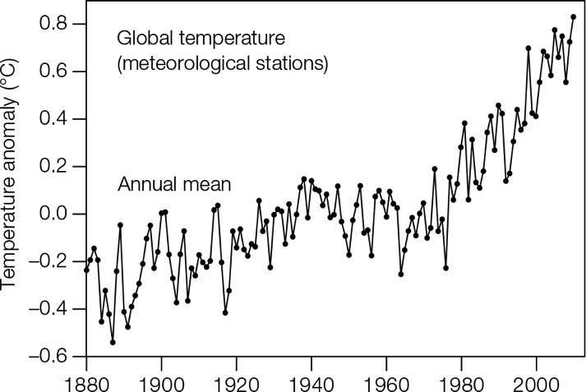
Rising Global Temperature
Notes:
Figure 44.8 Rising global temperature. The temperature anomaly is the amount a temperature deviates from average temperature during the interval from 1951 to 1980. Temperatures were measured at weather stations on land.

Slide 30
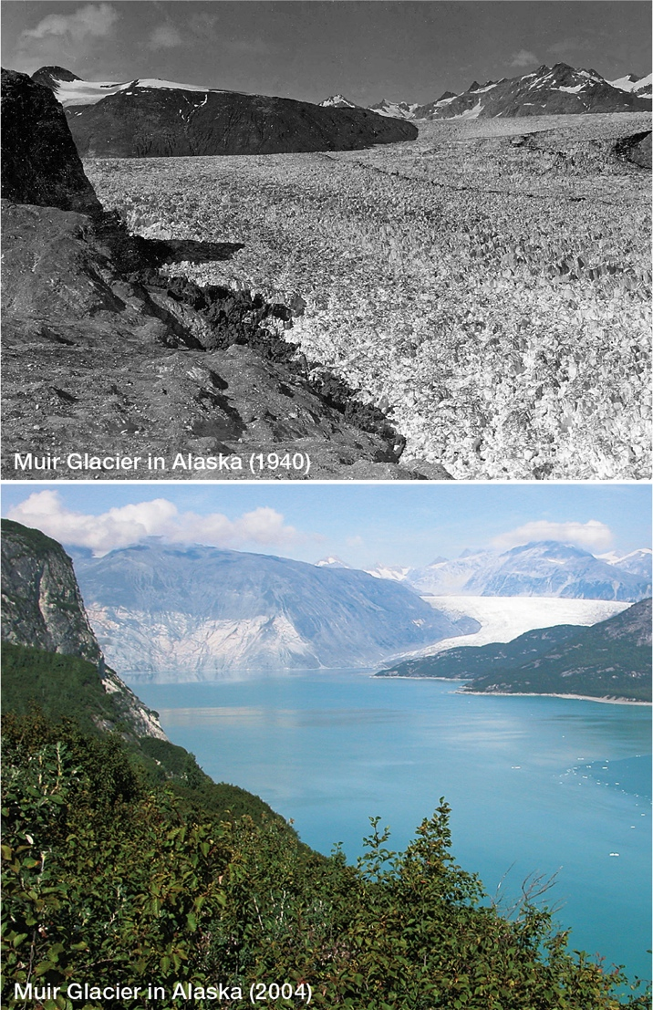
Melting Glaciers
Notes:
Figure 44.9 Melting glaciers, a sign of a warming world. A recent study estimates that Alaska’s glaciers lost an average of 75 million tons of ice per year between 1994 and 2013.

Slide 31
44.6 Conservation Biology
Conservation biologists survey and seek ways to protect the world’s existing biodiversity
Conservation biology
Field of applied biology that surveys biodiversity and seeks ways to maintain and use it

Slide 32
The Value of Biodiversity (1 of 2)
Biological wealth (biodiversity) is measured at three levels
Genetic diversity within species
Species diversity
Ecosystem diversity
Biodiversity is declining at all three levels, in all regions

Slide 33
The Value of Biodiversity (2 of 2)
Healthy ecosystems are essential to human survival
Produce our oxygen and food
Remove, decompose, and detoxify wastes
Prevent erosion and reduce risk of flooding
Allow for new medicines to be derived from compounds in wild species
Encourage plant breeders to use genes in wild species to protect and improve crops

Slide 34
Setting Priorities
People often oppose environmental protections because they fear adverse economic consequences
Conservation biologists help determine which regions should be targeted for protection first by identifying hot spots
Threatened region with great biodiversity that is considered a high priority for conservation efforts

Slide 35
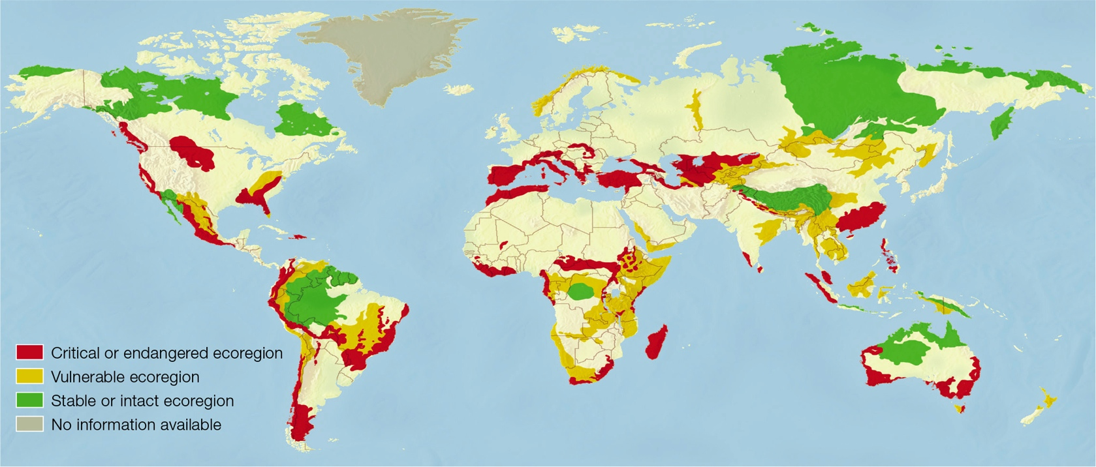
Biodiversity Hot Spots
Notes:
Figure 44.10 The location and conservation status of the land ecoregions deemed most important by the World Wildlife Fund.

Slide 36
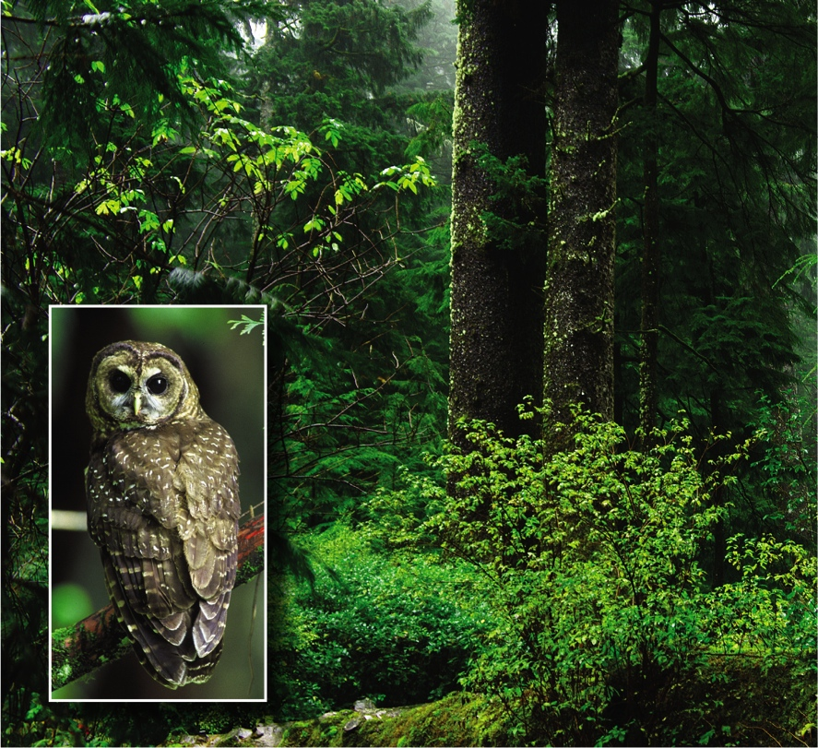
Klamath–Siskiyou Forest
Notes:
Figure 44.11 Klamath–Siskiyou forest, one of North America’s critical ecoregions. Endangered northern spotted owls (inset) are endemic to this coniferous forest.

Slide 37
Preservation and Restoration
Many biodiverse regions have been protected in ways that benefit local people
Sometimes ecological restoration is needed
Actively altering an area in an effort to restore or create a functional ecosystem
Required when a natural ecosystem has been degraded or destroyed
Example: Louisiana’s coastal wetlands

Slide 38
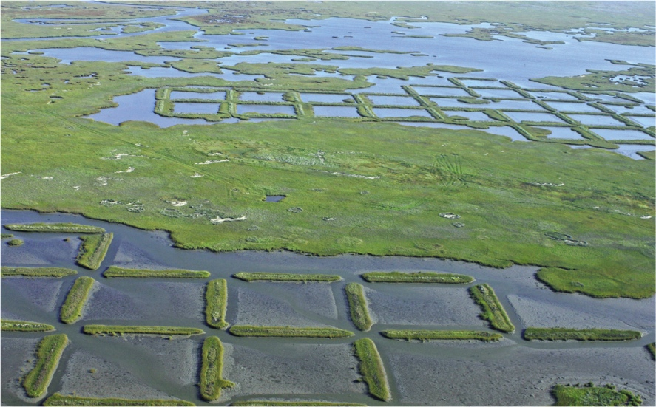
Ecological Restoration
Notes:
Figure 44.12 Ecological restoration in Louisiana’s Sabine National Wildlife Refuge. Where marshland has become open water, sediments are barged in and marsh grasses are planted on them. The squares are new sediment with marsh grass.

Slide 39
44.7 Reducing Human Impacts (1 of 2)
Ultimately, the health of our planet depends on our ability to recognize the principles of energy flow and resource limitation
The goal is living sustainably
Meeting the needs of the present generation without reducing the ability of future generations to meet their own needs

Slide 40
Reducing Human Impacts (2 of 2)
Living sustainably begins with recognizing the environmental consequences of one’s own lifestyle
People in industrial nations use enormous quantities of resources, and the extraction, delivery, and use of these resources has negative effects on biodiversity

Slide 41
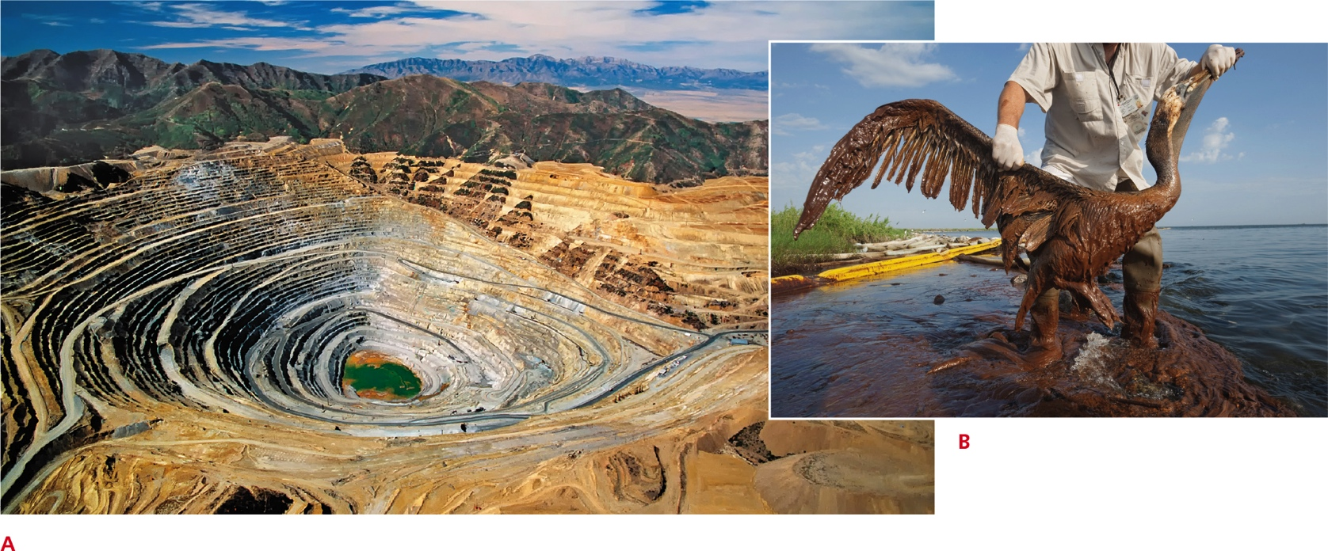
Costs of Resource Extraction
Notes:
Figure 44.13 Environmental costs of resource extraction.
A Bingham copper mine near Salt Lake City, Utah. This open pit mine is 4 kilometers (2.5 miles) wide and 1,200 meters (0.75 miles) deep, the largest man-made excavation on Earth.
B Pelican covered with oil that accidentally escaped from a deep sea-drilling platform in the Gulf of Mexico.

Slide 42
Sustainable Living (1 of 3)
Minimizing energy use is also part of living sustainably
Burning nonrenewable fossil fuels contributes to global warming and acid rain
Extracting and transporting fossil fuels add environmental costs
Environmental damage from spills and leaks

Slide 43
Sustainable Living (2 of 3)
Nuclear energy produces no CO₂, but occasional accidents allow dangerous radioactive material to escape
Renewable energy sources have their own drawbacks
Dams in rivers can alter the array of species in the river by slowing its flow
Wind turbines kill birds and bats
Industrial-scale solar farms can pose a threat to birds too

Slide 44
Sustainable Living (3 of 3)
The best way to minimize your impact is to use less energy
If you want to make more of a difference, learn about the threats to ecosystems in your own area
Support efforts to document, preserve, and restore local biodiversity
Many ecological restoration projects are supervised by trained biologists but carried out primarily by volunteers

Slide 45
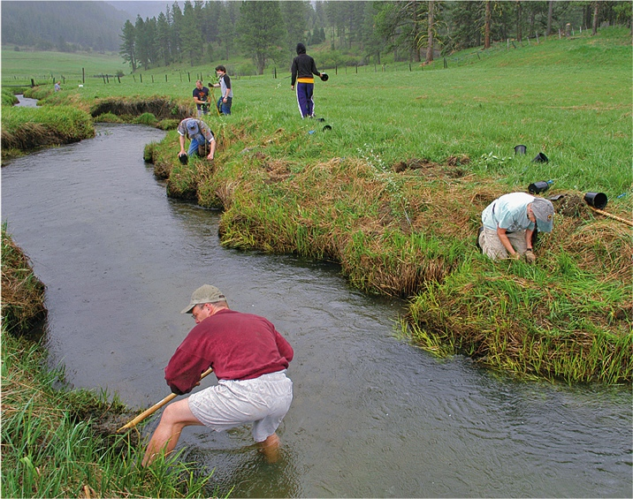
Restoring Ecosystems
Notes:
Figure 44.14 Volunteers restoring the Little Salmon River in Idaho so that salmon can migrate upstream to their breeding grounds.

Slide 46
Application: Citizen Scientists (1 of 2)
Documenting Earth’s existing biodiversity and monitoring the effects of climate change and other human-caused factors are enormous undertakings
Gathering such information is a task too big to be accomplished by scientists alone
Modern technology makes it easy to crowdsource data—to gather and organize information collected independently by a large number of individuals

Slide 47
Citizen Scientists (2 of 2)
Consider the iNaturalist project, an online social network for sharing information about biodiversity
The goal of iNaturalist is to foster a public appreciation of biodiversity, while also gathering scientifically valuable biodiversity data
The iNaturalist app (available for iOS and Android) allows users to upload photos of organisms they observe, along with the time and location of the observation

Slide 48
Documenting Biodiversity
Notes:
Figure 44.15 Documenting biodiversity.

Slide 49
Discuss
Are human activities the only cause of global change?
Defend and refute the statement, “Extinction, like speciation, is a natural process.”
In terms of biological magnification, is it better to be a strict vegetarian or omnivorous?

