Slide 1
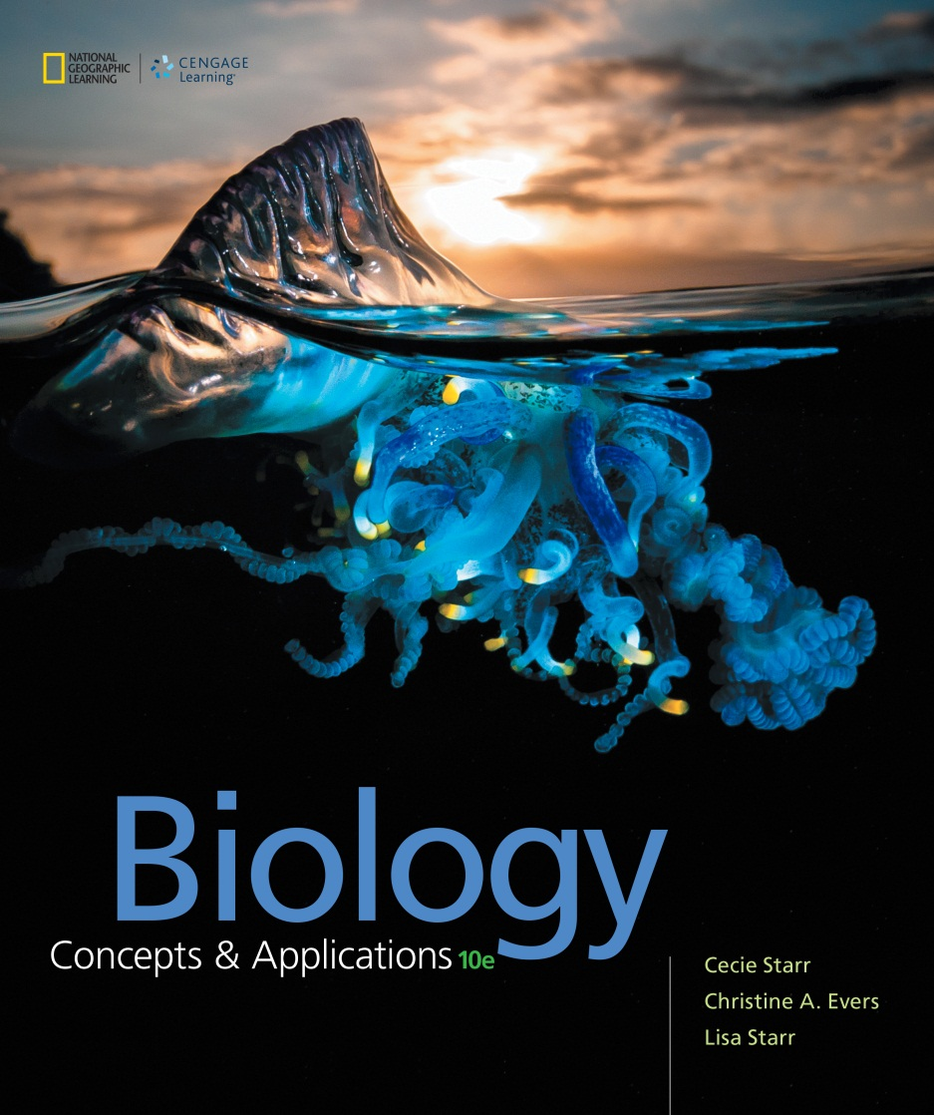
Biology Concepts & Applications
10 Edition
Chapter 3
Molecules of Life
Copyright © 2018 Cengage Learning. All Rights Reserved. May not be copied, scanned, or duplicated, in whole or in part, except for use as permitted in a license distributed with a certain product or service or otherwise on a password-protected website for classroom use.

Slide 2
3.1 The Chemistry of Biology
The stuff of life: carbon
  Molecules that have primarily hydrogen and carbon atoms are said to be organic
  Carbon’s importance to life arises from its versatile bonding behavior
    Carbon has four vacancies
  Many organic molecules have a backbone: a chain of carbon atoms

Slide 3
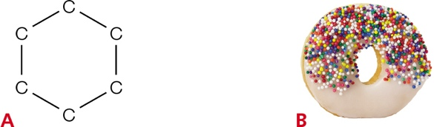
Carbon Rings
Notes:
Figure 3.1 Carbon rings.
A Carbon’s versatile bonding behavior allows it to form a variety of structures, including rings.
B Carbon rings form the framework of many sugars, starches, and fats (such as those found in doughnuts).

Slide 4
Carbon Assembles into a Variety of Compounds
Hydrocarbon: consists only of carbon and hydrogen atoms
Functional group
  An atom (other than hydrogen) or small molecular group bonded to a carbon of an organic compound
  Imparts a specific chemical property
Biological molecules are often modeled to reduce some complexity

Slide 5
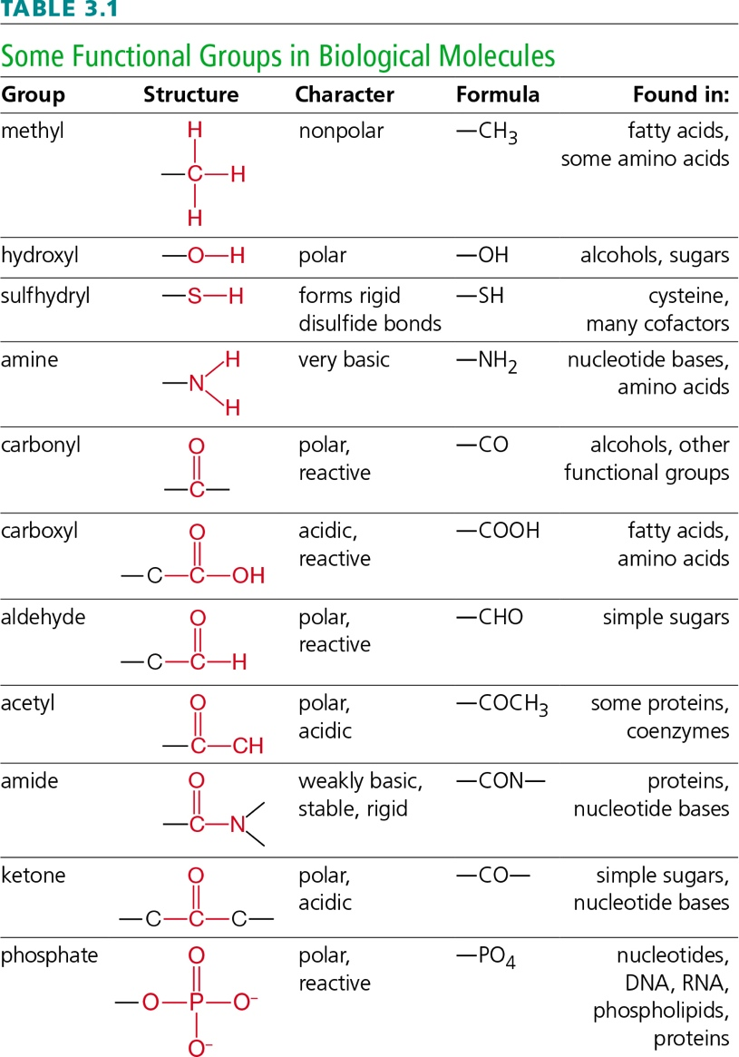
Functional Groups
Notes:
Table 3.1 Some Functional Groups in Biological Molecules

Slide 6
Modeling Glucose
Notes:
Figure 3.2 Modeling an organic molecule. All of these models represent the same molecule: glucose.
A A structural formula for an organic molecule—even a simple one—can be very complicated. The overall structure is obscured by detail.
B Structural formulas of organic molecules are typically simplified by using polygons as symbols for rings, omitting some bonds and element labels.
C A ball-and-stick model is often used to show the arrangement of atoms and bonds in three dimensions.
D A space-filling model can be used to show a molecule’s overall shape. Individual atoms are visible in this model. Space-filling models of larger molecules often show only the surface contours.

Slide 7
Metabolic Reactions (1 of 4)
All biological systems are based on the same organic molecules
  The details of those molecules differ among organisms
Monomers: subunits of larger molecules
  Simple sugars, fatty acids, amino acids, and nucleotides
Polymers: consist of multiple monomers

Slide 8
Metabolic Reactions (2 of 4)
Cells build polymers from monomers, and break down polymers to release monomers
  These processes of molecular change are called chemical reactions
Metabolism: chemical reactions by which cells acquire and use energy
  Enzyme: organic molecule that speeds up a reaction without being changed by it

Slide 9
Metabolic Reactions (3 of 4)
Hydrolysis: chemical reaction in which an enzyme uses water to break a molecule into smaller subunits
Condensation: chemical reaction in which an enzyme builds a large molecule from smaller subunits
  Water is formed during condensation

Slide 10
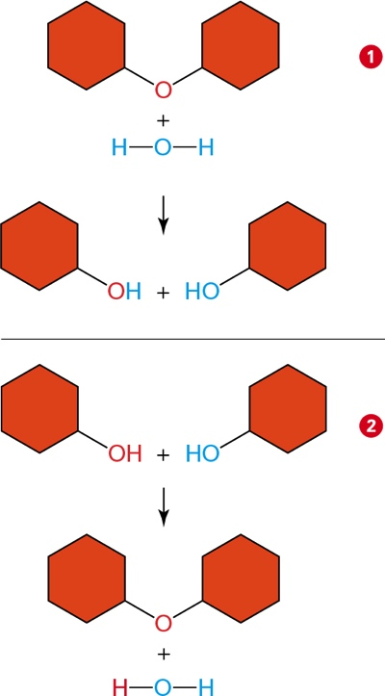
Examples of Metabolic Reactions (4 of 4)
Notes:
Figure 3.3 Examples of metabolic reactions. Common reactions by which cells build and break down organic molecules are shown.
1 Hydrolysis. Cells use this water-requiring reaction to split polymers into monomers. An enzyme attaches a hydroxyl group and a hydrogen atom (both from water) at the site of the split.
2 Condensation. Cells use this reaction to build polymers from monomers. An enzyme removes a hydroxyl group from one molecule and a hydrogen atom from another. A covalent bond forms between the two molecules. Water forms, so this reaction is also called dehydration.

Slide 11
3.2 Carbohydrates
Carbohydrate: organic compound that consists of carbon, hydrogen, and oxygen in a 1:2:1 ratio
Three main types of carbohydrates in living systems
  Monosaccharides
  Oligosaccharides
  Polysaccharides

Slide 12
Simple Sugars (1 of 3)
Monosaccharides (one sugar) are the simplest type of carbohydrates
Common monosaccharides have a backbone of five or six carbon atoms
  Examples:
    Glucose has six carbon atoms
    Five-carbon monosaccharides are components of the nucleotide monomers of DNA and RNA

Slide 13
Simple Sugars (2 of 3)
Cells use monosaccharides for cellular fuel
  Breaking the bonds of sugars releases energy that can be harnessed to power other cellular processes
Monosaccharides are also used as:
  Precursors for other molecules
  Structural materials to build larger molecules

Slide 14
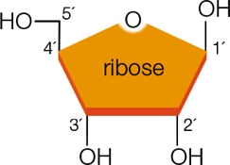
Simple Sugar Ribose (3 of 3)

Slide 15
Short-Chain Carbohydrates
Disaccharides consist of two monosaccharide monomers
  Examples:
    Lactose: composed of glucose + galactose
    Sucrose: composed of glucose + fructose

Slide 16
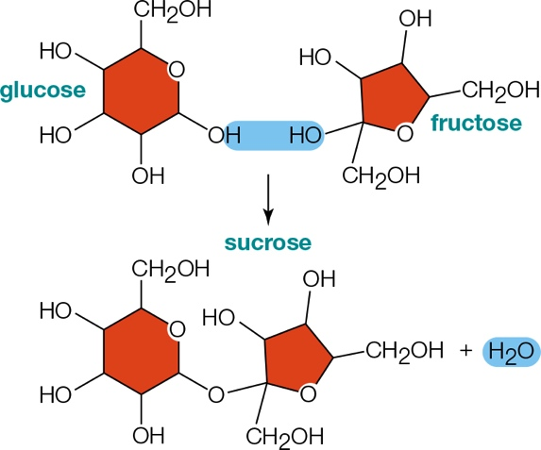
Sucrose Disaccharide
Notes:
Figure 3.4 Formation of sucrose, a disaccharide.

Slide 17
Polysaccharides
Polysaccharides: chains of hundreds or thousands of monosaccharide monomers
Most common polysaccharides
  Cellulose
  Starch
  Glycogen

Slide 18
Cellulose
Main structural component of plants
Tough and insoluble
Composed of chains of glucose monomers stretched side by side and hydrogen-bonded at many –OH groups

Slide 19
Starch
Main energy reserve in plants
Stored roots, stems, leaves, seeds, and fruits
Composed of a series of glucose monomers that form a chain that coils up

Slide 20
Glycogen
Main energy reserve in animals
Very abundant in muscle and liver cells
Highly branched chains of glucose monomers

Slide 21
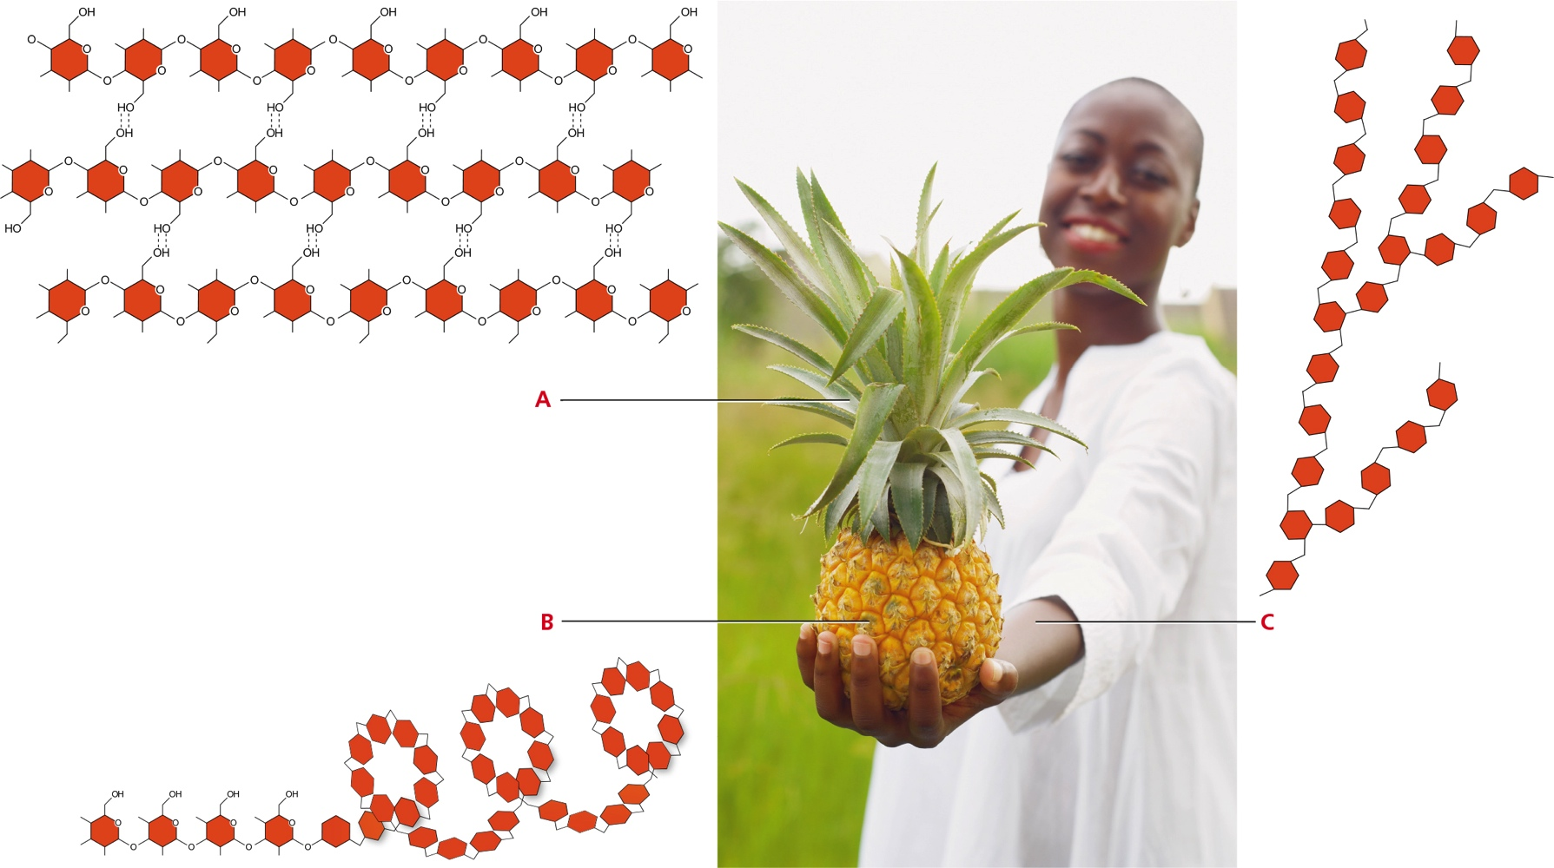
Complex Carbohydrates
Notes:
Figure 3.5 Three of the most common complex carbohydrates and their locations in a few organisms. Each polysaccharide consists only of glucose subunits, but different bonding patterns result in substances with very different properties.
A Cellulose is the main structural component of plants. Above, in cellulose, hydrogen bonds stabilize long, straight chains of glucose monomers. The crosslinked chains form long, tough fibers that few organisms can digest.
B Starch is the main energy reserve in plants, which store it in their roots, stems, leaves, seeds, and fruits. Below, starch consists of long, coiled chains of glucose monomers.
C Glycogen functions as an energy reservoir in animals, including people. It is especially abundant in the liver and muscles. Above, glycogen consists of highly branched chains of glucose monomers.

Slide 22
3.3 Lipids
Lipids: fatty, oily, or waxy organic compounds
Many lipids incorporate fatty acids: consist of a long hydrocarbon “tail” with a carboxyl group “head”
  The tail is hydrophobic
  The head is hydrophilic

Slide 23
Lipids in Living Systems
Saturated fatty acids have only single bonds linking the carbons in their tails
  Flexible and wiggle freely
Unsaturated fatty acids have some double bonds linking the carbons in their tails
  Flexibility is limited

Slide 24
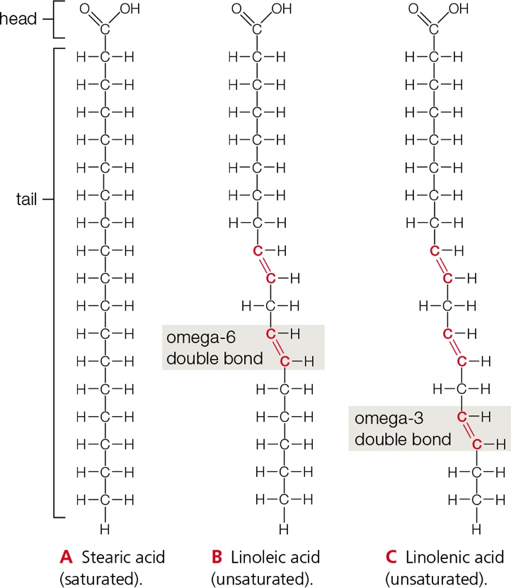
Fatty Acids
Notes:
Figure 3.7 Fatty acids. Each fatty acid molecule has a carboxyl group head and a long hydrocarbon tail.
A The tail of stearic acid is fully saturated with hydrogen atoms.
B Linoleic acid, with two double bonds, is unsaturated. The first double bond occurs at the sixth carbon from the end of the tail, so linoleic acid is called an omega-6 fatty acid. Omega-6 and C omega-3 fatty acids are “essential fatty acids,” which means your body does not make them; they must come from food.

Slide 25
Fats
Fats: lipid that consists of a glycerol molecule with one, two, or three fatty acid tails
Triglyceride: a fat with three fatty acid tails
  Saturated fats: triglycerides with saturated fatty acid tails; solid at room temperature
  Unsaturated fats: triglycerides with unsaturated fatty acid tails; liquid at room temperature

Slide 26
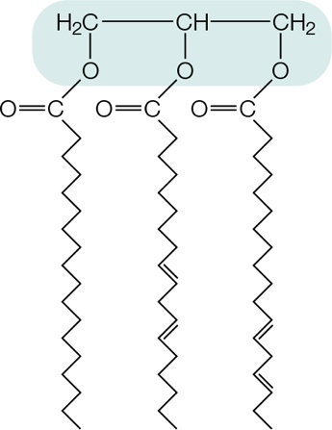
Triglyceride
Notes:
Figure 3.8 Triglyceride.
A triglyceride has three fatty acid tails attached to a glycerol (shaded blue). The molecule is entirely hydrophobic. Fats are hydrophobic because they consist mainly of triglycerides.

Slide 27
Phospholipids (1 of 2)
Phospholipid: main component of cell membranes
  Contains phosphate group in hydrophilic head and two nonpolar fatty acid tails

Slide 28
Phospholipids (2 of 2)
In a cell membrane, phospholipids are arranged in two layers called a lipid bilayer
  One layer of hydrophilic heads are dissolved in cell’s watery interior
  Other layer of hydrophilic heads are dissolved in the cell’s fluid surroundings
  Hydrophobic tails are sandwiched between the hydrophilic heads

Slide 29
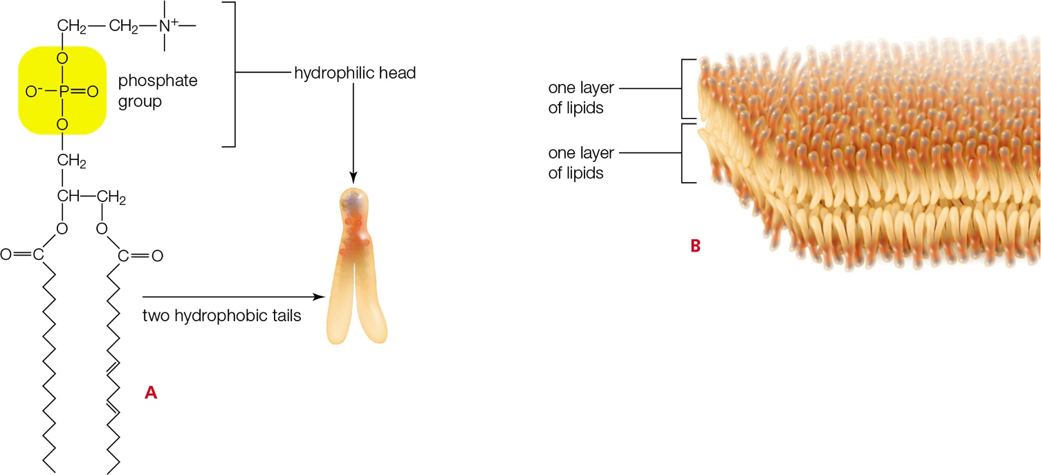
Phospholipids in Cell Membranes
Notes:
Figure 3.9 Phospholipids as components of cell membranes.
A Phospholipid. Two fatty acid tails are attached to a head that contains a phosphate group (yellow). The phosphate group makes the head very hydrophilic; the tails are hydrophobic.
B The lipid bilayer. The opposing hydrophilic and hydrophobic properties of phospholipid molecules give rise to this double-layered structure, which is the foundation of all cell membranes.

Slide 30
Waxes
Wax: complex, varying mixture of lipids with long fatty acid tails bonded to alcohols or carbon rings
Molecules pack tightly, so waxes are firm and water repellent
  Plants secrete waxes to restrict water loss and keep out parasites and other pests
  Other types of waxes protect, lubricate, and soften skin and hair

Slide 31
Steroids (1 of 2)
Steroids: lipids with no tails
  Contain a rigid backbone that consists of twenty carbon atoms arranged in a characteristic pattern of four rings
Functional groups attached to the rings define the type of steroid
Examples: estrogen and testosterone
  Dictates many sex characteristics

Slide 32
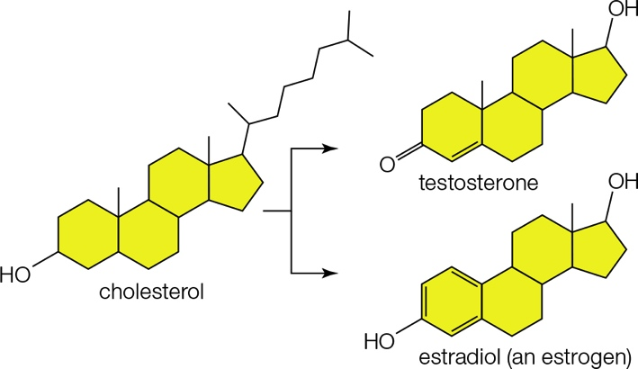
Steroids (2 of 2)
Notes:
Figure 3.10 Steroids. Above, cells remodel cholesterol (a steroid) into many other compounds, including estradiol and testosterone: two steroid hormones that govern reproduction and secondary sexual traits. Despite the small differences in structure, the two hormones have very different effects in the body. They are the source of gender-specific traits in many species, including wood ducks (left).

Slide 33
3.4 Proteins
Amino acid subunits
  Cells can make thousands of different proteins from only twenty kinds of monomers called amino acids
  An amino acid contains
    An amine group (–NH₂)
    A carboxyl group (–COOH, the acid)
    A side chain called an “R group”; defines the kind of amino acid

Slide 34
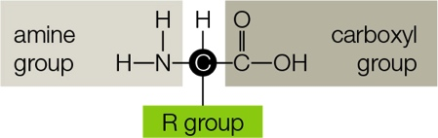
Generalized Amino Acid
Notes:
Figure 3.11 Generalized structure of an amino acid. The R group, which varies in structure, defines the type of amino acid. See Appendix II for the complete structures of the twenty most common amino acids found in eukaryotic proteins.

Slide 35
Building Proteins
The covalent bond that links amino acids in a protein is called a peptide bond
A short chain of amino acids is called a peptide
  As the chain lengthens, it becomes a polypeptide
Proteins consist of polypeptides that are hundreds or even thousands of amino acids long

Slide 36
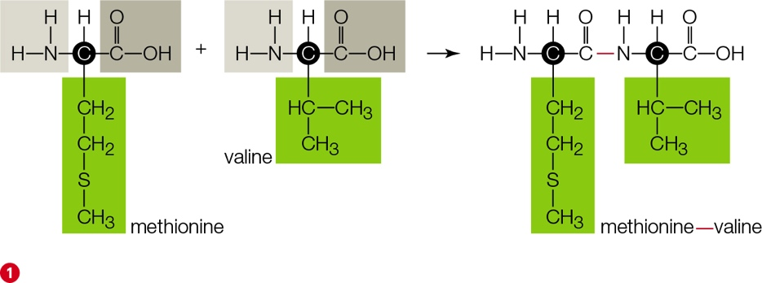
Peptide Bond Formation
Notes:
Figure 3.12 How protein structure arises.
1 A condensation reaction joins the carboxyl group of one amino acid and the amine group of another to form a peptide bond. In this example, a peptide bond forms between the amino acids methionine and valine.

Slide 37
From Structure to Function (1 of 2)
Proteins function in movement, defense, and cellular communication
  Example: enzymes
A protein’s biological activity arises from and depends on its structure

Slide 38
From Structure to Function (2 of 2)
Primary structure: linear series of amino acids; defines the type of protein
Secondary structure: polypeptide chain that forms twists and folds
Tertiary structure: nonadjacent regions of protein adjoin to create compact domains
Quaternary structure: two or more polypeptide chains that are closely associated or covalently bonded together

Slide 39
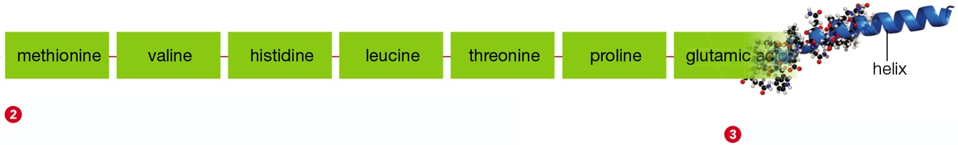
Primary and Secondary Structure
Notes:
Figure 3.12 How protein structure arise
Primary structure As the chain lengthens, it becomes a polypeptide. The linear sequence of amino acids making up the polypeptide is primary structure. It gives rise to higher orders of structure that form the protein’s shape—and ultimately, its function. This is part of the amino acid sequence of a polypeptide called globin.
Secondary structure Characteristic patterns such as helices and sheets are secondary structure. These patterns arise when hydrogen bonds that form between amino acids make the polypeptide twist and turn.

Slide 40
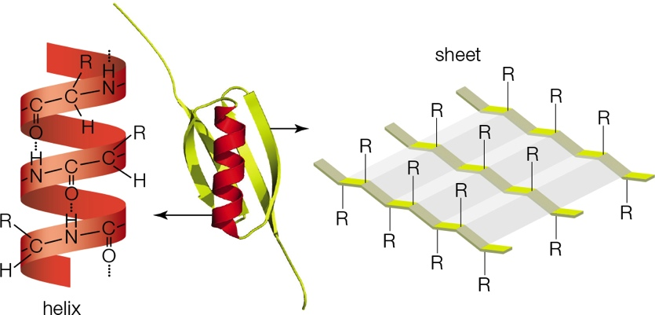
Secondary Structures
Notes:
Figure 3.13 Examples of secondary structure in proteins.
The small protein in the middle has a helix (in red) and a sheet (in yellow). Tight turns reverse direction of the polypeptide to form the sheet; flexible loops connect the sheet to the helix.

Slide 41
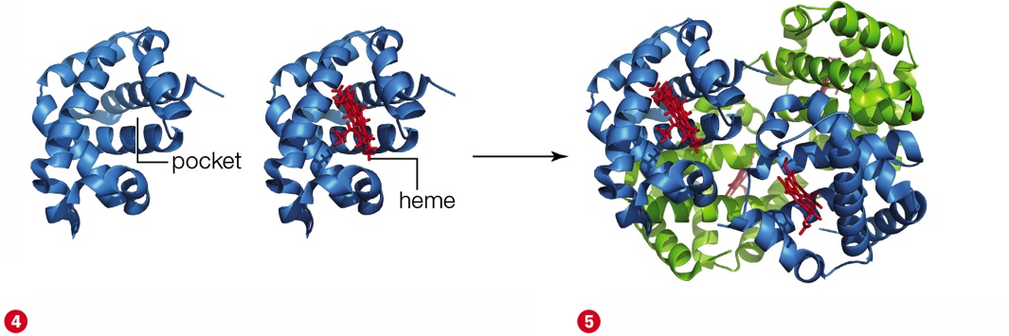
Tertiary and Quaternary Structure
Notes:
Figure 3.12 How protein structure arise
4 Tertiary structure Interactions between the helices and sheets make them fold up together into functional domains. These domains are tertiary structure. In this example, the helices of the globin chain form a pocket for a small molecule called a heme (in red).
5 Quaternary structure The association of multiple polypeptides is quaternary structure. Many proteins are like this. A working molecule of hemoglobin, shown here, consists of four globin chains (green and blue), each holding its heme.

Slide 42
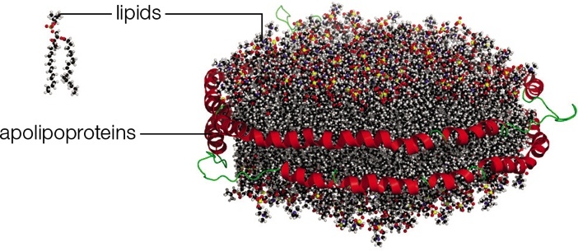
Finishing Touches
Enzymes often attach sugars or lipids to proteins
  Examples: glycoproteins and lipoproteins
Notes:
Figure 3.14 A lipoprotein particle. The one depicted here (HDL, which is often called “good” cholesterol) consists of thousands of lipids lassoed into a clump by apolipoproteins (a type of lipoprotein).

Slide 43
3.5 The Importance of Protein Structure
Heat, some salts, shifts in pH, or detergents can denature (unravel) a protein by breaking hydrogen bonds
Denaturation causes a protein to lose its function

Slide 44
Prions
Misfolding of the glycoprotein PrPC causes a prion (infectious protein) to form
May lead to:
  Scrapie in sheep
  Mad cow disease
  Variant Creutzfeldt–Jakob disease in humans
    Confusion, memory loss, and lack of coordination

Slide 45
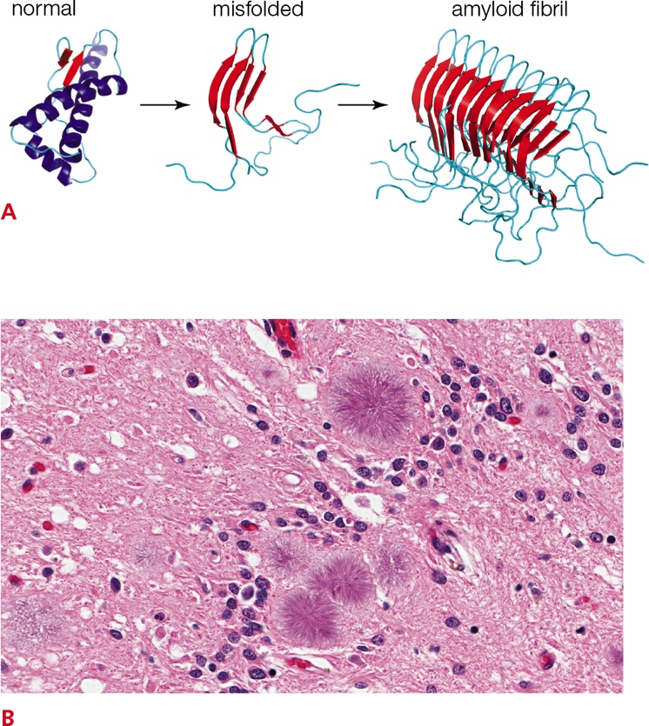
Variant Creutzfeldt–Jakob Disease (vCJD)
Notes:
Figure 3.15 Variant Creutzfeldt–Jakob disease (vCJD).
A A misfolded form of the PrP^{C} protein causes other PrP^{C} proteins to misfold and align tightly. Misfolded proteins accumulate in amyloid fibrils that form plaques in the brain as they grow.
B Amyloid fibrils radiating from several plaques are visible in this slice of brain tissue from a person with vCJD.

Slide 46
3.6 Nucleic Acids (1 of 3)
Nucleotide: consists of a sugar with a five-carbon ring bonded to a nitrogen-containing base and one, two, or three phosphate groups
  Example: ATP (adenosine triphosphate); an energy carrier in cells

Slide 47
Nucleic Acids (2 of 3)
Nucleic acids: chains of nucleotides in which the sugar of one nucleotide is bonded to the phosphate group of the next
  RNA (ribonucleic acid): single-stranded chain of nucleotides; important for protein synthesis
  DNA (deoxyribonucleic acid): consists of two chains of nucleotides twisted into a double helix; holds information to build a new cell

Slide 48
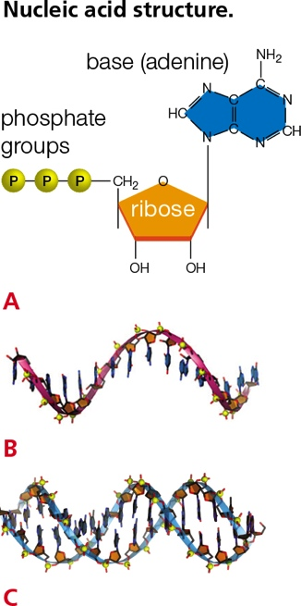
Nucleic Acids Structure (3 of 3)
Notes:
Figure 3.16 Nucleic acid structure.
A The nucleotide ATP.
B The nucleic acid RNA.
C The nucleic acid DNA.

Slide 49
Application: Fear of Frying (1 of 3)
Trans fats have unsaturated fatty acid tails with hydrogen atoms around the double bonds
Small amounts of trans fats occur naturally
Main source of trans fats is an artificial food product called partially hydrogenated vegetable oil
Hydrogenation: adds hydrogen atoms to oils in order to change them into solid fats

Slide 50
Application: Fear of Frying (2 of 3)
In 1908, Procter & Gamble Co. developed partially hydrogenated oil to make candles
As electricity replaced candles, the company began marketing partially hydrogenated oils as a low cost alternative to lard
For decades, hydrogenated oils were considered healthier than animal fats

Slide 51
Application: Fear of Frying (3 of 3)
Trans fats raise the level of cholesterol in our blood more than any other fat
Directly alters the function of our arteries and veins
  Eating as little as 2 grams a day of hydrogenated vegetable oil increases a person’s risk of atherosclerosis, heart attack, and diabetes

Slide 52
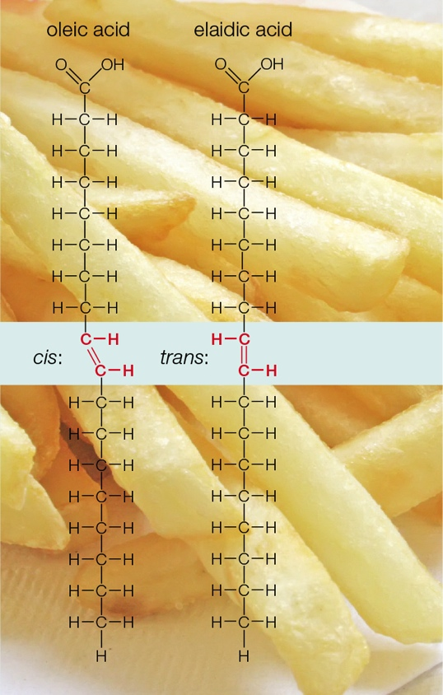
Trans Fats

Slide 53
Discuss
Why are sugars controversial as a component of our diets? Discuss the trend toward and motivation for removal of soda and candy vending machines in schools and public buildings.
Is it the responsibility of food manufacturers to produce healthy foods, or simply to make obvious on their packaging the presence of potential health hazards?

