Slide 1
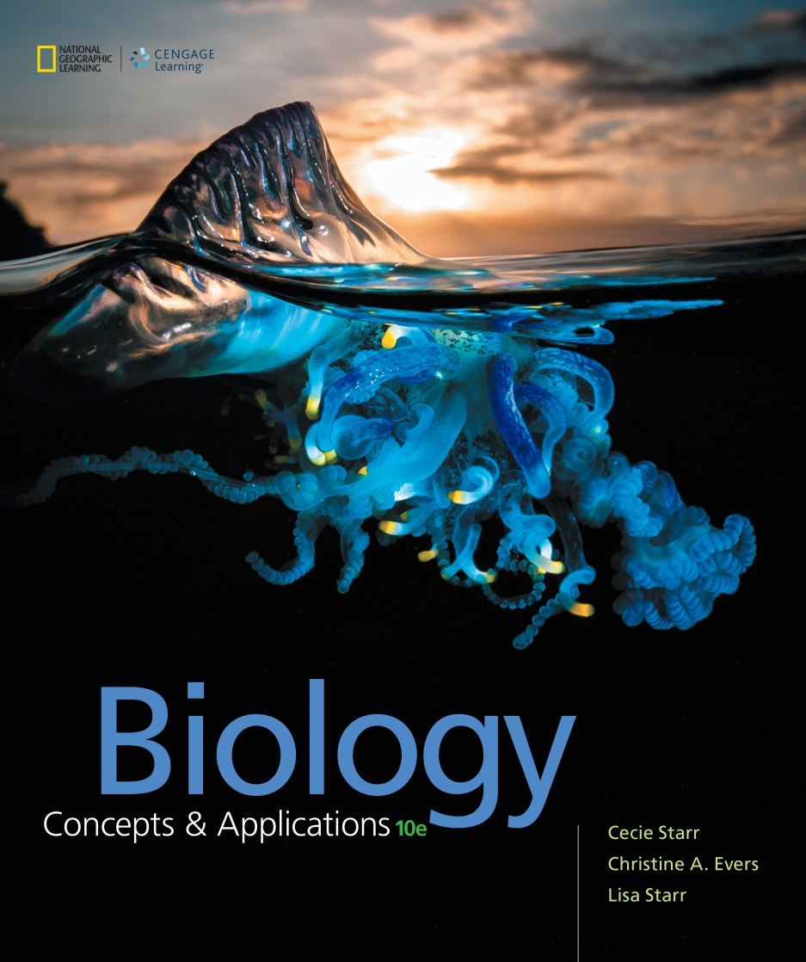
Biology Concepts & Applications
10 Edition
Chapter 39
Animal Behavior
Copyright © 2018 Cengage Learning. All Rights Reserved. May not be copied, scanned, or duplicated, in whole or in part, except for use as permitted in a license distributed with a certain product or service or otherwise on a password-protected website for classroom use.

Slide 2
39.1 Factors Affecting Behavior
Much variation in behavior within or among species results from inherited differences
Behavior can be influenced
Proximate causes include genes and epigenetic factors that specify the behavior, the physiological mechanisms that bring about the behavior, and environmental factors that influence and elicit the behavior
Ultimate causes are the evolutionary factors that shaped it

Slide 3
Foraging in Fruit Flies
One way to study behavior is to study variation within a species
Example: Fruit fly larvae eat yeast on decaying fruit
70% “rovers”; 30% “sitters”
The foraging gene controls this behavior
Dominant allele = rover phenotype
Homozygous recessive = sitter phenotype

Slide 4
Foraging Behavior
Notes:
Figure 39.1 Genetic polymorphism for foraging behavior in fruit fly larvae. When a larva is placed in the center of a yeast-filled plate, its genotype at the foraging locus influences whether it moves a little or a lot while it feeds. Black lines show a representative larva’s path.
A Rovers (genotype FF or Ff ) move often as they feed. When a rover’s movements on a petri dish filled with yeast are traced for 5 minutes, the trail is relatively long.
B Sitters (genotype ff ) move little as they feed. When a sitter’s movements on a petri dish filled with yeast are traced for 5 minutes, the trail is relatively short.

Slide 5
Pair-Bonding in Voles
Comparing behavior of related species can clarify the genetic basis of a behavior
Example: In voles, inherited differences in hormone receptors influence mating and bonding behavior
Only some are monogamous
Brains of monogamous species have many receptors for the hormone oxytocin
Males of monogamous species have more arginine vasopressin (AVP) receptors

Slide 6
Bonding in Voles
Notes:
Figure 39.2 Genetic roots of mating and bonding behavior in voles. Closely related vole species vary in their behavior, and in the number and distribution of receptors for the hormone oxytocin.
A Vole (Microtus), a type of small rodent.
B PET scan of a monogamous prairie vole’s brain with many oxytocin receptors (red).
C PET scan of a promiscuous mountain vole’s brain with fewer oxytocin receptors.

Slide 7
Social Dominance in Cichlids
Environmental factors can also influence behavior
Example: Male cichlids are influenced by the social environment
During the course of a male cichlid’s life, he can switch back and forth between two social roles, depending on the presence of a larger dominant male
Transformation between subordinate and dominant phenotypes involves epigenetic changes

Slide 8
Social Dominance
Notes:
Figure 39.3 Social dominance. Dominant male cichlids with distinctive eye bars face off.

Slide 9
39.2 Instinct and Learning
All animals are born with the capacity for instinctive behavior
An innate response to a simple stimulus
The stimulus always triggers the same response
Adaptive when the triggering stimulus almost always signals the same situation and requires the same response
Sometimes open the way to exploitation

Slide 10
Instinctive Behavior
A female cuckoo lays her eggs in nests of other birds
When a cuckoo egg hatches, contact with other eggs stimulates a fixed action pattern
Blind hatchling shoves the eggs out of the nest, eliminating the competition

Slide 11
Instinctive Responses
Notes:
Figure 39.4 Instinctive response to simple cues.
A Young cuckoo shoving its foster parents’ egg from the nest. It pushes out any object beside it.
B A foster parent (left) feeds a cuckoo chick (right) in response to a simple cue: a gaping mouth.

Slide 12
Learned Behavior
Behavior altered by experience
A genetic capacity to learn, combined with actual experiences in the environment, shapes most forms of behavior
Learning may occur throughout an animal’s life, or be restricted to a critical period

Slide 13
Time-Sensitive Learning (1 of 2)
Imprinting is a form of learning that occurs during a genetically determined time period early in life
Baby geese follow the large object that bends over them in response to their first peep; usually, their mother

Slide 14
Time-Sensitive Learning (2 of 2)
Example: songbirds
A male songbird recognizes his species’ song when he hears older males singing it
Males reared with no model sing a simplified version of their species’ song
Many birds can only learn the details of their species-specific song during a limited period early in life

Slide 15
Conditioned Responses
Nearly all animals learn to associate certain stimuli with rewards and others with negative consequences
Examples:
Conditioned taste aversion: an animal learns to avoid a food that sickened it
Operant conditioning: an animal modifies its voluntary behavior in response to the behavior’s consequences

Slide 16
Habituation
An animal learns by experience not to respond to a stimulus that has neither positive nor negative effects
Example: Pigeons in cities learn not to flee from people who walk past them

Slide 17
Spatial Learning
Many animals learn the landmarks in their environment, creating a mental map
Example:
Young whooping cranes follow older birds to learn the route of their long seasonal migration
A bird’s ability to remember the route improves with repeated trips

Slide 18
Social Learning
Animals also learn the details of their social landscape
Many animals learn to recognize mates, offspring, or competitors by their appearance, calls, odor, or some combination of cues.
Example: two male lobsters that meet up for the first time will fight; later the loser will actively avoid the winner

Slide 19
Imitative Learning
An animal copies behavior it observes in another individual
Example: a chimpanzee strips leaves from branches to make a “fishing stick” for use in capturing termites as food
Different groups of chimpanzees use different methods of tool shaping and insect fishing
In each group, young individuals learn by imitating behavior of others

Slide 20
Learned Behaviors
Notes:
Figure 39.5 Examples of learned behavior.
A Imprinting. Nobel laureate and animal behaviorist Konrad Lorenz with geese that imprinted on him. The inset photos shows a more common result of imprinting.
B Social learning. Captive male lobsters fight at their first meeting. The loser remembers the winner’s scent and avoids him. Without another meeting, memory of the defeat lasts up to two weeks.
C Imitative learning. Chimpanzees use sticks as tools for extracting tasty termites from a nest. The method of shaping the stick and catching termites is learned by imitation.

Slide 21
39.3 Animal Communication
Evolved cues that transmit information from one member of a species to another
Animal communication signal can only evolve if communication benefits both signal senders and signal receivers

Slide 22
Types of Communication Signals
Pheromones are chemical signals
Examples: honeybee alarm pheromone, sex attractants, priming pheromones
Bird song and other animal calls are acoustical signals
Attracts mates, defines territories, and conveys alarms

Slide 23
How and Why Do Animals Communicate?
Most bird courtship involves coordinated visual communication
Threat displays demonstrate each individual’s strength and how well armed it is
Honeybees use tactile displays to communicate the distance to a food source and its direction relative to the sun

Slide 24
Vertebrate Communication
Notes:
Figure 39.6 Examples of vertebrate communication.
A Ground squirrel giving an alarm call.
B Courtship display in grebes; the birds move in unison.
C Threat display of a male collared lizard. This display allows rival males to assess one another’s strengths without engaging in a potentially damaging fight.

Slide 25
The Waggle Dance
Notes:
Figure 39.7 Honeybee waggle dance. The angle of the waggle run, in which the bee wiggles back and forth, gives the direction of the food. The faster the dance is performed, the closer the food.
A When the waggle portion of the dance (wiggly portion) runs up the surface of the vertically oriented comb, workers fly in the direction of the sun to locate the food.
B When the waggle portion of the dance runs at an angle (in this case 120°) relative to vertical, the workers fly at the same angle relative to the position of the sun to locate the food.

Slide 26
Eavesdroppers and Fake Signals
Predators sometimes use the signaling systems of their prey against them
Frog-eating bats follow the frogs’ mating calls to find food
Predatory female fireflies imitate flashing of prey species to attract food

Slide 27
39.4 Reproductive and Parenting Behavior
Mating systems
Promiscuous: multiple mates for both sexes
Polygynous: multiple mates for males only
Polyandrous: multiple mates for females only
Monogamous: a single mate for both sexes
Sexual selection occurs when males or females of a species compete for access to mates, or when they are choosy about their mates

Slide 28
Selecting Mates
Sexual selection favors characteristics that provide a competitive advantage in attracting and retaining mates
Males usually maximize their reproductive success by mating as many times as possible
Females are more likely than males to turn down opportunities to breed with a low-quality individual
Females usually chose mates based on their ability to provide necessary resources

Slide 29
Courtship Behaviors
Notes:
Figure 39.8 Male courtship behavior.
A Male hanging fly dangling a moth as a gift for a potential mate.
B Male fiddler crab waving his one enlarged claw to attract a female to his burrow.
C Male sage grouse on his portion of a communal display ground (a lek), where he will dance, inflate the sacs on his chest, and make gurgling calls.

Slide 30
Territory
Region that an animal or animals occupy and defend against competitors
In species such as lions, elk, elephant seals, and bison; females cluster around a necessary resource, and males may hold a territory that they defend from others
The territory holder mates with all females in his territory

Slide 31
Sexual Dimorphism
Distinct male and female phenotypes
Example: Large claws in male fiddler crabs
When females choose among a group of displaying males or males defend a mating territory, nearly all females mate, but many males do not
These systems impose strong selective pressure for mating-related traits on males
Lek
Of some birds, a communal mating display area for males
Male grouse converge at a lek to attract a mate by displaying, dancing, and calling

Slide 32
Parental Care (1 of 3)
Parental care requires time and energy that an individual could otherwise invest in reproducing again
Evolution of parental care requires that benefits to a parent (increased offspring survival) be greater than the cost (lost reproductive opportunity)

Slide 33
Parental Care (2 of 3)
Most fishes provide no parental care, but in those that do, this duty usually falls to the male
In birds, two-parent care is most common
In about 90% of mammals, the female rears young
Both sexes participate in the remaining 10% of mammals

Slide 34
Parental Care (3 of 3)
Notes:
Figure 39.9 Parental care.
A Male sergeant majors guard eggs (pink) until they hatch.
B Male and female terns cooperate in the care of their chicks.
C A female grizzly bear cares for her cub for as long as two years.

Slide 35
39.5 Group Living and Social Behavior
Many animals benefit by clustering in groups
Some groups are temporary, like schools of fish; others such as prairie dog colonies or wolf packs are more permanent
A tendency to group together, whether briefly or for the longer term, will evolve only if the benefits of being near others outweigh the costs

Slide 36
Benefits of Grouping (1 of 4)
Selfish herd effect
Groups can emerge from the collective tendencies of individuals to reduce their risk of danger by drawing near one another
Multiple individuals are then on watch
Some animals warn others of approaching predators
In other cases, group members simply run together when one member begins fleeing

Slide 37
Benefits of Grouping (2 of 4)
Musk oxen stand their ground together as a united defense
Eastern tent caterpillars benefit by the group’s coordinated response to predators
Predatory birds to avoid the mass of fluid-exuding caterpillars, preferring to attack individuals

Slide 38
Safety in Numbers
Notes:
Figure 39.10 Safety in numbers. Clustering with others provides defense against parasites and predators.
A Sardines attempting to hide behind one another during an attack by predatory sailfish.
B Tent caterpillars on the surface of their communally produced tent. If threatened, the group wriggles and produces cyanide-laced vomit.

Slide 39
Benefits of Grouping (3 of 4)
Social animals: individuals benefit by cooperating in a permanent multigenerational group
Example: Wolves and lions are cooperative hunters
Not more efficient than solitary ones
Major advantage of group living lies in help fending off scavengers, caring for one another’s young, and protecting territory together

Slide 40
Cooperative Hunting
Notes:
Figure 39.11 Cooperating to obtain food. Lions enjoy the results of a communal hunt while a group of hyenas collaborate in attempting to steal a share.

Slide 41
Benefits of Grouping (4 of 4)
Group living also allows transmission of cultural traits or behaviors learned by imitation
Example: chimpanzees make and use simple tools
Different groups of chimpanzees use slightly different tool-shaping and termite-fishing methods
Youngsters learn by imitating adults

Slide 42
Cost of Group Living
Individuals that group together are easier for predators to locate
Parasites and contagious diseases spread more quickly
Increases competition for food and mates
Dominance hierarchy
Social system in which resources and mating opportunities are unequally distributed within a group

Slide 43
Evolution of Cooperation
Altruism: behavior that decreases the altruist’s fitness but increases the fitness of other group members
Kin selection: favors individuals who have the highest inclusive fitness
Inclusive fitness: number of offspring that individual could produce with no help from others, plus a fraction of the number of extra offspring produced by other individuals because of help from it
Altruism is usually directed at relatives

Slide 44
39.6 Eusocial Animals (1 of 2)
Extreme cases of sterility and self-sacrifice have evolved in a few insects and one group of mammals
Ants, termites, honeybees, and mole-rats are eusocial; they live in colonies with overlapping generations and have a reproductive division of labor
Most colony members do not reproduce; they assist their relatives instead

Slide 45
Eusocial Animals (2 of 2)
Inbreeding increases the genetic similarity among relatives
According to the theory of inclusive fitness, genes associated with altruism are selected if they lead to behavior that promotes reproductive success of close relatives

Slide 46
Eusocial Species
Notes:
Figure 39.12 Examples of eusocial animals.
A Honeybee queen surrounded by sterile worker females.
B Termite queen and workers.
C Naked mole rat worker.

Slide 47
Application: Can You Hear Me Now?
Right whales, like other whales, communicate with one another through sound
Research indicates the level of shipping noise influences the whales’ calling patterns
For humans, chronic exposure to noise is stressful, and the same may be true for whales

Slide 48
Whales in Shipping Channels
Notes:
Figure 39.13 Whales in a shipping channel. Ship noise can impair whales’ ability to communicate.

Slide 49
Discuss
Can avoidance behavior in Paramecium be considered learning?
What is the link between environment and behavior? Can environment mask instinctive behaviors? What is the role of crossbreeding in modifying behaviors in animals?

