Slide 1
Chapter 37
0
Communities and Ecosystems

Slide 2
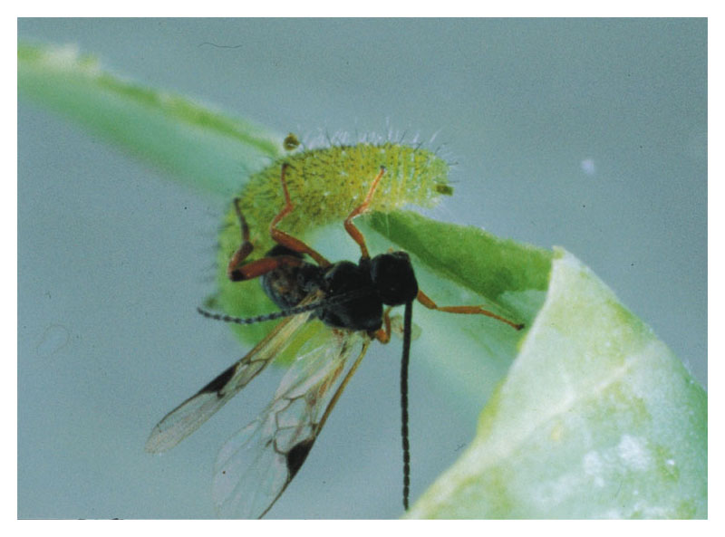
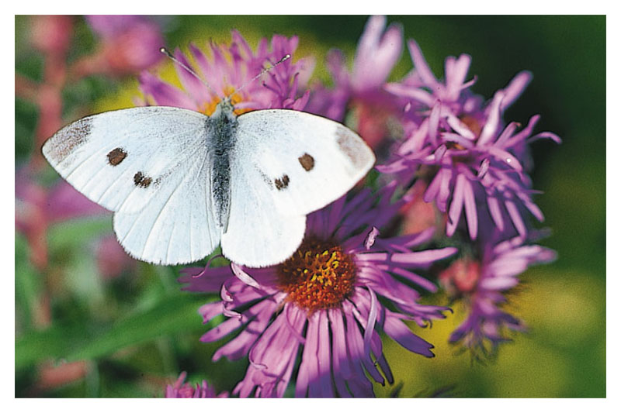
0
Dining In
The wasp called Apanteles glomeratus
Lays its eggs inside the caterpillar larva of the cabbage white butterfly
The eggs of the wasp will develop into larvae
Which will eat the caterpillar from the inside
Apanteles glomeratus
A cabbage white butterfly (pieris rapae)

Slide 3
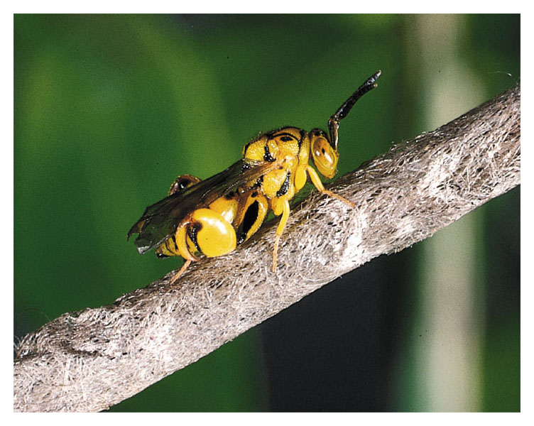
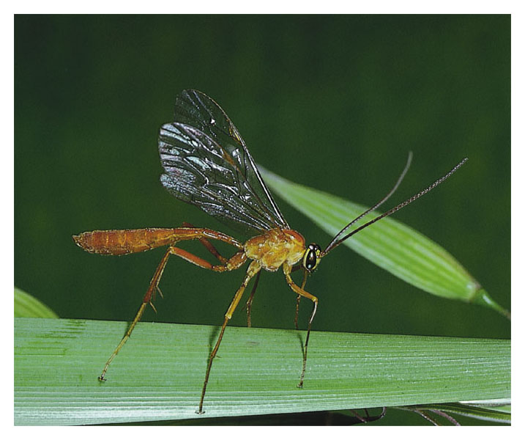
0
This same phenomenon
Occurs in other wasp populations
A chalcid wasp
An ichneumon wasp

Slide 4
0
Interactions such as these between organisms
Are examples of interactions that occur in biological communities

Slide 5
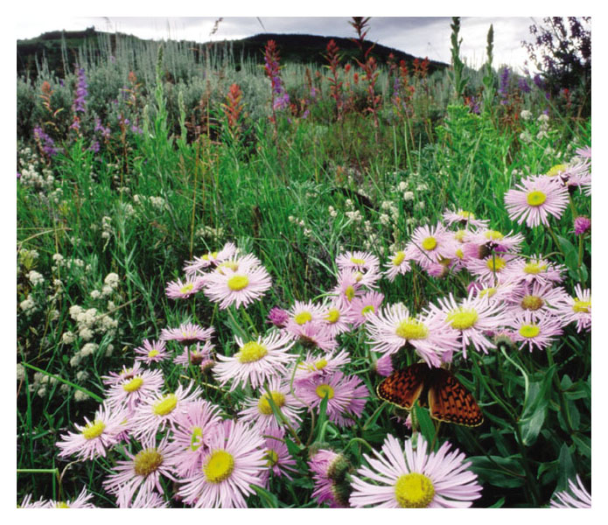
STRUCTURAL FEATURES OF COMMUNITIES
0
37.1 A community includes all the organisms inhabiting a particular area
A biological community
Is an assemblage of all the populations of organisms living close enough together for potential interaction
Figure 37.1

Slide 6
0
Communities are characterized by
Species diversity
Response to disturbance
Trophic structure

Slide 7
0
37.2 Competition may occur when a shared resource is limited
Interspecific competition
Occurs between two species if they both require the same limited resource
A species’ niche
Includes its total use of biotic and abiotic resources

Slide 8
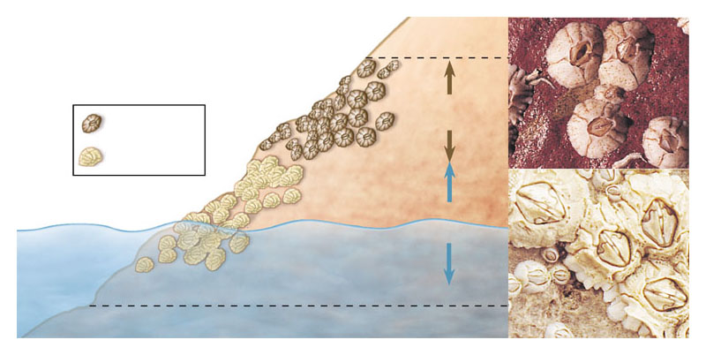
0
The competitive exclusion principle
States that two species cannot coexist in a community if their niches are identical
High tide
Chthamalus
realized niche
Chthamalus
Balanus
Balanus
realized niche
Ocean
Low tide
Figure 37.2A

Slide 9
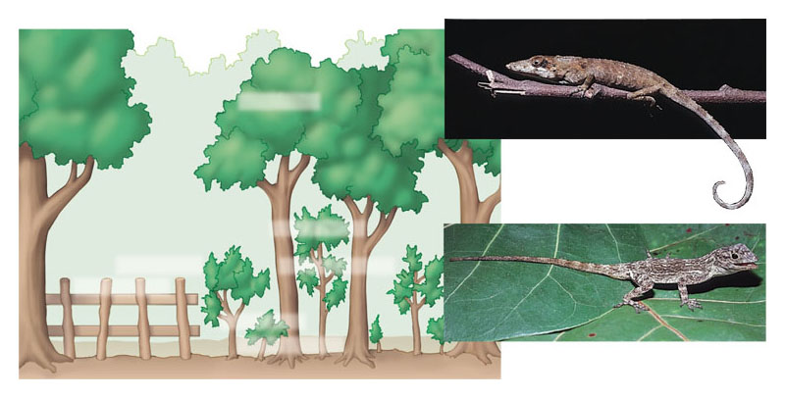
0
One outcome of competition is resource partitioning
Where one of the species may evolve enough through natural selection to use a different set of resources
A. ricordii
A. insolitus perches on shady branches.
A. distichus perches on sunny surfaces.
A. insolitus
A. aliniger
A. christophei
A. distichus
A. cybotes
A. etheridgei
Figure 37.2B

Slide 10
0
37.3 Predation leads to diverse adaptations in both predator and prey
Predation is an interaction between species
In which one species, the predator, kills and eats another, the prey
The adaptations of both predators and prey
Tend to be refined through natural selection

Slide 11
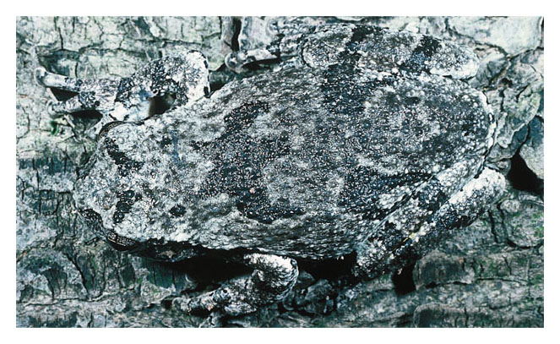
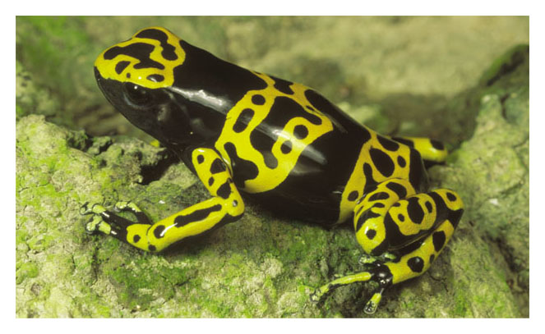
0
Some prey gain protection through
Camouflage or chemical defenses
Figure 37.3A
Figure 37.3B

Slide 12
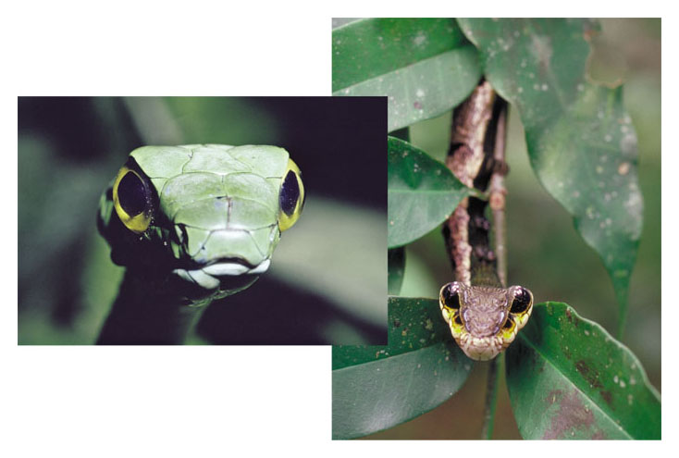
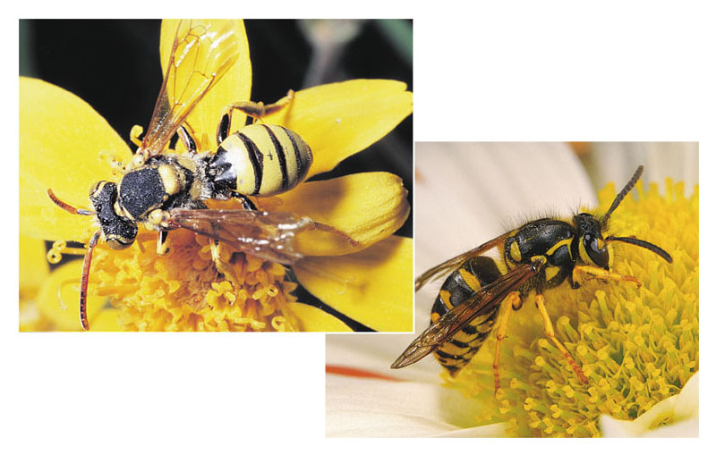
0
Some prey gain protection through mimicry
A “copycat” adaptation in which one species mimics the appearance of another
Figure 37.3C
Figure 37.3D

Slide 13
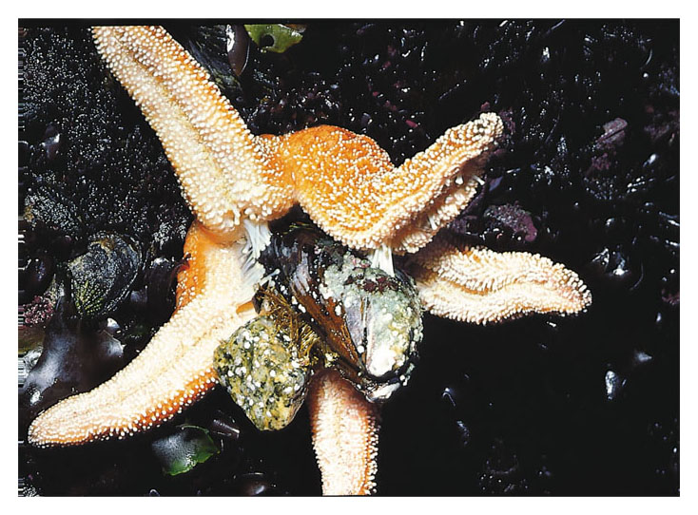
0
37.4 Predation can maintain diversity in a community
A keystone predator may maintain community diversity
By reducing the numbers of the strongest competitors
Figure 37.4A

Slide 14
0
Removal of a keystone predator from a community
Can cause major changes in community dynamics
Figure 37.4B

Slide 15
0
37.5 Herbivores and the plants they eat have various adaptations
Herbivores
Are animals that have adaptations for eating plants or algae
Many plants
Produce toxic chemicals to protect against herbivores

Slide 16
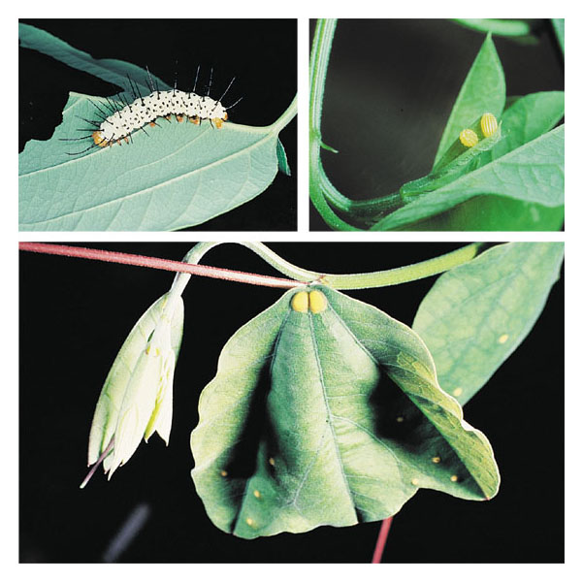
0
Some herbivore-plant interactions illustrate coevolution
Or reciprocal evolutionary adaptations
Eggs
Sugar deposits
Figure 37.5

Slide 17
0
37.6 Symbiotic relationships help structure communities
A symbiotic relationship
Is an interaction between two or more species that live together in direct contact

Slide 18
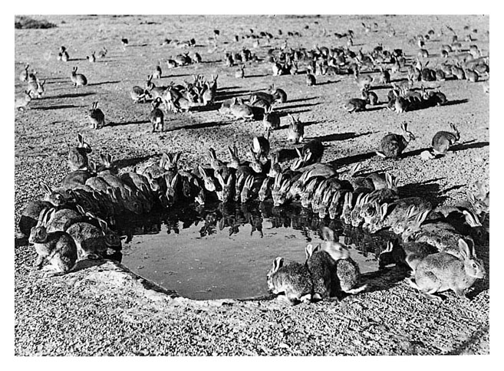
0
In parasitism
A parasite obtains food at the expense of its host
Pathogens are parasites
That are often lethal to their hosts
Figure 37.6A

Slide 19
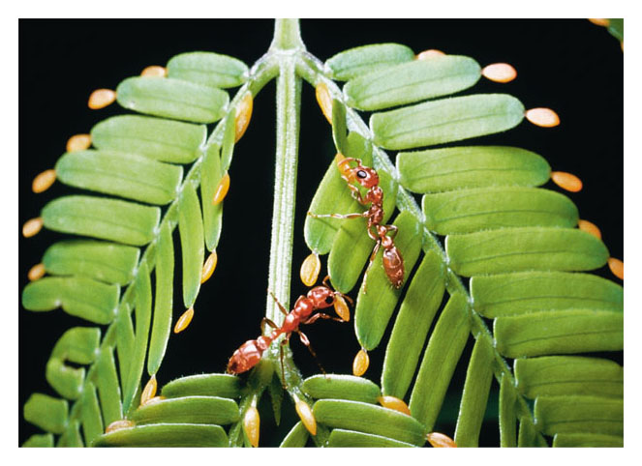
0
In commensalism
One species benefits while the other is unaffected
In mutualism
Both partners benefit
Figure 37.6B

Slide 20
0
37.7 Disturbance is a prominent feature of most communities
Disturbances are events that
Damage biological communities, remove organisms from them, and alter the availability of resources
Are characteristic of most communities

Slide 21
0
Ecological succession
Is a transition in species composition of a community following a disturbance

Slide 22
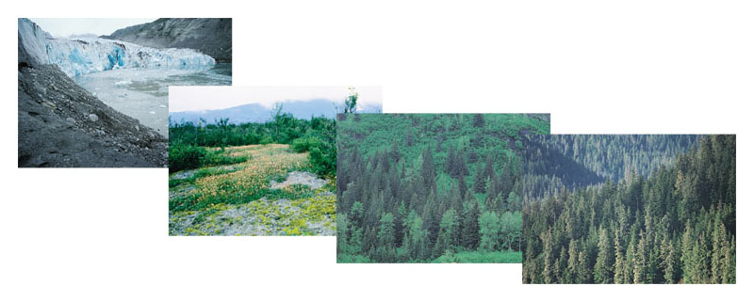
0
Primary succession
Is the gradual colonization of barren rocks
Retreating glacier with moraine in the foreground
Dryas stage
Spruce starting to appear in the alder and cottonwood forest
Spruce and hemlock forest
Figure 37.7

Slide 23
0
Secondary succession
Occurs after a disturbance has destroyed a community but left the soil intact

Slide 24
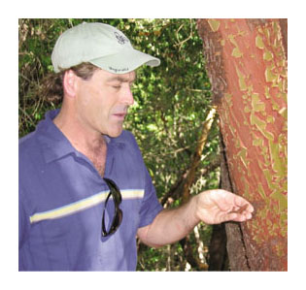
TALKING ABOUT SCIENCE
0
37.8 Fire specialist Max Moritz discusses the role of fire in ecosystems
Dr. Max Moritz
Is a wildland fire specialist who studies fire in chaparral ecosystems
Figure 37.8A

Slide 25
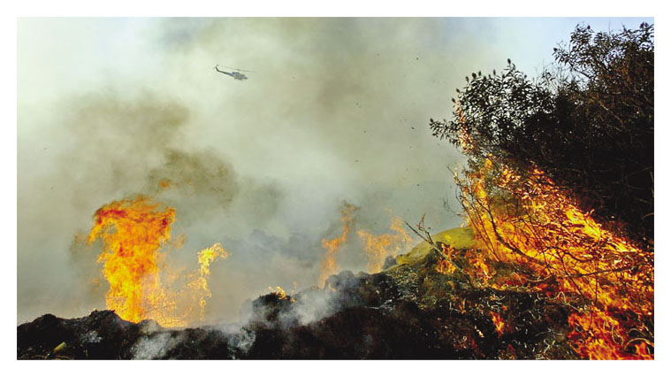
0
Fire is a key abiotic factor in many ecosystems
Figure 37.8B

Slide 26
0
37.9 Trophic structure is a key factor in community dynamics
Every community has a trophic structure
A pattern of feeding relationships consisting of several different levels

Slide 27
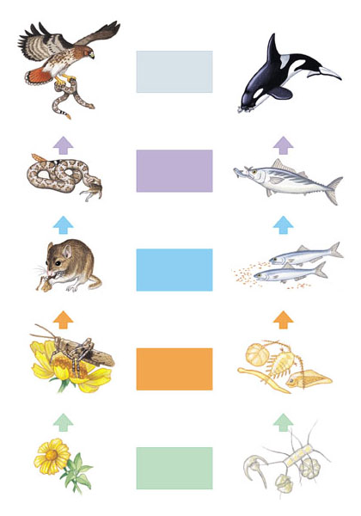
0
Trophic structures can be represented by food chains
The stepwise flow of energy and nutrients from plants (producers), to herbivores (primary consumers), to carnivores (secondary and higher-level consumers)
Trophic level
Quaternary
consumers
Hawk
Killer whale
Tertiary consumers
Snake
Tuna
Secondary consumers
Mouse
Herring
Primary consumers
Grasshopper
Zooplankton
Producers
Figure 37.9
Plant
Phytoplankton
A terrestrial food chain
An aquatic food chain

Slide 28
0
Detritivores (animal scavengers, fungi, and prokaryotes)
Decompose waste matter and recycle nutrients in ecosystems

Slide 29
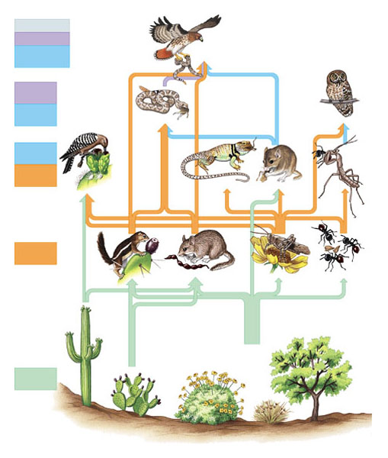
0
37.10 Food chains interconnect, forming food webs
A food web
Is a key biotic factor in many ecosystems
Quaternary,
tertiary,
and secondary
consumers
Tertiary
and
Secondary
consumers
Secondary
and
Primary
consumers
Primary
consumers
Producers
(plants)
Figure 37.10

Slide 30
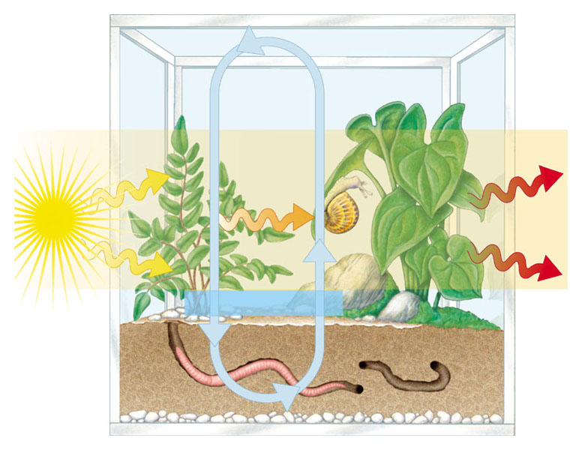
ECOSYSTEM STRUCTURE AND DYNAMICS
0
37.11 Ecosystem ecology emphasizes energy flow and chemical cycling
An ecosystem
Includes a community and the abiotic factors with which it interacts
Chemical
cycling
Energy
flow
Chemical
energy
Light
energy
Heat
energy
Chemical elements
Figure 37.11

Slide 31
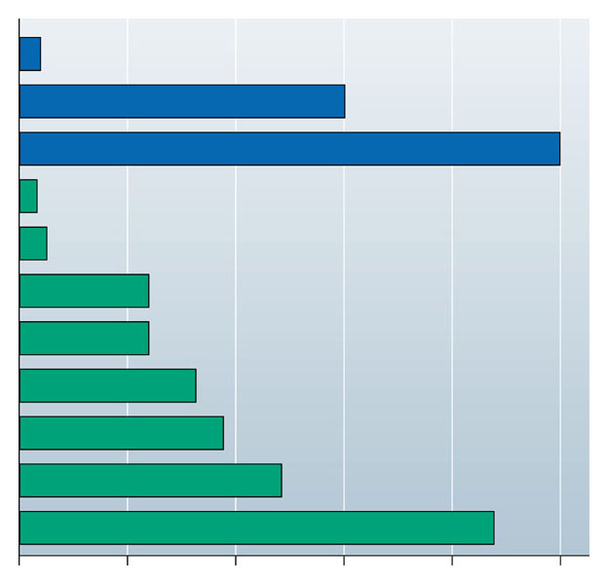
0
37.12 Primary production sets the energy budget for ecosystems
Primary production
Is the rate at which producers convert sunlight to chemical energy in organic matter, or biomass
Open ocean
Estuary
Algal beds and coral reefs
Desert and semidesert scrub
Tundra
Temperate grassland
Cultivated land
Boreal forest (taiga)
Savanna
Temperate deciduous forest
Tropical rain forest
Figure 37.12
0
500
1,000
1,500
2,000
2,500
Average net primary productivity (g/m²/yr)

Slide 32
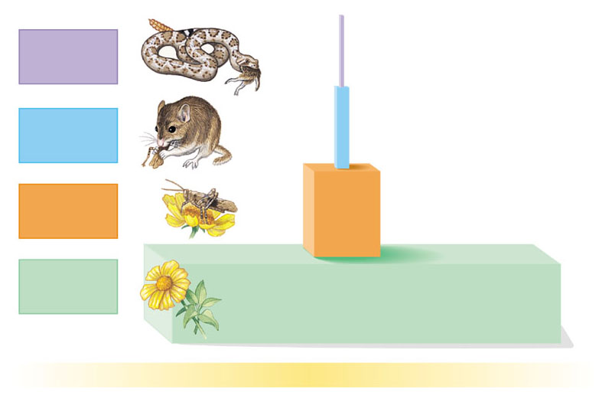
0
37.13 Energy supply limits the length of food chains
A pyramid of production
Shows the flow of energy from producers to primary consumers and to higher trophic levels
Tertiary
consumers
10 kcal
100 kcal
Secondary consumers
Primary
consumers
1,000 kcal
Producers
10,000 kcal
Figure 37.13
1,000,000 kcal of sunlight

Slide 33
0
Only about 10% of the energy stored at each trophic level
Is available to the next level

Slide 34
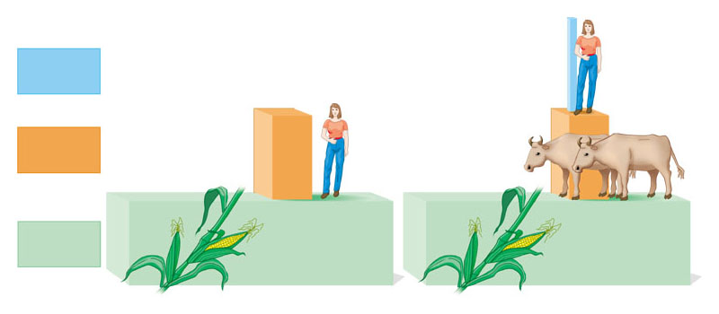
CONNECTION
0
37.14 A production pyramid explains why meat is a luxury for humans
A field of corn
Can support many more human vegetarians than meat-eaters
Trophic level
Secondary consumers
Human
meat-eaters
Primary consumers
Cattle
Human
vegetarians
Corn
Corn
Producers
Figure 37.14

Slide 35
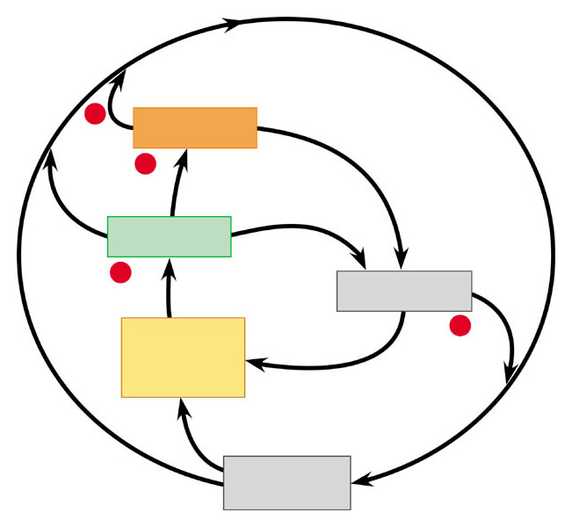
0
37.15 Chemicals are recycled between organic matter and abiotic reservoirs
Nutrients recycle between
Organisms and abiotic reservoirs
3
Consumers
2
Producers
1
Detritivores
Nutrients
available
to producers
4
Abiotic reservoir
Figure 37.15

Slide 36
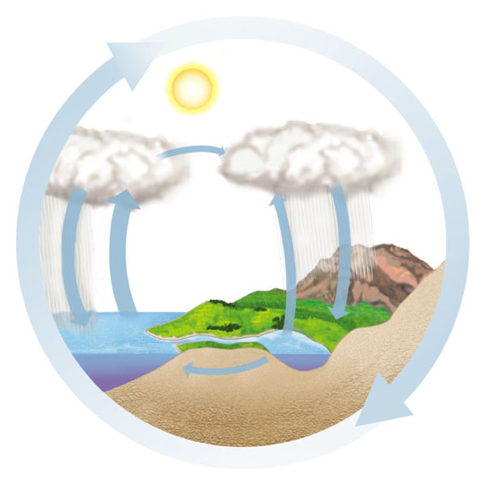
0
37.16 Water moves through the biosphere in a global cycle
Solar heat
Drives the global water cycle of precipitation, evaporation, and transpiration
Transport over land
Solar energy
Net movement of water vapor by wind
Precipitation
over ocean
Evaporation from ocean
Precipitation over land
Evaporation and
transpiration from
land
Percolation
through soil
Runoff and
groundwater
Figure 37.16

Slide 37
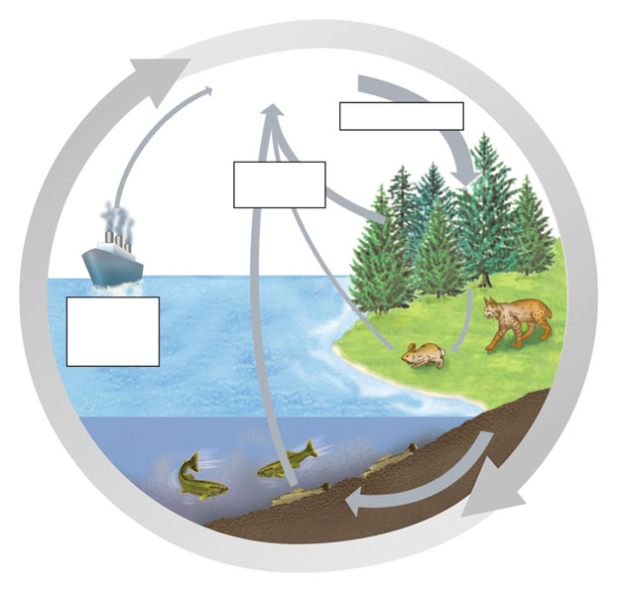
0
37.17 The carbon cycle depends on photosynthesis and respiration
Carbon is taken from the atmosphere by photosynthesis
Used to make organic molecules, and returned to the atmosphere by cellular respiration
CO₂ in atmosphere
Photosynthesis
Cellular
respiration
Burning of fossil fuels and wood
Primary
consumers
Higher-level
consumers
Carbon compounds in water
Detritus
Figure 37.17
Decomposition

Slide 38
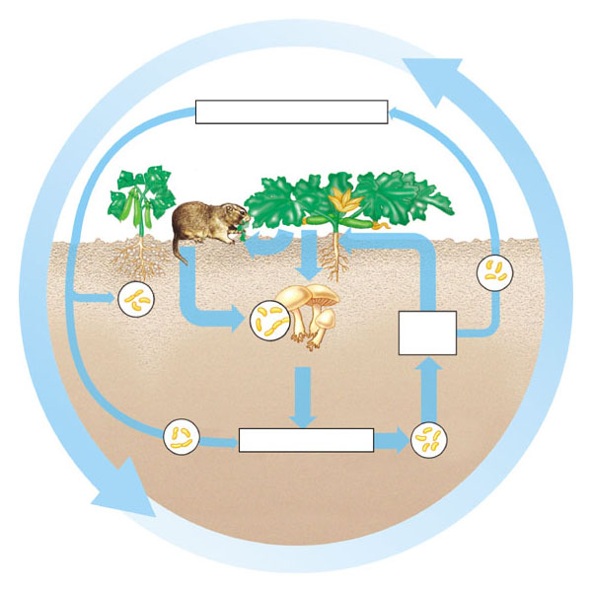
0
37.18 The nitrogen cycle relies heavily on bacteria
Various bacteria in soil
Convert gaseous N₂ to compounds that plants use: ammonium (NH₄⁺) and nitrate (NO₃–)
Nitrogen in atmosphere (N₂)
Nitrogen fixation
Assimilation
by plants
Nitrates
(NO₃–)
Denitrifying
bacteria
Nitrogen-fixing
bacteria in root
nodules of legumes
Detritivores
Decomposition
Nitrifying
bacteria
Ammonium (NH₄⁺)
Nitrogen-fixing
soil bacteria
Figure 37.18

Slide 39
0
Detritivores
Decompose organic matter and recycle nitrogen to plants

Slide 40
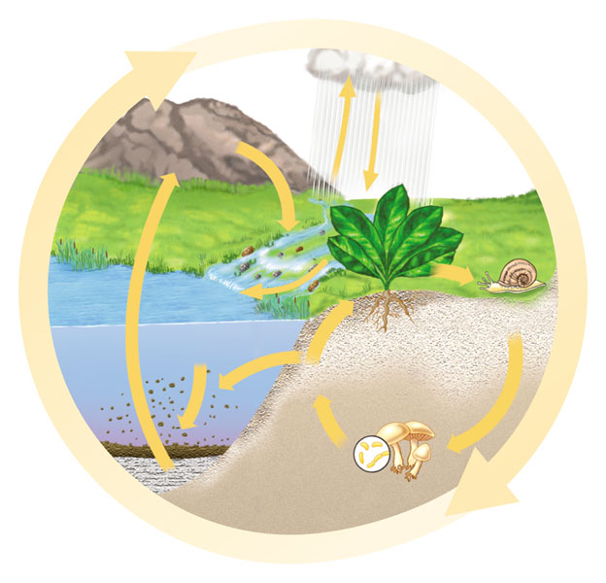
0
37.19 The phosphorus cycle depends on the weathering of rock
Phosphorus and other soil minerals
Are recycled locally
Rain
Geologic
uplift
of rocks
Weathering
of rocks
Plants
Runoff
Sedimentation
Consumption
Plant uptake
of PO₄^{3–}
Soil
Leaching
Decomposition
Figure 37.19

Slide 41
ECOSYSTEM ALTERATION CONNECTION
0
37.20 Ecosystem alteration can upset chemical cycling

Slide 42
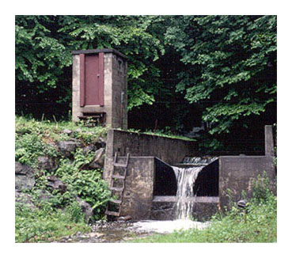
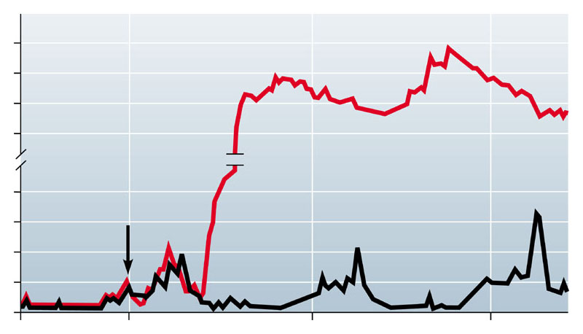
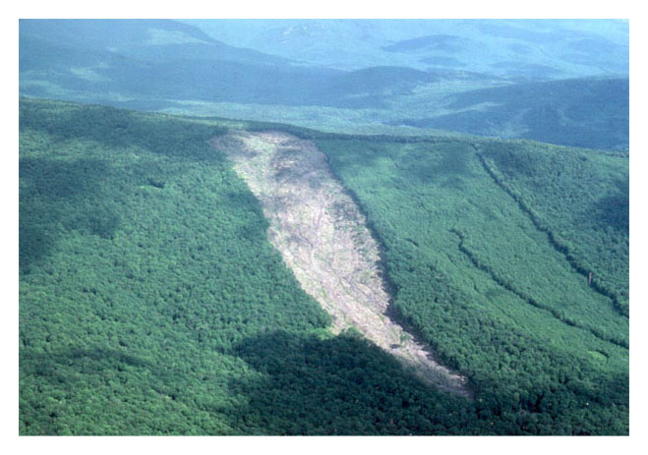
0
Ecosystem studies show that drastic alterations, such as the total removal of vegetation
Can increase the runoff and loss of soil nutrients
80.0
60.0
Deforested
40.0
20.0
Nitrate concentration in runoff (mg/L)
4.0
Completion of tree cutting
3.0
Control
2.0
1.0
0
1965
1966
1967
1968
Figure 37.20A—C

Slide 43
0
Environmental changes caused by humans, such as acid precipitation
Can unbalance nutrient cycling over the long term

Slide 44
TALKING ABOUT SCIENCE
0
37.21 David Schindler talks about the effects of nutrients on freshwater ecosystems
Figure 37.21A

Slide 45
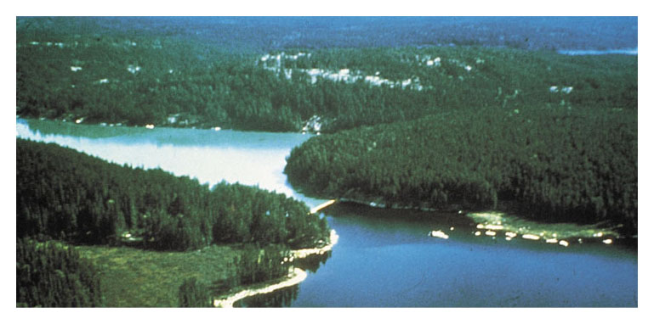
0
Nutrient runoff from agricultural lands and large livestock operations
May cause excessive algal growth
This cultural eutrophication
Reduces species diversity and harms water quality
Figure 37.21B

