Slide 1
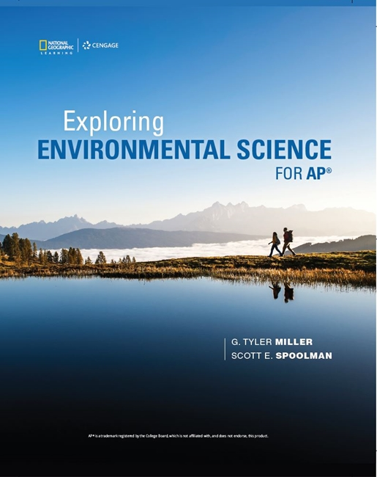
Exploring Environmental Science for AP®
1st Edition
Chapter 2
Science, Matter, Energy, and Systems
Copyright © 2018 Cengage Learning. All Rights Reserved. May not be copied, scanned, or duplicated, in whole or in part, except for use as permitted in a license distributed with a certain product or service or otherwise on a password-protected website for classroom use.

Slide 2
Core Case Study: How Do Scientists Learn about Nature?
Experimenting with a forest
Hubbard Brook Experimental Forest in New Hampshire
Compared the loss of water and nutrients from an uncut forest (control site) with one that had been stripped (experimental site)
Stripped site
30–40% more runoff
More dissolved nutrients
More soil erosion

Slide 3
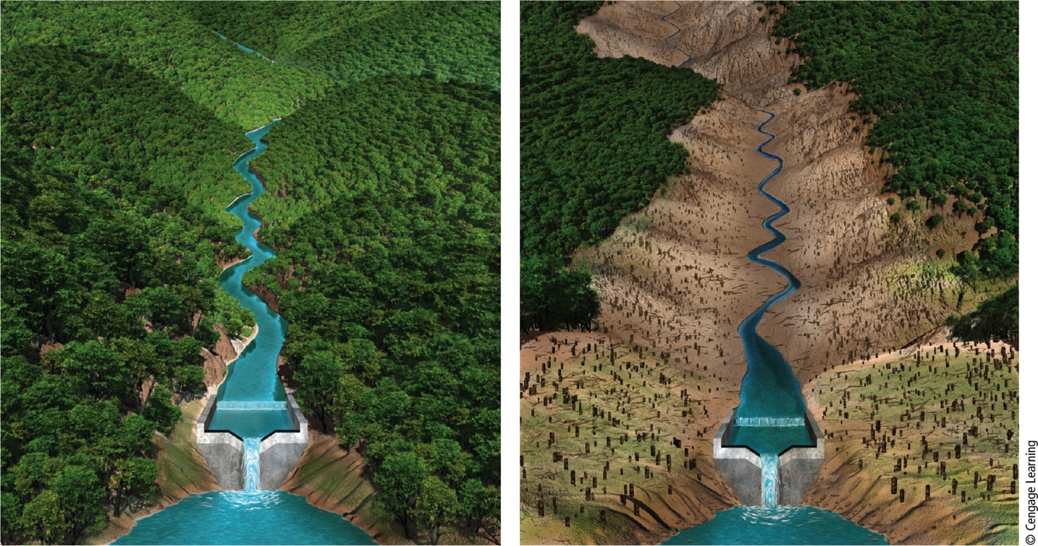
The Effects of Deforestation on the Loss of Water and Soil Nutrients
Stepped Art
Notes:
Figure 2.1 This controlled field experiment measured the loss of water and soil nutrients from a forest due to deforestation. The forested valley (left) was the control site; the cutover valley (right) was the experimental site.

Slide 4
2.1 What Do Scientists Do?
Scientists collect data and develop theories, models, and laws about how nature works
Tools of the scientist
Observations
Measurements
Experimentation

Slide 5
Scientists Collect Evidence to Learn How Nature Works (1 of 3)
Steps in the scientific method
Identify a problem
Find out what is known about the problem
Ask a question to investigate
Perform an experiment, collect data, and analyze data to answer the question
Propose a scientific hypothesis to explain the data

Slide 6
Scientists Collect Evidence to Learn How Nature Works (2 of 3)
Steps in the scientific method (cont’d.)
Use the hypothesis to make testable projections
Perform an experiment to test projections
Accept or revise the hypothesis
Developing a model
Another way to study nature
Scientific theory
Well-tested and widely accepted hypothesis

Slide 7
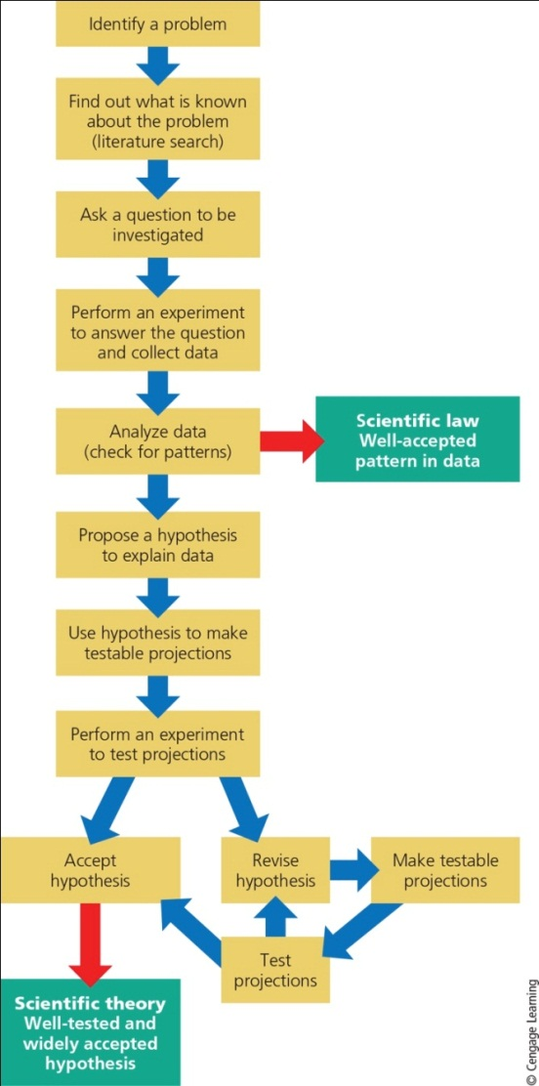
Scientists Collect Evidence to Learn How Nature Works (3 of 3)
Notes:
Figure 2.2 Scientific method: The general process that scientists use for discovering and testing ideas about how the natural world works.

Slide 8
Scientists Are Curious and Skeptical and Demand Evidence
Scientific knowledge advances through:
Scientists publishing details of methods and results
Peer review
New data and analysis can lead to revised hypotheses

Slide 9
Critical Thinking and Creativity Are Important in Science
Thinking critically
Have a skeptical outlook
Evaluate evidence and hypotheses using inputs from a variety of reliable sources
Identify and evaluate personal assumptions, biases, and beliefs to distinguish facts and opinions before coming to a conclusion
Imagination, creativity, and intuition also vital

Slide 10
Scientific Theories and Laws: The Most Important and Certain Results of Science
Scientific theory
Widely tested and supported by evidence
Scientific law or law of nature
Well-tested, widely accepted description of what happens repeatedly and in the same way in nature

Slide 11
Science Can Be Reliable, Unreliable, and Tentative
Reliable science
Data, hypothesis, models, theories, and laws widely accepted by experts
Unreliable science
Results presented as reliable without peer review or having been discredited
Tentative science
Preliminary scientific results without adequate testing and peer review

Slide 12
Science Has Limitations
Scientists cannot prove or disprove anything absolutely
Science attempts to establish high probability
Scientists not free of bias about their own hypotheses and results
Systems in the natural world involve a many variables and complex interactions
Mathematical models and statistical tools help deal with these

Slide 13
2.2 What Is Matter and What Happens When It Undergoes Change?
Matter has mass and takes up space
Exists in three physical states: solid, liquid, or gas
Two chemical forms: elements and compounds
Elements
Have unique properties
Cannot be broken down chemically into other substances

Slide 14
Matter Consists of Elements and Compounds
Known elements arranged in a chart called periodic table of the elements
Compounds
Two or more different elements held together in fixed proportions

Slide 15
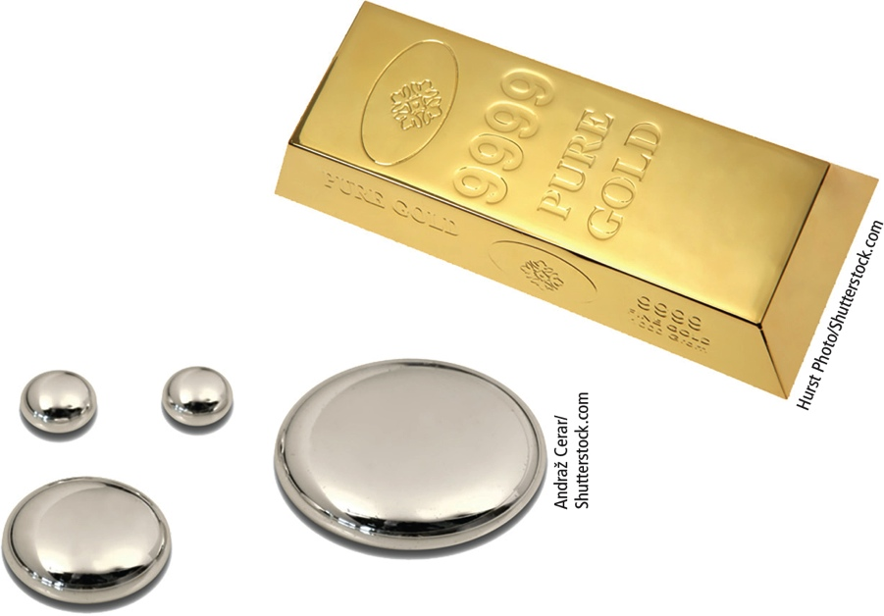
Gold and Mercury Are Chemical Elements
Notes:
Figure 2.3 Mercury(left) and gold(right) are chemical elements. Each has a unique set of properties and cannot be broken down into simpler substances.

Slide 16
Elements and Compounds Are Made of Atoms, Molecules, and Ions (1 of 7)
Atomic theory
All elements are made of atoms
Subatomic particles
Nucleus of the atom
Protons have positive charge
Neutrons have negative charge
Negatively charged electrons orbit the nucleus

Slide 17
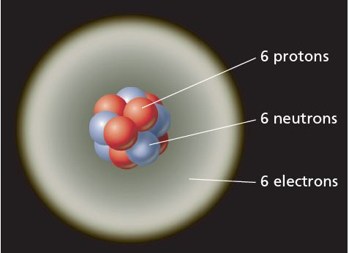
Elements and Compounds Are Made of Atoms, Molecules, and Ions (2 of 7)

Slide 18
Elements and Compounds Are Made of Atoms, Molecules, and Ions (3 of 7)
Each element has a unique atomic number
Same as number of protons in nucleus
Mass number
Number of protons plus neutrons in nucleus
Isotope
Form of an element with same atomic number but different mass number

Slide 19
Elements and Compounds Are Made of Atoms, Molecules, and Ions (4 of 7)
Molecule
Combination of two or more atoms of same or different elements
Held together by chemical bonds
Ions
Atom or group of atoms with net positive or negative electric charge
Formed when electrons are gained or lost

Slide 20
Elements and Compounds Are Made of Atoms, Molecules, and Ions (5 of 7)
Acidity
Measure of comparative amounts of hydrogen ions (H⁺) and hydroxide ions (OH–) in a volume of water solution
Measured with pH
Neutral solution has pH equal to 7
Acidic solution has pH < 7
Basic solution has pH > 7

Slide 21
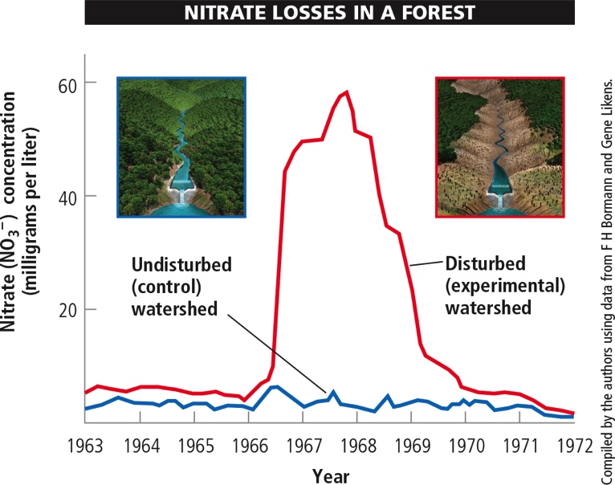
Elements and Compounds Are Made of Atoms, Molecules, and Ions (6 of 7)
Notes:
Figure 2.5 Loss of nitrate ions (NO₃–) from a deforested watershed in the Hubbard Brook Experimental Forest (Core Case Study, Figure 2.1) Data Analysis: By what percent did the nitrate concentration increase between 1965 and the peak concentration between 1967 and 1968?

Slide 22
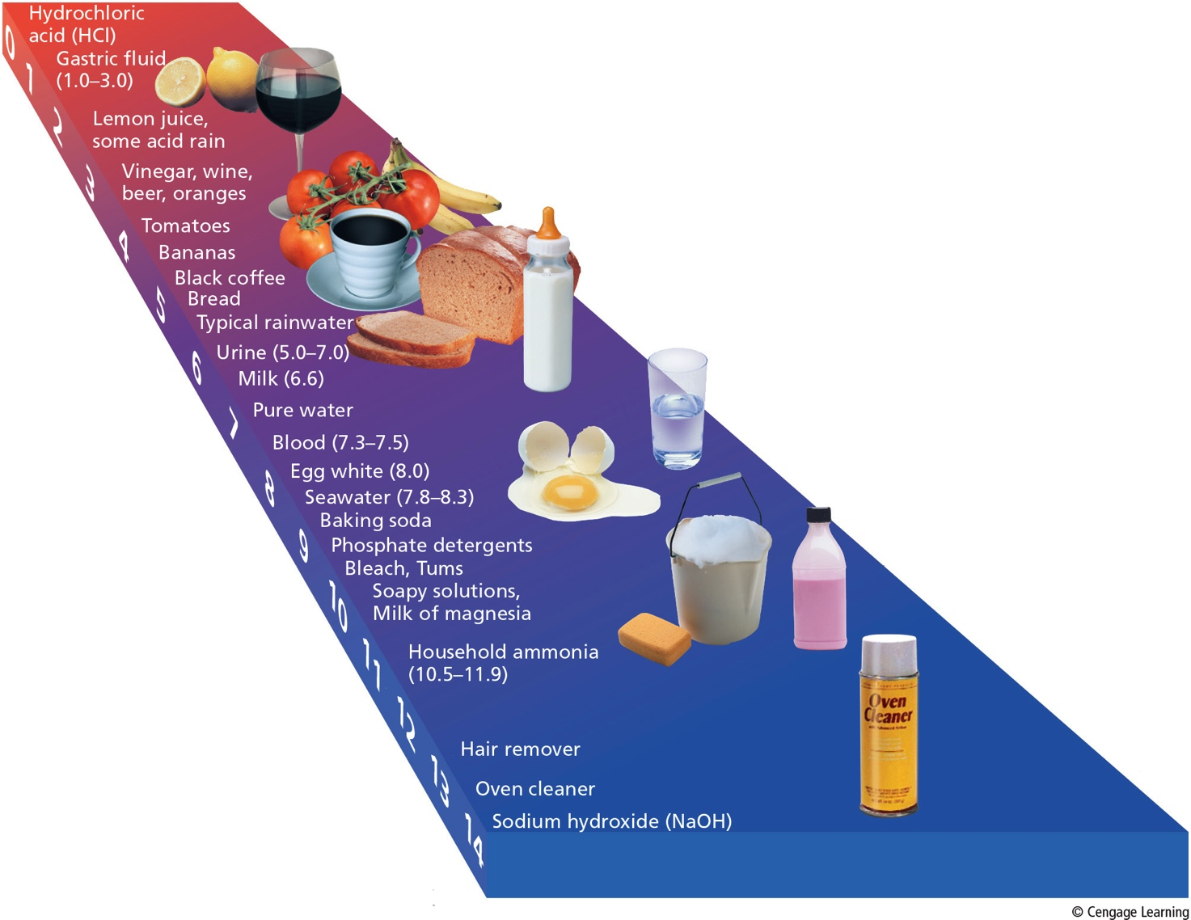
Elements and Compounds Are Made of Atoms, Molecules, and Ions (7 of 7)
Notes:
Figure 2.6 The pH scale measures the acidity of solutions. A neutral solution has a pH of 7, an acidic solution has a pH less than 7, and a basic solution has a pH greater than 7. A one-unit change in pH means a tenfold change, that is, a tenfold increase or decrease in acidity. Data Analysis: How many times more acidic is a solution with a pH of 2 than one with a pH of 6?

Slide 23
Chemical Formula (1 of 3)
Shows number of each type of atom or ion in a compound
Ionic compounds
Example: Sodium chloride (NaCl)
Tend to dissolve in water and break into ions
Covalent compounds
Example: water (H₂O)

Slide 24
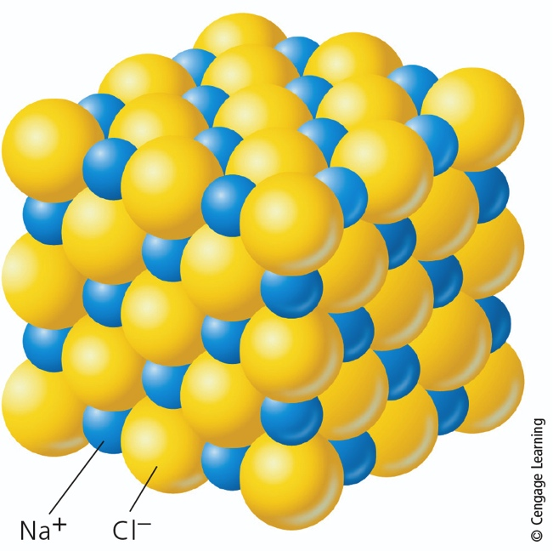
Chemical Formula (2 of 3)
Notes:
Figure 2.7 A solid crystal of an ionic compound such as sodium chloride (NaCl) consists of a three-dimensional array of oppositely charged ions held together by the strong forces of attraction between oppositely charged ions.

Slide 25
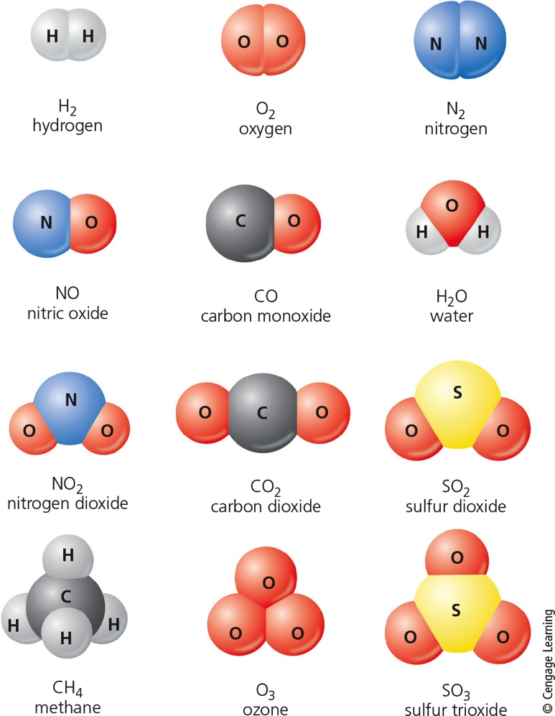
Chemical Formula (3 of 3)
Notes:
Figure 2.8 Chemical formulas and shapes for some covalent compound molecules.

Slide 26
Organic Compounds Are the Chemicals of Life
Organic compounds
Contain at least two carbon atoms
Exception: methane (CH₄)
Types
Hydrocarbons
Simple carbohydrates
Macromolecules: complex organic molecules
Complex carbohydrates, proteins, nucleic acids, and lipids

Slide 27
Matter Comes to Life through Cells, Genes, and Chromosomes (1 of 3)
Cells
Fundamental units of life
All organisms have one or more cells
Genes
Sequences of nucleotides within DNA
Instructions called genetic information
Create inheritable traits
Chromosomes: composed of many genes

Slide 28
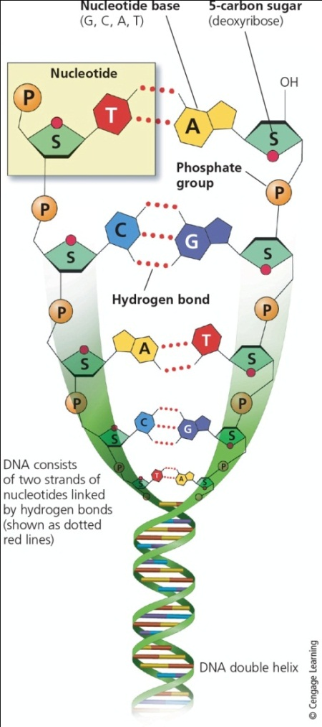
Matter Comes to Life through Cells, Genes, and Chromosomes (2 of 3)
Notes:
Figure 2.9 Portion of a DNA molecule, which is composed of spiral (helical) strands of nucleotides. Each nucleotide contains three units: phosphate (P), a sugar (S, which is deoxyribose), and one of four different nucleotide bases represented by the letters A, G, C, and T.

Slide 29
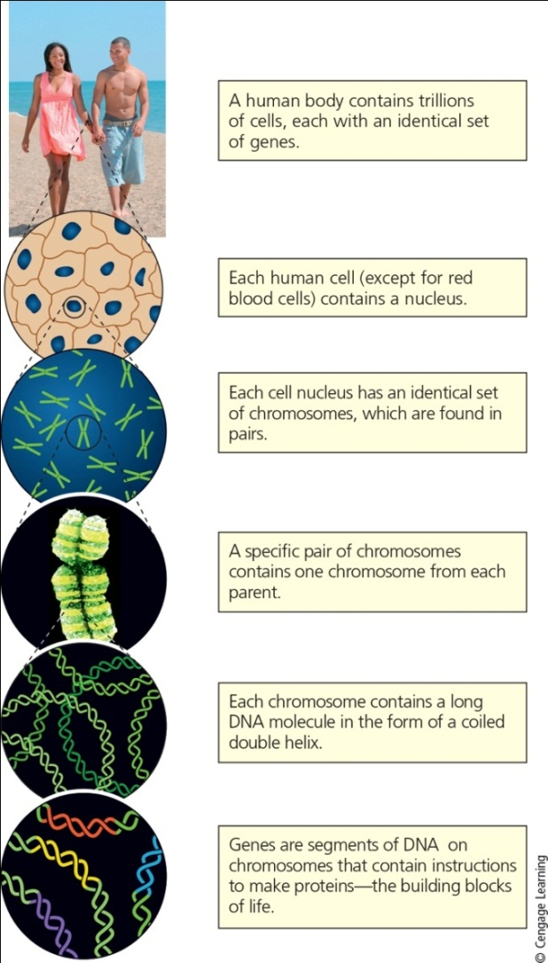
Matter Comes to Life through Cells, Genes, and Chromosomes (3 of 3)
Notes:
Figure 2.10 The relationships among cells, nuclei, chromosomes, DNA, and genes.

Slide 30
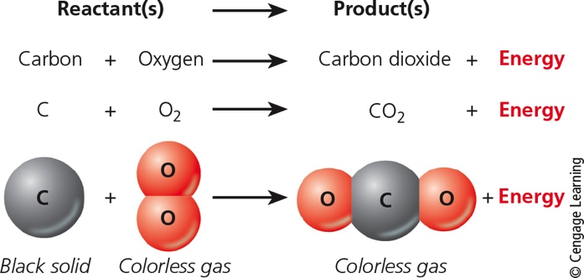
Matter Can Change
Physical change
No change in chemical composition
Chemical change
Change in chemical composition

Slide 31
Law of Conservation of Matter
We can change elements and compounds from one physical or chemical form to another
We cannot create or destroy atoms

Slide 32
2.3 What is Energy and What Happens When It Undergoes Change?
Whenever energy is converted from one form to another in a physical or chemical change:
No energy is created or destroyed (first law of thermodynamics)
We end up with lower quality or less-usable energy than we started with (second law of thermodynamics)

Slide 33
Energy Comes in Many Forms (1 of 4)
Energy: ability to do work
Kinetic energy
Energy of movement
Heat
Electromagnetic radiation
Potential energy
Stored energy
Can be changed into kinetic energy

Slide 34
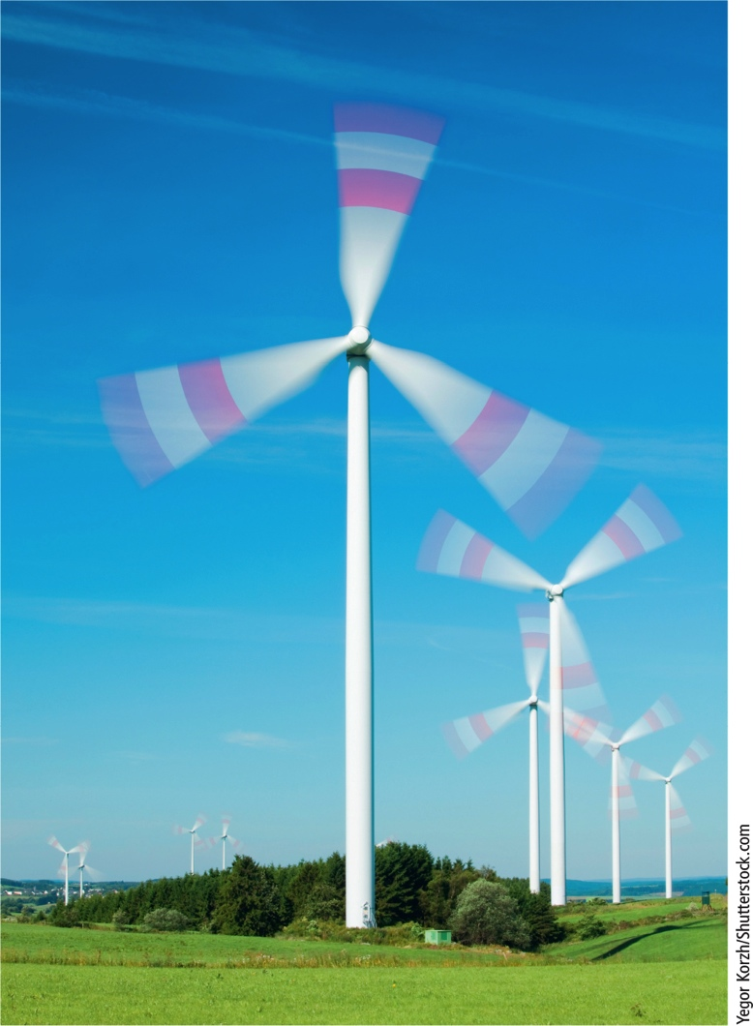
Energy Comes in Many Forms (2 of 4)
Notes:
Figure 2.11 Kinetic energy, created by the gaseous molecules in a mass of moving air, turns the blades of these wind turbines. The turbines then convert this kinetic energy to electrical energy, which is another form of kinetic energy.

Slide 35
Energy Comes in Many Forms (3 of 4)
Notes:
Figure 2.12 The electromagnetic spectrum consists of a range of electromagnetic waves, which differ in wavelength (the distance between successive peaks or troughs) and energy content.

Slide 36
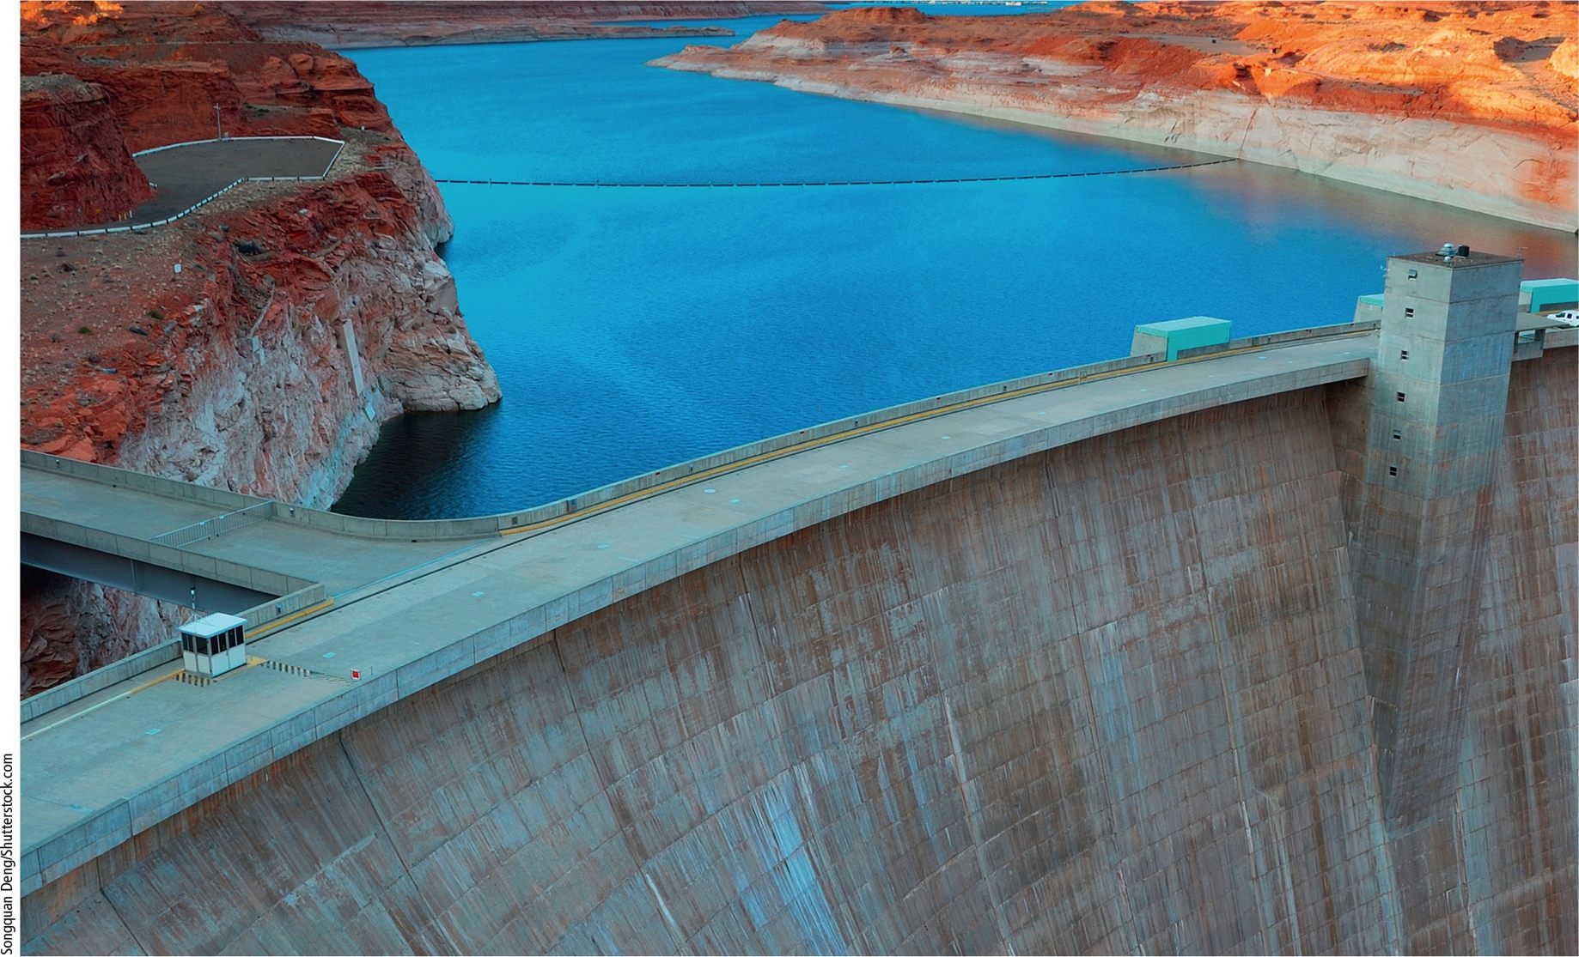
Energy Comes in Many Forms (4 of 4)
Notes:
Figure 2.13 The water stored in this reservoir behind a dam has potential energy, which becomes kinetic energy when the water flows through channels built into the dam where it spins a turbine and produces electricity—another form of kinetic energy.

Slide 37
Energy Is Renewable and Nonrenewable (1 of 2)
Renewable energy
Gained from resources that are replenished by natural processes in a relatively short time
Nonrenewable energy
Gained from resources that can be depleted and are not replenished by natural processes within human time scale

Slide 38
Energy Is Renewable and Nonrenewable (2 of 2)
Solar energy
99% of the energy that keeps us warm and supports plants and other organisms
Commercial energy
Energy sold in the marketplace
Supplements sun’s energy
90% comes from burning fossil fuels
Oil, coal, and natural gas

Slide 39
Energy Varies in Its Quality
High-quality energy
Concentrated energy with high capacity to do useful work
Examples: high-temperature heat, strong winds, and energy released by burning fossil fuels
Low-quality energy
Dispersed energy with low capacity to do useful work
Example: low-temperature moving molecules

Slide 40
Energy Changes Obey Two Scientific Laws (1 of 2)
First law of thermodynamics
Also called law of conservation of energy
Energy is neither created nor destroyed in physical and chemical changes
Second law of thermodynamics
Energy always goes from a more useful to a less useful form when it changes from one form to another

Slide 41
Energy Changes Obey Two Scientific Laws (2 of 2)
Energy efficiency
Measure of how much work results from a unit of energy put into a system
Improving efficiency reduces waste
Estimate: 84% of energy used in the U.S. is wasted
Unavoidably because of second law of thermodynamics (41%)
Unnecessarily (43%)

Slide 42
2.4 What Are Systems and How Do They Respond to Change? (1 of 2)
System
Set of components that interact in a regular way
Examples: human body, a cell, a TV set, and an economy
Systems have inputs, flows, and outputs of matter, energy, and information
Feedback can affect their behavior

Slide 43
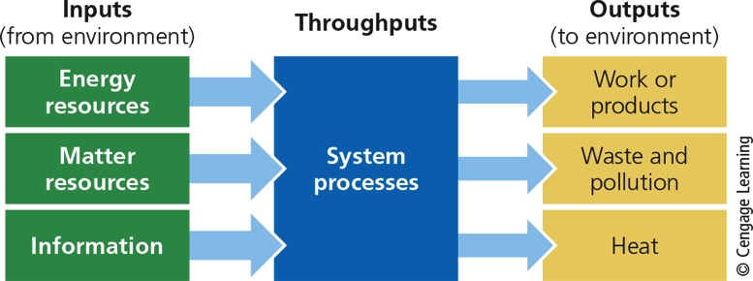
2.4 What Are Systems and How Do They Respond to Change? (2 of 2)
Notes:
Figure 2.14 Simplified model of a system.

Slide 44
Systems and Feedback Loops (1 of 4)
Feedback
Any process that increases or decreases a change to a system
Positive feedback loop
Causes system to change further in the same direction
Negative, or corrective, feedback loop
Causes system to change in opposite directions

Slide 45
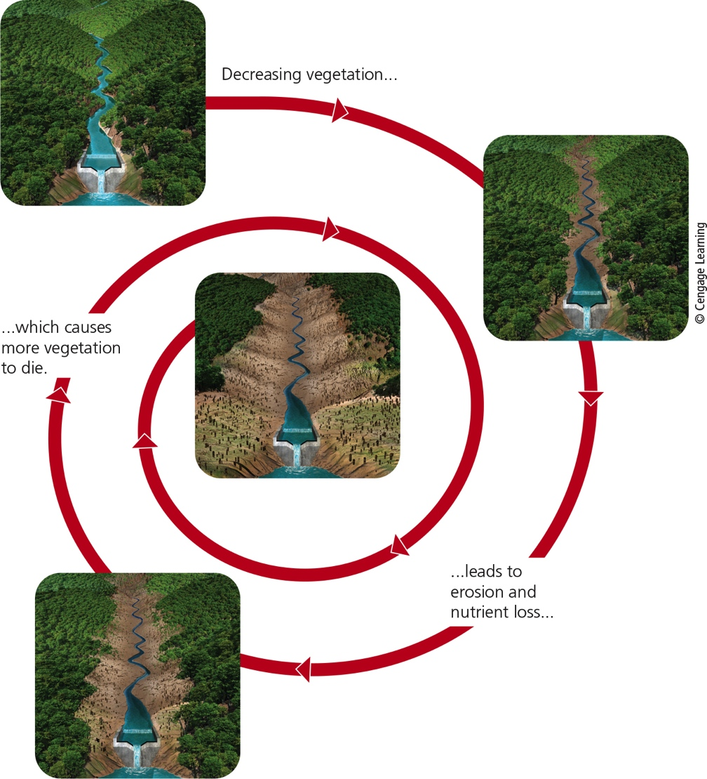
Systems and Feedback Loops (2 of 4)
Notes:
Figure 2.15 A positive feedback loop. Decreasing vegetation in a valley causes increasing erosion and nutrient losses that in turn cause more vegetation to die, resulting in more erosion and nutrient losses. Question: Can you think of another positive feedback loop in nature?

Slide 46
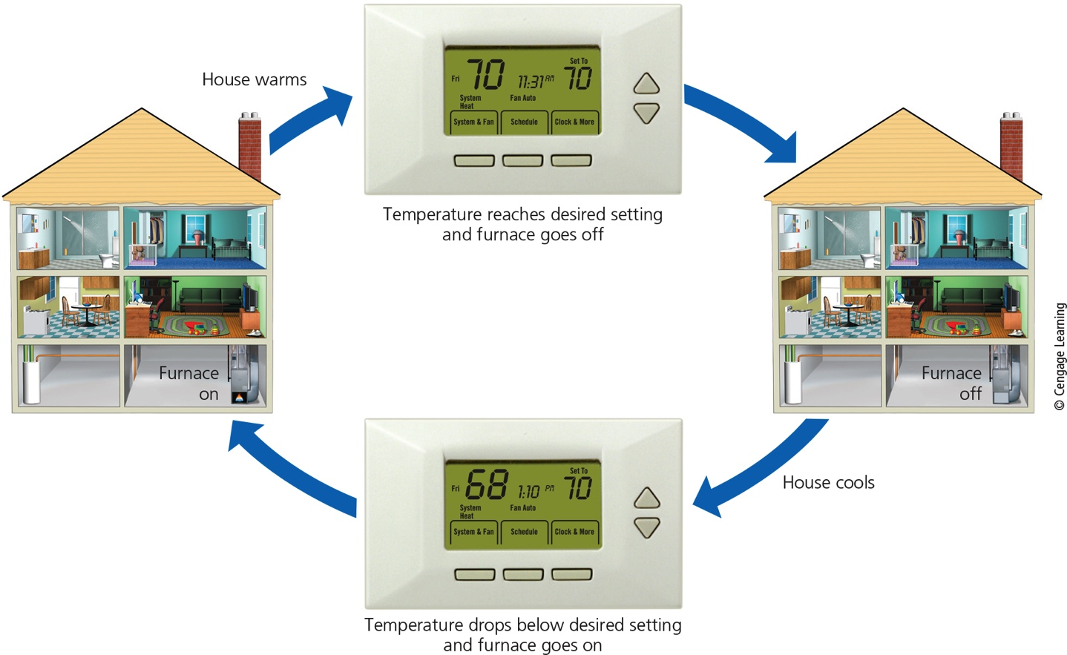
Systems and Feedback Loops (3 of 4)
Notes:
Figure 2.16 A negative feedback loop. When a house being heated by a furnace gets to a certain temperature, its thermostat is set to turn off the furnace, and the house begins to cool instead of continuing to get warmer. When the house temperature drops below the set point, this information is fed back to turn the furnace on until the desired temperature is reached again.

Slide 47
Systems and Feedback Loops (4 of 4)
Most systems in nature use negative feedback to enhance long-term stability
Ecological tipping point
Natural system stuck in positive feedback loop can reach this point
Beyond this point, system changes so drastically it suffers from severe degradation or collapse

