Slide 1

Biology Concepts & Applications
10 Edition
Chapter 2
Life’s Chemical Basis
Copyright © 2018 Cengage Learning. All Rights Reserved. May not be copied, scanned, or duplicated, in whole or in part, except for use as permitted in a license distributed with a certain product or service or otherwise on a password-protected website for classroom use.

Slide 2
2.1 Building Blocks of Matter
Positively charged protons (p⁺) and uncharged neutrons are found in an atom’s nucleus (core)
Negatively charged electrons (e–) move around the nucleus
  Charge: electrical property; opposite charges attract, and like charges repel

Slide 3
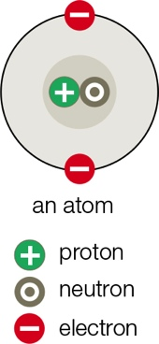
An Atom

Slide 4
Atoms and Elements
A typical atom has about the same number of electrons and protons
  Atomic number: number of protons in the atomic nucleus
Element: pure substance that consists only of atoms with the same number of protons
Periodic table: tabular arrangement of all known elements by their atomic number

Slide 5
The Periodic Table

Slide 6
Isotopes and Radioisotopes (1 of 2)
Although all atoms of an element have the same number of protons, they can differ in the number of other subatomic particles
Isotopes: forms of an element that differ in the number of neutrons their atoms carry
  Mass number: total number of protons and neutrons in the atomic nucleus
Radioisotope: isotope with an unstable nucleus

Slide 7
Isotopes and Radioisotopes (2 of 2)
Radioactive decay: process in which an atom emits energy and/or subatomic particles when its nucleus spontaneously breaks up
Radioisotopes can be used as tracers to study biological processes
  Tracer: any substance with a detectable component

Slide 8
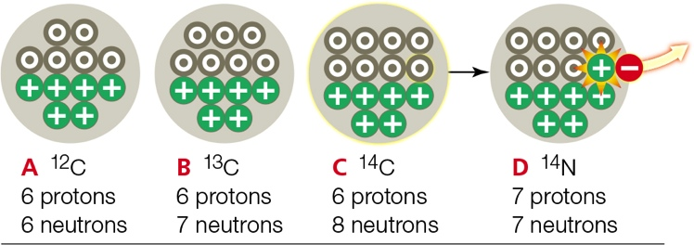
Carbon Isotopes
Notes:
Figure 2.2 Carbon isotopes. A–C show nuclei of the three naturally occurring isotopes of carbon. Carbon 14 (¹⁴C) C is a radioisotope that becomes a nitrogen atom (¹⁴N) D when it decays.

Slide 9
2.2 Why Electrons Matter
Electrons occupy different orbitals: volumes of space around an atom’s nucleus
Orbitals are filled from lower to higher energy
The farther an electron is from the nucleus, the greater its energy

Slide 10
Electrons Have Energy
An electron can move to a higher energy orbital if an input gives it a boost
  Electron then immediately emits the extra energy and moves back down to the lower energy orbital

Slide 11
Shell Models (1 of 2)
A shell model helps us visualize how electrons populate atoms
  Nested “shells” correspond to successively higher energy levels
  Each shell includes all of the orbitals on one energy level

Slide 12
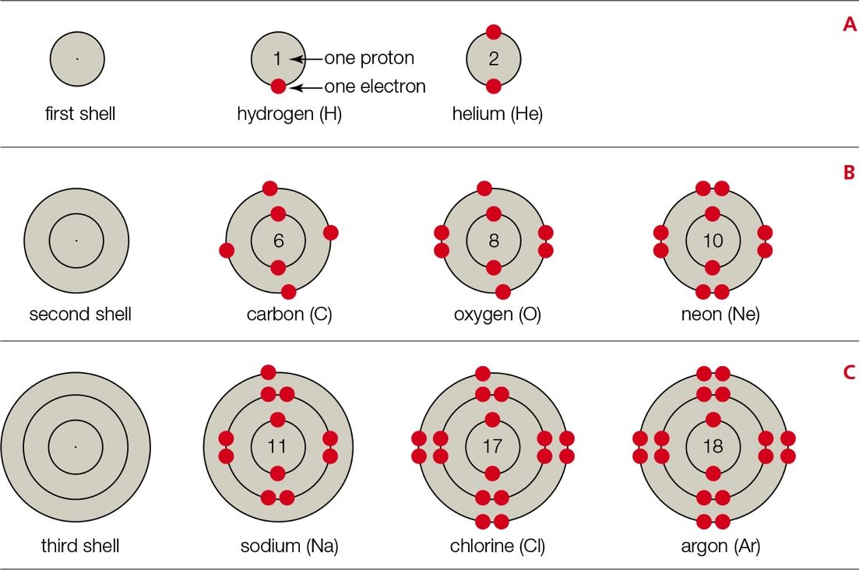
Shell Models (2 of 2)
Notes:
Figure 2.4 Shell models. Each circle (shell) represents one energy level. To make these models, we fill the shells with electrons from the innermost shell out, until there are as many electrons as the atom has protons. The number of protons in each model is indicated.
A The first shell corresponds to the first energy level, and it can hold up to 2 electrons. Hydrogen has one proton, so it has 1 electron and 1 vacancy. A helium atom has 2 protons, 2 electrons, and no vacancies.
B The second shell corresponds to the second energy level, and it can hold up to 8 electrons. Carbon has 6 electrons, so its first shell is full. Its second shell has 4 electrons and four vacancies. Oxygen has 8 electrons and two vacancies. Neon has 10 electrons and no vacancies.
C The third shell corresponds to the third energy level, and it can hold up to 8 electrons. A sodium atom has 11 electrons, so its first two shells are full; the third shell has one electron. Thus, sodium has seven vacancies. Chlorine has 17 electrons and one vacancy. Argon has 18 electrons and no vacancies.

Slide 13
The Importance of Vacancies (1 of 2)
When an atom’s outermost shell is filled with electrons, it has no vacancies
  Most stable state
Vacancy: an atom’s outermost shell has room for another electron
  Chemically active; atoms interact with one another
  Example: sodium atom has one electron in its outer (third) shell, which can hold eight

Slide 14
The Importance of Vacancies (2 of 2)
Solitary atoms that have unpaired electrons are called free radicals
  Typically very unstable
Atoms with an unequal number of protons and electrons are called ions
  Carry a net (overall) charge

Slide 15
Ion Formation
Notes:
Figure 2.5 Ion formation. Electrons, e–; protons, p+
A A sodium atom (Na) becomes a positively charged sodium ion (Na⁺) when it loses the single electron in its third shell. The atom’s full second shell is now its outermost, so it has no vacancies.
B A chlorine atom (Cl) becomes a negatively charged chloride ion (Cl–) when it gains an electron and fills the vacancy in its third, outermost shell.

Slide 16
2.3 From Atoms to Molecules
An atom can get rid of vacancies by participating in a chemical bond with another atom
  Chemical bond: attractive force that arises between two atoms when their electrons interact
  Compound: molecule that has atoms of more than one element

Slide 17
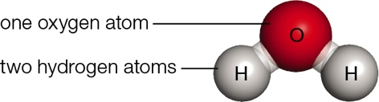
Water Molecule
Notes:
Figure 2.6 The water molecule. Each water molecule has two hydrogen atoms bonded to the same oxygen atom.

Slide 18
Ionic Bonds (1 of 3)
Ionic bond: strong mutual attraction links ions of opposite charge
  Ionically bonded sodium and chloride ions make up sodium chloride (NaCl; table salt)
Notes:
Figure 2.7 Ionic bonds in table salt (NaCl).
A Tiny crystals of sodium chloride compose table salt (NaCl). Each crystal consists of many sodium ions (Na⁺) locked together with chloride ions (Cl–) in a cubic lattice by ionic bonds.

Slide 19
Ionic Bonds (2 of 3)
Ions retain their respective charges when participating in an ionic bond
  Polarity: separation of charge into positive and negative regions
  A NaCl molecule is polar because the chloride ion keeps a very strong hold on its extra electron
  Electronegativity: measure of the ability of an atom to pull electrons away from other atoms

Slide 20
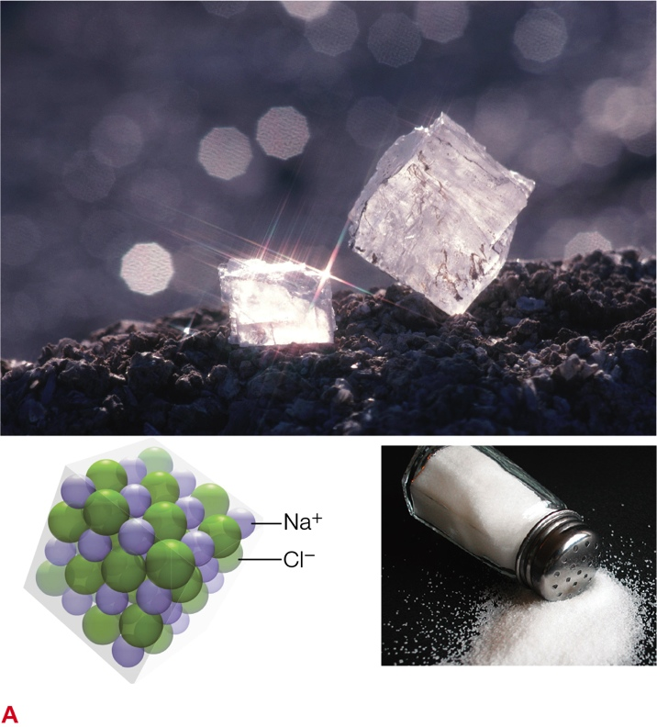
Ionic Bonds (3 of 3)
Notes:
Figure 2.7 Ionic bonds in table salt (NaCl).
A Tiny crystals of sodium chloride compose table salt (NaCl). Each crystal consists of many sodium ions (Na⁺) locked together with chloride ions (Cl–) in a cubic lattice by ionic bonds.

Slide 21
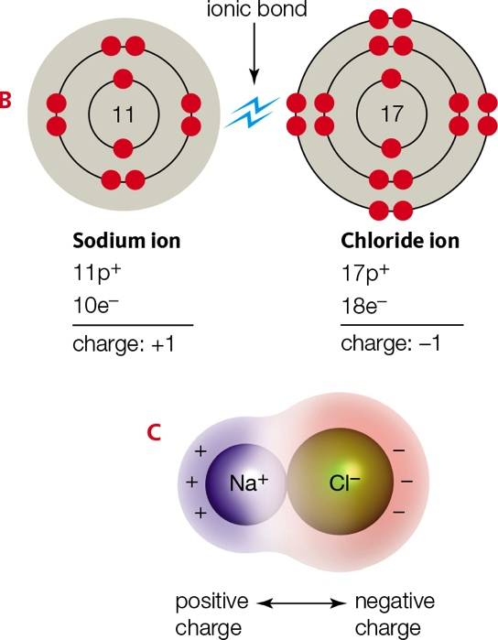
Table Salt
Notes:
Figure 2.7 Ionic bonds in table salt (NaCl).
B The strong mutual attraction of opposite charges holds a sodium ion and a chloride ion together in an ionic bond.
C Ions taking part in an ionic bond retain their charge, so the molecule itself is polar. One side is positively charged (represented by a blue overlay); the other side is negatively charged (red overlay).

Slide 22
Covalent Bonds (1 of 3)
Covalent bond: two atoms share a pair of electrons
  Formed between atoms with a small or no difference in electronegativity
  Covalent bonds are often stronger than ionic bonds (but not always)

Slide 23
Covalent Bonds (2 of 3)
  Covalent bonds in compounds are usually polar
  Atoms share electrons unequally in a polar covalent bond
    Example: water molecules

Slide 24
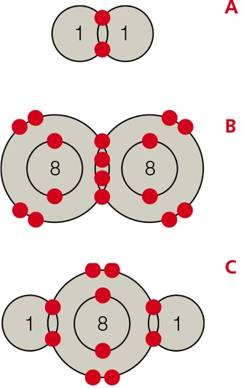
Covalent Bonds (3 of 3)
Notes:
Figure 2.8 Covalent bonds, in which atoms fill vacancies by sharing electrons. Two electrons are shared in each covalent bond. When sharing is equal, the bond is nonpolar. When one atom exerts a greater pull on the electrons, the bond is polar.
A Molecular Hydrogen (H-H) Two hydrogen atoms, each with one proton, share two electrons in a nonpolar covalent bond.
B Molecular Oxygen (O=O) Two oxygen atoms, each with eight protons, share four electrons in a double covalent bond. This bond is nonpolar.
C Water (H-O-H) Two hydrogen atoms share electrons with the same oxygen atom in two covalent bonds. Each bond is polar because the oxygen exerts a greater pull on the shared electrons than the hydrogens do.

Slide 25
Representing Molecules and Bonds
  Structural formulas: lines between atoms represent the number of covalent bonds
    Example: H–H
      H₂ has one covalent bond between the atoms
    Example: O=O
      A double bond links the two oxygen atoms
    Example: N=N
      A triple covalent bond links the two nitrogen atoms

Slide 26
Representing Molecules
Notes:
Table 2.2 Six Ways of Representing the Same Molecule

Slide 27
2.4 Hydrogen Bonding and Water
Water has unique properties that arise from the two polar covalent bonds in each water molecule
In water, the oxygen atom carries a slight negative charge; the hydrogen atoms carry a slight positive charge

Slide 28
Hydrogen Bonds (1 of 3)
The polarity of individual water molecules attracts them to one another
  This type of interaction is called a hydrogen bond
    Hydrogen bond: attraction between a covalently bonded hydrogen atom and another atom taking part in a separate polar covalent bond

Slide 29
Hydrogen Bonds (2 of 3)
Hydrogen bonds form and break much more easily than covalent or ionic bonds
  Collectively they are quite strong
Hydrogen bonds stabilize DNA and protein structures
Extensive hydrogen bonding among water molecules gives liquid water several special properties that make life possible

Slide 30
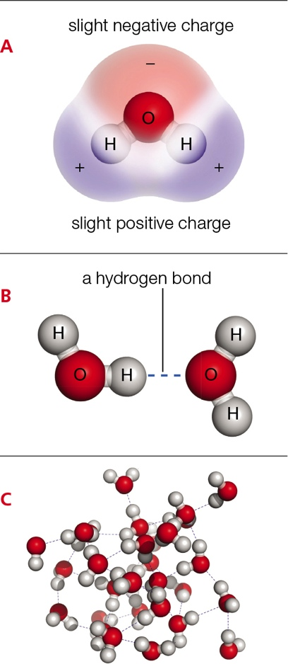
Hydrogen Bonds (3 of 3)
Notes:
Figure 2.9 Hydrogen bonds.
A Polarity of the water molecule. Each of the hydrogen atoms in a water molecule bears a slight positive charge (represented by a blue overlay). The oxygen atom carries a slight negative charge (red overlay).
B A hydrogen bond is an attraction between a hydrogen atom and another atom taking part in a separate polar covalent bond.
C The many hydrogen bonds that form among water molecules impart special properties to liquid water.

Slide 31
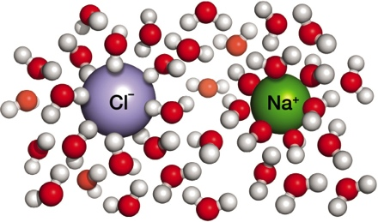
Water’s Special Properties (1 of 6)
Hydrogen bonds among many water molecules are collectively stronger than an ionic bond between two ions
  The solid dissolves as water molecules tug the ions apart and surround each one

Slide 32
Water’s Special Properties (2 of 6)
Water is an excellent solvent
  Substances that dissolve easily in water are hydrophilic
  Ionic solids, such as sodium chloride (NaCl), dissolve in water
    The slight positive charge on each hydrogen atom in a water molecule attracts negatively charged Cl–
    The slight negative charge on the oxygen atom attracts positively charged Na⁺

Slide 33
Water’s Special Properties (3 of 6)
Salt: releases ions other than H⁺ and OH– when it dissolves in water (e.g., NaCl)
Solute: a dissolved substance
Solution: uniform mixture of solute completely dissolved in solvent
  Chemical bonds do not form between molecules of solute and solvent
Concentration: amount of solute per unit volume of solution

Slide 34
Water’s Special Properties (4 of 6)
Nonionic solids (e.g., sugars) are usually hydrophilic and dissolve easily in water
Substances that resist dissolving in water are hydrophobic (e.g., oils)
  Oils consist of nonpolar molecules, and hydrogen bonds do not form between nonpolar molecules and water

Slide 35
Water’s Special Properties (5 of 6)
Water has cohesion
  Cohesion: tendency of molecules to resist separating from one another
  Water has cohesion because hydrogen bonds collectively exert a continuous pull on its individual molecules
Cohesion takes energy
  Evaporation (transition of a liquid to a vapor) is resisted by hydrogen bonding among water molecules

Slide 36
Water’s Special Properties (6 of 6)
Water stabilizes temperature
  Temperature: measure of molecular motion
  Because of hydrogen bonding, it takes more heat to raise the temperature of water compared with other liquids
  Below 0°C (32°F), water molecules become locked in the bonding pattern of ice
    Sheets of ice that form on the surface of ponds, lakes, and streams insulate the water
    Protects aquatic organisms during cold winters

Slide 37
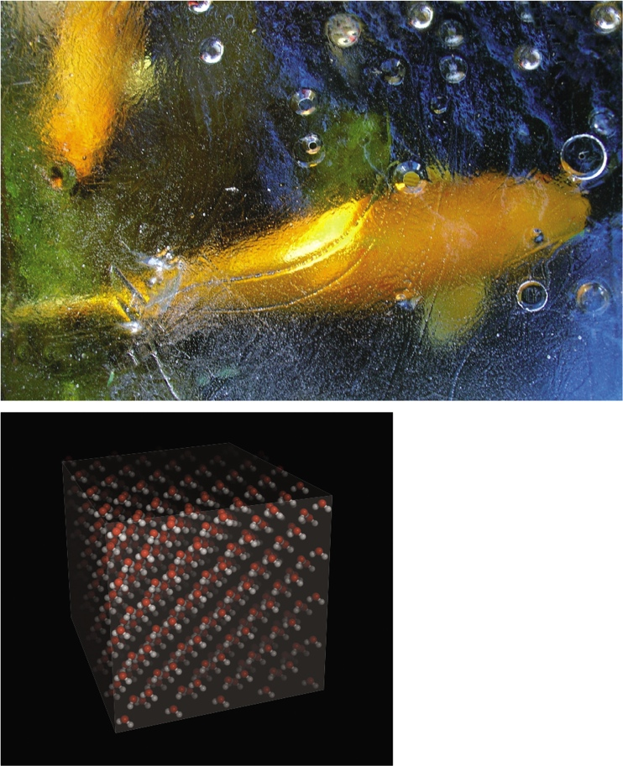
Hydrogen Bonds in Ice
Notes:
Figure 2.10 Hydrogen bonds in ice. A covering of ice can insulate water underneath it, thus keeping aquatic organisms from freezing during long, cold winters (above). In ice, water molecules are locked in a rigid lattice by hydrogen bonds (left). The molecules in this lattice pack less densely than they do in liquid water, which is why ice floats.

Slide 38
2.5 Acids and Bases
When water is liquid, some of its molecules spontaneously separate into hydrogen ions (H⁺) and hydroxide ions (OH–)
These ions can combine again to form water

Slide 39
Hydrogen Atoms and pH
pH: measure of the number of hydrogen ions in a fluid
Base: accepts hydrogen ions in water
  Above pH 7
Acid: releases hydrogen ions in water
  Below pH 7

Slide 40
The pH Scale
Notes:
Figure 2.11 A pH scale. Here, red dots signify hydrogen ions (H⁺) and grey dots signify hydroxyl ions (OH–). Also shown are the approximate pH values for some common solutions.
This pH scale ranges from 0 (most acidic) to 14 (most basic). A change of one unit on the scale corresponds to a tenfold change in the amount of H⁺ ions.

Slide 41
Buffers
Buffer: set of chemicals that can keep the pH of a solution stable by alternately donating and accepting ions that contribute to pH
The fluids inside cells stay within a consistent range of pH because they are buffered

Slide 42
Carbonic Acid and Bicarbonate Buffer
Carbonic acid and bicarbonate together act as a buffer

Slide 43
Importance of Buffers
Most biological molecules can function properly only within a narrow range of pH
  Buffer failure can be catastrophic in a biological system
  Such changes can overwhelm the buffering capacity of fluids inside organisms, with lethal effects
Burning fossil fuels such as coal releases sulfur and nitrogen compounds that affect the pH of rain

Slide 44
Application: Mercury Rising
Mercury is a naturally occurring element
Most of it is safely locked away in rocks
  Volcanic activity and human activity release it into the atmosphere

Slide 45
Mercury Rising (1 of 2)
Microbes combine airborne mercury with carbon to form methylmercury
  Unlike mercury alone, methylmercury easily crosses skin and mucous membranes
When mercury enters the body, it damages the nervous system, brain, kidneys, and other organs

Slide 46
Mercury Rising (2 of 2)
It takes months or years for mercury to be cleared from the body
  The toxin can build up to high levels if even small amounts are ingested on a regular basis
Large predatory fish have a lot of mercury
  U.S. Environmental Protection Agency recommends that adult humans ingest less than 0.1 microgram of mercury per kilogram of body weight per day

Slide 47
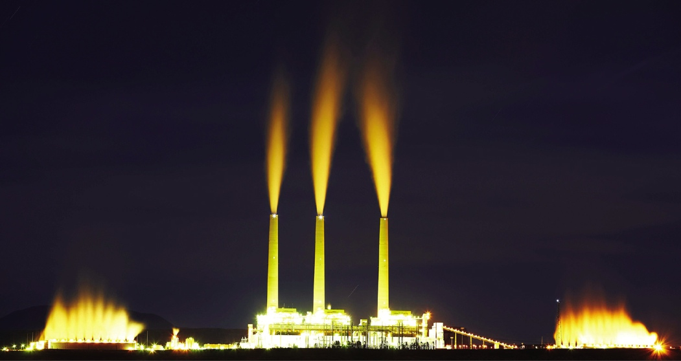
Mercury Pollution
Notes:
Figure 2.12 The Navajo Generating Station, a coal-fired power plant in Arizona. Emissions from such plants are by far the largest source of mercury pollution worldwide.

Slide 48
Discuss
Some pain relievers are advertised as “tribuffered.” What is meant by this statement? Do you think this is an important advantage or just a sales gimmick?
Television commercials portray the “acid stomach” as needing immediate R-O-L-A-I-D-S. Is the stomach normally acidic?

