Slide 1
Chapter 1
Environmental Science: Studying the State of Our Earth
Friedland and Relyea Environmental Science for AP®, second edition
© 2015 W.H. Freeman and Company/BFW
AP® is a trademark registered and/or owned by the College Board®, which was not involved in the production of, and does not endorse, this product.

Slide 2
Module 1 Environmental Science
After reading this module you should be able to
define the field of environmental science and discuss its importance.
identify ways in which humans have altered and continue to alter our environment.

Slide 3
Environmental science offers important insights into our world and how we influence it
Environment The sum of all the conditions surrounding us that influence life.
Environmental science The field that looks at interactions among humans and those found in nature.
Ecosystem A particular location on Earth with interacting biotic and abiotic components.

Slide 4
Environmental Science
Biotic Living.
Abiotic Nonliving.
Environmentalist A person who participates in environmentalism, a social movement that seeks to protect the environment through lobbying, activism, and education.
Environmental studies The field of study that includes environmental science and additional subjects such as environmental policy, economics, literature, and ethics.

Slide 5
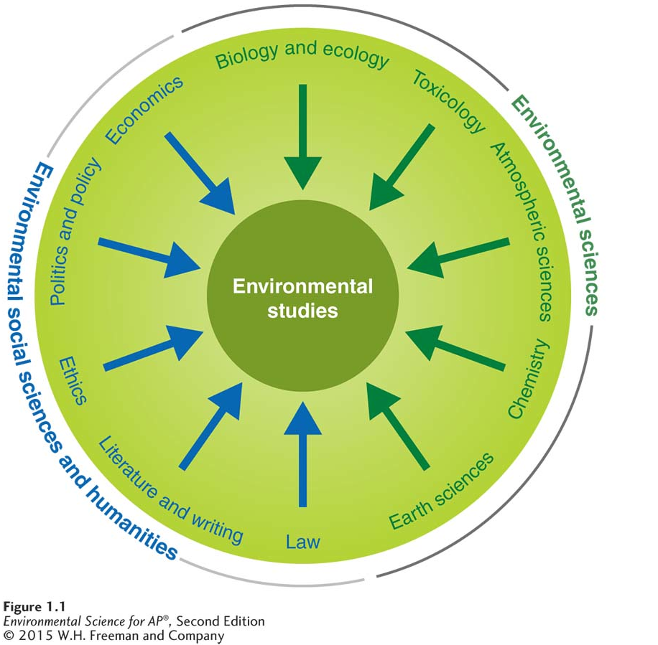
Environmental Science
Environmental studies. The study of environmental science uses knowledge from many disciplines.

Slide 6
Humans alter natural systems
Humans manipulate their environment more than any other species.

Slide 7
Module 2 Environmental Indicators and Sustainability
After reading this module you should be able to
identify key environmental indicators and their trends over time.
define sustainability and explain how it can be measured using the ecological footprint.

Slide 8
Environmental scientists monitor natural systems for signs of stress
Ecosystem services The processes by which life-supporting resources such as clean water, timber, fisheries, and agricultural crops are produced.
Environmental indicator An indicator that describes the current state of an environmental system.

Slide 9
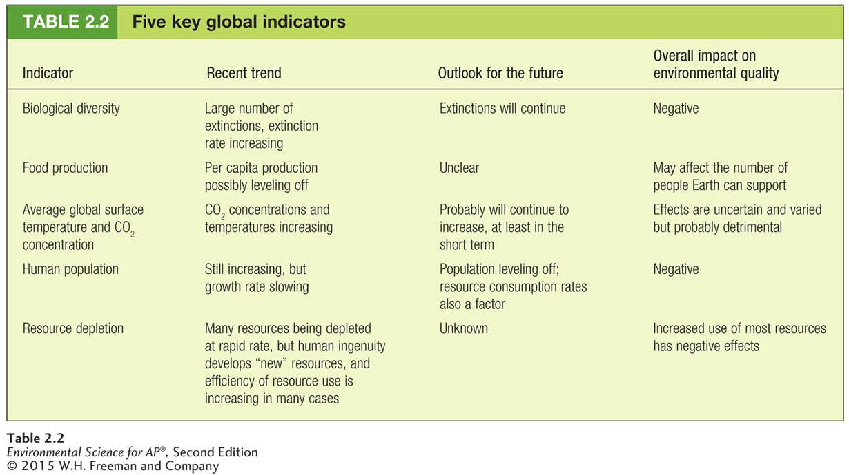
Environmental Indicators

Slide 10
Environmental Indicators
Environmental indicators help us describe the current state of an environmental system. The five key global environmental indicators are:
Biological diversity
Food production
Average global surface temperature and CO₂ concentrations in the atmosphere
Human population
Resource depletion

Slide 11
Biodiversity
Key Global Environmental Indicator 1: Biological Diversity
Biodiversity The diversity of life forms in an environment
Biodiversity exists on three scales:
Genetic
Species
Ecosystem

Slide 12
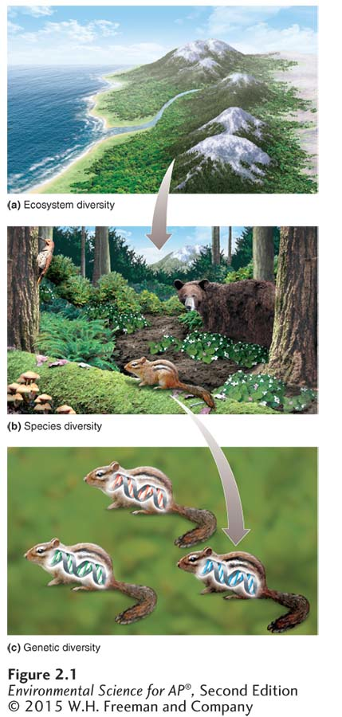
Biodiversity
Levels of biodiversity. Biodiversity exists at three scales.
Ecosystem diversity is the variety of ecosystems within a region.
Species diversity is the variety of species within an ecosystem.
(c) Genetic diversity is the variety of
genes among individuals of a
species.

Slide 13
Genetic Diversity
Genetic Diversity A measure of the genetic variation among individuals in a population
Populations with high genetic diversity are better able to respond to environmental change than populations with lower genetic diversity.

Slide 14
Species Diversity
Species A group of organisms that is distinct form other groups in its morphology (body form and structure), behavior, or biochemical properties.
Species diversity The number of species in a region or in a particular type of habitat.
Speciation The evolution of new species.
Background extinction rate The average rate at which species become extinct over the long term.

Slide 15
Ecosystem Diversity
Ecosystem diversity is a measure of the diversity of of ecosystems of habitats in that exist in a given region.

Slide 16
Food Production
Key Global Environmental Indicator 2: Food Production
Food production is our ability to grow food to nourish the human population.
We use science and technology to increase the amount of food we can produce on a given area of land.

Slide 17
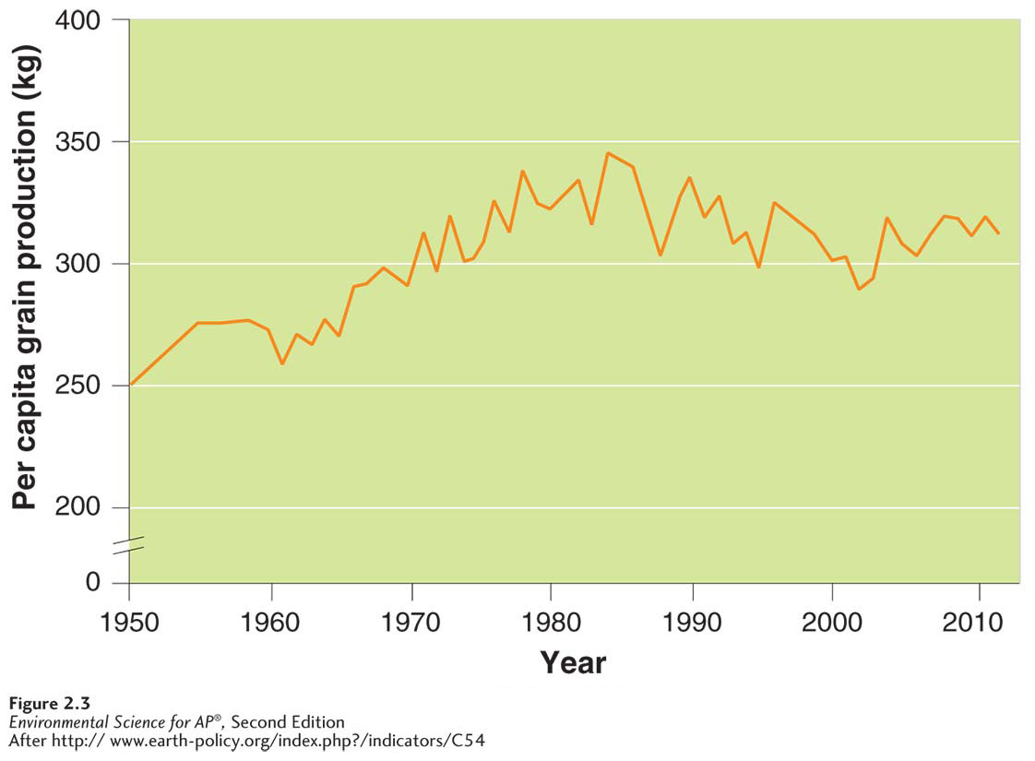
Food Production
World grain production per person. Grain production has increased since the 1950s, but it has recently begun to level off.

Slide 18
Surface Temperature and CO₂ Concentration
Key Global Environmental Indicator 3: Average Global Surface Temperature and CO₂ Concentration
Greenhouse gases Gases in Earth's atmosphere that trap heat near the surface.
The most significant greenhouse gas is carbon dioxide (CO₂).
Anthropogenic Derived from human activities.

Slide 19
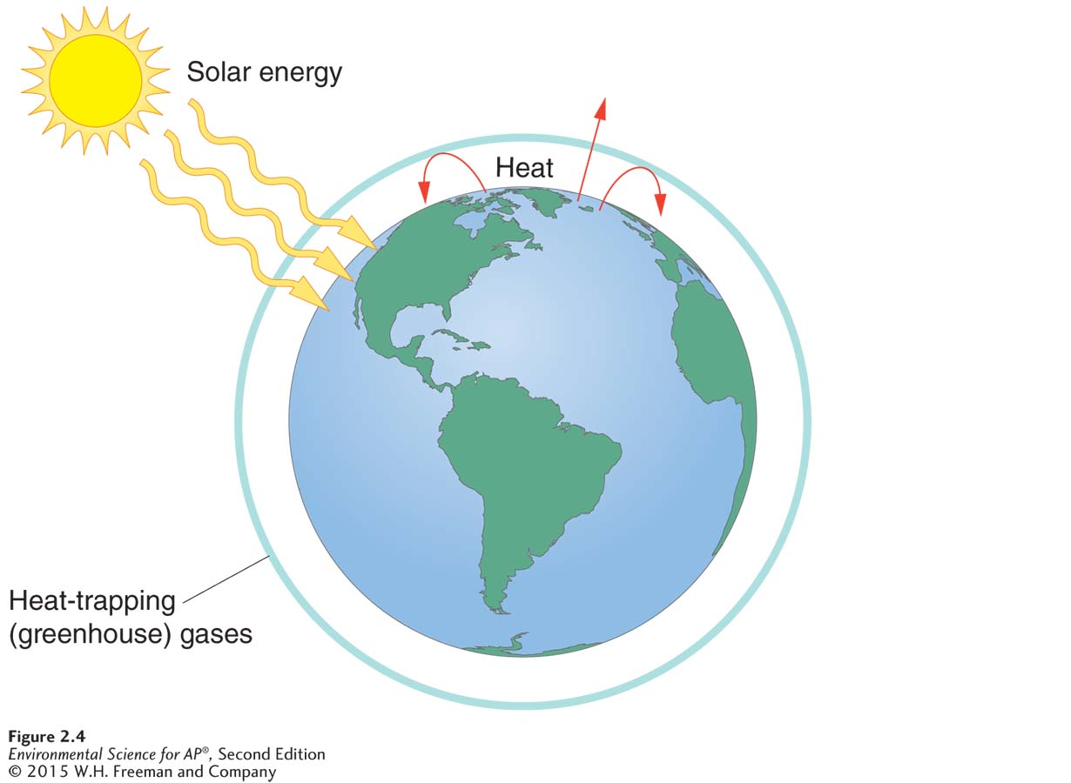
Surface Temperature and CO₂ Concentration
The Earth-surface energy balance. Earth’s surface is warmed by the Sun, radiating heat outward. Heat-trapping gases absorb the outgoing heat, reradiating some back to Earth.

Slide 20
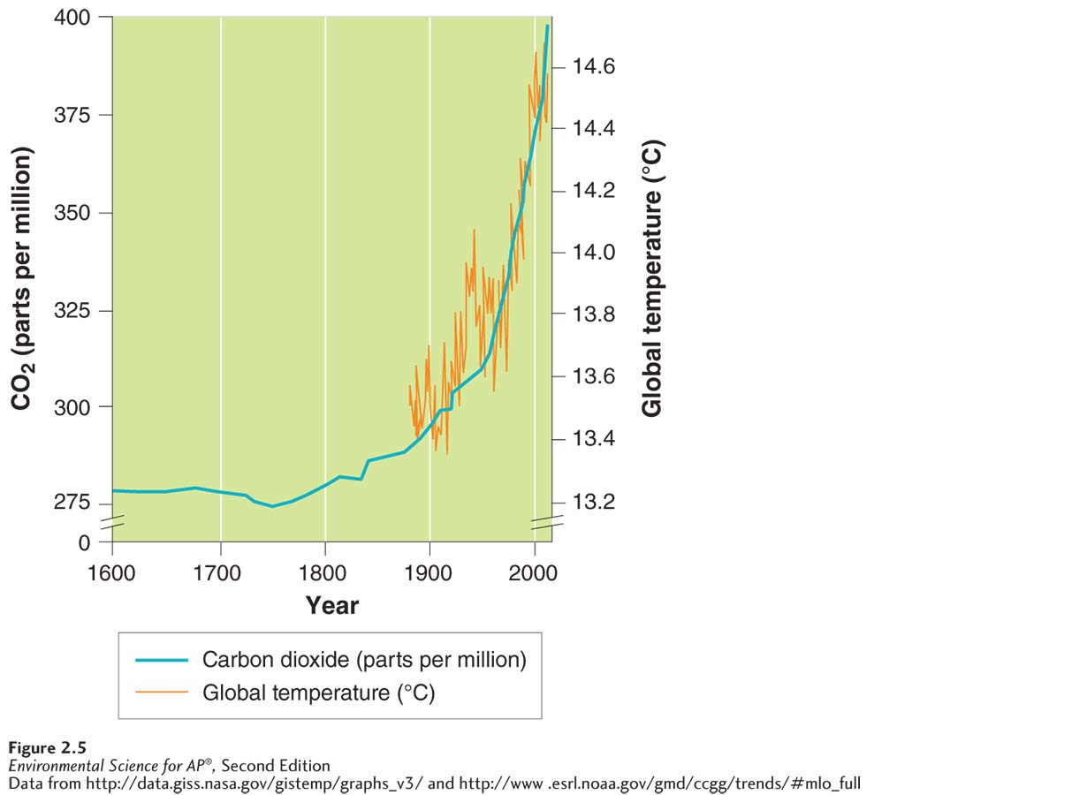
Surface Temperature and CO₂ Concentration
Changes in average global surface temperature and atmospheric CO₂ concentrations. Earth’s average global surface temperature has increased steadily for at least the past 100 years.
Notes:
CO2 needs to be subscript.

Slide 21
Human Population
Key Global Environmental Indicator 4: Human Population
The current human population is 7.2 billion and growing.
Population scientists project the human population will reach 8.1-9.6 billion by 2050 and stabilize between 7.1-10.5 billion by 2100.

Slide 22
Resource Depletion
Key Global Environmental Indicator 5: Resource Depletion
Some natural resources, for example, coal, oil, and uranium are finite and cannot be renewed or reused.
Other natural resources, for example aluminum or copper, also exist in finite amounts but can be recycled.
As the human population grows, it places greater demand on finite resources.
Development Improvement in human well-being through economic advancement.

Slide 23
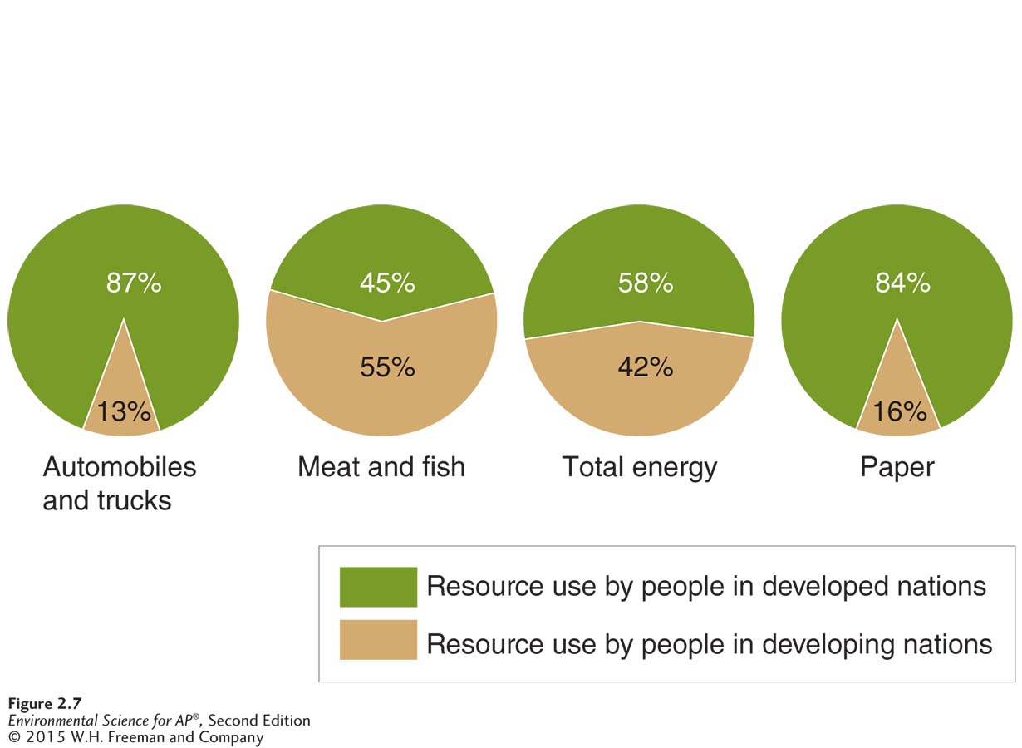
Patterns of Resource Consumption
Resource use in developed and developing countries. Only 20 percent of the world’s population lives in developed countries, but that 20 percent uses most of the world’s resources. The remaining 80 percent of the population lives in developing countries and uses far fewer resources per capita.

Slide 24
Human well-being depends on sustainable practice
Sustainability Living on Earth in a way that allows humans to use its resources without depriving future generations of those resources.
Sustainable development Development that balances current well-being and economic advancement with resource management for the benefit of future generations.

Slide 25
Sustainable Practices
Environmental systems must not be damaged beyond their ability to recover.
Renewable resources must not be depleted faster than they can regenerate.
Nonrenewable resources must be used sparingly.
Biophilia Love of life.

Slide 26
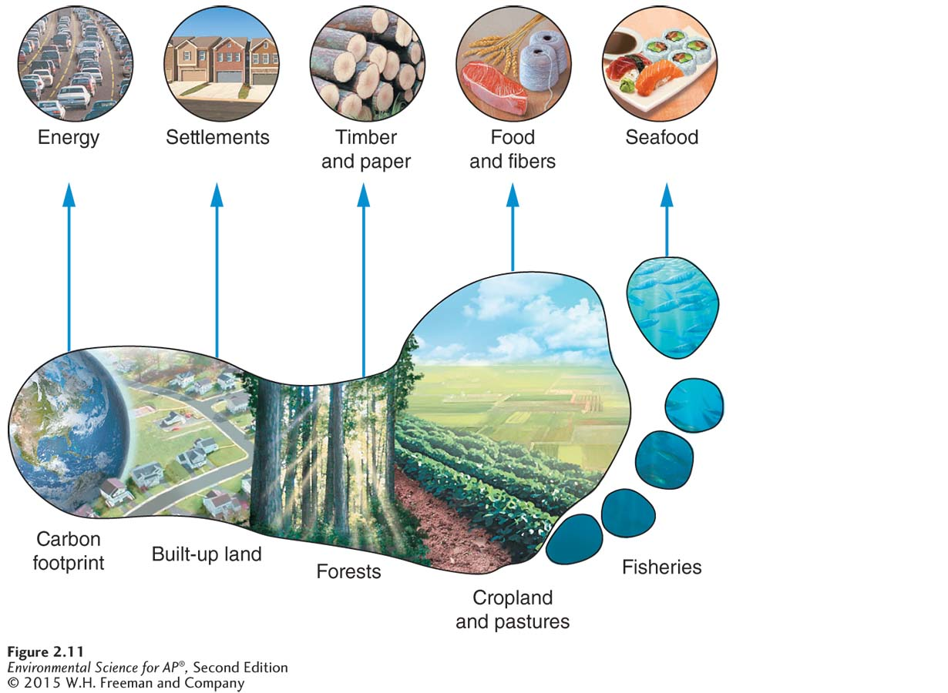
The Ecological Footprint
Ecological footprint A measure of how much an individual consumes, expressed in an area of land.
The ecological footprint. Some of the many factors that go into the calculation of the footprint are shown here.

Slide 27
Module 3 Scientific Method
After reading this module you should be able to
• explain the scientific method and its application to the study of environmental problems.
• describe some of the unique challenges and limitations of environmental science.

Slide 28
Science is a process
Scientific method An objective method to explore the natural world, draw inferences from it, and predict the outcome of certain events, process, or changes.

Slide 29
Scientific Method
Observe and question
Form testable hypothesis/ prediction
Collect data/ conduct experiment to test prediction
Interpret results
Disseminate findings

Slide 30
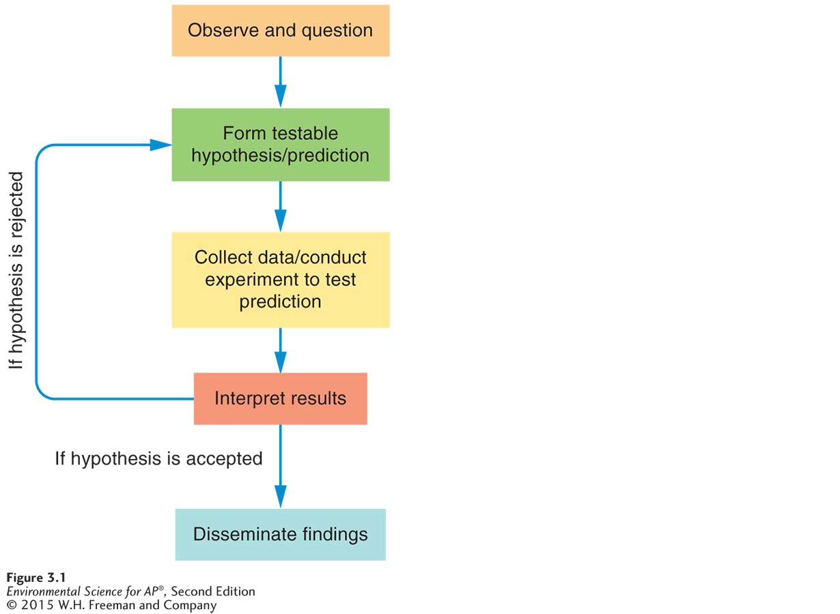
Scientific Method
The scientific method. In an actual investigation, a researcher might reject a hypothesis and investigate further with a new hypothesis, several times if necessary, depending on the results of
the experiment.

Slide 31
Hypothesis
Hypothesis A testable conjecture about how something works
Null hypothesis A prediction that there is no difference between groups or conditions, or a statement or idea that can be falsified, or proven wrong.

Slide 32
Collect Data
Replication The data collection procedure of taking repeated measurements.
Sample size (n) The number of times a measurement is replicated in data collection.
Accuracy How close a measured value is to the actual or true value.
Precision How close the repeated measurements of a sample are to one another.
Uncertainty An estimate of how much a measured or calculated value differs from a true value.

Slide 33
Collect Data
Accuracy and precision. Accuracy refers to how close a measured value is to the actual or true value. Precision is how close repeated measurements of the same sample are to one another.

Slide 34
Interpret Results
Once results have been obtained, analysis of the data begins. This process involves two types of reasoning, inductive and deductive.
Inductive reasoning is the process of making general statements from specific facts or examples.
Deductive reasoning is the process of applying a general statement to specific facts or situations.
Scientists maintain multiple working hypotheses.
Scientists reject or accept a hypothesis based on what the data show and begin to generate conclusions based on their results.

Slide 35
Disseminate Findings
Scientists present papers at conferences and publish the results of their investigations. This allows other scientists to repeat the original experiment and verify or challenge the results. This can lead to a hypothesis eventually becoming a theory.
Theory A hypothesis that has been repeatedly tested and confirmed by multiple groups of researchers and has reached wide acceptance.

Slide 36
Controlled Experiments
Controlled experiments take place in a laboratory.
Control group In a scientific investigation, a group that experiences exactly the same conditions as the experimental group, except for the single variable under study.

Slide 37
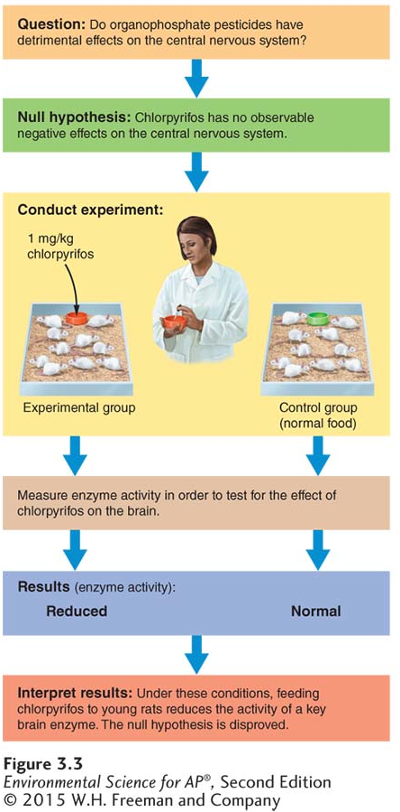
Controlled Experiments
A typical experimental process. An investigation of the effects of chlorpyrifos on the central nervous system illustrates how the scientific method is used.

Slide 38
Natural Experiments
Natural experiment A natural event that acts as an experimental treatment in an ecosystem.

Slide 39
Environmental Science Presents Unique Challenges
There is no control planet with which we can compare Earth.
It is difficult to determine what is better or worse for the environment.
Environmental science has so many interacting parts, it is not easy to apply one system to another.
When people are unable to meet their basic needs, they are less likely to be interested in protecting the environment.

