Slide 1
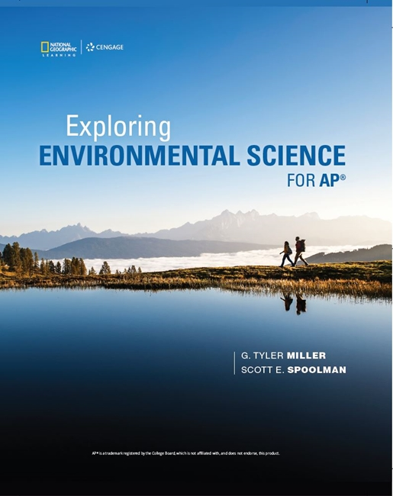
Exploring Environmental Science for AP®
1st Edition
Chapter 18
Solid and Hazardous Waste
Copyright © 2018 Cengage Learning. All Rights Reserved. May not be copied, scanned, or duplicated, in whole or in part, except for use as permitted in a license distributed with a certain product or service or otherwise on a password-protected website for classroom use.

Slide 2
Core Case Study: Cradle-to-Cradle Design (1 of 2)
Traditional product life cycle
Beginning (cradle) through disposal (grave)
New approach: cradle-to-cradle design
Reusing parts over and over in other products
Thinking of solid wastes and pollution as potentially valuable materials and chemicals

Slide 3
Core Case Study: Cradle-to-Cradle Design (2 of 2)
Notes:
Figure 21.1 Cradle-to-cradle design and manufacturing aims to make all products reusable and all components that must be discarded biodegradable. By connecting technical and biological nutrient cycles, it mimics nature and essentially eliminates waste by converting it to nutrients.

Slide 4
18.1 What Environmental Problems are Related to Solid and Hazardous Wastes?
Solid waste contributes to pollution and includes valuable resources that could be reused or recycled
Hazardous waste contributes to pollution, natural capital degradation, health problems, and premature deaths

Slide 5
Solid Waste Is Piling Up (1 of 3)
Virtually no waste in the natural world
Solid waste
Industrial solid waste
Mines, farms, and industries
Municipal solid waste (MSW)
Garbage or trash
Much waste ends up in rivers, lakes, the ocean, and natural landscapes

Slide 6
Solid Waste Is Piling Up (2 of 3)
Single-use plastic bags
100 billion used in the U.S. each year
Take 400–1,000 years to break down
Never disintegrate completely
Block drains and sewage systems and kill wildlife
Discarded plastic threatens wildlife

Slide 7
Solid Waste Is Piling Up (3 of 3)
Where does MSW end up?
Buried in landfills or burned in more-developed countries
Open dumps in less-developed countries

Slide 8
Case Study: Solid Waste in the United States (1 of 2)
The United States is the world’s largest producer of solid waste
And highest in solid waste per person
Industrial waste represents 98.5% of all solid waste
Mining, agriculture, and industry
Most wastes break down very slowly
Lead, mercury, glass, Styrofoam, and most plastic bottles do not break down completely

Slide 9
Case Study: Solid Waste in the United States (2 of 2)
Notes:
Figure 21.4 Composition of MSW in the United States and data on where it goes after collection. Data analysis: How many times more than the amount recycled is the amount of materials put into landfills

Slide 10
Hazardous Waste Is a Serious and Growing Problem (1 of 3)
Hazardous (toxic) waste
Threatens human health or the environment
Toxic, corrosive, flammable, can undergo violent or explosive chemical reactions, or can cause disease
Classes of hazardous waste
Organic compounds
Toxic heavy metals
Radioactive waste

Slide 11
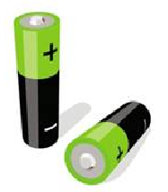
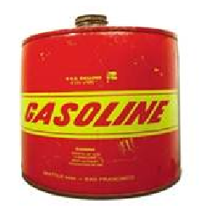
Hazardous Waste Is a Serious and Growing Problem (2 of 3)
What Harmful Chemicals Are in Your Home?
Cleanning
Disinfectants
Drain, toilet, and window cleaners Spot removers
Septic tank cleaners
Paint Products
Paints, stains, varnishes, and lacquers
Paint thinners, solvents, and strippers
Wood preservatives
Artist paints and inks
General
Dry-cell batteries (mercury and cadmium)
Glues and cements
Gardening
Pesticides Weed killers
Ant and rodent killers
Flea powders
Notes:
Figure 21.5 Harmful chemicals are found in many homes. The U.S. Congress has exempted the disposal of many of these household chemicals and other items from government regulation. Question: Which of these chemicals could you find in the place where you live?

Slide 12
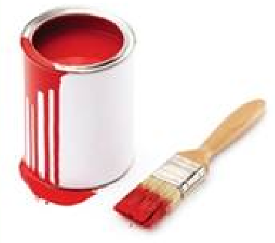
Hazardous Waste Is a Serious and Growing Problem (3 of 3)
Automotive
Gasoline
Used motor oil
Antifreeze
Battery acid Brake and transmission fluid

Slide 13
Case Study: E-Waste—An Exploding Hazardous Waste Problem
Electronic waste
Fastest-growing solid waste problem in the United States and the world
Driven by increasing sales and short life cycles
Leading producers: the United States and China
Recycling increased to 30% in 2010
Also shipped to other countries for processing
Workers (children) exposed to toxic heavy metals and chemicals
Contains valuable materials that could be recycled or reused

Slide 14
18.2 How Should We Deal with Solid Waste?
Sustainable approach to solid waste
Produce less of it
Reuse or recycle it
Safely dispose of what is left

Slide 15
Waste Management (1 of 3)
First produce less, then reuse or recycle, finally safely dispose what is left

Slide 16
Waste Management (2 of 3)
Waste management
focuses on controlling waste in order to limit their environmental harm but does not attempt to reduce amount of waste
Waste reduction
Reducing less solid waste and reusing and recycling
Integrated waste management
Variety of strategies for management and reduction of waste

Slide 17
Waste Management (3 of 3)
Notes:
Figure 21.6 Integrated waste management: We can reduce wastes by refusing or reducing resource use and by reusing, recycling, and composting what we discard, or we can manage them by burying them in landfills or incinerating them. Most countries rely primarily on burial and incineration. Critical thinking: What happens to the solid waste you produce?

Slide 18
The Four Rs of Waste Reduction (1 of 3)
Refuse–don’t use it
Reduce–use less of it
Reuse–use it over and over
Recycle
Convert used resources to useful items and buy products made from recycled materials
Composting
Using bacteria to decompose biodegradable waste

Slide 19
The Four Rs of Waste Reduction (2 of 3)
Six strategies
Change industrial processes to eliminate or reduce use of harmful chemicals
Redesign manufacturing process to use less material and energy
Develop easy-to-recycle products
Establish cradle-to-cradle responsibility
Eliminate unnecessary packaging
Use fee-per-bag waste collection systems

Slide 20
The Four Rs of Waste Reduction (3 of 3)
Notes:
Figure 21.7 Priorities recommended by the U.S. National Academy of Sciences for dealing with municipal solid waste (left) compared with actual waste-handling practices in the United States based on data (right). Critical thinking: Why do you think most countries do not follow most of the scientific-based priorities listed on the left?

Slide 21
18.3 Why Are Refusing, Reducing, Reusing, and Recycling So Important?
Benefits of refusing, reducing, reusing, and recycling
Decreases consumption of matter and energy resources
Reduces pollution and natural capital degradation
Saves money

Slide 22
Alternatives to the Throwaway Economy (1 of 2)
Today’s industrialized societies have substituted throwaway items for reusable ones
Questions to ask to reduce consumption
Do I really need this?
How many of these do I really need?
Is this something I can use more than once?
Can I repurpose this product when I am done with it?

Slide 23
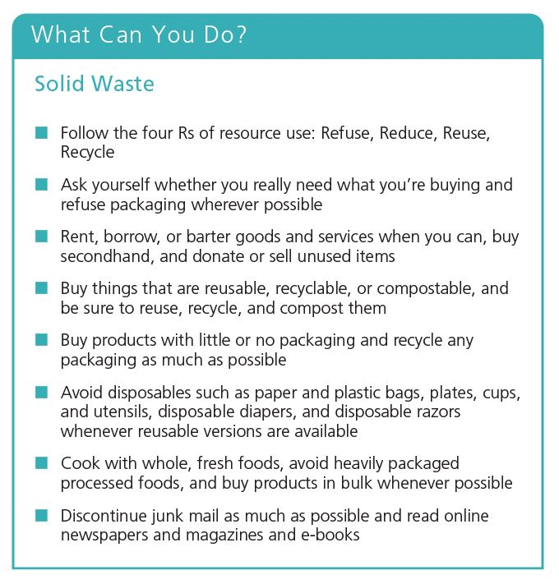
Alternatives to the Throwaway Economy (2 of 2)
Notes:
Figure 21.8 Individuals matter: You can save resources by reducing your output of solid waste and pollution. Critical thinking: Which three of these steps do you think are the most important ones to take? Why? Which of these things do you already do?

Slide 24
Revisiting Cradle-to-Cradle Design: Reuse Is on the Rise (1 of 3)
European Union (EU) has banned e-waste from landfills and incinerators
Manufacturers required to take back products at end of their useful lives
Finland banned all beverage containers that cannot be reused
Rechargeable batteries
Reusable cloth bags for groceries
Taxing plastic shopping bags

Slide 25
Revisiting Cradle-to-Cradle Design: Reuse Is on the Rise (2 of 3)
Many cities have banned plastic bags and polystyrene foam food containers
Shared use
Neighborhood tool libraries
Toy libraries
Companies rent tools and household goods

Slide 26
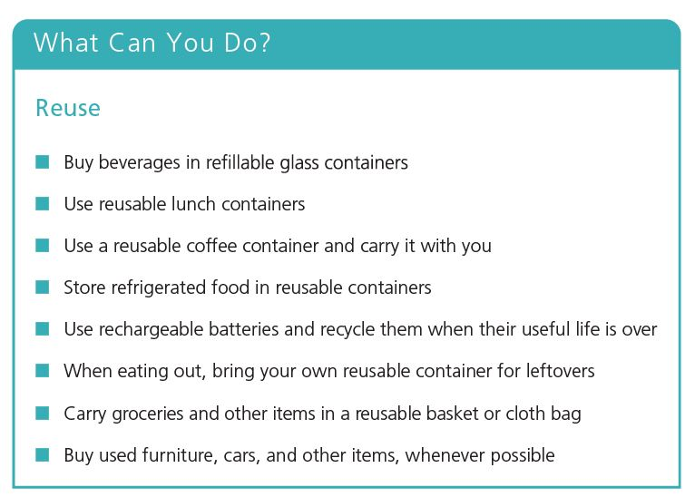
Revisiting Cradle-to-Cradle Design: Reuse Is on the Rise (3 of 3)
Notes:
Figure 21.9 Individuals matter: Some ways to reuse the items we purchase. Questions: Which of these suggestions have you tried and how did they work for you?

Slide 27
Recycling (1 of 3)
Primary, closed-loop recycling
Materials recycled into same type
Secondary recycling
Materials converted to other products
Types of wastes that can be recycled
Preconsumer, internal waste generated in manufacturing process
Postconsumer, external waste generated by product use

Slide 28
Recycling (2 of 3)
Upcycling
Recycled form more useful than original item
Downcycling
Recycled form less useful than original item
Necessary steps
Collecting materials
Converting to new products
Buying and selling products that contain recycled material

Slide 29
Recycling (3 of 3)
With incentives, the United States could recycle and compost 80% of its MSW
2014: e-waste contained more than one-tenth of all gold mined that year
Source of iron, copper, silver, and aluminum
Composting
Mimics nature’s recycling of nutrients

Slide 30
We Can Mix or Separate Household Solid Wastes for Recycling
Materials-recovery facilities (MRFs)
Can encourage increased trash production
Mixed waste approach becoming less sustainable in many communities
People throw trash in recycling bins
Source separation costs less to implement
Pay-as-you-throw or fee-per-bag
Charge for garbage but not recycling

Slide 31
Recycling Paper
55% of the world’s industrial tree harvest used to make paper
Could make tree-free paper from straw, kenaf
Pulp and paper industry
Energy use–world’s fifth largest consumer
Water use
Pollution

Slide 32
Recycling Paper
Recycled paper compared with making paper from wood pulp
Generates 35% less water pollution
Generates 74% less air pollution

Slide 33
Recycling Plastics
Plastics
Composed of resins created from oil and natural gas
Currently only 7% by weight is recycled in the United States
Many types of plastic resins
Difficult to separate
2014: First recyclable thermoset plastic

Slide 34
Recycling Has Advantages and Disadvantages (1 of 2)
Advantages
Net economic, health, and environmental benefits
Disadvantages
Costly
Single-pickup system
Sorting recyclables by type

Slide 35
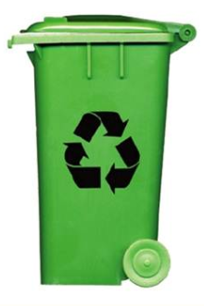
Recycling Has Advantages and Disadvantages (2 of 2)
Trade-Offs
Recycling
Advantages
Reduces energy and mineral use and air and water pollution
Reduces greenhouse gas emissions
Reduces solid waste
Disadvantages
Can cost more than burying in areas with ample landfill space
Reduces profits for landfill and incinerator owners
Inconvenient for some
Notes:
Figure 21.12 Recycling solid waste has advantages and disadvantages (Concept 21.3). Critical thinking: Which single advantage and which single disadvantage do you think are the most important? Why?

Slide 36
18.4 What Are the Advantages and Disadvantages of Burning or Burying Solid Waste?
Technologies for burning and burying solid wastes well developed
Burning can contribute to air and water pollution and greenhouse gas emissions
Buried wastes can contribute to water pollution

Slide 37
Burning Solid Waste Has Advantages and Disadvantages (1 of 3)
Heat released by burning trash can be used to heat water or interior spaces
Waste-to-energy incinerators produce electricity
Landfills emit more air pollutants than modern waste-to-energy incinerators
Incinerator ash contains toxic chemicals that must be disposed of or stored

Slide 38
Burning Solid Waste Has Advantages and Disadvantages (2 of 3)
Notes:
Figure 21.13 Solutions: A waste-to-energy incinerator with pollution controls burns mixed solid wastes and recovers some of the energy to produce steam to use for heating or producing electricity. Critical thinking: Would you invest in such a project? Why or why not?

Slide 39
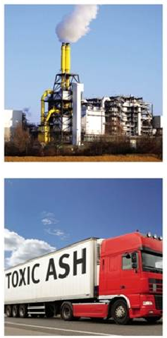
Burning Solid Waste Has Advantages and Disadvantages (3 of 3)
Trade-Offs
Waste-to-Energy Incineration
Advantages
Reduces trash volume
Produces energy
Concentrates hazardous substances into ash for burial
Sale of energy reduces cost
Disadvantages
Expensive to build
Produces a hazardous waste
Emits some CO2 and other air pollutants
Encourages waste production
Notes:
Figure 21.14 Incinerating solid waste has advantages and disadvantages (Concept 21.4). These trade-offs also apply to the incineration of hazardous waste. Critical thinking: Which single advantage and which single disadvantage do you think are the most important? Why?

Slide 40
Critical Concept: Environmental Justice
Environmental justice is the ideal that all people are entitled
Many polluting factories, hazardous waste sites, incinerators and landfills are located in communities populated by minority groups
Analysts argue that the ethical principle of environmental justice should carry as much weight in siting hazardous sites as economic factors

Slide 41
Burying Solid Waste Has Advantages and Disadvantages (1 of 5)
Sanitary landfills
Compacted layers of waste between clay or foam
Bottom liners and containment systems collect leaching liquids
Some have methods for collecting methane
Types of waste placed into landfills
Paper, yard waste, plastics, metals, wood, glass, and food waste

Slide 42
Burying Solid Waste Has Advantages and Disadvantages (2 of 5)
Notes:
Figure 21.15 Solutions: A state-of-the-art sanitary landfill is designed to eliminate or minimize environmental problems that plague older landfills. Critical thinking: Some experts say that these landfills will eventually develop leaks and could emit toxic liquids. How do you think this could happen?

Slide 43
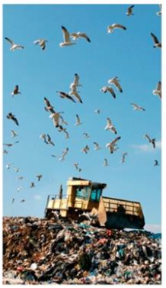
Burying Solid Waste Has Advantages and Disadvantages (3 of 5)
Trade-Offs
Sanitary Landfills
Advantages
Low operating costs Can handle large amounts of waste Filled land can be used for other purposes
No shortage of landfill space in many areas
Disadvantages
Noise, traffic, and dust
Releases greenhouse gases (methane and CO2) unless they are collected
Output approach that encourages waste production
Eventually leaks and can contaminate groundwater
Notes:
Figure 21.16 Using sanitary landfills to dispose of solid waste has advantages and disadvantages (Concept 21.4). Critical thinking: Which single advantage and which single disadvantage do you think are the most important? Why?

Slide 44
Burying Solid Waste Has Advantages and Disadvantages (4 of 5)
Open dumps
Widely used in less-developed countries
Open field or large pit

Slide 45
Burying Solid Waste Has Advantages and Disadvantages (5 of 5)
Notes:
Figure 21.17 Some open dumps, especially in less-developed countries, are routinely burned, releasing large quantities of pollutants into the atmosphere. They can burn for days or weeks.

Slide 46
18.5 How Should We Deal with Hazardous Waste?
Sustainable approach to hazardous waste
Produce less of it
Reuse or recycle it
Convert it to less-hazardous materials
Safely store what is left

Slide 47
Hazardous Waste Requires Special Handling (1 of 2)
Best practices
Produce less
Convert as much as possible to less-hazardous substances
Put the rest in long-term safe storage

Slide 48
Hazardous Waste Requires Special Handling (2 of 2)
Integrated hazardous waste management: The U.S. National Academy of Sciences has suggested these priorities for dealing with hazardous waste.

Slide 49
Case Study: Recycling E-Waste (1 of 2)
Much of the world’s e-waste shipped to China
Hazardous working conditions
Includes child workers
The United States produces roughly 50% of the world’s e-waste
Recycles only 14%
13 states: manufacturers responsible for recycling electronic devices

Slide 50
Case Study: Recycling E-Waste (2 of 2)
Notes:
Figure 21.19 This young girl in Dhaka, Bangladesh, is recycling batteries by hammering them apart to extract tin and lead. The workers at this shop are mostly women and children.

Slide 51
Detoxifying Hazardous Wastes (1 of 2)
Collect and then detoxify
Physical methods
Chemical methods
Bioremediation
Phytoremediation
Plasma gasification
Incineration using a plasma arc torch

Slide 52
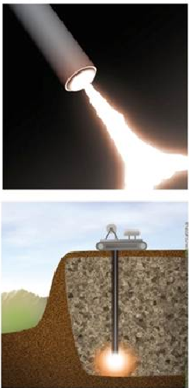
Detoxifying Hazardous Wastes (2 of 2)
Trade-Offs
Plasma Arc
Advantages
Produces a mixture of CO and H2 that can be used as a fuel
Mobile. Easy to move to different sites
Produces no toxic ash
Disadvantages
High cost
Produces CO₂ and CO
Can release particulates and chlorine gas
Can vaporize and release toxic metals and radioactive elements
Notes:
Figure 21.20 Using plasma gasification to detoxify hazardous wastes has advantages and disadvantages. Questions: Which single advantage and which single disadvantage do you think are the most important? Why?

Slide 53
Storing Hazardous Waste (1 of 4)
Burial on land or long-term storage
Most widely used method today due to low cost
Deep-well disposal
Surface impoundments
Lined ponds, pits, or lagoons
Secure hazardous waste landfills
Expensive

Slide 54
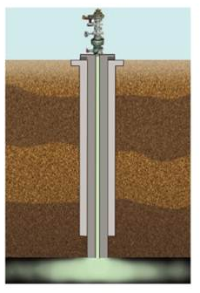
Storing Hazardous Waste (2 of 4)
Trade-Offs
Deep-Well Disposal
Advantages
Safe if sites are chosen carefully
Wastes can often be retrieved
Low cost
Disadvantages
Leaks can occur from corrosion of well casing
Emits CO₂ and other air pollutants
Output approach that encourages waste production
Notes:
Figure 21.21 Injecting liquid hazardous wastes into deep underground wells has advantages and disadvantages. Critical thinking: Which single advantage and which single disadvantage do you think are the most important? Why?

Slide 55
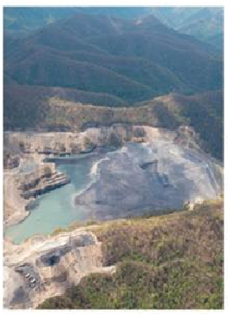
Storing Hazardous Waste (3 of 4)
Trade-Offs
Surface impoundments
Advantages
Low cost
Wastes can often be retrieved
Can store wastes indefinitely with secure double liners
Disadvantages
Watter pollution from leaking liners and overflows
Air pollution from volatile organic compounds
Output approach that encourages waste production
Notes:
Figure 21.22 Storing liquid hazardous wastes in surface impoundments has advantages and disadvantages. Critical thinking: Which single advantage and which single disadvantage do you think are the most important? Why?

Slide 56
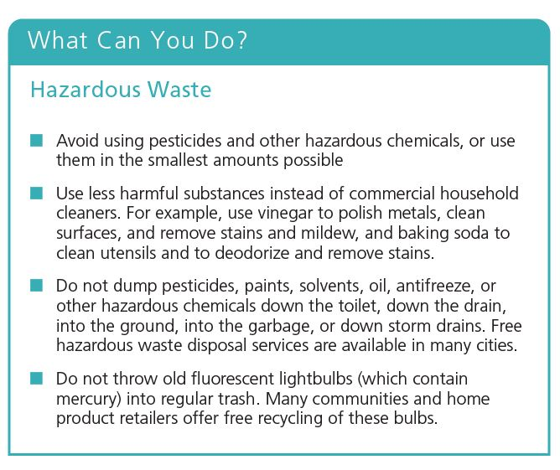
Storing Hazardous Waste (4 of 4)
Notes:
Figure 21.24 Individuals matter: You can reduce your output of hazardous wastes (Concept 21.5). Critical thinking: Which two of these measures do you think are the most important ones to take? Why?

Slide 57
Case Study: Hazardous Waste Regulation in the United States (1 of 4)
Toxic Substances Control Act
1976: Resource Conservation and Recovery Act (RCRA)
EPA sets standards and gives permits
Cradle to grave
Covers only 5% of hazardous waste produced in the United States

Slide 58
Case Study: Hazardous Waste Regulation in the United States (2 of 4)
1980: Comprehensive Environmental, Compensation, and Liability Act (CERCLA)
National Priorities List
2016: 1323 Superfund sites; 391 cleaned
Pace of cleanup has slowed
Funding discontinued
Laws encouraging the cleanup of brownfields
Abandoned industrial sites

Slide 59
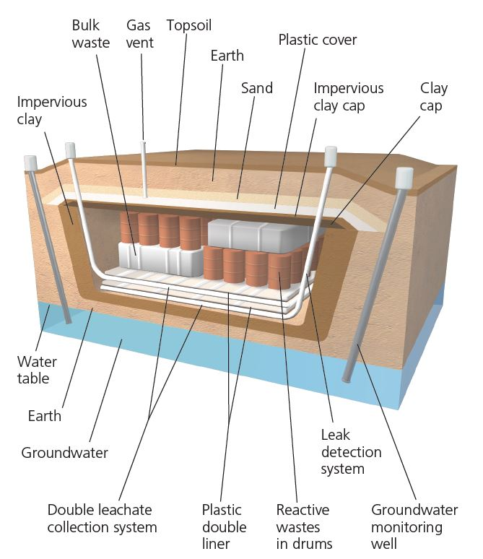
Case Study: Hazardous Waste Regulation in the United States (3 of 4)
Hazardous wastes can be isolated and stored in a secure hazardous waste landfill.

Slide 60
Case Study: Hazardous Waste Regulation in the United States (4 of 4)
Notes:
Figure 21.25 Leaking barrels of toxic waste

Slide 61
18.6 How Can We Shift to a Low-Waste Economy?
Requirements of shifting to a low-waste economy
Reduce resource use
Reuse and recycle most solid and hazardous wastes
Must happen at local, national, and global levels

Slide 62
Citizens Can Take Action
Many citizens have acted to oppose construction of:
Incinerators, landfills, treatment plants, and chemical plants
Argument: something must be done with hazardous wastes
Counterargument: focus on producing less

Slide 63
Using International Treaties to Reduce Hazardous Waste
1992: Basel Convention
Bans participating countries from shipping hazardous waste to other countries
2000: Stockholm Convention on Persistent Organic Pollutants
2020: Sweden ban of hazardous chemicals will become effective
Places burden on industries to show chemicals are safe

Slide 64
Encouraging Reuse and Recycling
Factors that hinder reuse and recycling
Market prices do not include harmful costs
Economic playing field is uneven
Demand for recycled materials fluctuates
Governments can increase subsidies for using recycled materials
Require government purchase of recycled products
Fee-per-bag waste collection system

Slide 65
Reuse and Recycling Present Economic Opportunities
Yard sales, secondhand stores, eBay, and Craigslist
Freecycle network
Upcycling
Recycling materials into products of higher value

Slide 66
Making the Transition to Low-Waste Economies
Zero-waste movement
Some restaurants, corporations, and others have dramatically lowered waste outputs
Key principles
Everything is connected
There is no away
Producers and polluters should pay
We can mimic nature by reusing, recycling, composting, or exchanging

Slide 67
Case Study: Industrial Ecosystems: Copying Nature (1 of 2)
Resource exchange webs
Waste as raw material
Ecoindustrial parks
Two major steps of biomimicry
Observe how natural systems respond
Apply to human industrial systems

Slide 68
Case Study: Industrial Ecosystems: Copying Nature (2 of 2)
Notes:
Figure 21.27 Solutions: This industrial ecosystem in Kalundborg, Denmark, reduces waste production by mimicking a natural ecosystem’s food web. The wastes of one business become the raw materials for another, thus mimicking the way that nature recycles chemicals. Question: Is there an industrial ecosystem near where you live or go to school? If not, think about where and how such a system could be set up.

